Slide 1
9-1 Introduction
A pointer is a constant or variable that contains an address that can be used to access data. Pointers are built on the basic concept of pointer constants.
Topics discussed in this section:
Pointer Constants
Pointer Values
Pointer Variables
Accessing Variables Through Pointers
Pointer Declaration and Definition
Declaration versus Redirection
Initialization of Pointer Variables
Computer Science: A Structured Programming Approach Using C

Slide 2
Note
An address expression, one of the expression types in the unary expression category, consists of an ampersand (&) and a variable name.
Computer Science: A Structured Programming Approach Using C

Slide 3
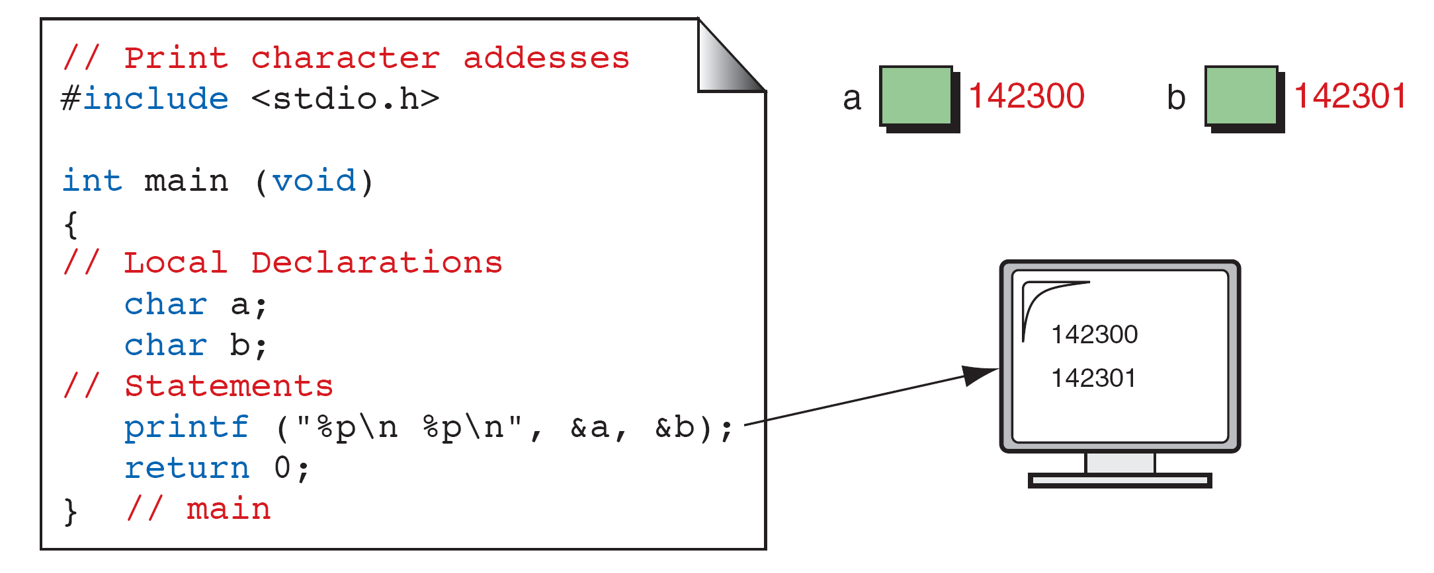
FIGURE 9-4 Print Character Addresses
Computer Science: A Structured Programming Approach Using C

Slide 4
Note
A variable’s address is the first byte occupied
by the variable.
Computer Science: A Structured Programming Approach Using C

Slide 5
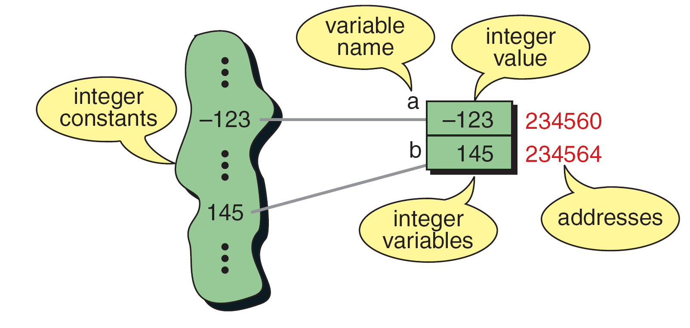
FIGURE 9-5 Integer Constants and Variables
Computer Science: A Structured Programming Approach Using C

Slide 6
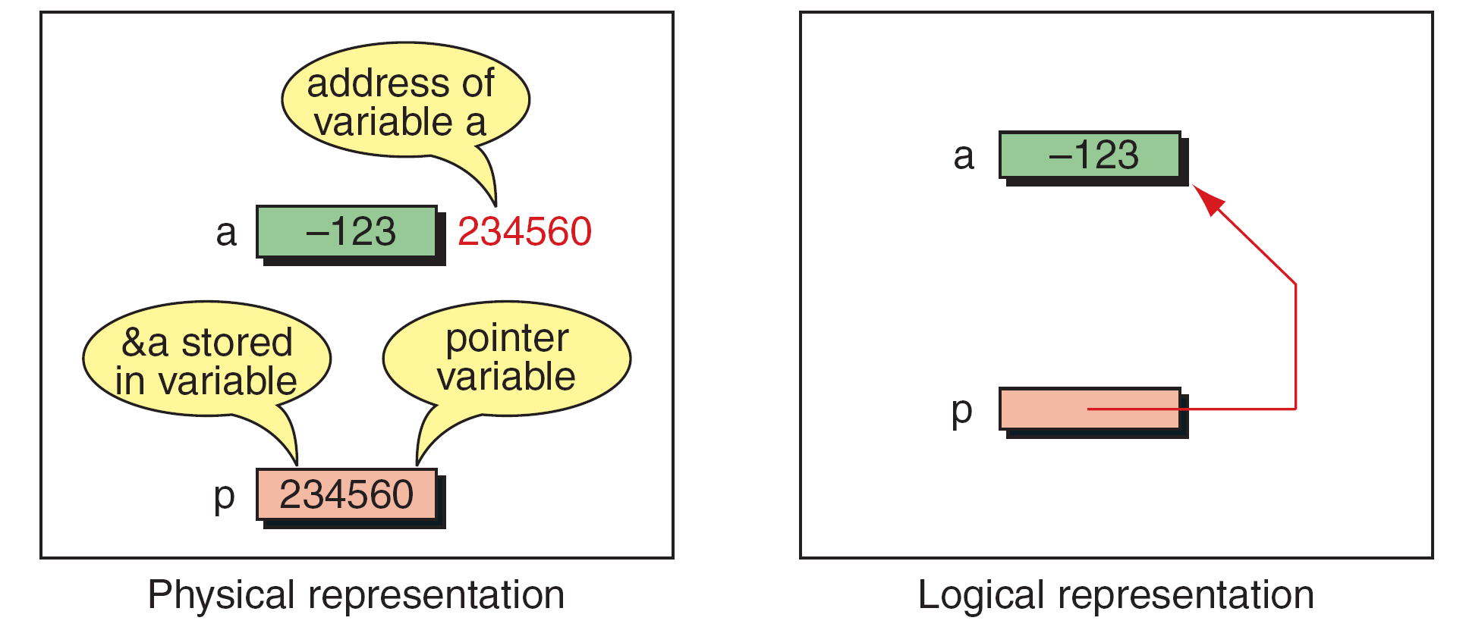
FIGURE 9-6 Pointer Variable
Computer Science: A Structured Programming Approach Using C

Slide 7
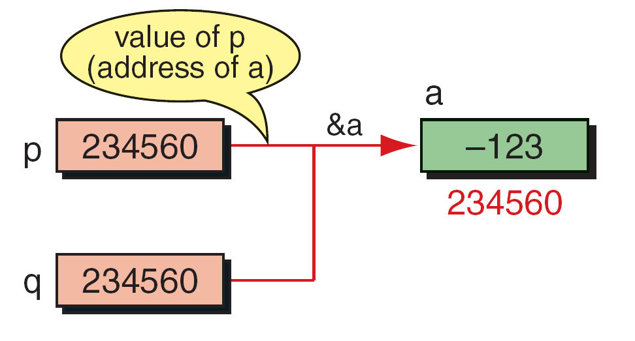
FIGURE 9-7 Multiple Pointers to a Variable
Computer Science: A Structured Programming Approach Using C

Slide 8
Note
A pointer that points to no variable contains the
special null-pointer constant, NULL.
Computer Science: A Structured Programming Approach Using C

Slide 9
Note
An indirect expression, one of the expression types in the unary expression category, is coded with an
asterisk (*) and an identifier.
Computer Science: A Structured Programming Approach Using C

Slide 10
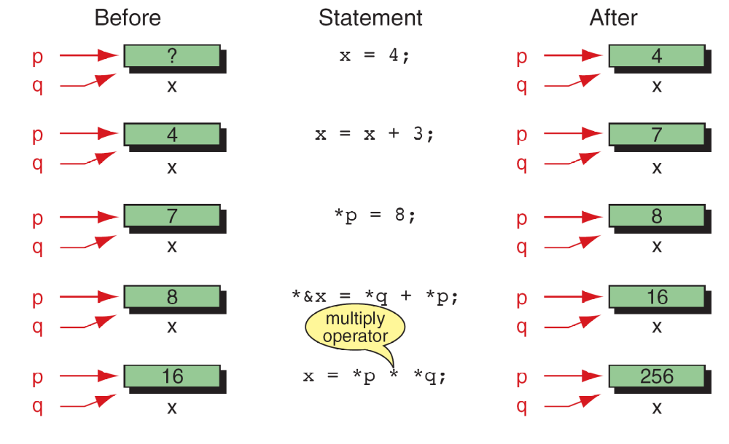
FIGURE 9-8 Accessing Variables Through Pointers
Computer Science: A Structured Programming Approach Using C

Slide 11
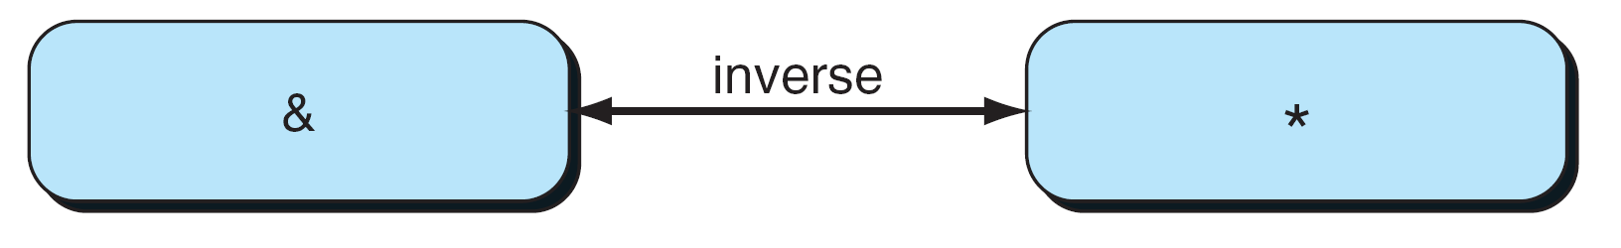
FIGURE 9-9 Address and Indirection Operators
Computer Science: A Structured Programming Approach Using C

Slide 12
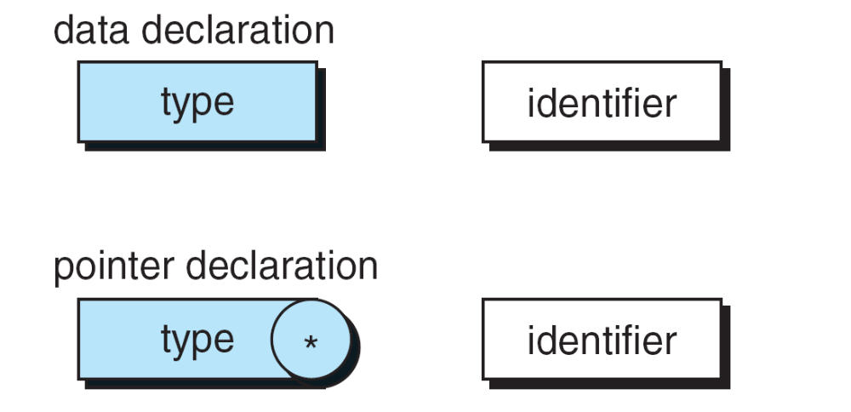
FIGURE 9-10 Pointer Variable Declaration
Computer Science: A Structured Programming Approach Using C

Slide 13
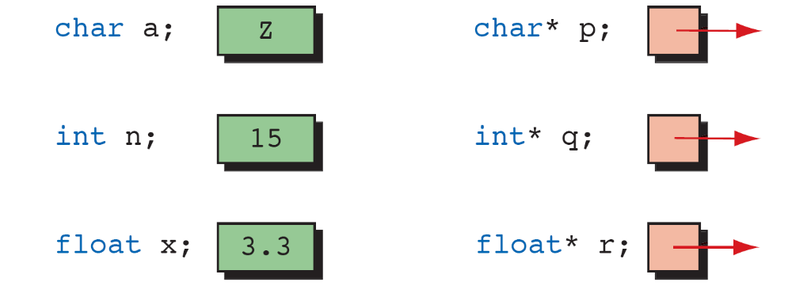
FIGURE 9-11 Declaring Pointer Variables
Computer Science: A Structured Programming Approach Using C

Slide 14
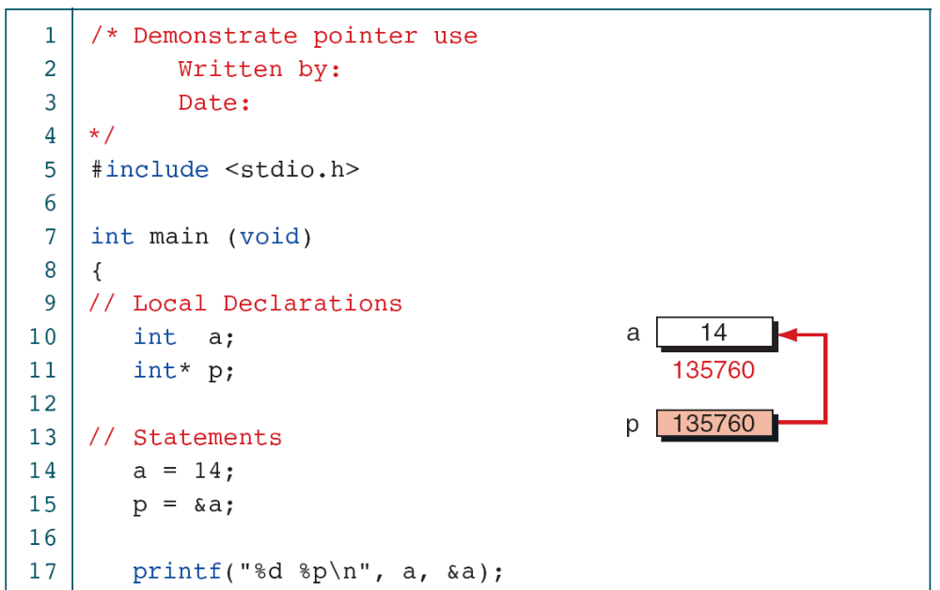
PROGRAM 9-1
Demonstrate Use of Pointers
Computer Science: A Structured Programming Approach Using C

Slide 15
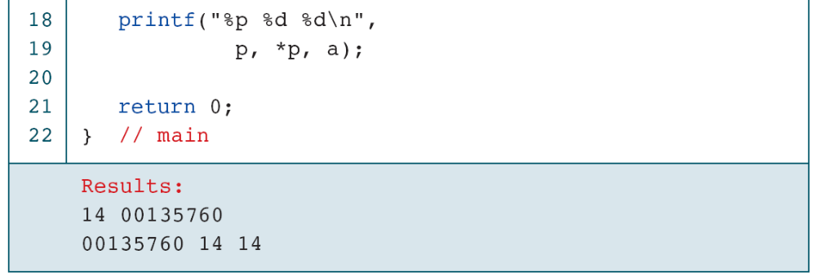
PROGRAM 9-1
Demonstrate Use of Pointers
Computer Science: A Structured Programming Approach Using C

Slide 16
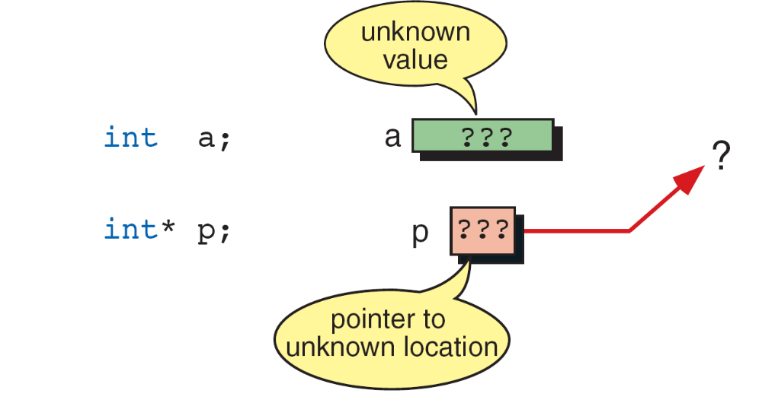
FIGURE 9-12 Uninitialized Pointers
Computer Science: A Structured Programming Approach Using C

Slide 17
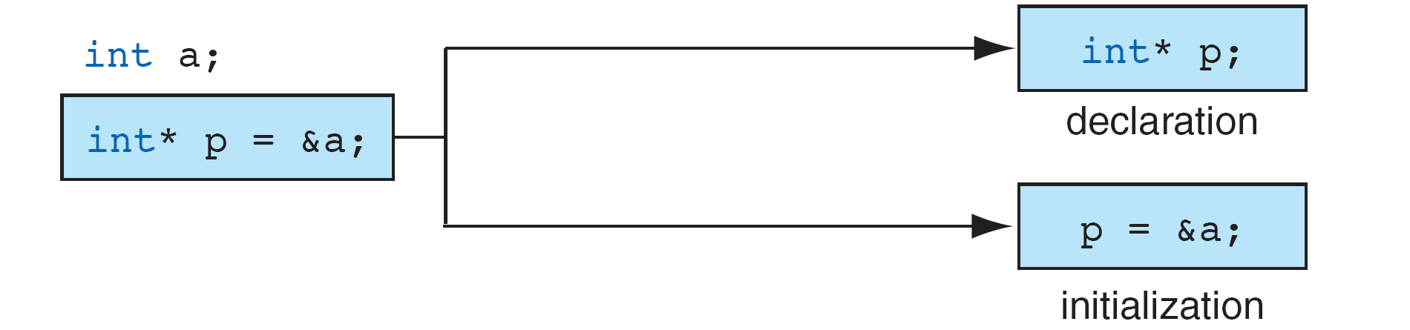
FIGURE 9-13 Initializing Pointer Variables
Computer Science: A Structured Programming Approach Using C

Slide 18
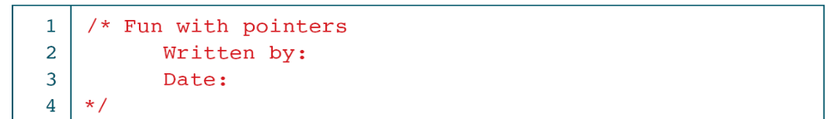
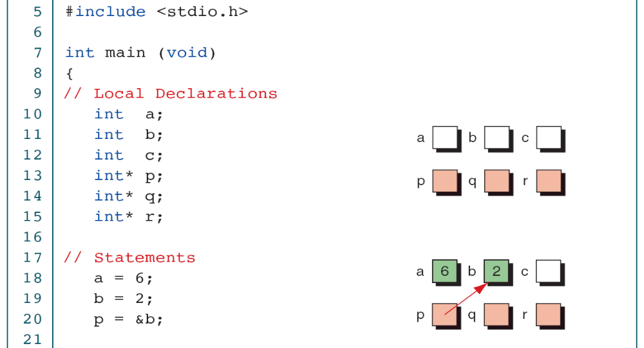
PROGRAM 9-2
Fun with Pointers
Computer Science: A Structured Programming Approach Using C

Slide 19
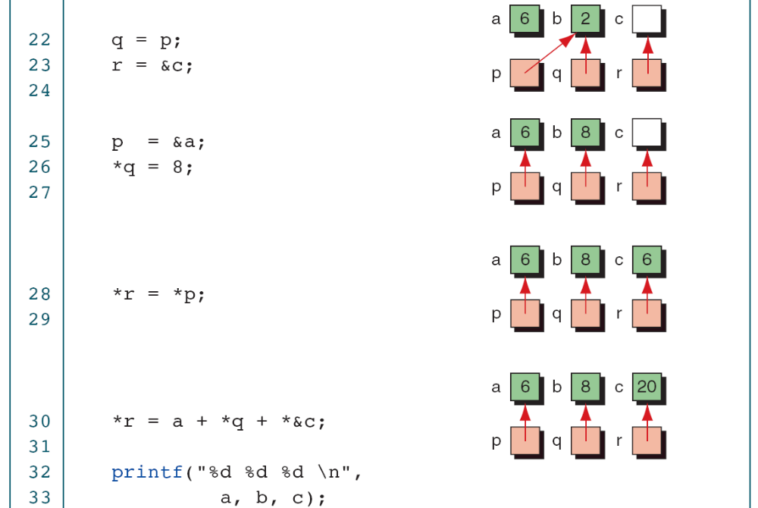
PROGRAM 9-2
Fun with Pointers
Computer Science: A Structured Programming Approach Using C

Slide 20
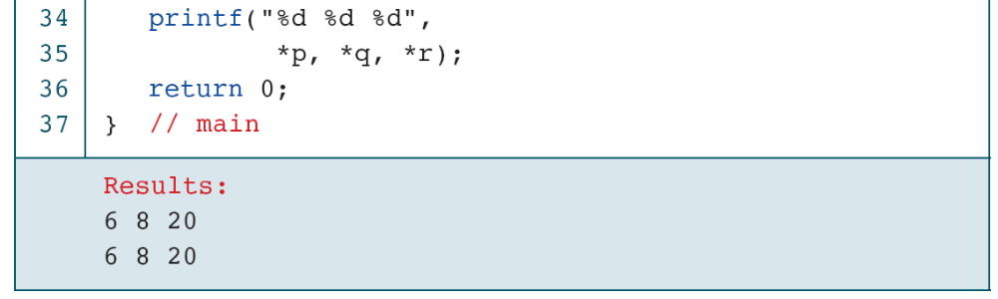
PROGRAM 9-2
Fun with Pointers
Computer Science: A Structured Programming Approach Using C

Slide 21
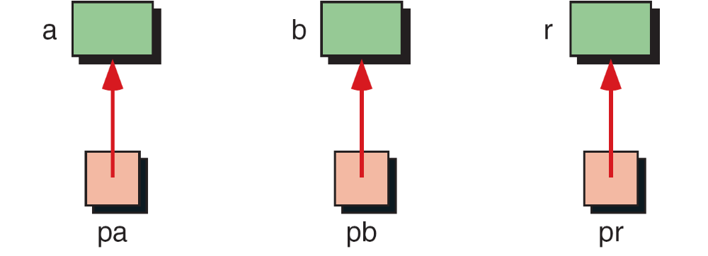
FIGURE 9-14 Add Two Numbers Using Pointers
Computer Science: A Structured Programming Approach Using C

Slide 22
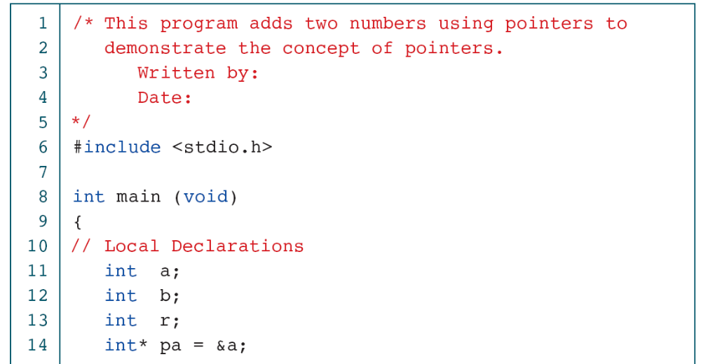
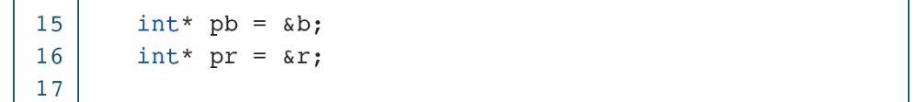
PROGRAM 9-3
Add Two Numbers Using Pointers
Computer Science: A Structured Programming Approach Using C

Slide 23
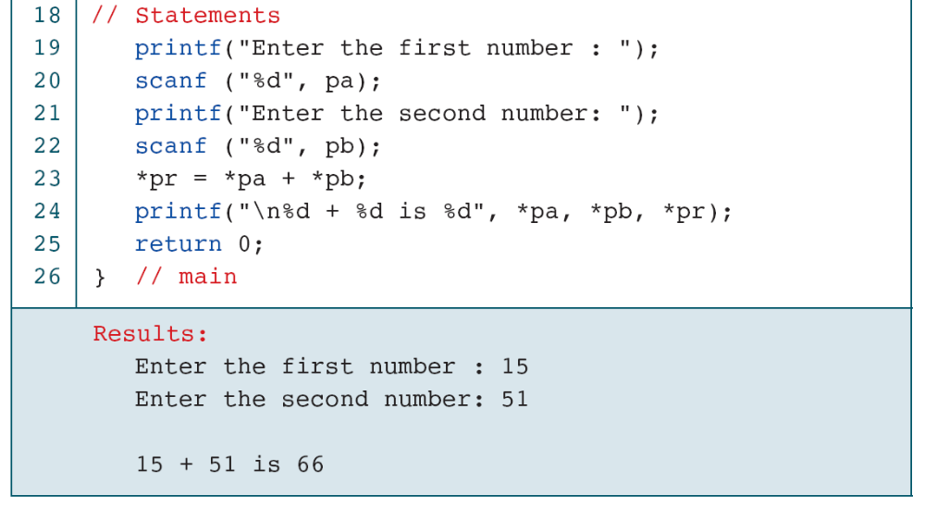
PROGRAM 9-3
Add Two Numbers Using Pointers
Computer Science: A Structured Programming Approach Using C

Slide 24
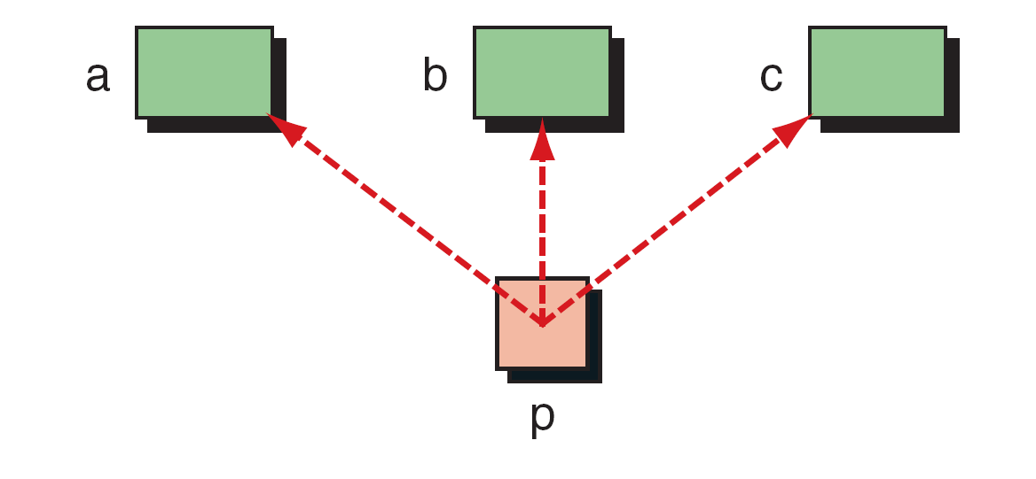
FIGURE 9-15 Demonstrate Pointer Flexibility
Computer Science: A Structured Programming Approach Using C

Slide 25
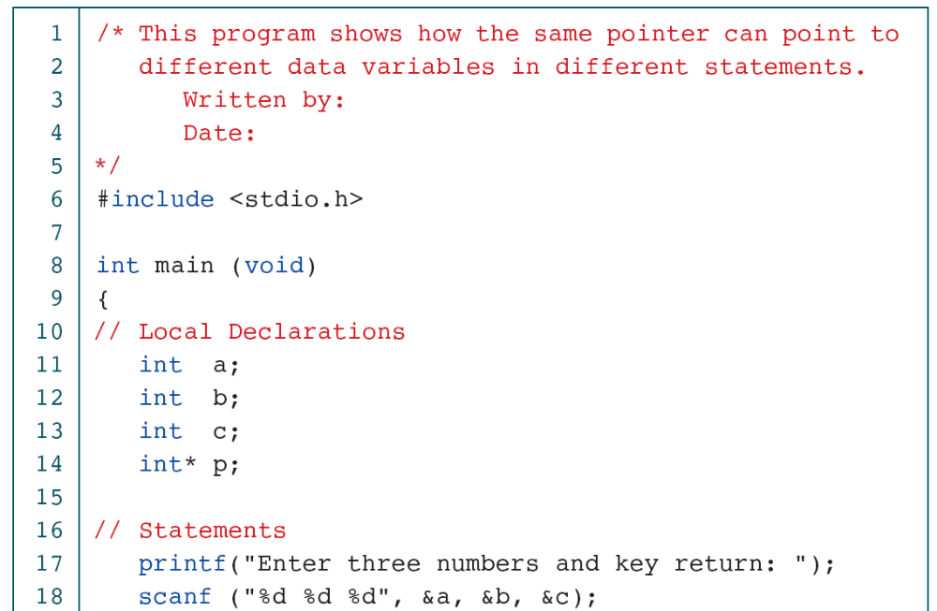
PROGRAM 9-4
Using One Pointer for Many Variables
Computer Science: A Structured Programming Approach Using C

Slide 26
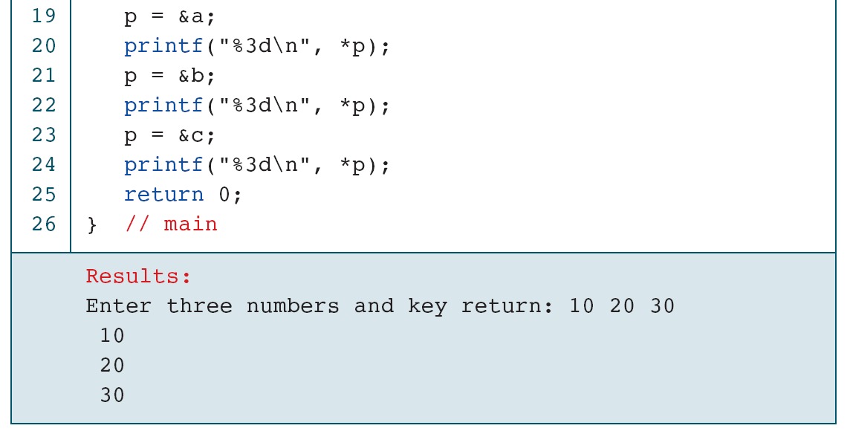
PROGRAM 9-4
Using One Pointer for Many Variables
Computer Science: A Structured Programming Approach Using C

Slide 27
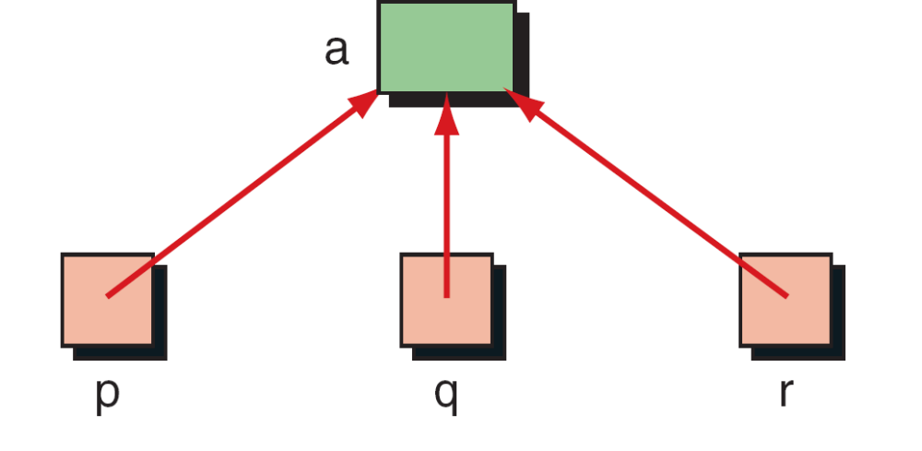
FIGURE 9-16 One Variable with Many Pointers
Computer Science: A Structured Programming Approach Using C

Slide 28
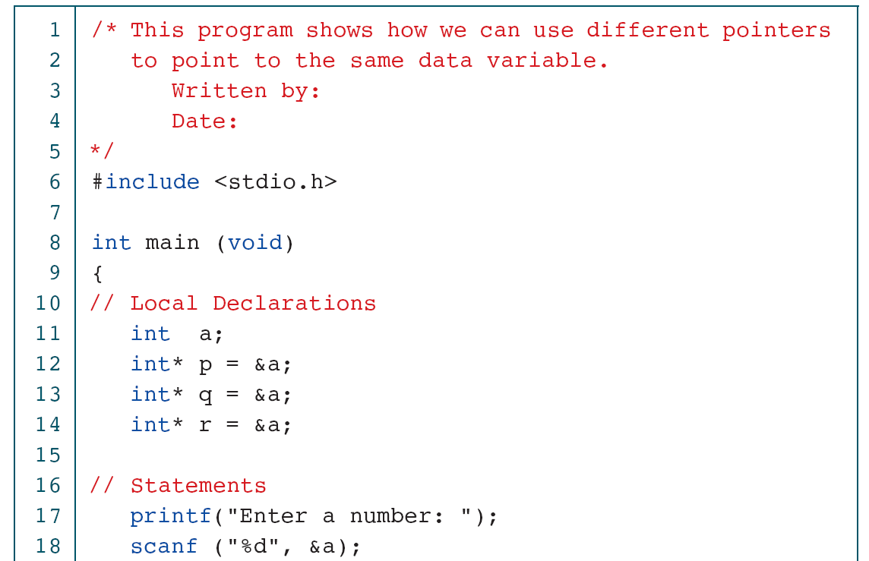
PROGRAM 9-5
Using A Variable with Many Pointers
Computer Science: A Structured Programming Approach Using C

Slide 29
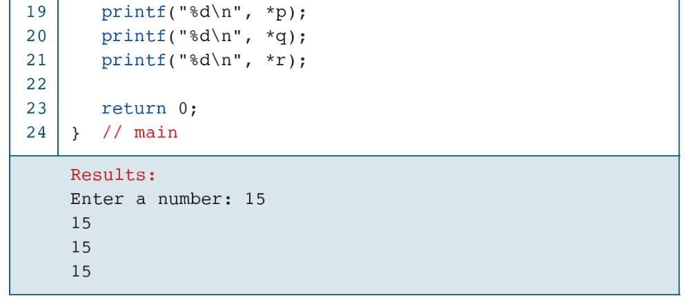
PROGRAM 9-5
Using A Variable with Many Pointers
Computer Science: A Structured Programming Approach Using C

