Slide 1
Exception Handling
By,
T.Jalaja
CSE department, VCE

Slide 2
Exception Handling
An exception is an abnormal condition that arises in a code sequence at run time.
An exception is a run-time error.
In computer languages that do not support exception handling, errors must be checked and handled manually.
Java’s exception handling avoids these problems and, in the process, brings run-time error management into the object-oriented world.

Slide 3
Exception Handling
A Java exception is an object that describes an exceptional (that is, error) condition that has occurred in a piece of code.
When an exceptional condition arises, an object representing that exception is created and thrown in the method that caused the error.
That method may choose to handle the exception itself, or pass it on. Either way, at some point, the exception is caught and processed.
Exceptions can be generated by the Java run-time system, or they can be manually generated by your code.
Exceptions thrown by Java relate to fundamental errors that violate the rules of the Java language or the constraints of the Java execution environment.
Manually generated exceptions are typically used to report some error condition to the caller of a method.

Slide 4
Exception Handling
Java exception handling is managed via five keywords: try, catch, throw, throws, and finally.
Program statements that you want to monitor for exceptions are contained within a try block.
If an exception occurs within the try block, it is thrown.
Your code can catch this exception (using catch) and handle it in some rational manner.
System-generated exceptions are automatically thrown by the Java run-time system.
To manually throw an exception, use the keyword throw..

Slide 5
Exception Handling
Any exception that is thrown out of a method must be specified as such by a throws clause.
Any code that absolutely must be executed after a try block completes is put in a finally block.
ExceptionType is the type of exception that has occurred

Slide 6
Exception Handling
• This is the general form of an exception-handling block:
try {
// block of code to monitor for errors
}
catch (ExceptionType1 exOb) {
// exception handler for ExceptionType1
}
catch (ExceptionType2 exOb) {
// exception handler for ExceptionType2
}
// ...
finally {
// block of code to be executed after try block ends
}

Slide 7
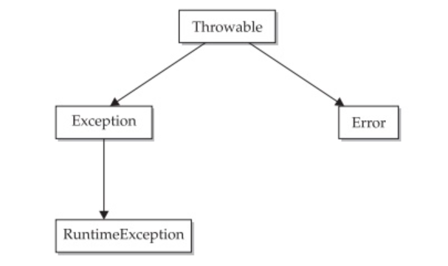
Exception Handling
Exception Types
All exception types are subclasses of the built-in class Throwable. Thus, Throwable is at the top of the exception class hierarchy. Immediately below Throwable are two subclasses that partition exceptions into two distinct branches.

Slide 8
Exception Handling
Exception Types
One branch is headed by Exception. This class is used for exceptional conditions that user programs should catch.
This is also the class that you will subclass to create your own custom exception types.
There is an important subclass of Exception, called RuntimeException.
Exceptions of this type are automatically defined for the programs that you write and include things such as division by zero and invalid array indexing.

Slide 9
Exception Handling
The other branch is topped by Error, which defines exceptions that are not expected to be caught under normal circumstances by your program.
Exceptions of type Error are used by the Java run-time system to indicate errors having to do with the run-time environment, itself. Stack overflow is an example of such an error.
This chapter will not be dealing with exceptions of type Error, because these are typically created in response to catastrophic failures that cannot usually be handled by your program.

Slide 10
Exception Handling
Uncaught Exceptions
class Exc0 {
public static void main(String args[]) {
int d = 0;
int a = 42 / d;
}
}
Here is the exception generated when this example is executed:
java.lang.ArithmeticException: / by zero at Exc0.main(Exc0.java:4)

Slide 11
Exception Handling
When the Java run-time system detects the attempt to divide by zero, it constructs a new exception object and then throws this exception.
This causes the execution of Exc0 to stop.
Here the exception is caught by the default handler provided by the Java run-time system
The default handler displays a string describing the exception, prints a stack trace from the point at which the exception occurred, and terminates the program.

Slide 12
Exception Handling
class Exc1 {
static void subroutine() { int d = 0;
int a = 10 / d;
}
public static void main(String args[]) {
Exc1.subroutine();
}
}
java.lang.ArithmeticException: / by zero at Exc1.subroutine(Exc1.java:4) at Exc1.main(Exc1.java:7)
The call stack is quite useful for debugging, because it pinpoints the precise sequence of steps that led to the error.

Slide 13
Exception Handling
Using try and catch
First, it allows you to fix the error.
Second, it prevents the program from automatically terminating.
To guard against and handle a run-time error, simply enclose the code that you want to monitor inside a try block.
Immediately following the try block, include a catch clause that specifies the exception type that you wish to catch.

Slide 14
Exception Handling
class Exc2 {
public static void main(String args[]) { int d, a;
try {
d = 0;
a = 42 / d;
System.out.println("This will not be printed.");
} catch (ArithmeticException e) { // catch divide-by-zero error
System.out.println("Division by zero.");
}
System.out.println("After catch statement.");
}
}
output:
Division by zero.
After catch statement.

Slide 15
Exception Handling
execution never “returns” to the try block from a catch
Once the catch statement has executed, program control continues with the next line in the program following the entire try / catch mechanism.
A try and its catch statement form a unit. The scope of the catch clause is restricted to those statements specified by the immediately preceding try statement.
A catch statement cannot catch an exception thrown by another try statement (except in the case of nestedtry statements)

Slide 16
Exception Handling
import java.util.Random;
class HandleError {
public static void main(String args[]) { int a=0, b=0, c=0;
Random r = new Random();
for(int i=0; i<32000; i++) {
try {
b = r.nextInt(); c = r.nextInt();
a = 12345 / (b/c);
} catch (ArithmeticException e) {
System.out.println("Division by zero."); a = 0; //set a to zero continue
}
System.out.println("a: " + a);
}
}}

Slide 17
Exception Handling
Multiple catch Clauses
more than one exception could be raised by a single piece of code.
When an exception is thrown, each catch statement is inspected in order, and the first one whose type matches that of the exception is executed.
After one catch statement executes, the others are bypassed, and execution continues after the try / catch block.

Slide 18
Exception Handling
// Demonstrate multiple catch statements.
class MultipleCatches {
public static void main(String args[]) {
try {
int a = args.length;
System.out.println("a = " + a);
int b = 42 / a;
int c[] = { 1 };
c[42] = 99;
} catch(ArithmeticException e) {
System.out.println("Divide by 0: " + e);
} catch(ArrayIndexOutOfBoundsException e) {
System.out.println("Array index oob: " + e);
}
System.out.println("After try/catch blocks.");
}}

Slide 19
Exception Handling
Here is the output generated by running it both ways:
C:\>java MultipleCatches
a = 0
Divide by 0: java.lang.ArithmeticException: / by zero
After try/catch blocks.
C:\>java MultipleCatches TestArg
a = 1
Array index oob: java.lang.ArrayIndexOutOfBoundsException:42 After try/catch blocks.

Slide 20
Exception Handling
When you use multiple catch statements, it is important to remember that exception subclasses must come before any of their superclasses.
This is because a catch statement that uses a superclass will catch exceptions of that type plus any of its subclasses.

Slide 21
Exception Handling
class SuperSubCatch {
public static void main(String args[]) {
try {
int a = 0;
int b = 42 / a;
} catch(Exception e) {
System.out.println("Generic Exception catch.");
}
/* This catch is never reached because ArithmeticException is a subclass of Exception. */
catch(ArithmeticException e) { // ERROR – unreachable
System.out.println("This is never reached.");
}
}}

Slide 22
Exception Handling
Nested try Statements
class NestTry {
public static void main(String args[]) {
try {
int a = args.length;
int b = 42 / a;
System.out.println("a = " + a);
try { // nested try block
if(a==1) a = a/(a-a); // division by zero
if(a==2) {
int c[] = { 1 };
c[42] = 99; // generate an out-of-bounds exception
}
} catch(ArrayIndexOutOfBoundsException e) {
System.out.println("Array index out-of-bounds: " + e);
}
} catch(ArithmeticException e) {
System.out.println("Divide by 0: " + e);
}
}}

Slide 23
Exception Handling
:\>java NestTry
Divide by 0: java.lang.ArithmeticException: / by zero
C:\>java NestTry One
a = 1
Divide by 0: java.lang.ArithmeticException: / by zero
C:\>java NestTry One Two
a = 2
Array index out-of-bounds: java.lang.ArrayIndexOutOfBoundsException:42

Slide 24
Exception Handling
throw
It is possible for your program to throw an exception explicitly, using the throw statement. The general form of throw is shown here:
throw ThrowableInstance;
ThrowableInstance must be an object of type Throwable or a subclass of Throwable
The flow of execution stops immediately after the throw statement; any subsequent statements are not executed. The nearest enclosing try block is inspected to see if it has a catch statement that matches the type of exception.
If it does find a match, control is transferred to that statement.
If not, then the next enclosing try statement is inspected, and so on. If no matching catch is found, then the default exception handler halts the program and prints the stack trace.

Slide 25
Exception Handling
class ThrowDemo {
static void demoproc() {
try {
throw new NullPointerException("demo");
} catch(NullPointerException e) {
System.out.println("Caught inside demoproc.");
throw e; // rethrow the exception
}
}
public static void main(String args[]) {
try {
demoproc();
} catch(NullPointerException e) {
System.out.println("Recaught: " + e);
}}
}
Caught inside demoproc.
Recaught: java.lang.NullPointerException: demo

Slide 26
Exception Handling
throws
If a method is capable of causing an exception that it does not handle, it must specify this behavior so that callers of the method can guard themselves against that exception -by including a throws clause in the method’s declaration.
A throws clause lists the types of exceptions that a method might throw.
This is necessary for all exceptions, except those of type Error or RuntimeException, or any of their subclasses.
If they are not, a compile-time error will result.

Slide 27
Exception Handling
This is the general form of a method declaration that includes a throws clause:
type method-name(parameter-list) throws exception-list
{
// body of method
}

Slide 28
Exception Handling
// This program contains an error and will not compile.
class ThrowsDemo {
static void throwOne() {
System.out.println("Inside throwOne.");
throw new IllegalAccessException("demo");
}
public static void main(String args[]) {
throwOne();
}
}

Slide 29
Exception Handling
// This is now correct.
class ThrowsDemo {
static void throwOne() throws IllegalAccessException {
System.out.println("Inside throwOne.");
throw new IllegalAccessException("demo");
}
public static void main(String args[]) {
try {
throwOne();
} catch (IllegalAccessException e) {
System.out.println("Caught " + e);
}
}}
Output:
inside throwOne
Caught java.lang.IllegalAccessException: demo

Slide 30
Exception Handling
finally
finally creates a block of code that will be executed after a try /catch block has completed and before the code following the try/catch block.
The finally block will execute whether or not an exception is thrown.
If an exception is thrown, the finally block will execute even if no catch statement matches the exception.
Any time a method is about to return to the caller from inside a try/catch block, via an uncaught exception or an explicit return statement, the finally clause is also executed just before the method returns.
This can be useful for closing file handles and freeing up any other resources that might have been allocated at the beginning of a method with the intent of disposing of them before returning.
The finally clause is optional.

Slide 31
Exception Handling
Each try statement requires at least one catch or a finally clause.
class FinallyDemo {
static void procA() {
try {
System.out.println("inside procA");
throw new RuntimeException("demo");
} finally {
System.out.println("procA's finally");
}
}
static void procB() {
try {
System.out.println("inside procB"); return;
} finally {
System.out.println("procB's finally");
}}
static void procC() {
try {
System.out.println("inside procC");
} finally {
System.out.println("procC's finally");
}
}
public static void main(String args[]) {
try {
procA();
} catch (Exception e) {
System.out.println("Exception caught");
}
procB();
procC();
}}

Slide 32
Exception Handling
Here is the output generated by the preceding program:
inside procA
procA's finally
Exception caught
inside procB
procB's finally
inside procC
procC's finally

Slide 33
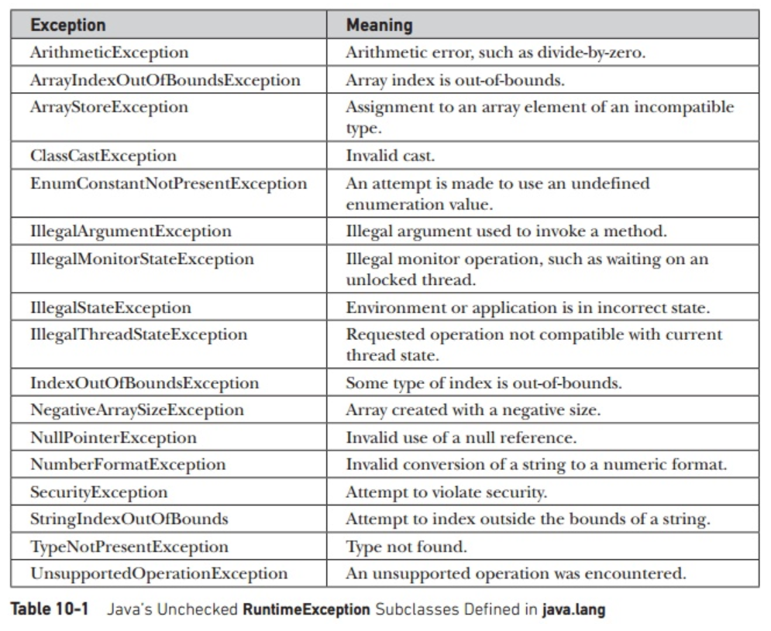
Exception Handling
Java’s Built-in Exceptions (in java.lang package)

Slide 34
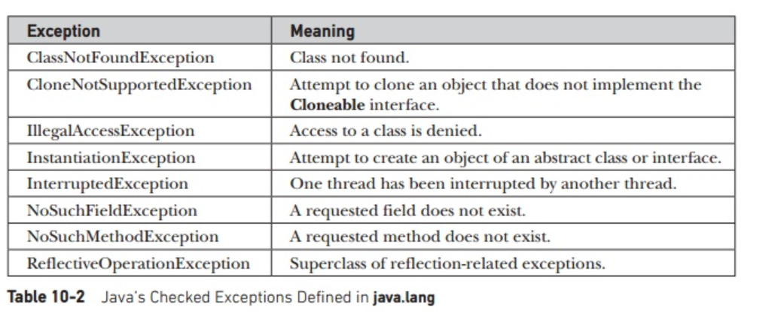
Exception Handling
unchecked exceptions because the compiler does not check to see if a method handles or throws these exceptions.

Slide 35
Exception Handling
Creating Your Own Exception Subclasses
to handle situations specific to applications.
define a subclass of Exception (which is a subclass of Throwable)
class MyException extends Exception {
private int detail;
MyException(int a) {
detail = a;
}
public String toString() {
return "MyException[" + detail + "]";
}
}

Slide 36
Exception Handling
class ExceptionDemo {
static void compute(int a) throws MyException {
System.out.println("Called compute(" + a + ")");
if(a > 10)
throw new MyException(a);
System.out.println("Normal exit");
}
public static void main(String args[]) { try {
compute(1);
compute(20);
} catch (MyException e) {
System.out.println("Caught " + e);
}}}

Slide 37
Exception Handling
Output
Called compute(1)
Normal exit
Called compute(20)
Caught MyException[20]

Slide 38
Exception Handling
Chained Exceptions
The chained exception feature allows you to associate another exception with an exception. This second exception describes the cause of the first exception.
class ChainExcDemo {
static void demoproc() {
NullPointerException e = new NullPointerException("top layer");
e.initCause(new ArithmeticException("cause"));
throw e;
}

Slide 39
Exception Handling
public static void main(String args[]) {
try {
demoproc();
} catch(NullPointerException e) {
System.out.println("Caught: " + e);
System.out.println("Original cause: " + e.getCause());
}}
}
Caught: java.lang.NullPointerException: top layer
Original cause: java.lang.ArithmeticException: cause

Slide 40
Exception Handling
Three Recently Added Exception Features
Beginning with JDK 7, three interesting and useful features have been added to the exception system.
The first automates the process of releasing a resource, such as a file, when it is no longer needed. It is based on an expanded form of the try statement called try-with-resources.
The second feature is called multi-catch, and the third is sometimes referred to as final rethrow or more precise rethrow.

Slide 41
Exception Handling
// Demonstrate the multi-catch feature.
class MultiCatch {
public static void main(String args[]) { int a=10, b=0;
int vals[] = { 1, 2, 3 };
try {
int result = a / b; // generate an ArithmeticException
vals[10] = 19; // generate an ArrayIndexOutOfBoundsException
// This catch clause catches both exceptions.
}
catch(ArithmeticException | ArrayIndexOutOfBoundsException e) { System.out.println("Exception caught: " + e);
}
System.out.println("After multi-catch.");
}
}

Slide 42
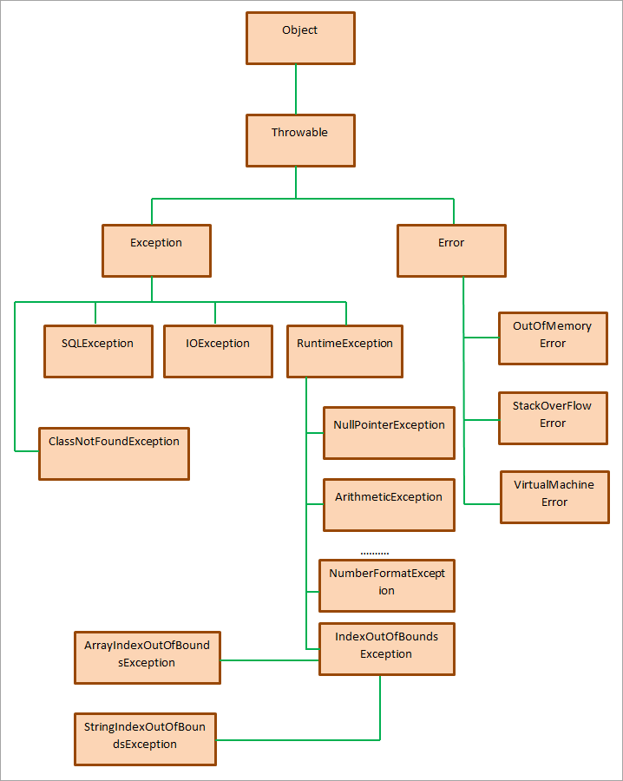

Slide 43
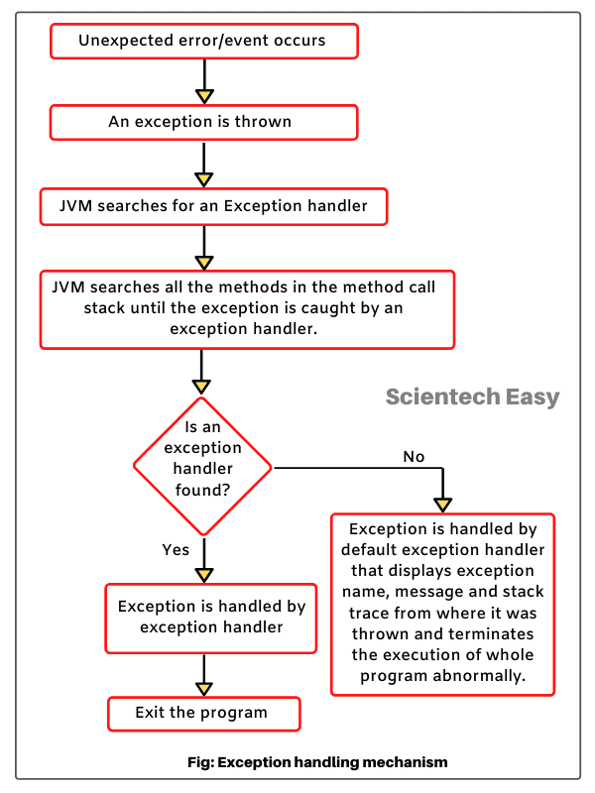

Slide 44
class InvalidAgeException extends Exception
{
public InvalidAgeException (String str)
{
super(str);
}
}
public class TestCustomException1
{
static void validate (int age) throws InvalidAgeException{
if(age < 18){
throw new InvalidAgeException("age is not valid to vote");
}
else {
System.out.println("welcome to vote");
}
}

Slide 45
public static void main(String args[])
{
try
{
validate(13);
}
catch (InvalidAgeException ex)
{
System.out.println("Caught the exception");
System.out.println("Exception occured: " + ex);
}
System.out.println("rest of the code...");
}
}

Slide 46
//user-defined exception in java
import java.util.*;
class InvalidCredentialsException extends Exception{
String msg;
InvalidCredentialsException(String msg){
super(msg);
this.msg=msg;
}
public String toString(){
return msg;
} }
public class Main{
public static void main(String[] args) {
Scanner sc=new Scanner(System.in);
String id = sc.next();
String password = sc.next();
try{
if(id!="user1" || password!="1234"){
throw new InvalidCredentialsException("no user with username - "+id);
} }
catch(InvalidCredentialsException ex){
System.out.println(ex);
System.out.println(ex.getMessage());
} } }

Slide 47
End
Thank you…

