Slide 1
Inheritance
By
T.Jalaja
CSE Dept, VCE

Slide 2
Inheritance
Inheritance allows the creation of hierarchical classifications.
Using inheritance, you can create a general class that defines traits common to a set of related items. This class can then be inherited by other, more specific classes, each adding those things that are unique to it.
A class that is inherited is called a superclass. The class that does the inheriting is called a subclass.
Therefore, a subclass is a specialized version of a superclass. It inherits all of the members defined by the superclass and adds its own, unique elements.

Slide 3
Inheritance
To inherit a class use the extends keyword.
class A {
int i, j;
void showij() {
System.out.println("i and j: " + i + " " + j);
}
}
// Create a subclass by extending class A.
class B extends A {
int k;
void showk() { System.out.println("k: " + k); }
void sum() {
System.out.println("i+j+k: " + (i+j+k));
}}

Slide 4
Inheritance
class SimpleInheritance {
public static void main(String args []) {
A superOb = new A();
B subOb = new B();
superOb.i = 10;
superOb.j = 20;
System.out.println("Contents of superOb: ");
superOb.showij();
subOb.i = 7; subOb.j = 8; subOb.k = 9;
System.out.println("Contents of subOb: "); subOb.showij();
subOb.showk();
System.out.println("Sum of i, j and k in subOb:"); subOb.sum();
} }

Slide 5
Inheritance
A subclass can be a superclass for another subclass.
The general form of a class declaration that inherits a superclass is shown here:
class subclass-name extends superclass-name {
// body of class
}
You can only specify one superclass for any subclass that you create.
Java does not support the inheritance of multiple superclasses into a single subclass.
No class can be a superclass of itself

Slide 6
Member Access and Inheritance
Although a subclass includes all of the members of its superclass, it cannot access those members of the superclass that have been declared as private.
class A {
int i; // public by default
private int j; // private to A
void setij(int x, int y) {
i = x;
j = y;
}}
class B extends A {
int total;
void sum() {
total = i + j; // ERROR, j is not accessible here
}}

Slide 7
Inheritance
class Access {
public static void main(String args[]) {
B subOb = new B();
subOb.setij(10, 12);
subOb.sum();
System.out.println("Total is " + subOb.total);
}
}
//Compilation Error in the above program. Since j is declared as private, it is only accessible by other members of its own class. Subclasses have no access to it.

Slide 8
Inheritance
class Box {
double width; double height; double depth;
Box(Box ob) { // pass object to constructor
width = ob.width;
height = ob.height;
depth = ob.depth;
}
Box(double w, double h, double d) {
width = w; height = h; depth = d;
}
Box() {
width = -1;
height = -1;
depth = -1;
}

Slide 9
Inheritance
Box(double len) {
width = height = depth = len;
}
double volume() {
return width * height * depth;
}
}
// Here, Box is extended to include weight.
class BoxWeight extends Box {
double weight;
BoxWeight(double w, double h, double d, double m) {
width = w;
height = h; depth = d; weight = m;
}}

Slide 10
Inheritance
class DemoBoxWeight {
public static void main(String args[]) {
BoxWeight mybox1 = new BoxWeight(10, 20, 15, 34.3);
BoxWeight mybox2 = new BoxWeight(2, 3, 4, 0.076);
double vol;
vol = mybox1.volume();
System.out.println("Volume of mybox1 is " + vol);
System.out.println("Weight of mybox1 is " + mybox1.weight); System.out.println();
vol = mybox2.volume();
System.out.println("Volume of mybox2 is " + vol);
System.out.println("Weight of mybox2 is " + mybox2.weight);
}
}

Slide 11
Inheritance
A major advantage of inheritance is that once you have created a superclass that defines the attributes common to a set of objects, it can be used to create any number of more specific subclasses. ( One super class and any number of sub classes inheriting it.)
Once you have created a superclass that defines the general aspects of an object, that superclass can be inherited to form specialized classes.
Each subclass simply adds its own unique attributes. This is the essence of inheritance.

Slide 12
Inheritance
A Superclass Variable Can Reference a Subclass Object
A reference variable of a superclass can be assigned a reference to any subclass derived from that superclass.
class RefDemo {
public static void main(String args[]) {
BoxWeight weightbox = new BoxWeight(3, 5, 7, 8.37);
Box plainbox = new Box();
double vol = weightbox.volume();
System.out.println("Volume of weightbox is " + vol); System.out.println("Weight of weightbox is " +weightbox.weight);
plainbox = weightbox;
vol = plainbox.volume();
System.out.println("Volume of plainbox is " + vol);
System.out.println("Weight of plainbox is " + plainbox.weight);
}}

Slide 13
Inheritance
It is important to understand that it is the type of the reference variable—not the type of the object that it refers to—that determines what members can be accessed.
That is, when a reference to a subclass object is assigned to a superclass reference variable, you will have access only to those parts of the object defined by the superclass.

Slide 14
Using super
Whenever a subclass needs to refer to its immediate superclass, it can do so by use of the keyword super.
super has two general forms.
The first calls the superclass’ constructor.
The second is used to access a member of the superclass that has been hidden by a member of a subclass.
Using super to Call Superclass Constructors
A subclass can call a constructor defined by its superclass as follows
super(arg-list);
arg-list specifies any arguments needed by the constructor in the superclass. super( ) must always be the first statement executed inside a subclass’ constructor.

Slide 15
Using super
class BoxWeight extends Box {
double weight;
// initialize width, height, and depth using super()
BoxWeight(double w, double h, double d, double m) {
super(w, h, d); // call superclass constructor
weight = m;
}
}

Slide 16
Using super
A Second Use for super
It always refers to the superclass of the subclass in which it is used. This usage has the following general form:
super.member
Here, member can be either a method or an instance variable.
This second form of super is most applicable to situations in which member names of a subclass hide members by the same name in the superclass.
In the next example Although the instance variable i in B hides the i in A, super allows access to the i defined in the superclass.

Slide 17
Using super
class A { int i; }
class B extends A {
int i; // this i hides the i in A
B(int a, int b) {
super.i = a; // i in A
i = b; // i in B
}
void show() {
System.out.println("i in superclass: " + super.i); System.out.println("i in subclass: " + i);
}
}
class UseSuper {
public static void main(String args[]) {
B subOb = new B(1, 2);
subOb.show(); }}

Slide 18
Creating a Multilevel Hierarchy
It is perfectly acceptable to use a subclass as a superclass of another.
Class Box{…}
class BoxWeight extends Box {……..}
class Shipment extends BoxWeight{…………}
Because of inheritance, Shipment can make use of the previously defined classes of Box and BoxWeight, adding only the extra information it needs for its own, specific application (reuse of code).
super( ) always refers to the constructor in the closest superclass. The super( ) inShipment calls the constructor in BoxWeight. The super( ) in BoxWeight calls the constructor in Box. In a class hierarchy, if a superclass constructor requires parameters, then all subclasses must pass those parameters “up the line.” This is true whether or not a subclass needs parameters of its own.

Slide 19
When constructors are executed
In a class hierarchy, constructors complete their execution in order of derivation, from superclass to subclass.
Since super( ) must be the first statement executed in a subclass’ constructor, this order is the same whether or not super( ) is used.
If super( ) is not used, then the default or parameter less constructor of each superclass will be executed.

Slide 20
when constructors are executed
class A {
A() {
System.out.println("Inside A's constructor.");
}}
class B extends A {
B() {
System.out.println("Inside B's constructor.");
}}
class C extends B { C() {
System.out.println("Inside C's constructor.");
}
}
C obj = new C();

Slide 21
when constructors are executed
class CallingCons {
public static void main(String args[]) {
C c = new C();
}}
The output from this program is shown here:
Inside A's constructor
Inside B's constructor
Inside C's constructor
/////the constructors are executed in order of derivation.

Slide 22
Method Overriding
In a class hierarchy, when a method in a subclass has the same name and type signature as a method in its superclass, then the method in the subclass is said to override the method in the superclass.
When an overridden method is called from within its subclass, it will always refer to the version of that method defined by the subclass. The version of the method defined by the superclass will be hidden.

Slide 23
Method Overriding
class A {
int i, j;
A(int a, int b) {
i = a;
j = b;
}
void show() {
System.out.println("i and j: " + i + " " + j);
}
}
class B extends A {
int k;
B(int a, int b, int c) {
super(a, b);
k = c; }

Slide 24
Method Overriding
void show() {
super.show();
System.out.println("k: " + k);
}
}
class Override {
public static void main(String args[]) {
B subOb = new B(1, 2, 3);
subOb.show(); // this calls show() in B
}}
Method overriding occurs only when the names and the type signatures of the two methods are identical. If they are not, then the two methods are simply overloaded

Slide 25
Dynamic Method Dispatch
Dynamic method dispatch is the mechanism by which a call to an overridden method is resolved at run time, rather than compile time.
Dynamic method dispatch is important because this is how Java implements run-time polymorphism.
When an overridden method is called through a superclass reference, Java determines which version of that method to execute based upon the type of the object being referred to at the time the call occurs.
Thus, this determination is made at run time.
In other words, it is the type of the object being referred to (not the type of the reference variable) that determines which version of an overridden method will be executed.

Slide 26
Dynamic Method Dispatch
class A {
void callme() {
System.out.println("Inside A's callme method");
}
}
class B extends A { // override callme()
void callme() {
System.out.println("Inside B's callme method");
}
}
class C extends A { // override callme()
void callme() {
System.out.println("Inside C's callme method");
}}

Slide 27
Dynamic Method Dispatch
class Dispatch {
public static void main(String args[]) {
A a = new A(); // object of type A
B b = new B(); // object of type B
C c = new C(); // object of type C
A r; // obtain a reference of type A
r = a; // r refers to an A object
r.callme(); // calls A's version of callme
r = b; // r refers to a B object
r.callme(); // calls B's version of callme
r = c; // r refers to a C object
r.callme(); // calls C's version of callme
}}

Slide 28
Dynamic Method dispatch
Polymorphism is essential to object-oriented programming for one reason: it allows a general class to specify methods that will be common to all of its derivatives, while allowing subclasses to define the specific implementation of some or all of those methods.
Overridden methods are another way that Java implements the “one interface, multiple methods” aspect of polymorphism.
the superclass provides all elements that a subclass can use directly. It also defines those methods that the derived class must implement on its own.
Dynamic, run-time polymorphism is one of the most powerful mechanisms that object-oriented design brings to bear on code reuse and robustness.

Slide 29
Dynamic Method dispatch
class Figure {
double dim1; double dim2;
Figure(double a, double b) {
dim1 = a;
dim2 = b;
}
double area() {
System.out.println("Area for Figure is undefined."); return 0;
}
}
class Rectangle extends Figure {
Rectangle(double a, double b) {
super(a, b);
}

Slide 30
Dynamic Method dispatch
// override area for rectangle
double area() {
System.out.println("Inside Area for Rectangle.");
return dim1 * dim2;
}
}
class Triangle extends Figure {
Triangle(double a, double b) {
super(a, b);
}
// override area for right triangle
double area() {
System.out.println("Inside Area for Triangle.");
return dim1 * dim2 / 2;
}}

Slide 31
Dynamic Method dispatch
class FindAreas {
public static void main(String args[]) {
Figure f = new Figure(10, 10);
Rectangle r = new Rectangle(9, 5);
Triangle t = new Triangle(10, 8);
Figure figref;
figref = r;
System.out.println("Area is " + figref.area());
figref = t;
System.out.println("Area is " + figref.area());
figref = f;
System.out.println("Area is " + figref.area());
}
}

Slide 32
Dynamic Method dispatch
The output from the program is shown here:
Inside Area for Rectangle.
Area is 45.0
Inside Area for Triangle.
Area is 40.0
Area for Figure is undefined.
Area is 0.0

Slide 33
Using Abstract Classes
There are situations in which you will want to define a superclass that declares the structure of a given abstraction without providing a complete implementation of every method. Such a class determines the nature of the methods that the subclasses must implement.
To declare an abstract method, use this general form:
abstract type name(parameter-list);
No method body is present.

Slide 34
Using Abstract Classes
Any class that contains one or more abstract methods must also be declared abstract.
To declare a class abstract, use the abstract keyword in front of the class keyword at the beginning of the class declaration.
There can be no objects of an abstract class. That is, an abstract class cannot be directly instantiated with the new operator.
Such objects would be useless, because an abstract class is not fully defined.
Also, you cannot declare abstract constructors, or abstract static methods.
Any subclass of an abstract class must either implement all of the abstract methods in the superclass, or be declared abstract itself.

Slide 35
Using Abstract Classes
abstract class A {
abstract void callme();
classes void callmetoo() {
System.out.println("This is a concrete method.");
}}
class B extends A {
void callme() {
System.out.println("B's implementation of callme.");
}}
class AbstractDemo {
public static void main(String args[]) {
B b = new B();
b.callme();
b.callmetoo();
}}

Slide 36
Using Abstract Classes
Although abstract classes cannot be used to instantiate objects, they can be used to create object references, because Java’s approach to run-time polymorphism is implemented through the use of superclass references.
Thus, it must be possible to create a reference to an abstract class so that it can be used to point to a subclass object.

Slide 37
Using final with Inheritance
The keyword final has three uses.
it can be used to create the constant. final float f1=3.4f;
Using final to Prevent Overriding
Using final to Prevent Inheritance
Using final to Prevent Overriding
To disallow a method from being overridden, specify final as a modifier at the start of its declaration. Methods declared as final cannot be overridden.

Slide 38
Using final with Inheritance
class A {
final void meth() {
System.out.println("This is a final method.");
}
}
class B extends A {
void meth() { // ERROR! Can't override.
System.out.println("Illegal!");
}
}
.

Slide 39
Using final with Inheritance
class A {
final void meth() {
System.out.println("This is a final method.");
}
}
class B extends A {
void meth() { // ERROR! Can't override.
System.out.println("Illegal!");
}
}
Methods declared as final can sometimes provide a performance enhancement
.

Slide 40
Using final with Inheritance
Using final to Prevent Inheritance
Precede the class declaration with final to prevent a class from being inherited.
Declaring a class as final implicitly declares all of its methods as final, too.
final class A { //...
}
// The following class is illegal.
class B extends A { // ERROR! Can't subclass A //...
}

Slide 41
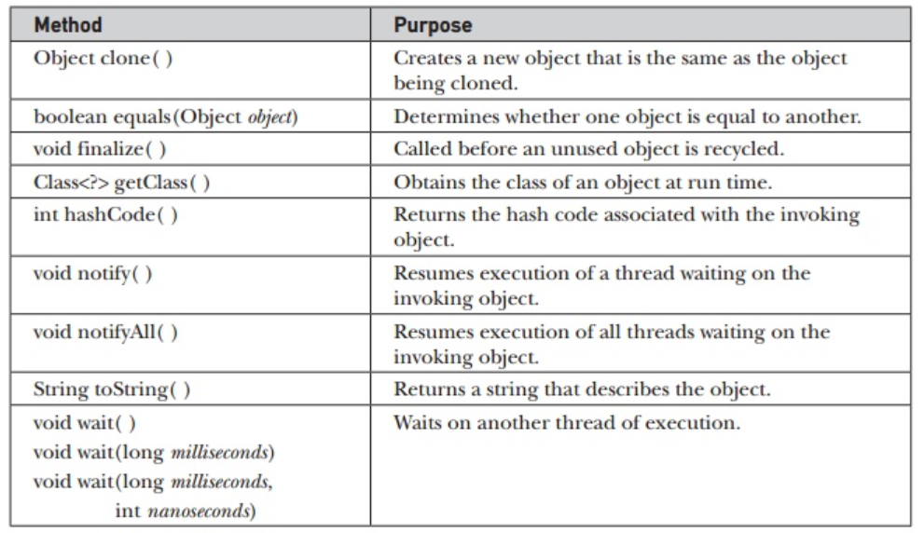
The Object Class
There is one special class, Object, defined by Java. All other classes are subclasses of Object. Object is a superclass of all other classes.

Slide 42
The Object Class
The methods getClass( ), notify( ), notifyAll( ), and wait( ) are declared as final. You may override the others.
The equals( ) method compares two objects. It returns true if the objects are equal, and false otherwise.
The toString( ) method returns a string that contains a description of the object on which it is called. Also, this method is automatically called when an object is output using println( ).
Many classes override this method. Doing so allows them to tailor a description specifically for the types of objects that they create.

Slide 43
End
Thank you…

