Slide 1
UNIT-V
Lambda expressions: Expressions, Functions, lambda as argument Stream API: Basics, Filter,Sort, Map, Collect Regular Expressions: Pattern, Matcher, Regular expression Syntax MVC: Architecture, Usecase

Slide 2
Lambda expression
Lambda expression in java is an anonymous (no name) function that does not need to define the data type of input parameters and does not need to have a return type.
Lambda expression in java implements the functional interface and it can be treated as any other java object.
It can be used to create threads, comparators and can be used to add event Listeners.
Lambda expressions combine functional programming features with Java's object-oriented programming characteristics, resulting in more powerful concurrency features that are easier to use.

Slide 3
Java Lambda Expression Syntax
The Syntax of Lambda Expression in Java consists of three components.
Arguments-list: It is the first portion of the Lambda expression in Java. It can also be empty or non-empty. In the expression, it is enclosed by a round bracket.
Lambda operator ->: It's an arrow sign that appears after the list of arguments. It connects the arguments-list with the body of the expression.
Body: It contains the function body of lambda expression. It is surrounded by curly brackets. //Syntax of the lambda expression
(parameter_list) -> {function_body}

Slide 4
syntax for three different instances
1. No Parameter Syntax
() -> {body of function}
2. One Parameter Syntax
( p1 ) -> {body of function}
3.Two Parameter Syntax
( p1, p2 ) -> {body of function}

Slide 5
Lambda Use Cases in Java
Lambda expressions are used to replicate the functionality of an anonymous class without the need for a complex implementation.
Lambda is extremely beneficial for functional programming approaches in Java because of these qualities.
Functional programming is a programming paradigm that seeks to apply and combine functions to create programmes.

Slide 6
Five fundamental principles of functional programming
First-class functions
When functions in a programming language are handled like any other variable, the language is said to have first-class functions. In such a language, for example, a function can be supplied as an argument to other functions, returned by another function, and assigned as a value to a variable.
Function Composition
The act or method of combining simple functions to create more complex ones is known as function composition.
Pure functions
Pure function is functions that operate independently of the state outside the function and contain only the operations required to find the output.

Slide 7
Immutability
An immutable object is one whose state cannot be changed after it is created. In the immutable functions, inputs are only referred to; they are not changed.
Higher-order functions
A higher-order function is a function that accepts other functions as parameters and/or uses a function as the return value. These are essential to creating complex behaviours with functional programming.

Slide 8
@FunctionalInterface
interface MyName{
public void SayMyName();
}
public class LambdaExpressionExample {
public static void main(String[] args) {
//without lambda, MyName implementation
// using anonymous class
MyName person = new MyName(){
public void SayMyName(){
System.out.println("Himanshu Yadav");
}
};
person.SayMyName();
}
}
@FunctionalInterface //It is optional
interface MyName{
public void SayMyName();
}
public class LambdaExpressionExample {
public static void main(String[] args) {
//implementing with lambda
MyName p2 = () -> {
System.out.println("Himanshu Yadav");
};
// function call.
p2.SayMyName();
}
}

Slide 9
Java Lambda Expression with a single parameter
interface Speaker{
public String say(String name);
}
public class LambdaExpressionExample{
public static void main(String[] args) {
// Lambda expression with a single parameter.
Speaker s1 = (name) -> {
return "Hello, "+name;
};
System.out.println(s1.say("Himanshu"));
// You can omit function parentheses
Speaker s2 = name ->{
return "Hello, "+name;
};
System.out.println(s2.say("Scaler"));
// can omit the return statement and curly brackets,
// because it has only one statement in the function body
Speaker s3 = name ->"Hello, "+name;
System.out.println(s3.say("Content"));
}
}

Slide 10
Lambda Expression with Multiple Parameters
interface MyInter{
int add(int a,int b);
}
public class LambdaExpressionExample5{
public static void main(String[] args) {
// Multiple parameters in lambda expression
MyInter ad1 = (a,b) -> (a+b);
System.out.println(ad1.add(100,200));
// Multiple parameters with data type in the lambda expression
MyInter ad2 = (int a,int b) -> (a+b);
System.out.println(ad2.add(200,300));
}
}

Slide 11
lambda expression as a method parameter in Java
interface Algebra
{
int operate(int a, int b);
}
enum Operation
{
ADD, SUB, MUL, DIV
}
public class LambdaMethodArgTest
{
public static void main(String[] args)
{
print((a, b) -> a + b, Operation.ADD);
print((a, b) -> a - b, Operation.SUB);
print((a, b) -> a * b, Operation.MUL);
print((a, b) -> a / b, Operation.DIV);
}

Slide 12
lambda expression as a method parameter in Java
static void print(Algebra alg, Operation op)
{
switch (op)
{
case ADD: System.out.println("The addition of a and b is: " + alg.operate(40, 20));
break;
case SUB: System.out.println("The subtraction of a and b is: " + alg.operate(40, 20));
break;
case MUL: System.out.println("The multiplication of a and b is: " + alg.operate(40, 20));
break;
case DIV: System.out.println("The division of a and b is: " + alg.operate(40, 20));
break;
default: throw new AssertionError();
}
}
}

Slide 13
Advantages of Lambda Expression
It reduces the amount of code. Lambda expressions can only be used with a functional interface, as we know. Because Runnable has a functional interface, we can use lambda expressions with convenience.
Lambda Makes it easy to work with stream APIs and we get more Efficiency when doing bulk operations on collections, we can obtain higher efficiency (parallel processing) by leveraging the Stream API and lambda expressions.

Slide 14
Disadvantages of Lambda Expression in Java
Lambda expressions (as well as anonymous classes) in Java can only access the final (or effectively final) variables of the enclosing scope.
Lambda functions themselves lack names and documentation, meaning that the only way to know what they do is to read the code.

Slide 15
Stream In Java
Stream API is used to process collections of objects. A stream is a sequence of objects that supports various methods which can be pipelined to produce the desired result.
The features of Java stream are
A stream is not a data structure, it cant store data, instead it takes input from the Collections, Arrays or I/O channels.
Streams don’t change the original data structure, they only provide the result as per the pipelined methods.
Each intermediate operation is lazily executed and returns a stream as a result, hence various intermediate operations can be pipelined. Terminal operations mark the end of the stream and return the result.

Slide 16
Stream is a sequence of objects that provides various sequential and parallel aggregate operations.
Stream provides many intermediate and terminal operations that can be applied to the stream instance.
Intermediate operations return a stream as the output and are not executed until a terminal operation is invoked on the stream. filter, map, sorted are some intermediate operations.
Terminal operations produce the results of the stream. forEach, collect, min, max are some of the terminal operations.
Some stream operations are short-circuiting that is operations terminate without processing all the elements in a stream.
Stream follows lazy evaluation, and all intermediate operations are performed on the stream only when a terminal operation is invoked.

Slide 17
Intermediate Operations
map: The map method is used to returns a stream consisting of the results of applying the given function to the elements of this stream.
List number = Arrays.asList(2,3,4,5); List square = number.stream().map(x->x*x).collect(Collectors.toList());
filter: The filter method is used to select elements as per the Predicate passed as argument.
List names = Arrays.asList("Reflection","Collection","Stream"); List result = names.stream().filter(s->s.startsWith("S")).collect(Collectors.toList());
sorted: The sorted method is used to sort the stream.
List names = Arrays.asList("Reflection","Collection","Stream"); List result = names.stream().sorted().collect(Collectors.toList());

Slide 18
Terminal Operations
collect: The collect method is used to return the result of the intermediate operations performed on the stream.
List number = Arrays.asList(2,3,4,5,3); Set square = number.stream().map(x->x*x).collect(Collectors.toSet());
forEach: The forEach method is used to iterate through every element of the stream.
List number = Arrays.asList(2,3,4,5); number.stream().map(x->x*x).forEach(y->System.out.println(y));
reduce: The reduce method is used to reduce the elements of a stream to a single value.
The reduce method takes a BinaryOperator as a parameter.

Slide 19
filter()
The filter() method returns a stream with the stream's elements that match the given predicate. Predicate is a functional interface in Java that accepts a single input and can return a boolean value.
public class Main {
public static void main(String[] args) {
final List<Integer> list = new ArrayList<>( Arrays.asList(1, 2, 3, 4, 5));
final List<Integer> ans = list.stream().filter(value -> value % 2 == 0).collect(Collectors.toList());
System.out.println(Arrays.toString(ans.toArray()));
}
}
[2, 4]

Slide 20
map()
The map() method returns a stream with the resultant elements after applying the given function on the stream elements.
public class Main {
public static void main(String[] args) {
final List<Integer> list = new ArrayList<>(Arrays.asList(1, 2, 3, 4, 5));
final List<Integer> ans = list.stream()
.map(value -> value * 10)
.collect(Collectors.toList());
System.out.println(Arrays.toString(ans.toArray()));
}
}
[10, 20, 30, 40, 50]

Slide 21
Sorted()
public class Main {
public static void main(String[] args) {
final List<Integer> list = new ArrayList<>(Arrays.asList(5, 1, 3, 4, 2));
System.out.println("Ascending Order");
list.stream().sorted()
.forEach(System.out::println);
System.out.println("\nDescending Order");
list.stream().sorted(Comparator.reverseOrder())
.forEach(System.out::println);
}
}

Slide 22
Regular expression
A regular expression is nothing but a series of characters that we use to describe substrings or strings through a pattern.
It is actually a String that describes a pattern in another String.
Regular Expression in Java Syntax
Validating whether a given string is a valid email address or not,
it would be extremely tedious to perform with methods like
equals(), contains(), replaceAll().

Slide 23
common symbols we can use to formulate our
regular expression in Java.
String regex = "^[a-z0-9]@[a-z0-9].com$";
Symbol | Description | Example
XY | Characters in their raw form, used as it is | abc represents a followed by b followed by c
. | Any single character | .@abc represents any character followed by @abc
[ ] | Any character that belongs to the group inside the brackets | [abc] represents a or b or c
– | Denotes a range of characters | [a-z0-9] represents any character from a to z or 0 to 9.
^ | The subsequent expression must be at the beginning. When used inside a square bracket, it is a negation symbol | ^abc means that the String must start with abc. [^abc] represents any character except a or b or c
$ | The previous expression must be at the end | com$ means that the String must end with com

Slide 24
Quantifiers
Symbol | Description | Column 3
? | Denotes zero or one occurrence of the expression | @? means that @ may occur or may not occur
* | Denotes zero or more occurrences | [0-9]* means that any digit between 0 to 9 can occur as many times as needed
+ | Denotes one or more occurrences | [a-z]+ means that any alphabet occurs at least once or more times
{n} | Denotes exactly n occurrences | [a-z]{3} means 3 occurrences of characters from a to z must be present
{m,n} | Denotes at least m occurrences and at most n occurrences | [a-z]{2,6} means 2, 3, 4, 5 or 6 characters from a-z

Slide 25
Meta characters
Symbol | Description
\s | A whitespace character like space, newline, tab
\d | Any digit. Works the same way as [0-9]
\w | Any word. Works the same way as [a-zA-Z_0-9]+
\b | A word boundary, like at the beginning or at the end of a word

Slide 26
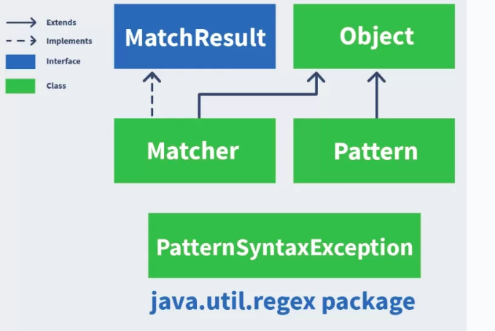
The Java Regex package and API

Slide 27
Pattern Class
This class is used to define our pattern. It can take the regular expression we have created as input, and it will then use our special characters to compile our regular expression into a Pattern object.
In short, it is nothing but a compiled version of our regular expression
//compiling emailRegex into a Pattern object
Pattern pattern =
Pattern.compile("^[a-z0-9._%+-]+@[a-z0-9.-]+\\.[a-z]{2,6}$",
Pattern.CASE_INSENSITIVE);

Slide 28
Return type and Method name | Description
Matcher matcher(CharSequence input) | Creates a Matcher object that can be used to match the input parameter against our Pattern object. This is illustrated in detail in the next section when we discuss the Matcher Class.
int flags() | Returns the pattern’s matched flags
static String quote(String s) | Returns a literal pattern String for the given String s
Stream splitAsStream(CharSequence input) | Returns a Stream of type String, from given input around matches of this pattern

Slide 29
The Matcher Class
This is the class we use to search for the defined Pattern in a string.
It interprets our Pattern against our input String when we invoke the matcher() method of our Pattern object, and then returns a Matcher object which we can use to verify.
Pattern pattern = Pattern.compile("^[a-z0-9._%+-]+@[a-z0-9.-]+\\.[a-z]{2,6}$", Pattern.CASE_INSENSITIVE);
//creating a Matcher object against the given input sequence test@examplecom
Matcher matcher1 = pattern.matcher("test@examplecom");
//creating a Matcher object against the given input sequence test@example.com
Matcher matcher2 = pattern.matcher("test@example.com");

Slide 30
boolean matchFound1 = matcher1.find(); //this will be false, as our test email address is missing the . between example and com
boolean matchFound2 = matcher2.find(); //this will be true, as our test email address is a valid email address

Slide 31
methods in the Matcher Class
Return type and Method name | Description
int start() | Returns the start index of the previous match (from MatchResult interface)
int end() | Returns the offset after which the last character was matched (from MatchResult interface)
String group() | Returns the input subsequence which was last matched in the previous match operation (from MatchResult interface)
int groupCount() | Returns the number of groups that were captured in this Matcher’s pattern (from MatchResult interface)
String replaceFirst(String replacement) String replaceAll(String replacement) | Replaces the first subsequence or all subsequences that matches the pattern, with the given replacement String
Matcher reset(CharSequence newInput) | Resets the Matcher with the new input sequence

Slide 32
MVC Architecture
The Model-View-Controller (MVC) is a well-known design pattern in the web development field.
It is way to organize our code. It specifies that a program or application shall consist of data model, presentation information and control information.
The MVC pattern needs all these components to be separated as different objects.

Slide 33
The MVC pattern architecture consists of three layers:
Model: It represents the business layer of application. It is an object to carry the data that can also contain the logic to update controller if data is changed.
View: It represents the presentation layer of application. It is used to visualize the data that the model contains.
Controller: It works on both the model and view. It is used to manage the flow of application, i.e. data flow in the model object and to update the view whenever data is changed.

Slide 34
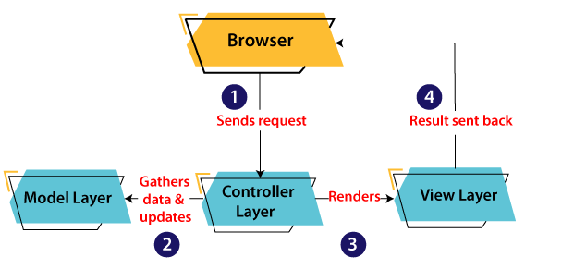
A client (browser) sends a request to the controller on the server side, for a page.
The controller then calls the model. It gathers the requested data.
Then the controller transfers the data retrieved to the view layer.
Now the result is sent back to the browser (client) by the view.

Slide 35
Advantages of MVC Architecture
MVC has the feature of scalability that in turn helps the growth of application.
The components are easy to maintain because there is less dependency.
A model can be reused by multiple views that provides reusability of code.
The developers can work with the three layers (Model, View, and Controller) simultaneously.
Using MVC, the application becomes more understandable.
Using MVC, each layer is maintained separately therefore we do not require to deal with massive code.
The extending and testing of application is easier.

Slide 36
Implementation of MVC
To implement MVC pattern in Java, we are required to create the following three classes.
Employee Class, will act as model layer
EmployeeView Class, will act as a view layer
EmployeeContoller Class, will act a controller layer

Slide 37
Model Layer
The Model in the MVC design pattern acts as a data layer for the application. It represents the business logic for application and also the state of application.
The model object fetch and store the model state in the database. Using the model layer, rules are applied to the data that represents the concepts of application.
The following code snippet is the first step to implement MVC pattern.

Slide 38
Employee.java // class that represents model
public class Employee {
// declaring the variables
private String EmployeeName;
private String EmployeeId;
private String EmployeeDepartment;
// defining getter and setter methods
public String getId() {
return EmployeeId;
}
public void setId(String id) {
this.EmployeeId = id;
}
public String getName() {
return EmployeeName;
}
public void setName(String name) {
this.EmployeeName = name;
}
public String getDepartment() {
return EmployeeDepartment;
}
public void setDepartment(String Department) {
this.EmployeeDepartment = Department;
}
}

Slide 39
View Layer
As the name depicts, view represents the visualization of data received from the model.
The view layer consists of output of application or user interface.
It sends the requested data to the client, that is fetched from model layer by controller.
Let's take an example where we create a view using the EmployeeView class.

Slide 40
EmployeeView.java
// class which represents the view
public class EmployeeView {
// method to display the Employee details
public void printEmployeeDetails (String EmployeeName, String EmployeeId, String EmployeeDepartment){
System.out.println("Employee Details: ");
System.out.println("Name: " + EmployeeName);
System.out.println("Employee ID: " + EmployeeId);
System.out.println("Employee Department: " + EmployeeDepartment);
}
}

Slide 41
Controller Layer
The controller layer gets the user requests from the view layer and processes them, with the necessary validations.
It acts as an interface between Model and View. The requests are then sent to model for data processing. Once they are processed, the data is sent back to the controller and then displayed on the view.
Let's consider the following code snippet that creates the controller using the EmployeeController class.

Slide 42
EmployeeController.java
// class which represent the controller
public class EmployeeController {
// declaring the variables model and view
private Employee model;
private EmployeeView view;
// constructor to initialize
public EmployeeController(Employee model, EmployeeView view) {
this.model = model;
this.view = view;
}
// getter and setter methods
public void setEmployeeName(String name){
model.setName(name);
}
public String getEmployeeName(){
return model.getName();
}
public void setEmployeeId(String id){
model.setId(id);
}
public String getEmployeeId(){
return model.getId();
}

Slide 43
public void setEmployeeDepartment(String Department){
model.setDepartment(Department);
}
public String getEmployeeDepartment(){
return model.getDepartment();
}
// method to update view
public void updateView() {
view.printEmployeeDetails(model.getName(), model.getId(), model.getDepartment());
}
}

Slide 44
MVCMain.java
// main class
public class MVCMain {
public static void main(String[] args) {
// fetching the employee record based on the employee_id from the database
Employee model = retriveEmployeeFromDatabase();
// creating a view to write Employee details on console
EmployeeView view = new EmployeeView();
EmployeeController controller = new EmployeeController(model, view);
controller.updateView();
//updating the model data
controller.setEmployeeName("Nirnay");
System.out.println("\n Employee Details after updating: ");
controller.updateView();
}
private static Employee retriveEmployeeFromDatabase(){
Employee Employee = new Employee();
Employee.setName("Anu");
Employee.setId("11");
Employee.setDepartment("Salesforce");
return Employee;
}
}

Slide 45
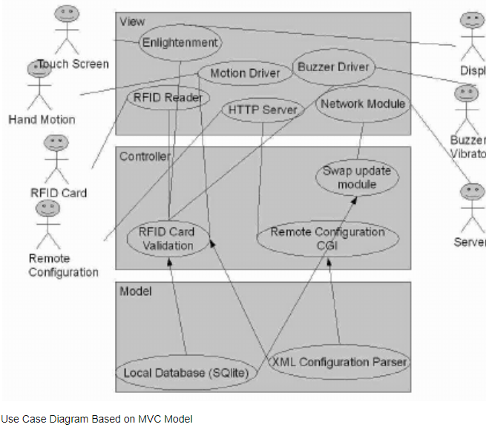

Slide 46
Features of Java 8
Functional Interfaces
Lambda Expression
Method Expression
Stream API
forEach() Method
Date Time API
Default and Static Method
Optional Class
Collectors Class
Parallel Array Sorting

