Slide 1
Learning Resource's
MACHINE LEARNING
By
Tom M. Mitchell
McGraw-Hill Education (India)
Edition 2013

Slide 2
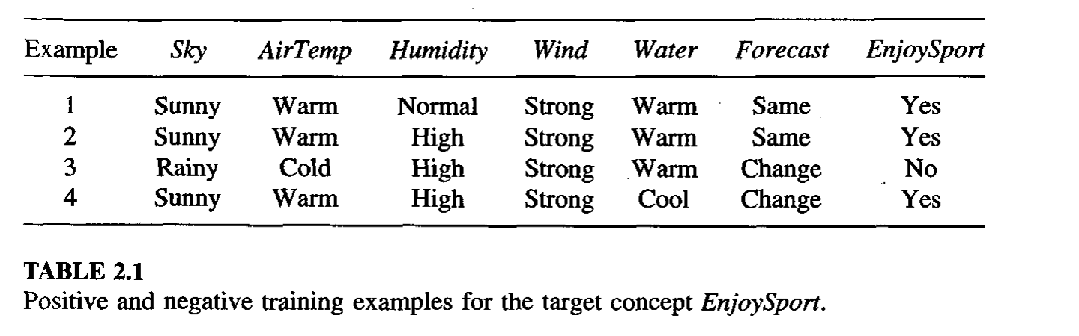
Example of Concept Learning: EnjoySport

Slide 3
COURSE OBJECTIVES
To formulate machine learning problems corresponding to an application
COURSE OUTCOMES
1 Explain the basics of concept learning and inductive learning.
2 Design decision tree and neural network to solve classification problems.
3 Comprehend probabilistic methods for learning.
4 Explain the instance based learning and reinforcement learning.
5 Build optimal classifiers using Genetic Algorithm and Deep Learning.

Slide 4
Unit-I
Introduction: Well-Posed Learning Problems, Designing a Learning System, Issues in Machine Learning.
The Concept Learning: A concept Learning Task, General –to- Specific Ordering of Hypothesis, Find-S, The List-Then-Eliminate Algorithm, Candidate Elimination Learning Algorithm, Inductive bias.

Slide 5
Machine Learning - Chapter 1
Introduction

Slide 6
Artificial intelligence and Machine learning
Artificial intelligence is a technology that enables a machine to simulate human behavior.
Machine learning is a subset of AI which allows a machine to automatically learn from past data without programming explicitly.
The goal of AI is to make a smart computer system like humans to solve complex problems.

Slide 7
INTRODUCTION
A subfield of Computer Science that gives computers the ability to learn without being explicitly programmed.
To improve automatically with experience.
We do not yet know how to make computers learn nearly as well as people learn.
However, algorithms have been invented that are effective for certain types of learning tasks

Slide 8
For problems such as speech recognition, algorithms based on machine learning outperform all other approaches that have been attemped.
In the field of data mining, machine learning algorithms are being used routinely to discover valuable knowledge from large commercial databases containing, loan applications, financial transactions, medical records.
As our understanding of computers continues to mature, it is inevitable that machine learning will play an increasingly central role in computer science and computer technology.

Slide 9
Well-Posed Learning Problems
Study of machine learning by considering a few learning tasks(responsibilities).
Define learning broadly: to include any computer program that improves its performance at some task through experience.
Definition: A computer program is said to learn from experience E with respect to some class of tasks T and performance measure P, if its performance at tasks in T, as measured by P, improves with experience E.
For example, a computer program that learns to play checkers might improve its performance as measured by its ability to win at the class of tasks, through experience obtained by playing games against itself.

Slide 10
What is the Learning Problem
To have a well-defined learning problem, we must identity the following three features:
The class of tasks
The measure of performance to be improved
The source of experience(knowledge or skill)

Slide 11
Examples of Learning Problem
Example Problem 1
A checkers learning problem:
Task T: playing checkers
Performance measure P: percent of games won against opponents
Training experience E: playing practice games against itself

Slide 12
Example Problem 2
A handwriting recognition learning problem
Task T: recognizing and classifying handwritten words within images
Performance measure P: percent of words correctly classified
Training experience E: a database of handwritten words with given classifications

Slide 13
Example Problem 3
A robot driving learning problem:
Task T: driving on public four-lane highways using vision sensors
Performance measure P: average distance traveled before an error(as judged by human)
Training experience E: a sequence of images and steering commands recorded while observing a human driver

Slide 14
Successful Applications of Machine Learning
Learning to recognize spoken words: the SPHINX system learns speaker-specific strategies for recognizing the primitive sounds and words from the observed speech signal.
Learning to drive an autonomous vehicle: Machine learning methods have been used to train computer-controlled vehicles to steer correctly when driving on a variety of road types. For example, the ALVINN system has used its learned strategies to drive unassisted at 70 miles per hour for 90 miles on public highways among other cars

Slide 15
Learning to classify new astronomical structures: decision tree learning algorithms have been used by NASA to learn how to classify celestial objects.
Learning to play world-class backgammon: the world's top computer program for backgammon, TD-GAMMON (Tesauro 1992, 1995). learned its strategy by playing over one million practice games against itself

Slide 16
Disciplines and Examples of their influence on Machine Learning
Artificial intelligence - Learning symbolic representations of concepts. Machine learning as a search problem. Learning as an approach to improving problem solving. Using prior knowledge together with training data to guide learning.
Bayesian methods - Bayes' theorem as the basis for calculating probabilities of hypotheses. The naive Bayes classifier. Algorithms for estimating values of unobserved variables.
Computational complexity theory- Theoretical bounds on the inherent complexity of different learning tasks, measured in terms of the computational effort, number of training examples, number of mistakes, etc. required in order to learn.

Slide 17
Control theory -Procedures that learn to control processes in order to optimize predefined objectives and that learn to predict the next state of the process they are controlling.
Information theory - Measures of entropy and information content. Minimum description length approaches to learning.
Philosophy - Occam's razor, suggesting that the simplest hypothesis is the best. Analysis of the justification for generalizing beyond observed data.
Psychology and neurobiology -The power law of practice, which states that over a very broad range of learning problems, people's response time improves with practice according to a power law.
Statistics - Characterization of errors (e.g, variance) that occur when estimating the accuracy of a hypothesis based on a limited sample of data.

Slide 18
Checkers game
https://www.youtube.com/watch?v=ScKIdStgAfU

Slide 19
DESIGNING A LEARNING SYSTEM
let us consider designing a program to learn to play checkers, with the goal of entering it in the world checkers tournament. We adopt the performance measure: the percent of games it wins in this world tournament.
Choosing the Training Experience
Choosing the Target Function
Choosing a Representation for the Target Function
Choosing a Function Approximation Algorithm
The Final Design

Slide 20
Choosing the Training Experience
First design choice is to choose the type of training experience from which our system will learn.
The type of training experience available can have a significant impact on success or failure of the learner
One key attribute is whether the training experience provides direct or indirect feedback regarding the choices made by the performance system.

Slide 21
For example, in learning to play checkers, the system might learn from
Direct training examples consisting of individual checkers board states and the correct move for each.
Indirect information consisting of the move sequences and final outcomes of various games played.
In this case, information about the correctness of specific moves early in the game must be inferred indirectly from the fact that the game was eventually won or lost.

Slide 22
A second important attribute of the training experience is the degree to which the learner controls the sequence of training examples.
For example, the learner might rely on the teacher to select informative board states and to provide the correct move for each.
Alternatively, the learner might itself propose board states that it finds confusing and ask the teacher for the correct move.
Or the learner may have complete control over both the board states and training classifications, as it does when it learns by playing against itself with no teacher present.

Slide 23
A third important attribute of the training experience is how well it represents the distribution of examples over which the final system performance P must be measured.
learning is most reliable when the training examples follow a distribution similar to that of future test examples.
In our checkers learning scenario, the performance metric P is the percent of games the system wins in the world tournament.
If its training experience E consists only of games played against itself, there is an obvious danger that this training experience might not be fully representative of the distribution of situations over which it will later be tested.
For example, the learner might never encounter certain crucial board states that are very likely to be played by the human checkers champion

Slide 24
To proceed with our design, let us decide that our system will train by playing games against itself. This has the advantage that no external trainer need be present, and it therefore allows the system to generate as much training data as time permits. We now have a fully specified learning task.
A checkers learning problem:
Task T: playing checkers
Performance measure P: percent of games won in the world tournament
Training experience E: games played against itself
In order to complete the design of the learning system, we must choose
the exact type of knowledge to be learned
a representation for this target knowledge
a learning mechanism

Slide 25
2. Choosing the Target Function
To determine what type of knowledge will be learned and how this will be used by the performance program
Example: checkers-playing program that can generate the legal moves from any board state. The program needs only to learn how to choose the best move from these legal moves.
Target Function ChooseMove : B -> M to indicate that this function accepts as input any board from the set of legal board states B and produces as output some move from the set of legal moves M.
The choice of the target function will therefore be a key design choice.
Target function V use the notation, V : B -> R to denote that V maps any legal board state from the set B to some real value

Slide 26
We intend for this target function V to assign higher scores to better board states.
then it can easily use it to select the best move from any current board position.
This can be accomplished by generating the successor board state produced by every legal move,
then using V to choose the best successor state and therefore the best legal move

Slide 27
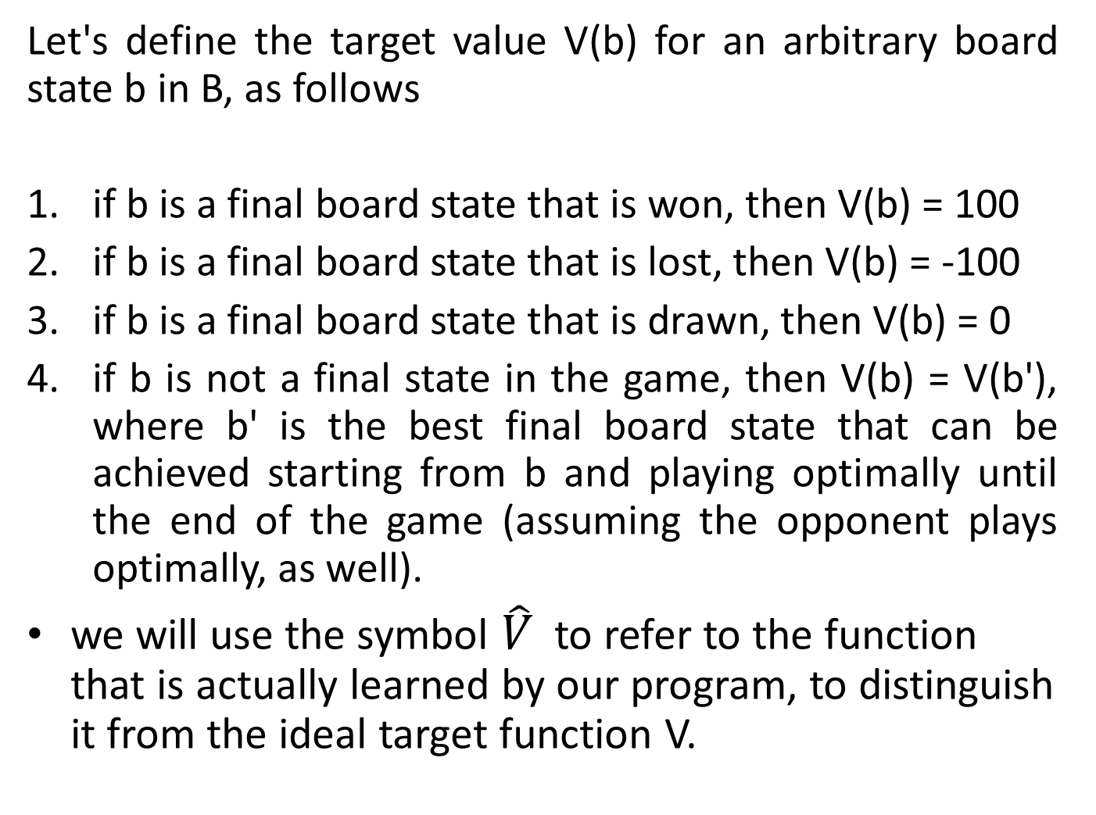
Let's define the target value V(b) for an arbitrary board state b in B, as follows
if b is a final board state that is won, then V(b) = 100
if b is a final board state that is lost, then V(b) = -100
if b is a final board state that is drawn, then V(b) = 0
if b is not a final state in the game, then V(b) = V(b'), where b' is the best final board state that can be achieved starting from b and playing optimally until the end of the game (assuming the opponent plays optimally, as well).
we will use the symbol $\hat{V}$ to refer to the function that is actually learned by our program, to distinguish it from the ideal target function V.

Slide 28
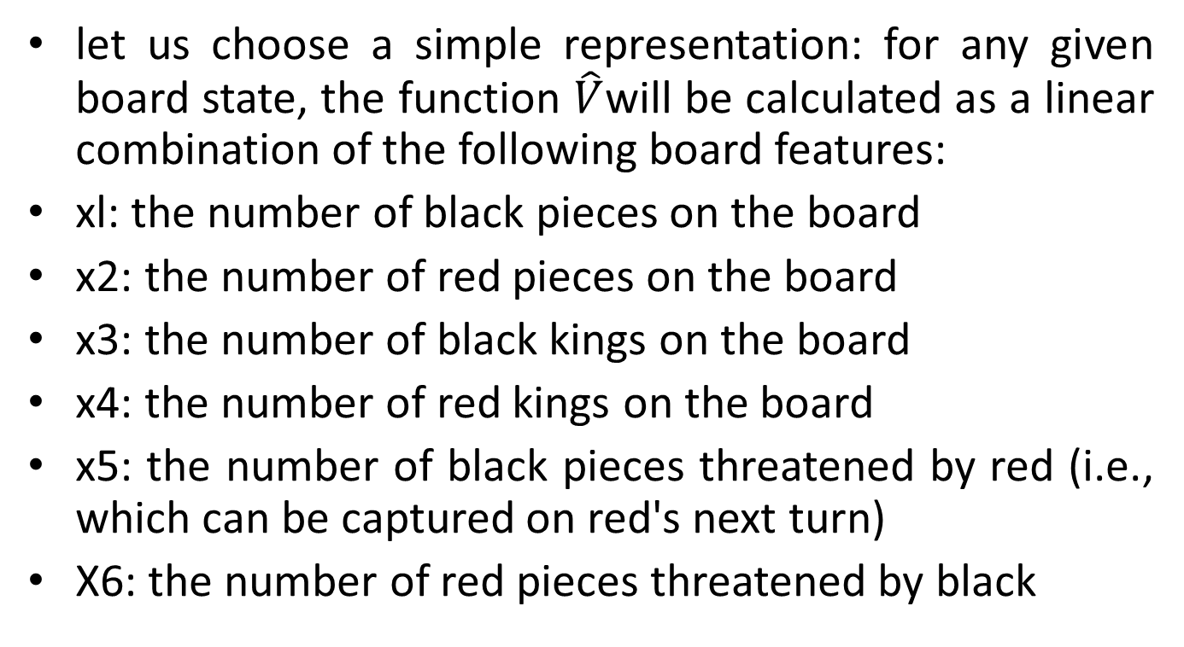
3. Choosing a Representation for the Target Function
let us choose a simple representation: for any given board state, the function $\hat{V}$will be calculated as a linear combination of the following board features:
xl: the number of black pieces on the board
x2: the number of red pieces on the board
x3: the number of black kings on the board
x4: the number of red kings on the board
x5: the number of black pieces threatened by red (i.e., which can be captured on red's next turn)
X6: the number of red pieces threatened by black

Slide 29
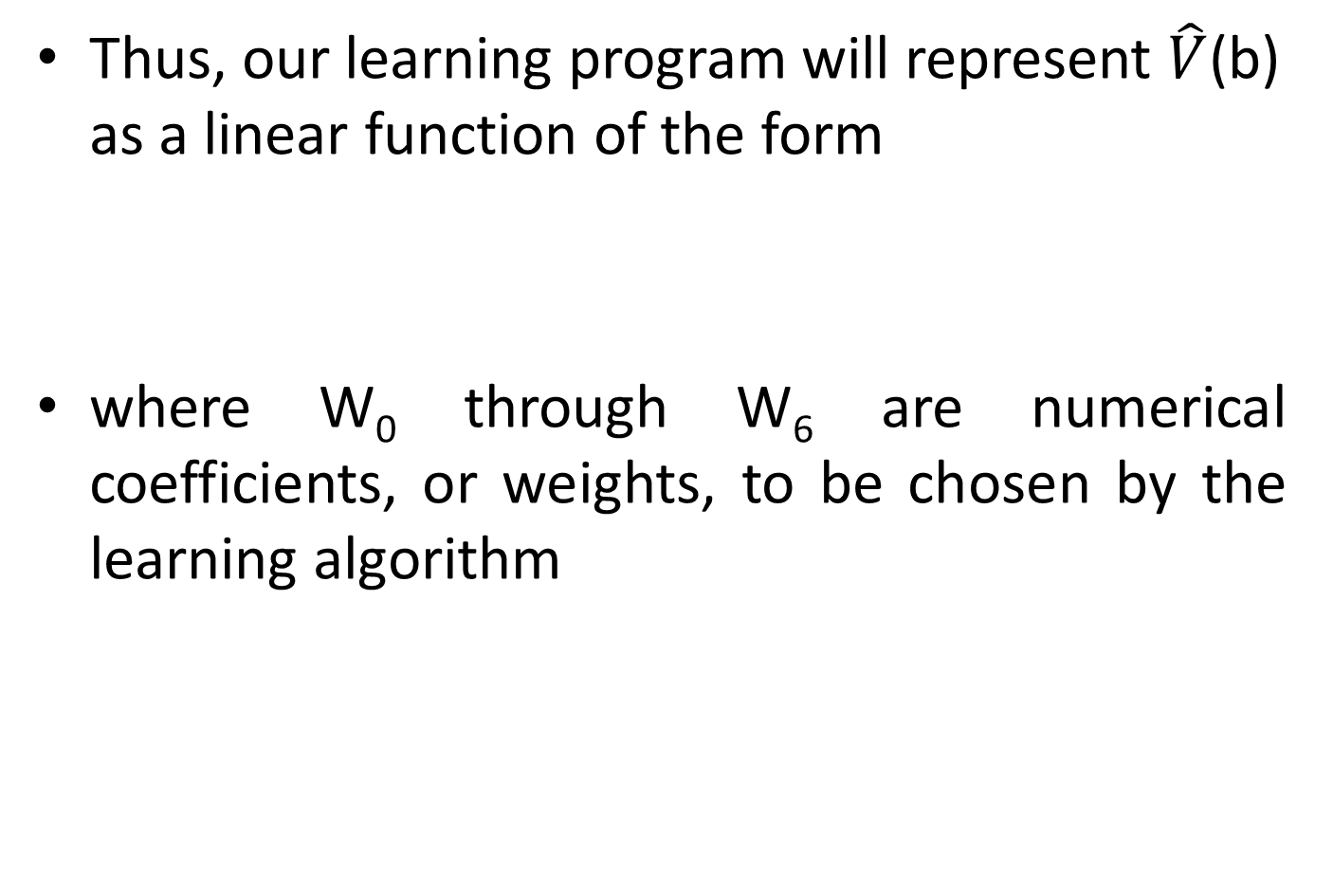
Thus, our learning program will represent $\hat{V}$(b) as a linear function of the form
where W₀ through W₆ are numerical coefficients, or weights, to be chosen by the learning algorithm

Slide 30
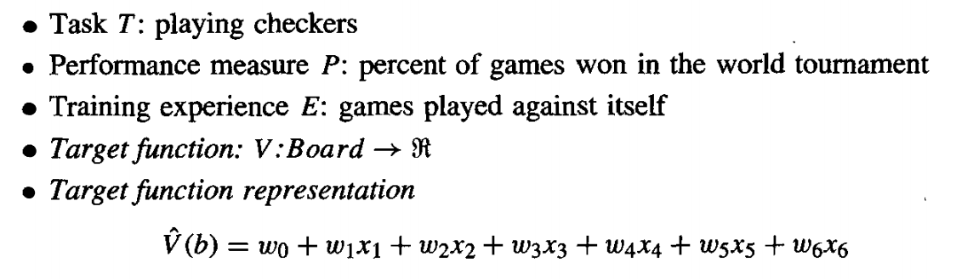
Partial design of a checkers learning program
the net effect of this set of design choices is to reduce the problem of learning a checkers strategy to the problem of learning values for
the coefficients wo through w6 in the target function representation.

Slide 31
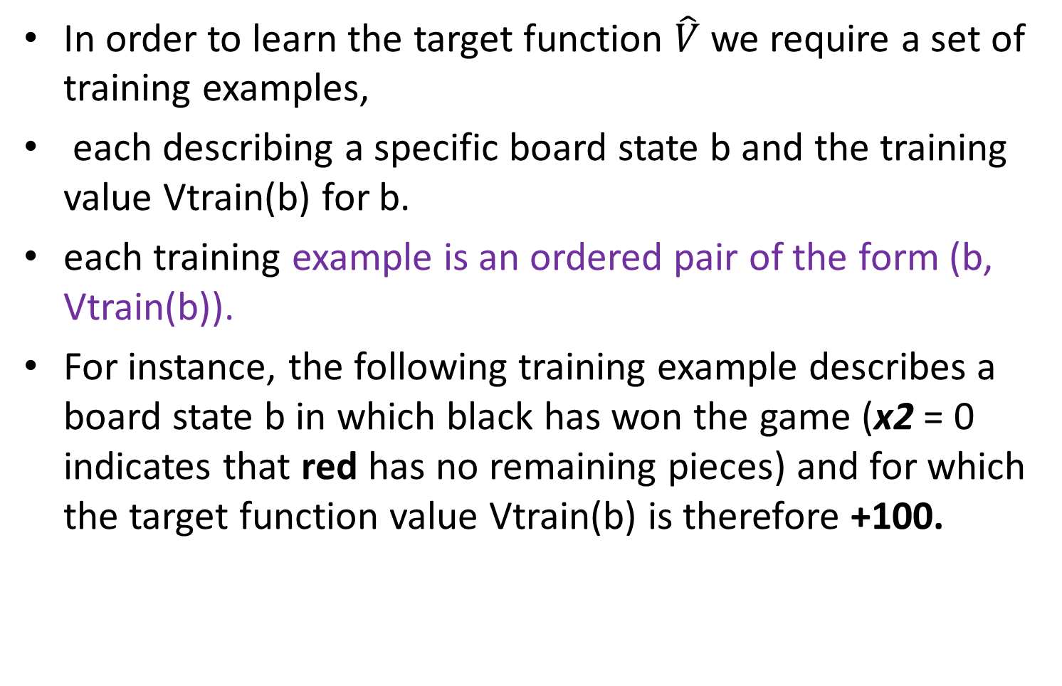
4. Choosing a Function Approximation Algorithm
In order to learn the target function $\hat{V}$ we require a set of training examples,
each describing a specific board state b and the training value Vtrain(b) for b.
each training example is an ordered pair of the form (b, Vtrain(b)).
For instance, the following training example describes a board state b in which black has won the game (x2 = 0 indicates that red has no remaining pieces) and for which the target function value Vtrain(b) is therefore +100.

Slide 32
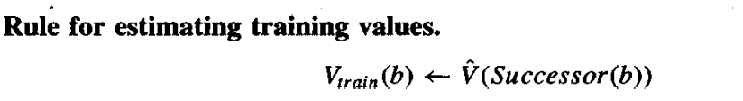
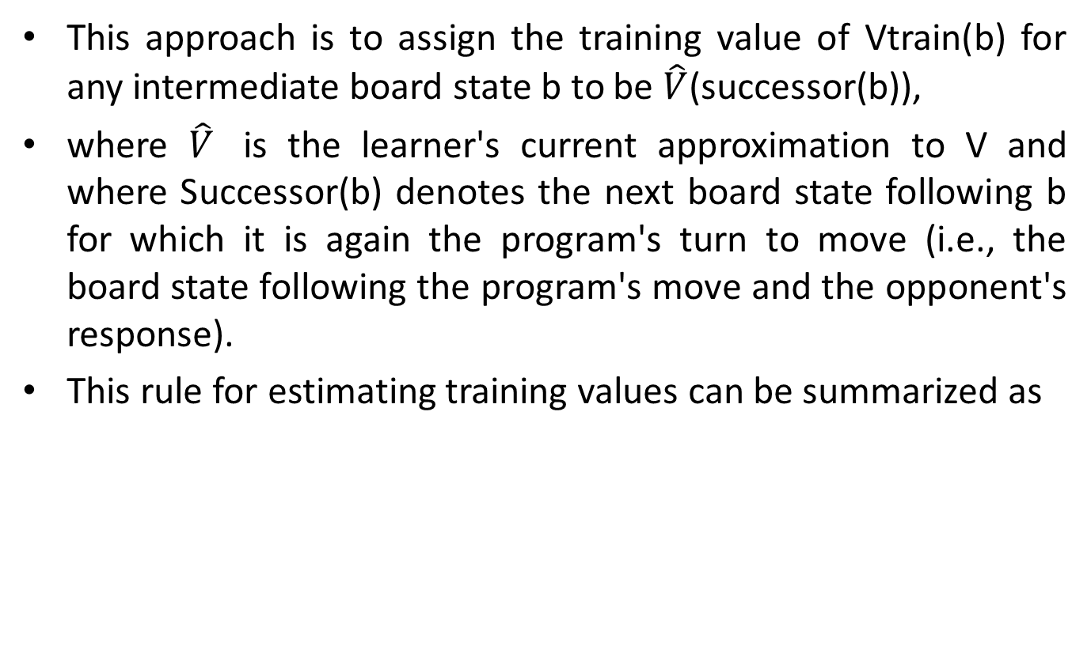
Estimating Training Values
This approach is to assign the training value of Vtrain(b) for any intermediate board state b to be $\hat{V}$(successor(b)),
where $\hat{V}$ is the learner's current approximation to V and where Successor(b) denotes the next board state following b for which it is again the program's turn to move (i.e., the board state following the program's move and the opponent's response).
This rule for estimating training values can be summarized as

Slide 33
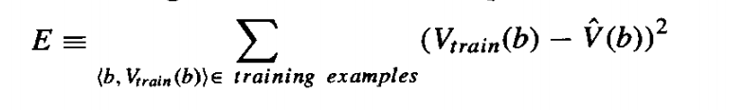
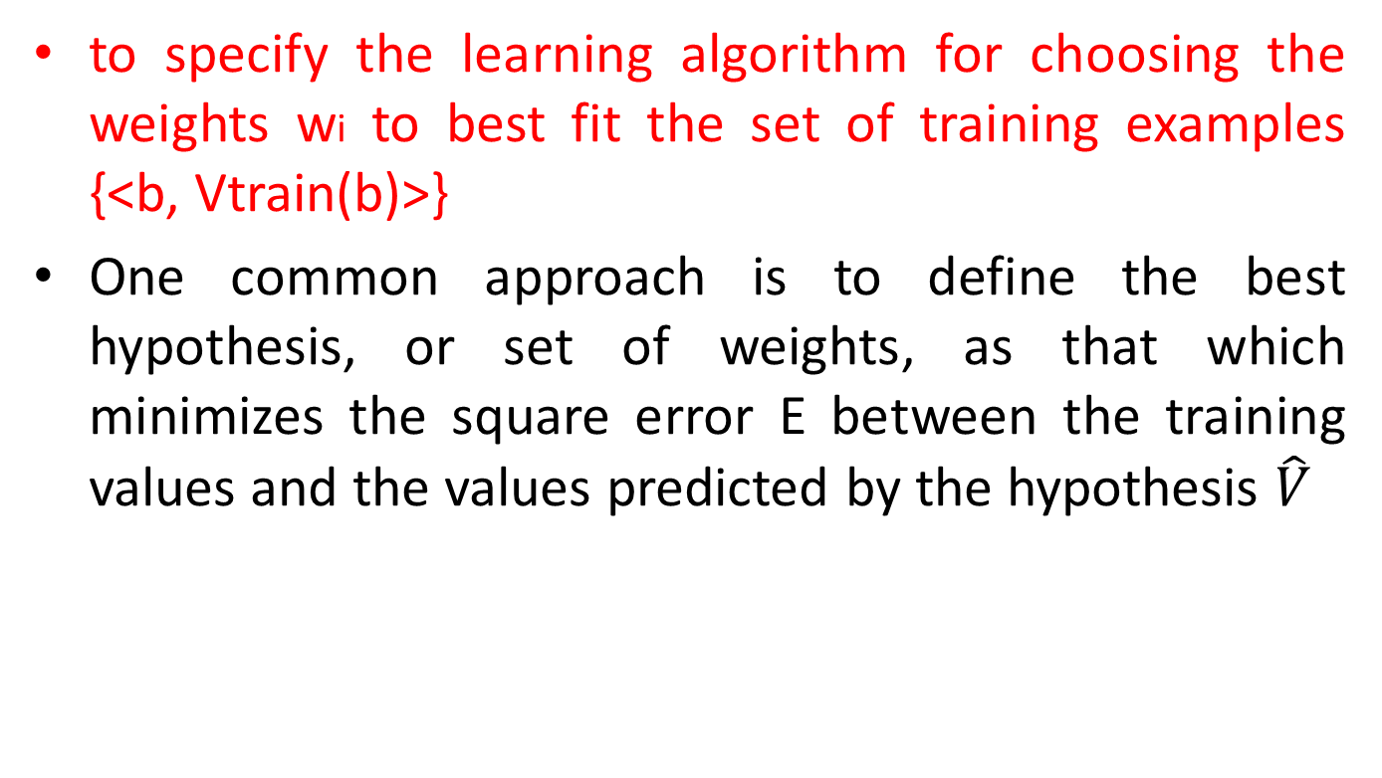
ADJUSTING THE WEIGHTS
to specify the learning algorithm for choosing the weights wi to best fit the set of training examples {<b, Vtrain(b)>}
One common approach is to define the best hypothesis, or set of weights, as that which minimizes the square error E between the training values and the values predicted by the hypothesis $\hat{V}$

Slide 34
Several algorithms are known for finding weights of a linear function that minimize E
In our case, we require an algorithm that will incrementally refine the weights as new training examples become available
One such algorithm is called the least mean squares, or LMS training rule.
For each observed training example it adjusts the weights a small amount in the direction that reduces the error on this training example.

Slide 35
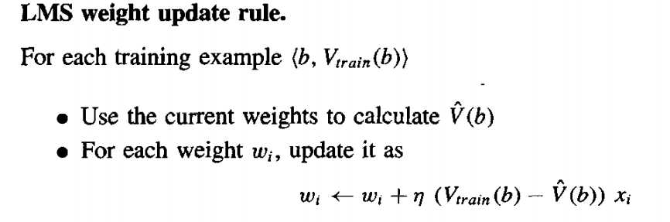
LMS training rule

Slide 36
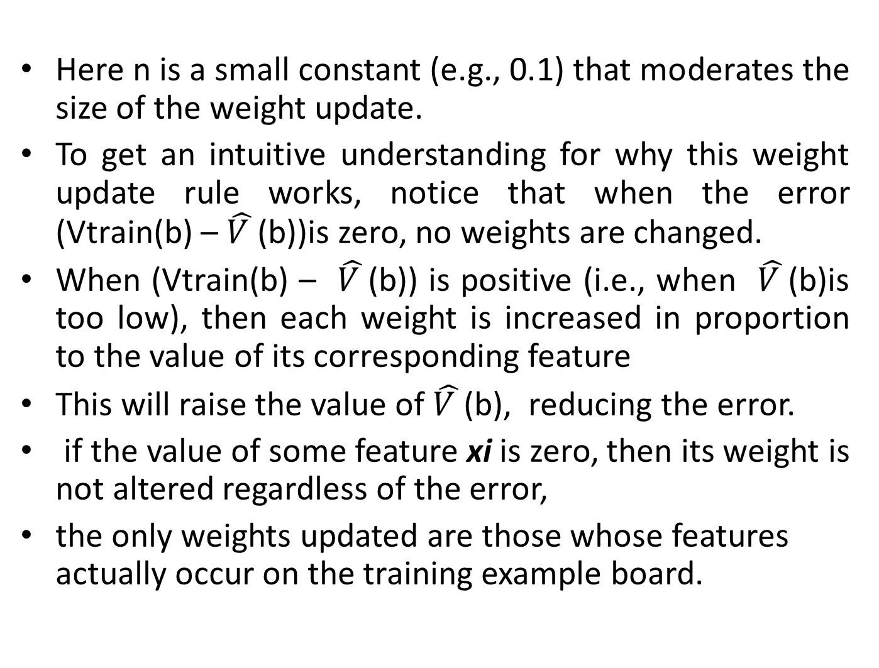
Here n is a small constant (e.g., 0.1) that moderates the size of the weight update.
To get an intuitive understanding for why this weight update rule works, notice that when the error (Vtrain(b) – $\hat{V }$(b))is zero, no weights are changed.
When (Vtrain(b) – $\hat{V }$(b)) is positive (i.e., when $\hat{V }$(b)is too low), then each weight is increased in proportion to the value of its corresponding feature
This will raise the value of $\hat{V }$(b), reducing the error.
if the value of some feature xi is zero, then its weight is not altered regardless of the error,
the only weights updated are those whose features actually occur on the training example board.

Slide 37
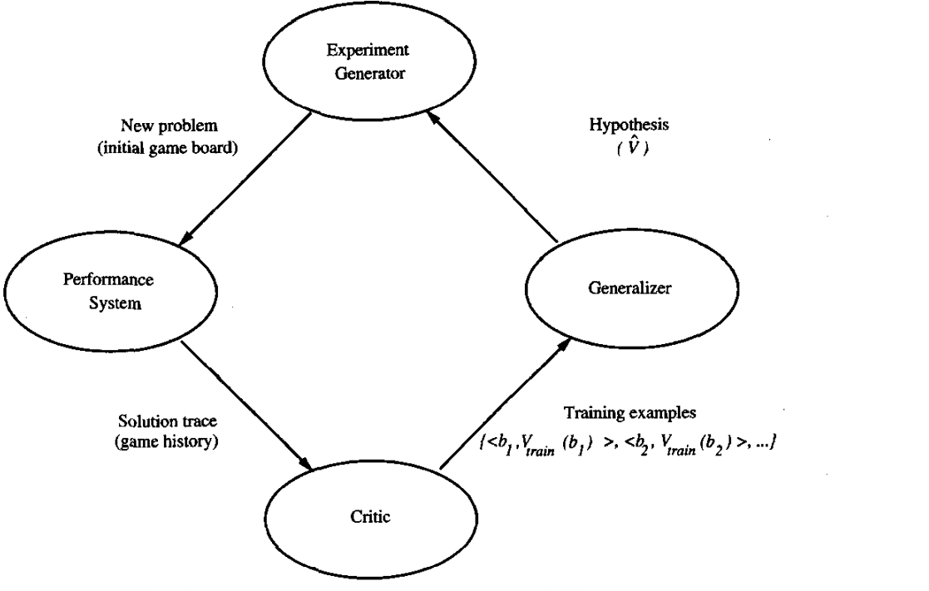
5. The Final Design
The final design of checkers learning system can be described by four modules that represent the central components in many learning systems.

Slide 38
The Performance System is the module that must solve the given performance task, in this case playing checkers, It takes an instance of a new problem (new game) as input and produces a trace of its solution (game history) as output.
The Critic takes as input the history or trace of the game and produces as output a set of training examples of the target function.

Slide 39
The Generalizer takes as input the training examples and produces an output hypothesis that is its estimate of the target function.
It generalizes from the specific training examples, hypothesizing a general function that covers these examples and other cases beyond the training examples.
In our example, the Generalizer corresponds to the LMS algorithm, and the output hypothesis is the function f described by the learned weights wo, . . . , W6.

Slide 40
The Experiment Generator takes as input the current hypothesis (currently learned function) and outputs a new problem (i.e., initial board state) for the Performance System to explore.
Its role is to pick new practice problems that will maximize the learning rate of the overall system.

Slide 41
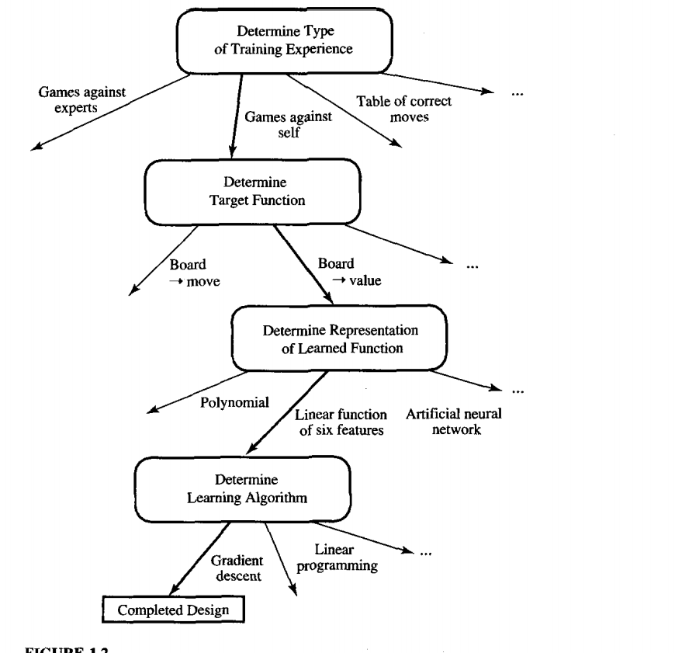
The sequence of design choices made for the checkers program is summarized in Fig

Slide 42
PERSPECTIVES AND ISSUES IN MACHINE LEARNING
machine learning involves searching a very large space of possible hypotheses to determine one that best fits the observed data.

Slide 43
Issues in Machine Learning
What algorithms exist for learning general target functions from specific training examples? Which algorithms perform best for which types of problems and representations?
How much training data is sufficient?
When and how can prior knowledge held by the learner guide the process of generalizing from examples?

Slide 44
What is the best strategy for choosing a useful next training experience, and how does the choice of this strategy alter the complexity of the learning problem?
what specific functions should the system attempt to learn?

