Slide 1
SW METRICS – MADE EASY

Slide 2
METRICS FOR ANALYSIS
Function Point
LoC -Lines of Code

Slide 3
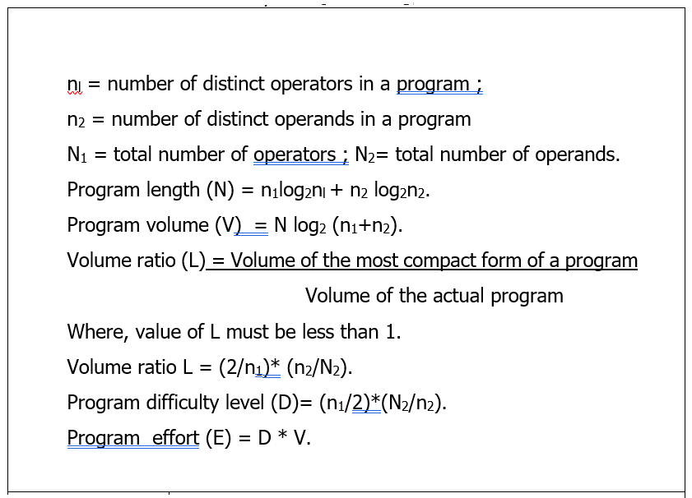
METRICS FOR SOURCE CODE

Slide 4
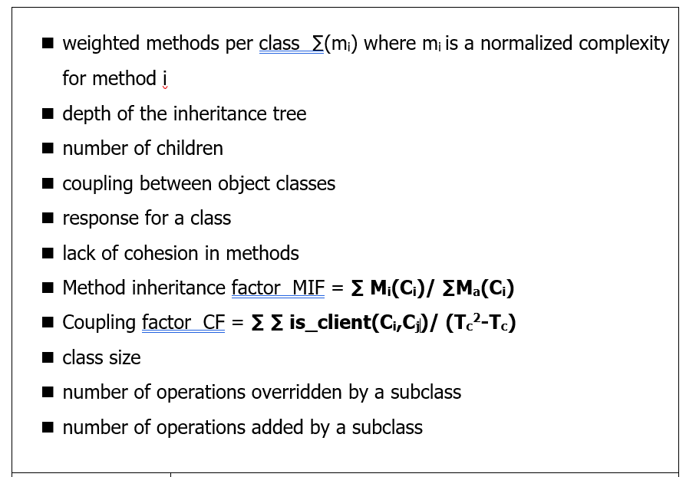
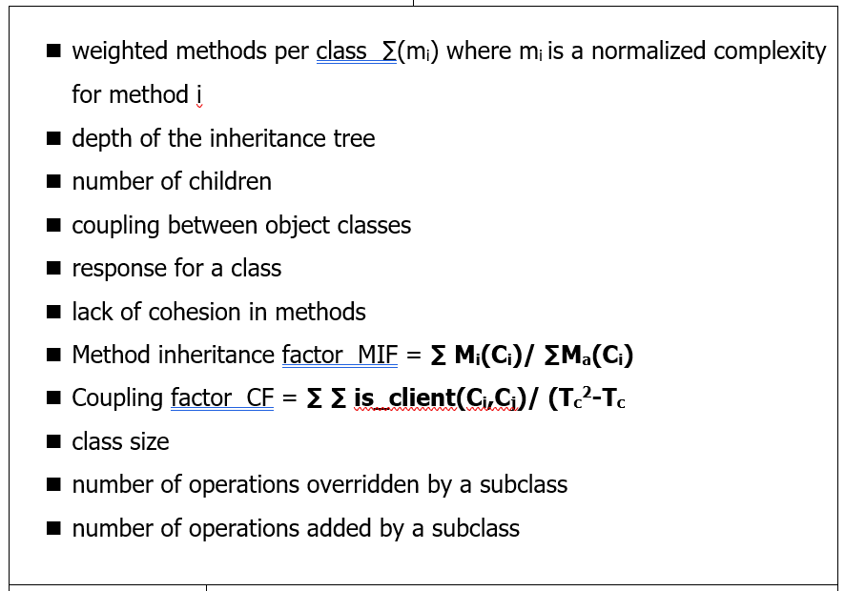
CLASS ORIENTED METRICS

Slide 5
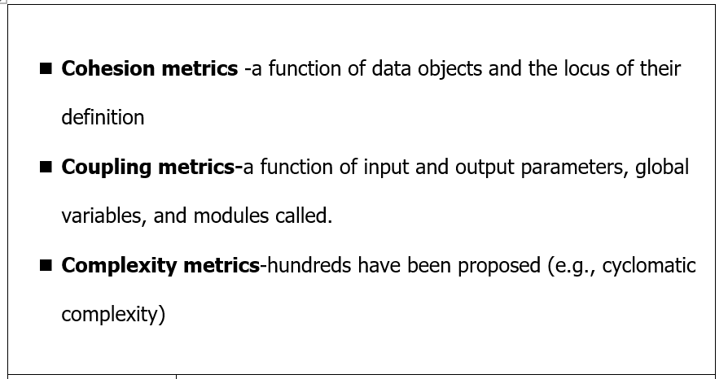
COMPONENT LEVEL DESIGN METRICS

Slide 6
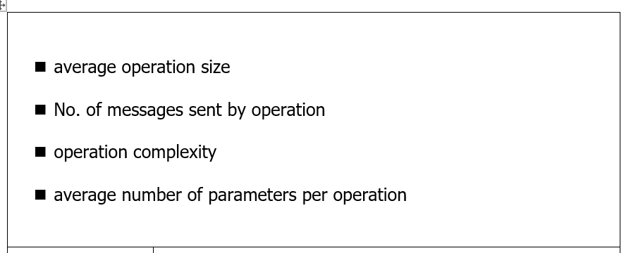
OPERATION METRICS

Slide 7
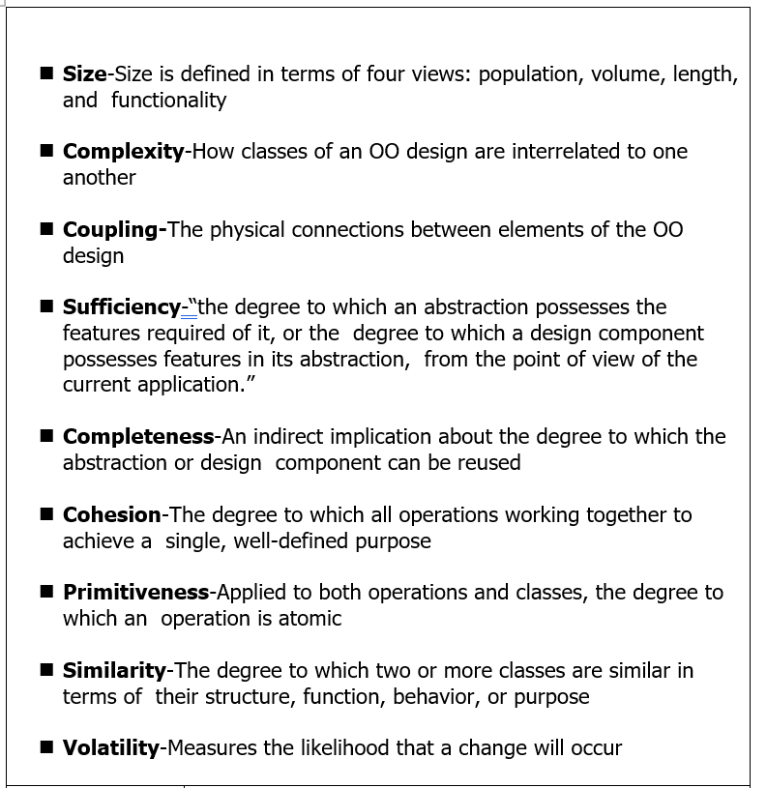
OO METRICS

Slide 8
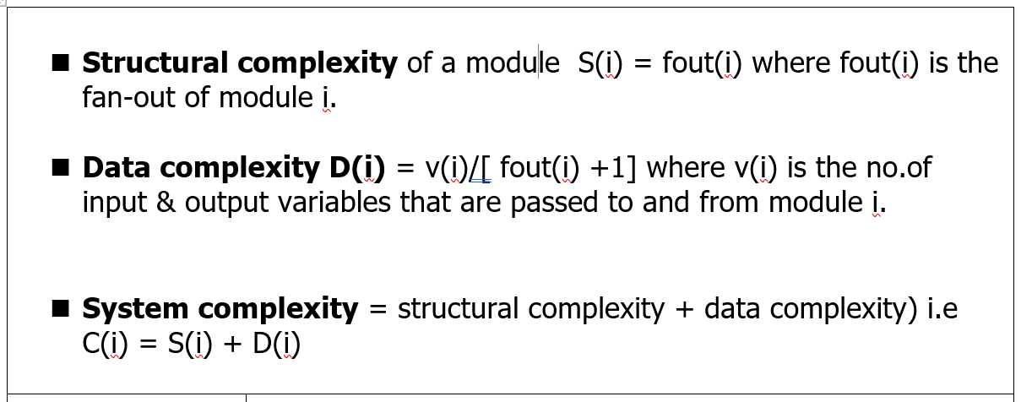
METRICS FOR DESIGN

Slide 9
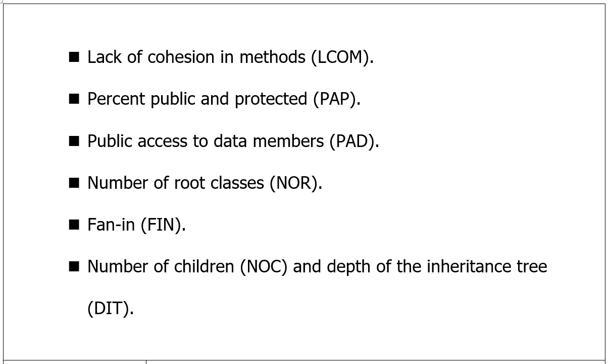
METRICS FOR TESTING

Slide 10
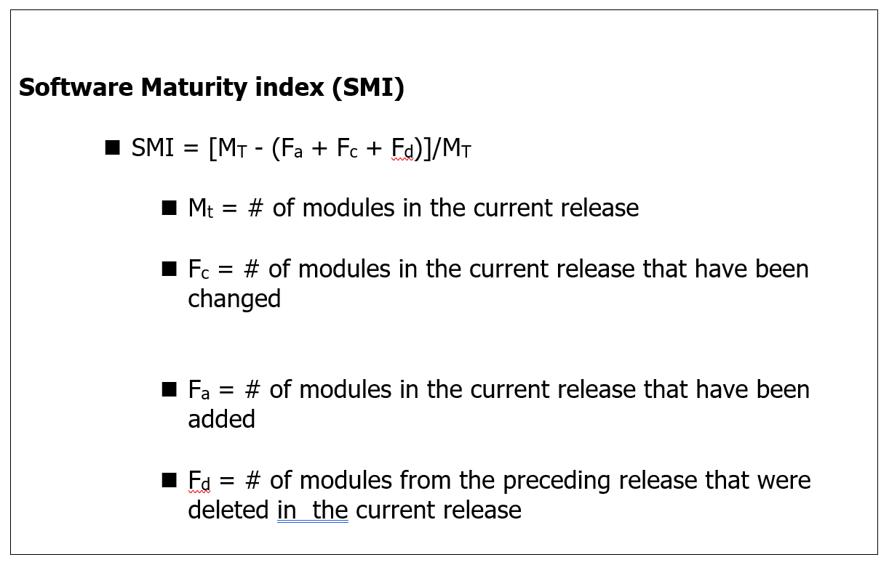
METRICS FOR MAINTENANCE

Slide 11
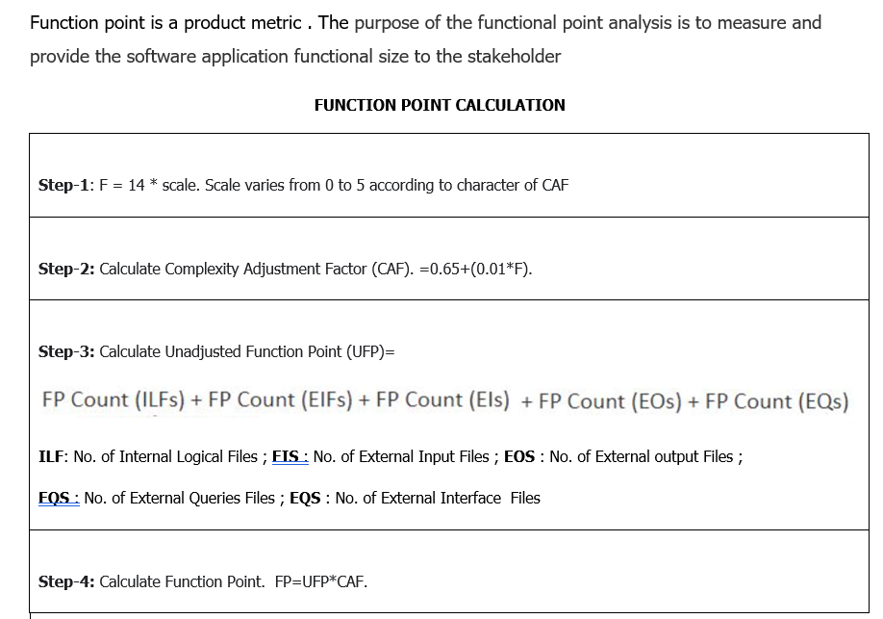

Slide 12
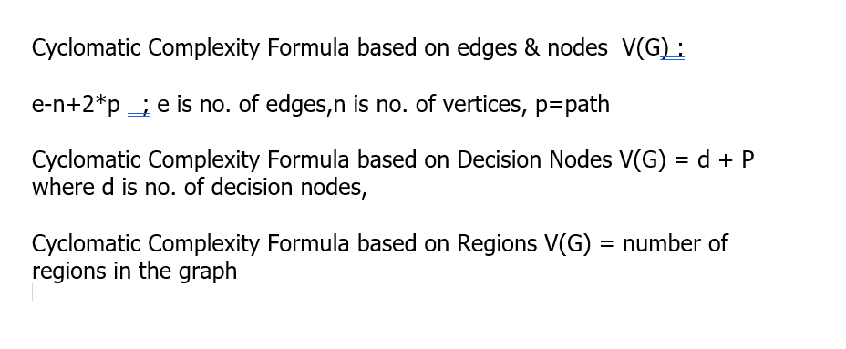
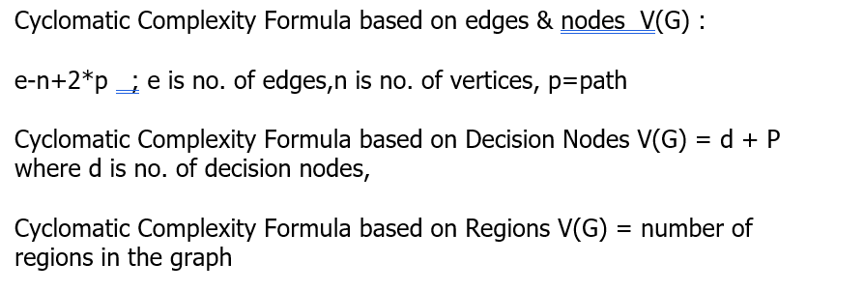
CYCLOMATIC COMPLEXITY

Slide 13
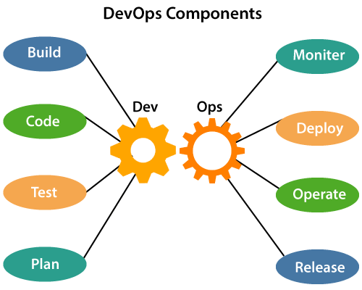

Slide 14

7 Cs of DevOps

Slide 15

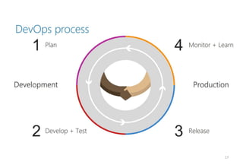

DevOps Process

Slide 16
What is the Goal of DevOps?
DevOps represents a change in mindset for IT culture.
In building on top of Agile practices, DevOps focuses on incremental development and rapid delivery of software.

Slide 17
What is the framework for product metrics?
A fundamental framework and a set of basic principles for the measurement of product metrics for software should be established. Talking in terms of software engineering: - Measure provides a quantitative indication of extent, amount, dimension, size of an attribute of a product or process. Measure is established when a single data point has been collected. - Measurement is an act of determining a measure. Measurement occurs when one or more data points are collected. - Metric is the quantitative measure of the degree to which a system, component or process possess a given attribute. It relates individual measures in some way. - Indicator is a metric or combination of metrics providing insight into software process, project or product itself.

Slide 18
SMI
There is a need to measure and control software complexity. It should be possible to develop measures of different attributes. These measures and metric can be used as independent indicators of the quality of analysis and design models.
The metric is calculated as follows:
SMI = Mt – (Fa + Fc + Fd)/Mt
This calculation can be broken down into the elements below:
SMI is the Software Maturity Index value
Mt is the number of software functions/modules in the current release
Fc is the number of functions/modules that contain changes from the previous release
Fd is the number of functions/modules that are deleted from the previous release.
Fa is the number of functions/modules that are added from the previous release.

Slide 19
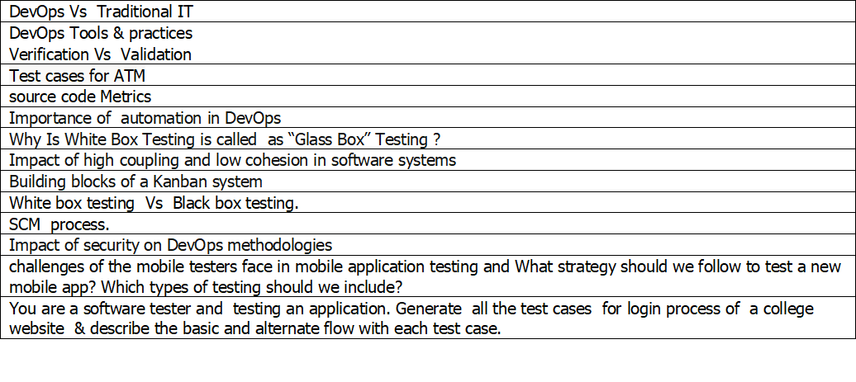

Slide 20
