Slide 1
II-B.E. IV-SEMESTER
Operating Systems
(OS)
Presented By
Dr. D. BASWARAJ
Professor, CSE DEPT.
VCE, HYDERABAD

Slide 2
UNIT-I
PART-1: Introduction to operating systems
  Definition, User view and System view of the Operating system
  Computer- system organization and architecture
  Operating system structure and operations
  Operating system services, System calls
PART-2: Process:
  Process concept, Process Scheduling
  Operations on process
  Inter-process communication
  Threads, Multithreading Models
  Multicore programming

Slide 3
1. Process Concept and process Scheduling
An operating system executes a variety of programs.
We uses the terms job and process almost interchangeably.
Program is passive entity stored on disk (executable file); process is active entity stored on memory (RAM).
The Program becomes process when executable file loaded into memory.
One program can be several processes. For example, Consider multiple users executing the same program.

Slide 4

Process Concept and process Scheduling …
Process – is a program under execution; process execution must progress in sequential fashion, Process contains-
  The program code, also called text section
  Current activity including program counter, processor registers
  Stack containing temporary data like function parameters, return addresses
  Data section containing global variables
  Heap containing memory dynamically allocated during run time.

Slide 5

Process Concept and process Scheduling …
Program Execution:
Alternate sequence of CPU burst and I/O burst

Slide 6

Process Concept and process Scheduling …
Process state: As a process executes, it changes its state
  new: The process is being created
  running: Instructions are being executed
  waiting: The process is waiting for some event to occur
  ready: The process is waiting to be assigned to a processor
  terminated: The process has finished execution
  Figure: Five State Process Diagram

Slide 7
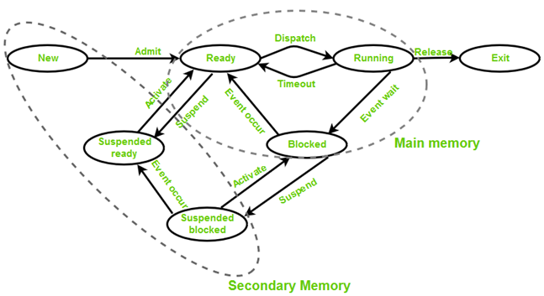
Process Concept and process Scheduling …
Process state: As a process executes, it changes its state among seven states along with previous five states:
  Suspended ready – Process that was initially in the ready state but was swapped out of main memory
  Suspended blocked –Uses the process which was performing I/O operation and lack of main memory caused them to move to secondary memory
  Figure: Seven State Process Diagram

Slide 8

Process Concept and process Scheduling …
Process Control Block (PCB): Information associated with each process (also called task control block), which contain…
  Process state – running, waiting, etc
  Program counter – location of instruction to next execute
  CPU registers – contents of all process-centric registers
  CPU scheduling information- priorities, scheduling queue pointers
  Memory-management information – memory allocated to the process
  Accounting information – CPU used, clock time elapsed since start, time limits
  I/O status information – I/O devices allocated to process, list of open files

Slide 9

Process Concept and process Scheduling …
Context Switch: When CPU switches to another process, the system must save the state of the old process and load the saved state for the new process via a context switch.

Slide 10
Process Concept and process Scheduling …
Process Scheduling: Maximize CPU use, quickly switch processes onto CPU for time sharing
Process scheduler selects among available processes for next execution on CPU. Maintains scheduling queues of processes
  Job queue – set of all processes in the system
  Ready queue – set of all processes residing in main memory, ready and waiting to execute
  Device queues – set of processes waiting for an I/O device
  Processes migrate among the various queues

Slide 11

Process Concept and process Scheduling …
Ready and various I/O device Queues:

Slide 12

Process Concept and process Scheduling …
Representation of Process Scheduling:
Queueing diagram represents queues, resources, flows

Slide 13
Process Concept and process Scheduling …
Schedulers: The operating system must select, for scheduling purposes, processes from queues in some fashion. The selection process is carried out by the appropriate scheduler.
Short-term scheduler (or CPU scheduler) – selects which process should be executed next from ready queue and allocates CPU.
  Short-term scheduler is invoked frequently (milliseconds) ⇒ (must be fast)
Long-term scheduler (or job scheduler) – selects which processes should be brought into the ready queue
  The long-term scheduler controls the degree of multiprogramming
Processes can be described as either I/O-bound process or CPU-bound process
Long-term scheduler strives for good process mix

Slide 14

Process Concept and process Scheduling …
Medium-term scheduler (or Swap scheduler) can be added if degree of multiple programming needs to decrease
  Remove process from memory, store on disk, bring back in from disk to continue execution: swapping

Slide 15
2. Operations on Process
The processes in most systems can execute concurrently, and they may be created and deleted dynamically. Thus, these systems must provide a mechanism for process creation and termination.
Process Creation: Parent process create children processes, which, in turn create other processes, forming a tree of processes.
Generally, process identified and managed via a process identifier (pid)
Resource sharing options
  Parent and children share all resources
  Children share subset of parent’s resources
  Parent and child share no resources
Execution options
  Parent and children execute concurrently
  Parent waits until children terminate

Slide 16

Operations on Process…
Process Creation…
Address space
  Child duplicate of parent
  Child has a program loaded into it
UNIX examples
  fork() system call creates new process
  exec() system call used after a fork() to replace the process’ memory space with a new program.

Slide 17
Operations on Process…
Process Termination:
Process executes last statement and then asks the operating system to delete it using the exit() system call.
  Returns status data from child to parent (via wait())
  Process’ resources are deallocated by operating system
Parent may terminate the execution of children processes using the abort() system call. Some reasons for doing so:
  Child has exceeded allocated resources
  Task assigned to child is no longer required
  The parent is exiting, and the operating systems does not allow a child to continue if its parent terminates

Slide 18
Operations on Process…
Process Termination…
Some operating systems do not allow child to exists if its parent has terminated. If a process terminates, then all its children must also be terminated.
  cascading termination. All children, grandchildren, etc. are terminated.
  The termination is initiated by the operating system.
The parent process may wait for termination of a child process by using the wait()system call. The call returns status information and the pid of the terminated process
pid = wait(&status);
If no parent waiting (did not invoke wait()) process is a zombie
If parent terminated without invoking wait , process is an orphan

Slide 19

Operations on Process…
Multiprocess Architecture – Chrome Browser:
Google Chrome Browser is multiprocess with 3 different types of processes:
  Browser process manages user interface, disk and network I/O
  Renderer process renders web pages, deals with HTML, Javascript. A new renderer created for each website opened
    Runs in sandbox restricting disk and network I/O, minimizing effect of security exploits
  Plug-in process for each type of plug-in

Slide 20
3. Inter-Process Communication (IPC)
Processes within a system may be independent or cooperating
Cooperating process can affect or be affected by other processes, including sharing data
Reasons for cooperating processes:
  Information sharing
  Computation speedup
  Modularity
  Convenience
Cooperating processes need inter-process communication (IPC)
Two models of IPC
  Shared memory
  Message passing

Slide 21

Inter-Process Communication (IPC)…
Communications Models:
(a) Message passing (b) shared memory

Slide 22
Inter-Process Communication (IPC)…
Shared Memory System:
IPC using shared memory requires communicating processes to establish a region of shared memory.
The processes are also responsible for ensuring that they are not writing to the same location simultaneously.
To illustrate the concept of cooperating processes, let’s consider the producer–consumer problem, which is a common paradigm for cooperating processes.
A producer process produces information that is consumed by a consumer process.
For example, a compiler may produce assembly code that is consumed by an assembler.

Slide 23
Inter-Process Communication (IPC)…
Shared Memory System… Paradigm for cooperating processes, producer process produces information that is consumed by a consumer process
  unbounded-buffer places no practical limit on the size of the buffer
  bounded-buffer assumes that there is a fixed buffer size
Bounded Buffer: The following variables reside in a region of memory shared by the producer and consumer processes:
      #define BUFFER_SIZE 10
      typedef struct {
      . . .
      } item;
      item buffer[BUFFER_SIZE];
      int in = 0;
      int out = 0;

Slide 24
Inter-Process Communication (IPC)…
Bounded-Buffer – Producer…
item next_produced;
while (true) { /* produce an item in next produced */
while (((in + 1) % BUFFER_SIZE) == out) ; /* do nothing */
buffer[in] = next_produced;
in = (in + 1) % BUFFER_SIZE; }
Bounded-Buffer – Consumer…
item next_consumed;
while (true) {
while (in == out) ; /* do nothing */
next_consumed = buffer[out];
out = (out + 1) % BUFFER_SIZE;
/* consume the item in next consumed */ }

Slide 25
Inter-Process Communication (IPC)…
Shared Memory System…
An area of memory shared among the processes that wish to communicate
The communication is under the control of the users processes not the operating system.
Major issues is to provide mechanism that will allow the user processes to synchronize their actions when they access shared memory.
Synchronization details are discussed in UNIT-III

Slide 26
Inter-Process Communication (IPC)…
Message passing System:
Mechanism for processes to communicate and to synchronize their actions
Message system – processes communicate with each other without resorting to shared variables
IPC facility provides two operations:
  send(message)
  receive(message)
The message size is either fixed or variable
If processes P and Q wish to communicate, they need to:
  Establish a communication link between them
  Exchange messages via send/receive

Slide 27
Inter-Process Communication (IPC)…
Message passing System…
Implementation of communication link
  Physical:
    Shared memory
    Hardware bus
    Network
  Logical:
    Direct or indirect
    Synchronous or asynchronous
    Automatic or explicit buffering
    Direct Communication:
Processes must name each other explicitly:
  send (P, message) – send a message to process P
  receive(Q, message) – receive a message from process Q

Slide 28
Inter-Process Communication (IPC)…
    Indirect Communication:
Messages are directed and received from mailboxes (also referred to as ports)
  Each mailbox has a unique id
  Processes can communicate only if they share a mailbox
Operations
  create a new mailbox (port)
  send and receive messages through mailbox
  destroy a mailbox
Primitives are defined as:
send(A, message) – send a message to mailbox A
receive(A, message) – receive a message from mailbox A

Slide 29
Inter-Process Communication (IPC)…
    Indirect Communication Issues:
Mailbox sharing
  P₁, P₂, and P₃ share mailbox A
  P₁, sends; P₂ and P₃ receive
  Who gets the message?
Solutions
  Allow a link to be associated with at most two processes
  Allow only one process at a time to execute a receive operation
  Allow the system to select arbitrarily the receiver. Sender is notified who the receiver was.

Slide 30
4. Threads, Multithreading Models
Thread—a fundamental unit of CPU utilization that forms the basis of multithreaded computer systems
Most modern applications are multithreaded
Threads run within application
Multiple tasks with the application can be implemented by separate threads
  Update display
  Fetch data
  Spell checking
  Answer a network request
Process creation is heavy-weight while thread creation is light-weight
Can simplify code, increase efficiency
Kernels are generally multithreaded

Slide 31
Threads, Multithreading Models …
A thread (or lightweight process) is a basic unit of CPU utilization; it consists of:
  Program counter
  Register set
  Stack space
A thread shares with its peer threads its:
  Code segment
  Data segment
  Operating-system resources
A traditional or heavyweight process is equal to a task with one thread.

Slide 32

Threads, Multithreading Models …
Single and Multithreaded Processes:

Slide 33
Threads, Multithreading Models …
User Threads and Kernel Threads:
User threads - management done by user-level threads library
Three primary thread libraries:
  POSIX Pthreads
  Windows threads
  Java threads
Kernel threads - Supported by the Kernel
Examples – virtually all general-purpose operating systems, including:
  Windows
  Solaris
  Linux
  Tru64 UNIX
  Mac OS X

Slide 34
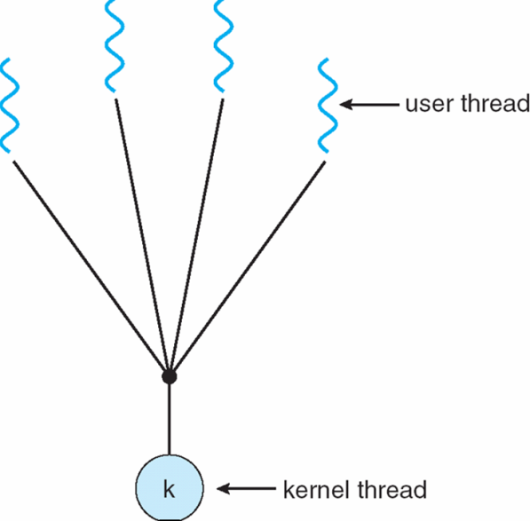
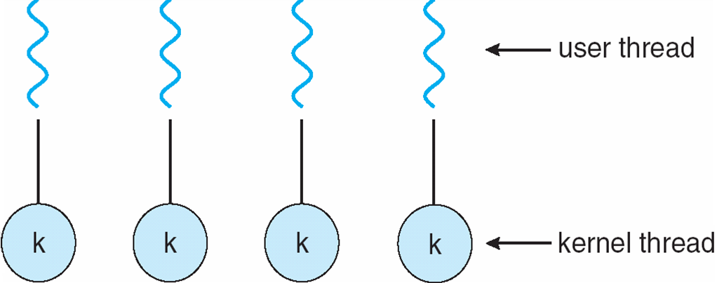
Threads, Multithreading Models …
Multithreading Models:
Many-to-One
Many user-level threads mapped to single kernel thread
Examples:
Solaris Green Threads
GNU Portable Threads
One-to-One
Each user-level thread maps to kernel thread
Examples
Windows NT/XP/2000
Linux
Solaris 9 and later

Slide 35
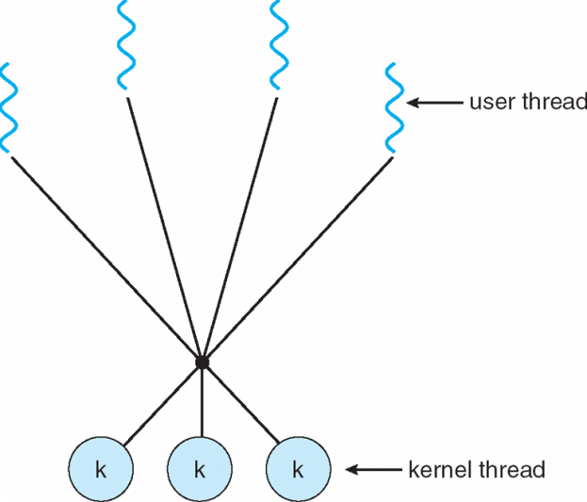
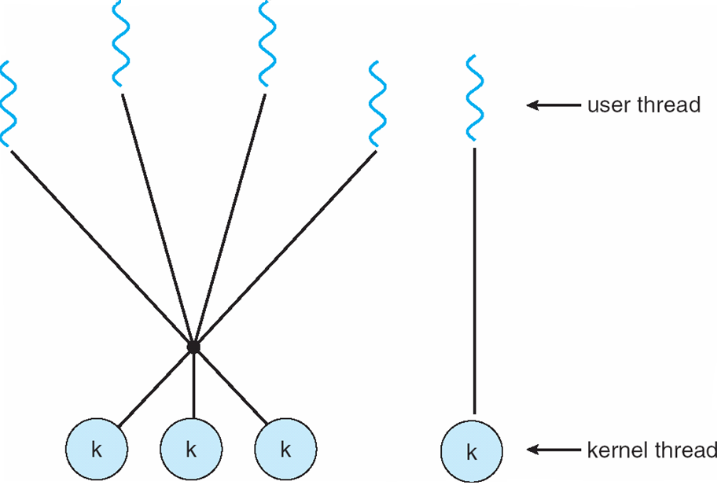
Threads, Multithreading Models …
Multithreading Models…
Many-to-Many Model
Allows many user level threads to be mapped to many kernel threads
Allows the operating system to create a sufficient number of kernel threads
Solaris prior to version 9
Windows NT/2000 with the thread Fiber package
Two-Level Model: variation of M:M model, except that it allows a user thread to be bound to kernel thread
Examples: IRIX, HP-UX, Tru64 UNIX, Solaris 8 and earlier

Slide 36
Threads, Multithreading Models …
Thread Libraries:
Thread library provides programmer with API for creating and managing threads
Two primary ways of implementing
  Library entirely in user space
  Kernel-level library supported by the OS
Pthreads - May be provided either as user-level or kernel-level
A POSIX standard (IEEE 1003.1c) API for thread creation and synchronization
Specification, not implementation
API specifies behavior of the thread library, implementation is up to development of the library
Common in UNIX operating systems (Solaris, Linux, Mac OS X)

Slide 37

Threads, Multithreading Models …
Thread Libraries…
Java threads - Java threads are managed by the JVM
Typically implemented using the threads model provided by underlying OS
Java threads may be created by:
  Extending Thread class
  Implementing the Runnable interface

Slide 38
Threads, Multithreading Models …
Thread Libraries…
Implicit threading - Growing in popularity as numbers of threads increase, program correctness more difficult with explicit threads
Creation and management of threads done by compilers and run-time libraries rather than programmers
Three methods explored
  Thread Pools
  OpenMP
  Grand Central Dispatch
Other methods include Microsoft Threading Building Blocks (TBB), java.util.concurrent package

Slide 39
5. Multicore programming
Multicore or multiprocessor systems putting pressure on programmers, challenges include:
  Dividing activities
  Balance
  Data splitting
  Data dependency
  Testing and debugging
Parallelism implies a system can perform more than one task simultaneously, while Concurrency supports more than one task making progress
Types of parallelism
  Data parallelism – distributes subsets of the same data across multiple cores, same operation on each
  Task parallelism – distributing threads across cores, each thread performing unique operation

Slide 40

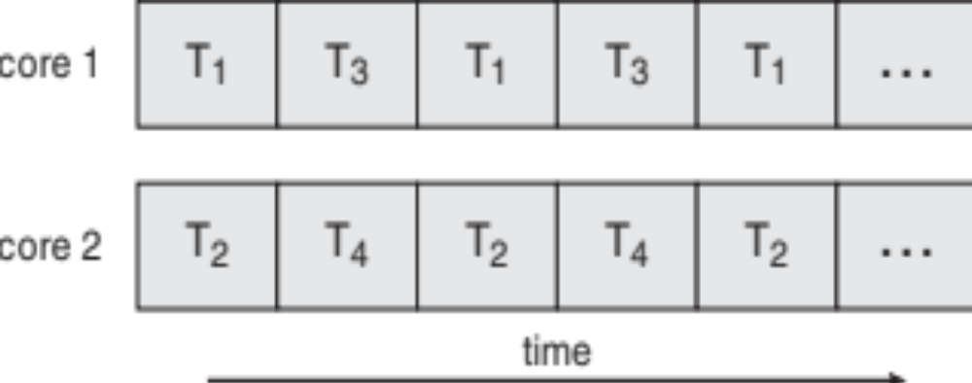
Multicore programming…
As # of threads grows, so does architectural support for threading
  CPUs have cores as well as hardware threads
  Consider Oracle SPARC T4 with 8 cores, and 8 hardware threads per core
Concurrency vs. Parallelism
Concurrent execution on single-core system:
Parallelism on a multi-core system:

Slide 41
END OF
Unit-1: Part-2

