Slide 1
II-B.E. IV-SEMESTER
Operating Systems
(OS)
Presented By
Dr. D. BASWARAJ
Professor, CSE DEPT.
VCE, HYDERABAD

Slide 2
SYLLABUS
UNIT – I: Introduction to operating systems: Definition, User view and System view of the Operating system, Computer- system organization, Computer-system architecture, Operating system structure, Operating system operations, Operating system services, System calls
Process: Process concept, Process Scheduling, Operations on process, Inter-process communication, Threads, Multithreading Models, Multicore programming.
UNIT – II: CPU Scheduling: Scheduling Criteria, Scheduling Algorithms, Multiprocessor scheduling.
Memory Management: Swapping, Contiguous memory allocation, Paging, Segmentation, Structure of the page table.
Virtual memory: Demand paging, Page replacement Algorithms, Thrashing.

Slide 3
UNIT-II
PART-1: CPU Scheduling
  Scheduling Criteria
  Scheduling Algorithms
  Multiprocessor scheduling
PART-2: Memory management
  Swapping, Contiguous memory allocation
  Paging, Segmentation, Structure of the page table
  Virtual memory: Demand paging,
  Page replacement Algorithms
  Thrashing

Slide 4
Part-1 Objectives
To introduce CPU scheduling, which is the basis for multiprogrammed operating systems
To describe various CPU-scheduling algorithms
To discuss evaluation criteria for selecting a CPU-scheduling algorithm for a particular system

Slide 5
CPU Scheduling: Introduction
Process – a program in execution; process execution must progress in sequential fashion, Process contain…
  The program code, also called text section
  Current activity including program counter, processor registers
  Stack containing temporary data like function parameters, return addresses
  Data section containing global variables
  Heap containing memory dynamically allocated during run time
Maximum CPU utilization obtained with multiprogramming
CPU–I/O Burst Cycle – Process execution consists of a cycle of CPU execution and I/O wait
CPU burst followed by I/O burst
CPU burst distribution is of main concern

Slide 6

CPU Scheduling: Introduction…
CPU Schedular or Short Term Schedular:
Short-term scheduler selects from among the processes in ready queue, and allocates the CPU to one of them
  Queue may be ordered in various ways
CPU scheduling decisions may take place when a process:
  Switches from running to waiting state
  Switches from running to ready state
  Switches from waiting to ready
  Terminates
Scheduling under 1 and 4 is nonpreemptive
All other scheduling is preemptive
  Consider access to shared data
  Consider preemption while in kernel mode
  Consider interrupts occurring during crucial OS activities

Slide 7
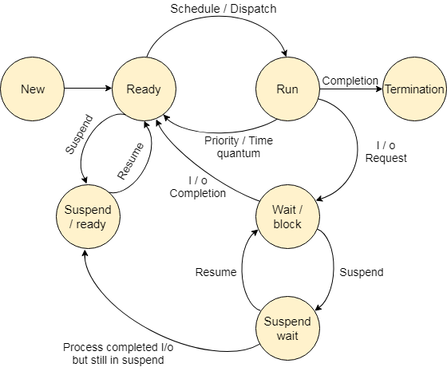
CPU Scheduling: Introduction…
Seven state process transition diagram:
Suspend ready: A process in the ready state, which is moved to secondary memory from the main memory due to lack of the resources (mainly primary memory) is called in the suspend ready state.
Suspend wait: Instead of removing the process from the ready queue, it's better to remove the blocked process which is waiting for some resources in the main memory.

Slide 8
1. Scheduling Criteria
Dispatcher - module gives control of the CPU to the process selected by the short-term scheduler; this involves:
  switching context
  switching to user mode
  jumping to the proper location in the user program to restart that program
Dispatch latency – time it takes for the dispatcher to stop one process and start another running.
Scheduling Criteria -
CPU utilization – keep the CPU as busy as possible
Throughput – # of processes that complete their execution per time unit
Turnaround time – amount of time to execute a particular process
Waiting time – amount of time a process has been waiting in the ready queue
Response time – amount of time it takes from when a request was submitted until the first response is produced, not output.

Slide 9
2. CPU Scheduling Algorithms
The following are the CPU scheduling algorithms
  First-Come, First-Served (FCFS)
  Shortest-Job-First (SJF)
  Priority (Preemptive, Non-Preemptive)
  Round-Robin (RR)
  Multilevel Queue
  Multilevel Feedback Queue
Scheduling Algorithm Optimization Criteria:
  Max CPU utilization
  Max throughput
  Min turnaround time
  Min waiting time
  Min response time

Slide 10
CPU Scheduling Algorithms…
  First-Come, First-Served (FCFS):
With this scheme, the process that requests the CPU first is allocated the CPU first.
The average waiting time is often quite large.
This scheme is non-preemptive, because, once cpu has been allocated to process, then cpu releases the process only either by terminating or by requesting I/O.
  Shortest-Job-First (SJF):
To schedule process, CPU uses burst lengths associated with each process having shortest time.
When the cpu is available, it is assigned to the process that has smallest next cpu burst. If two processes have the same length next cpu burst, FCFS scheduling break the tie.
SJF is optimal – gives minimum average waiting time for a given set of processes.

Slide 11
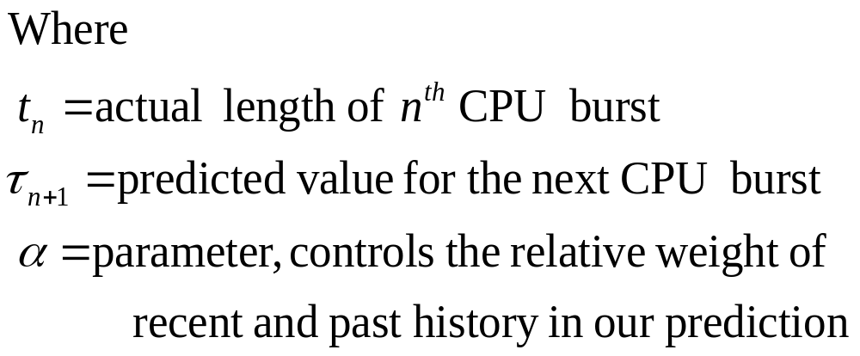
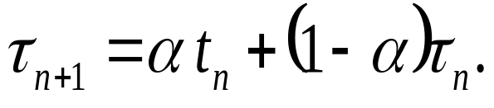
CPU Scheduling Algorithms…
  Shortest-Job-First (SJF)…
Shortest Remaining Time First (SRTF) Scheduling Algorithm is the preemptive version of SJF scheduling.
In SRTF, the execution of the process can be stopped after certain amount of time. At the arrival of every process, the short-term scheduler schedules the process with the least remaining burst time among the list of available processes and the running process.
Generally next cpu burst predicted as an exponential average of the measured lengths of the previous cpu bursts. Then, for α, 0≤ α ≤ 1, define

Slide 12
CPU Scheduling Algorithms…
  Shortest-Job-First (SJF)…
If α=0, recent history has no effect, if α=1, only most recent cpu burst matters and if α=1/2, recent and past history are equally weighted. Commonly, α set to ½
To understand the behavior of the exponential average, we expand the formula for τ_{n+1} by substituting for τ_{n} ,we get:
    τ_{n+1} = α t_{n}+(1 - α)α t_{n} -1 + …
    +(1 - α )^{j} α t_{n} _{-j} + …
    +(1 - α )^{n +1} τ₀
Since both α and (1 - α) are less than or equal to 1, each successive term has less weight than its predecessor.
Hence the SJF algorithm may be preemptive or non-preemptive.
The choice arises when a new process arrives at the ready queue while a previous process executing.

Slide 13

CPU Scheduling Algorithms…
  Shortest-Job-First (SJF)…
Prediction of the Length of the Next CPU Burst:

Slide 14
CPU Scheduling Algorithms…
  Priority (Preemptive, Non-Preemptive):
A priority number (integer) is associated with each process
Priorities can be defined either internally or externally.
The CPU is allocated to the process with the highest priority (smallest integer ≡ highest priority)
  Preemptive
  Nonpreemptive
SJF is priority scheduling where priority is the inverse of predicted next CPU burst time
Problem ≡ Starvation or indefinite blocking – low priority processes may never execute
Solution ≡ Aging – as time progresses increase the priority of the process

Slide 15
CPU Scheduling Algorithms…
  Round-Robin (RR):
Each process gets a small unit of CPU time (time quantum q), usually 10-100 milliseconds. After this time has elapsed, the process is preempted and added to the end of the ready queue.
If there are n processes in the ready queue and the time quantum is q, then each process gets 1/n of the CPU time in chunks of at most q time units at once.
No process waits more than (n-1)q time units.
Timer interrupts every quantum to schedule next process. Typically, higher average turnaround than SJF, but better response.
Performance
  q large ⇒ FIFO
  q small ⇒ q must be large with respect to context switch, otherwise overhead is too high

Slide 16

CPU Scheduling Algorithms…
  Round-Robin (RR)…
In software, however, we need also to consider the effect of context switching on the performance of RR scheduling.
Following figure depicts, how quantum time results the performance:

Slide 17

CPU Scheduling Algorithms…
  Round-Robin (RR)…
Turnaround time also depends on the size of the time quantum.
In following figure, the average turnaround time of a set of processes does not necessarily improve as the time quantum size increases:

Slide 18
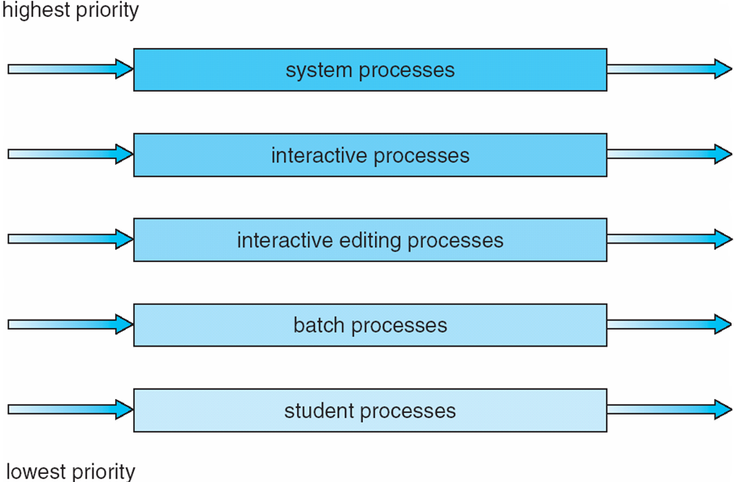
CPU Scheduling Algorithms…
  Multilevel Queue Scheduling:
It has been created for situations in which processes are easily classified into different groups.
This algorithm partitions the ready queue into several separate queues.
The processes are permanently assigned to one queue, generally based on some property like size, priority or process type.
Each queue has its own scheduling algorithm and has absolute priority over lower-priority queues.

Slide 19
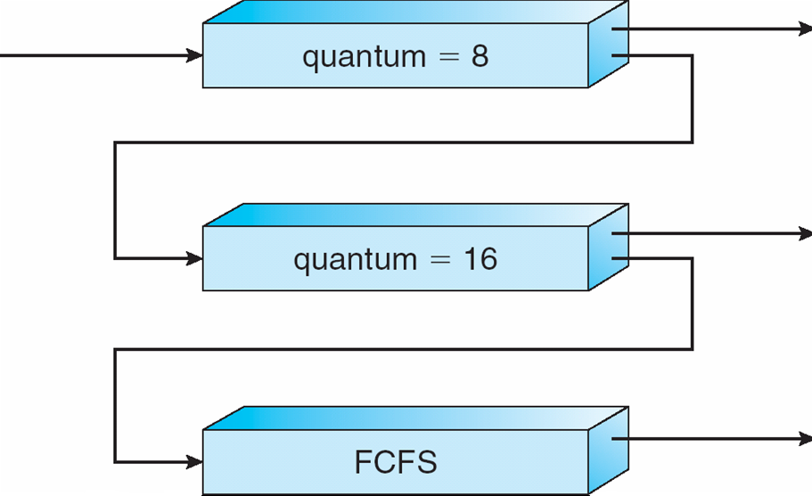
CPU Scheduling Algorithms…
  Multilevel Feedback Queue Scheduling:
It is like multilevel queue scheduling; however, it allows a process to move between queues.
The idea is to separate processes with different cpu-burst characteristics. If a process uses too much cpu time, it will be moved to a lower-priority queue.
Similarly, a process that waits too long in a lower priority queue may be moved to a higher-priority queue.

Slide 20
CPU Scheduling Algorithms…Problems
  Exercise-1: Suppose that the following processes arrive for execution at the times indicated. Each process will run the listed amount of time. In answering the questions, use non-preemptive scheduling and base all decisions on the information you have at the time the decision must be made.
Process Arrival Time Burst Time
        P1 0.0 8
        P2 0.4 4
        P3 1.0 1
a. What is the average turnaround time for these processes with the FCFS?
b. What is the average turnaround time for these processes with the SJF?
c. Compute what the average turnaround time will be if the CPU is left idle for the first 1 unit and then SJF scheduling is used. This algorithm could be known as future-knowledge scheduling.
Answer: a. 10.53 b. 9.53 c. 6.86

Slide 21
CPU Scheduling Algorithms…Problems
  Exercise-2: Consider the following set of processes, with the length of the CPU-burst time given in milliseconds:
Process Burst Time priority
        P1 10 3
        P2 1 3
        P3 2 3
        P4 1 4
        P5 5 2
The processes are assumed to have arrived in the order P1, P2, P3, P4 and P5, all at time 0.
a. Draw Gantt charts separate for FCFS, SJF, non-preemptive priority and RR (quantum = 1) scheduling.
b. What is the average turnaround time for scheduling algorithms in part a?
c. Which of the schedules in part a is the minimal average waiting time?

Slide 22
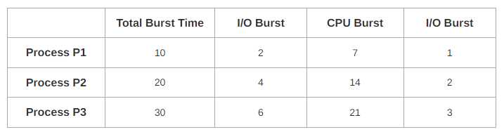
CPU Scheduling Algorithms…Problems
  Exercise-3: Consider three process, all arriving at time zero, with total execution time of 10, 20 and 30 units respectively. Each process spends the first 20% of execution time doing I/O, the next 70% of time doing computation, and the last 10% of time doing I/O again. The operating system uses a shortest remaining compute time first scheduling algorithm and schedules a new process either when the running process gets blocked on I/O or when the running process finishes its compute burst. Assume that all I/O operations can be overlapped as much as possible. For what percentage of does the CPU remain idle?
  According to question, we have-

Slide 23
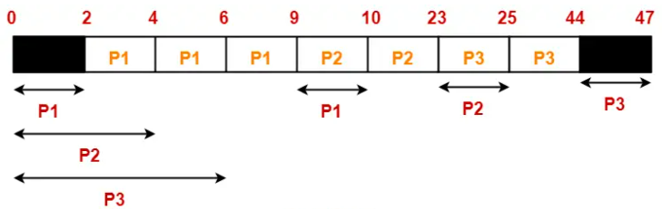
CPU Scheduling Algorithms…Problems
  The scheduling algorithm used is Shortest Remaining Time First.
  Gantt Chart-
  Percentage of time CPU remains idle
  = (5 / 47) x 100
  = 10.638%

Slide 24
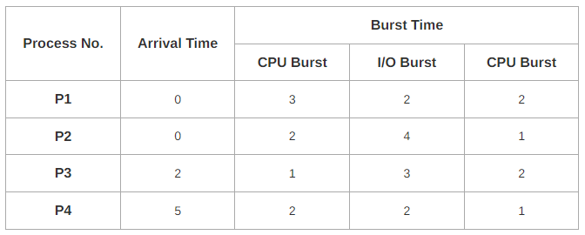
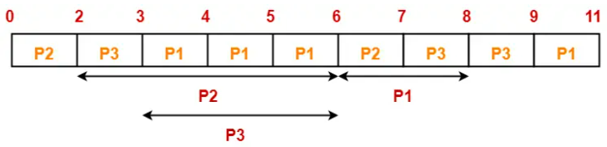
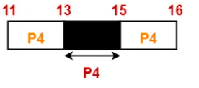
CPU Scheduling Algorithms…Problems
  Exercise-4: Consider the set of 4 processes whose arrival time and burst time are given below. If the CPU scheduling policy is Shortest Remaining Time First, calculate the average WT and average TAT.
  Gantt Chart-

Slide 25
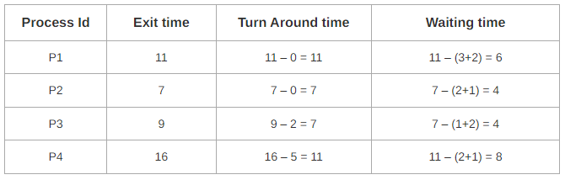
CPU Scheduling Algorithms…Problems
  Now, we know-
  Turn Around time = Exit time – Arrival time
  Waiting time = Turn Around time – Burst time
  Now,
  Average Turn Around time = (11 + 7 + 7 + 11) / 4 = 36 / 4 = 9 units
  Average waiting time = (6 + 4 + 4 + 8) / 4 = 22 / 5 = 4.4 units

Slide 26
Thread Scheduling
Distinction between user-level and kernel-level threads
When threads supported, threads scheduled, not processes
Many-to-one and many-to-many models, thread library schedules user-level threads to run on LWP
  Known as process-contention scope (PCS) since scheduling competition is within the process
  Typically done via priority set by programmer
Kernel thread scheduled onto available CPU is system-contention scope (SCS) – competition among all threads in system.
Pthread Scheduling: API allows specifying either PCS or SCS during thread creation
  PTHREAD_SCOPE_PROCESS schedules threads using PCS scheduling
  PTHREAD_SCOPE_SYSTEM schedules threads using SCS scheduling
Can be limited by OS – Linux and Mac OS X only allow PTHREAD_SCOPE_SYSTEM

Slide 27
3. Multiprocessor Scheduling
If multiple cps’s are available, the scheduling problem correspondingly is more complex.
We concentrate on systems where the processes are identical (homogeneous) or different (heterogeneous) in terms of their functionality.
For homogeneous, load sharing can occur, may provide separate queue for each processor.
In such a system, one of two scheduling approaches are used
  Self scheduling by each processor
  Master-slave structure
Processor affinity – process has affinity for processor on which it is currently running
  soft affinity: When an operating system has a policy of attempting to keep a process running on the same processor but not guaranteeing it will do so, this situation is called soft affinity.
  hard affinity: It allows a process to specify a subset of processors on which it may run.

Slide 28
Multiprocessor Scheduling…
Symmetric multiprocessing (SMP) – each processor is self-scheduling, all processes in common ready queue, or each has its own private queue of ready processes. In SMP, need to keep all CPUs loaded for efficiency.
Load balancing attempts to keep workload evenly distributed
Push migration – periodic task checks load on each processor, and if found pushes task from overloaded CPU to other CPUs
Pull migration – idle processors pulls waiting task from busy processor
Example: NUMA and CPU Scheduling:

Slide 29
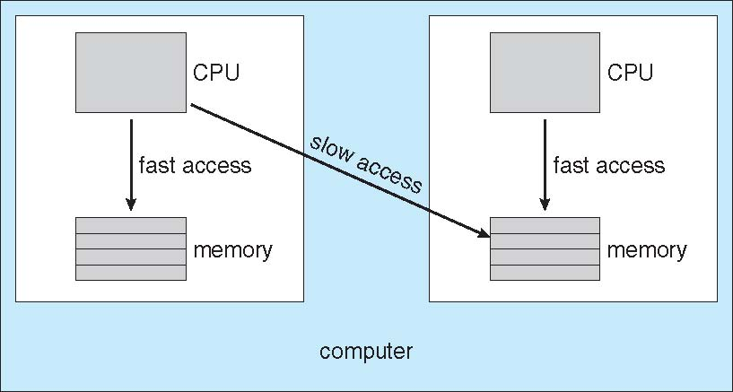
Multiprocessor Scheduling…
NUMA and CPU Scheduling…
Systems and methods for performing selection of non-uniform memory access (NUMA) nodes for mapping of virtual central processing unit (vCPU) operations to physical processors are provided.
A CPU scheduler evaluates the latency between various candidate processors and the memory associated with the vCPU, and the size of the working set of the associated memory.
The vCPU scheduler selects an optimal processor for execution of a vCPU based on the expected memory access latency and the characteristics of the vCPU and the processors.

Slide 30


Multiprocessor Scheduling…
Multicore Processors: Recent trend to place multiple processor cores on same physical chip
Faster and consumes less power
Multiple threads per core also growing
  Takes advantage of memory stall to make progress on another thread while memory retrieve happens
Multithreaded Multicore System:

Slide 31

Real Time CPU Scheduling
Can present obvious challenges
Soft real-time systems – no guarantee as to when critical real-time process will be scheduled
Hard real-time systems – task must be serviced by its deadline
Two types of latencies affect performance
  Interrupt latency – time from arrival of interrupt to start of routine that services interrupt
  Dispatch latency – time for schedule to take current process off CPU and switch to another

Slide 32

Real Time CPU Scheduling…
Conflict phase of dispatch latency:
  Preemption of any process running in kernel mode
  Release by low-priority process of resources needed by high-priority processes

Slide 33

Real Time CPU Scheduling…
Priority-based Scheduling:
For real-time scheduling, scheduler must support preemptive, priority-based scheduling - but only guarantees soft real-time
For hard real-time must also provide ability to meet deadlines
Processes have new characteristics: periodic ones require CPU at constant intervals
  Has processing time t, deadline d, period p, where 0 ≤ t ≤ d ≤ p
  Rate of periodic task is 1/p

Slide 34
POSIX Real-Time Scheduling
Uses the Portable Operating System Interface POSIX.1b standard
API provides functions for managing real-time threads
Defines two scheduling classes for real-time threads:
  SCHED_FIFO - threads are scheduled using a FCFS strategy with a FIFO queue. There is no time-slicing for threads of equal priority
  SCHED_RR - similar to SCHED_FIFO except time-slicing occurs for threads of equal priority
Defines two functions for getting and setting scheduling policy:
  pthread_attr_getsched_policy(pthread_attr_t *attr, int *policy)
  pthread_attr_setsched_policy(pthread_attr_t *attr, int policy)

Slide 35
END OF
Unit-2: Part-1

