Slide 1
II-B.E. IV-SEMESTER
Operating Systems
(OS)
Presented By
Dr. D. BASWARAJ
Professor, CSE DEPT.
VCE, HYDERABAD

Slide 2
SYLLABUS…
UNIT – III: Process synchronization: The critical Section problem, Peterson’s solution, Synchronization Hardware, Semaphores, Classic problems of Synchronization, Monitors.
Deadlocks: System model, deadlock characterization, Methods for handling deadlocks, Deadlock Prevention, Deadlock Avoidance, Deadlock Detection, Recovery from deadlock.
UNIT – IV: File System Interface: File Concept, Access Methods, Directory and Disk Structure
File System Implementation: File-System Structure, File-System Implementation, Directory Implementation, Allocation Methods, Free Space management.
Device Management: Disk Structure, Disk Attachment, Disk Scheduling, Disk Management, Swap Space Management, RAID structure.

Slide 3
UNIT-III
PART-1: Process synchronization
  The critical Section problem
  Peterson’s solution
  Synchronization Hardware
  Semaphore
  Classic problems of Synchronization
  Monitors
PART-2: Deadlocks
  System model
  Deadlock characterization
  Methods for handling deadlocks
  Deadlock Prevention
  Deadlock Avoidance
  Deadlock Detection
  Recovery from deadlock

Slide 4
Process synchronization - Introduction
Concurrent Processes can be
      Independent processes
      Cooperating processes
Advantages of process cooperation:
        Information (data and/or code) sharing
        Computation speedup
        Modularity
        Convenience(e.g., editing, printing, compiling)
Concurrent access to shared data may result in data inconsistency
Maintaining data consistency requires mechanisms to ensure the orderly execution of cooperating processes
Concurrent execution requires
        process communication and process synchronization

Slide 5
Introduction…
Example: Producer-Consumer Problem
Paradigm for cooperating processes;
  producer process produces information that is consumed by a consumer process.
We need buffer of items that can be filled by producer and emptied by consumer.
  Unbounded-buffer places no practical limit on the size of the buffer. Consumer may wait, producer never waits.
  Bounded-buffer assumes that there is a fixed buffer size. Consumer waits for new item, producer waits if buffer is full.
  Producer and Consumer must synchronize.

Slide 6
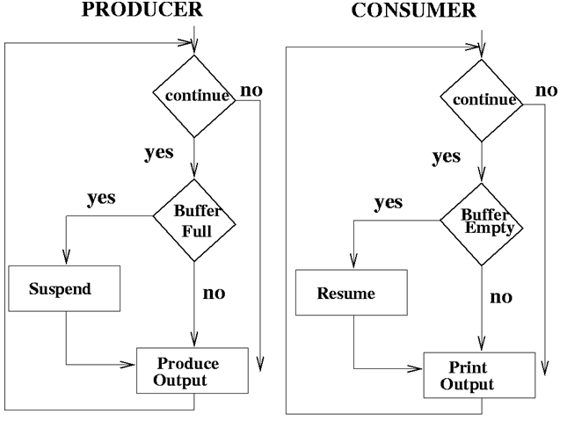
Introduction…
Example: Producer-Consumer Problem…

Slide 7
Introduction…
Example: Producer-Consumer Problem…Bounded Buffer - Shared Memory Solution
Producer process - creates filled buffers
while (true) {
// produce an item and put in nextProduced
while (count == BUFFER_SIZE); // do nothing
buffer [in] = nextProduced;
in = (in + 1) % BUFFER_SIZE;
count++;
}

Slide 8
Introduction…
Example…
Consumer process - Empties filled buffers
while (true) {
while (count == 0); // do nothing
nextConsumed = buffer[out];
out = (out + 1) % BUFFER_SIZE;
count--;
// consume the item in nextConsumed
}

Slide 9
Introduction…
Race Condition:
count++ could be implemented as
register1 = count
register1 = register1 + 1
count = register1
count-- could be implemented as
register2 = count
register2 = register2 - 1
count = register2
Consider this execution interleaving with “count = 5” initially:
  S0: producer execute register1 = count {register1 = 5}
  S1: producer execute register1 = register1 + 1 {register1 = 6}
  S2: consumer execute register2 = count {register2 = 5}
  S3: consumer execute register2 = register2 – 1 {register2 = 4}
  S4: producer execute count = register1 {count= 6 }
  S5: consumer execute count = register2 {count = 4}

Slide 10

1. The Critical Section (CS) problem
Consider system of n processes {p₀, p₁, … p_{n-1}}
Each process has critical section segment of code
  Process may change common variables, update table, write file, etc.
  When one process in CS, then, no other may be in its CS
CS problem is to design protocol to solve this issue.
Each process must ask permission to enter critical section in entry section, may follow critical section with exit section, then remainder section.
General structure of process P_{i}

Slide 11
The Critical Section (CS) problem…
Two approaches depending on if kernel is preemptive or non- preemptive
  Preemptive – allows preemption of process when running in kernel mode
  Non-preemptive – runs until exits kernel mode, blocks, or voluntarily yields CPU
    Essentially free of race conditions in kernel mode
Algorithm for Process P_{i}
do {
while (turn == j);
critical section
turn = j;
remainder section
} while (true);

Slide 12
The Critical Section (CS) problem…
Solution to Critical-Section Problem must satisfy following three conditions:
Mutual Exclusion - If process P_{i} is executing in its CS, then no other processes can be executing in their CS.
Progress - If no process is executing in its CS and there exist some processes that wish to enter their CS, then the selection of the processes that will enter the CS next cannot be postponed indefinitely
Bounded Waiting - A bound must exist on the number of times that other processes are allowed to enter their CS after a process has made a request to enter its CS and before that request is granted
    Assume that each process executes at a nonzero speed
    No assumption concerning relative speed of the n processes

Slide 13
2. Peterson’s solution
Good algorithmic description of solving the problem
Two process solution
Assume that the load and store machine-language instructions are atomic; that is, cannot be interrupted
The two processes share two variables:
  int turn;
  Boolean flag[2]
The variable turn indicates whose turn it is to enter the critical section
The flag array is used to indicate if a process is ready to enter the critical section. flag[i] = true implies that process P_{i} is ready!

Slide 14
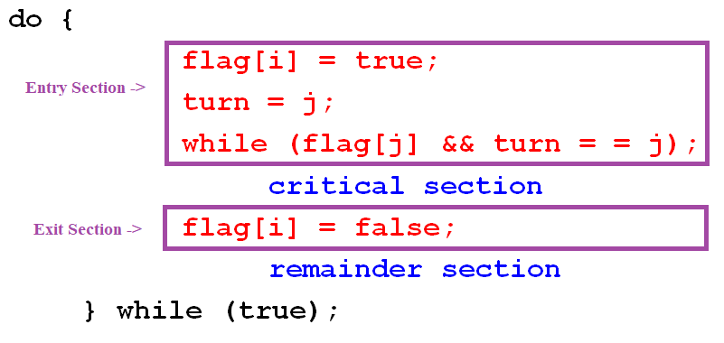
Peterson’s solution…
Algorithm for Process P_{i}:

Slide 15
Peterson’s solution…
To prove condition-1, we note that each Pi enters its CS, if either flag[j]==false or turn=i.
Also note that, if both are simultaneously executing CS, the flag[i]==flag[j]==true, which is not possible at all.
To prove condition 2 and 3, we note that a process Pi can be prevented from entering the CS only if it is stuck in the while loop; this loop is the only one possible.
If Pj is not ready to enter the CS, then flag[j]==false, and Pi will enter the CS.

Slide 16
3. Synchronization Hardware
Many systems provide hardware support for implementing the critical section code.
All solutions below based on idea of locking
  Protecting critical regions via locks
Uniprocessors – could disable interrupts
  Currently running code would execute without preemption
  Generally, too inefficient on multiprocessor systems
    Operating systems using this not broadly scalable
Modern machines provide special atomic hardware instructions
    Atomic = non-interruptible
  Either test memory word and set value
  Or swap contents of two memory words

Slide 17
Synchronization Hardware…
Solution to Critical-section Problem Using Locks:
do {
acquire lock
critical section
release lock
remainder section
} while (TRUE);

Slide 18
Synchronization Hardware…
test_and_set Instruction:
Definition:
boolean test_and_set (boolean *target)
{
boolean rv = *target;
*target = TRUE;
return rv:
}
Executed atomically
Returns the original value of passed parameter
Set the new value of passed parameter to “TRUE”.

Slide 19
Synchronization Hardware…
Solution using test_and_set():
Shared Boolean variable lock, initialized to FALSE
Solution:
do {
while (test_and_set(&lock)); // do nothing
/* critical section */
lock = false;
/* remainder section */
} while (true);

Slide 20
Synchronization Hardware…
compare_and_swap Instruction:
Definition:
int compare_and_swap(int *value, int expected, int new_value) {
int temp = *value;
if (*value == expected)
*value = new_value;
return temp;
}
Executed atomically
Returns the original value of passed parameter “value”
Set the variable “value” the value of the passed parameter “new_value” but only if “value” ==“expected”. That is, the swap takes place only under this condition.

Slide 21
Synchronization Hardware…
Solution using compare_and_swap:
Shared integer “lock” initialized to 0;
Solution:
do {
while (compare_and_swap(&lock,0,1)!=0);
/* do nothing */
/* critical section */
lock = 0;
/* remainder section */
} while (true);

Slide 22
Synchronization Hardware…
Bounded-waiting Mutual Exclusion with test_and_set:
do {
waiting[i] = true; key = true;
while (waiting[i] && key) key = test_and_set(&lock);
waiting[i] = false;
/* critical section */
j = (i + 1) % n;
while ((j != i) && !waiting[j]) j = (j + 1) % n;
if (j == i) lock = false; else waiting[j] = false;
/* remainder section */
} while (true);

Slide 23
Synchronization Hardware…
Bounded-waiting Mutual Exclusion with test_and_set:
To prove that the progress requirement is met, we note that, the process exiting the CS either sets lock to false or sets waiting[j] to false
Both allows a process that is waiting to enter its CS to proceed.
To prove that the bounded-waiting requirement is met, we note that, when a process exiting the CS, it scans the array waiting in the cycle ordering (i+1,i+2,…n-1,0,1,….i-1).
It designates the first process in this ordering that is in the entry section (waiting[j]==true) as the next one to enter the CS.
Any process waiting to enter its CS will thus do so within n-1 turns.

Slide 24
Synchronization Hardware…
Mutex (Mutual Exclusion) Locks:
Previous solutions are complicated and generally inaccessible to application programmers
OS designers build software tools to solve critical section problem
Simplest is mutex lock
Protect a critical section by first acquire() a lock then release() the lock
  Boolean variable indicating if lock is available or not
Calls to acquire() and release() must be atomic
  Usually implemented via hardware atomic instructions
But this solution requires busy waiting
  This lock therefore called a spinlock

Slide 25
Synchronization Hardware…
acquire() and release():
acquire() {
while (!available); /* busy wait */
available = false;
}
release() { available = true; }
do {
acquire lock
critical section
release lock
remainder section
} while (true);

Slide 26
4. Semaphore
Synchronization tool that provides more sophisticated ways (than mutex locks) for process to synchronize their activities.
A semaphore S is an integer variable, is accessed only through two standard operations: wait() and signal().
The wait() was originally called P (from the Dutch proberen, “to test”); signal() was originally called V (from verhogen, “to increment”).
Definition of the wait() operation
  wait(S) {
  while (S <= 0); // busy wait
  S--;
  }
Definition of the signal() operation
  signal(S) { S++; }

Slide 27
Semaphore …
Counting semaphore – integer value can range over an unrestricted domain
Binary semaphore – integer value can range only between 0
and 1; can be simpler to implement; Also known as mutex locks.
We can use binary semaphores to deal with CS problem for multiple processes.
The n processes share a semaphore, mutex, initialized to 1.
Each Process Pi is organized as shown below:
  do {
  wait (mutex);
  // Critical Section
  signal (mutex);
  // remainder section
  } while (TRUE);

Slide 28
Semaphore …
Example: Consider P₁ and P₂ that require S₁ to happen before S₂
Create a semaphore “synch” initialized to 0
  P1:
  S₁;
  signal(synch);
  P2:
  wait(synch);
  S₂;
Because synch is initialized to 0, P2 will execute S2 only after P1 has invoked signal(synch), which is after statement S1 has been executed.

Slide 29
Semaphore …
Semaphore implementation:
Must guarantee that no two processes can execute wait() & signal() on the same semaphore at the same time
Thus, implementation becomes the CS problem where the wait and signal code are placed in the CS.
The main disadvantage of semaphore definition is that it requires busy waiting i.e. while a process is in its CS, any other process that tries to enter CS must loop continuously in the entry code.
Busy waiting wastes CPU cycles, this type of semaphore is also called a spinlock, because process spins while waiting for the lock.
To overcome the need for busy waiting, we can modify the definition of the wait() and signal() semaphore operations.

Slide 30
Semaphore …
Semaphore implementation with no busy waiting:
In this, when a process waiting for semaphore value , can block itself, rather engaging in busy waiting.
Two operations:
  block – place the process invoking the operation on the appropriate waiting queue.
  wakeup – remove one of processes in the waiting queue and place it in the ready queue.
To implement this, we define a semaphore as a ‘C’ struct: typedef struct {
  int value;
  struct process *list;
  } semaphore;
Each semaphore has an integer value and a list of process list.

Slide 31
Semaphore …
Semaphore implementation with no busy waiting…
The new definition of wait() semaphore operation:
wait(semaphore *S) {
S->value--;
if (S->value < 0) {
add this process to S->list;
block();
}
}
The new definition of signal() semaphore operation :
signal(semaphore *S) {
S->value++;
if (S->value <= 0) {
remove a process P from S->list;
wakeup(P);
}
}

Slide 32
Semaphore …
Semaphore implementation with no busy waiting…
Deadlock – two or more processes are waiting indefinitely for an event that can be caused by only one of the waiting processes
Let S and Q be two semaphores initialized to 1
P₀ P₁
wait(S); wait(Q);
wait(Q); wait(S);
... ...
signal(S); signal(Q);
signal(Q); signal(S);
Starvation – indefinite blocking
  A process may never be removed from the semaphore queue in which it is suspended
Priority Inversion – Scheduling problem when lower-priority process holds a lock needed by higher-priority process
  Solved via priority-inheritance protocol

Slide 33
5. Classic problems of Synchronization
This section presents number of synchronization problems as an examples of a large class of concurrency-control problems.
These problems are used for testing nearly every newly proposed synchronization scheme.
The solution to these problems uses semaphores for synchronization.
Examples:
  The bounded-Buffer Problem
  Readers-Writers Problem
  The Dining-Philosophers Problem

Slide 34
Classic problems of Synchronization …
1. The bounded-Buffer Problem:
It is used to illustrate the power of synchronization primitives.
We assume that the pool consists of n buffers, each can hold one item.
The mutex semaphore provides mutual exclusion for access to buffer pool and initialized to 1.
The empty and full semaphores count the number of empty and full buffers, initialized to n and 0 respectively.
The code for producer and consumer process given in next slide…

Slide 35
Classic problems of Synchronization …
The bounded-Buffer Problem…
The structure of the producer process
do {
…
// produce an item in nextp
…
wait (empty);
wait (mutex);
…
// add the item to the buffer
…
signal (mutex);
signal (full);
} while (TRUE);

Slide 36
Classic problems of Synchronization …
The bounded-Buffer Problem…
The structure of the consumer process
do {
wait (full);
wait (mutex);
…
// remove an item from buffer to nextc
…
signal (mutex);
signal (empty);
…
// consume the item in nextc
…
} while (TRUE);

Slide 37
Classic problems of Synchronization …
2. Readers-Writers Problem:
A data set is shared among several concurrent processes which are of two types:
Readers: only read the data set;
Writers: can both read and write.
Problem – allow multiple readers to read at the same time. Only one single writer can access the shared data at the same time.
The variable readcount keeps track of how many processes are currently reading the shared object and initialized to 0.
The Semaphore mutex is used to ensure mutual exclusion, when readcount is updated and is initialized to 1.
The semaphore wrt is common to both reader and write process and is initialized to 1.

Slide 38
Classic problems of Synchronization …
Readers-Writers Problem…
The code for the writer process is given as:
do {
wait (wrt) ;
…
// writing is performed
…
signal (wrt) ;
} while (TRUE);

Slide 39
Classic problems of Synchronization …
Readers-Writers Problem…
The code for the reader process is given as:
do {
wait (mutex) ;
readcount ++ ;
if (readcount == 1) wait (wrt) ;
signal (mutex)
…
//reading is performed
…
wait (mutex) ;
readcount - - ;
if (readcount == 0) signal (wrt) ;
signal (mutex) ;
} while (TRUE);

Slide 40
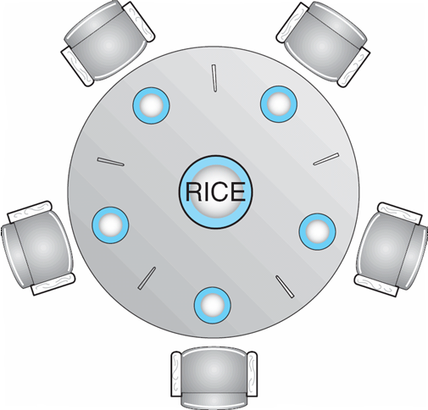
Classic problems of Synchronization …
3. Dining-Philosophers Problem:
Consider 5 philosophers who spend their lives in thinking and eating.
The philosophers share circular round table with 5 chairs and bowl of rice with 5 single chopsticks.
When a philosopher thinks, philosopher does not interact with colleagues.
When a philosopher gets hungry, philosopher tries to pickup 2 chopsticks which are closed.
When philosopher finished eating, philosopher puts down both chopsticks and start think again.
Philosopher may pick up one chopsticks at a time, obviously philosopher may not pickup another one, maybe it is hold by other philosopher.

Slide 41
Classic problems of Synchronization …
Dining-Philosophers Problem…
One simple solution is to represent each chopstick with a semaphore, with philosophers tries to get chopstick by wait() and release by signal() operation.
The Semaphore chopstick [5] initialized to 1, the structure of philosopher i is shown below:
do {
wait ( chopstick[i] );
    wait ( chopstick[ (i + 1) % 5] ) ;
    …
    // eat
    signal (chopstick[i] );
    signal (chopstick[ (i + 1) % 5] );
    …
    // think
    } while (TRUE);

Slide 42
Classic problems of Synchronization …
Dining-Philosophers Problem…
What is the problem with this algorithm? Deadlock
Deadlock handling
  Allow at most 4 philosophers to be sitting simultaneously at the table.
  Allow a philosopher to pick up the forks only if both are available (picking must be done in a critical section.
  Use an asymmetric solution -- an odd-numbered philosopher picks up first the left chopstick and then the right chopstick. Even-numbered philosopher picks up first the right chopstick and then the left chopstick.
Problems with Semaphores: Deadlock and starvation
  Incorrect use of semaphore operations:
  signal (mutex) …. wait (mutex)
  wait (mutex) … wait (mutex)
  Omitting of wait (mutex) or signal (mutex) (or both)

Slide 43
6. Monitors
Although semaphores provides a convenient and effective mechanism for process synchronization, using them incorrectly can result in timing errors, that are difficult to detect.
To deal with such errors, researchers have developed high level language (HLL) constructs, such as monitors.
It is a high-level abstraction that provides a convenient and effective mechanism for process synchronization.
It encapsulates private data with public methods to operate on the data.
It presents a set of programmers defined operations that are provided mutual exclusion within the monitor.
The monitor type contains the declaration of variables and are used with the bodies of functions or procedures.

Slide 44
Monitors …
The representation of monitor cannot be used directly by the various processes.
Thus, a procedure defined within a monitor can access only those variables declared locally within the monitor and its formal parameters.
The syntax of monitor type is shown below:
    monitor monitor-name
    {
    // shared variable declarations
    procedure P1 (…) { …. }
    …
    procedure Pn (…) {……}
    Initialization code ( ….) { … }
    }

Slide 45
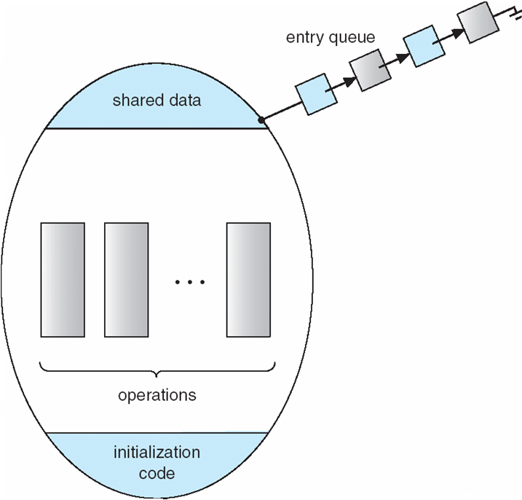
Monitors …
The monitor construct ensures that only one process at a time can be active within the monitor.
Consequently, the programmer does not need to code this synchronization explicitly. (see fig)

Slide 46
Monitors …
Condition Variables Choices:
If process P invokes x.signal(), and process Q is suspended in x.wait(), what should happen next?
Both Q and P cannot execute in parallel. If Q is resumed, then P must wait.
Options include
  Signal and wait – P waits until Q either leaves the monitor or it waits for another condition
  Signal and continue – Q waits until P either leaves the monitor or it waits for another condition
  Both have pros and cons – language implementer can decide
    Monitors implemented in Concurrent Pascal compromise
  P executing signal immediately leaves the monitor, Q is resumed
Implemented in other languages including Mesa, C#, Java

Slide 47
Monitors …
Solution to Dining Philosophers using Monitors:
This deadlock free solution, in which we assume that, a philosopher may pick chopstick only if both available.
We need to use enum to distinguish three states of philosopher (eat, think and hungry). We also need to define condition self[5], where philosopher i can delay by self when hungry.
The distribution of chopsticks is controlled by monitor DP, whose definition is shown below:
monitor DP
{
enum { THINKING, HUNGRY, EATING) state [5] ;
condition self [5];
void pickup (int i) {
state[i] = HUNGRY;
test(i);
if (state[i] != EATING) self [i].wait;
}

Slide 48
Monitors …
Solution to Dining Philosophers using Monitors:
  void putdown (int i) {
  state[i] = THINKING;
  // test left and right neighbors
  test((i + 4) % 5);
  test((i + 1) % 5);
  }
  void test (int i) {
  if ( (state[(i + 4) % 5] != EATING) && (state[i] == HUNGRY) &&
  (state[(i + 1) % 5] != EATING) ) {
  state[i] = EATING ;
  self[i].signal () ;
  }
  }
  Initialization_code() {
  for (int i = 0; i < 5; i++)
  state[i] = THINKING;
  }

Slide 49
Monitors …
Solution to Dining Philosophers using Monitors:
Each philosopher, before starting to eat, must invoke the operation pickup().
This may result in the suspension of the philosopher process.
After successful of pickup operation, the philosopher may eat.
Following this, the philosopher invokes the putdown() operation.
Thus, philosopher i invokes the operations pickup() and putdown() in the following sequence:
DP.pickup (i);
…
EAT
…
DP.putdown (i);
It is easy to show that deadlock never occur, as no two neighbors are eating simultaneously.
However, it is possible for philosopher to starve to death.

Slide 50
Monitors …
Monitor Implementation Using Semaphores:
For each monitor, a semaphore mutex (initialize to 1) is provided.
A process must execute wait(mutex) before entering the monitor and must execute signal (mutex) after leaving the monitor.
Since a signaling process must wait until the resumed process either leaves or waits, an additional semaphore, next, is introduced, initialized to 0, on which the signaling processes may suspend themselves.
An integer variable next_count is used to count the number of processes suspended on next.
Mutual exclusion within a monitor is ensured.
Thus, each external procedure F will be replaced by:
wait(mutex);
…
body of F;
…
if (next_count > 0)
signal(next)
else
signal(mutex);

Slide 51
Monitors …
Monitor Implementation Using Semaphores:
To implement condition variable, for each condition variable x, we introduce a semaphore x_sem and an integer variable x_count, both initialized to 0:
The operation x.wait() can be implemented as:
x_count++;
if (next_count > 0)
signal(next);
else
signal(mutex);
wait(x_sem);
x_count--;
The operation x.signal() can be implemented as:
if (x_count > 0) {
next_count++;
signal(x_sem);
wait(next);
next_count--; }

Slide 52
Monitors …
Monitor Implementation – Condition Variables:
For each condition variable x, we have:
semaphore x_sem; // (initially = 0)
int x_count = 0;
The operation x.wait can be implemented as:
x_count++;
if (next_count > 0)
signal(next);
else
signal(mutex);
wait(x_sem);
x_count--;
The operation x.signal can be implemented as:
if (x_count > 0) {
next_count++;
signal(x_sem);
wait(next);
next_count--; } }

Slide 53
Monitors …
Resuming Processes within a Monitor:
If several processes queued on condition x, and x.signal() executed, which should be resumed?
FCFS frequently not adequate
conditional-wait construct of the form x.wait(c)
  Where c is priority number
  Process with lowest number (highest priority) is scheduled next
Allocate a single resource among competing processes using priority numbers that specify the maximum time a process plans to use the resource
R.acquire(t);
...
access the resurce;
...
R.release;
Where R is an instance of type ResourceAllocator

Slide 54
END OF
Unit-3: Part-1

