Slide 1
II-B.E. IV-SEMESTER
Operating Systems
(OS)
Presented By
Dr. D. BASWARAJ
Professor, CSE DEPT.
VCE, HYDERABAD

Slide 2
SYLLABUS…
UNIT – III: Process synchronization: The critical Section problem, Peterson’s solution, Synchronization Hardware, Semaphores, Classic problems of Synchronization, Monitors.
Deadlocks: System model, deadlock characterization, Methods for handling deadlocks, Deadlock Prevention, Deadlock Avoidance, Deadlock Detection, Recovery from deadlock.
UNIT – IV: File System Interface: File Concept, Access Methods, Directory and Disk Structure
File System Implementation: File-System Structure, File-System Implementation, Directory Implementation, Allocation Methods, Free Space management.
Device Management: Disk Structure, Disk Attachment, Disk Scheduling, Disk Management, Swap Space Management, RAID structure.

Slide 3
UNIT-III
PART-1: Process synchronization
  The critical Section problem
  Peterson’s solution
  Synchronization Hardware
  Semaphore
  Classic problems of Synchronization
  Monitors
PART-2: Deadlocks
  System model
  Deadlock characterization
  Methods for handling deadlocks
  Deadlock Prevention
  Deadlock Avoidance
  Deadlock Detection
  Recovery from deadlock

Slide 4
PART-2: Deadlocks
Deadlock: It is a situation, in which, a set of blocked processes each holding a resource and waiting to acquire a resource held by another process in the set.
Example-1: Suppose system has 2 disk drives, where both processes P1 and P2 each hold one disk drive, and each needs another one.
Example-2: Consider two semaphores A and B and initialized to 1. If two processes execute the wait function in the following order
P0 P1
wait (A); wait(B)
wait (B); wait(A)

Slide 5
1. System model
A system consists of a finite number of resources to be distributed among several competing processes.
The resources may be partitioned into several types (or classes), each consisting of some number of identical instances.
If a process requests an instance of a resource type, the allocation of any instance of the type should satisfy the request.
Under the normal mode of operation, a process may utilize a resource in only the following sequence:
  Request: The process requests the resource. If the request cannot be granted immediately, then the requesting process must wait until it can acquire the resource.
  Use: The process can operate on the resource
  Release: The process releases the resource

Slide 6
2. Deadlock characterization
In a deadlock, processes never finish executing, and system resources are tied up, preventing other jobs from starting.
Before, we discuss the various methods for dealing with the deadlock problem, we look more closely at features that characterize deadlocks.
Deadlock situation can arise if following four conditions hold simultaneously in a system.
Mutual exclusion: only one process at a time can use a resource.
Hold and wait: a process holding at least one resource is waiting to acquire additional resources held by other processes.
No preemption: a resource can be released only voluntarily by the process holding it, after that process has completed its task.
Circular wait: there exists a set {P₀, P₁, …, P₀} of waiting processes such that P₀ is waiting for a resource that is held by P₁, P₁ is waiting for a resource that is held by P₂, …, P_{n–1} is waiting for a resource that is held by P_{n}, and P₀ is waiting for a resource that is held by P₀.

Slide 7
3. Methods for handling deadlocks
Deadlock Detection and Recovery: Deadlock can be detected by the resource scheduler as it keeps track of all the resources that are allocated to different processes. After a deadlock is detected, it can be handled using the given methods −
  All the processes that are involved in the deadlock are terminated.
  Resources can be preempted from some processes and given to others until the deadlock situation is resolved.
Deadlock Prevention: It is important to prevent a deadlock before it can occur. So, the system checks each transaction before it is executed to make sure it does not lead to deadlock.
Deadlock Avoidance: It is better to avoid a deadlock rather than take measures after the deadlock has occurred.
Deadlock Ignorance (Ostrich Algorithm): In this, deadlock is simply ignored, and it is assumed that it will never occur. This is done because in some systems the cost of handling the deadlock is much higher than simply ignoring it as it occurs very rarely.

Slide 8
4. Deadlock Prevention
Deadlock happens only when Mutual Exclusion, hold and wait, No preemption and circular wait holds simultaneously.
If it is possible to violate one of the four conditions at any time, then the deadlock can never occur in the system.
Mutual Exclusion – not required for sharable resources; must hold for non-sharable resources.
Hold and Wait – must guarantee that whenever a process requests a resource, it does not hold any other resources.
  Require process to request and be allocated all its resources before it begins execution or allow process to request resources only when the process has none.
  Low resource utilization;
  Starvation possible

Slide 9
Deadlock Prevention…
No Preemption –
  If a process that is holding some resources requests another resource that cannot be immediately allocated to it, then all resources currently being held are released.
  Preempted resources are added to the list of resources for which the process is waiting.
  Process will be restarted only when it can regain its old resources, as well as the new ones that it is requesting.
Circular Wait – impose a total ordering of all resource types and require that each process requests resources in an increasing order of enumeration.

Slide 10
5. Deadlock Avoidance
Requires that the system has some additional a priori information available.
Simplest and most useful model requires that each process declare the maximum number of resources of each type that it may need.
The deadlock-avoidance algorithm dynamically examines the resource-allocation state to ensure that there can never be a circular-wait condition.
Resource-allocation state is defined by the number of available and allocated resources, and the maximum demands of the processes.

Slide 11
Deadlock Avoidance…
Safe State:
When a process requests an available resource, system must decide if immediate allocation leaves the system in a safe state.
System is in safe state if there exists a sequence <P₁, P₂, …, P_{n}> of ALL the processes is the systems such that for each P_{i}, the resources that P_{i} can still request can be satisfied by currently available resources + resources held by all the P_{j}, with j < i
That is:
  If P_{i} resource needs are not immediately available, then P_{i} can wait until all P_{j} have finished
  When P_{j} is finished, P_{i} can obtain needed resources, execute, return allocated resources, and terminate
  When P_{i} terminates, P_{i +1} can obtain its needed resources, and so on.

Slide 12

Deadlock Avoidance…
Basic Facts:
If a system is in safe state, ⇒ no deadlocks
If a system is in unsafe state, ⇒ possibility of deadlock
Avoidance ⇒ ensure that a system will never enter an unsafe state.

Slide 13
Deadlock Avoidance…
Resource-Allocation Graph:
It is directed graph, which describes deadlocks more precisely.
It consists of set vertices V and a set of directed edges E.
V is further partitioned into two types:
  P = {P₁, P₂, …, P_{n}}, the set of all the processes in the system.
  R = {R₁, R₂, …, R_{m}}, the set of all resource types in the system
E is further partitioned into two types:
  request edge: P_{i} → R_{j} (Process P₁ request resource R_{j} )
  assignment edge: R_{j} → P_{i} (resource R_{j} assigned to process P_{i})

Slide 14

Deadlock Avoidance…
Resource-Allocation Graph Example…
In this graph:
P1, P2 and P3 are processes
R1,R2,R3…R4 are resources in which
  R1, R3 have 1 instances
  R2 have 2 instances and
  R4 have 3 instances
Out of 6 edges, 2 are request edges and 4 are assignment edges.

Slide 15

Deadlock Avoidance…
Graph With A Cycle with may Deadlock or not…
Basic Facts
If graph contains no cycles ⇒ no deadlock
If graph contains a cycle
⇒ if only one instance per resource type, then deadlock occur
⇒ if several instances per resource type, possibility of deadlock occur

Slide 16
Deadlock Avoidance…
Deadlock can be avoided by using following two ways:
Single instance of a resource type
  Use a resource-allocation graph
Multiple instances of a resource type
  Use the banker’s algorithm

Slide 17
Deadlock Avoidance…
Single instance of a resource type
  Use a resource-allocation graph
Claim edge Pi → Rj indicated that process Pj may request resource Rj; represented by a dashed line.
Claim edge converts to request edge when a process requests a resource.
Request edge converted to an assignment edge when the resource is allocated to the process.
When a resource is released by a process, assignment edge reconverts to a claim edge.
Resources must be claimed a priori in the system.

Slide 18
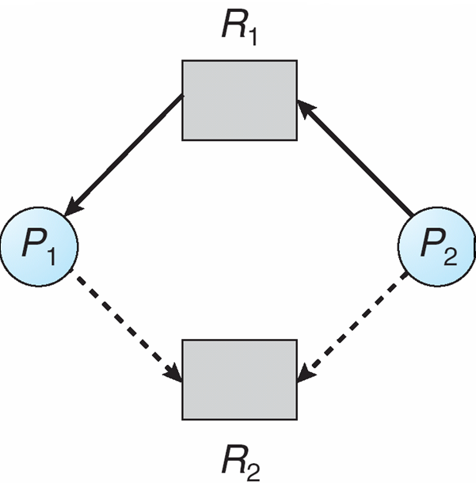
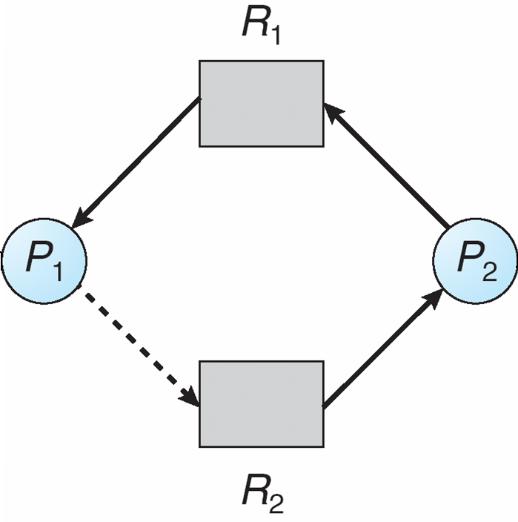
Deadlock Avoidance…
Resource-Allocation Graph Algorithm:
Suppose that process Pi requests a resource Rj
The request can be granted only if converting the request edge to an assignment edge does not result in the formation of a cycle in the resource allocation graph
Safe state Unsafe state

Slide 19
Deadlock Avoidance…
Multiple instances of a resource type: Banker’s algorithm
Multiple instances. Each process must a priori claim maximum use.
When a process requests a resource, it may have to wait. When a process gets all its resources it must return them in a finite amount of time. Following data structures are used in this algorithm:
Let n = no. of processes, and m = no. of resources types.
Available: Vector of length m. If available [j] = k, there are k instances of resource type R_{j} available
Max: n x m matrix. If Max [i,j] = k, then process P_{i} may request at most k instances of resource type R_{j}
Allocation: n x m matrix. If Allocation[i,j] = k then P_{i} is currently allocated k instances of R_{j}
Need: n x m matrix. If Need[i,j] = k, then P_{i} may need k more instances of R_{j} to complete its task
    Need [i,j] = Max[i,j] – Allocation [i,j]

Slide 20
Deadlock Avoidance…
Safety Algorithm:
Let Work and Finish be vectors of length m and n, respectively. Initialize:
      Work = Available
      Finish [i] = false for i = 0, 1, …, n- 1
Find an i such that both:
  Finish [i] = false
  Need_{i} ≤ Work
  If no such i exists, go to step 4
Work = Work + Allocation_{i}
Finish[i] = true
go to step 2
If Finish [i] == true for all i, then the system is in a safe state

Slide 21
Deadlock Avoidance…
Resource-Request Algorithm for Process Pi:
Request = request vector for process P_{i}.
If Request_{i} [j] = k then process P_{i} wants k instances of resource type R_{j}
  1. If Request_{i} ≤ Need_{i} go to step 2. Otherwise, raise error condition, since process has exceeded its maximum claim
  2. If Request_{i} ≤ Available, go to step 3. Otherwise, P_{i} must wait, since resources are not available
  3. Pretend to allocate requested resources to P_{i} by modifying the state as follows:
      Available = Available – Request;
      Allocation_{i} = Allocation_{i} + Request_{i};
      Need_{i} = Need_{i} – Request_{i};
    If safe ⇒ the resources are allocated to Pi
    If unsafe ⇒ Pi must wait, and the old resource-allocation state is restored

Slide 22
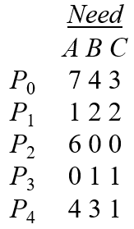
Deadlock Avoidance…
Example of Banker’s Algorithm:
Assume system contain 5 processes P₀ to P₄ and
3 resource types: A (10 instances), B (5instances), and C (7 instances)
Snapshot at time T₀:
Allocation Max Available
A B C A B C A B C
P₀ 0 1 0 7 5 3 3 3 2
P₁ 2 0 0 3 2 2
P₂ 3 0 2 9 0 2
P₃ 2 1 1 2 2 2
P₄ 0 0 2 4 3 3
The content of the matrix Need is defined to be
Max – Allocation
The system is in a safe state since the sequence < P₁, P₃, P₄, P₀, P₂> satisfies safety criteria

Slide 23
Deadlock Avoidance…
Example-2 of Banker’s Algorithm:
Assume system contain 5 processes P₀ to P₄ and
4 resource types: A:4 B:27 C:23 D:16
Snapshot at time t₀:
Allocation Max Available Need
A B C D A B C D A B C D A B C D
P₀ 0 0 1 2 0 0 1 2 1 5 2 0
P₁ 1 0 0 0 1 7 5 0
P₂ 1 3 5 4 2 3 5 6
P₃ 0 6 3 2 0 6 5 2
P₄ 0 0 1 4 0 6 5 6
Determine the sequence, where the system to be in safe state?
< P₀ , P ₂ , P₃ , P₄ , P ₁ > satisfies safety criteria.

Slide 24
6. Deadlock Detection
Three stages:
  Allow system to enter deadlock state
  Detection algorithm
  Recovery scheme.
Single Instance of Each Resource Type:
Maintain wait-for graph
  Nodes are processes
  Pi → Pj, if Pi is waiting for Pj
Periodically invoke an algorithm that searches for a cycle in the graph. If there is a cycle, there exists a deadlock
An algorithm to detect a cycle in a graph requires an order of n² operations, where n is the number of vertices in the graph

Slide 25
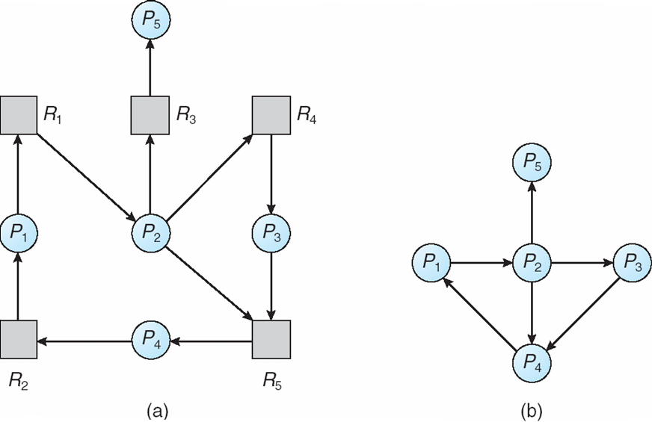
Deadlock Detection…
Resource-Allocation Graph and Wait-for Graph:
(a) Resource-Allocation Graph (b) Wait-for Graph

Slide 26
Deadlock Detection…
Multiple Instances of Each Resource Type:
Available: A vector of length m indicates the number of available resources of each type.
Allocation: An n x m matrix defines the number of resources of each type currently allocated to each process.
Request: An n x m matrix indicates the current request of each process. If Request [i,j] = k, then process Pi is requesting k more instances of resource type.

Slide 27
Deadlock Detection…
Detection Algorithm:
1. Let Work and Finish be vectors of length m and n, respectively Initialize: (a) Work = Available
  For i = 1,2, …, n, if Allocation_{i} ≠ 0, then
  Finish[i] = false otherwise, Finish[i] = true
2. Find an index i such that both:
  (a) Finish[i] == false
  (b) Request_{i} ≤ Work
  If no such i exists, go to step 4
3. Work = Work + Allocation_{i}
Finish[i] = true
go to step 2
4. If Finish[i] == false, for some i, 1 ≤ i ≤ n, then the system is in deadlock state. Moreover, if Finish[i] == false, then P_{i} is deadlocked

Slide 28
Example of Detection Algorithm…
Five processes P₀ through P₄; three resource types
A (7 instances), B (2 instances), and C (6 instances)
Snapshot at time T₀:
Allocation Request Available
A B C A B C A B C
P₀ 0 1 0 0 0 0 0 0 0
P₁ 2 0 0 2 0 2
P₂ 3 0 3 0 0 0
P₃ 2 1 1 1 0 0
P₄ 0 0 2 0 0 2
Sequence <P₀, P₂, P₃, P₁, P₄> will result in Finish[i] = true for all i

Slide 29
Example (Cont.)
P₂ requests an additional instance of type C
Request
A B C
P₀ 0 0 0
P₁ 2 0 1
P₂ 0 0 1
P₃ 1 0 0
P₄ 0 0 2
State of system?
  Can reclaim resources held by process P₀, but insufficient resources to fulfill other processes requests
  Deadlock exists, consisting of processes P₁, P₂, P₃, and P₄

Slide 30
Detection-Algorithm Usage
When, and how often, to invoke depends on:
  How often a deadlock is likely to occur?
  How many processes will need to be rolled back?
    one for each disjoint cycle
If detection algorithm is invoked arbitrarily, there may be many cycles in the resource graph and so we would not be able to tell which of the many deadlocked processes “caused” the deadlock

Slide 31
6. Recovery from deadlock
Two ways: Process termination, Resource Preemption
Recovery from Deadlock - Process Termination:
Abort all deadlocked processes
Abort one process at a time until the deadlock cycle is eliminated
In which order should we choose to abort?
  Priority of the process
  How long process has computed, and how much longer to completion
  Resources the process has used
  Resource's process needs to complete
  How many processes will need to be terminated
  Is process interactive or batch?

Slide 32
Recovery from deadlock…
Recovery from Deadlock - Resource Preemption:
Selecting a victim – minimize cost
Rollback – return to some safe state, restart process for that state
Starvation – same process may always be picked as victim, include number of rollback in cost factor

Slide 33
END OF
Unit-3: Part-2

