Slide 1
II-B.E. IV-SEMESTER
Operating Systems
(OS)
Presented By
Dr. D. BASWARAJ
Professor, CSE DEPT.
VCE, HYDERABAD

Slide 2
SYLLABUS…
UNIT – III: Process synchronization: The critical Section problem, Peterson’s solution, Synchronization Hardware, Semaphores, Classic problems of Synchronization, Monitors.
Deadlocks: System model, deadlock characterization, Methods for handling deadlocks, Deadlock Prevention, Deadlock Avoidance, Deadlock Detection, Recovery from deadlock.
UNIT – IV: File System Interface: File Concept, Access Methods, Directory and Disk Structure
File System Implementation: File-System Structure, File-System Implementation, Directory Implementation, Allocation Methods, Free Space management.
Device Management: Disk Structure, Disk Attachment, Disk Scheduling, Disk Management, Swap Space Management, RAID structure.

Slide 3
UNIT-IV
PART-1: File System Management
  File System Interface:
    File Concept,
    Access Methods,
    Directory and Disk Structure
  File System Implementation:
    File-System Structure,
    File-System Implementation
    Directory Implementation,
    Allocation Methods
    Free Space management

Slide 4
PART-1: File system management
Introduction:
A file is a collection of related information that is recorded on secondary storage. Or file is a collection of logically related entities.
File system is the part of the operating system which is responsible for file management. It provides a mechanism to store the data and access to the file contents including data and programs.
Some of the tasks performed by file management are:
  It helps to create new files and placing them at the specific locations.
  It helps in easily and quickly locating these files in computer system.
  It makes the process of sharing of the files among different users.
  It helps to stores the files in separate folders known as directories.
  It helps the user to modify the data of files or to modify the name of the file in the directories.

Slide 5
File system management…
Introduction…
The File system takes care of the following issues:
File Structure - We have seen various data structures in which the file can be stored. The task of the file system is to maintain an optimal file structure.
Recovering Free space -Whenever a file gets deleted from the hard disk, there is a free space created in the disk. There can be many such spaces which need to be recovered in order to reallocate them to other files.
Disk space assignment to the files - The major concern about the file is deciding where to store the files on the hard disk. There are various disks scheduling algorithm which will be covered later in this part.
Tracking data location - A File may or may not be stored within only one block. It can be stored in the noncontiguous blocks on the disk. We need to keep track of all the blocks on which the part of the files reside.

Slide 6
A. File System Interface
1. File Concept:
Contiguous logical address space
Types:
  Data
    numeric
    character
    binary
  Program
Contents defined by file’s creator
  Many types
    Consider text file, source file, executable file

Slide 7
File Concept…
File Attributes:
Name – only information kept in human-readable form
Identifier – unique tag (number) identifies file within file system
Type – needed for systems that support different types
Location – pointer to file location on device
Size – current file size
Protection – controls who can do reading, writing, executing
Time, date, and user identification – data for protection, security, and usage monitoring
Many variations, including extended file attributes such as file checksum
Information about files are kept in the directory structure, which is maintained on the disk

Slide 8
File Concept…
File Operations :
A File is an abstract data type (ADT), on which the following operations can be performed.
  Create
  Write
  Read
  Reposition within file (seek)
  Delete
  Truncate (delete contents of file but keep its attributes)
  Other common operations:
    Append, Rename, Copy, Get/Set File attributes, Open and close the files.

Slide 9
File Concept…
File Operations…
Open(F_{i}) – search the directory structure on disk for entry F_{i}, and move the content of entry to memory
Close (F_{i}) – move the content of entry F_{i} in memory to directory structure on disk
Several pieces of information are associated with an open file:
  File pointer: pointer to last read/write location, per process that has open the file.
  File-open counter tracks the number of times a file is open and closes and reaches zero on the last close. The system can then remove the entry.
  Disk location of the file: needed to locate the file on disk is kept in memory
  Access rights: stored on the per-process table, so the OS can allow or deny subsequent I/O requests.

Slide 10
File Concept…
Locking Files…
Some OS provides facilities for locking an open file (or sections of a file).
Provided by some operating systems and file systems
  Like reader-writer locks
  Shared lock like reader lock – several processes can acquire concurrently
  Exclusive lock like writer lock
Mediates access to a file
Mandatory or advisory:
  Mandatory – access is denied depending on locks held and requested
  Advisory – processes can find status of locks and decide what to do

Slide 11
File Concept…
File structure…
None - sequence of words, bytes
Simple record structure
  Lines
  Fixed length
  Variable length
Complex Structures
  Formatted document
  Relocatable load file
Can simulate last two with first method by inserting appropriate control characters
Who decides:
  Operating system
  Program

Slide 12

File Concept…
File Types – Name, Extension:

Slide 13
2. Access Methods
Sequential Access
read next
write next
reset
no read after last write (rewrite)
Direct Access – file is fixed length logical records
read n
write n
position to n
read next
write next
rewrite n
where, n = relative block number
Relative block numbers allow OS to decide where file should be placed

Slide 14


Access Methods…
Sequential Access File:
Simulation of Sequential Access on Direct-access File:

Slide 15
Access Methods…
Other Access Methods:
Can be built on top of base methods
General involve creation of an index for the file
Keep index in memory for fast determination of location of data to be operated on (consider UPC code plus record of data about that item)
If too large, index (in memory) of the index (on disk)
IBM indexed sequential-access method (ISAM)
  Small master index, points to disk blocks of secondary index
  File kept sorted on a defined key
  All done by the OS
VMS operating system provides index and relative files as another example (see next slide)

Slide 16

Access Methods…
Example of Index and Relative Files:

Slide 17
3. Directory and Disk Structure
Directory: A collection of nodes containing information about all files.
Both the directory structure and the files reside on disk
Backups of these two structures are kept on tapes
Directory
Files
F 1
F 2
F 3
F 4
F n

Slide 18
Directory and Disk Structure…
Disk Structure:
A disk (or any storage device ) can be used in its entirety for a file system.
It is possible to place the multiple files on a disk in the form of parts known as disk partitions or slices or mini-disks.
Disks or partitions can be RAID (Redundant arrays of inexpensive disks) protected against failure
Disk or partition can be used raw – without a file system, or formatted with a file system
The parts can also be combined to form larger structures known as a volumes. Each volume that contain file system must also contain information about the files in the system.
This information is kept in entries in a device directory or volume table of contents.

Slide 19

Directory and Disk Structure…
A Typical File-system Organization:

Slide 20
Directory and Disk Structure…
Operations performed on Directory:
Search for a file
Create a file
Delete a file
List a directory
Rename a file
Traverse the file system
Create a Directory
Delete a Directory
Rename a Directory

Slide 21
Directory and Disk Structure…
Directory Organization:
The directory can be viewed as a symbol table that translates file names into their directory entries.
Organize the Directory (Logically) to Obtain
  Efficiency – locating a file quickly
  Naming – convenient to users
    Two users can have same name for different files
    The same file can have several different names
  Grouping – logical grouping of files by properties, (e.g., all Java programs, all games, …)

Slide 22
Directory and Disk Structure…
Directory Organization:
The directory can be viewed as a symbol table that translates file names into their directory entries.
Organize the Directory (Logically) to Obtain
  Efficiency – locating a file quickly
  Naming – convenient to users
    Two users can have same name for different files
    The same file can have several different names
  Grouping – logical grouping of files by properties, (e.g., all Java programs, all games, …)
Directory structure classified in to
  Single-Level Directory, Two-Level Directory
  Tree-Structure Directory, Acyclic-Graph Directory

Slide 23

Directory and Disk Structure…
Single-Level Directory:
It is one of most common and simplest scheme to represent the logical structure of a directory.
In this all files contained in the same directory, which is easy to support and understand.
Limitation: Naming problem, Grouping problem

Slide 24

Directory and Disk Structure…
Two-Level Directory:
Separate directory for each user
Each user has its own user file directory (UFD), usually kept in master file directory (MFD).
Advantages: Path name , Can have the same file name for different user, Efficient searching, No grouping capability
Limitations: Complex search process

Slide 25
Directory and Disk Structure…
Hierarchical/Tree-Structured Directory:
Extends the two-level directory structure to a tree of arbitrary height.
Two types of Path names: absolute and relative
Absolute path name begins at the root and follows a path down to the specified file. Example- c:/abc/xyz/t1.doc
A relative path name defines the path from the current directory.
The present working directory is called as current directory.
E.g. If c:\abc is the current directory, then the relative path name for the file t1.doc is /xyz/t1.doc.
Creating a new directory in working directory: mkdir <dir-name>
Delete a directory from current directory is: rm <file-name>
Advantages: Efficient searching , Grouping Capability

Slide 26

Directory and Disk Structure…
Hierarchical/Tree-Structured Directory…

Slide 27

Directory and Disk Structure…
Acyclic-Graph Directories: A tree structure prohibits the sharing of files/directories.
An Acyclic graph (no cycles) allows to share directories/files .
Implemented in several ways, a common way is to create a new directory entry called link.

Slide 28
Directory and Disk Structure…
Acyclic-Graph Directories: A tree structure prohibits the sharing of files/directories.
An Acyclic graph (no cycles) allows to share directories/files .
Implemented in several ways, a common way is to create a new directory entry called link.

Slide 29
Directory and Disk Structure…
Acyclic-Graph Directories…
It is more flexible than a simple tree structure, but it is also more complex.
Several files must be considered carefully:
  File may have multiple absolute path name
  When file deleted, whether space de-allocated or reused?
How do we guarantee no cycles?
  Allow only links to file not subdirectories
  Garbage collection
  Every time a new link is added use a cycle detection algorithm to determine whether it is OK

Slide 30

Directory and Disk Structure…
General Graph Directory:
A serious problem with acyclic graph is ensuring that there are no cycles.
However, when we add links to an existing tree-structured directory , the tree structure is destroyed, resulting in a simple graph structure.

Slide 31
B. File System Implementation
1. File-System Structure :
File structure
  Logical storage unit
  Collection of related information
File system resides on secondary storage (disks)
  Provided user interface to storage, mapping logical to physical
  Provides efficient and convenient access to disk by allowing data to be stored, located retrieved easily
Disk provides in-place rewrite and random access
  I/O transfers performed in blocks of sectors (usually 512 bytes)
File control block – storage structure consisting of information about a file
Device driver controls the physical device

Slide 32

File-System Structure…
File system organized into layers:

Slide 33
File-System Structure…
The file system is composed of many different levels, each level in the design uses the features of lower levels to create new features for use by higher levels.
The lowest level, the i/o control consists of device drivers and interrupt handlers to transform info between main memory and disk system.
  For example, Given commands like “read drive1, cylinder 72, track 2, sector 10, into memory location 1060” outputs low-level hardware specific commands to hardware controller
The basic file system needs only to issue generic commands to the appropriate device drivers to read and write physical blocks on the system. For e.g. “retrieve block 123” translates to device driver
The file-organization module knows about files and their logical blocks as well as physical blocks.
  Translates logical block # to physical block #
  Manages free space, disk allocation

Slide 34
File-System Structure…
The logical file system manages metadata information.
  Translates file name into file number, file handle, location by maintaining file control blocks (inodes in UNIX)
  Directory management
  Protection
Layering useful for reducing complexity and redundancy but adds overhead and can decrease performance. Translates file name into file number, file handle, location by maintaining file control blocks (inodes in UNIX)
  Logical layers can be implemented by any coding method according to OS designer

Slide 35
2. File-System Implementation
Several on-disk and in-memory structures are used to implement a file system.
These structures vary depending on OS and the file system.
Boot control block (per volume) can contain info needed by system to boot an OS from that volume and is typically the first block of a volume.
In UFS (Unix File System) it is called boot block; in NTFS (Windows NT File System) called partition boot sector.
Volume control block (per volume) contains volume (or partition) details, such as the number of blocks, size of block, free block counter etc.
In UFS it is called super block; in NTFS it is stored in the master file table.

Slide 36

File-System Implementation…
Directory structure organizes the files
  Names and inode numbers, master file table
Per-file File Control Block (FCB) contains many details about the file
  inode number, permissions, size, dates
  NFTS stores into in master file table using relational DB structures

Slide 37
File-System Implementation…
In-Memory File System Structures:
The in-memory info is used for both file system management and performance improvement via caching.
The data are loaded at mount time and discarded at dismount.
The structure may include ones described below:
  An in-memory mount table contains info about each mounted volume
  An in-memory directory-structure cache hold the info of recently accessed directories.
  The system-wide open-file table (SWOFT) contain a copy of the FCB of each open file as well as other info.
  The per-process open-file table (PPOFT) contains a pointer to the appropriate entry in the SWOFT as well as other info.

Slide 38

File-System Implementation…
In-Memory File System Structures…
The following figure illustrates the necessary file system structures provided by the operating systems.

Slide 39
File-System Implementation…
Partitions and Mounting: Partition can be a volume containing a file system (“cooked”) or raw – just a sequence of blocks with no file system
Boot block can point to boot volume or boot loader set of blocks that contain enough code to know how to load the kernel from the file system
  Or a boot management program for multi-os booting
Root partition contains the OS, other partitions can hold other Oses, other file systems, or be raw
  Mounted at boot time
  Other partitions can mount automatically or manually
At mount time, file system consistency checked
  Is all metadata correct? If not, fix it, try again
    If yes, add to mount table, allow access

Slide 40
File-System Implementation…
Virtual File Systems: on Unix provide an object-oriented way of implementing file systems
VFS allows the same system call interface (the API) to be used for different types of file systems
  Separates file-system generic operations from implementation details
  Implementation can be one of many file systems types, or network file system
    Implements vnodes which hold inodes or network file details
  Then dispatches operation to appropriate file system implementation routines
The file-system implementation consists of 3 major layer as depicted in next slide.

Slide 41
File-System Implementation…
Virtual File Systems: The first layer is the file-system interface, based on the open, read, write and close calls and on file descriptors.
The second layer, VFS, serves two important functions:
  It separate file-system-generic operations from their implementation by defining a clean VFS interface.
  It provides a mechanism for uniquely representing a file throughout a network, called vnode.
Thus, the VFS distinguishes local files from remote ones, and local files are further distinguished according to their file-system types.

Slide 42

File-System Implementation…
Virtual File Systems: The API is to the VFS interface, rather than any specific type of file system.

Slide 43
3. Directory Implementation
The section of directory-allocation and directory -management algorithms significantly affects the efficiency, performance and the reliability of the file system.
Linear list of file names with pointer to the data blocks
  Simple to program
  Time-consuming to execute
    Linear search time
    Could keep ordered alphabetically via linked list or use B+ tree
Hash Table – linear list with hash data structure
  Decreases directory search time
  Collisions – situations where two file names hash to the same location
  Only good if entries are fixed size, or use chained-overflow method

Slide 44
4. Allocation Methods
The direct-access nature of disks allows us flexibility in the implementation of files.
In almost every case, many files are stored on the same disk.
The main problem is how to allocate space to these files so that disk space is utilized effectively, and files can be accessed quickly.
An allocation method refers to how disk blocks are allocated for files and are in wide use:
  Contiguous allocation
  Linked allocation
  Indexed allocation

Slide 45
Allocation Methods…
  Contiguous allocation:
Each file occupies a set of contiguous blocks on the disk
Disk addresses define a linear ordering on the disk.
Number of disk seeks required for accessing files is minimal.
Advantages:
  Simple – only starting location (block #) and length (number of blocks) are required
  Random access
Disadvantages:
  Wasteful of space (dynamic storage-allocation problem)
  Files cannot grow

Slide 46

Allocation Methods…
  Contiguous allocation:

Slide 47
Allocation Methods…
  Contiguous allocation - Extent-Based Systems:
Many newer file systems (i.e. Virtual File System) use a modified contiguous allocation scheme.
Here, a contiguous chunk of space is allocated initially; and then, if that amount proves not to be large enough, another chunk of contiguous space, known as extent, is added.
Extent-based file systems allocate disk blocks in extents.
An extent is a contiguous block of disks
  Extents are allocated for file allocation
  A file consists of one or more extents

Slide 48
Allocation Methods…
  Linked allocation:
It solves all the problems of contiguous allocation. Each file is a linked list of disk blocks; blocks may be scattered anywhere on the disk.
The directory contains a pointer to the first and last block of the file. To create a new file, we simply create a new entry in the directory, with nil in first and last pointer.
Advantages:
  Simple – need only starting address
  Free-space management system – no waste of space
  Improve efficiency by clustering blocks into groups
Disadvantages:
  increases internal fragmentation
  Reliability can be a problem
  Locating a block can take many I/Os and disk seeks

Slide 49

Allocation Methods…
  Linked allocation:

Slide 50
Allocation Methods…
  Indexed allocation:
However, in the absence of FAT, linked allocation cannot support efficient direct access.
Indexed allocation solves this problem by bringing all pointers together into the one location: the index block.
Each file has its own index block, which is an array of disk-block addresses.
The i^{th} entry in the index block points to the i^{th} block of the file.
The directory contains the address of the index block (see fig).
When the file is created, all pointers in the index block are set to NULL.

Slide 51
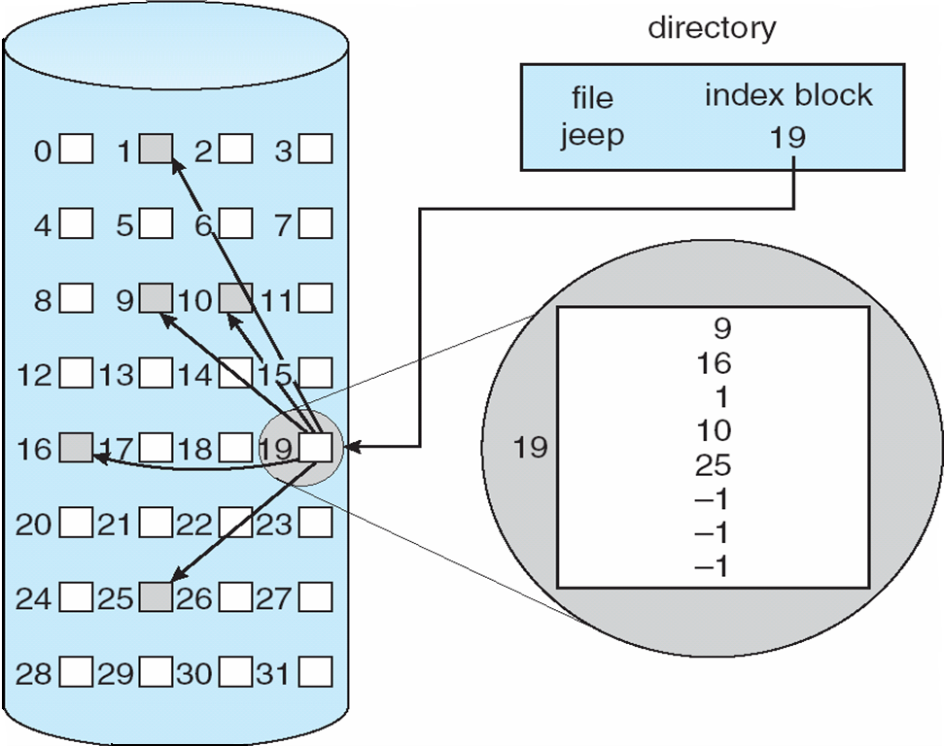
Allocation Methods…
  Indexed allocation:

Slide 52
Allocation Methods…
  Indexed allocation:
Advantages:
  Supports direct access without suffering from external fragmentation
Disadvantages:
  Suffers from wasted space, because of index table
Following are the mechanisms to deal with how large the index block should be:
  Linked Scheme
  Multilevel Index
  Combined Scheme.
In Linked scheme, to allow large files, we can link together several index blocks.
In Multilevel scheme, use a first level index block to a set of second-level index blocks, which in turn point to the files blocks.

Slide 53
Allocation Methods…
  Indexed allocation - Linked scheme:
Index block
file block
link
link

Slide 54
Allocation Methods…
  Indexed allocation - Multilevel scheme:
2nd level Index
Index block
link
link

Slide 55

Allocation Methods…
  Combined scheme: UNIX UFS
  4K bytes per block, 32-bit addresses
  More index blocks than can be addressed with 32-bit file pointer

Slide 56
4. Free-Space Management
Since disk space is limited, we need to reuse the space from deleted files for new files.
To keep track of free space, the system maintains a free-space list , which records all free blocks.
Free-space list usually implemented by Bit-vector or bit-map (n blocks), shown below:
0
1
2
n-1
Block number =
(number of bits per word) *
(number of 0-value words) +
(offset of first 1 bit)
…
0 ⇒ block[i] free
1 ⇒ block[i] occupied
bit[i] =


Slide 57
Free-Space Management…
Bit map requires extra space
  Example:
block size = 2¹² bytes
disk size = 2³⁰ bytes (1 gigabyte)
n = 2³⁰/2¹² = 2¹⁸ bits (or 32K bytes)
Easy to get contiguous files
Another way to implement free-space list is by using Linked list (free list)
Advantages of linked list:
  Cannot get contiguous space easily
  No waste of space

Slide 58
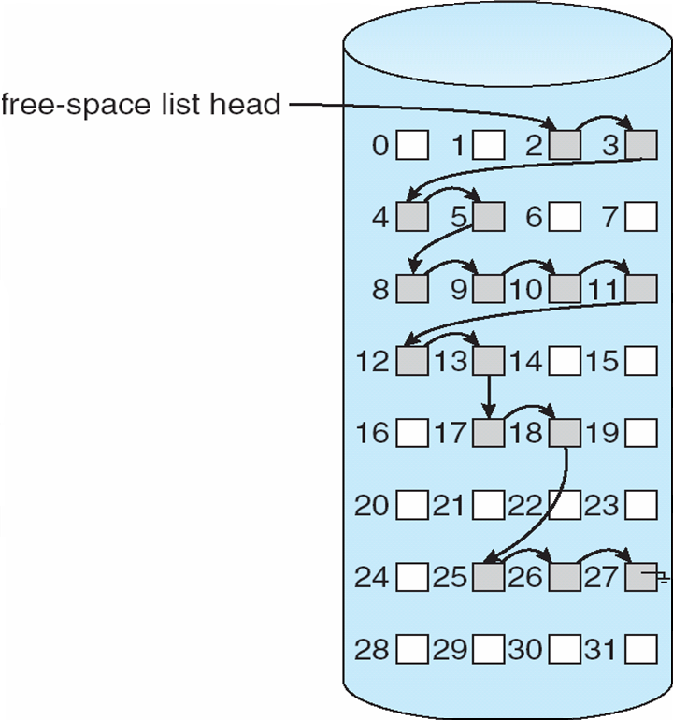
Free-Space Management…
Linked list (free list) on disk:
  Cannot get contiguous space easily
  No waste of space
  No need to traverse the entire list (if # free blocks recorded)

Slide 59
Free-Space Management…
Grouping
  Modify linked list to store address of next n-1 free blocks in first free block, plus a pointer to next block that contains free-block-pointers (like this one)
Counting
  Because space is frequently contiguously used and freed, with contiguous-allocation allocation, extents, or clustering
    Keep address of first free block and count of following free blocks
    Free space list then has entries containing addresses and counts

Slide 60
END OF
Unit-4: Part-1

