Slide 1
II-B.E. IV-SEMESTER
Operating Systems
(OS)
Presented By
Dr. D. BASWARAJ
Professor, CSE DEPT.
VCE, HYDERABAD

Slide 2
SYLLABUS…
UNIT – III: Process synchronization: The critical Section problem, Peterson’s solution, Synchronization Hardware, Semaphores, Classic problems of Synchronization, Monitors.
Deadlocks: System model, deadlock characterization, Methods for handling deadlocks, Deadlock Prevention, Deadlock Avoidance, Deadlock Detection, Recovery from deadlock.
UNIT – IV: File System Interface: File Concept, Access Methods, Directory and Disk Structure
File System Implementation: File-System Structure, File-System Implementation, Directory Implementation, Allocation Methods, Free Space management.
Device Management: Disk Structure, Disk Attachment, Disk Scheduling, Disk Management, Swap Space Management, RAID structure.

Slide 3
UNIT-IV
PART-2: Device Management
  Disk Structure
  Disk Attachment
  Disk Scheduling
  Disk Management
  Swap Space Management
  RAID structure

Slide 4
PART-1: Device Management
Magnetic disks are relatively simple and provide bulk of secondary storage of modern computers.
  Each disk platter has flat circular shape with diameter 1.8 to 5.25 inches.
  The two surfaces of a platter covered with magnetic material.
  A read-write head “flies” just above each surface of each platter.
  The surface of a platter is logically divided into circular tracks, which are subdivided into sectors.
  The set of tracks that are at one arm position makes up a cylinder.
  Drives rotate at 60 to 200 times per second
  Transfer rate is rate at which data flow between drive and computer
  Positioning time ( or random-access time) is time to move disk arm to desired cylinder (seek time) and time for desired sector to rotate under the disk head (rotational latency)
  Head crash results from disk head will damage the disk surface.

Slide 5

Device Management…
Moving-head Disk Mechanism:

Slide 6
Device Management…
Disks can be removable, allowing different disks to be mounted as needed.
A disk drive is attached to a computer by a set of wires called an I/O bus.
The data transfers on a bus are carried out by special electronic processors called Controllers.
  Host controller is at the computer end of the bus.
  disk controller is built into each disk drive or storage array
Several kinds of buses are available, including
  EIDE (Enhanced integrated drive electronics)
  ATA (Advanced Technology Attachment)
  SATA (Serial ATA)
  USB (Universal Serial Bus)
  Fibre Channel (FC)
  SCSI (Small Computer System Interface)

Slide 7
Device Management…
Magnetic tape was early secondary-storage medium
Relatively permanent and holds large quantities of dat
Access time slow
Random access is 1000 times slower than disk
Kept in spool and wound or rewound past a read-write head
Once head positioned, then data can be written at a speed comparable to disks.
Typically store data from 20-200GB
Tapes and their drives are usually categorized by width, including 4, 8 and 19mm, ¼ and ½ inch.
Mainly used for
  Backup
  Storage of infrequently used info
  As a medium for transferring info between systems

Slide 8
1. Disk Structure
Disk drives are addressed as large 1-D arrays of logical blocks, where the logical block is the smallest unit of transfer.
The size of logical block is usually having 512 bytes, although the range is 32-1024bytes.
In CD-ROM and DVD-ROM, the drive increases its rotation speed as the head moves from the outer to inner track, to keep same rate of data – called Constant Linear Velocity (CLV).
While in hard disk, the drive rotation speed can stay constant and the density of bits decreases from inner to outer track, to keep same rate of data – called Constant Angular Velocity (CAV).
The 1-D array of logical blocks is mapped into the sectors of the disk sequentially
  Sector 0 is the first sector of the first track on the outermost cylinder
  Mapping proceeds in order through that track, then the rest of the tracks in that cylinder, and then through the rest of the cylinders from outermost to innermost.

Slide 9
2. Disk Attachment
Computer access disk storage in two ways:
  Via I/O ports called host attached storage (HAS).
  Via remote host called network attached storage(NAS).
HAS accessed through local I/O ports and these ports uses several technologies like IDE, ATA, SATA, SCSI and FC.
SCSI itself is a bus, up to 16 devices on one cable, SCSI initiator requests operation and SCSI targets perform tasks
  Each target can have up to 8 logical units (disks attached to device controller
FC is high-speed serial architecture
  Can be switched fabric with 24-bit address space – the basis of storage area networks (SANs) in which many hosts attach to many storage units
  Can be arbitrated loop (FC-AL) of 126 devices

Slide 10
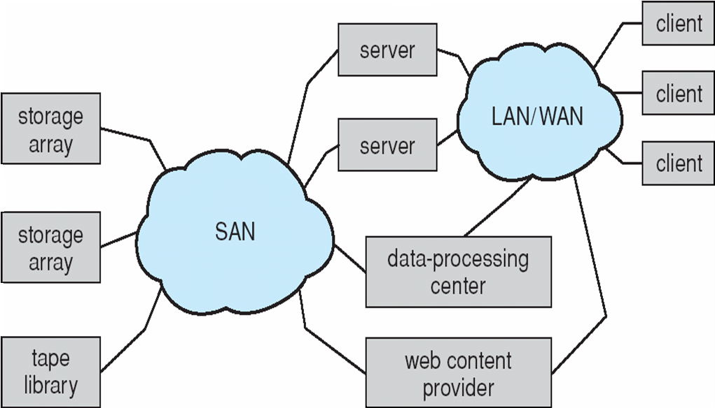
Disk Attachment…
Network-Attached Storage:
SAN is a private network (using storage protocols rather than network protocols) connecting servers and storage units.(see fig)
Common in large storage environments
Multiple hosts attached to multiple storage arrays - flexible

Slide 11

Disk Attachment…
Storage Area Network (SAN).
NAS is storage made available over a network rather than over a local connection (such as a bus)
NFS (n/w file system) and CIFS (common internet file system) are common protocols
Implemented via RPCs between host and storage
New iSCSI protocol uses IP network to carry the SCSI protocol

Slide 12
3. Disk Scheduling
The operating system is responsible for using hardware efficiently — for the disk drives, this means having a fast access time and disk bandwidth
Access time has two major components
  Seek time is the time for the disk are to move the heads to the cylinder containing the desired sector
  Rotational latency is the additional time waiting for the disk to rotate the desired sector to the disk head
Minimize seek time (≈ seek distance)
Disk bandwidth is the total number of bytes transferred, divided by the total time between the first request for service and the completion of the last transfer.
For a multiprogramming system with many processes, the disk queue may often have several pending requests.
Disk scheduling algorithms are used to choose which pending request to service next.

Slide 13
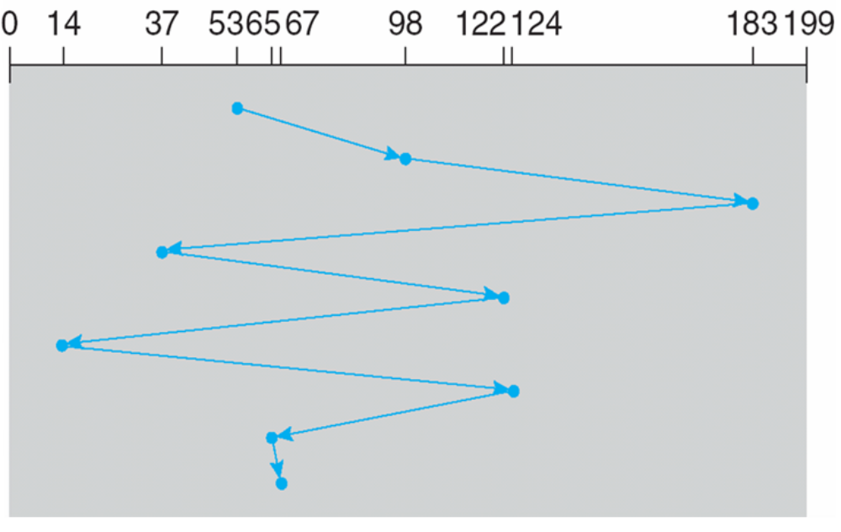
FCFS Disk Scheduling
The Fist-Come First-Served (FCFS) algorithm is simplest form of disk scheduling.
This algorithm is intrinsically fair, but it generally does not provide fastest service.
Example: A disk queue (0-199) with requests for I/O to blocks on cylinders are in the order: 98, 183, 37, 122, 14, 124, 65, 67
If disk head is initially at cylinder 53, it will first move from 53 to 98, then to 183,37,122,14,124,65 and finally 67, for a total movement of 640 cylinders.

Slide 14
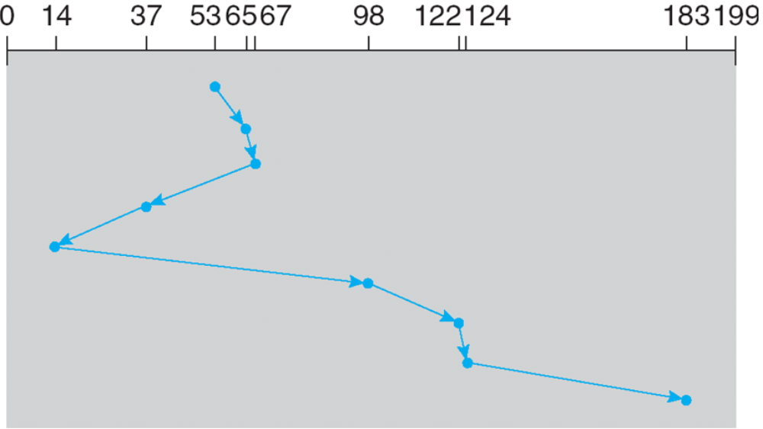
SSTF Disk Scheduling
Shortest Seek Time First (SSTF) algorithm selects the request with the minimum seek time from the current head position.
Since seek time increases with the number of cylinders traversed by the head, SSTF chooses the pending request closest to the current head position.
Like SJF CPU scheduling, it may cause starvation of some requests.
For previous example, it shows total head movement of 236 cylinders.

Slide 15
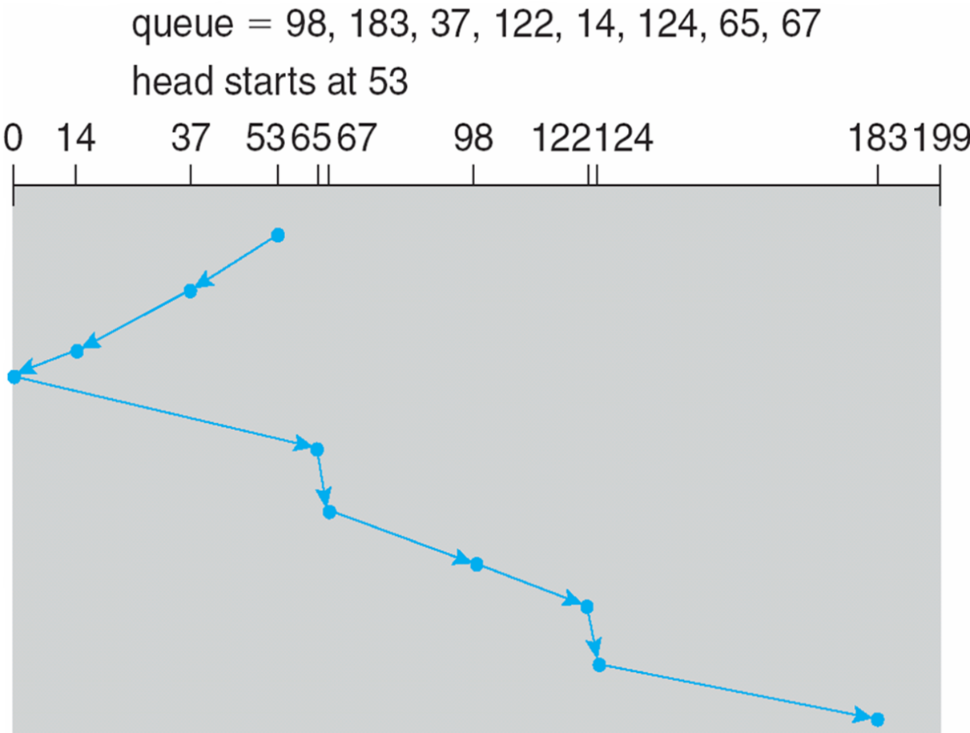
SCAN Disk Scheduling
In this, the disk arm starts at one end of the disk, and moves toward the other end, servicing requests until it gets to the other end of the disk, where the head movement is reversed, and servicing continues.
SCAN algorithm Sometimes called the elevator algorithm
For previous example, it shows total head movement of 208 cylinders.

Slide 16
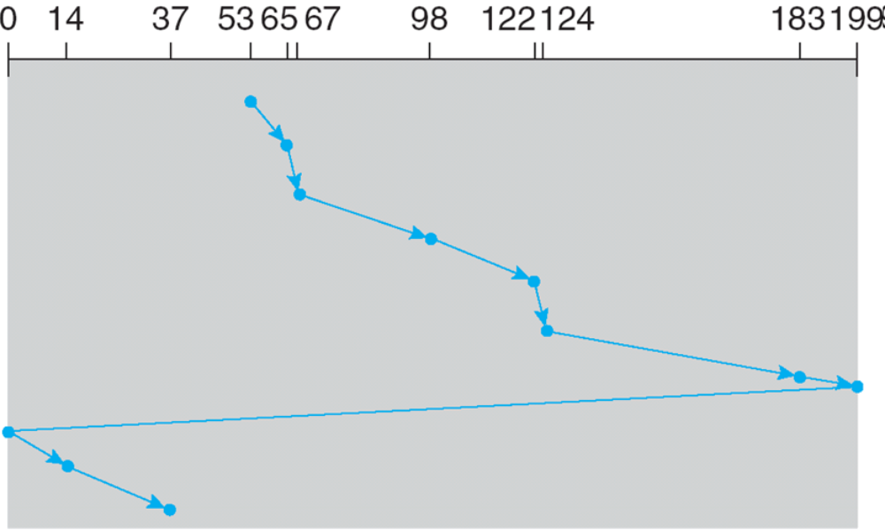
C-SCAN Disk Scheduling
Circular SCAN is a variant of SCAN designed to provides a more uniform wait time than SCAN
The head moves from one end of the disk to the other, servicing requests as it goes
  When it reaches the other end, however, it immediately returns to the beginning of the disk, without servicing any requests on the return trip
Treats the cylinders as a circular list that wraps around from the last cylinder to the first one

Slide 17
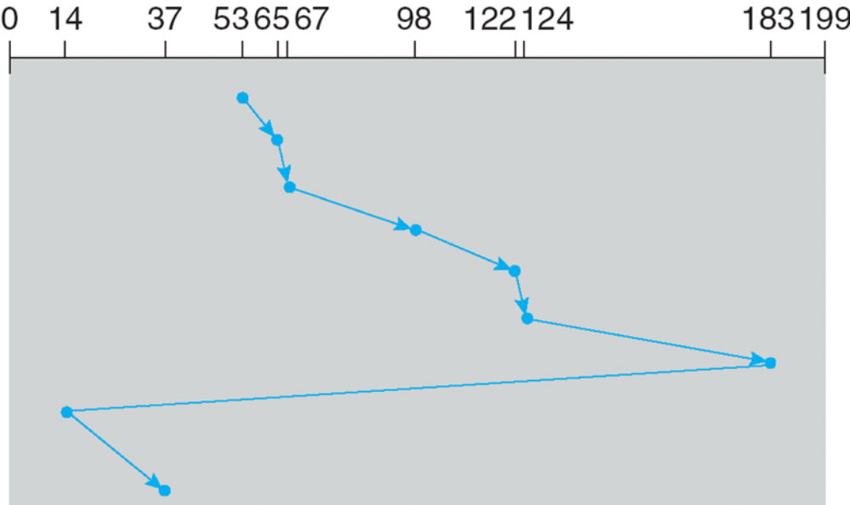
LOOK Disk Scheduling
In this, the arm goes only as far as the final request in each direction, then, it reverses direction immediately, without going all the way to the end of the disk
Like SCAN and C-SCAN, it also follow LOOK and C-LOOK scheduling, because they look for a request before continuing to move in given direction. (below shows C-Look example)

Slide 18
Selecting a Disk-Scheduling Algorithm
SSTF is common and has a natural appeal
SCAN and C-SCAN perform better for systems that place a heavy load on the disk
Performance depends on the number and types of requests
Requests for disk service can be influenced by the file-allocation method
The disk-scheduling algorithm should be written as a separate module of the operating system, allowing it to be replaced with a different algorithm if necessary
Either SSTF or LOOK is a reasonable choice for the default algorithm

Slide 19
4. Disk Management
Low-level formatting, or physical formatting — Dividing a disk into sectors that the disk controller can read and write
To use a disk to hold files, the operating system still needs to record its own data structures on the disk
  Partition the disk into one or more groups of cylinders
  Logical formatting or “making a file system”
  To increase efficiency most file systems group blocks into clusters
    Disk I/O done in blocks
    File I/O done in clusters
Boot block initializes system
  The bootstrap is stored in ROM
  Bootstrap loader program
Methods such as sector sparing or forwarding used to handle bad blocks.

Slide 20

Booting from a Disk in Windows 2000

Slide 21
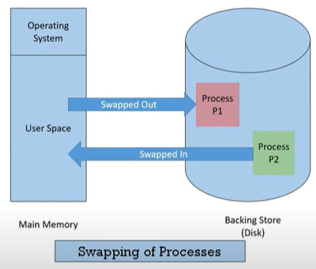
5. Swap-Space Management
Swap-space — Virtual memory uses disk space as an extension of main memory
Swap-space can be carved out of the normal file system, or, more commonly, it can be in a separate disk partition

Slide 22
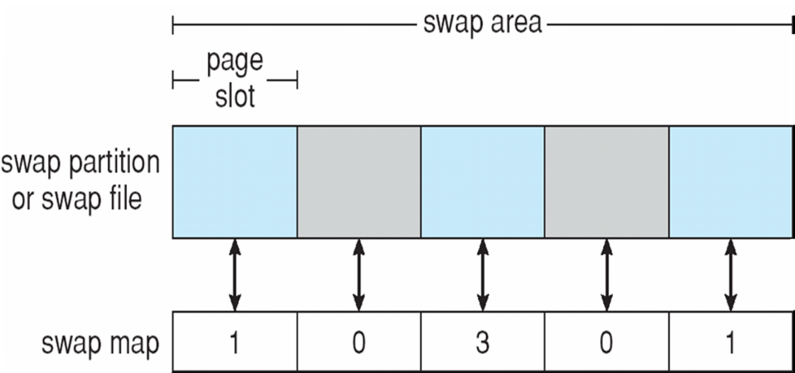
Swap-Space Management…
Swap-space management
  4.3BSD allocates swap space when process starts; holds text segment (the program) and data segment
  Kernel uses swap maps to track swap-space use
  Solaris 2 allocates swap space only when a page is forced out of physical memory, not when the virtual memory page is first created
Data Structures for Swapping on Linux Systems

Slide 23
6. Redundancy Array of Independent Disks (RAID) Structure
RAID is a technique, which makes use of a combination of multiple disks instead of using a single disk for increased performance, data redundancy or both.
A variety of disk-organization technique collectively called RAIDs are commonly used to address the performance and reliability issues.
RAID provides reliability via redundancy and increases the mean time to failure
RAID is arranged into six different levels.
Several improvements in disk-use techniques involve the use of multiple disks working cooperatively
Disk striping uses a group of disks as one storage unit.

Slide 24
RAID…
RAID schemes improve performance and improve the reliability of the storage system by storing redundant data
  Mirroring or shadowing (RAID 1) keeps duplicate of each disk
  Striped mirrors (RAID 1+0) or mirrored stripes (RAID 0+1) provides high performance and high reliability
  Block interleaved parity (RAID 4, 5, 6) uses much less redundancy
RAID within a storage array can still fail if the array fails, so automatic replication of the data between arrays is common
Frequently, a small number of hot-spare disks are left unallocated, automatically replacing a failed disk and having data rebuilt onto them

Slide 25
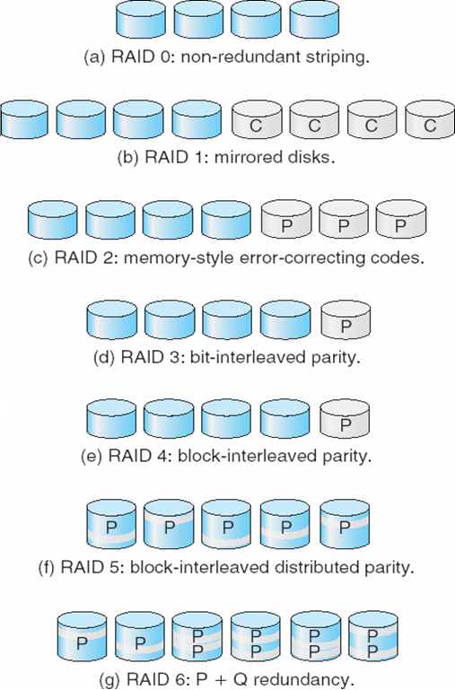
RAID Levels

Slide 26
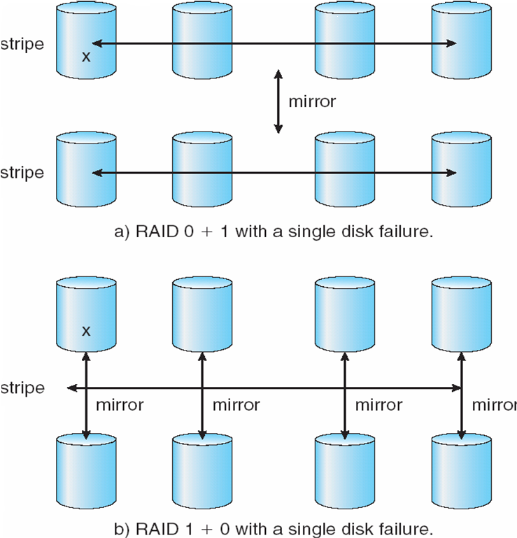
RAID
(0 + 1) and
(1 + 0)

Slide 27
Extensions
Problems with RAID
  Does not always assure that data are available for the OS and its users.
  Does not prevent or detect data corruption or other errors, because of just disk failures
Solaris ZFS (Zettabyte file system) file system takes and innovative approach to solve RAID problems.
It maintains internal checksums of all blocks, which includes data and metadata
Checksums kept with pointer to object, to detect if object is the correct or changed.
It Can detect and correct data and metadata corruption

Slide 28
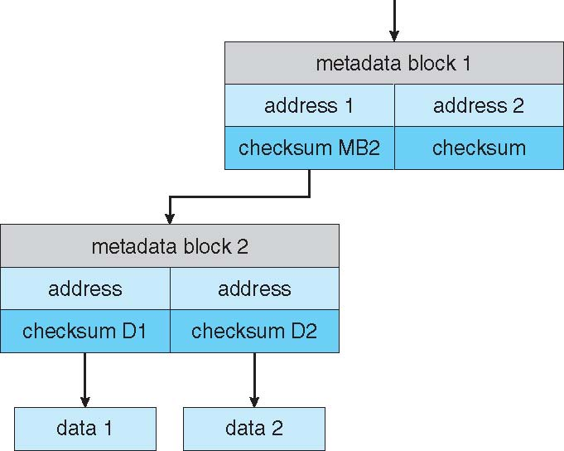
ZFS Checksums for All Metadata and Data

Slide 29
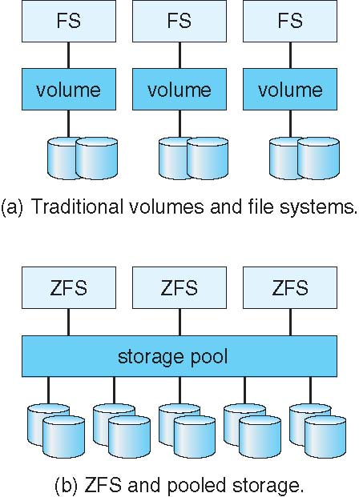
Traditional and Pooled Storage

Slide 30
END OF
Unit-4: Part-2

