Slide 1
II-B.E. IV-SEMESTER
Operating Systems
(OS)
Presented By
Dr. D. BASWARAJ
Professor, CSE DEPT.
VCE, HYDERABAD

Slide 2
SYLLABUS …
UNIT – V:
I/O System: I/O hardware, Application I/O Interface, Kernel I/O Subsystem, Transforming I/O request to hardware operation.
Protection: Goals of protection, Principles of protection, Domain of protection, Access matrix, Implementation of Access matrix
Case Studies: Linux System: Design Principles, Kernel Modules, Process Management, Scheduling Windows - Design Principles, System components ,File system Android: Architecture, Activity and Service life cycle.

Slide 3
UNIT-V
PART-1: I/O System
  I/O hardware
  Application I/O Interface
  Kernel I/O Subsystem
  Transforming I/O request to hardware operation
PART-2: Protection
  Goals of protection
  Principles of protection
  Domain of protection
  Access matrix
  Implementation of Access matrix
PART-3: Case Studies
  Linux System: Design Principles, Kernel Modules, Process Management, Scheduling
  Windows: Design Principles, System components ,File system
  Android: Architecture, Activity and Service life cycle.

Slide 4
Part-1: Objectives
To explore the structure of an operating system’s I/O subsystem.
To discuss the principles and complexities of I/O hardware.
To explain the performance aspects of I/O hardware and software

Slide 5
Overview
The control of devices connected to the computer is a major concern of operating-system designers.
Because I/O devices vary so widely in their function and speed (like a mouse, a hard disk, and a tape), varied methods are needed to control them.
These methods form the I/O subsystem of the kernel, which separates the rest of the kernel from the complexities of managing I/O devices.
I/O-device technology exhibits two conflicting trends:
  increasing standardization of software and hardware interfaces - helps us to incorporate improved device generations into existing computers and operating systems
  increasingly broad variety of I/O devices - incorporate new devices them into existing computers and operating systems. This challenge is met by a combination of hardware and software techniques.

Slide 6
Overview…
The basic I/O hardware elements, such as ports, buses, and device controllers, accommodate a wide variety of I/O devices.
To encapsulate the details and oddities of different devices, the kernel of an operating system is structured to use device-driver modules.
The device drivers present a uniform device access interface to the I/O subsystem, much as system calls provide a standard interface between the application and the operating system.

Slide 7
1. I/O Hardware
Computers operate a great kinds of I/O devices mainly character-oriented and block oriented.
Most of them fit into the general categories of
  Storage devices (disks, tapes)
  Transmission devices (network cards, modems, Bluetooth)
  Human-interface devices (Monitor/Screen, keyboard, mouse, speaker)
Common concepts:
  Port is a connection point, through which device communicates to computer system
  Bus (daisy chain or shared direct access) – carries information
  Controller (host adapter) – operate port/bus/device.
I/O instructions are used to control the devices.
Devices have addresses, used by
  Direct I/O instructions
  Memory-mapped I/O

Slide 8
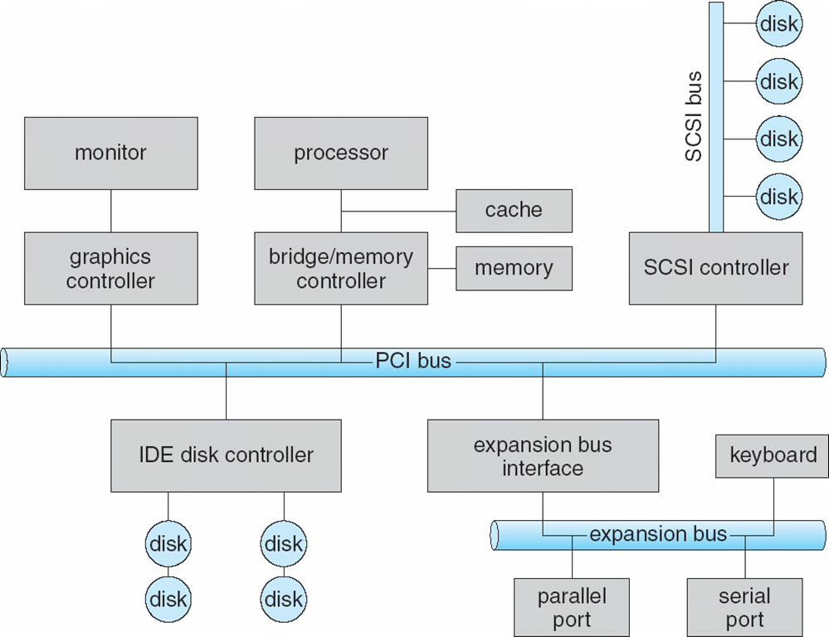
A Typical PC Bus Structure

Slide 9
A Typical PC Bus Structure…
The common PCI (Peripheral Component Interconnect) bus connects the processor–memory subsystem to fast devices, and an expansion bus connects relatively slow devices, through serial and parallel ports.
In the upper-right portion of the figure, four disks are connected on a SCSI (Small Computer System Interface) bus plugged into a SCSI controller.
A Device Controller is a collection of electronics that can operate a port, a bus, or a device. It has one or more registers for data and control signals.
The processor communicates with the controller by reading and writing bit patterns in these registers.
One way, the communication can occur is using special I/O instructions that specify the transfer of a byte or word to an I/O port address.
Alternatively, the device controller support memory-mapped I/O, in which, the device-control registers are mapped into the address space of the processor

Slide 10
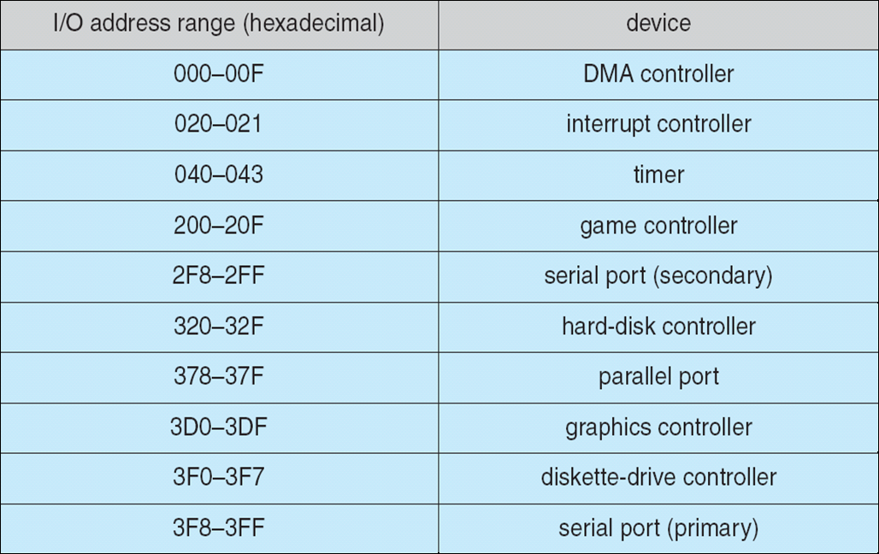
Device I/O Port Locations on PCs (partial)
Some systems use both techniques. For instance, PCs use I/O instructions to control some devices and memory-mapped I/O to control others. Following table shows the usual I/O port addresses for PCs.

Slide 11
Device I/O Port Locations on PCs (partial)
An I/O port typically consists of four registers, called the status, control, data-in, and data-out registers.
The data-in register is read by the host to get input.
The data-out register is written by the host to send output.
The status register contains bits that can be read by the host.
These bits indicate states, such as whether the current command has completed, whether a byte is available to be read from the data-in register, and whether a device error has occurred.
The control register can be written by the host to start a command or to change the mode of a device.
For instance, a certain bit in the control register of a serial port chooses between full-duplex and half-duplex communication, another bit enables parity checking, a third bit sets the word length to 7 or 8 bits, and other bits select one of the speeds supported by the serial port.

Slide 12
Polling
Determines status of device
  command-ready
  busy
  Error
Busy-wait cycle to wait for I/O from device.
In many computer architecture, 3 CPU-instruction cycles are sufficient to poll a device
  Read a device register
  Logical-and to extract a status-bit and
  Branch if not zero.
Clearly, the basic polling operation is efficient. But polling becomes inefficient when it is attempted repeatedly yet rarely finds a device ready for service, while other useful CPU processing remains undone.

Slide 13
Interrupts
The hardware mechanism that enables a device to notify the CPU is called an interrupt.
It is more efficient to arrange for the hardware controller to notify the CPU when the device becomes ready for service, rather than to require the CPU to poll repeatedly for an I/O completion.
The basic interrupt mechanism works as follows.
  The CPU hardware has a wire called the interrupt-request line that the CPU senses after executing every instruction.
  When the CPU detects that a controller has asserted a signal on the interrupt-request line, the CPU performs a state save and jumps to the interrupt-handler routine at a fixed address in memory.
  The interrupt handler determines the cause of the interrupt, performs the necessary processing, performs a state restore, and executes a return from interrupt instruction to return the CPU to the execution state prior to the interrupt.

Slide 14
Interrupts
The basic interrupt mechanism just described enables the CPU to respond to an asynchronous event, as when a device controller becomes ready for service.
  We need the ability to defer interrupt handling during critical processing.
  We need an efficient way to dispatch to the proper interrupt handler for a device without first polling all the devices to see which one raised the interrupt.
  We need multilevel interrupts, so that the operating system can distinguish between high- and low-priority interrupts and can respond with the appropriate degree of urgency.
In modern computer hardware, these three features are provided by the CPU and by the interrupt-controller hardware.
Most CPUs have two interrupt request lines.
  Non-maskable interrupt, which is reserved for events such as unrecoverable memory errors.
  Maskable interrupt: it can be turned off by the CPU before the execution of critical instruction sequences that must not be interrupted.
The maskable interrupt is used by device controllers to request service..

Slide 15
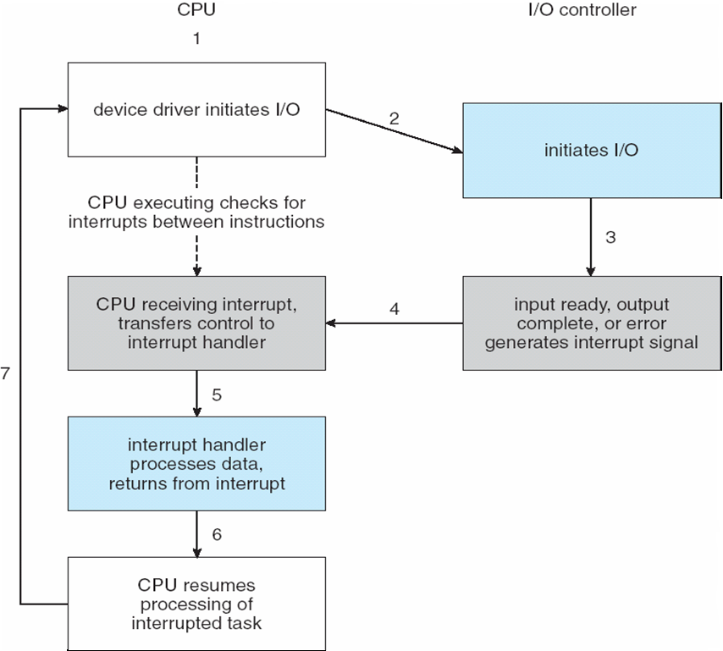
Interrupt-Driven I/O Cycle

Slide 16
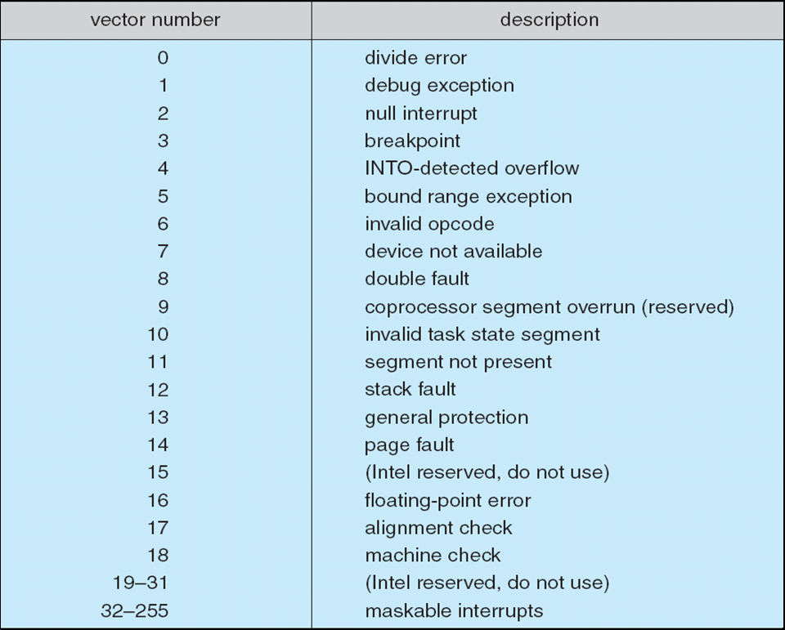
Intel Pentium Processor Event-Vector Table

Slide 17
Direct Memory Access
Used to avoid programmed I/O for large data movement
Requires DMA controller
Bypasses CPU to transfer data directly between I/O device and memory

Slide 18
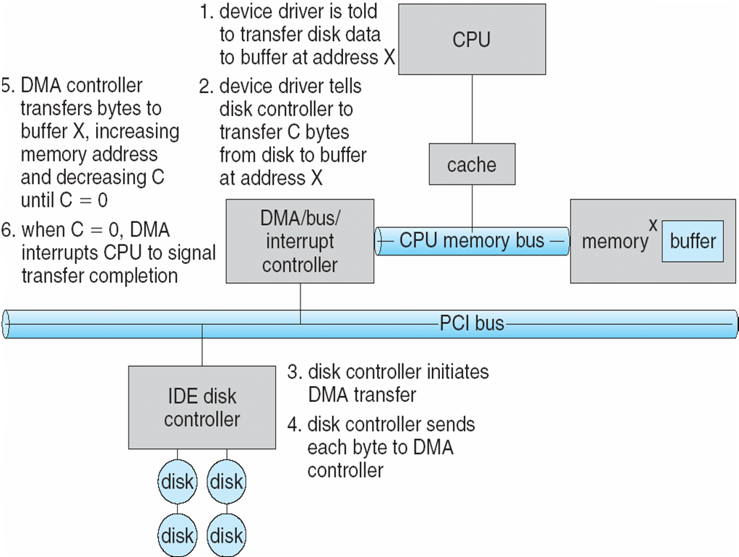
Six Step Process to Perform DMA Transfer

Slide 19
2. Application I/O Interface
I/O system calls encapsulate device behaviors in generic classes
Device-driver layer hides differences among I/O controllers from kernel
Devices vary in many dimensions
  Character-stream or block
  Sequential or random-access
  Sharable or dedicated
  Speed of operation
  read-write, read only, or write only

Slide 20
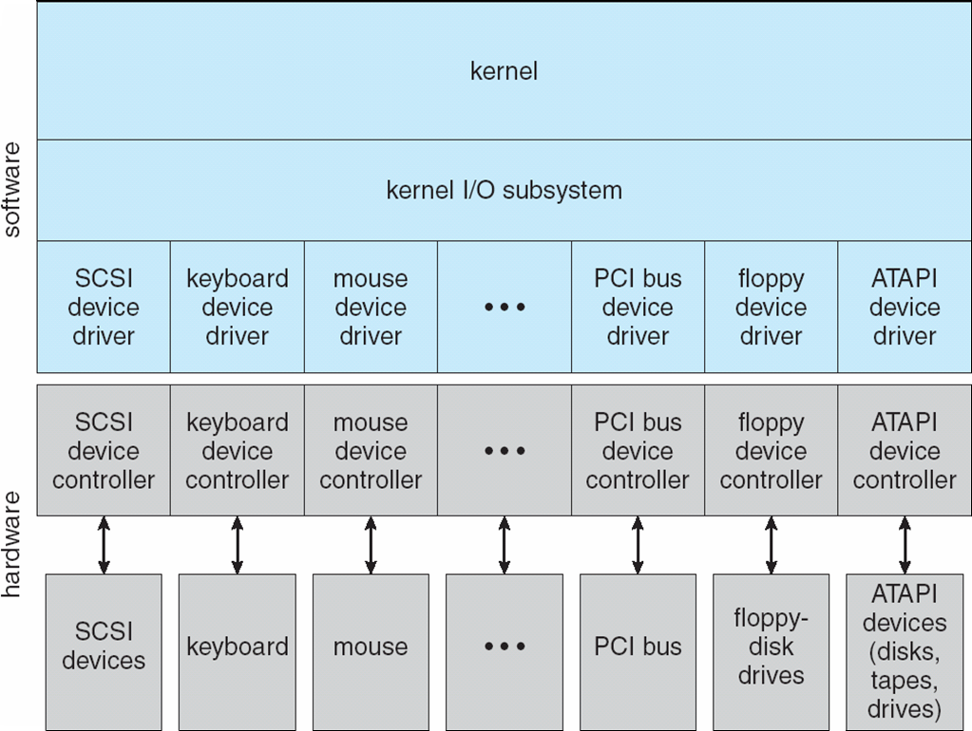
A Kernel I/O Structure

Slide 21
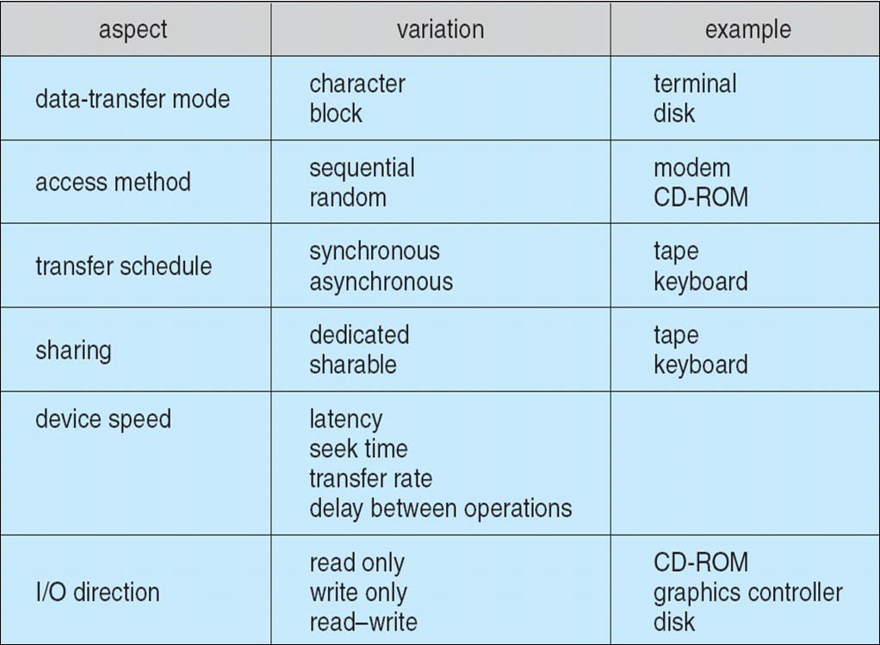
Characteristics of I/O Devices

Slide 22
Block and Character Devices
Block devices include disk drives
  Commands include read, write, seek
  Raw I/O or file-system access
  Memory-mapped file access possible
Character devices include keyboards, mice, serial ports
  Commands include get(), put()
  Libraries layered on top allow line editing

Slide 23
Network Devices
Varying enough from block and character to have own interface
Unix and Windows NT/9x/2000 include socket interface
  Separates network protocol from network operation
  Includes select() functionality
Approaches vary widely (pipes, FIFOs, streams, queues, mailboxes)

Slide 24
Clocks and Timers
Provide current time, elapsed time, timer
Programmable interval timer used for timings, periodic interrupts
ioctl() (on UNIX) covers odd aspects of I/O such as clocks and timers

Slide 25
Blocking and Non blocking I/O
Blocking - process suspended until I/O completed
  Easy to use and understand
  Insufficient for some needs
Nonblocking - I/O call returns as much as available
  User interface, data copy (buffered I/O)
  Implemented via multi-threading
  Returns quickly with count of bytes read or written
Asynchronous - process runs while I/O executes
  Difficult to use
  I/O subsystem signals process when I/O completed

Slide 26
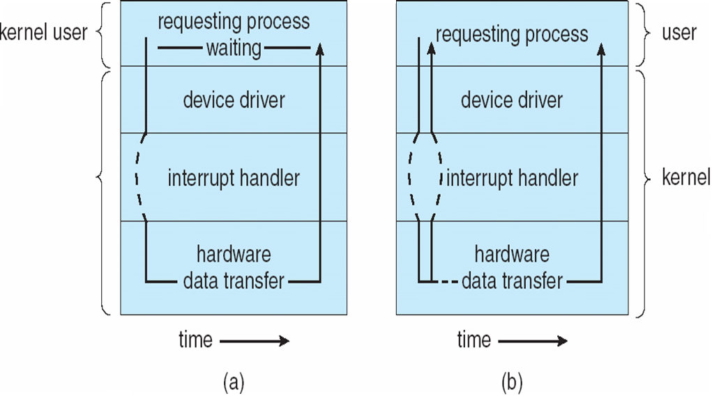
Two I/O Methods
Synchronous
Asynchronous

Slide 27
3. Kernel I/O Subsystem
Scheduling
  Some I/O request ordering via per-device queue
  Some OSs try fairness
Buffering - store data in memory while transferring between devices
  To cope with device speed mismatch
  To cope with device transfer size mismatch
  To maintain “copy semantics”

Slide 28
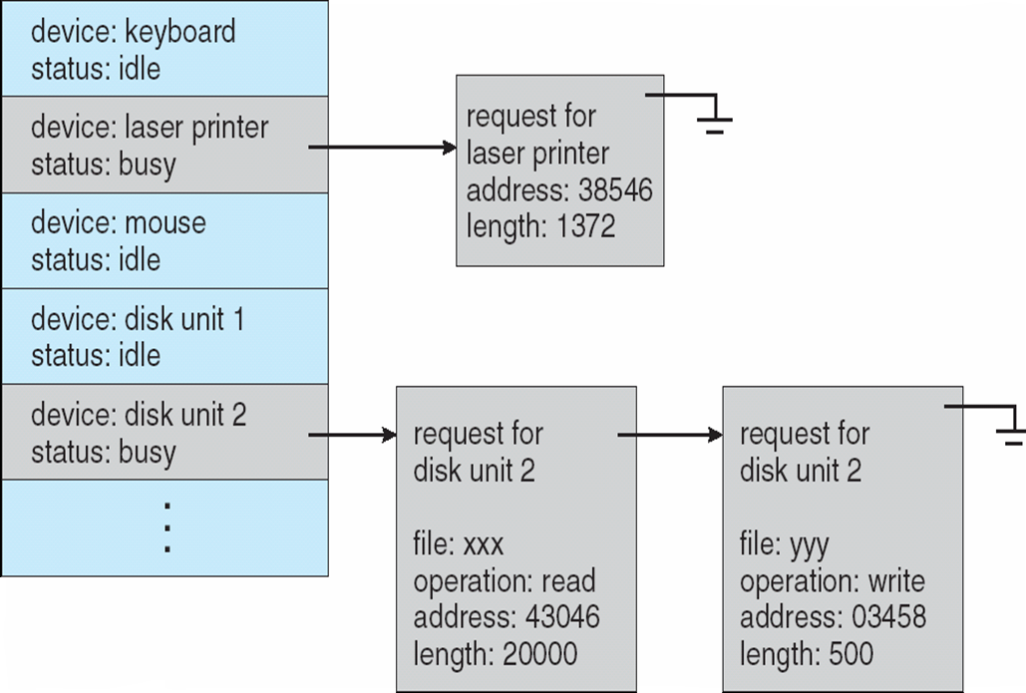
Device-status Table

Slide 29
Kernel I/O Subsystem
Caching - fast memory holding copy of data
  Always just a copy
  Key to performance
Spooling - hold output for a device
  If device can serve only one request at a time
  i.e., Printing
Device reservation - provides exclusive access to a device
  System calls for allocation and deallocation
  Watch out for deadlock

Slide 30
Error Handling
OS can recover from disk read, device unavailable, transient write failures
Most return an error number or code when I/O request fails
System error logs hold problem reports

Slide 31
I/O Protection
User process may accidentally or purposefully attempt to disrupt normal operation via illegal I/O instructions
  All I/O instructions defined to be privileged
  I/O must be performed via system calls
    Memory-mapped and I/O port memory locations must be protected too

Slide 32
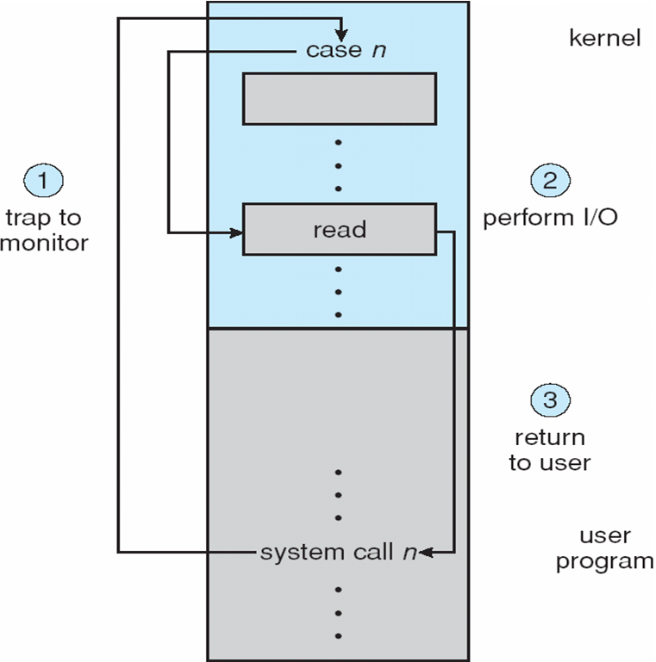
Use of a System Call to Perform I/O

Slide 33
Kernel Data Structures
Kernel keeps state info for I/O components, including open file tables, network connections, character device state
Many, many complex data structures to track buffers, memory allocation, “dirty” blocks
Some use object-oriented methods and message passing to implement I/O

Slide 34
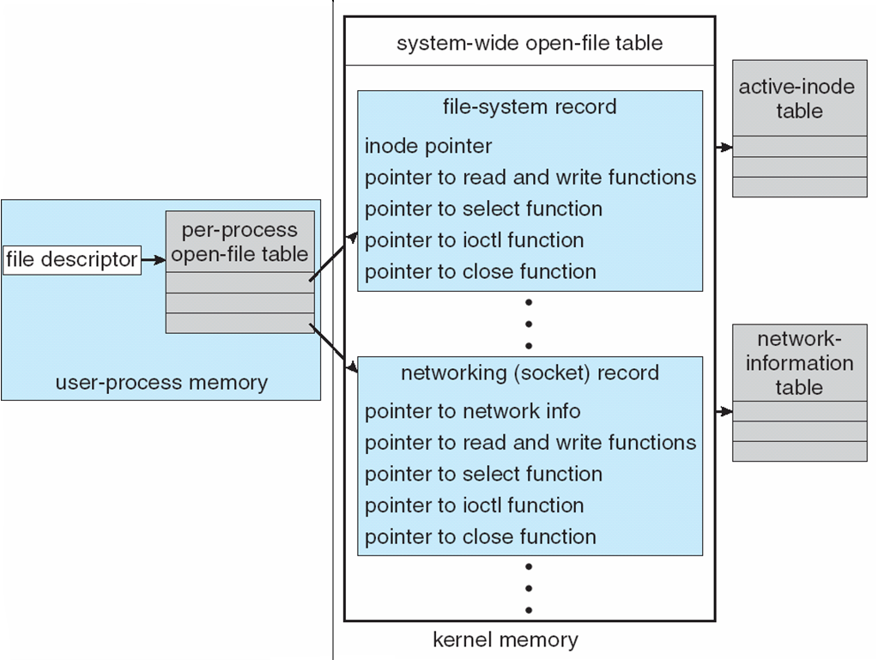
UNIX I/O Kernel Structure

Slide 35
4. Transforming I/O Requests to Hardware Operations
Consider reading a file from disk for a process:
  Determine device holding file
  Translate name to device representation
  Physically read data from disk into buffer
  Make data available to requesting process
  Return control to process

Slide 36
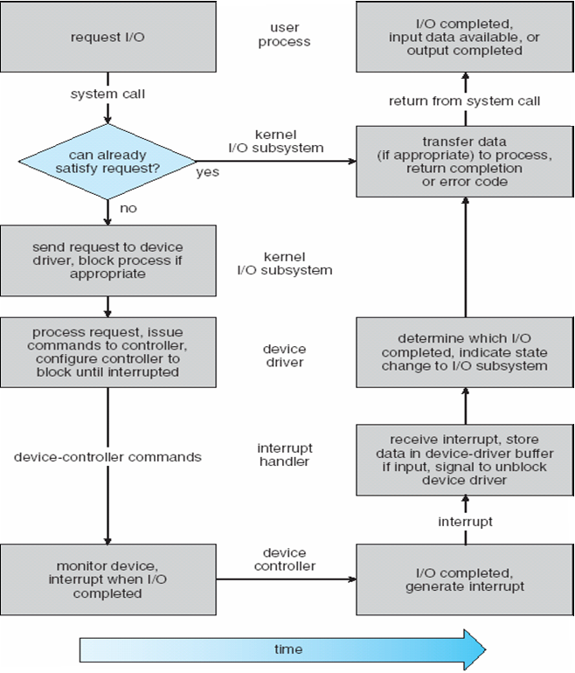
Life Cycle of An I/O Request

Slide 37
END OF
Unit-5: Part-1

