Slide 1
II-B.E. IV-SEMESTER
Operating Systems
(OS)
Presented By
Dr. D. BASWARAJ
Professor, CSE DEPT.
VCE, HYDERABAD

Slide 2
SYLLABUS …
UNIT – V:
I/O System: I/O hardware, Application I/O Interface, Kernel I/O Subsystem, Transforming I/O request to hardware operation.
Protection: Goals of protection, Principles of protection, Domain of protection, Access matrix, Implementation of Access matrix
Case Studies: Linux System: Design Principles, Kernel Modules, Process Management, Scheduling Windows - Design Principles, System components ,File system Android: Architecture, Activity and Service life cycle.

Slide 3
UNIT-V
PART-1: I/O System
  I/O hardware
  Application I/O Interface
  Kernel I/O Subsystem
  Transforming I/O request to hardware operation
PART-2: Protection
  Goals of protection
  Principles of protection
  Domain of protection
  Access matrix
  Implementation of Access matrix
PART-3: Case Studies
  Linux System: Design Principles, Kernel Modules, Process Management, Scheduling
  Windows: Design Principles, System components ,File system
  Android: Architecture, Activity and Service life cycle.

Slide 4
1. Goals of Protection
Operating system consists of a collection of objects, hardware or software
Each object has a unique name and can be accessed through a well-defined set of operations
Protection problem - ensure that each object is accessed correctly and only by those processes that are allowed to do so

Slide 5
2. Principles of Protection
Guiding principle – principle of least privilege
  Programs, users and systems should be given just enough privileges to perform their tasks
  Limits damage if entity has a bug, gets abused
  Can be static (during life of system, during life of process)
  Or dynamic (changed by process as needed) – domain switching, privilege escalation
  “Need to know” a similar concept regarding access to data

Slide 6
Principles of Protection…
Must consider “grain” aspect
  Rough-grained privilege management easier, simpler, but least privilege now done in large chunks
    For example, traditional Unix processes either have abilities of the associated user, or of root
  Fine-grained management more complex, more overhead, but more protective
    File ACL lists
Domain can be user, process, procedure

Slide 7

3. Domain of Protection
Domain Structure:
Access-right = <object-name, rights-set>
where rights-set is a subset of all valid operations that can be performed on the object.
Domain = set of access-rights
System consists of 2 domains: i. User and ii. Supervisor

Slide 8
Domain Implementation (UNIX)
Domain = user-id
Domain switch accomplished via file system
    Each file has associated with it a domain bit (setuid bit)
    When file is executed and setuid = on, then user-id is set to owner of the file being executed
    When execution completes user-id is reset
Domain switch accomplished via passwords
  su command temporarily switches to another user’s domain when other domain’s password provided
Domain switching via commands
  sudo command prefix executes specified command in another domain (if original domain has privilege or password given)

Slide 9

Domain Implementation (MULTICS)
Multics ("Multiplexed Information and Computing Service") is an influential early time-sharing operating system based on the concept of a single-level memory.
Let D_{i} and D_{j} be any two domain rings
If j < i ⇒ D_{i} ⊆ D_{j}

Slide 10
Domain Implementation (MULTICS)…
Multics Benefits and Limits:
If j < i ⇒ D_{i} Ring / hierarchical structure provided more than the basic kernel / user or root / normal user design
Fairly complex -> more overhead
But does not allow strict need-to-know
  Object accessible in D_{j} but not in D_{i}, then j must be < i
  But then every segment accessible in D_{i} also accessible in D_{j}

Slide 11

4. Access Matrix
It is used for the implementation of protection model.
Rows represent domains, Columns represent objects
Each cell Access(i, j) represent the set of operations (i.e. set of access rights) that a process executing in Domain_{i} can invoke on Object_{j}
For instance, in following access matrix, the process in domain D₁ able to read both files F₁ and F₃.

Slide 12
Use of Access Matrix
If a process in Domain D_{i} tries to do “op” on object O_{j}, then “op” must be in the access matrix
User who creates object can define access column for that object
Can be expanded to dynamic protection
  Operations to add, delete access rights
  Special access rights:
    owner of O_{i}
    copy op from O_{i} to O_{j} (denoted by “*”)
    control – D_{i} can modify D_{j} access rights
    transfer – switch from domain D_{i} to D_{j}
  Copy and Owner applicable to an object
  Control applicable to domain object

Slide 13
Use of Access Matrix…
Access matrix design separates mechanism from policy
  Mechanism
    Operating system provides access-matrix + rules
    If ensures that the matrix is only manipulated by authorized agents and that rules are strictly enforced
  Policy
    User dictates policy
    Who can access what object and in what mode
But doesn’t solve the general confinement problem

Slide 14

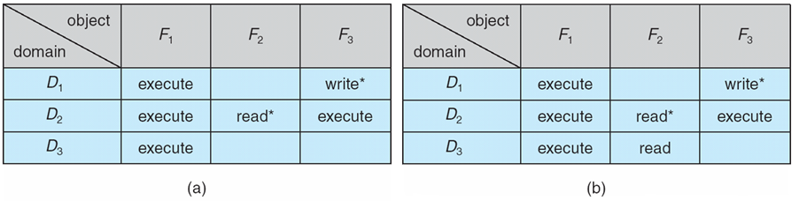
Example: Access Matrix with Domains as Objects
Access Matrix with Copy Rights

Slide 15
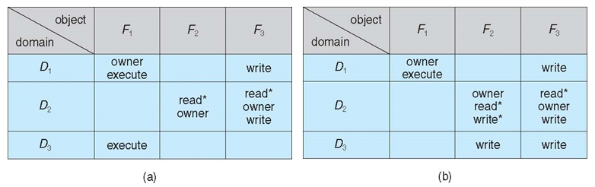

Access Matrix With Owner Rights
Modified Access Matrix

Slide 16
5. Implementation of Access Matrix
Access matrix will be generally a sparse matrix and implemented in following ways:
  Global Table
  Access Lists for Objects
  Capability Lists for Domains
  A Lock Key Mechanism
Global Table:
Set of ordered triple <domain, object, rights-set> in a global table.
A requested operation M on object Oj within domain Di, search table for <Di, Oj, Rk>, where M ϵRk.
But table could be large. So will not be fit in memory. (Difficult to group objects).

Slide 17
Implementation of Access Matrix…
Access Lists for Objects:
Each column implemented as an access list for one object.
For example:
Domain D1 – Read
Domain D4 – Read, write, execute
Domain D5 – Read, Write, Delete, copy
Resulting per-object list consisting of ordered pairs <domain, rights-set>, defining all domains with non-empty set of access rights for the objects.
We search the access list for object Oj, looking for an entry <Di, Rk>, where M ϵ Rk. If the entry found, we allow the operation, otherwise we check the default list.
If M is in the default set, we allow the access, otherwise access is denied, and an exception condition occur.
For efficiency, default set can be checked first and then search the access list.

Slide 18
Implementation of Access Matrix…
Capability Lists:
A capability list for a domain is a list of objects together with the operations allowed on those objects
For example:
Object F1 – Read
Object F4 – Read, write, execute
Object F5 – Read, Write, Delete, copy
An object is often represented by its physical name or address, called a capability.
To execute operation M on object Oj, the process executes the operation M, specifying the capability (or pointer) for object Oj as a parameter.
Simple possession of the capability means the access is allowed.

Slide 19
Implementation of Access Matrix…
Lock-Key Mechanism:
Compromise between access lists and capability lists.
Each object has list of unique bit patterns, called locks.
Each domain has list of unique bit patterns, called keys.
Process in a domain can only access object, if domain has key that matches one of the locks of the object.
Simple possession of the capability means the access is allowed.
This method is effective and flexible, keys can be passed freely from domain to domain, easy revocation by changing locks.

Slide 20
END OF
Unit-5: Part-2

