Slide 1
II-B.E. IV-SEMESTER
Operating Systems
(OS)
Presented By
Dr. D. BASWARAJ
Professor, CSE DEPT.
VCE, HYDERABAD

Slide 2
SYLLABUS …
UNIT – V:
I/O System: I/O hardware, Application I/O Interface, Kernel I/O Subsystem, Transforming I/O request to hardware operation.
Protection: Goals of protection, Principles of protection, Domain of protection, Access matrix, Implementation of Access matrix
Case Studies: Linux System: Design Principles, Kernel Modules, Process Management, Scheduling Windows - Design Principles, System components ,File system Android: Architecture, Activity and Service life cycle.

Slide 3
UNIT-V
PART-1: I/O System
  I/O hardware
  Application I/O Interface
  Kernel I/O Subsystem
  Transforming I/O request to hardware operation
PART-2: Protection
  Goals of protection
  Principles of protection
  Domain of protection
  Access matrix
  Implementation of Access matrix
PART-3: Case Studies
  Linux System: Design Principles, Kernel Modules, Process Management, Scheduling
  Windows: Design Principles, System components ,File system
  Android: Architecture, Activity and Service life cycle.

Slide 4
1. Linux Operating Systems
Linux is a modern, free operating system based on UNIX standards.
First developed as a small but self-contained kernel in 1991 by Linus Torvalds, with the major design goal of UNIX compatibility, released as open source.
The core Linux operating system kernel is entirely original, but it can run much existing free UNIX software, resulting in an entire UNIX-compatible operating system free from proprietary code
Linux system has many, varying Linux distributions including the kernel, applications, and management tools.
The families and representative distributions we are using are:
  Red Hat Family Systems (including CentOS and Fedora)
  SUSE Family Systems (including openSUSE)
  Debian Family Systems (including Ubuntu and Linux Mint).

Slide 5
Linux Operating Systems…
Linux uses many tools developed as part of Berkeley’s BSD operating system, MIT’s X Window System, and the Free Software Foundation's GNU project
The Linux system is maintained by a loose network of developers collaborating over the Internet, with a small number of public ftp sites acting as de facto standard repositories
The Linux kernel is distributed under the GNU General Public License (GPL), the terms of which are set out by the Free Software Foundation
  Not public domain, in that not all rights are waived
Anyone using Linux, or creating their own derivative of Linux, may not make the derived product proprietary; software released under the GPL may not be redistributed as a binary-only product
  Can sell distributions but must offer the source code too.

Slide 6
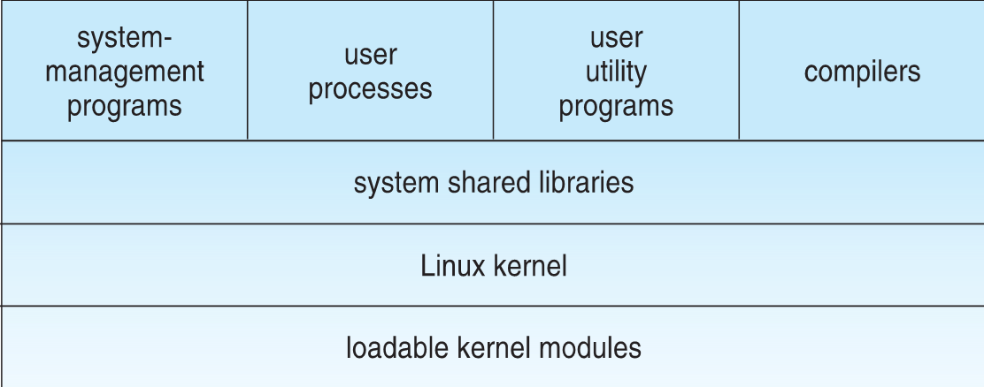
Design Principles
Linux is a multiuser, multitasking system with a full set of UNIX-compatible tools.
Its file system adheres to traditional UNIX semantics, and it fully implements the standard UNIX networking model
Main design goals are speed, efficiency, and standardization.
Components of a Linux System:

Slide 7
Design Principles…
The kernel is responsible for maintaining the important abstractions of the operating system
  Kernel code executes in kernel mode with full access to all the physical resources of the computer
  All kernel code and data structures are kept in the same single address space
The system libraries define a standard set of functions through which applications interact with the kernel, and which implement much of the operating-system functionality that does not need the full privileges of kernel code
The system utilities perform individual specialized management tasks
User-mode programs are rich and varied, including multiple shells like the bourne-again (bash), C-Shell (csh).

Slide 8
Kernel Modules
Sections of kernel code that can be compiled, loaded, and unloaded independent of the rest of the kernel.
A kernel module may typically implement a device driver, a file system, or a networking protocol
The module interface allows third parties to write and distribute, on their own terms, device drivers or file systems that could not be distributed under the GPL.
Kernel modules allow a Linux system to be set up with a standard, minimal kernel, without any extra device drivers built in.
Four components to Linux module support:
  module-management system
  module loader and unloader
  driver-registration system
  conflict-resolution mechanism

Slide 9
Kernel Modules…
Module Management:
Supports loading modules into memory and letting them talk to the rest of the kernel
Module loading is split into two separate sections:
  Managing sections of module code in kernel memory
  Handling symbols that modules are allowed to reference
The module requestor manages loading requested, but currently unloaded, modules; it also regularly queries the kernel to see whether a dynamically loaded module is still in use and will unload it when it is no longer actively needed.

Slide 10
Kernel Modules…
Driver Registration:
Allows modules to tell the rest of the kernel that a new driver has become available
The kernel maintains dynamic tables of all known drivers, and provides a set of routines to allow drivers to be added to or removed from these tables at any time
Registration tables include the following items:
  Device drivers
  File systems
  Network protocols
  Binary format

Slide 11
Kernel Modules…
Conflict Resolution:
A mechanism that allows different device drivers to reserve hardware resources and to protect those resources from accidental use by another driver.
The conflict resolution module aims to:
  Prevent modules from clashing over access to hardware resources
  Prevent autoprobes from interfering with existing device drivers
  Resolve conflicts with multiple drivers trying to access the same hardware:
    Kernel maintains list of allocated HW resources
    Driver reserves resources with kernel database first
    Reservation request rejected if resource not available

Slide 12
Process Management
UNIX process management separates the creation of processes and the running of a new program into two distinct operations.
  The fork() system call creates a new process
  A new program is run after a call to exec()
Under UNIX, a process encompasses all the information that the operating system must maintain to track the context of a single execution of a single program
Under Linux, process properties fall into three groups: the process’s identity, environment, and context.
Process Identity:
Process ID (PID) - The unique identifier for the process; used to specify processes to the operating system when an application makes a system call to signal, modify, or wait for another process
Credentials - determine the process’s rights to access system resources and files.

Slide 13
Process Management…
Namespace – Specific view of file system hierarchy
  Most processes share common namespace and operate on a shared file-system hierarchy
  But each can have unique file-system hierarchy with its own root directory and set of mounted file systems
Process Environment:
The process’s environment is inherited from its parent, and is composed of two null-terminated vectors:
  The argument vector lists the command-line arguments used to invoke the running program; conventionally starts with the name of the program itself.
  The environment vector is a list of “NAME=VALUE” pairs that associates named environment variables with arbitrary textual values.

Slide 14
Process Management…
Passing environment variables among processes and inheriting variables by a process’s children are flexible means of passing information to components of the user-mode system software.
The environment-variable mechanism provides a customization of the operating system that can be set on a per-process basis, rather than being configured for the system as a whole.
Process Context:
The (constantly changing) state of a running program at any point in time.
The scheduling context is the most important part of the process context; it is the information that the scheduler needs to suspend and restart the process
The kernel maintains accounting information about the resources currently being consumed by each process, and the total resources consumed by the process in its lifetime so far.

Slide 15
Scheduling
The job of allocating CPU time to different tasks within an operating system
While scheduling is normally thought of as the running and interrupting of processes, in Linux, scheduling also includes the running of the various kernel tasks
Running kernel tasks encompasses both tasks that are requested by a running process and tasks that execute internally on behalf of a device driver
As of 2.5, new scheduling algorithm – preemptive, priority-based, known as O(1)
  Real-time range
  nice value
  Had challenges with interactive performance
2.6 introduced Completely Fair Scheduler (CFS).

Slide 16
Scheduling…
Completely Fair Scheduler (CFS): Eliminates traditional, common idea of time slice.
Instead, all tasks allocated portion of processor’s time, CFS calculates how long a process should run as a function of total number of tasks.
N runnable tasks means each gets 1/N of processor’s time. Then weights each task with its nice value
  Smaller nice value -> higher weight (higher priority)
Then each task run with for time proportional to task’s weight divided by total weight of all runnable tasks
Configurable variable target latency is desired interval during which each task should run at least once
  Consider simple case of 2 runnable tasks with equal weight and target latency of 10ms – each then runs for 5ms
    If 10 runnable tasks, each runs for 1ms
    Minimum granularity ensures each run has reasonable amount of time (which violates fairness idea)

Slide 17
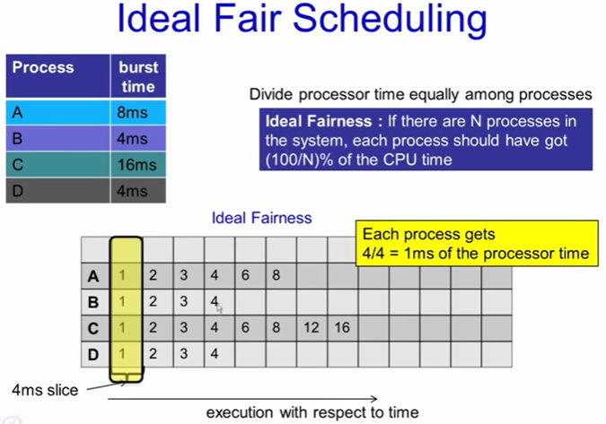
Scheduling…
Completely Fair Scheduler (CFS)…

Slide 18
Scheduling…
CFS is similar as IFS, instead it priorities each process according to there virtual run able time.
Idea behind CFS –
  Each run able process have a virtual time associated with it in PCB (process control block).
  Whenever a context switch happens(or at every scheduling point) then current running process virtual time is increased by virtualruntime_currprocess += T. where T is time for which it is executed recently.
  Runtime for the process therefore monotonically increases.
So initially every process have some starting virtual time.
CFS is quite simple algorithm for the process scheduling, and it is implemented using Red Black Trees (RBT) and not queues.
So, all the process which are on main memory are inserted into RBT and whenever a new process comes it is inserted into the tree.

Slide 19
2. Windows Operating Systems
The WIN OS refers to a family of OS developed by Microsoft Corporation. We look at the history of Windows OS.
  MS-DOS – MICROSOFT DISK OPERATING SYSTEM (1981)
  WINDOWS 1.0 – 2.0 (1985-1992)
  WINDOWS 3.0 – 3.1 (1990-1994)
  WINDOWS 95 (AUGUST 1995)
  WINDOWS New Technology (NT) 3.1 – 4.0 (1993 – 1996)
  WINDOWS 98 (JUNE 1998)
  WINDOWS Millennium Edition (ME) – (SEPTEMBER 2000)
  WINDOWS 2000 (FEBRUARY 2000)
  WINDOWS XP (OCTOBER 2001)
  WINDOWS VISTA (NOVEMBER 2006)
  WINDOWS 7 (OCTOBER 2009)
  WINDOWS 8 (AUGUST 2021)
  WINDOWS 10 (JULY 2015)
  WINDOWS 11 (October 4, 2021)

Slide 20
Windows Operating Systems…
Windows-7 is a 32-bit preemptive multitasking operating system for Intel microprocessors.
Key goals for the system:
  Portability, security
  POSIX (Portable Operating System Interface) compliance
  multiprocessor support, extensibility
  international support
  compatibility with MS-DOS and MS-Windows applications.
Uses a micro-kernel architecture
Available in six client versions, Starter, Home Basic, Home Premium, Professional, Enterprise and Ultimate. Apart from Starter edition (32-bit only) all are available in both 32-bit and 64-bit.
Available in three server versions (all 64-bit only), Standard, Enterprise and Datacenter

Slide 21
Design Principles
Portability — Windows 7 can be moved from one hardware architecture to another with relatively few changes
  Written in C and C++
  Processor-specific portions are written in assembly language for a given processor architecture (small amount of such code).
  Platform-dependent code is isolated in a dynamic link library (DLL) called the “hardware abstraction layer” (HAL)
Reliability — Windows 7 uses hardware protection for virtual memory, and software protection mechanisms for operating system resources
Compatibility — applications that follow the IEEE 1003.1 (POSIX) standard can be complied to run on 7 without changing the source code

Slide 22
Design Principles…
Performance — Windows 7 subsystems can communicate with one another via high-performance message passing
  Preemption of low priority threads enables the system to respond quickly to external events
  Designed for symmetrical multiprocessing
International support — supports different locales via the national language support (NLS) API
Extensibility — layered architecture
  Protected mode — hardware abstraction layer (HAL), kernel, executive
  User mode — collection of subsystems
    Environmental subsystems emulate different operating systems
    Protection subsystems provide security functions

Slide 23
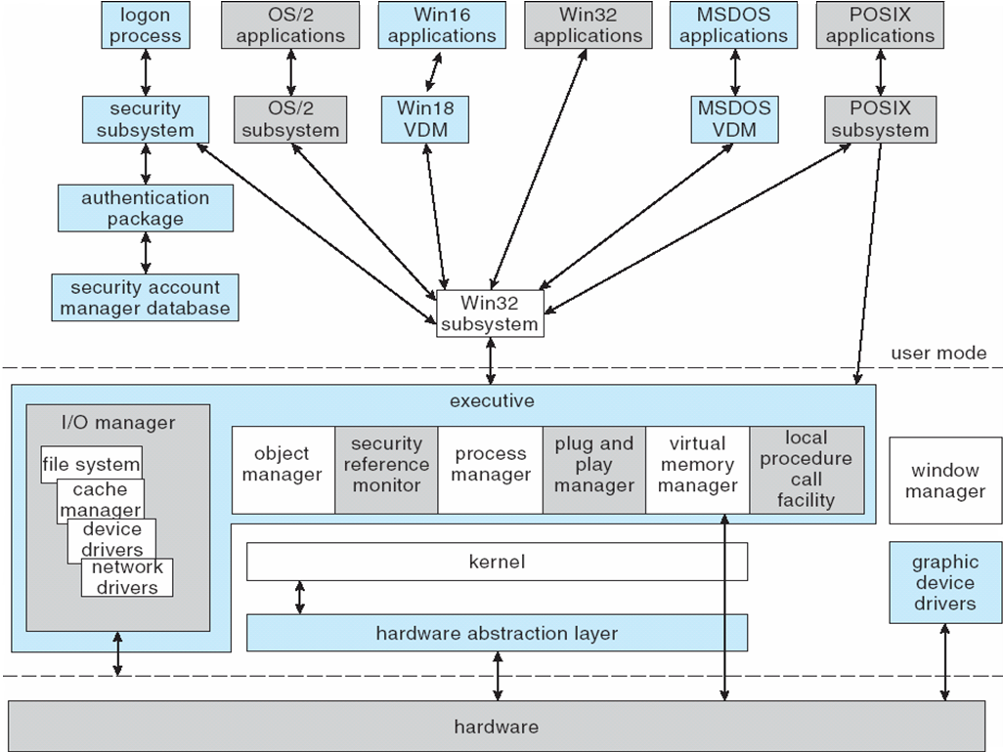
Design Principles…
Depiction of Windows 7 Architecture:

Slide 24
System Components — Kernel
Foundation for the executive and the subsystems
Never paged out of memory; execution is never preempted
Four main responsibilities:
  thread scheduling
  interrupt and exception handling
  low-level processor synchronization
  recovery after a power failure
Kernel is object-oriented, uses two sets of objects
  dispatcher objects control dispatching and synchronization (events, mutants, mutexes, semaphores, threads and timers)
  control objects (asynchronous procedure calls, interrupts, power notify, power status, process and profile objects)

Slide 25
System Components — Kernel
Process and Threads: The process has a virtual memory address space, information (such as a base priority), and an affinity for one or more processors.
Threads are the unit of execution scheduled by the kernel’s dispatcher.
Each thread has its own state, including a priority, processor affinity, and accounting information.
A thread can be one of six states: ready, standby, running, waiting, transition, and terminated.
Scheduling: The dispatcher uses a 32-level priority scheme to determine the order of thread execution.
  Priorities are divided into two classes
    The real-time class contains threads having priorities from 16 to 31
    The variable class contains threads having priorities from 0 to 15

Slide 26
System Components — Kernel
Characteristics of Windows 7’s priority strategy
  Trends to give very good response times to interactive threads that are using the mouse and windows
  Enables I/O-bound threads to keep the I/O devices busy
  Complete-bound threads soak up the spare CPU cycles in the background
Scheduling can occur when a thread enters the ready or wait state, when a thread terminates, or when an application changes a thread’s priority or processor affinity
Real-time threads are given preferential access to the CPU; but 7 does not guarantee that a real-time thread will start to execute within any particular time limit .
  This is known as soft realtime.

Slide 27
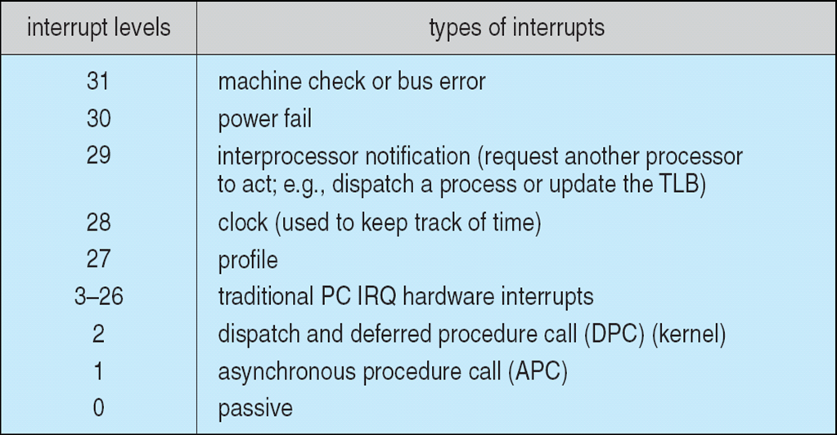
Kernel — Trap Handling
The kernel provides trap handling when exceptions and interrupts are generated by hardware of software.
Exceptions that cannot be handled by the trap handler are handled by the kernel's exception dispatcher.
The interrupt dispatcher in the kernel handles interrupts by calling either an interrupt service routine or an internal kernel routine.
The kernel uses spin locks that reside in global memory to achieve multiprocessor mutual exclusion.

Slide 28
System Components — Executive
Executive – Object Manager
Windows 7 uses objects for all its services and entities; the object manger supervises the use of all the objects
  Generates an object handle
  Checks security
  Keeps track of which processes are using each object
Objects are manipulated by a standard set of methods, namely create, open, close, delete, query name, parse and security.
Executive — Naming Objects
The Windows 7 executive allows almost any object to be given a name, which may be either permanent or temporary. Exceptions are process, thread and some others object types.
Object names are structured like file path names in MS-DOS and UNIX.

Slide 29
System Components — Executive
Windows 7 implements a symbolic link object, which is like symbolic links in UNIX that allow multiple nicknames or aliases to refer to the same file.
A process gets an object handle by creating an object by opening an existing one, by receiving a duplicated handle from another process, or by inheriting a handle from a parent process.
Each object is protected by an access control list.
Executive — Virtual Memory Manager
The design of the VM manager assumes that the underlying hardware supports virtual to physical mapping a paging mechanism, transparent cache coherence on multiprocessor systems, and virtual addressing aliasing.
The VM manager in Windows 7 uses a page-based management scheme with a page size of 4 KB.

Slide 30
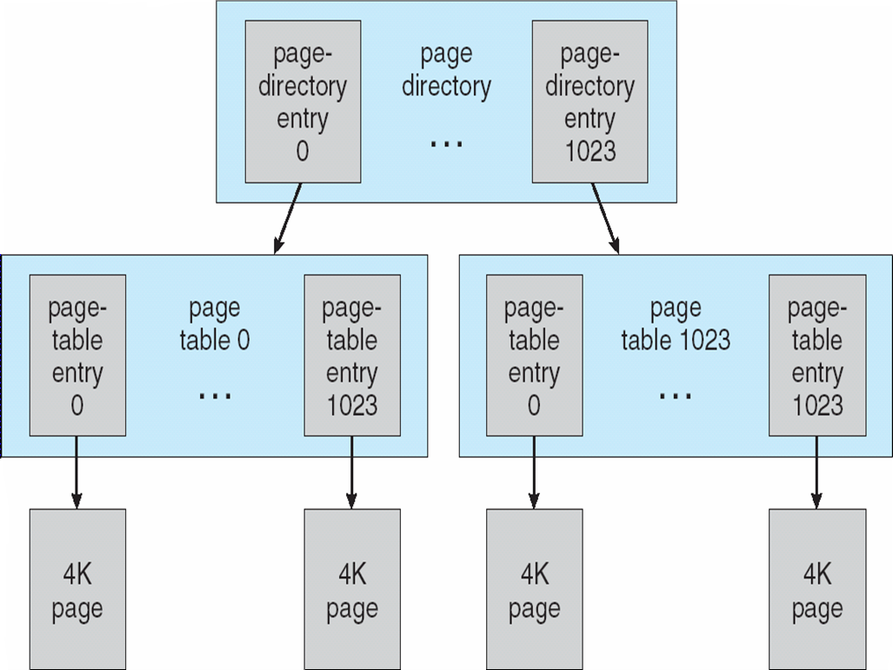
System Components — Executive
The Windows 7 VM manager uses a two-step process to allocate memory
  The first step reserves a portion of the process’s address space
  The second step commits the allocation by assigning space in the system’s paging file(s)
Virtual-Memory Layout:

Slide 31
System Components — Executive
The virtual address translation in Windows 7 uses several data structures
  Each process has a page directory that contains 1024 page directory entries of size 4 bytes.
  Each page directory entry points to a page table which contains 1024 page table entries (PTEs) of size 4 bytes.
  Each PTE points to a 4 KB page frame in physical memory.
A 10-bit integer can represent all the values form 0 to 1023, therefore, can select any entry in the page directory, or in a page table.
This property is used when translating a virtual address pointer to a bye address in physical memory.
A page can be in one of six states: valid, zeroed, free standby, modified and bad.

Slide 32
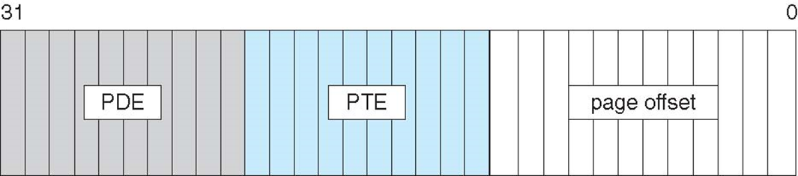
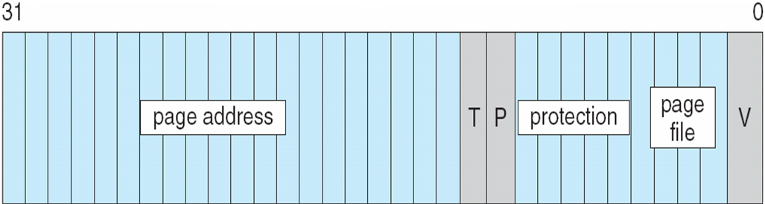
System Components — Executive
Virtual-to-Physical Address Translation:
10 bits for page directory entry, 20 bits for page table entry, and 12 bits for byte offset in page.
Page File Page-Table Entry:
5 bits for page protection, 20 bits for page frame address, 4 bits to select a paging file, and 3 bits that describe the page state. V = 0.

Slide 33
System Components — Executive
Executive – Process Manager
Provides services for creating, deleting, and using threads and processes
Issues such as parent/child relationships or process hierarchies are left to the environmental subsystem that owns the process.
Executive — Local Procedure Call Facility
The LPC passes requests and results between client and server processes within a single machine.
In particular, it is used to request services from the various Windows 7 subsystems.

Slide 34
System Components — Executive
When a LPC channel is created, one of three types of message passing techniques must be specified.
  First type is suitable for small messages, up to 256 bytes; port's message queue is used as intermediate storage, and the messages are copied from one process to the other.
  Second type avoids copying large messages by pointing to a shared memory section object created for the channel.
  Third method, called quick LPC was used by graphical display portions of the Win32 subsystem.
Executive — I/O Manager
The I/O manager is responsible for
  file systems
  cache management
  device drivers
  network drivers

Slide 35
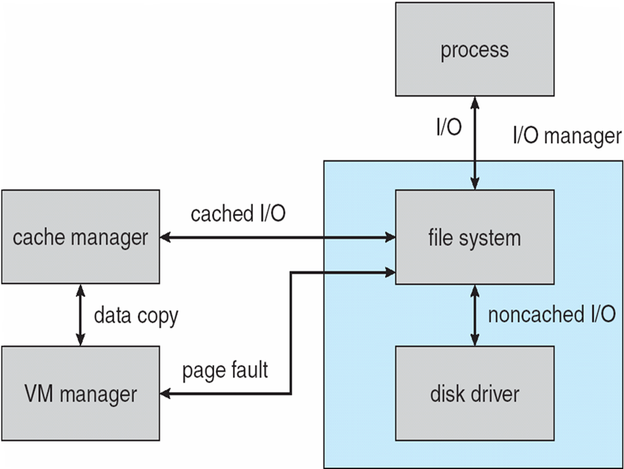
System Components — Executive
Keeps track of which installable file systems are loaded, and manages buffers for I/O requests
Works with VM Manager to provide memory-mapped file I/O
Controls the Windows 7 cache manager, which handles caching for the entire I/O system
Supports both synchronous & asynchronous operations, provides time outs for drivers, and has mechanisms for one driver to call another.
File I/O:

Slide 36
System Components — Executive
Executive – Plug-and-Play Manager
Plug-and-Play (PnP) manager is used to recognize and adapt to changes in the hardware configuration.
When new devices are added (for example, PCI or USB), the PnP manager loads the appropriate driver.
The manager also keeps track of the resources used by each device.
System Components — Environmental Subsystems:
User-mode processes layered over the native Windows 7 executive services to enable 7 to run programs developed for other OS.
Windows 7 uses the Win32 subsystem as the main operating environment; Win32 is used to start all processes.
It also provides all the keyboard, mouse and graphical display capabilities.

Slide 37
System Components — Environmental Subsystems
MS-DOS environment is provided by a Win32 application called the virtual dos machine (VDM), a user-mode process that is paged and dispatched like any other Windows 7 thread.
16-Bit Windows Environment:
  Provided by a VDM that incorporates Windows on Windows
  Provides the Windows 3.1 kernel routines and sub routines for window manager and GDI functions
The POSIX subsystem is designed to run POSIX applications following the POSIX.1 standard which is based on the UNIX model.
OS/2 subsystems runs OS/2 applications
Logon and Security Subsystems authenticates users logging on to Windows 7 systems
  Users are required to have account names and passwords.
  The authentication package authenticates users when they attempt to access
  Windows 7 uses Kerberos as the default authentication package

Slide 38
File System
The fundamental structure of the Windows 7 file system (NTFS – New Technology File System) is a volume
  Created by the Windows 7 disk administrator utility
  Based on a logical disk partition
  May occupy a portions of a disk, an entire disk, or span across several disks
All metadata, such as information about the volume, is stored in a regular file
NTFS uses clusters as the underlying unit of disk allocation
  A cluster is a number of disk sectors that is a power of two
  Because the cluster size is smaller than for the 16-bit FAT file system, the amount of internal fragmentation is reduced.

Slide 39
File System — Internal Layout
NTFS uses logical cluster numbers (LCNs) as disk addresses
A file in NTFS is not a simple byte stream, as in MS-DOS or UNIX, rather, it is a structured object consisting of attributes
Every file in NTFS is described by one or more records in an array stored in a special file called the Master File Table (MFT)
Each file on an NTFS volume has a unique ID called a file reference.
64-bit quantity that consists of a 48-bit file number and a 16-bit sequence number
Can be used to perform internal consistency checks
The NTFS name space is organized by a hierarchy of directories; the index root contains the top level of the B+ tree

Slide 40
File System — Recovery
All file system data structure updates are performed inside transactions that are logged.
  Before a data structure is altered, the transaction writes a log record that contains redo and undo information.
  After the data structure has been changed, a commit record is written to the log to signify that the transaction succeeded.
  After a crash, the file system data structures can be restored to a consistent state by processing the log records.
This scheme does not guarantee that all the user file data can be recovered after a crash, just that the file system data structures (the metadata files) are undamaged and reflect some consistent state prior to the crash.
The log is stored in the third metadata file at the beginning of the volume.
The logging functionality is provided by the Windows 7 log file service.

Slide 41
File System — Security
Security of an NTFS volume is derived from the Windows 7 object model.
Each file object has a security descriptor attribute stored in this MFT record.
This attribute contains the access token of the owner of the file, and an access control list that states the access privileges that are granted to each user that has access to the file.
Volume Management and Fault Tolerance:
The log is stored in the third metadata file at the beginning of the volume.
The logging functionality is provided by the Windows 7 log file service.
FtDisk: the fault tolerant disk driver for Windows 7, provides several ways to combine multiple SCSI disk drives into one logical volume

Slide 42
File System — Volume Management and Fault Tolerance
FtDisk: the fault tolerant disk driver for Windows 7, provides several ways to combine multiple SCSI disk drives into one logical volume
Logically concatenate multiple disks to form a large logical volume, a volume set
Interleave multiple physical partitions in round-robin fashion to form a stripe set (also called RAID level 0, or “disk striping”)
Variation: stripe set with parity, or RAID level 5
Disk mirroring, or RAID level 1, is a robust scheme that uses a mirror set — two equally sized partitions on tow disks with identical data contents
To deal with disk sectors that go bad, FtDisk, uses a hardware technique called sector sparing and NTFS uses a software technique called cluster remapping

Slide 43
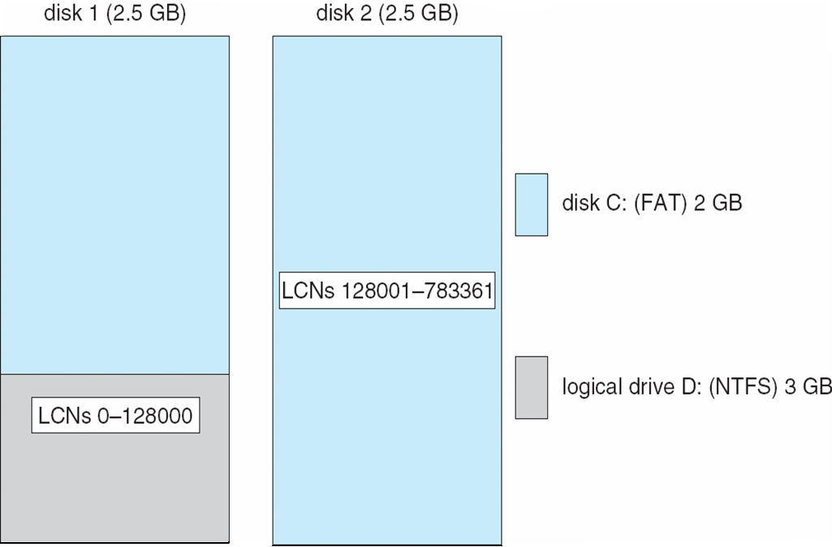
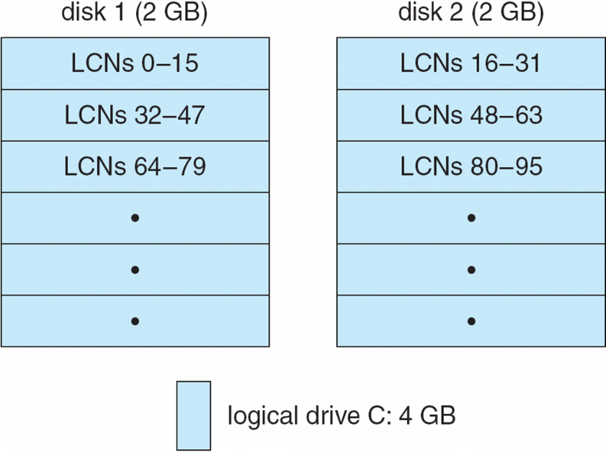
File System — Volume Management and Fault Tolerance
Volume Set On Two Drives:
Stripe Set on Two Drives

Slide 44
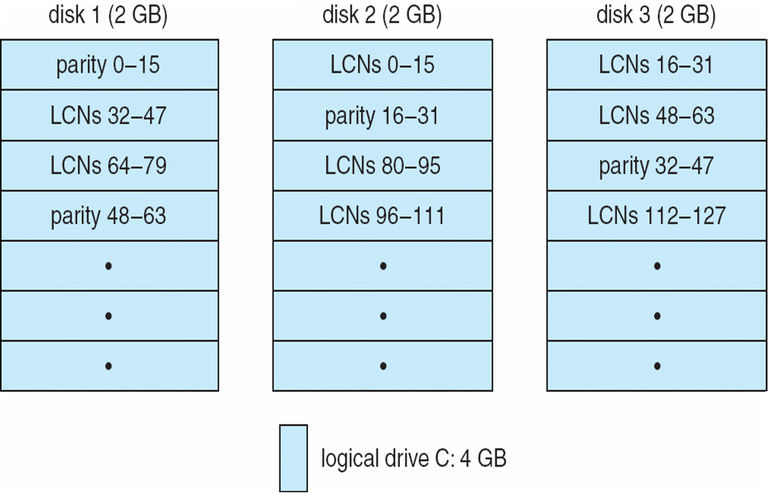
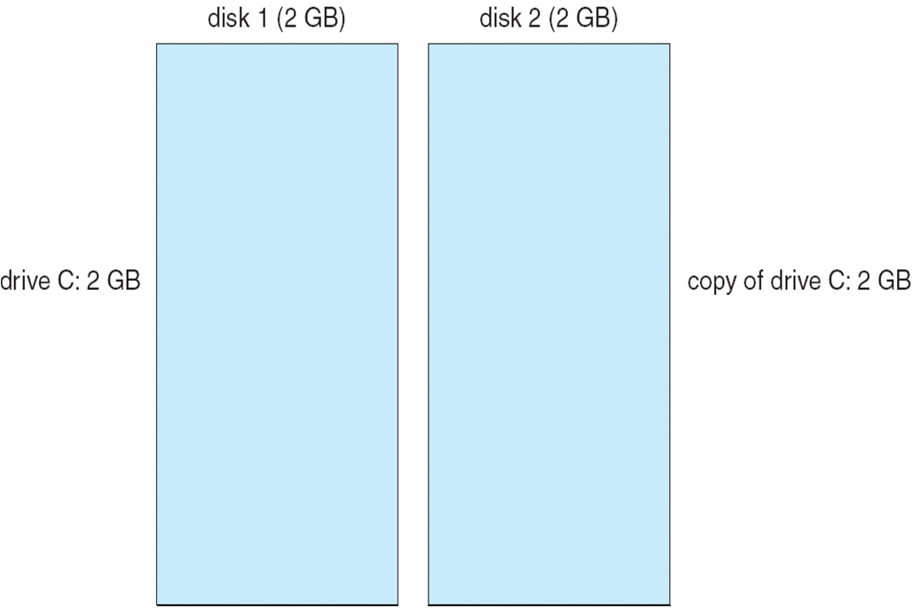
File System — Volume Management and Fault Tolerance
Stripe Set With Parity on Three Drives:
Mirror Set on Two Drives

Slide 45
File System — Compression
To compress a file, NTFS divides the file’s data into compression units, which are blocks of 16 contiguous clusters.
For sparse files, NTFS uses another technique to save space.
  Clusters that contain all zeros are not actually allocated or stored on disk.
  Instead, gaps are left in the sequence of virtual cluster numbers stored in the MFT entry for the file.
  When reading a file, if a gap in the virtual cluster numbers is found, NTFS just zero-fills that portion of the caller’s buffer.
File System — Reparse Points
A reparse point returns an error code when accessed. The reparse data tells the I/O manager what to do next.
Reparse points can be used to provide the functionality of UNIX mounts.
Reparse points can also be used to access files that have been moved to offline storage.

Slide 46
3. Android Operating Systems
Android is an open source & Linux-based operating system for mobile devices like smartphones, tablets etc. Actually, android is a mobile platform consists OS, middleware, and Key Applications.
Android was developed by the Open Handset Alliance, led by Google, and other companies.
Android offers a unified approach to application development for mobile devices which means developers need only develop for Android, and their applications should be able to run on different devices powered by Android.
The first beta version of the Android Software Development Kit (SDK) was released by Google in 2007 whereas the first commercial version, Android 1.0, was released in September 2008.
On June 27, 2012, at the Google I/O conference, Google announced the next Android version, 4.1 Jellybean. Jellybean is an incremental update, with the primary aim of improving the user interface, both in terms of functionality and performance.

Slide 47
Features of Android
Beautiful UI
Connectivity: GSM/EDGE, IDEN, CDMA, EV-DO, UMTS, Bluetooth, Wi-Fi, LTE, NFC and WiMAX.
Storage: SQLite, a lightweight relational database, is used for data storage purposes
Media support: H.263, H.264, MPEG-4 SP, AMR, AMR-WB, AAC, HE-AAC, AAC 5.1, MP3, MIDI, Ogg Vorbis, WAV, JPEG, PNG, GIF, and BMP.
Web browser: Based on the open-source WebKit layout engine, coupled with Chrome's V8 JavaScript engine supporting HTML5 and CSS3.
Multi-tasking: User can jump from one task to another, and same time various application can run simultaneously.
Multi-touch
Wi-Fi Direct: A technology that lets apps discover and pair directly, over a high-bandwidth peer-to-peer connection.
Android Applications developed by languages like Java (SDK) , c, c++ (NDK), .NET (mono android).

Slide 48
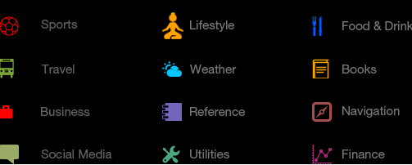
Features of Android…
GCM: Google Cloud Messaging (GCM) is a service that lets developers send short message data to their users on Android devices, without needing a proprietary sync solution.
Android Beam: A popular NFC-based technology that lets users instantly share, just by touching two NFC-enabled phones together.
Web Android Applications:

Slide 49
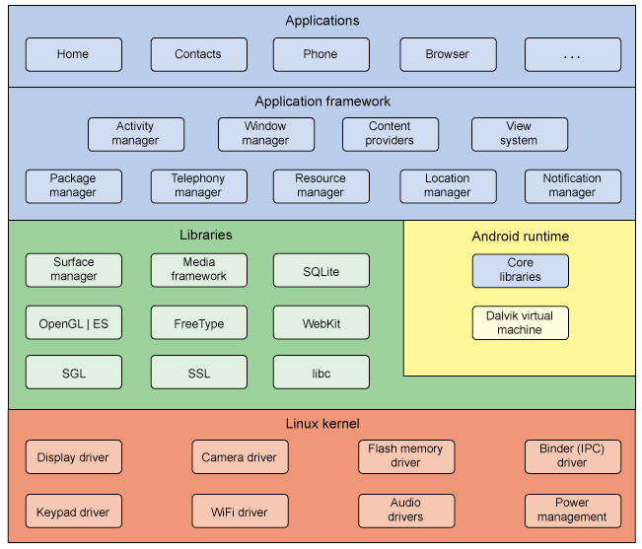
Android - Architecture
Android operating system is a stack of software components which is roughly divided
into five sections and four main layers as shown below in the architecture diagram.

Slide 50
Android – Architecture…
Linux kernel: At the bottom of the layers is Linux - Linux 3.6 with approximately 115 patches.
This provides a level of abstraction between the device hardware and it contains all the essential hardware drivers like camera, keypad, display etc.
Also, the kernel handles all the things that Linux is really good at such as networking and a vast array of device drivers, which take the pain out of interfacing to peripheral hardware.
Libraries: On top of Linux kernel there is a set of libraries including open-source Web browser engine WebKit, well known library libc, SQLite database which is a useful repository for storage and sharing of application data, libraries to play and record audio and video, SSL libraries responsible for Internet security etc..

Slide 51
Android – Architecture…
Android Runtime: This is the third section of the architecture and available on the second layer from the bottom. This section provides a key component called Dalvik Virtual Machine which is a kind of Java Virtual Machine specially designed and optimized for Android.
The Dalvik VM makes use of Linux core features like memory management and multi-threading, which is intrinsic in the Java language. The Dalvik VM enables every Android application to run in its own process, with its own instance of the Dalvik virtual machine.
The Android runtime also provides a set of core libraries which enable Android application developers to write Android applications using standard Java programming language.
Application Framework: The Application Framework layer provides many higher-level services to applications in the form of Java classes. Application developers are allowed to make use of these services in their applications.

Slide 52
Android – Architecture…
The Android framework includes the following key services −
Activity Manager − Controls all aspects of the application lifecycle and activity stack.
Content Providers − Allows applications to publish and share data with other applications.
Resource Manager − Provides access to non-code embedded resources such as strings, color settings and user interface layouts.
Notifications Manager − Allows applications to display alerts and notifications to the user.
View System − An extensible set of views used to create application user interfaces..
Applications: You will find all the Android application at the top layer. You will write your application to be installed on this layer only. Examples of such applications are Contacts Books, Browser, Games etc.

Slide 53
Android – Architecture…
Android Libraries: This category encompasses those Java-based libraries that are specific to Android development. Examples of libraries in this category include the application framework libraries in addition to those that facilitate user interface building, graphics drawing and database access.
Android Runtime: This is the third section of the architecture and available on the second layer from the bottom. This section provides a key component called Dalvik Virtual Machine which is a kind of Java Virtual Machine specially designed and optimized for Android.
The Dalvik VM makes use of Linux core features like memory management and multi-threading, which is intrinsic in the Java language. The Dalvik VM enables every Android application to run in its own process, with its own instance of the Dalvik virtual machine.
The Android runtime also provides a set of core libraries which enable Android application developers to write Android applications using standard Java programming language.

Slide 54
Activity and Service life cycle
Android system initiates its program within an Activity starting with a call on onCreate() callback method.
There is a sequence of callback methods that start up an activity and a sequence of callback methods that tear down an activity
Android Activity Lifecycle
Android Activity Lifecycle is controlled by 7 methods of android.app.Activity class. The android Activity is the subclass of ContextThemeWrapper class.
An activity is the single screen in android. It is like window or frame of Java.
By the help of activity, you can place all your UI components or widgets in a single screen.
The 7-lifecycle method of Activity describes how activity will behave at different states.

Slide 55
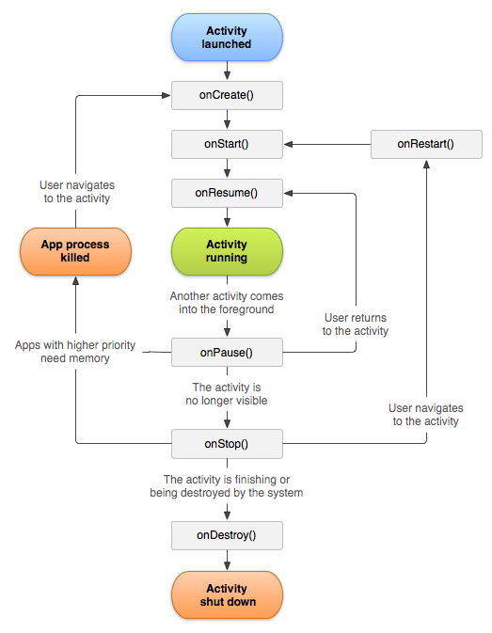
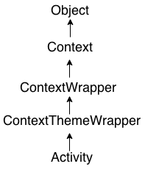
Activity and Service life cycle…

Slide 56
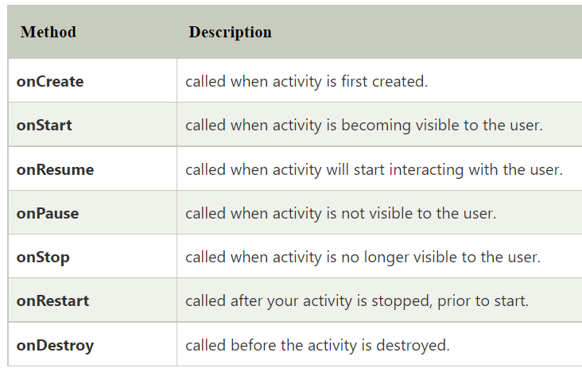
Activity and Service life cycle…
Let's see the 7 lifecycle methods of android activity.

Slide 57
Activity and Service life cycle…
Services:
A service is a component that runs in the background to perform long-running operations without needing to interact with the user and it works even if application is destroyed. A service can essentially take two states
Started: A service is started when an application component, such as an activity, starts it by calling startService().
Bound: A service is bound when an application component binds to it by calling bindService().
A service life cycle:
A service has life cycle callback methods that you can implement to monitor changes in the service's state, and you can perform work at the appropriate stage.

Slide 58
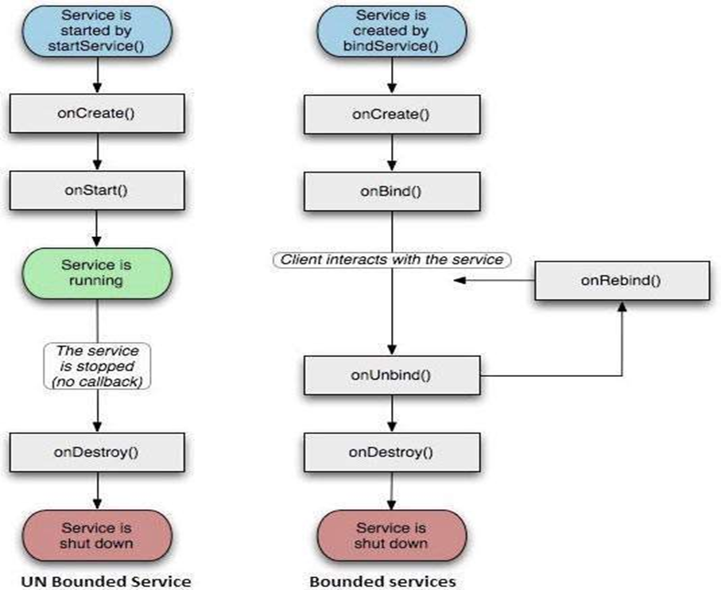
Activity and Service life cycle…
A service life cycle…The following diagram on the left shows the life cycle when the service is created with startService() and the diagram on the right shows the life cycle when the service is created with bindService():

Slide 59
Activity and Service life cycle…
A service life cycle…
onStartCommand(): The system calls this method when another component, such as an activity, requests that the service be started, by calling startService(). If you implement this method, it is your responsibility to stop the service when its work is done, by calling stopSelf() or stopService() methods.
onBind(): The system calls this method when another component wants to bind with the service by calling bindService(). If you implement this method, you must provide an interface that clients use to communicate with the service, by returning an IBinder object. You must always implement this method, but if you don't want to allow binding, then you should return null.
onUnbind(): The system calls this method when all clients have disconnected from a particular interface published by the service.

Slide 60
Activity and Service life cycle…
A service life cycle…
onRebind()
The system calls this method when new clients have connected to the service, after it had previously been notified that all had disconnected in its onUnbind(Intent).
onCreate()
The system calls this method when the service is first created using onStartCommand() or onBind(). This call is required to perform one-time set-up.
onDestroy()
The system calls this method when the service is no longer used and is being destroyed. Your service should implement this to clean up any resources such as threads, registered listeners, receivers, etc.

Slide 61
END OF
Unit-5: Part-3

