Slide 1

Project Title: Seasonal Agriculture Performance Analysis & Predictive Modeling
Student Name: Sathiyamoorthi K
College Name: IFET College of Engineering
AICTE STU ID: STU663c9352627131715245906

Slide 2

PROBLEM STATEMENT
Agricultural activities are influenced by seasonal variations in environmental conditions, farming practices, resource availability and market conditions. As a result, agricultural performance may differ from one season to another. However, raw agricultural data does not clearly explain how agricultural performance changes across seasons or what patterns can be observed in different seasonal conditions. The problem is to analyze the given agricultural dataset and investigate seasonal differences in agricultural performance by identifying meaningful patterns, trends, relationships and variations within the available data.

Slide 3
PROJECT DESCRIPTION
Overview: Comprehensive data science and machine learning project analyzing 4,000 agricultural farm operations across 8 major Indian states, 8 crops, and 3 distinct agricultural seasons (Kharif, Rabi, and Zaid).
Key Investigations: Explored the intricate relationships between seasonal weather patterns (rainfall, temperature, humidity, sunlight), soil nutrient profiles (N-P-K, pH, moisture), agronomic inputs (irrigation technologies, fertilizers, pesticides), and economic outcomes (production, costs, revenue, net profit, and water efficiency).
Methodology & Rigor: Implements domain-aware data imputation, multi-season exploratory data analysis (EDA), statistical hypothesis testing (One-way ANOVA), and machine learning regression and classification models.
Predictive Modeling: Trains and benchmarks multiple algorithms (Linear/Ridge Regression, Random Forest, Gradient Boosting, XGBoost), achieving an outstanding R² score of 0.990 for Crop Yield Prediction and 92.25% accuracy for Farm Profitability Classification.
Strategic Value: Delivers actionable, data-driven seasonal crop planning and irrigation recommendations to optimize resource efficiency and farmer livelihoods.

Slide 4

WHO ARE THE END USERS?
Farmers & Agricultural Cooperatives: Provides actionable seasonal advisories for optimal crop selection, timing, and irrigation management (Drip vs. Flood) to maximize yield and net profit while minimizing production costs.
Agronomists & Extension Officers: Empowers field officers with diagnostic tools to evaluate pest/disease vulnerabilities, soil nutrient requirements (N-P-K balance), and water efficiency metrics across varying seasons.
Government Agricultural Departments & Policymakers: Enables evidence-based regional production forecasting, drought/flood contingency planning, and targeted water-subsidy resource allocation.
AgTech Companies & Supply Chain Managers: Delivers high-precision pre-harvest yield estimations to stabilize storage, logistics, food processing, and fair market procurement pricing.

Slide 5

TECHNOLOGY USED
• Programming Language: Python 3.11+ (High performance data science & ML runtime)
• Data Manipulation & Wrangling: Pandas (DataFrame transformations, grouped aggregations), NumPy (Vectorized numerical computations)
• Statistical Inference: SciPy Stats (One-Way ANOVA hypothesis testing, p-value calculation, variance analysis)
• Machine Learning Frameworks: Scikit-Learn (Pipelines, ColumnTransformer, StandardScaler, OneHotEncoder, Ridge Regression, Random Forest, Gradient Boosting), XGBoost (Extreme Gradient Boosting Regressor & Classifier)
• Data Visualization & Analytics: Matplotlib & Seaborn (High-resolution multi-panel plots, heatmaps, boxplots, residual scatter plots)
• Model Serialization: Joblib (Model persistence .joblib), Jupyter Notebook (.ipynb)

Slide 6
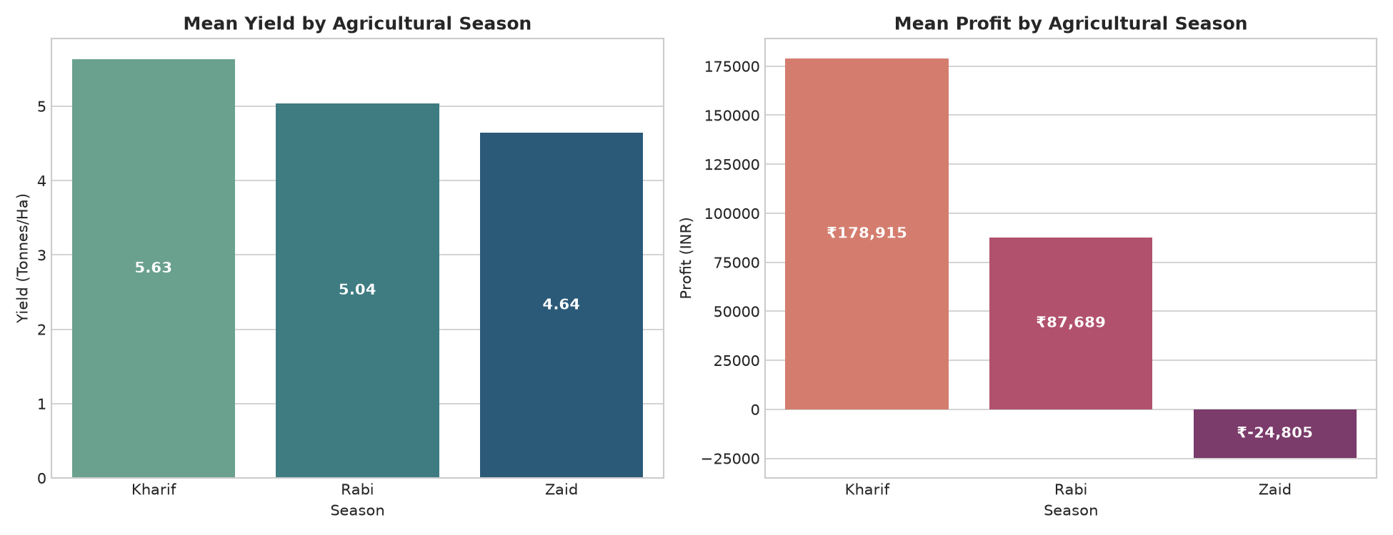
RESULTS: SEASONAL YIELD & PROFITABILITY DYNAMICS
• Kharif Season: Exhibits highest overall rainfall and moisture, supporting heavy crops but experiencing elevated disease/pest risks.
• Rabi Season: Delivers optimal yield consistency and strong net profits, benefiting from controlled irrigation and favorable winter temperatures.
• Zaid Season: Characterized by high ambient temperatures and dry conditions; profitability depends critically on high-efficiency irrigation methods.

Slide 7
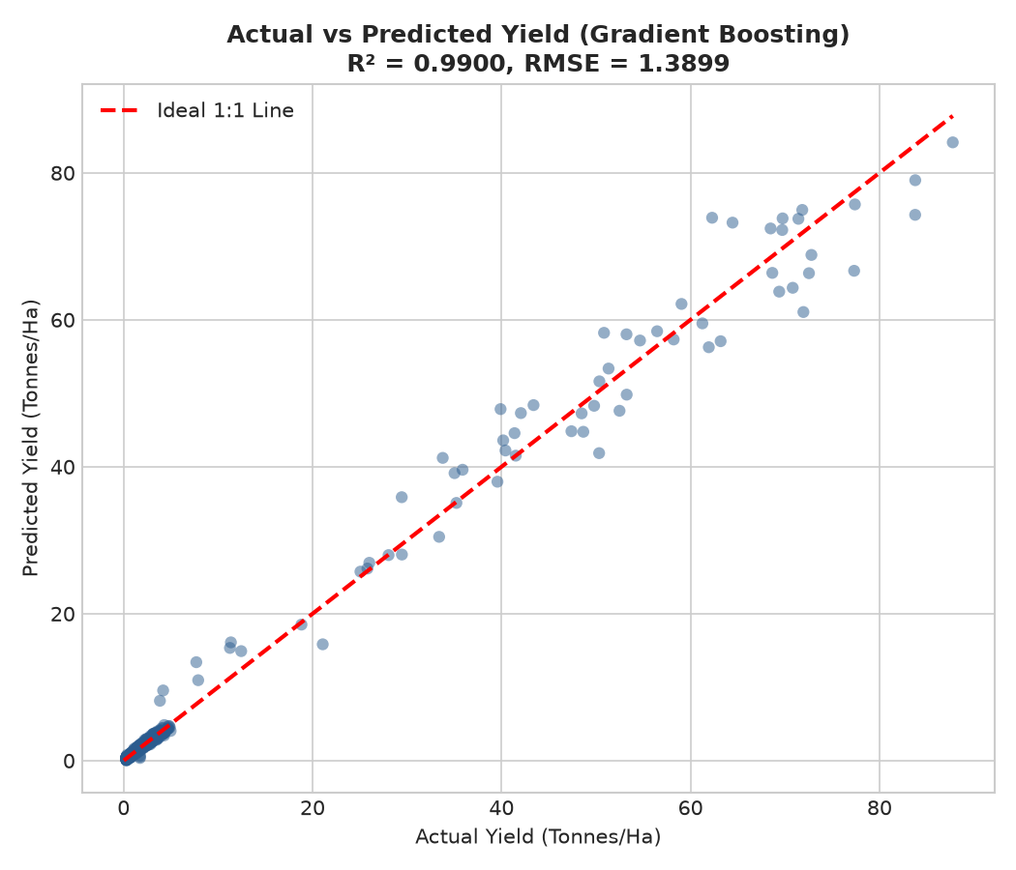
RESULTS: Crop Yield Prediction Model (R² = 0.990)
• Algorithm Benchmarking: Compared Linear Regression, Ridge, Random Forest, Gradient Boosting, and XGBoost using 5-Fold Cross-Validation.
• Top Performer: Gradient Boosting achieved an extraordinary R² of 0.9900, MAE of 0.4636 Tonnes/Ha, and RMSE of 1.3899 Tonnes/Ha.
• Validation Quality: Actual vs. Predicted scatter plot demonstrates tight alignment along the 1:1 diagonal across all yield distributions.

Slide 8
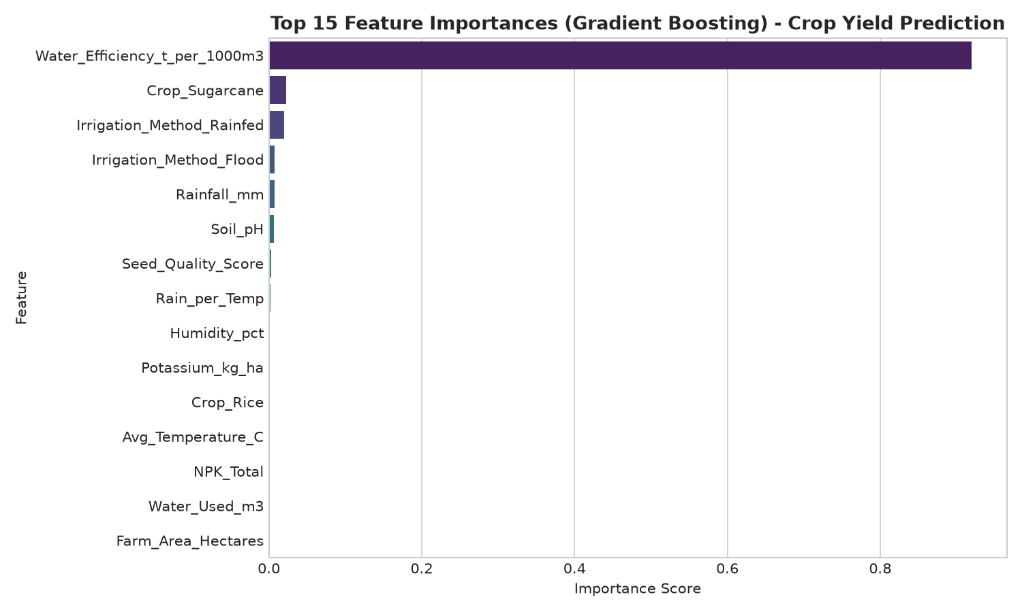
RESULTS: Feature Drivers & Farm Profitability Model
• Primary Yield Drivers: Crop variety, Seed Quality Score, and balanced N-P-K soil fertilization emerged as the most critical determinants of yield.
• Profitability Classifier: XGBoost Classifier predicted farm profitability with 92.25% Accuracy, 0.9242 F1-Score, and 0.9808 ROC-AUC.
• Practical Impact: Enables pre-season financial feasibility assessments before farmers invest capital in seeds and fertilizers.

Slide 9
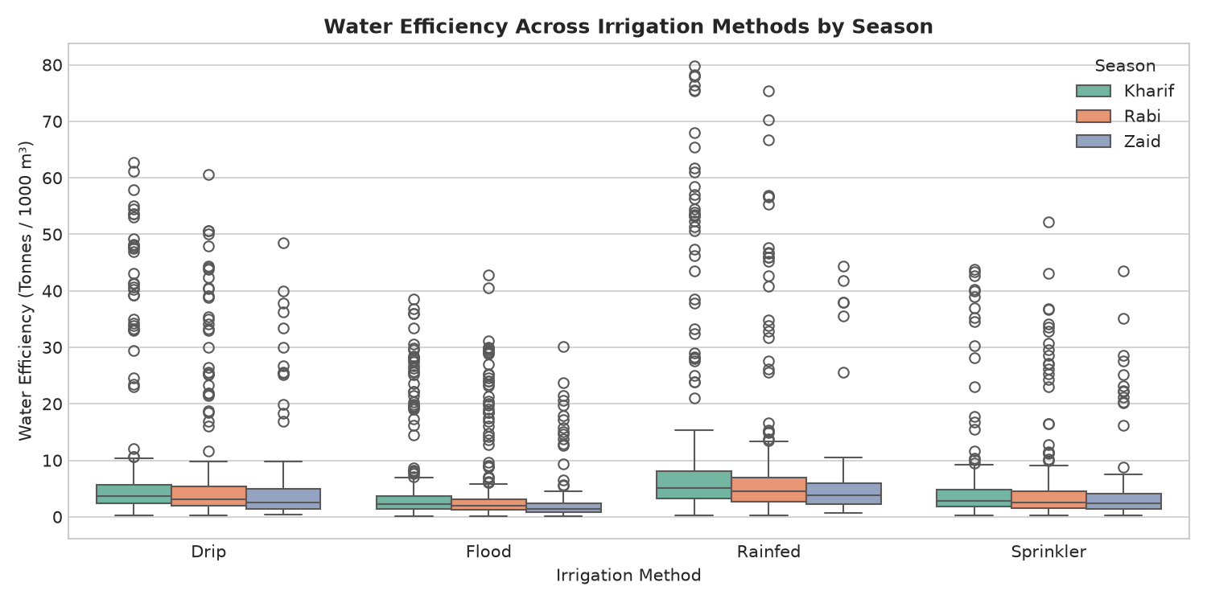
RESULTS: Irrigation Technology & Water Efficiency
• Drip Irrigation Superiority: Drip irrigation generated significantly higher water productivity (Tonnes/1000m³) across all 3 agricultural seasons.
• Flood Irrigation Waste: Traditional flood irrigation consumed the highest water volumes with the lowest marginal yield return.
• Correlation Findings: Strong positive correlation observed between water efficiency, optimized fertilizer usage, and net farm revenue.

Slide 10
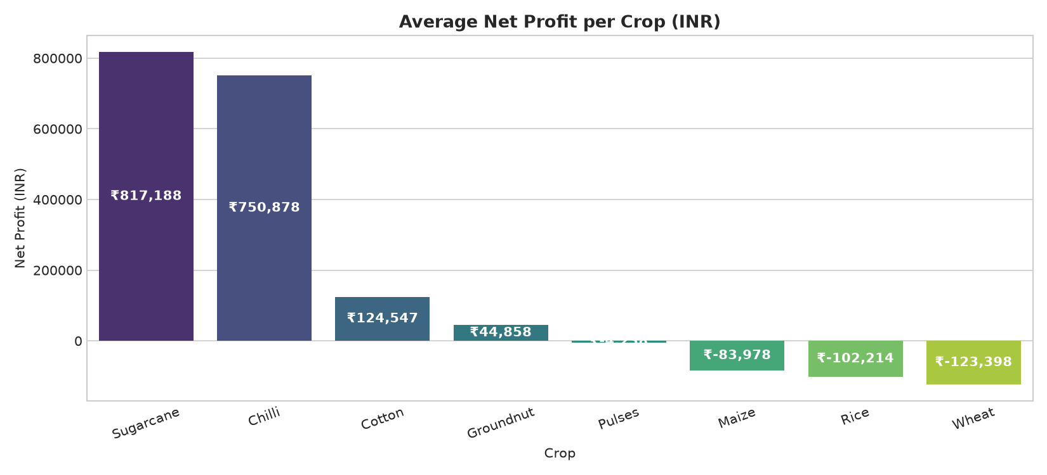
RESULTS: Crop Economic Breakdown & ANOVA Results
• Economic Leaders: Commercial cash crops (Sugarcane, Chilli, Cotton) achieved the highest net profits per hectare.
• Pulse & Grain Value: Pulses and Wheat provided critical soil nitrogen replenishment and steady seasonal cash flow.
• Hypothesis Testing: One-Way ANOVA confirmed statistically significant differences (p < 0.001) across seasons for Yield, Rainfall, and Net Profit.

Slide 11
FUTURE SCOPE
1. Real-Time IoT & Smart Sensor Integration: Integrate on-farm IoT sensors for continuous telemetry streaming of real-time soil moisture, temperature, and electrical conductivity to automate drip irrigation valves.
2. Satellite Remote Sensing & Computer Vision: Leverage high-resolution Sentinel/Landsat multispectral imagery (NDVI, NDWI) and drone surveys to spot localized crop stress, nutrient deficiencies, and pest infestations.
3. Deep Learning & Transformer-based Weather Forecasting: Incorporate regional numerical weather prediction and transformer models to predict monsoon onset anomalies, unseasonal rains, and heatwaves.
4. Mobile Decision Support Platform: Deploy lightweight quantized XGBoost models into a multilingual mobile app offering personalized, voice-assisted advisories for rural farmers without continuous internet access.

Slide 12
GITHUB LINK
https://github.com/Ksmashhero06/Seasonal-Agriculture-Performance-Analysis/

Slide 13
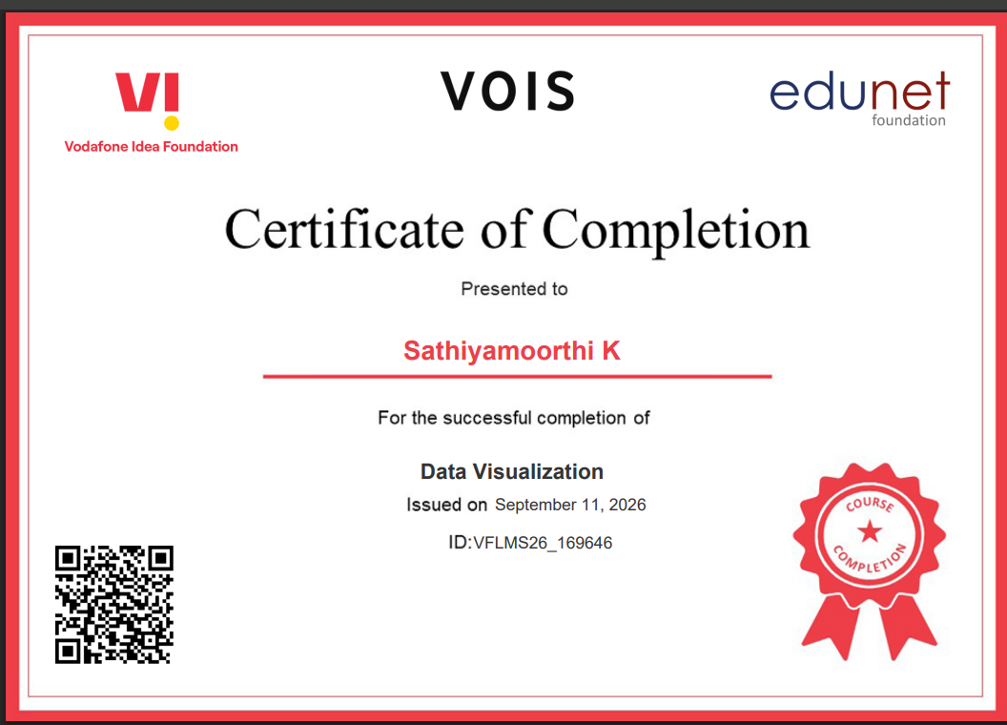
VOIS COURSE COMPLETION CERTIFICATE Course name: Data Visualization

Slide 14
THANK YOU
.
.

