Slide 1

Mini Project
HYPERGRAPH-BASED SPECTRUM SENSING AND ANALYSING THE DATA USING MACHINE LEARNING AND MATLAB
Team members : Project Guide:
Karanam Sathya Naga Pavan (124156018) Dr. Saravanan R
R. Lakshmi Narayanan (124156034) Assistant Professor I,
School of Computing ,
SASTRA Deemed University.

Slide 2
ABSTRACT
The integration of space and terrestrial communications is becoming increasingly important as the demand for reliable and high-speed communication continues to grow. However, managing the allocation of resources for such communication networks can be challenging, particularly when multiple conflicting requirements and constraints exist. This paper proposes a graph based resource allocation approach to address this challenge. The approach considers both space and terrestrial communications and allocates resources such as bandwidth and power in a coordinated manner. The proposed method models the communication network as a graph, with nodes representing communication devices and links representing communication channels. The resource allocation problem is formulated as an optimization problem, with the objective of maximizing the overall network performance while satisfying the various constraints, such as capacity limitations, power consumption limits, and quality-of-service requirements. The optimization problem is then solved using a graph-based algorithm that leverages the inherent structure of the communication network. The proposed approach has been evaluated using simulation experiments, which show that it can effectively allocate resources for integrated space and terrestrial communications. The results demonstrate that the proposed method outperforms existing resource allocation approaches in terms of network performance, such as throughput and network efficiency. In conclusion, this paper presents a novel graph-based resource allocation approach for integrated space and terrestrial communications. The approach takes into account the interdependence between space and terrestrial communications and allocates resources in a coordinated manner, leading to improved network performance. The proposed method provides a promising solution to the resource allocation problem in integrated communication networks and has the potential to be applied in practical communication systems.

Slide 3
Flow Plan
Spectrum Sensing Of Primary User And Cognitive Radio
Machine learning techniques using
Suitable Algorithm
Hypergraph-Based Analysis

Slide 4
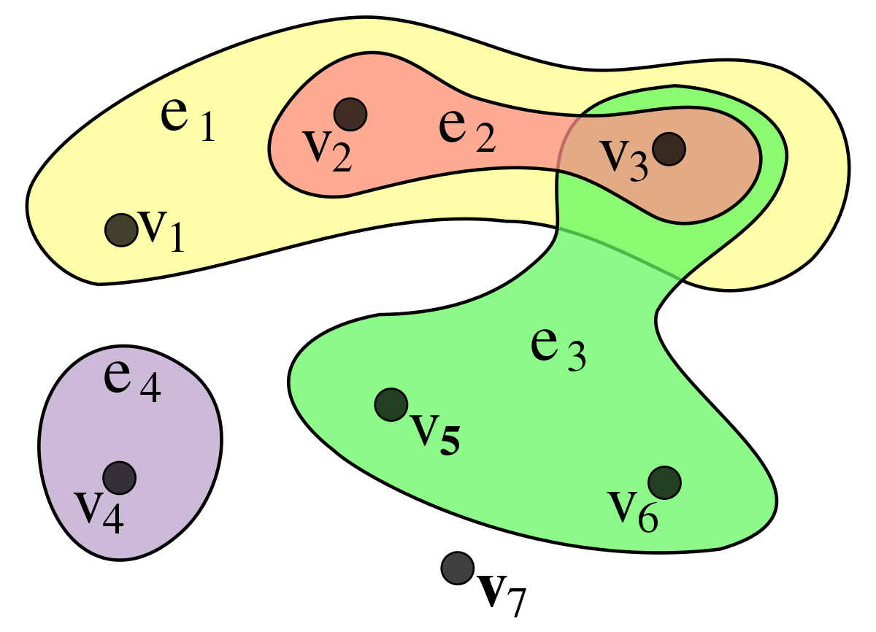
Hypergraphs
A Hypergraph is a generalization of a graph where an edge can connect any number of vertices connected by edges that can connect any number of vertices rather than just two.
Hyperedges can be through of as subset of vertices and they can overlap with each other. This representation is used to model various relationship model and structures.

Slide 5
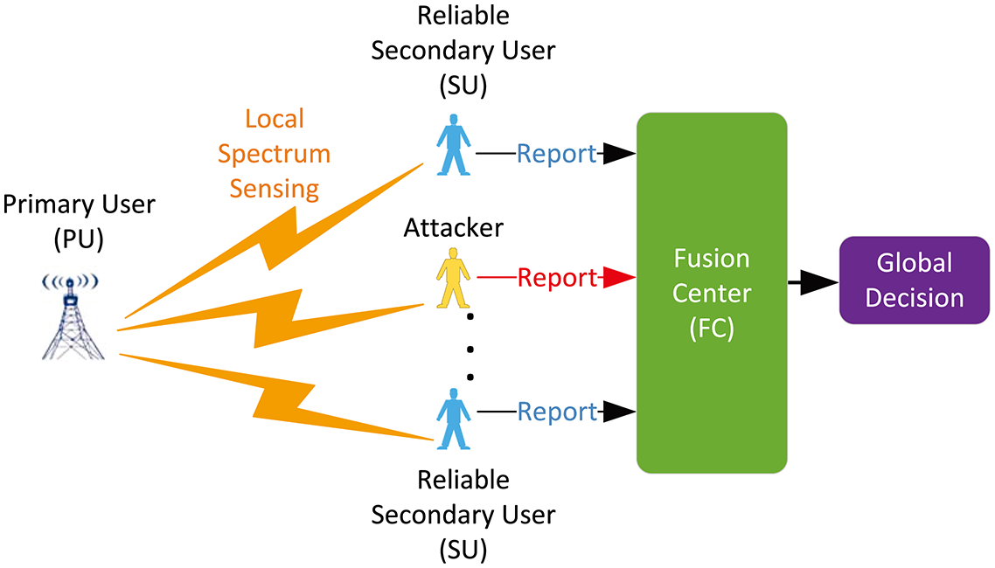
Spectrum Sensing
Spectrum sensing is the process of detecting the presence or absence of a signal in a given frequency spectrum or channel. It is a crucial aspect of cognitive radio technology, which enables wireless devices to intelligently detect and utilize unused or underutilized radio frequency bands or channels in real-time.
Spectrum sensing techniques can be classified into three main categories: energy detection, matched filtering, and cyclostationary feature detection. Energy detection is the simplest and most widely used technique, which involves measuring the power of the received signal in a given frequency band and comparing it to a predefined threshold. Spectrum sensing is essential for efficient spectrum utilization, as it enables cognitive radios to dynamically switch to a less congested frequency band, thereby reducing interference and improving the overall network performance.

Slide 6
How Hypergraphs Are Used In Spectrum Sensing !?
Hypergraphs can be used in spectrum sensing to represent the relationships between different frequency channels or bands. In particular, hypergraphs can be used to model the overlap and dependencies between different frequency bands, which can help improve the accuracy and efficiency of spectrum sensing algorithms .For example, in a hypergraph-based spectrum sensing approach, the frequency channels can be represented as vertices, and the hyperedges can represent the overlap between different channels. By analyzing the hypergraph structure, it is possible to identify the correlations between different frequency bands, which can be used to optimize the sensing process.Hypergraph-based spectrum sensing techniques can also be used to reduce the computational complexity of the sensing process by selectively sensing only the relevant frequency bands or channels. This can help improve the overall efficiency and accuracy of the spectrum sensing process, particularly in scenarios where there are a large number of overlapping frequency bands or channels.

Slide 7
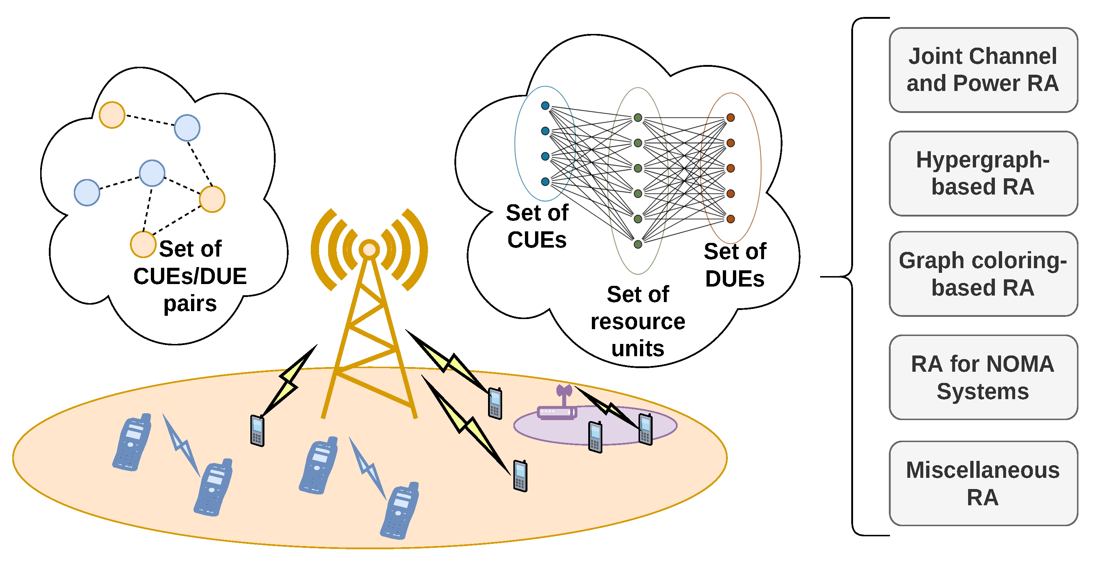

Slide 8
How “Graph-Based Resource Allocation for Integrated Space and Terrestrial Communications” With Spectrum Sensing
The research paper on "Graph-Based Resource Allocation for Integrated Space and Terrestrial Communications" is focused on developing a graph-based approach for optimizing the allocation of communication resources in a hybrid space-terrestrial communication network. While this paper does not explicitly discuss spectrum sensing, there is a relationship between the two concepts.
Spectrum sensing plays a crucial role in the optimization of communication resource allocation, particularly in cognitive radio networks, where the radio devices dynamically adjust their transmission parameters based on the available spectrum. In the context of the integrated space and terrestrial communication network considered in the research paper, the use of spectrum sensing techniques can help identify available frequency bands or channels for communication, which can then be allocated using the graph-based approach proposed in the paper.
Specifically, the graph-based resource allocation approach can be used to model the available communication resources, and the spectrum sensing techniques can be used to identify the available frequency bands or channels. By combining these two approaches, it is possible to optimize the allocation of communication resources in the hybrid space-terrestrial communication network, resulting in improved network performance and efficiency.

Slide 9
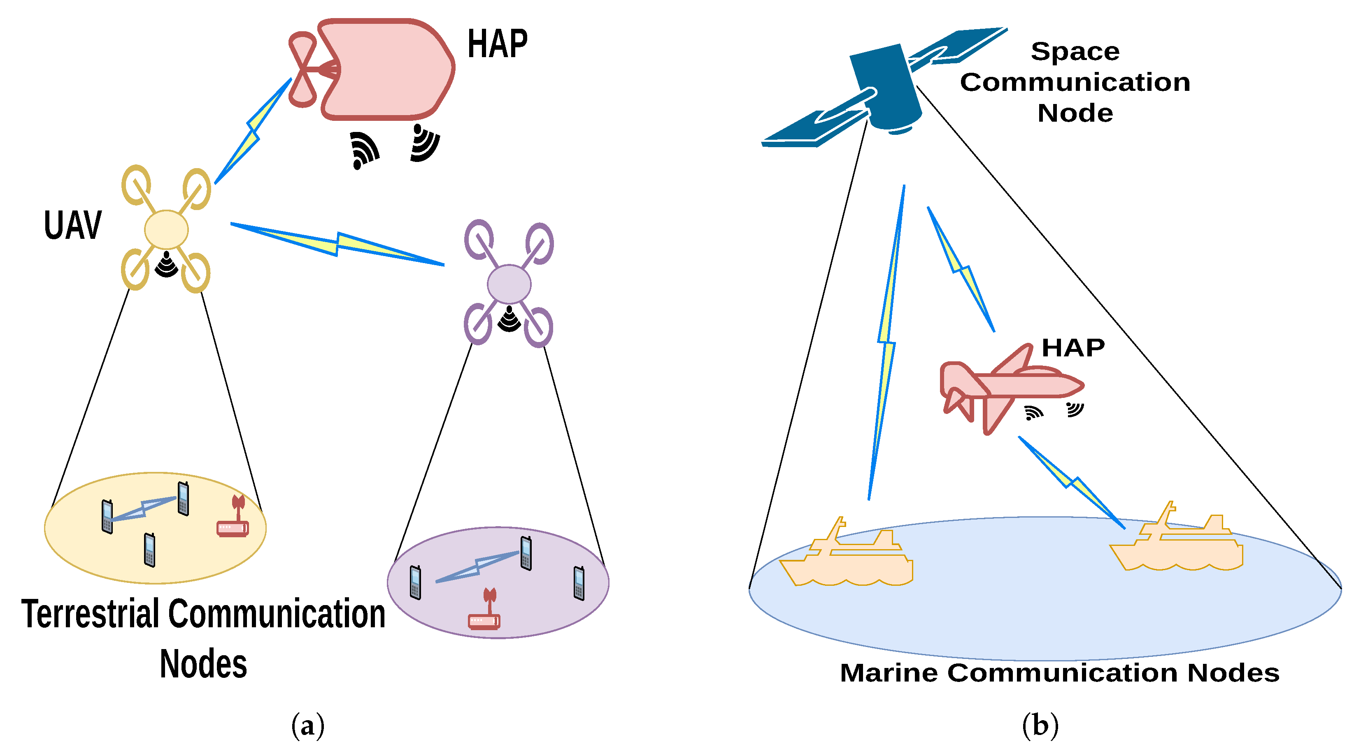

Slide 10
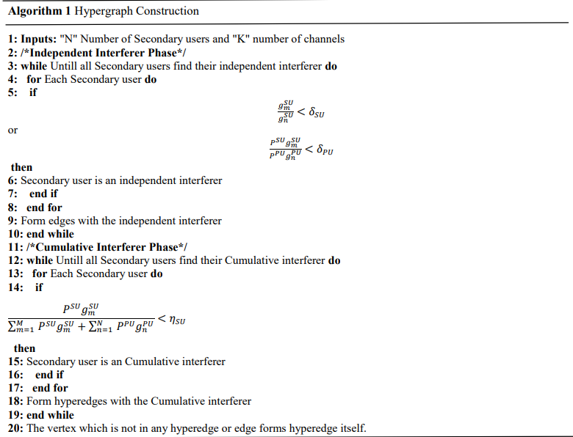
ALGORITHM

Slide 11
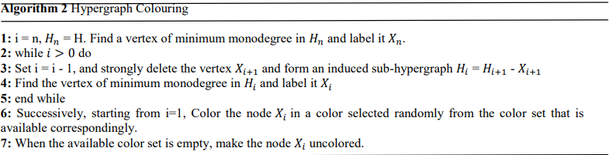
ALGORITHM

Slide 12
WORKFLOW
Bulding The Model,Testing It and Validating the Performance Of The Model And Creating A Matlab Model Too
Searching or Generating A Proper Dataset and Model(Algorithm)For The Problem
Learning about Spectrum Sensing, Hypergraphs and how to use it in Spectrum Sensing

Slide 13
LITERATURE REVIEW
S.No. | Title of the Paper | Authors | Published In | Comments
1 | Graph-Based Resource Allocation for Integrated Space and Terrestrial Communications | Antoni Ivanov , Krasimir Tonchev , Vladimir Poulkov , Agata Manolova and Nikolay N. Neshov | Sensors 2 Aug 2022 | The concept of Graph-based Resource allocation for Integrated Space and Terrestrial communications (GRIST), which uses a hypergraph to describe the inter-connectivity of various networks. The article also discusses implementation challenges and introduces a scheme for determining the appropriate balance between different design considerations.

Slide 14
LITERATURE REVIEW
S.No. | Title of the Paper | Authors | Published In | Comments
2. | HYPERGRAPH COLORING-BASED ALGORITHM FOR CHANNEL ALLOCATION………………………………………….. | Arun Kumar Sharma, Nikhlesh Kumar Badoga and Himanshu Monga | Asian Journal Of Advances In Research 03 Dec, 2021 | The proposed algorithm uses a hypergraph representation to model the communication channels and devices in the network, allowing for efficient allocation of channels based on the requirements of each device. The paper presents simulation results demonstrating that the proposed algorithm outperforms existing algorithms in terms of channel utilization and interference reduction. The research suggests that hypergraph coloring can be a useful technique for channel allocation in wireless networks and has the potential to improve network performance and efficiency.

Slide 15
INDIVIDUAL CONTRIBUTION
Karanam Sathya Naga Pavan - Literature study, Searching Datasets And Prefered Algorithm
R Lakshmi Narayanan – Developing, building prediction Model and Matlab Model

Slide 16
REFERENCES
HYPERGRAPH COLORING BASED ALGORITHM FOR CHANNEL ALLOCATION
Graph-Based Resource Allocation for Integrated Space and Terrestrial Communications

Slide 17
Progress Done Till Now !! (1st review)
After carefully going through the research paper, we have two works to be done
MATLAB Work
Machine Learning Work
MATLAB
After carefully going through the paper, we have found out that the algorithm just gave a outline of the algorithm and not the algorithm so after a quite a research we found a algorithm called ‘Bron-Kerbosch Algorithm’ (in-built function in MATLAB) which , majorly provides the Maximum ‘cliques’.
What are Cliques !?
A clique is a collection of vertices in an undirected graph G such that every two different vertices in the clique are nearby, implying that the induced subgraph is complete. Cliques are a fundamental topic in graph theory and are employed in many other mathematical problems and graph creations.
So basically from cliques we find the required vertices or nodes which are engaged in a single channel thereby we can isolate the nodes and give colors to each nodes.(that is the main moto of our mini-project)

Slide 18
Bron-Kerbosch
The Bron-Kerbosch algorithm is an efficient algorithm for finding all maximal cliques in an undirected graph, where each vertex is connected to every other vertex in the subset.
It works by maintaining three sets of vertices: a set of vertices that have already been included in the current candidate clique, a set of potential candidates to be added to the current clique, and a set of excluded from consideration.
After each recursive call returns, the vertex v is removed from the candidate clique and added to the excluded set, and the algorithm moves on to the next vertex in the potential candidate set. The algorithm terminates when the possible candidate set is empty.
It is efficient for small to moderate-sized graphs, but computationally expensive for large graphs. Variants of the algorithm have been developed to improve its efficiency and scalability.

Slide 19
Bron-Kerbosch Pseudo-Code
INPUTS: V = {1,...,n} (after renaming the vertices of G as in the preceding discussion)
and the closed neighborhoodsC(1) throughC(n). Also: MC =φ (the empty set), EXT =φ
and EXCAN = φ.
Phase 1 (Identifying the subordinate vertices not to be input in phase 2)
(1.1) S = φ and k = n
(1.2) if C(k) ⊂C(k− j) for some j ∈ {1,...,k−1}
then S ← S∪{k} and k ← k−1
else k ← k−1
(1.3) if k = 1 then V ←V −S
else return to (1.2)
Phase 2 (Maximal cliques)
Input m = 1
(2.1) r = 2
(2.2) EXCAN ← EXCAN ∪{m}
(2.3) Compute e(m) and the extensions {m,p} where p ∈ e(m) and m < p
(2.4) for each extension A = {m,p}, EXT ← EXT ∪{A}
(2.5) EXCAN ← EXCAN −{m}
(2.6) for each A ∈ EXT with |A| = r, say A = {m,p1,...,pr−1},
compute T =C(m)∩C(p1)∩...∩C(pr−1)
(2.7) if T = A then MC ← MC∪{A} and EXT ← EXT −{A}
else if T −B = φ for some B ∈ MC then EXT ← EXT −{A}
else EXCAN ← EXCAN ∪{A}
(2.8) if EXT = φ and EXCAN = φ then m ← m+1
(2.9) if m > n−1 then return MC
else if m / ∈V then m ← m+1 and return to (2.9)
else return to (2.2)
else if EXT = φ but EXCAN 6= φ then r ← r+1,
extend each member of EXCAN by one succeeding vertex
and return to (2.6)
else return to (2.6)
end for
OUTPUT: MC is the set of all the maximal cliques of G.

Slide 20
Bron-Kerbosch Algorithm
1) Representation of secondary user data for spectrum allocation as vertices
2) Building up hyper edges to construct a hyper graph by inducing hyper relation between secondary users versus channel data
3) Invoke maximal hyper cliques relations among the data for minimizing hyper relations.
4) Clustering the vertices into intersecting and non-intersecting hyper cliques
5) Separating isolated hyper cliques
6) Constructing a hyper graph partition by removing the redundancies
7) Applying the Roulette wheel selection operator for selecting pair of elements of population
8) Applying crossover operation to the selected pairs and realizing the conflict
9) If no conflict go to next step or go to step 6.
10) Applying conventional mutation operator to accelerate the optimal route
11) Check for fitness percentage
12) Repeat steps 6 to 11 till the specified number of generations to obtain optimal fitting individuals.

Slide 21
Bron-Kerbosch Code (MATLAB):
INPUTS: V = {1,...,n} (after renaming the vertices of G as in the preceding discussion)
and the closed neighborhoodsC(1) throughC(n). Also: MC =φ (the empty set), EXT =φ
and EXCAN = φ.
Phase 1 (Identifying the subordinate vertices not to be input in phase 2)
(1.1) S = φ and k = n
(1.2) if C(k) ⊂C(k− j) for some j ∈ {1,...,k−1}
then S ← S∪{k} and k ← k−1
else k ← k−1
(1.3) if k = 1 then V ←V −S
else return to (1.2)
Phase 2 (Maximal cliques)
Input m = 1% Load input data from file (replace 'your_data.mat' with actual file name)
load('your_data.mat');
% Initialize empty hypergraph
H = {};
% Define Bron-Kerbosch algorithm
function BronKerbosch(R, P, X)
if isempty(P) && isempty(X)
% Add maximal clique R to hypergraph
H{end+1} = R;
else
% Choose pivot vertex u
pivot = P(1);
for i = 1:length(P)
if length(intersect(A(pivot,:),P(i:end))) > length(intersect(A(pivot,:),pivot))
pivot = P(i);
end
end
% Iterate over vertices in P
for v = setdiff(P, A(pivot,:))
BronKerbosch([R v], intersect(P, A(v,:)), intersect(X, A(v,:)));
P = setdiff(P, v);
X = union(X, v);
end
end
end
% Run Bron-Kerbosch algorithm on input data
n = size(A,1);
vertices = 1:n;
BronKerbosch([],vertices,[]);
% Convert hypergraph to adjacency matrix
m = length(H);
Adj = zeros(m,m);
for i = 1:m
for j = i+1:m
if ~isempty(intersect(H{i},H{j}))
Adj(i,j) = 1;
Adj(j,i) = 1;
end
end
end
% Plot hypergraph
plot(Adj)

Slide 22
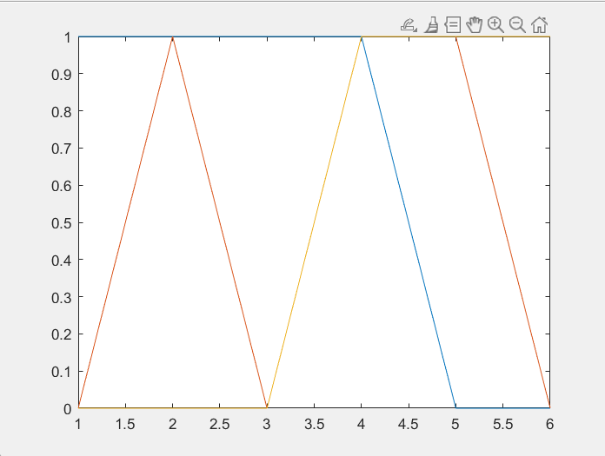
Output

Slide 23
Machine Learning Code: (Multi-Linear Regression)
import pandas as pd
import matplotlib.pyplot as plt
import numpy as np
dataset = pd.read_csv('data1.csv’)
X=dataset.iloc[:,:-1].values
y=dataset.iloc[:,-1].values
dataset.head()
print(X)
print(y)
from sklearn.model_selection import train_test_split
X_train,X_test,y_train,y_test = train_test_split(X,y,test_size=0.25,random_state=0)
print(X_train)
print(X_test)
print(y_train)
print(y_test)
from sklearn.preprocessing import StandardScaler
sc_X=StandardScaler()
sc_y=StandardScaler()
X_train=sc_X.fit_transform(X_train)
X_test=sc_X.transform(X_test)
y_train=sc_y.fit_transform(y_train.reshape(len(y_train),1))
y_test=sc_y.transform(y_test.reshape(len(y_test),1))

Slide 24
print(y_train)
print(X_train)
print(y_test)
print(X_test)
#multi_linear regression
from sklearn.linear_model import LinearRegression
regressor = LinearRegression()
regressor.fit(X_train, y_train)
y_pred =regressor.predict(X_test)
np.set_printoptions(precision=2)
print(np.concatenate((y_pred.reshape(len(y_pred),1), y_test.reshape(len(y_test),1)),1))
plt.scatter(y_test,y_pred,color='red')
plt.xlabel(' y test')
plt.ylabel(' y pred')
plt.title('Finding New Frequeies For Channel Allocation')
plt.show()
regressor.score(X_test,y_test)
regressor.score(X_test,y_pred)

Slide 25
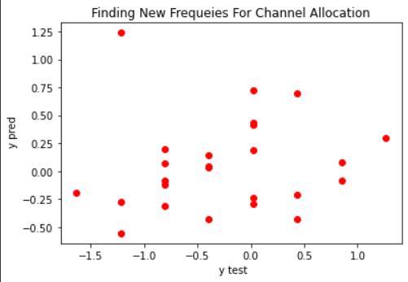
OUTPUT:
Accuracy Score:
0.37177816632298444(X_test,y_test)
1.0(X_test,y_pred)

Slide 26
THANK YOU

