Slide 1
Meta Pixel Setup with All Methods
Objective & Project Details: Demonstrate expertise in setting up Meta Pixel using all available methods( Manual, Partner Integration, Google Tag Manager,) for your own website.
Tools Required
Facebook Business Manager
Meta Events Manager
Google Tag Manager
Shopify or wordpress site Admin
Instructions
Pixel Creation: Pixel created in Events Manager along with screenshot
Manual Installation via Code: Screenshot of Pixel base code manually added in the
Google Tag Manager (GTM) Method: Screenshot of Pixel installed using GTM including GTM workspace with tag and trigger setup & Preview mode showing tag firing
Partner Integration Method: Screenshot of Pixel installed via plugin and reflecting into meta pixel helper extension.

Slide 2
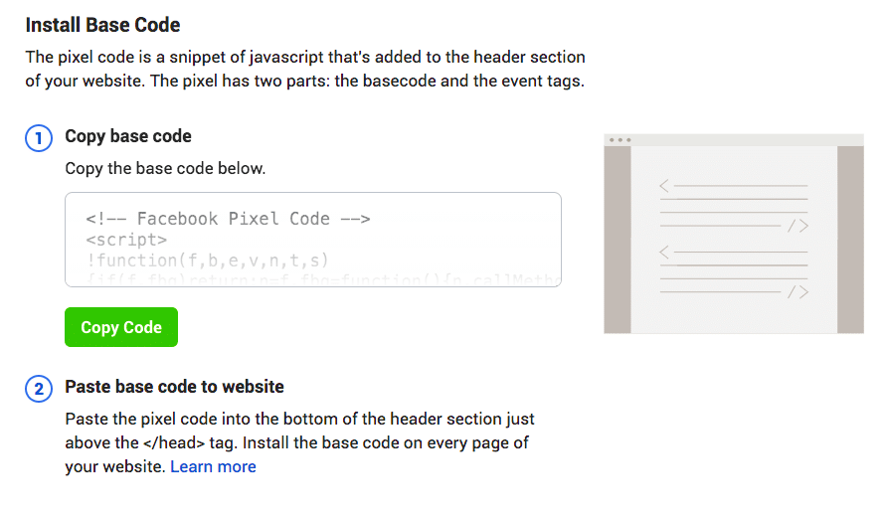
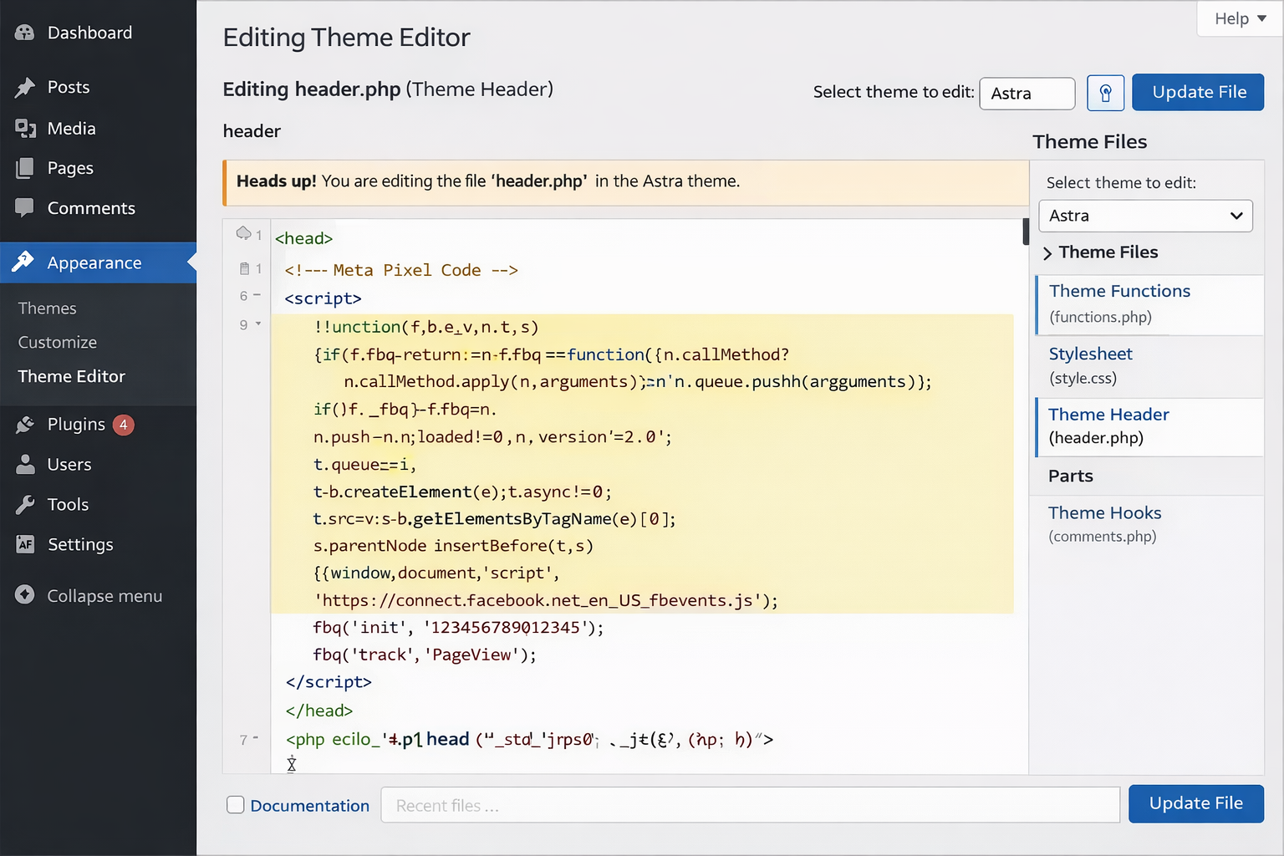
Pixel Creation (Events Manager, Manually)
Steps:-
Go to meta event manager
From Left Menu bar click on Event Manager
Go to next step of clicking on “Data Connect”
Select any options for which we want to set meta event Now I have selected for Website ~ Meta Pixel
Name the Meta Pixel Business
Paste Website URL for check
Window will pop up choose option do it by yourself click on next
Window will pop up, check the “meta pixel only” Next
Window will pop up with option will choose manually add pixel code to website
Manual Installation via Code:
10. Copy the Meta Pixel Base Code from Events Manager
11. Go to your website backend (WordPress/Shopify)
12. Paste the code inside the <head> section of your website
13. Save changes

Slide 3
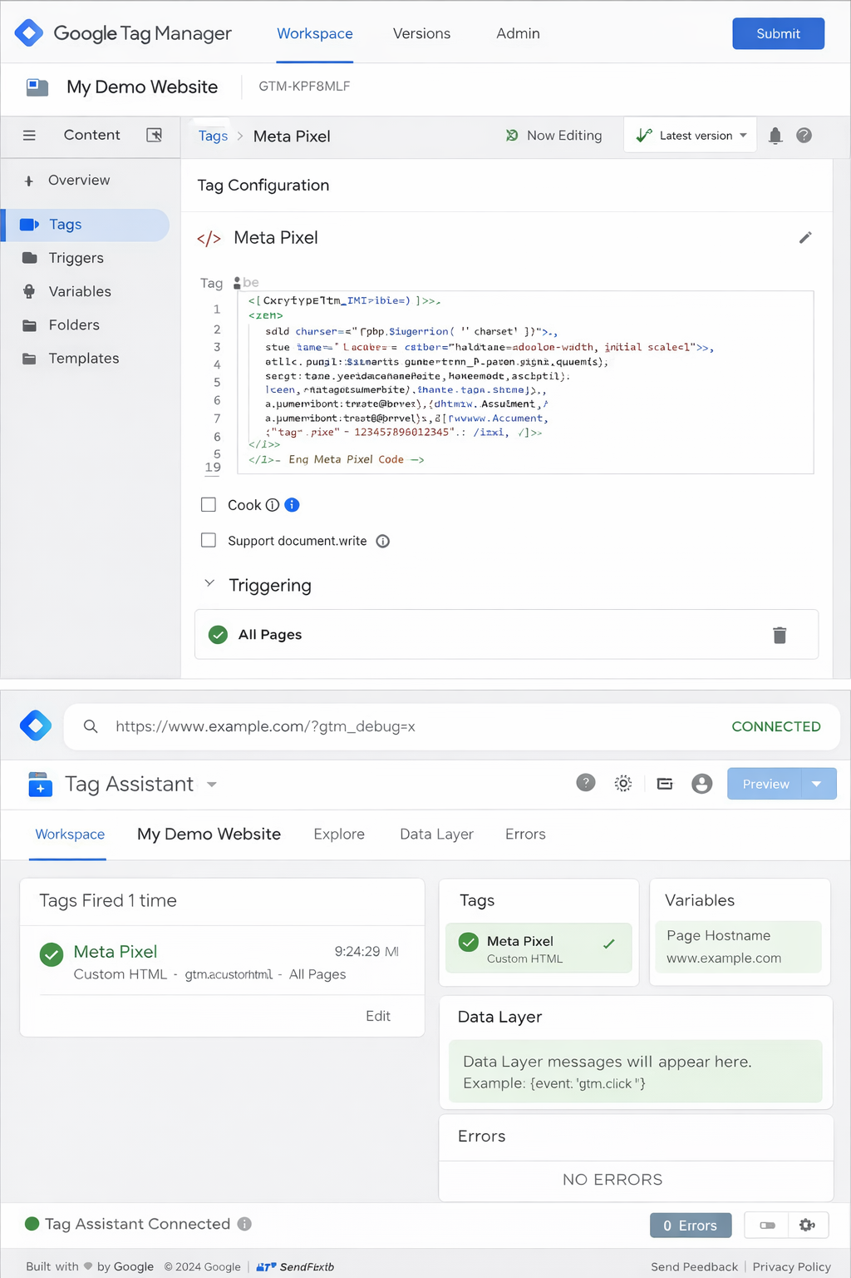
Google Tag Manager (GTM) Method
Steps:
1. Open Google Tag Manager
2. Click Add New Tag
3. Select Custom HTML Tag
4. Paste Meta Pixel Base Code
5. Set Trigger → All Pages
6. Save and Publish
Preview Mode:
7. Click Preview
8. Enter website URL
9. Verify Pixel firing on page load
Output:
Tag firing successfully in preview mode
(Attach screenshots of:)
GTM Workspace (Tag + Trigger setup)
Preview Mode (Tag firing)

Slide 4
Partner Integration Method:
Step 1. Create Meta Pixel
Go to Meta Events Manager
Click Connect Data Sources
Select Web → Meta Pixel
Enter:
Pixel Name
Website URL
Click Create Pixel
Your Pixel ID will be generated
Step 3: Setup in Shopify
Steps:
Login to Shopify Admin
Go to Apps → Shopify App Store
Install Facebook & Instagram App
Open the app and click Connect Account
Login with Facebook account
Select:
Business Manager
Ad Account
Pixel (select your created Pixel)
Click Finish Setup
Pixel automatically installed
Step 2: Choose Partner Integration
After creating Pixel, click Set Up Pixel
Select Use a Partner Integration
Choose your platform:
Shopify
WordPress
Wix
Others

Slide 5
Step 4: Setup in WordPress
By Using Plugin
Login to **WordPress Dashboard
Go to Plugins → Add New
Search: PixelYourSite or Meta Pixel Plugin
Click Install → Activate
Go to plugin settings
Paste your Pixel ID
Save changes
Step 5: Verify Pixel Installation
Install Chrome Extension: Meta Pixel Helper
Visit your website
Click extension icon
Check:
Pixel ID detected
PageView event firing
If green signal appears → Pixel working correctly

