Slide 1
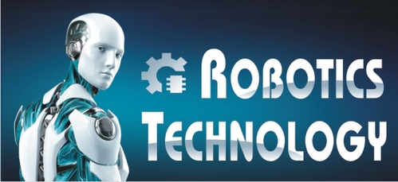
ROBOTICS TECHNOLOGY

Slide 2
𝙄𝙉𝙏𝙍𝙊𝘿𝙐𝘾𝙄𝙉𝙂 𝙊𝙁 𝙍𝙊𝘽𝙊𝙏𝙄𝘾𝙎
Robot and Robotics technology represented a practical applications of physics, computer science, engineering and mathematics.
It provides a very powerful and flexible approach to demonstrate a variety of engineering concept.
Robotics is the branch of technology that deals with the design, construction, operation, and application of robots, as well as computer system for their control, feedback, and information processing.

Slide 3
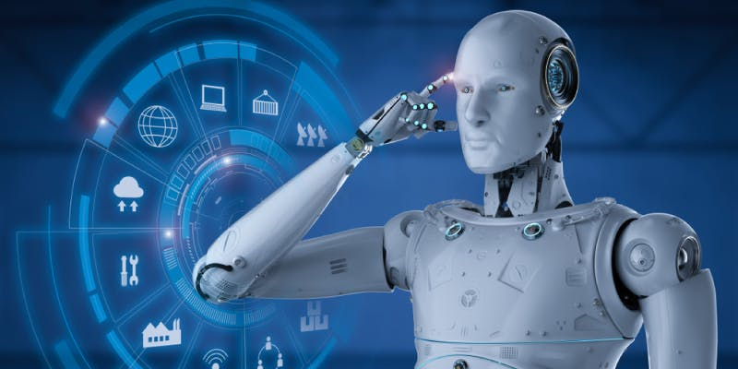
𝙒𝙃𝘼𝙏 𝙄𝙎 𝙍𝙊𝘽𝙊𝙏?

Slide 4
1. An electric or mechanical or electromechanical, programmable or non programmable multifunctional manipulator designed to move material, parts, tools, or specialized device through various programmed motions for the performance of a variety of tasks” 2. A robot is a mechanical or virtual, artificial agent. It is usually an electromechanical system.

Slide 5
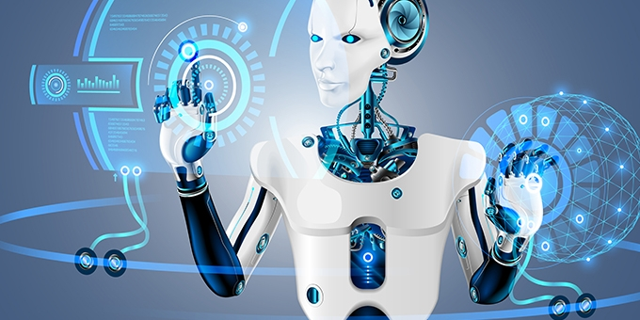
￼𝙒𝙃𝘼𝙏 𝙏𝙀𝘾𝙃𝙉𝙊𝙇𝙊𝙂𝙔 𝙄𝙎 𝙐𝙎𝙀𝘿 𝙄𝙉 𝙍𝙊𝘽𝙊𝙏𝙄𝘾𝙎?
These technology include artificial muscles, elastic electric cable, artificial skin, artificial brain, fast moving robots, artificial nose and have the potential to bring artificial device one step closer to living organisms and even humans.

Slide 6
CONTINUE....
A robot is any moving machine that can be programmed to perform tasks and gather information from its surrounding. Robots work from A central microprocessor that controls their movements, they also have sensors for examining the environment and power sources.... It controls and coordinates the motion of the actuators.
Robotics is needed because:-
Speed
Can work in dangerous temperature
Can do work with accuracy

Slide 7
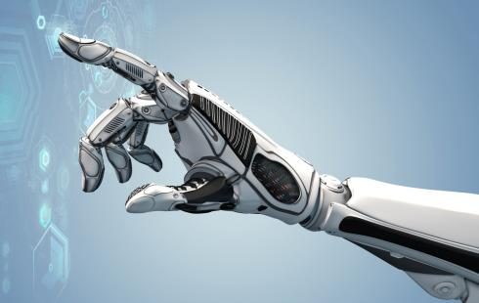
𝙍𝙊𝘽𝙊𝙏𝙎 𝘼𝙍𝙀 𝘾𝙐𝙍𝙍𝙀𝙉𝙏𝙇𝙔 𝙐𝙎𝙀𝘿 𝙁𝙊𝙍 𝙎𝙄𝙏𝙐𝘼𝙏𝙄𝙊𝙉 𝙒𝙃𝙀𝙍𝙀 𝙃𝙐𝙈𝘼𝙉 𝙎𝘼𝙁𝙀𝙏𝙔 𝙄𝙎 𝘼𝙉 𝙄𝙎𝙎𝙐𝙀...￼￼￼￼￼￼￼￼￼￼
Robots are used internationally by police, army, navy and air force organisation.
Robotic technology is used to deal with hazardous situations such as dealing with suspicious package, for the collection of foreign intelligence.
NASA scientists use robotic technology to explore other planets.

Slide 8
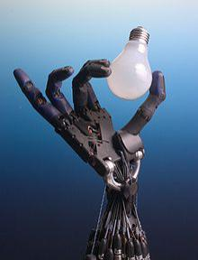
𝘾𝙐𝙍𝙍𝙀𝙉𝙏 𝙍𝙊𝘽𝙊𝙏𝙄𝘾𝙎 𝙏𝙀𝘾𝙃𝙉𝙊𝙇𝙊𝙂𝙔
Large organisation and companies reap many benefits from robotic technologies because:
Robots are expensive than paying human workers over the long run and robots are not prone to injure themselves.

