Slide 1
Main Topic: Web-Server attacks, web browser attacks and web user attacks.
Why is there an increasing risk of web-browser attacks?
Vulnerabilities of web-browser attacks:
Broken Authentication
Online Dictionary Attacks
XSS
Phishing
SQL Injection
CSRF
and the list goes on and on...

Slide 2
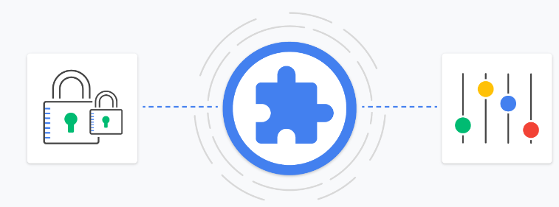
Extensions
Extensions provide an extra layer of protection to browsers, as they can detect and block malicious code or scripts from executing on websites.
Many extensions are specifically designed to block ads, tracking scripts, and other potentially harmful content that can compromise user privacy and security.
Browser extensions can also help users identify potentially dangerous websites and prevent them from accidentally visiting phishing sites or downloading malware.
While browser extensions can be helpful in mitigating browser-based attacks, they should not be relied upon as the sole line of defense. Users should also be mindful of their online behavior and take other steps to protect their devices and personal data.

Slide 3
Popular Extensions
NoScript | Ublock Origin | Umatrix |  | BlockDomain(Mine)
Selective whitelist or blacklist all domains | Automatically blocks most ad/unnecessary domains | Blocks javascript based on preferences |  | Selectively blocks javascript with a nice UI
Cross-compatible | click to block element | Click to block element |  | Uses chrome’s latest api calls
Android compatible | Protects against XSS and CSRF | Protects against XSS and CSRF |  | Depends on usage, can protect against malicious domains
Codebase is in a couple of thousands | Codebase is part-open source part proprietary | Uses deprecated codebase |  | Codebase is fully open, in my github
The more blacklisted domains, the less the performance | Chrome compatibility is non-existent | Development has halted years now |  | It is absolutely flawless, no downsides at all, protects 100%
Remember, no matter what security software you are using, the user(YOU) are the worst vulnerability, not the software/computer you use.

Slide 4
Domains
How many domains do we actually need?
base domain = www.{google.com}​/whatever
Adware domains:
1) doubleclick.net
2) ad.yieldmanager.com
3) adtech.com
4) adnxs.com
5) googleadservices.com
Malware or phishing domains:
For domain names, special characters and extended non-alphabet support was added. So for example, this would be valid domain names:
1) facébook.com
2) góógle.com
3) ámázon.com

Slide 5
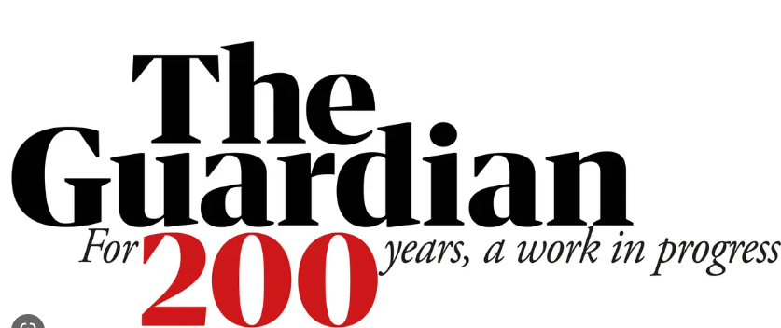
TheGuardian Incident
TheGuardian hosts about 15 domains. Out of those, only 3 are needed.
If for some domains from the other 12 domains are blocked, theguardian’s main domain’s (theguardian.com) javascript spams requests.
1000 requests per second, depending on computer resources
What does this tell us about other popular websites?
→ Fun fact, theguardian.com website had a revamp on january, 2015. Calculate how much bandwidth was
lost up until now with such programming practices that they use.

Slide 6

Presentantion > /dev/null
Be careful of hackers, common characteristics:
1) They wear hoodies
2) They have a terminal as a background
3) They wear glasses
If you see them, beat them up!

