Slide 1
Spotify Data Analysis Using SQL
by Srijana Kanuganti

Slide 2
Project Overview
This project analyzes a Spotify dataset containing track, album, and artist attributes using SQL. It involves executing SQL queries of varying complexity to explore the dataset and uncover valuable insights.

Slide 3
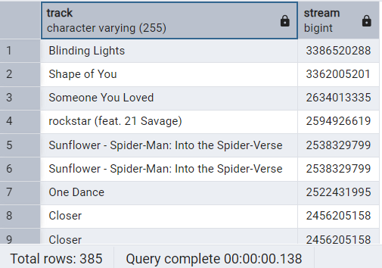
1. Retrieve Tracks with Over 1 Billion Streams
SQL Query
Result
select track,stream from spotify where stream>1000000000
order by stream desc;

Slide 4
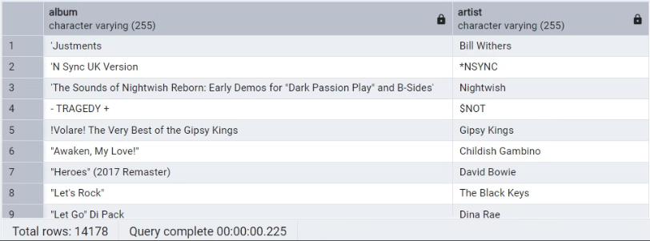
2. List Albums and Their Artists
SQL Query
Result
select distinct album,artist from spotify order by 1;

Slide 5

3. Total Comments for Licensed Tracks
SQL Query
Result
select sum(comments) as total_Comments from spotify where licensed;

Slide 6
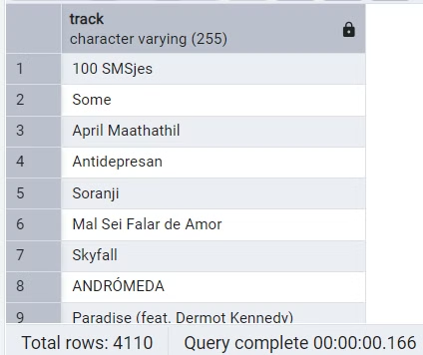
4. Tracks Belonging to Single Albums
SQL Query
Result
select distinct track from spotify where album_type = 'single';

Slide 7
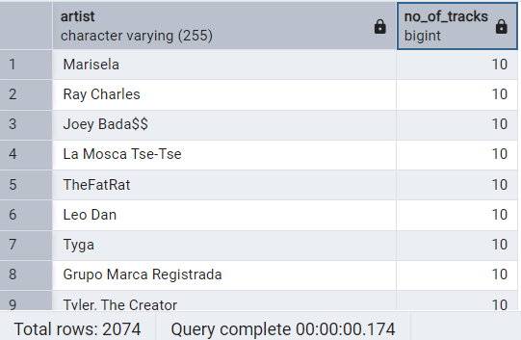
5. Track Count by Artist
SQL Query
Result
select artist,count(*) as No_of_tracks from spotify
group by artist
order by 2 desc;

Slide 8
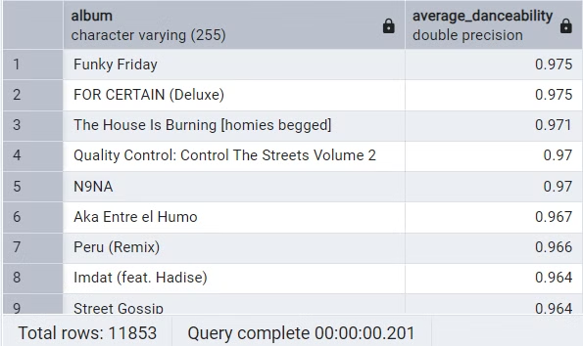
6. Average Danceability by Album
SQL Query
Result
select album,avg(danceability) as average_danceability from spotify group by album order by 2 desc;

Slide 9
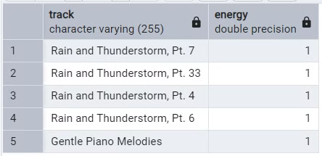
7. Top 5 Tracks with Highest Energy
SQL Query
Result
select track,max(energy) as energy from spotify group by 1 order by 2 desc limit 5;

Slide 10
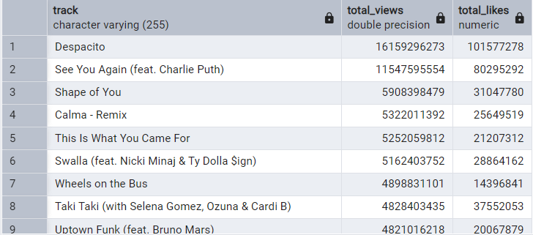
8. Tracks with Official Videos and Their Views/Likes
SQL Query
Result
select track,sum(views) as total_views,sum(likes) as total_likes
from spotify
where official_video
group by 1
order by 2 desc,3 desc;

Slide 11
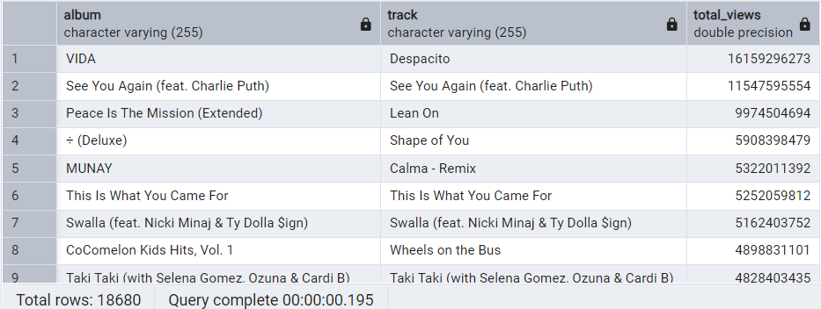
9. Total Track Views per Album
SQL Query
Result
select album,track,sum(views) as total_views
from spotify
group by 1,2
order by 3 desc;

Slide 12
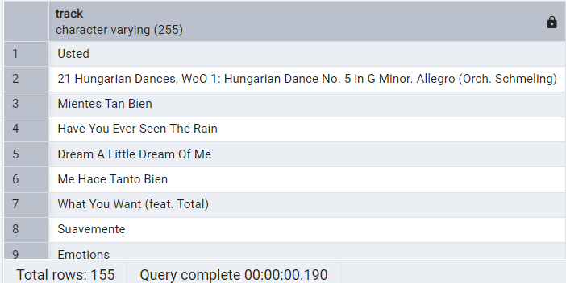
10. Tracks streamed more on Spotify than YouTube
SQL Query
Result
with Spo_Yt_Stream as
(
select track,
sum(case
when most_played_on = 'Spotify' then stream else 0
end) as spotify_stream,
sum(case
when most_played_on = 'Youtube' then stream else 0
end) as yt_stream
from spotify
group by track
)
select track
from Spo_Yt_Stream where spotify_stream>yt_stream and yt_stream<>0;

Slide 13
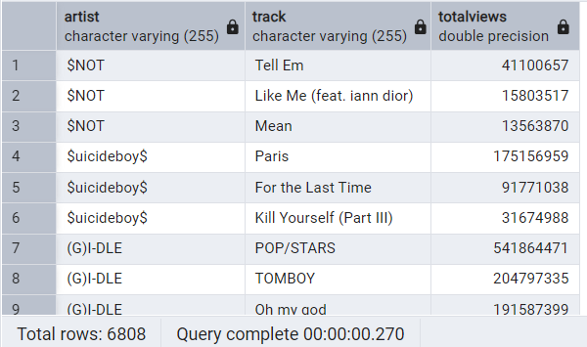
11. Top 3 most-viewed tracks for each artist using window functions
SQL Query
Result
with top_3_tracks as
(
select artist,
track,sum(views) as totalViews,
dense_rank() over(partition by artist order by sum(views) desc) as rank_
from spotify
group by 1,2
)
select artist,track,totalViews
from top_3_tracks where rank_<4;

Slide 14
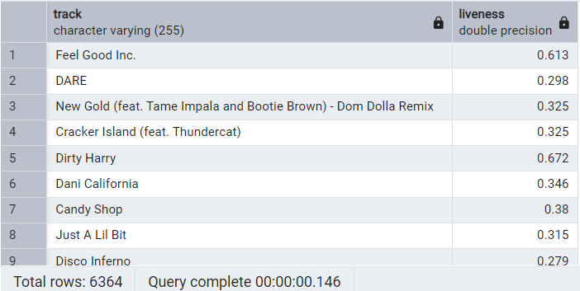
12. Tracks with a liveness score above the average
SQL Query
Result
select track,liveness from spotify
where liveness > (select avg(liveness) from spotify);

Slide 15
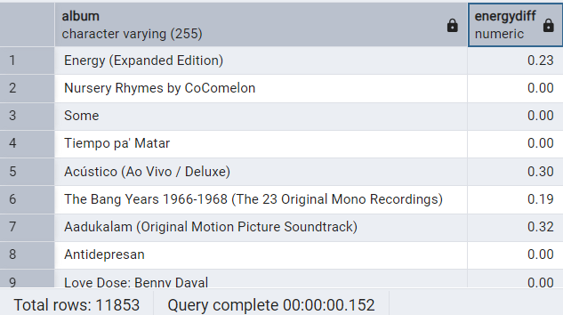
13. Difference between the highest and lowest energy values for tracks in each album
SQL Query
Result
with energyVal as
(
select album,
max(energy) as highest_energyVal,
min(energy) as lowest_energyVal
from spotify
group by 1
)
select album,highest_energyVal-lowest_energyVal as energyDiff
from energyVal;

Slide 16
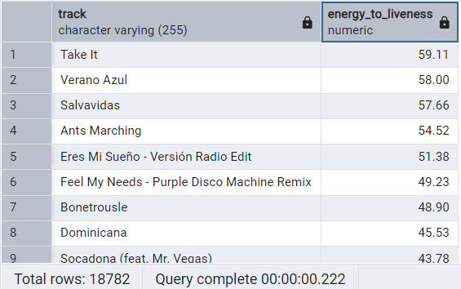
14. Tracks with a energy-to-liveness ratio greater than 1.2
SQL Query
Result
select track,round((energy/liveness)::numeric,2) as energy_to_liveness from spotify
where round((energy/liveness)::numeric,2) > 1.2
order by 2 desc;

Slide 17
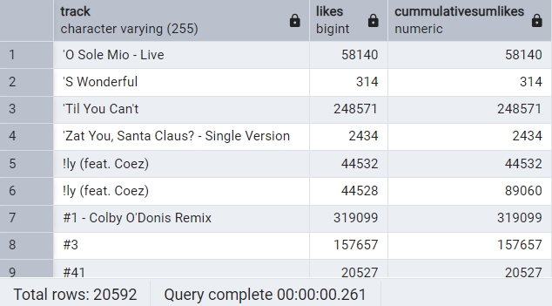
15. Cumulative sum of track likes using window functions
SQL Query
Result
select track,likes,
sum(likes) over(partition by track rows between unbounded preceding and current row) as cummulativeSumLikes
from spotify;

Slide 18
Insights
Top Tracks: Tracks like "Blinding Lights" and "Shape of You" exceed 1 billion streams, highlighting their massive popularity.
Prolific Artists: There is a mix of legendary and contemporary artists across various genres, each with 10 tracks, highlighting a diverse musical influence.
Licensed Content Engagement: Licensed tracks garnered 497015695 comments, indicating strong audience interaction.
Danceability: Albums like "Funky Friday" rank highest in danceability (0.975), making them ideal for energetic listeners.
High-Energy Tracks: Tracks such as "Rain and Thunderstorm, Pt. 7" have exceptional energy values (1), appealing to dynamic audiences.
Platform Preference: Tracks like "Usted" perform better on Spotify than YouTube, indicating Spotify's stronger user base for specific content.
Visual Content Appeal: Tracks with official videos, like "Despacito", amassed 16159296273 views and 101577278 likes, reflecting multimedia engagement.
Album Success: Album "VIDA" achieved the highest views (16159296273), emphasizing its wide appeal.
Energy-Liveness Balance: Tracks like "Take It" maintain high energy-to-liveness ratio (59.11), blending energy with a live feel.

Slide 19
The End

