Slide 1

Basic Details of the Team and Problem Statement
Ministry/Organization Name/Student Innovation: NATIONAL TECHNICAL RESEARCH ORGANISATION(NTRO)
PS Code:SIH1454
Problem Statement Title:CREATE AN INTELLIGENT SYSTEM USING AI/ML TO DETECT PHISHING DOMAINS WHICH IMITATE LOOK AND FEEL OF GENUINE DOMAINS
Team Name:AMIGOS
Team Leader Name:Y.S.V AJITH KUMAR
Institute Name:SAGI RAMA KRISHNAM RAJU (SRKR) ENGINEERING COLLEGE
Theme Name:CYBERSECURITY AND BLOCKCHAIN

Slide 2
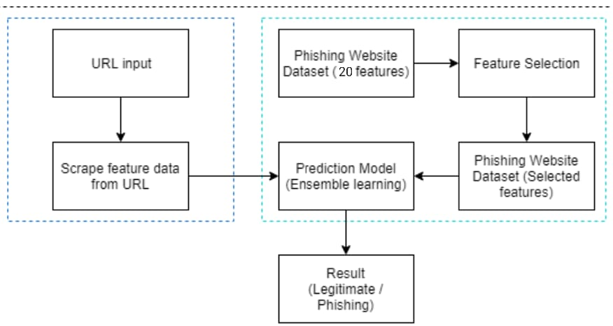
Idea/Approach Details
Idea/Solution/Prototype:
This project uses machine learning models to train the dataset to predict phishing websites.
Collect dataset containing phishing and legitimate websites from the opensource platforms.
Write a code to extract the required features from the URL database.
Analyse and preprocess the dataset by using EDA techniques.
And the divide the dataset into training and testing sets.
Run selected machine learning algorithms like Random Forest,XGBoost on the dataset.
Write a code for displaying the evaluation result considering accuracy metrices.
Compare the obtained results for trained models and specify which is better.
Develop a GUI based application for user interface.
Technology stack :
Machine Learning Libraries(scikit-learn,Tensorflow)
Web development(HTML,CSS,Jvascript,frameworks)
Database Management System(MySQL)
API Development Tools(Flask/Django)
DNS and WHOIS Analysis

Slide 3
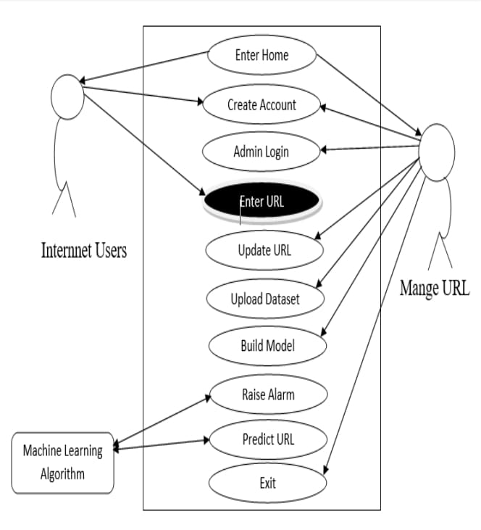
Idea/Approach Details
Usecase:
Dependencies/Show stopper:
Data Sources
Machine Learning Models
Feature Engineering
Scalable Infrasturcture
Security Expertise
Legal and Regulatory Compilance

Slide 4
Team Member Details
Team Leader Name: Y.S.V AJITH KUMAR
Branch: Btech Stream: CSE Year:III
Team Member 1 Name: K.SRINIVAS
Branch : Btech Stream: CSE Year:III
Team Member 2 Name: S.TAGORE
Branch : Btech Stream : CSE Year:III
Team Member 3 Name: T.TEJA VENKATA SAI
Branch : Btech Stream : CSE Year:III
Team Member 4 Name: P.KHADAR MASTAN
Branch : Btech Stream : CSE Year:III
Team Member 5 Name: M.BHANU
Branch: Btech Stream: CSE Year:III
Team Mentor:Dr.P.RAVIKIRAN VARMA PROFESSOR

