Slide 1


MULTI-AGENT REINFORCEMENT LEARNING FOR ADAPTIVE TCP CONGESTION CONTROL
OKAFOR KOSISOCHUKWU JOHNPAUL
20211287502
SUPERVISOR: Dr. IKENNA CAESAR NWANDU

Slide 2

INTRODUCTION
TCP Congestion Window: Crucial mechanism to govern data flow end-to-end.
Heuristic Limitations: Legacy protocols like Reno and CUBIC use "loss-based" rules.
Wireless Challenges: Random interference causes "fake" congestion signals, ruining throughput.
Adaptive Demand: Modern networks require intelligent, learning-based adaptation.

Slide 3

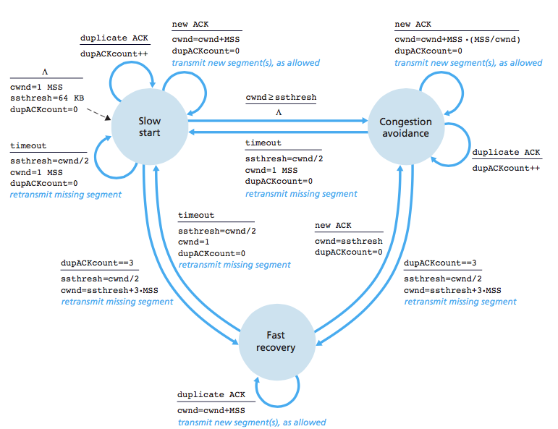

PROBLEM STATEMENT
Static Heuristics: Inability to differentiate between congestion and channel noise.
Coexistence Issues: Model-based protocols (BBR) often "bully" legacy CUBIC flows.
Selfish RL: Single-agent RL models maximize own speed, starving others and causing instability.

Slide 4

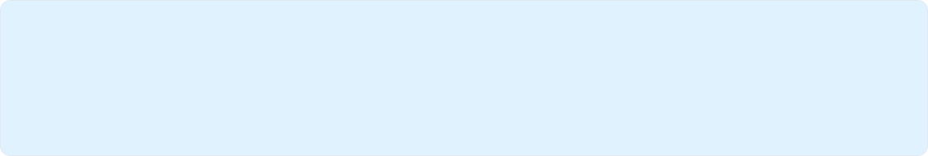
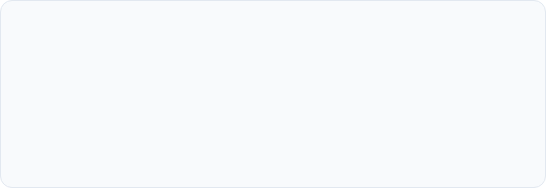
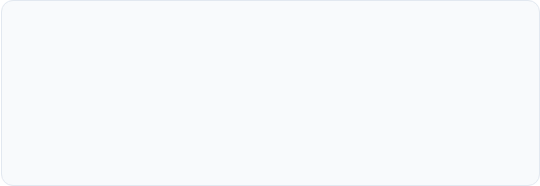
AIM AND OBJECTIVES
MAIN AIM
To design and evaluate a multi-agent reinforcement learning (MARL) framework for TCP congestion control that improves network performance while remaining computationally feasible.
OBJECTIVE 1
OBJECTIVE 2
Formulate TCP congestion control as a multi-agent reinforcement learning problem.
Design a discrete-event simulation environment for offline training of RL agents.

Slide 5
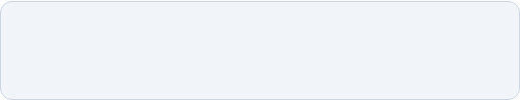
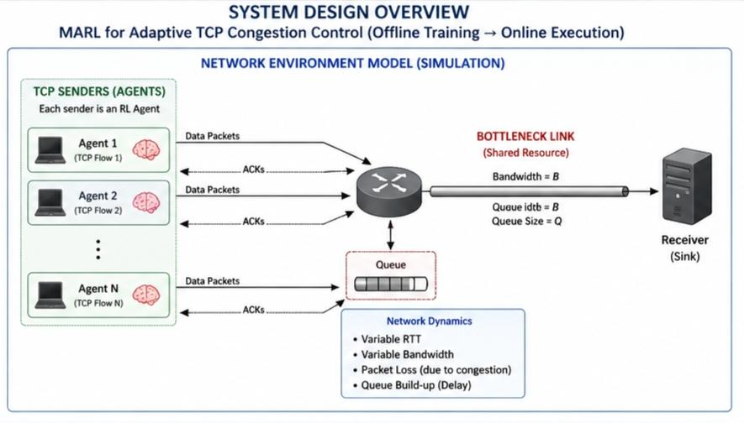
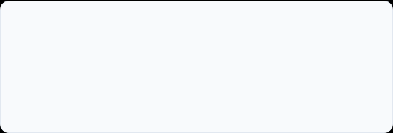
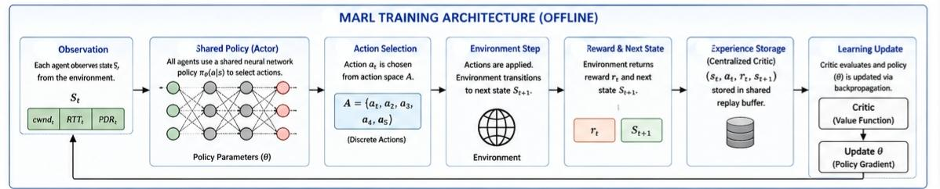
METHODOLOGY
Offline Training: Agents trained in NS-3 to bypass live kernel computational limits.
MARL Design: Independent agents share a globally aware cooperative policy.
Global Reward Function: Mathematically penalizes agents for selfish behavior.

Slide 6

QUESTIONS?

Slide 7




Thank you for listening
IMAGE SOURCES
https://witestlab.poly.edu/blog/content/images/2025/07/tcp-one-1.svg
Source: witestlab.poly.edu
https://i.sstatic.net/cJDMC.png
Source: stackoverflow.com
https://miro.medium.com/v2/resize:fit:1400/1*pSq718ln94kVTrrFC_CAqA.png
Source: medium.com

