Slide 1


MULTI-AGENT REINFORCEMENT LEARNING FOR ADAPTIVE TCP CONGESTION CONTROL
OKAFOR KOSISOCHUKWU JOHNPAUL
REG. NO.: 20211287502
SUPERVISOR: DR. IKENNA CAESAR NWANDU

Slide 2

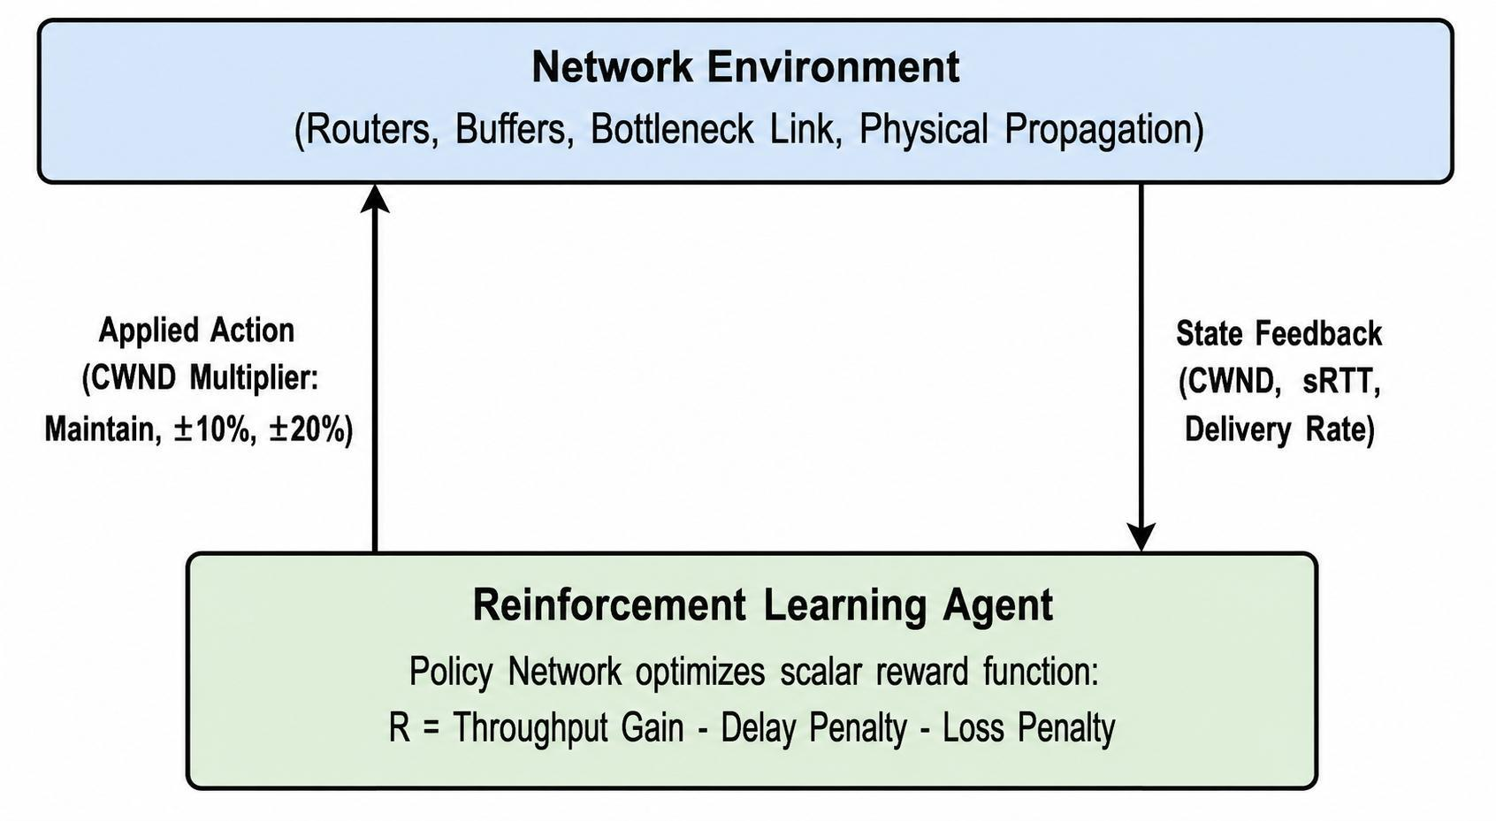
INTRODUCTION
Data on the internet travels as small units called packets. Transmission Control Protocol (TCP) makes sure they arrive reliably.
A sender cannot see how full a router's memory buffer is. It infers congestion from packet loss and delay, and limits the data in transit with a value called the congestion window (CWND).
TCP Reno and TCP CUBIC follow fixed rules and treat packet loss as congestion. Bottleneck Bandwidth and Round-trip propagation time (BBR) instead builds a model of the network path.
Reinforcement Learning (RL) lets a sender learn its own control policy from observations and reward feedback.
This project uses Multi-Agent RL (MARL), where several senders learn together on one shared link.
Figure 1.1: The RL control cycle for congestion control.

Slide 3

PROBLEM STATEMENT
Loss-based algorithms (Reno, CUBIC)
They assume every packet drop means a router queue overflowed. On wireless links, signal interference also drops packets, so these algorithms cut the CWND when they should not. The link is then underused.
Model-based algorithm (BBR)
BBR does not cut its rate when loss occurs. On a link shared with loss-based flows, it can starve them and split bandwidth unequally.
Single-agent RL
Most existing RL work uses one agent, which treats other flows as random noise. In competition it can take a disproportionate share of buffer space and starve other flows.
Standards requirement
The Internet Engineering Task Force (IETF) requires in RFC 9743 that a new algorithm coexists safely and shares capacity fairly. Single-agent RL does not address this, which motivates a multi-agent approach.

Slide 4

MAIN OBJECTIVES
Main objective
To design, implement, and evaluate a Multi-Agent Reinforcement Learning (MARL) framework for Transmission Control Protocol (TCP) congestion control that optimizes bandwidth utilization and reduces queueing delay, while keeping bandwidth fair among competing flows and staying within realistic computational limits.
Scope
Simulation only, using Network Simulator 3 (ns-3). Training is done offline.
Network setup
Dumbbell topology with a 10 Mbps bottleneck link and 20 ms one-way delay.
Out of scope
Changes to the live Linux kernel and tests on real hardware or live internet links.

Slide 5
SPECIFIC OBJECTIVES
1. Examine loss-based TCP
Study TCP Reno and TCP CUBIC: how they work, their throughput limits, and bufferbloat (high delay from over-full router buffers).
2. Analyze BBR
Identify BBR fairness problems and throughput loss when it competes with loss-based flows.
3. Formulate the problem
Express congestion control as a Markov Decision Process (MDP) with states, actions, and a cooperative reward.
4. Build a testbed
Connect Network Simulator 3 (ns-3) to Python through the ns3-gym bridge and the OpenAI Gymnasium interface.
5. Train a shared policy
Use Proximal Policy Optimization (PPO) under Centralised Training with Decentralised Execution (CTDE).
6. Evaluate
Compare the agent with Reno, CUBIC, and BBR on throughput, delay, loss ratio, and Jain's Fairness Index (RFC 9743 metrics).

Slide 6
METHODOLOGY
Simulation-based, offline training. All work runs inside Network Simulator 3 (ns-3), a discrete-event simulator, so a learning agent can explore without risking a real network.
Centralised Training with Decentralised Execution (CTDE). During training, one process sees all flows and trains a single shared policy. After training the weights are frozen, and each sender applies the policy using only its own observations.
The problem is framed as a Markov Decision Process (MDP): what the agent sees, what it does, and how it is scored.
State (what it sees)
Four values per flow:
1. Congestion window
2. Smoothed round-trip time
3. Packet loss count
4. Throughput delivery rate
Two flows give a vector of eight numbers, scaled to bounded ranges before reaching the neural network. The loss input is a placeholder; packet loss is measured after each run from FlowMonitor.
Action (what it does)
Each agent chooses one integer from 0 to 4, and the pair is sent as one joint value from 0 to 24, changing the window:
0: keep the window
1: increase by 10%
2: decrease by 10%
3: increase by 20%
4: decrease by 20%
Reward (how it is scored)
Reward = 60 × min(total throughput / 10, 1) + 20 × Jain fairness − 0.3 × delay(ms) − 20 × loss − 0.0005 × window(bytes)
Jain's Fairness Index is 1.0 when bandwidth is shared equally. The window charge stops both agents from filling the router queue without limit, and the delay penalty keeps the queue short.

Slide 7
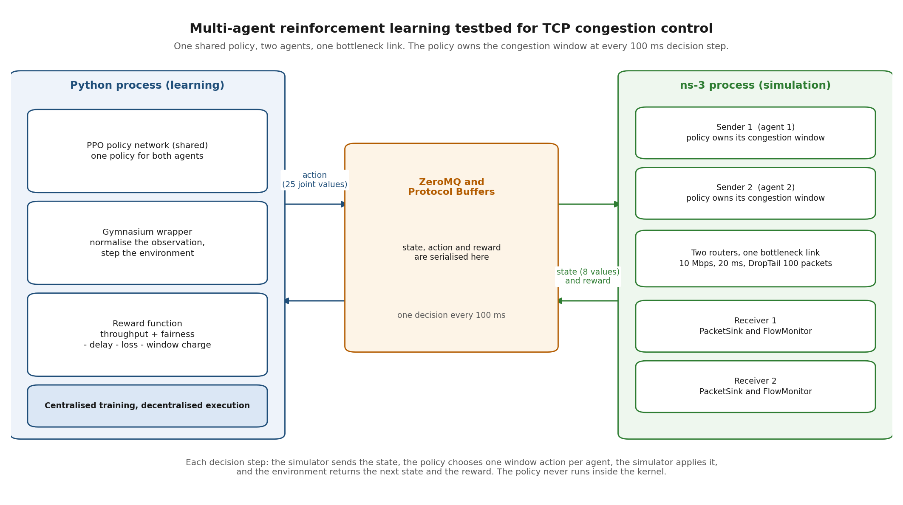
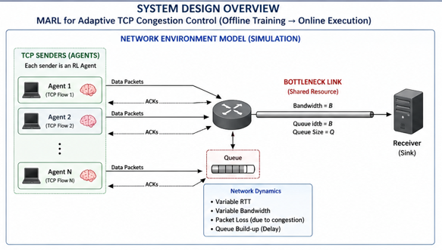
DESIGN AND IMPLEMENTATION
Network: two senders share one bottleneck link of 10 Mbps with 20 ms one-way delay. The router uses a DropTail queue (drops new packets when full) holding 100 packets.
Bridge: ns3-gym exposes ns-3 to Python through Gymnasium. ZeroMQ carries messages and Protocol Buffers (a binary data format) packs them.
Training: Stable-Baselines3, built on PyTorch, runs PPO with a shared policy. The delivered policy was warm-started by behaviour cloning from a reference controller and then refined with PPO. The agent chooses a new action every 100 ms.
Figure 3.1: Multi-agent simulation testbed.
Problems found and fixed during implementation
Throughput read as zero
Throughput was summed from bytes in flight. It now reads delivered bytes from the receiver.
Window set to 1100 bytes
Actions set an absolute value. They now scale the current window by the chosen multiplier.
Training crashed with NaN
Unscaled inputs broke the training. A Python wrapper now normalizes them.

Slide 8
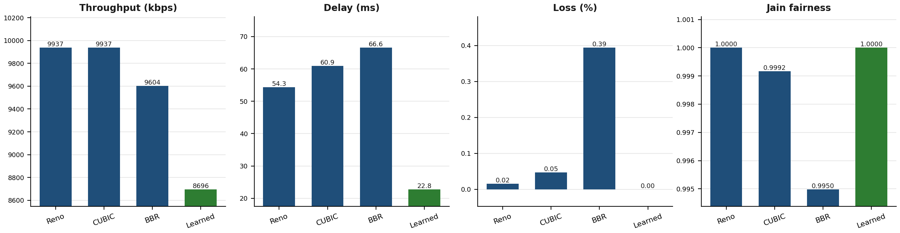
RESULTS/FINDINGS
Two-agent evaluation, 60-second run (Table 4.1)
Metric | Agent 1 | Agent 2 | Total / Average
Throughput | 4348.2 kbps | 4348.2 kbps | 8696.3 kbps
Delay | 22.81 ms | 22.80 ms | 22.80 ms
Loss ratio | 0.00% | 0.00% | 0.000%
Jain's Fairness | - | - | 1.0000
86.96%
of the 10 Mbps link used
1.0000
Jain's Fairness Index (1.0 is equal)
Training
The shared policy was warm-started by behaviour cloning from a reference controller and then refined with PPO. It holds the window near the bandwidth-delay product of the bottleneck.

Slide 9
RESULTS/FINDINGS (CONTINUED)
An earlier evaluation produced numbers identical to two standard TCP CUBIC flows. The fault was found and corrected, and the policy now controls the congestion window.
1. Configuration order
A custom no-op class disables ns-3 congestion control. It was configured before the TCP protocol object existed, so the setting matched nothing.
2. Silent default
The configuration function does not report a miss. Every socket used the default, TCP CUBIC, which changed the window on every acknowledgment.
3. Corrected and verified
The setting now runs after the internet stack installs and aborts on a miss. The program prints the live algorithm name, NoOpTcpCongestion.
What holds now
The RL actions own the window. A constant hold action keeps cwnd at exactly 5,360 bytes, which CUBIC cannot do.
The corrected policy keeps 86.96 percent of the link busy with 22.80 ms delay, no measured loss and a Jain fairness index of 1.0000.

Slide 10
CONTRIBUTION TO KNOWLEDGE
A reference implementation
A cooperative multi-agent formulation of congestion control, built with ns-3, ns3-gym, and PPO, using a reward based on Jain's Fairness Index. Code and models are public: github.com/Ksschkw/CongestiQ-FYP
Engineering documentation
A record of the failure points when linking Python learning code to the ns-3 C++ transport layer: the throughput bug, the action bug, and a configuration ordering fault that silently left the default TCP algorithm in control.
A systems finding
A congestion control replacement must be attached after the internet stack installs on a node. The configuration API does not report a miss, so a wrong order leaves the native algorithm in control, and every metric then describes that algorithm.
Recommended next steps
1. Attach the no-op congestion control after the internet stack installs, and verify it at runtime on a live socket.
2. Compile the trained network into an Extended Berkeley Packet Filter (eBPF) program for the Linux kernel.
3. Test in an emulator such as Mininet.
4. Trigger decisions once per round-trip time, not on a 100 ms timer.

Slide 11

QUESTIONS?

Slide 12

Thank you for listening

