Slide 1
Exploratory_Data_Analysis_on_Dataset-Terrorism
File created on: 21-09-2021 23:52:04

Slide 2
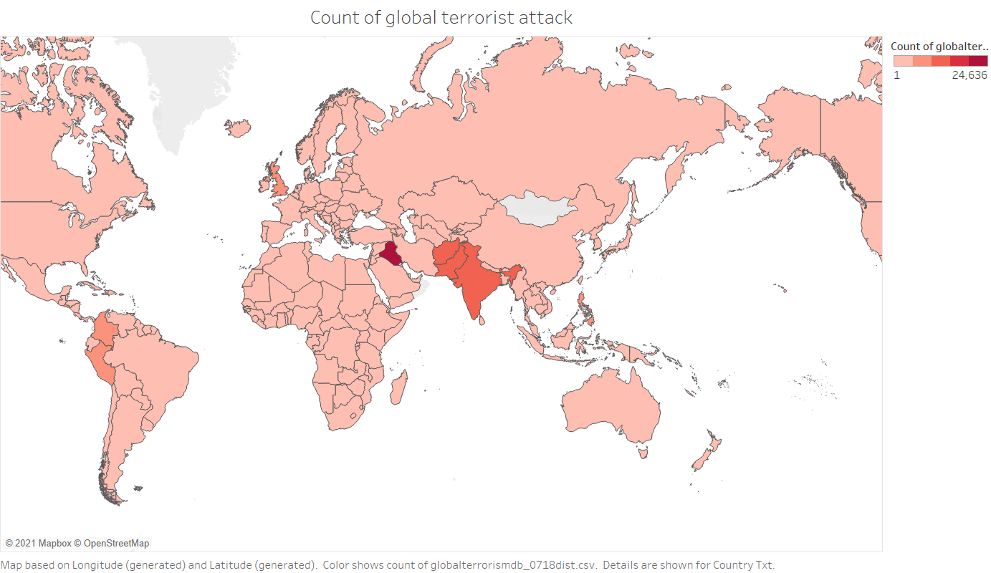

Slide 3
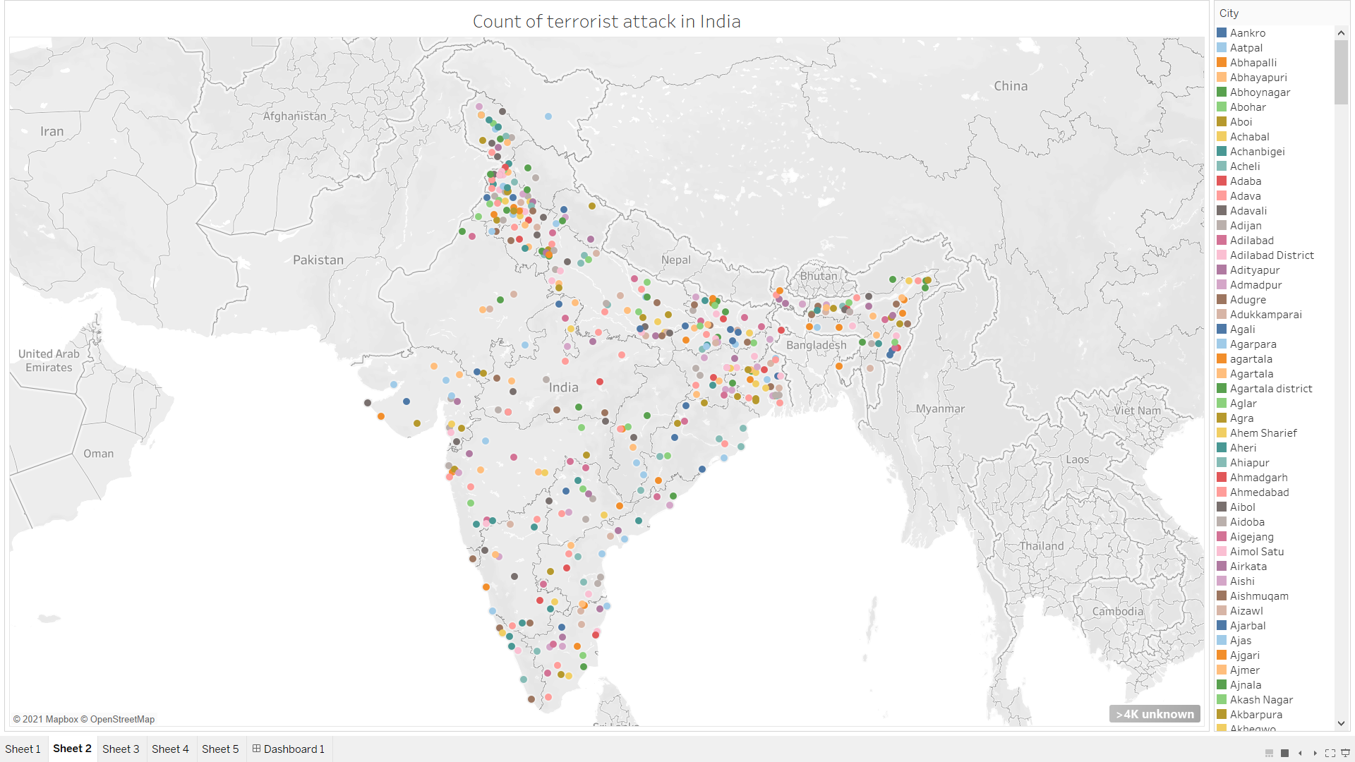

Slide 4
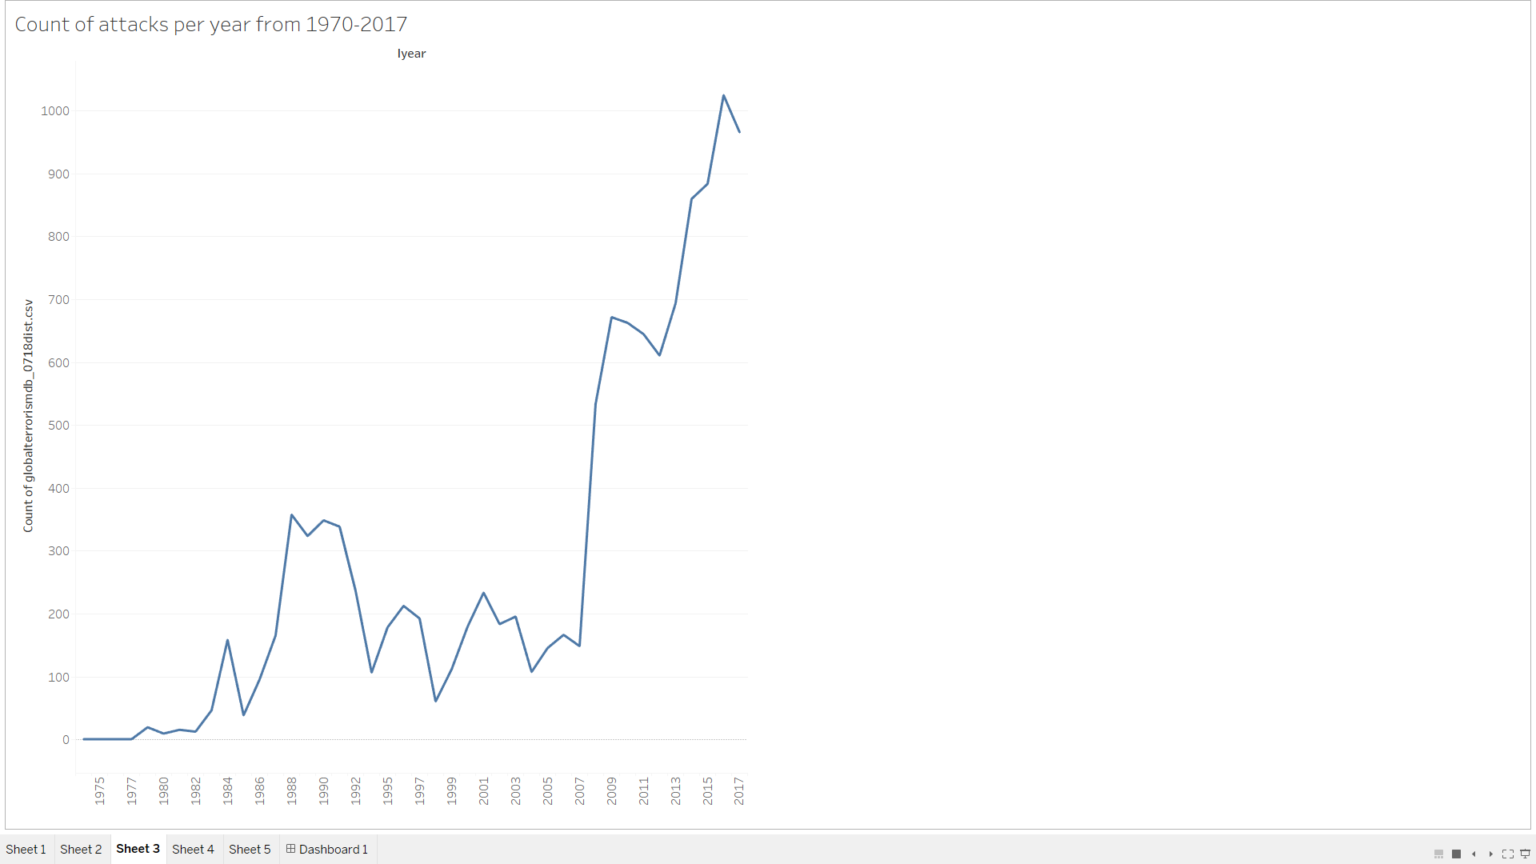

Slide 5
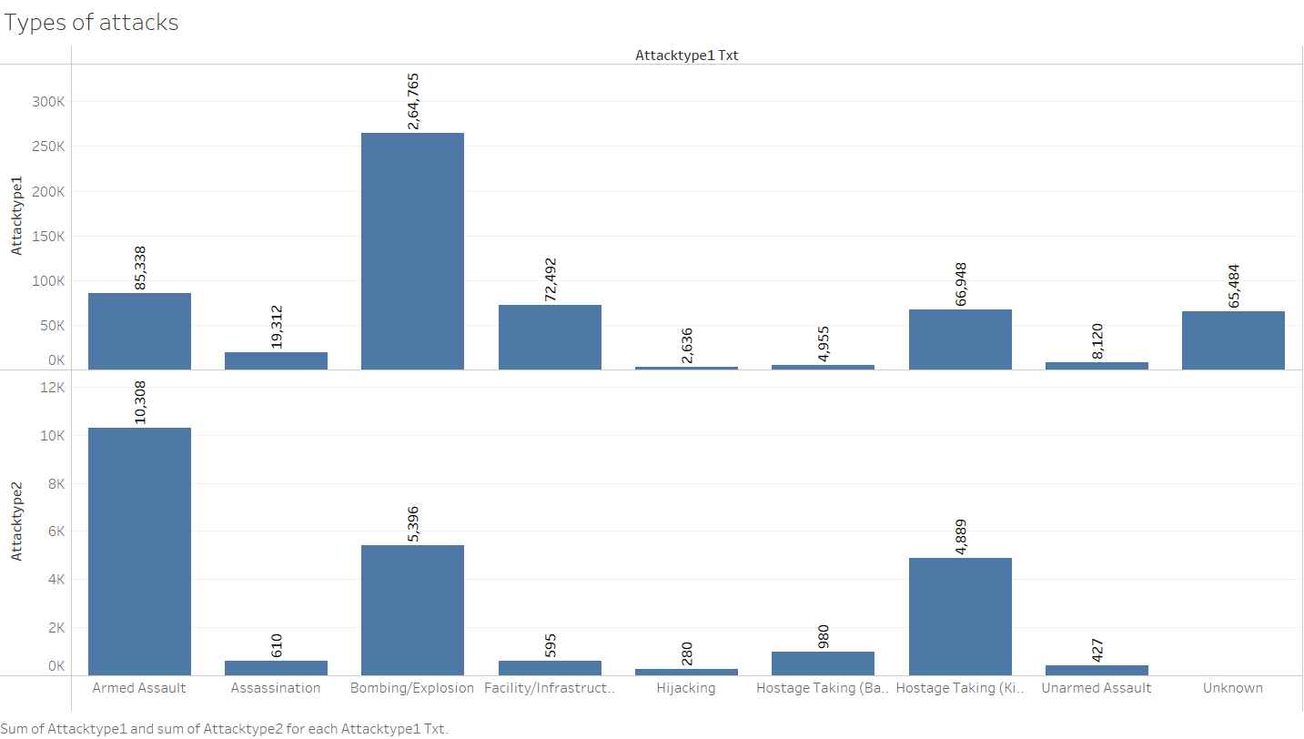

Slide 6
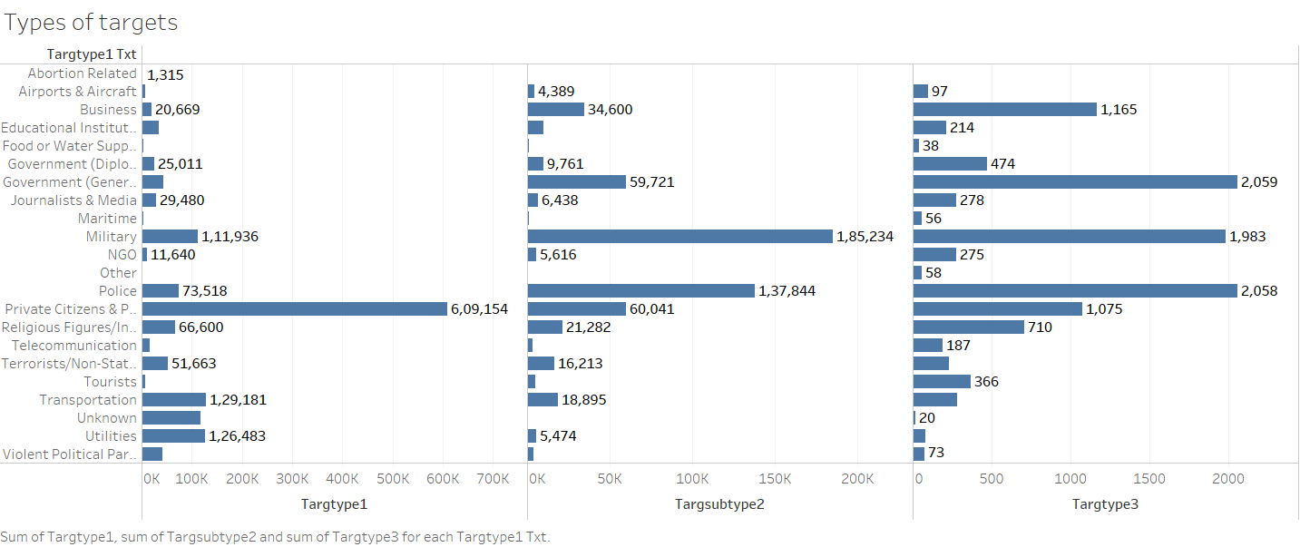

Slide 7
