Slide 1
linux

Slide 2
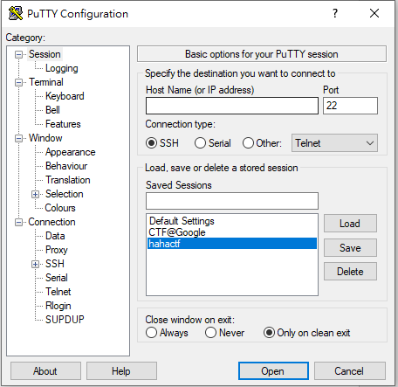

Slide 3


Slide 4


Slide 5
xxd
linux xxd

Slide 6


Slide 7
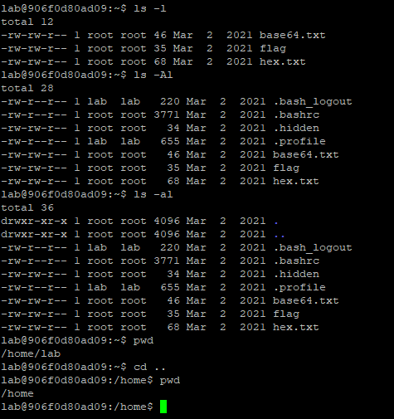

Slide 8
pwd

Slide 9
ls
ls –l
ls –a
ls –A
ls –Al

Slide 10


Slide 11


Slide 12
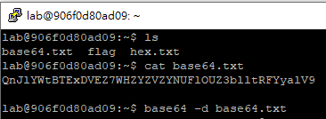

Slide 13
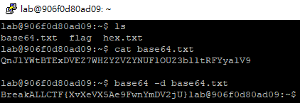

Slide 14
Linux find

Slide 15
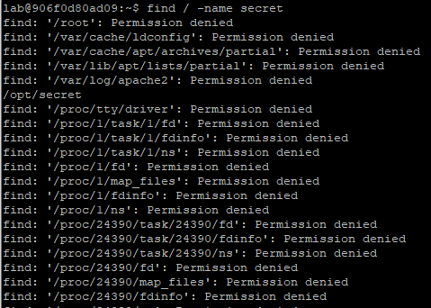
find / -name secret

Slide 16


Slide 17
Permission denied
允許
權限
被拒絕
權限不足 無法開啟

Slide 18

PS
process(行程) list

Slide 19
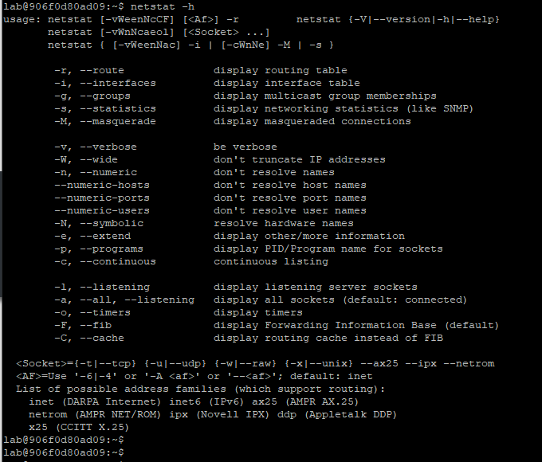

Slide 20
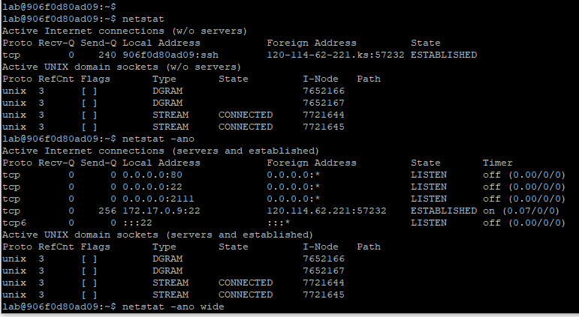

Slide 21
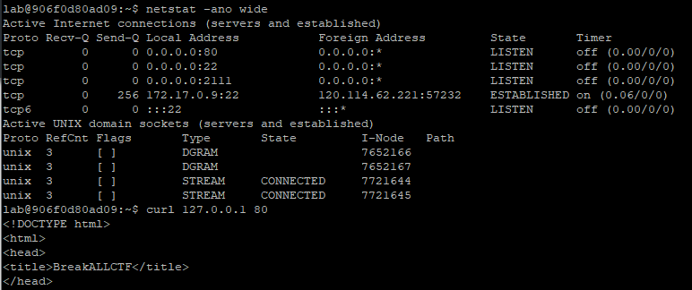

Slide 22
wget
tar

Slide 23
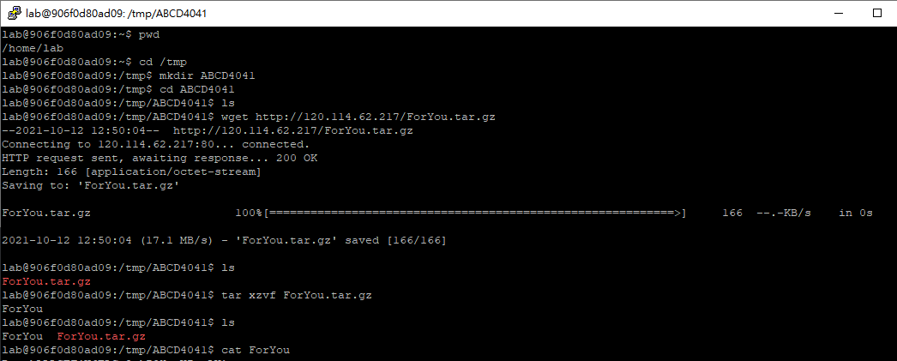

Slide 24
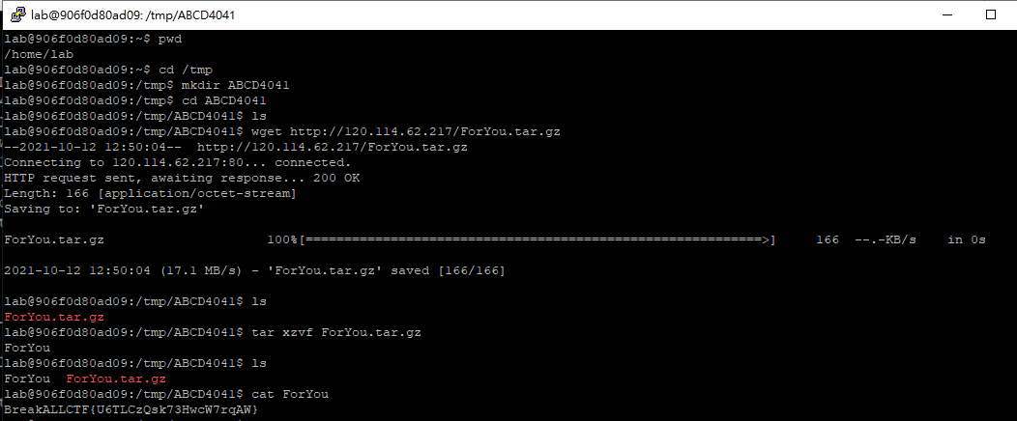

Slide 25
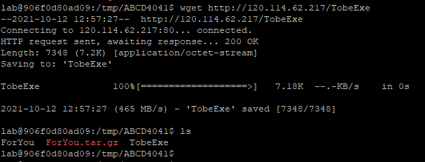

Slide 26
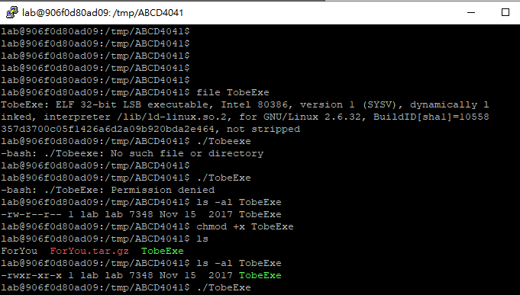

Slide 27
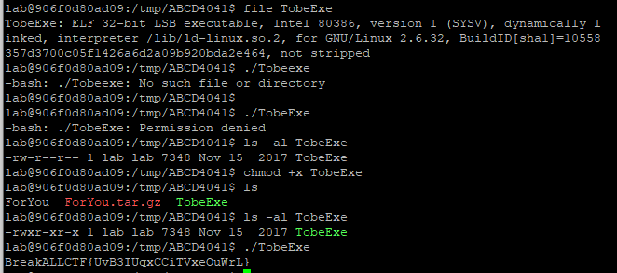

Slide 28
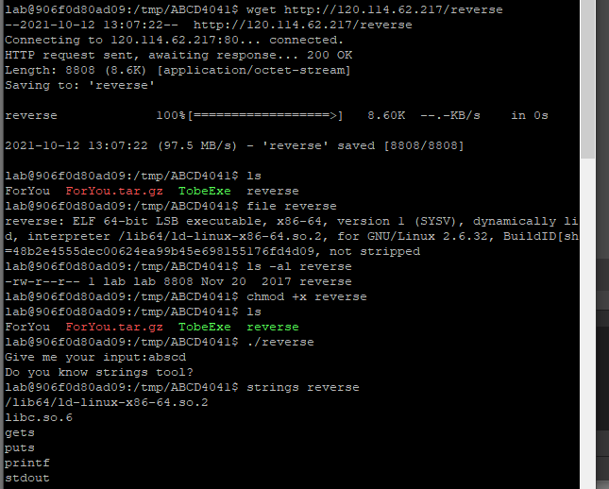

Slide 29
