Slide 1
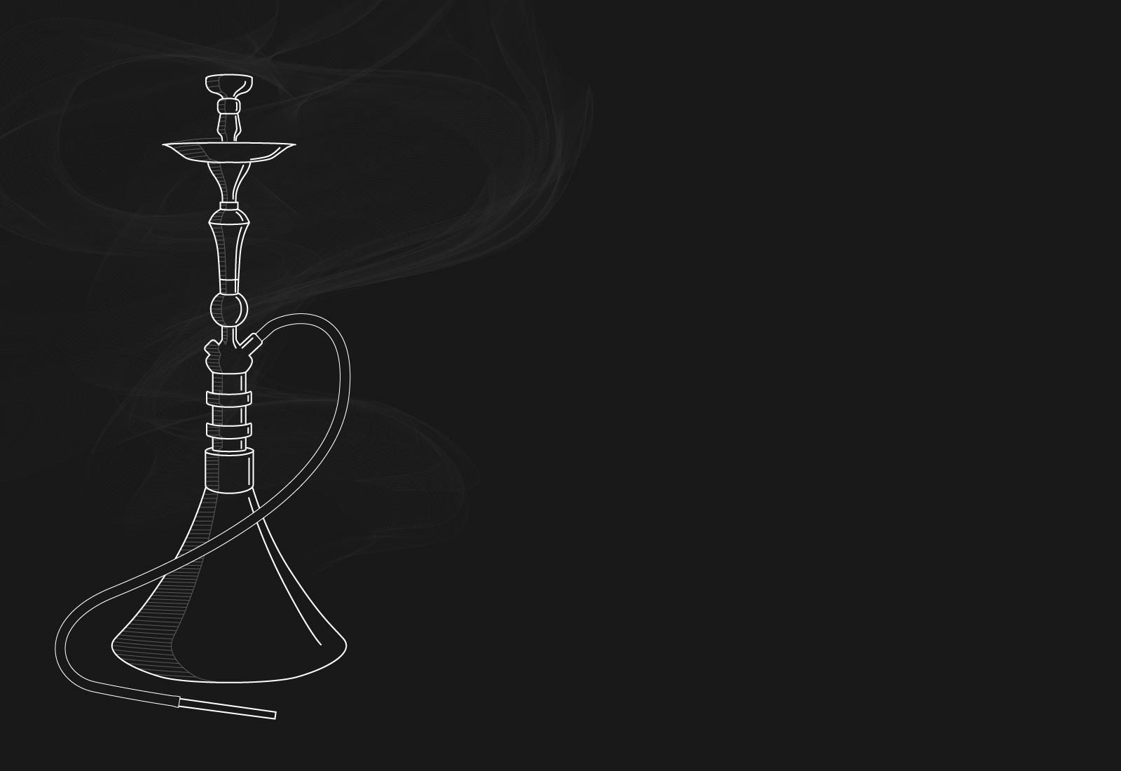
Hookah bar
MUST HAVE MOHITO
MUST HAVE MOHITO
1000
.00
1000
.00
MUST HAVE LIGHT
MUST HAVE LIGHT
1000
.00
1000
.00
DARK SIDE LIGHT
DARK SIDE LIGHT
1200
.00
1200
.00
Other
DARK SIDE LIGHT
DARK SIDE LIGHT
1200
.00
1200
.00

