Slide 1
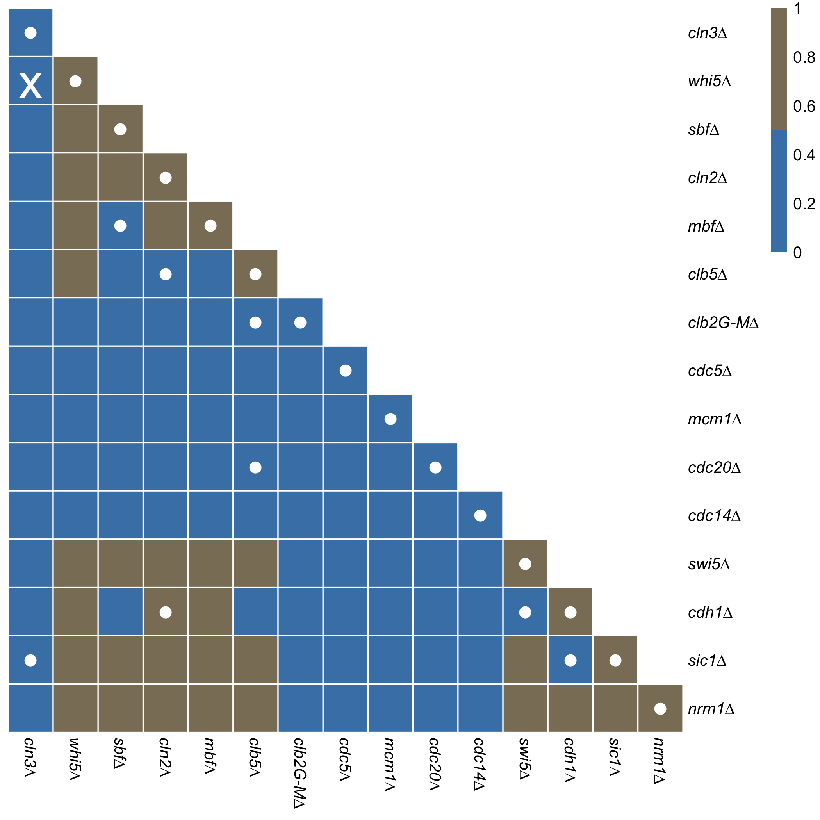
X = Inconsistent with experiment
• = Consistent with experiment

