Slide 1
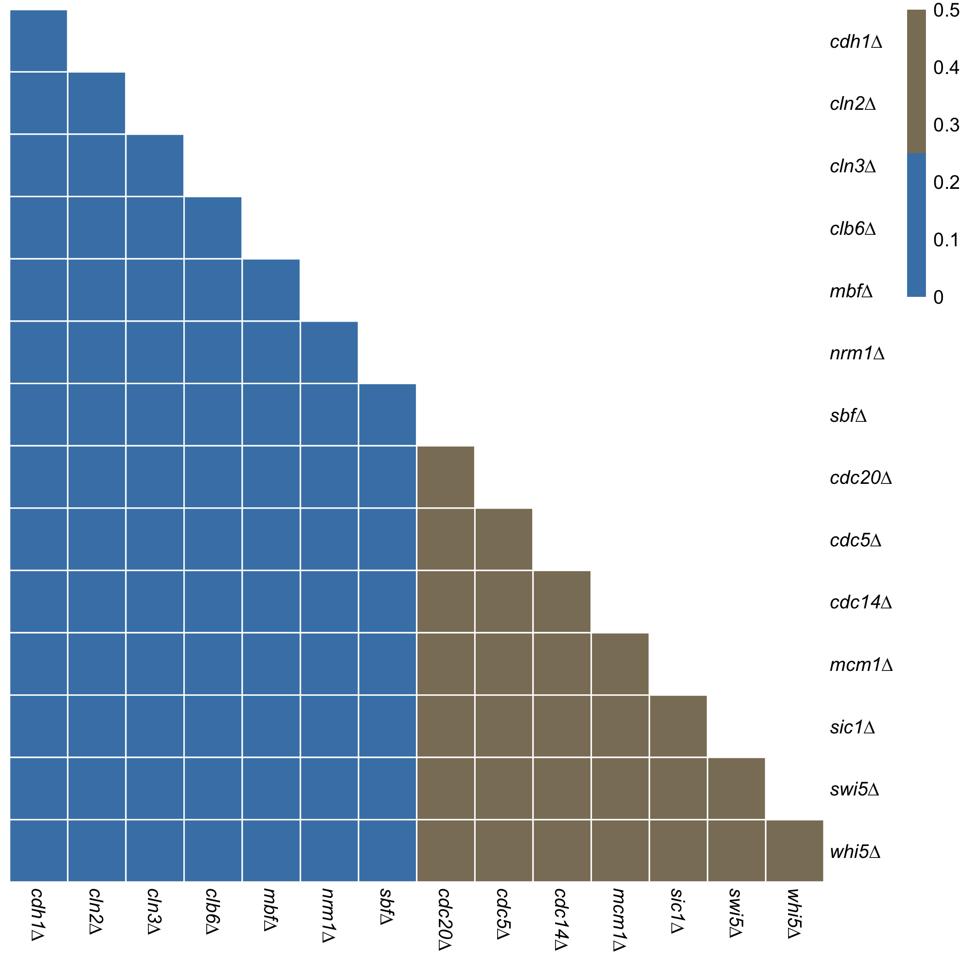
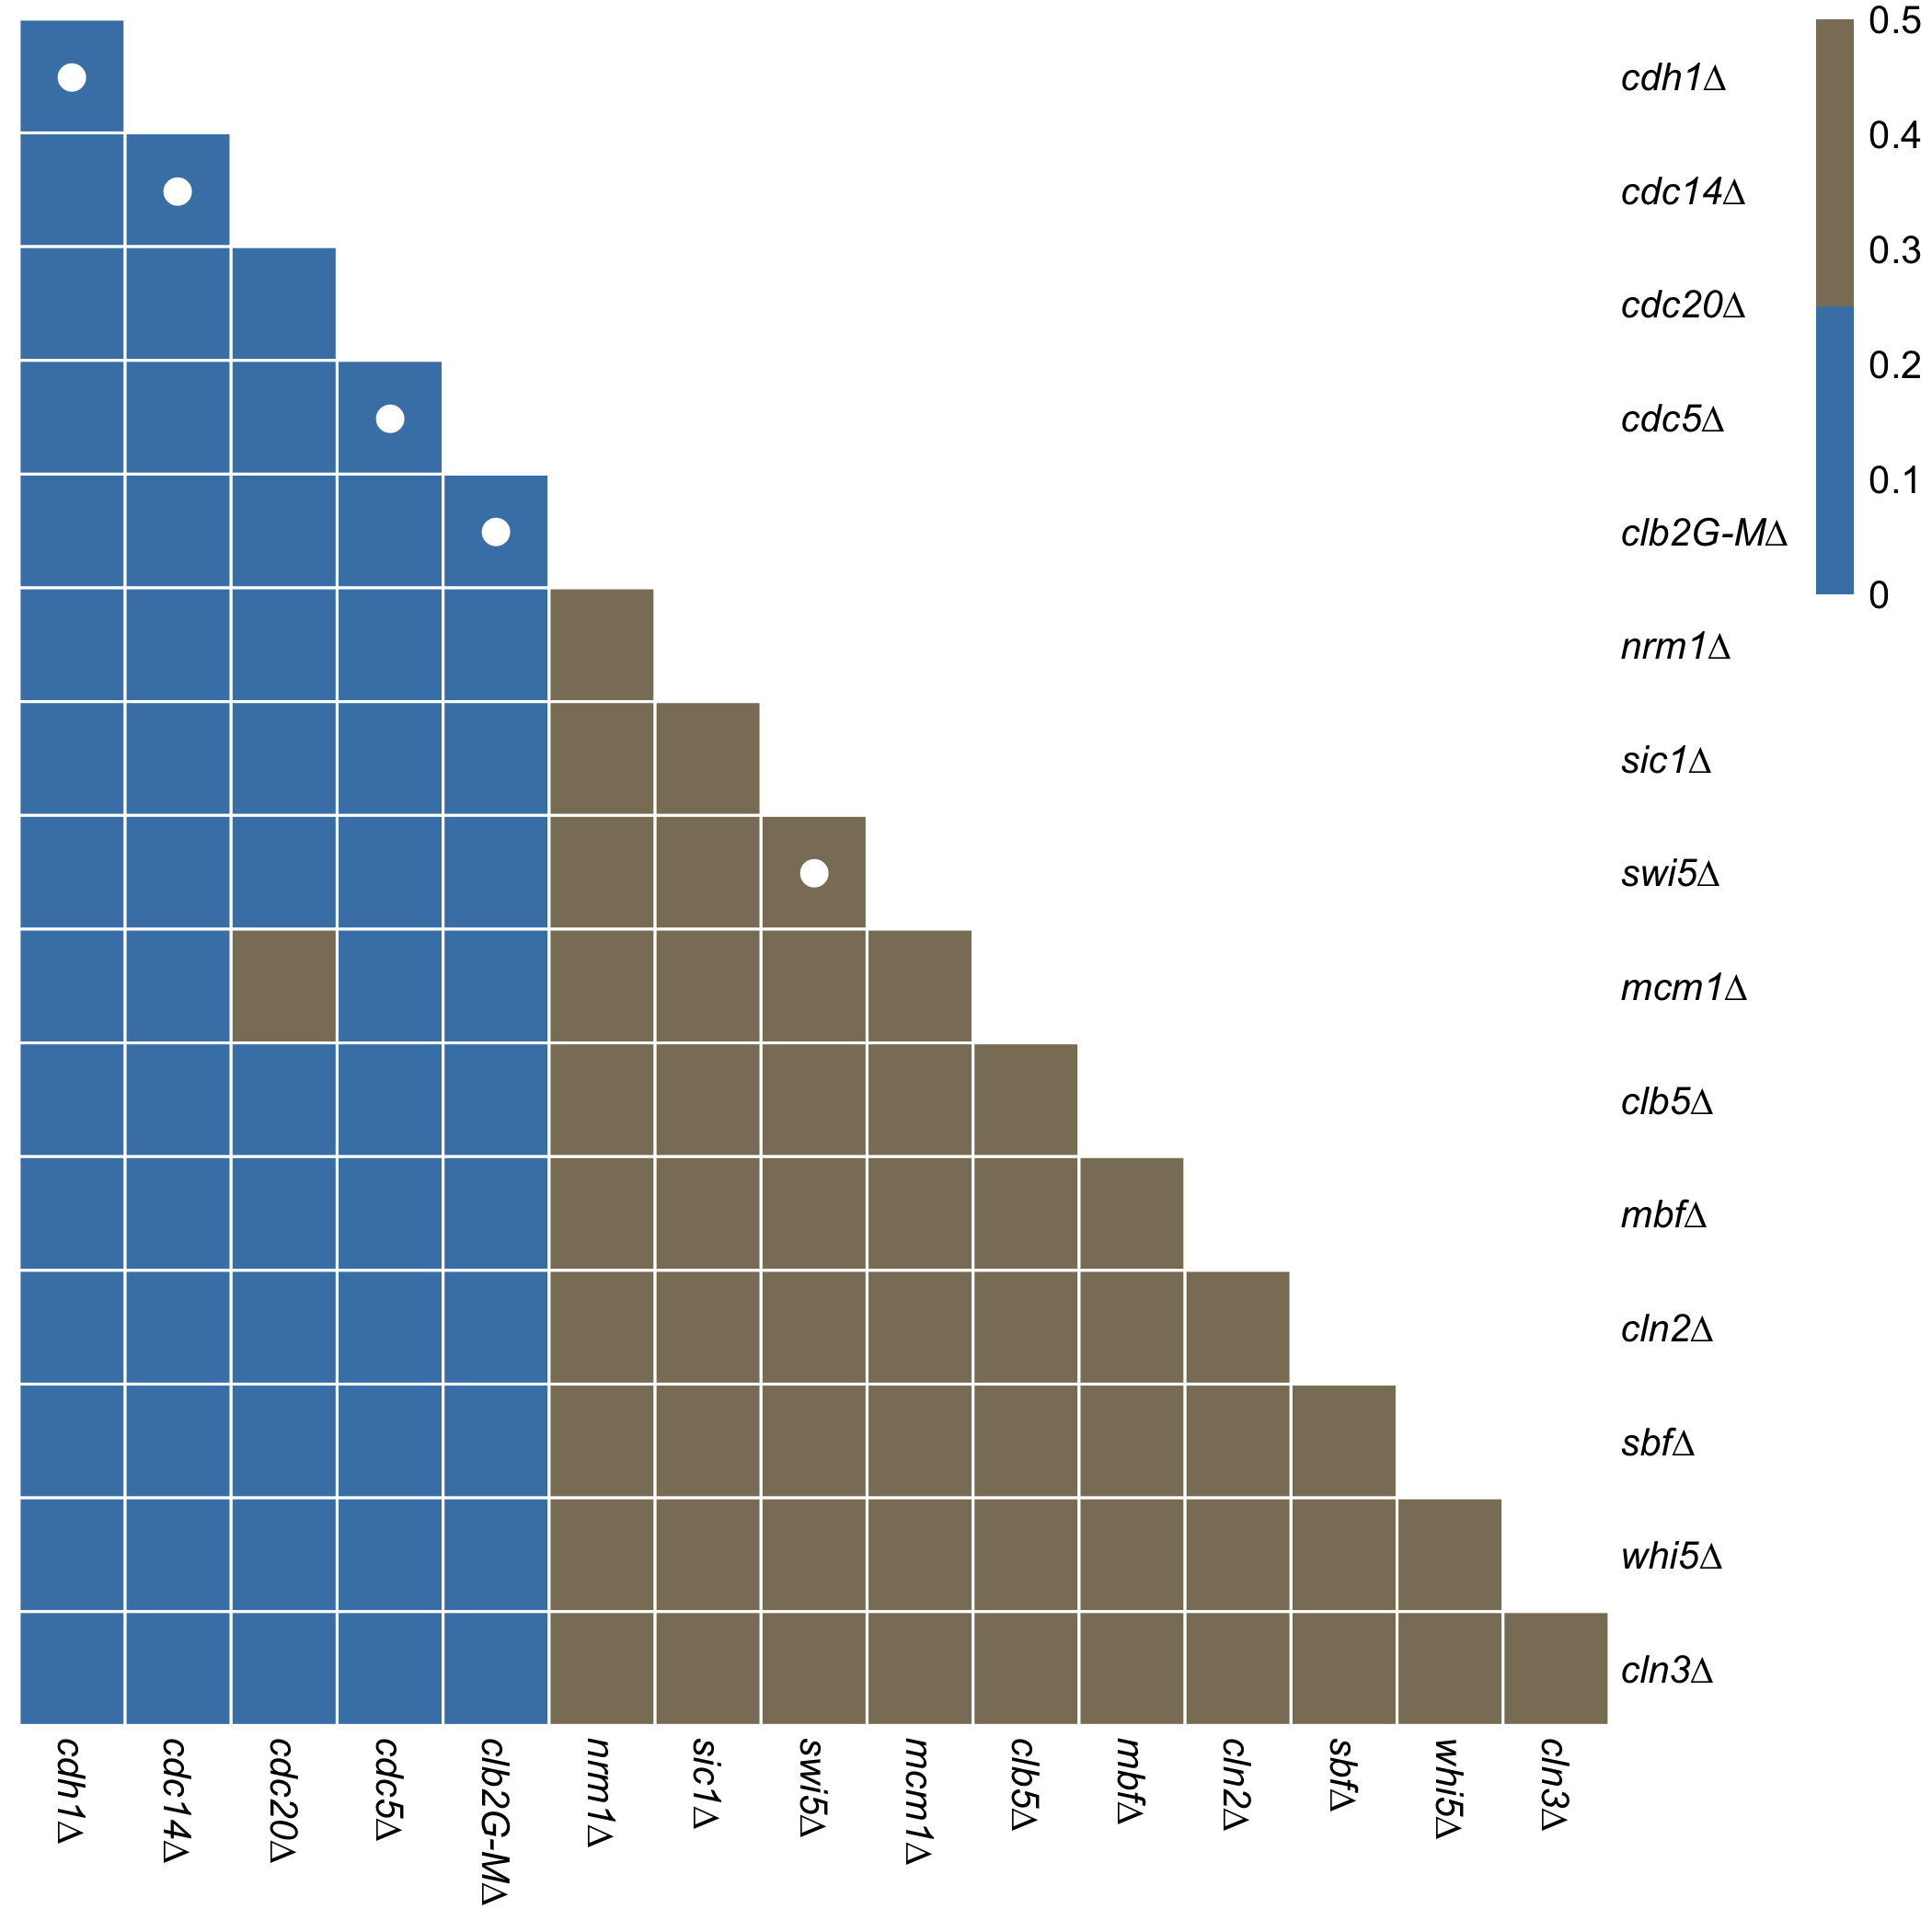
A)
B)
X = Inconsistent with experiment
• = Consistent with experiment

