Slide 1
Scalable Global Optimization via Local Bayesian Optimization
2019 Neurips Spotlight Paper
Taehyeon Kim

Slide 2
Contents
What is Bayesian Optimization (BO) ?
What is a key challenge?
What is TuRBO?
Implementation detail
Conclusion

Slide 3
What is Bayesian Optimization (BO) ?
Application
Hyperparameter Optimization
Learning a controller in robotics
Processing conditions in materials discovery

Slide 4
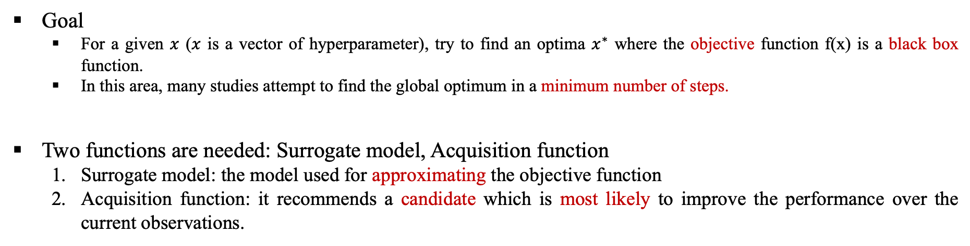
1. What is Bayesian Optimization (BO) ?
Goal
For a given $x$ ($x$ is a vector of hyperparameter), try to find an optima $x^{∗}$ where the objective function f(x) is a black box function.
In this area, many studies attempt to find the global optimum in a minimum number of steps.
Two functions are needed: Surrogate model, Acquisition function
Surrogate model: the model used for approximating the objective function
Acquisition function: it recommends a candidate which is most likely to improve the performance over the current observations.

Slide 5
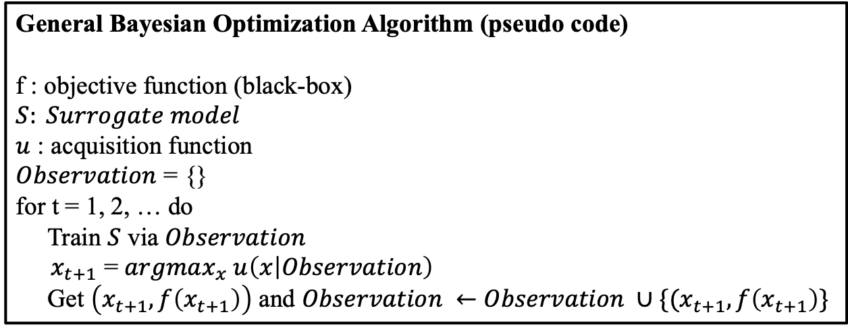
1. What is Bayesian Optimization (BO) ?
General Bayesian Optimization Algorithm (pseudo code)
f : objective function (black-box)
$S: Surrogate model$
$u$ : acquisition function
$Observation$ = {}
for t = 1, 2, … do
Train $S$ via $Observation$
${ x}_{t+1}$ = $argmax_{x} u\left(x | Observation\right)$
Get $\left(x_{t+1}, f\left(x_{t+1}\right)\right)$ and $Observation ←Observation ∪\{(x_{t+1}, f\left(x_{t+1}\right)\}$

Slide 6
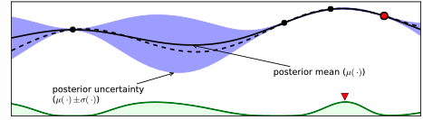
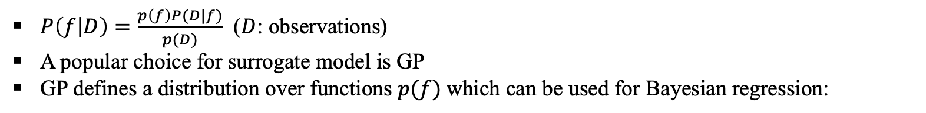
1. What is Bayesian Optimization (BO) - GP
Prior
Posterior
Likelihood
$P\left(f | D\right)=\frac{p\left(f\right)P(D|f)}{p(D)}$ ($D$: observations)
A popular choice for surrogate model is GP
GP defines a distribution over functions $p(f)$which can be used for Bayesian regression:

Slide 7
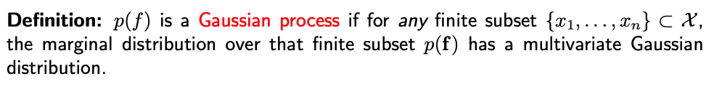
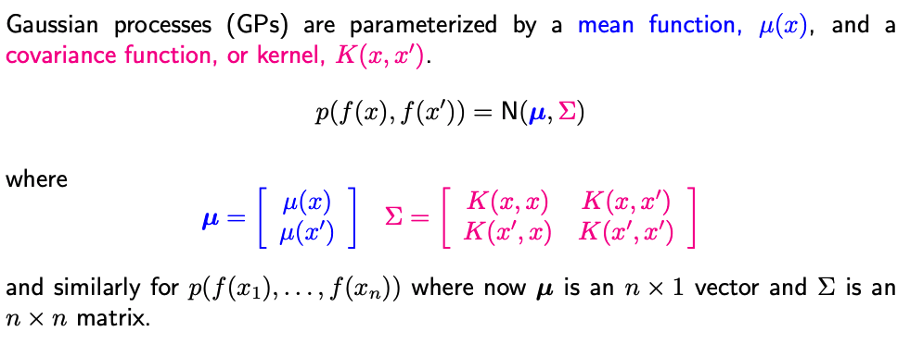
1. What is Bayesian Optimization (BO) - GP
Source: http://learning.eng.cam.ac.uk/zoubin

Slide 8
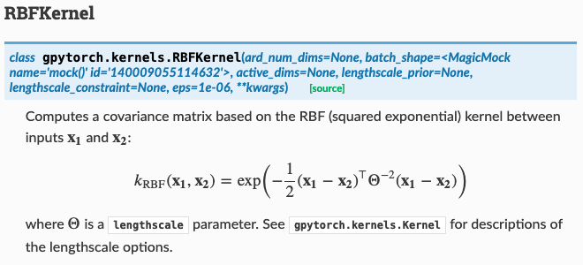
1. What is Bayesian Optimization (BO) - GP
Example of kernel function

Slide 9
2. What is a key challenge?
Challenges
It often scales poorly to high dimensions and large sample budgets.
Why is it hard?
The search space grows exponentially with the dimension while local optima become more plentiful.
The function is often heterogeneous, making the task of fitting a global surrogate model challenging.
Sparse reward (discrete) in bandit or RL.
The fact that search spaces grow considerably faster than sampling budgets due to the curse of dimensionality implies the inherent presence of regions with large posterior uncertainty.

Slide 10
3. What is TuRBO
Strategy
Adopt a local strategy for BO with the concept of trust region.
With N independent trust regions, run using independent probabilistic models, respectively.
Each trust region has local surrogate model.
To optimize globally, they leverage an implicit multi-armed bandit strategy (Thompson sampling) at each iteration to allocate samples between these local areas.

Slide 11
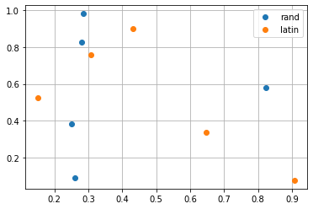
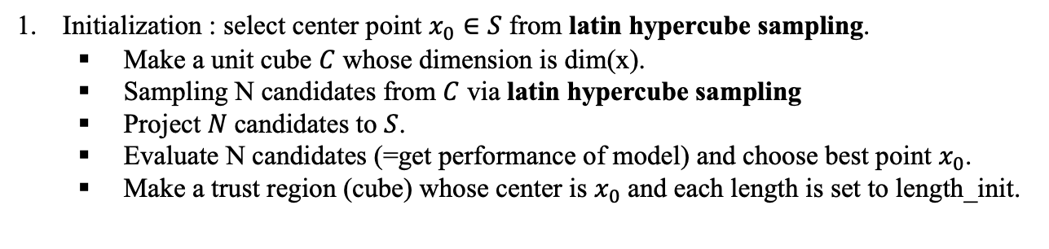
4. Details – TuRBO1
Initialization : select center point $x_{0}∈S$ from latin hypercube sampling.
Make a unit cube $C$ whose dimension is dim(x).
Sampling N candidates from $C$ via latin hypercube sampling
Project $N$candidates to $S$.
Evaluate N candidates (=get performance of model) and choose best point $x_{0}$.
Make a trust region (cube) whose center is $x_{0}$ and each length is set to length_init.
Latin Hypercube sampling one must first decide how many sample points to use and for each sample point remember in which row and column the sample point was taken. Such configuration is similar to having N rooks on a chess board without threatening each other.
https://en.wikipedia.org/wiki/Latin_hypercube_sampling

Slide 12
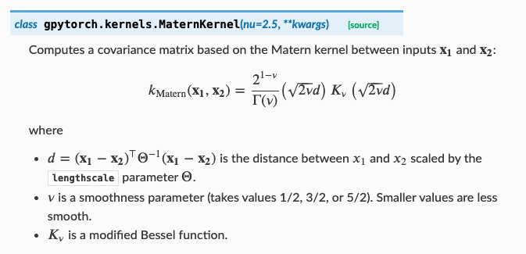
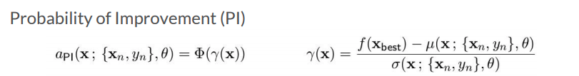
4. Details – TuRBO1
2. (After initialization) while convergence:
GP training (Surrogate model: GP)
Select candidate (Acquisition function: PI (probability of Improvement)
Adjust length
Train GP model (+ matern kernel) based on Observations
Choose new center and make Trust Regions based on length
Create N candidates via SobolEngine in Trust Region
Add random perturbation
Select M candidates among N candidates via PI

Slide 13
4. Details – TuRBO1
2. (After initialization) while convergence:
GP training (Surrogate model: GP)
Select candidate (Acquisition function: PI (probability of Improvement)
Adjust length
Implicit bandit algorithm: Thompson sampling is applied
If winning candidate is in selected candidates, +1 to success.
Else, +1 to fail.
There is success tolerance and fail tolerance.
If the number of success is equal to success tolerance, expand the length of trust region. (multiply 2x)
If the number of failure is equal to failure tolerance, shrink the length of trust region. (divide 2%)
3. Restart
After a few fails, if length is lower than minimum length, restart !!

Slide 14
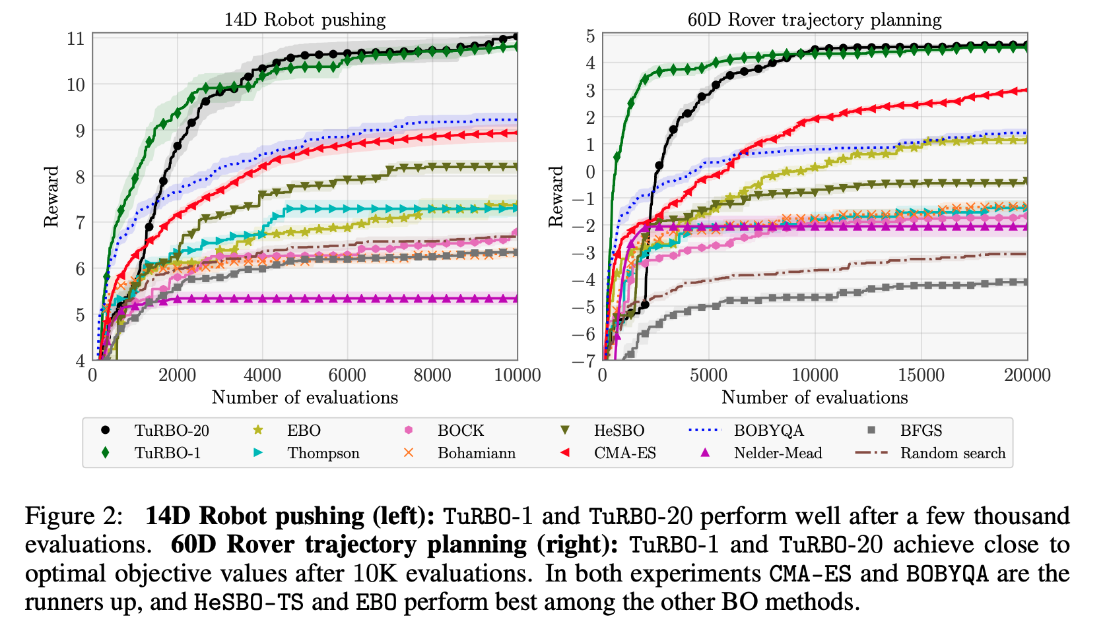
4. Details – TuRBOm
Run M parallel TuRBO1 models!

Slide 15
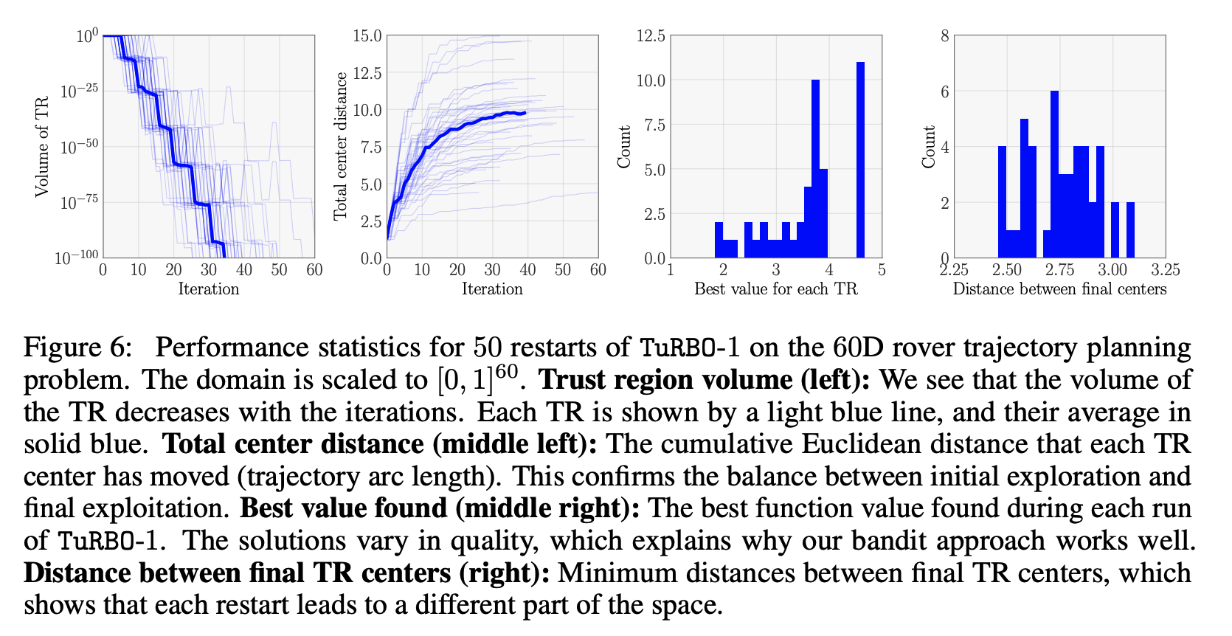
5. Discussion
Local GPs have the advantage of being able to learn different hyperparameters in each region while the global GP has the advantage of having access to all of the data
Why high-dimensional spaces are challenging
Each TR restart finds distant solutions of varying quality, which highlights the multimodal nature of the problem.

Slide 16
5. Discussion
In my opinion,
Still many things are not investigated;
Other bandit based algorithms?
How about explicit bandit algorithms?
Broadly applicable! Maybe it is easy to combine TuRBO with other algorithms
Just change kernel and acquisition function!
There is no theoretical analysis and many hyperparameters
Maximum length, minimum length, number of candidates, train epoch, kernel, space shape (ball or cube)

