Slide 1
On the training dynamics of deep networks with L2 regularization
GSAI Taehyeon Kim

Slide 2
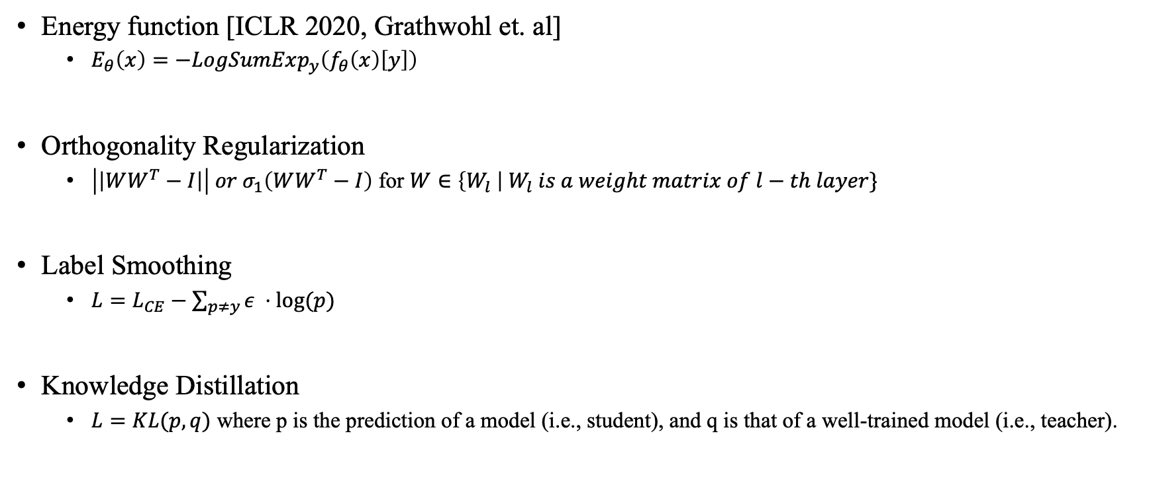
Regularizations in CNN
Energy function [ICLR 2020, Grathwohl et. al]
$E_{θ}\left(x\right)=−LogSumExp_{y}\left(f_{θ}\left(x\right)\left[y\right]\right)$
Orthogonality Regularization
$\left|\left|WW^{T}−I\right|\right| or σ_{1}\left(WW^{T}−I\right)$ for $W∈\left\{W_{l} \right| W_{l} is a weight matrix of l−th layer\}$
Label Smoothing
$L=L_{CE}−\sum_{p≠y}{ε ⋅log⁡(p) }$
Knowledge Distillation
$L=KL(p, q)$ where p is the prediction of a model (i.e., student), and q is that of a well-trained model (i.e., teacher).

Slide 3
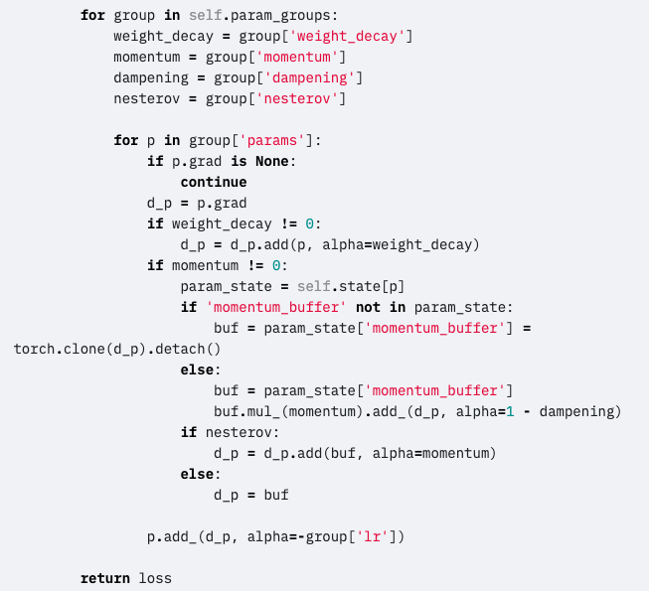
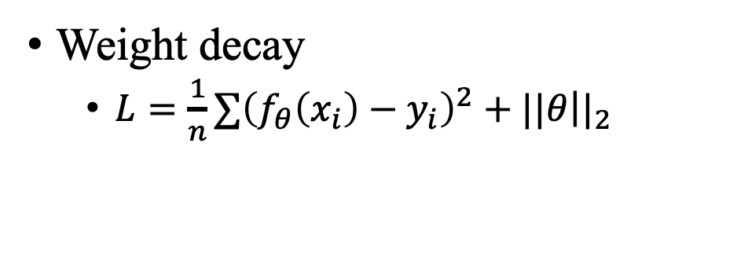
Weight decay
Weight decay Code in Torch
Weight decay
$L=\frac{1}{n}∑{\left(f_{θ}\left(x_{i}\right)−y_{i}\right)}^{2}+||θ{\left.​\right||}_{2}$
https://pytorch.org/docs/stable/_modules/torch/optim/sgd.html#SGD

Slide 4
Weight decay in Batchnorm
No clear tuning strategy.
The theoretical motivation for its use is less clear.
https://pytorch.org/docs/stable/_modules/torch/optim/sgd.html#SGD

Slide 5
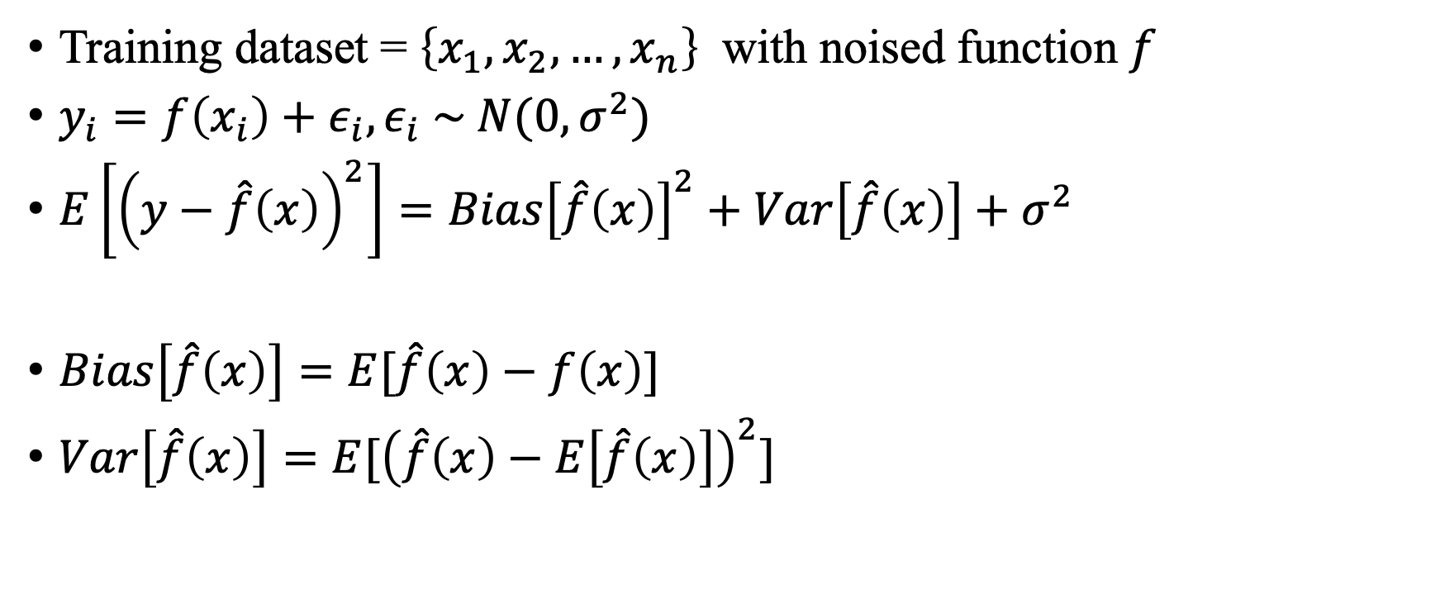
Bias & Variance
Training dataset = $\left\{x_{1},x_{2}, …, x_{n}\right\}$ with noised function $f$
$y_{i}=f\left(x_{i}\right)+ε_{i}, ε_{i} \sim N(0, σ^{2})$
$E\left[{\left(y−\hat{f}\left(x\right)\right)}^{2}\right]=Bias{\left[\hat{f}\left(x\right)\right]}^{2}+Var\left[\hat{f}\left(x\right)\right]+σ^{2}$
$Bias\left[\hat{f}\left(x\right)\right]=E[\hat{f}\left(x\right)−f\left(x\right)]$
$Var\left[\hat{f}\left(x\right)\right]=E[{\left(\hat{f}\left(x\right)−E\left[\hat{f}\left(x\right)\right]\right)}^{2}]$
High Bias
Low Variance
Low Bias
High Variance
https://en.wikipedia.org/wiki/Bias%E2%80%93variance_tradeoff

Slide 6
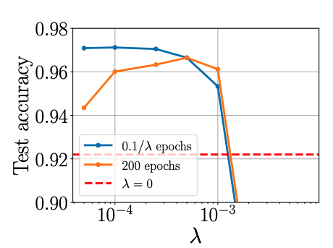


Optimal Value of the $L_{2}$ parameter
The number of SGD steps until a model achieves maximum performance is $t_{∗}≈\frac{c}{λ}$, where c is a coefficient that depends on the data, the architecture, and all other hyperparameters.

Slide 7
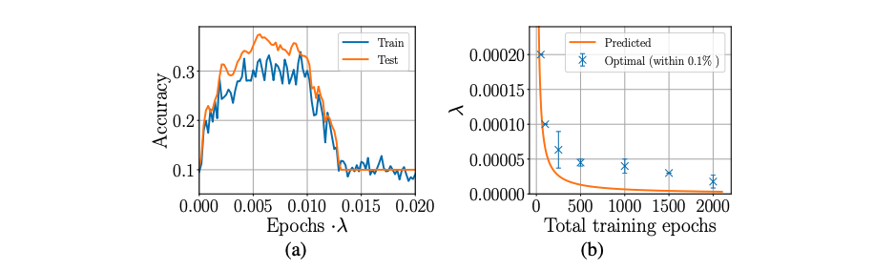

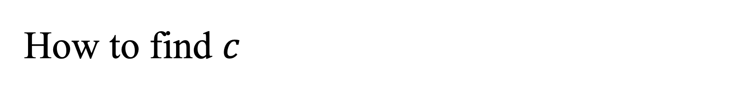
How to find $c$
Firstly, training the model with a large L_2 parameter for 2 epochs in order to measure c, and find optimal value (below $≈0.0066)$. Then retrain the model with the tuned value of $λ$

Slide 8

More: Optimal value in vanilla SGD training
When training with vanilla SGD (without momentum), we observe that the number of steps until maximum performance depends on the learning rate $η$ and on $λ$ as $t_{∗}≈\frac{c^{′}}{η⋅λ}$

Slide 9
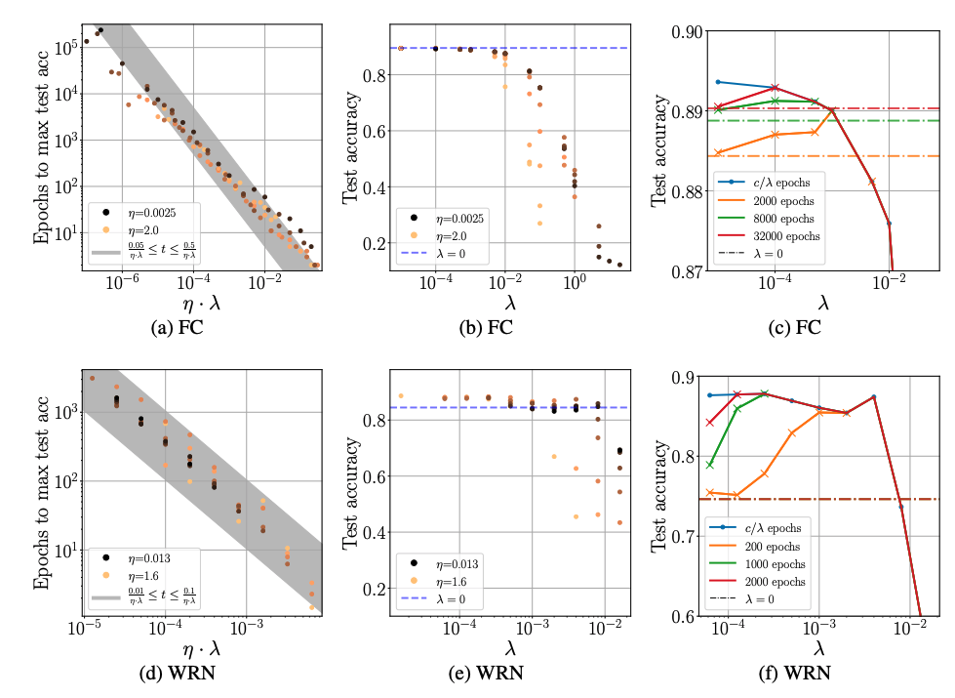
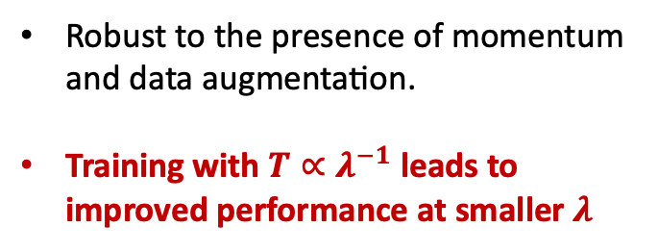
More: Optimal value in vanilla SGD training
Robust to the presence of momentum and data augmentation.
Training with $T∝λ^{−1}$ leads to improved performance at smaller $λ$

Slide 10
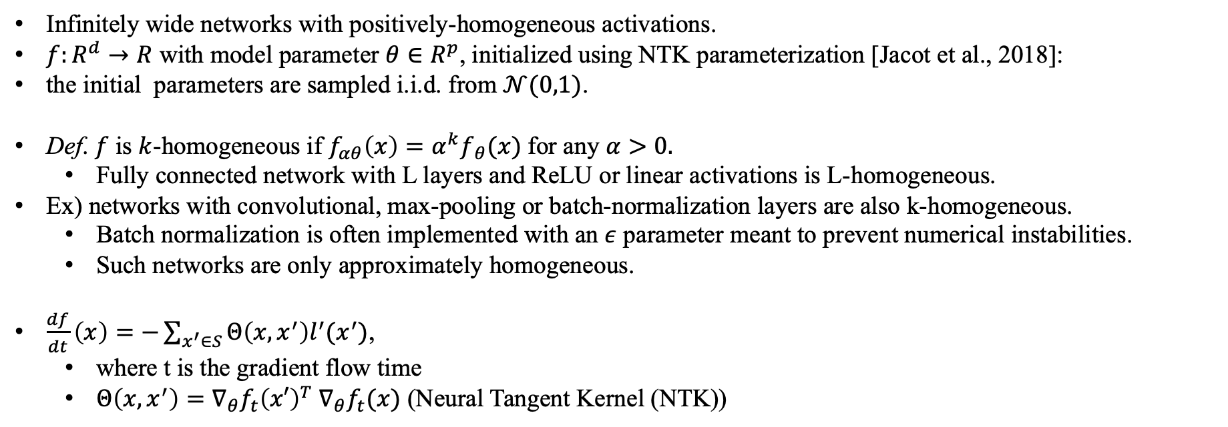
Thm: infinitely wide networks with positively-homogeneous activations
Infinitely wide networks with positively-homogeneous activations.
$f:R^{d}→R$ with model parameter $θ∈R^{p}$, initialized using NTK parameterization [Jacot et al., 2018]:
the initial parameters are sampled i.i.d. from $𝒩(0,1)$.
Def. $f$ is $k$-homogeneous if $f_{αθ}\left(x\right)=α^{k}f_{ θ}(x)$for any $α>0.$
Fully connected network with L layers and ReLU or linear activations is L-homogeneous.
Ex) networks with convolutional, max-pooling or batch-normalization layers are also k-homogeneous.
Batch normalization is often implemented with an $ε$ parameter meant to prevent numerical instabilities.
Such networks are only approximately homogeneous.
$\frac{df}{dt}\left(x\right)=−\sum_{x^{′}∈S}{Θ\left(x,x^{′}\right)l^{′}(x^{′})}$,
where t is the gradient flow time
$Θ\left(x,x^{′}\right)=∇_{θ}f_{t}{\left(x′\right)}^{T}$ $∇_{θ}f_{t}(x)$ (Neural Tangent Kernel (NTK))

Slide 11
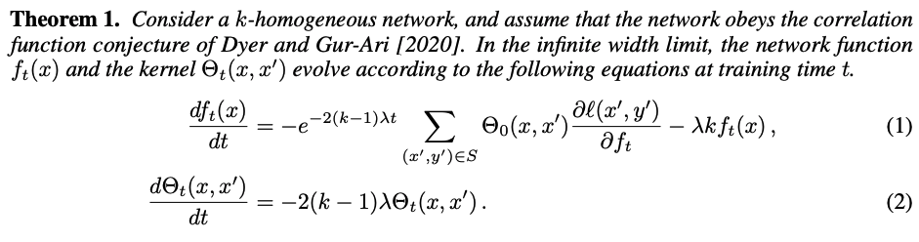
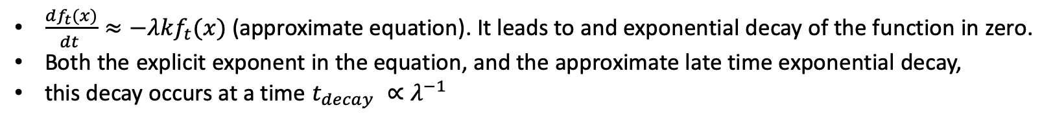
Thm: infinitely wide networks with positively-homogeneous activations
$\frac{df_{t}(x)}{dt }≈−λkf_{t}(x)$ (approximate equation). It leads to and exponential decay of the function in zero.
Both the explicit exponent in the equation, and the approximate late time exponential decay,
this decay occurs at a time $t_{decay} ∝λ^{−1}$

Slide 12
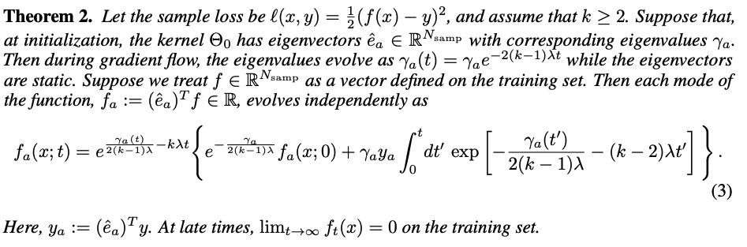
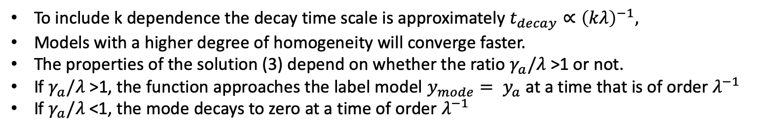
Thm: infinitely wide networks with positively-homogeneous activations
To include k dependence the decay time scale is approximately $t_{decay}∝{\left(kλ\right)}^{−1},$
Models with a higher degree of homogeneity will converge faster.
The properties of the solution (3) depend on whether the ratio $γ_{a}/λ$ >1 or not.
If $γ_{a}/λ$ >1, the function approaches the label model $y_{mode}= y_{a}$ at a time that is of order $λ^{−1}$
If $γ_{a}/λ$ <1, the mode decays to zero at a time of order $λ^{−1}$

Slide 13
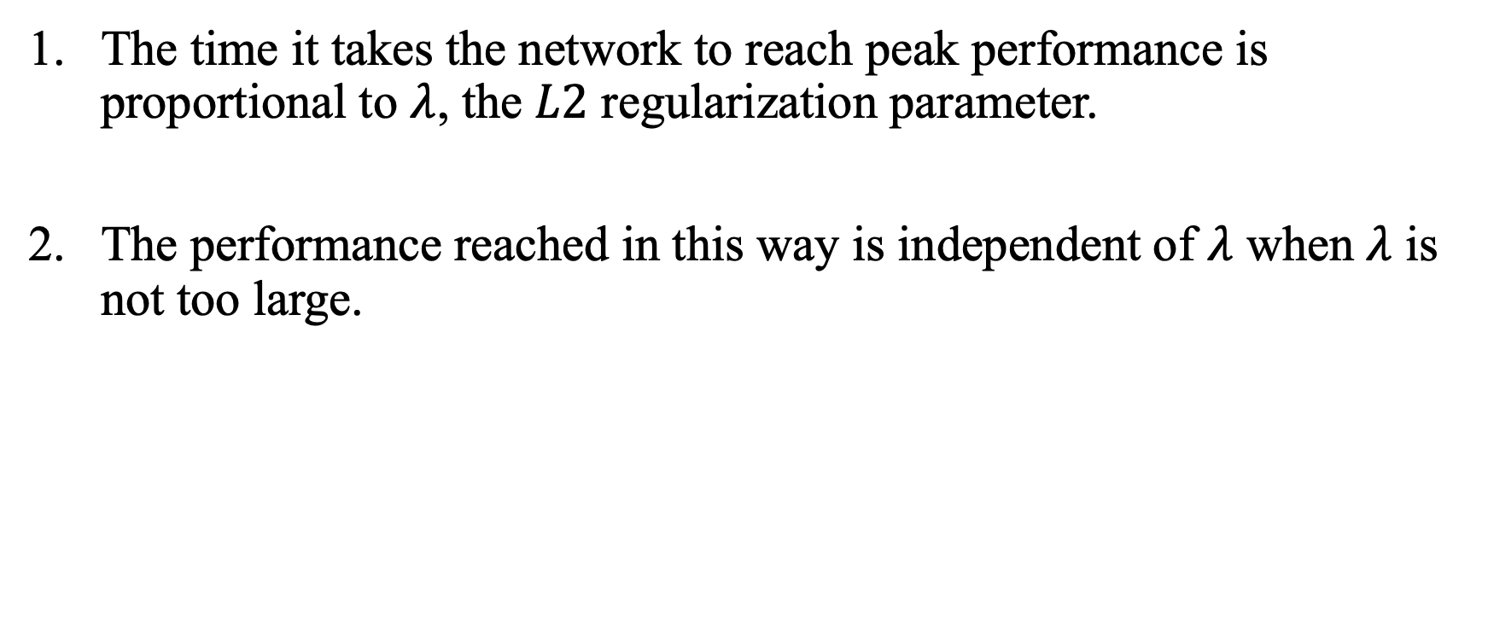
Discussion
The time it takes the network to reach peak performance is proportional to $λ$, the $L2$ regularization parameter.
The performance reached in this way is independent of $λ$ when $λ$ is not too large.

