Slide 1
Memory Management
Chapter 4

Slide 2
What is Memory Management?
Memory Management is the process of controlling and coordinating computer memory, assigning portions known as blocks to various running programs to optimize the overall performance of the system
It is the most important function of an operating system that manages primary memory.
It helps processes to move back and forward between the main memory and execution disk.
It helps OS to keep track of every memory location, irrespective of whether it is allocated to some process or it remains free.

Slide 3
Why Use Memory Management?
It allows you to check how much memory needs to be allocated to processes that decide which processor should get memory at what time.
It allocates the space to application routines.
It also make sure that these applications do not interfere with each other.
Helps protect different processes from each other
It places the programs in memory so that memory is utilized to its full extent.

Slide 4
What is logical and physical address?
Logical Address is generated by CPU while a program is running.
The logical address is virtual address as it does not exist physically, therefore, it is also known as Virtual Address.
This address is used as a reference to access the physical memory location by CPU.
The hardware device called Memory-Management Unit is used for mapping logical address to its corresponding physical address.

Slide 5
What is logical and physical address?
Physical Address identifies a physical location of required data in a memory.
The user never directly deals with the physical address but can access by its corresponding logical address.
The user program generates the logical address and thinks that the program is running in this logical address but the program needs physical memory for its execution, therefore, the logical address must be mapped to the physical address by MMU before they are used.

Slide 6
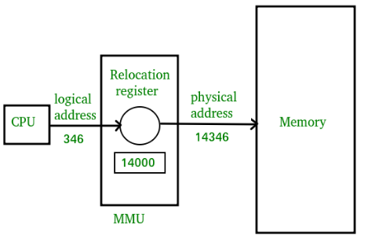
Mapping logical address to physical address

Slide 7
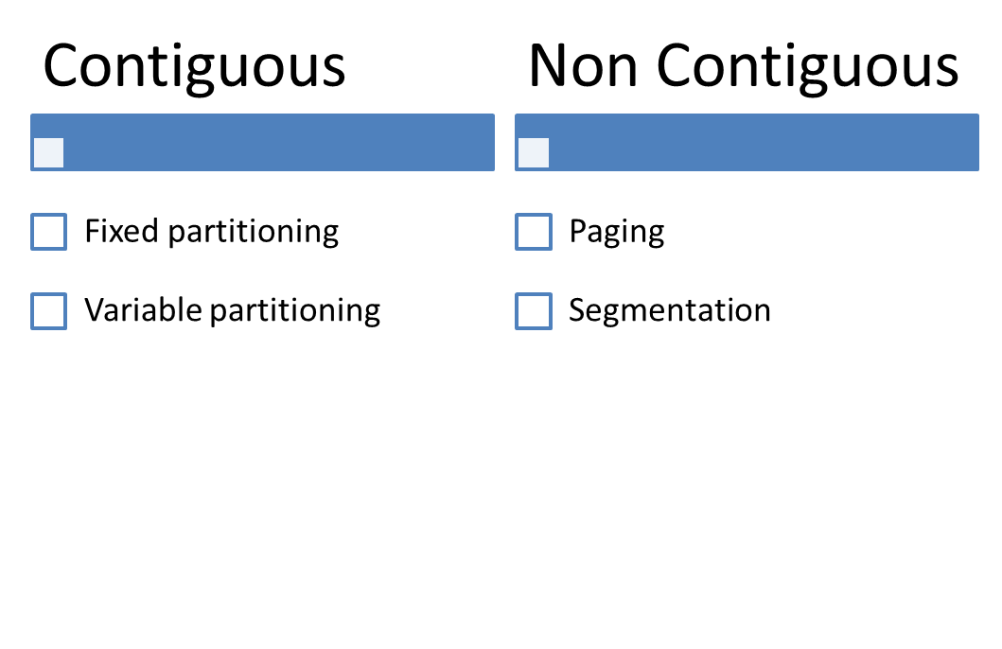
Memory Management Techniques

Slide 8
Contiguous memory allocation
Contiguous memory allocation is basically a method in which a single contiguous section/part of memory is allocated to a process or file needing it.
Because of this all the available memory space resides at the same place together
Which means that the freely/unused available memory partitions are not distributed in a random fashion here and there across the whole memory space.

Slide 9
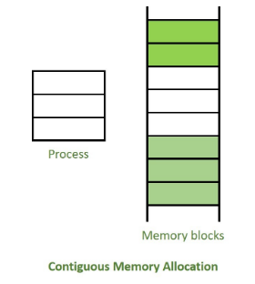
Contiguous memory allocation

Slide 10
Non-Contiguous memory allocation
Non-Contiguous memory allocation is basically a method which allocates the memory space present in different locations to the process as per it’s requirements.
This technique of memory allocation helps to reduce the wastage of memory, which eventually gives rise to Internal and external fragmentation.

Slide 11
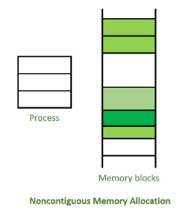
Non-Contiguous memory allocation

Slide 12
Contiguous Memory Management Techniques
Contiguous Technique can be divided into:
  Fixed (or static) partitioning
  Variable (or dynamic) partitioning

Slide 13
Fixed (or static) partitioning
This is the oldest and simplest technique used.
In this partitioning, number of partitions in RAM are fixed but size of each partition may or may not be same.
As it is contiguous allocation, hence no spanning is allowed.
Here partition are made before execution or during system configure.

Slide 14
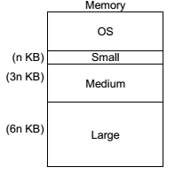
Fixed (or static) partitioning contd..

Slide 15
Fixed (or static) partitioning contd..
Disadvantages of Fixed Partitioning –
Internal Fragmentation:
Main memory use is inefficient. Any program, no matter how small, occupies an entire partition. This can cause internal fragmentation.
External Fragmentation:
The total unused space of various partitions cannot be used to load the processes even though there is space available but not in the contiguous form (as spanning is not allowed).

Slide 16
What is Fragmentation?
Processes are stored and removed from memory, which creates free memory space, which are too small to use by other processes.
After sometimes, that processes not able to allocate to memory blocks because its small size and memory blocks always remain unused is called fragmentation.
When free blocks are quite small, so it is not able to fulfill any request.

Slide 17
What is Fragmentation? Contd..
Fragmentation is of two types
1. External fragmentation
Total memory space is enough to satisfy a request or to reside a process in it, but it is not contiguous, so it cannot be used.
2. Internal fragmentation
Memory block assigned to process is bigger. Some portion of memory is left unused, as it cannot be used by another process.

Slide 18
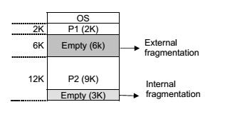
Internal and External fragmentation
If a new process P3, requiring a 8 kb of memory comes, it can not be loaded because of fragmentation, although there is enough total space

Slide 19
Variable Partitioning
Variable Partitioning is a part of Contiguous allocation technique.
It is used to alleviate the problem faced by Fixed Partitioning.
In contrast with fixed partitioning, partitions are not made before the execution or during system configure.

Slide 20
Variable Partitioning
Various features associated with variable Partitioning-
Initially RAM is empty and partitions are made during the run-time according to process’s need instead of partitioning during system configure.
The size of partition will be equal to incoming process.
The partition size varies according to the need of the process so that the internal fragmentation can be avoided to ensure efficient utilization of RAM.
Number of partitions in RAM is not fixed and depends on the number of incoming process and Main Memory’s size.

Slide 21
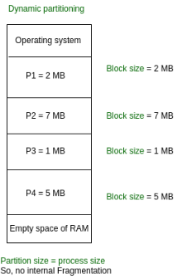
Variable Partitioning

Slide 22
Advantages of Variable Partitioning
1. No Internal Fragmentation:
In variable Partitioning, space in main memory is allocated strictly according to the need of process, hence there is no case of internal fragmentation. There will be no unused space left in the partition.
2. No restriction on Degree of Multiprogramming:
More number of processes can be accommodated due to absence of internal fragmentation. A process can be loaded until the memory is empty.
3. No Limitation on the size of the process:
In Fixed partitioning, the process with the size greater than the size of the largest partition could not be loaded and process can not be divided as it is invalid in contiguous allocation technique.
Here, In variable partitioning, the process size can’t be restricted since the partition size is decided according to the process size.

Slide 23
Disadvantages of Variable Partitioning
1. Difficult Implementation:
Implementing variable Partitioning is difficult as compared to Fixed Partitioning as it involves allocation of memory during run-time rather than during system configure.
2. External Fragmentation:
There will be external fragmentation inspite of absence of internal fragmentation.

Slide 24
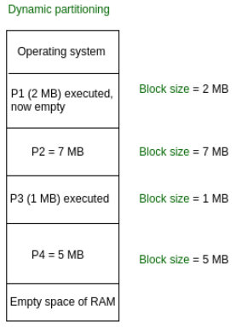
Disadvantages of Variable Partitioning
Now P5 of size 3 MB cannot be accommodated in spite of required available space because in contiguous no spanning is allowed.

Slide 25
Compaction
It is a method to overcome external fragmentation
All free blocks are brought together to as one large block of free space
It requires dynamic free allocation
It has cost and selection of optimal compaction strategy is difficult
One method for compaction is swapping

Slide 26
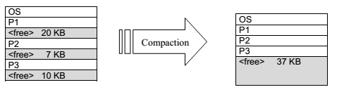
Compaction

Slide 27
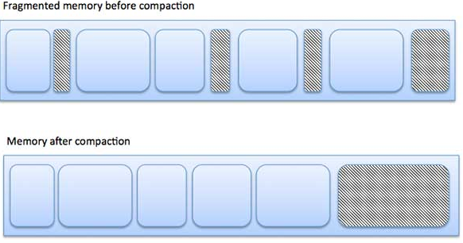
How fragmentation can cause waste of memory and a compaction technique can be used to create more free memory out of fragmented memory

Slide 28
What is Swapping?
Swapping is a method in which the process should be swapped temporarily from the main memory to the backing store.
It will be later brought back into the memory for continue execution.
Backing store is a hard disk or some other secondary storage device that should be big enough inorder to accommodate copies of all memory images for all users.
It is also capable of offering direct access to these memory images.

Slide 29
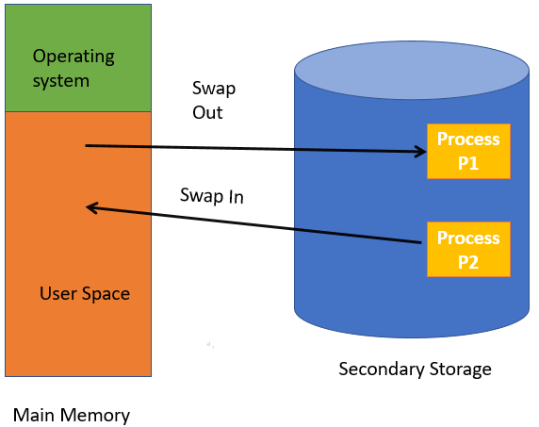
What is Swapping?

Slide 30
Benefits of Swapping
It offers a higher degree of multiprogramming.
Allows dynamic relocation. Processes can be swap in different locations.
It helps to get better utilization of memory.
Minimum wastage of CPU time on completion so it can easily be applied to a priority-based scheduling method to improve its performance.

Slide 31
What is Memory allocation?
Memory allocation is a process by which computer programs are assigned memory or space.
Here, main memory is divided into two types of partitions
Low Memory - Operating system resides in this type of memory.
High Memory- User processes are held in high memory.

Slide 32
Memory allocation technique/
Partition Allocation algorithm
Memory is divided into different blocks or partitions. Each process is allocated according to the requirement.
Below are the various partition allocation schemes :
First Fit: In this type fit, the partition is allocated, which is the first sufficient block from the beginning of the main memory.
Best Fit: It allocates the process to the partition that is the first smallest partition among the free partitions.
Worst Fit: It allocates the process to the partition, which is the largest sufficient freely available partition in the main memory.

Slide 33
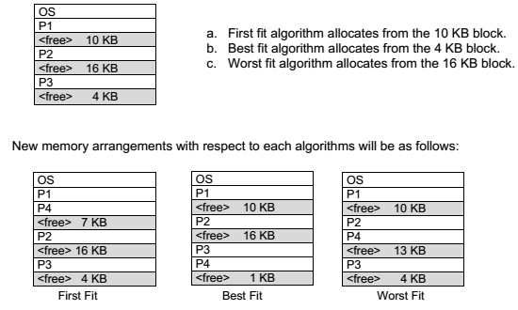
Ex. Assume a process P4 comes with a memory requirement 3 KB. Locate this process.

Slide 34
Non-Contiguous Memory Allocation Technique
In the non-contiguous memory allocation technique, different parts of the same process are stored in different places of the main memory.
Types:
Paging [Fixed partitioning]
Segmentation[Variable partitioning]

Slide 35
What is Paging?
In Operating Systems, Paging is a storage mechanism used to retrieve processes from the secondary storage into the main memory in the form of pages.
The main idea behind the paging is to divide each process in the form of pages.
The main memory will also be divided in the form of equal size frames.
One page of the process is to be stored in one of the frames of the memory.

Slide 36
What is Paging? Contd..
The pages can be stored at the different locations of the memory but the priority is always to find the contiguous frames or holes.
Pages of the process are brought into the main memory only when they are required otherwise they reside in the secondary storage.
The pages are mapped to the frames in Paging, page size needs to be as same as frame size.

Slide 37
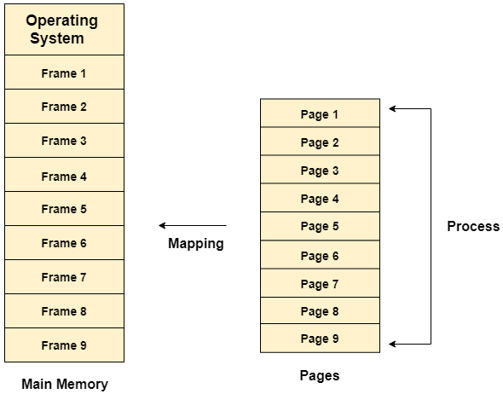
Paging concept

Slide 38
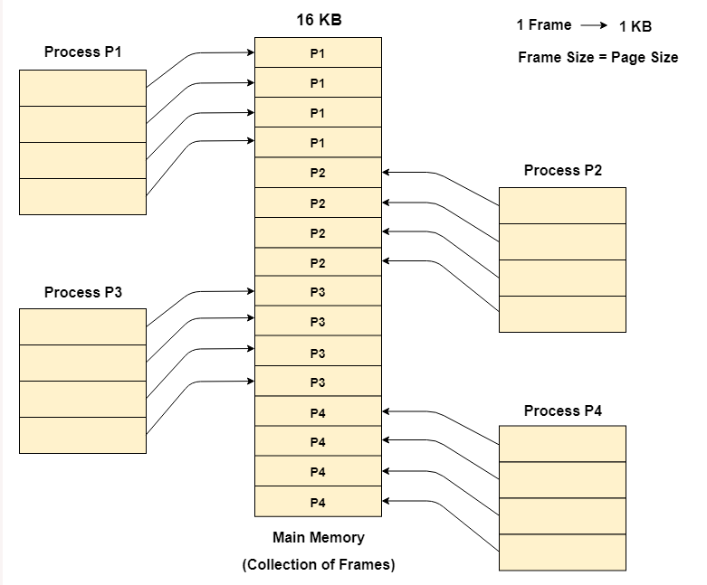

Slide 39
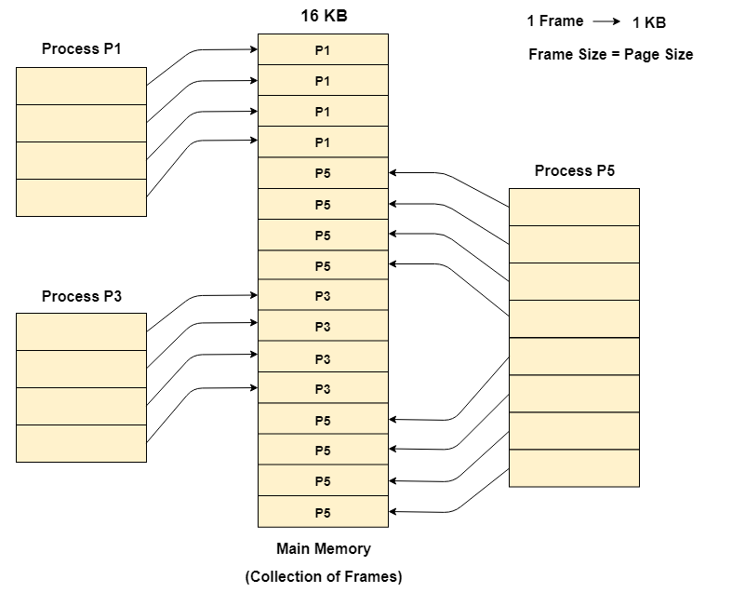

Slide 40

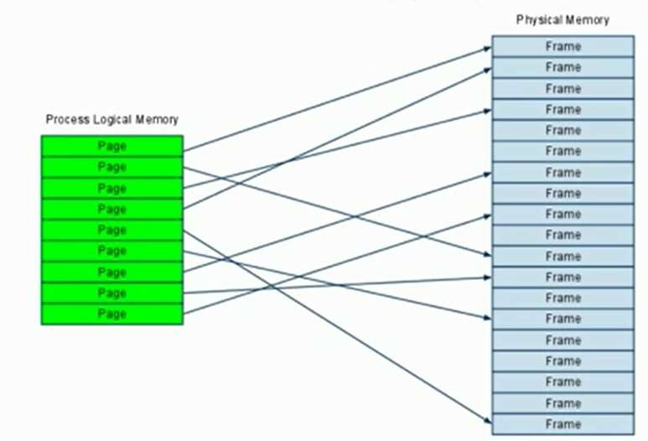
Address Mapping

Slide 41
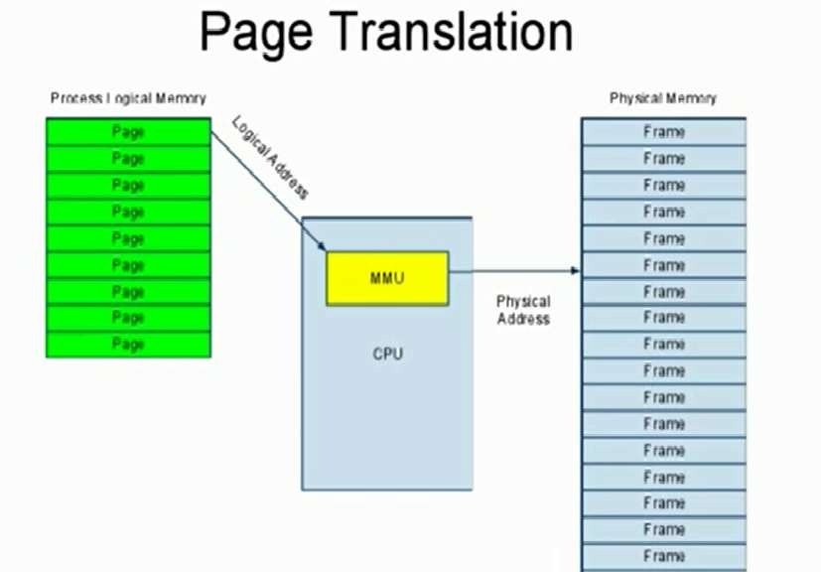

Slide 42
Translation of logical Address into physical Address
As a CPU always generates a logical address and we need a physical address for accessing the main memory.
This mapping is done by the MMU(memory management Unit) with the help of the page table.

Slide 43

Translation of logical Address into physical Address contd..
Logical Address: The logical address consists of two parts page number and page offset.
1. Page Number: It tells the exact page of the process which the CPU wants to access.
2. Page Offset: It tells the exact word on that page which the CPU wants to read.
Logical Address = Page Number + Page Offset

Slide 44
Translation of logical Address into physical Address contd..
Physical Address: The physical address consists of two parts frame number and page offset.
1. Frame Number: It tells the exact frame where the page is stored in physical memory.
2. Page Offset: It tells the exact word on that page which the CPU wants to read. It requires no translation as the page size is the same as the frame size.
Physical Address = Frame Number + Page Offset

Slide 45
Translation of logical Address into physical Address contd..
Page table:
A page table contains the frame number corresponding to the page number of some specific process.
The page table maps the page number to its actual location (frame number) in the memory.
So, each process will have its own page table. A register called Page Table Base Register(PTBR) which holds the base value of the page table.

Slide 46
How is the translation done?
The CPU generates the logical address which contains the page number and the page offset.
The PTBR register contains the address of the page table.
Now, the page table helps in determining the frame number corresponding to the page number.
Now, with the help of frame number and the page offset the physical address is determined and the page is accessed in the main memory.

Slide 47
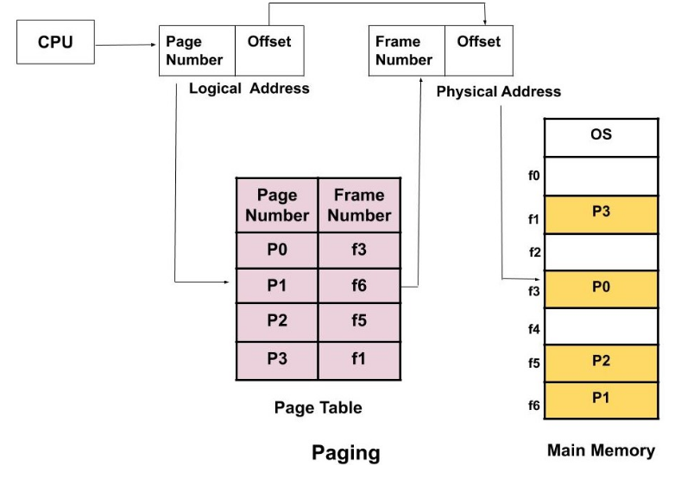

Slide 48
Advantages of Paging
There is no external fragmentation as it allows us to store the data in a non-contiguous way.
Swapping is easy between equal-sized pages and frames.

Slide 49
Disadvantages of Paging
As the size of the frame is fixed, so it may suffer from internal fragmentation. It may happen that the process is too small and it may not acquire the entire frame size.
The access time increases because of paging as the main memory has to be now accessed two times. First, we need to access the page table which is also stored in the main memory and second, combine the frame number with the page offset and then get the physical address of the page which is again stored in the main memory.
For every process, we have an independent page table and maintaining the page table is extra overhead.

Slide 50
What is Segmentation?
Segmentation method works almost similarly to paging. The only difference between the two is that segments are of variable-length, whereas, in the paging method, pages are always of fixed size.

Slide 51
What is Segmentation? Contd..
In paging, we were blindly diving the process into pages of fixed sizes but in segmentation, we divide the process into modules for better visualization of the process.
Here each segment or module consists of the same type of functions.
For example, the main function is included in one segment, library function is kept in other segments, and so on.
As the size of segments may vary, so memory is divided into variable size parts.

Slide 52
Translation of logical Address into physical Address
As a CPU always generates a logical address and we need a physical address for accessing the main memory.
This mapping is done by the MMU(memory management Unit) with the help of the segment table.
The OS maintains a segment map table for all the processes.

Slide 53
Translation of logical Address into physical Address contd..
Logical Address: The logical address consists of two parts segment number and segment offset.
1. Segment Number: It tells the specific segment of the process from which the CPU wants to read the data.
2. Segment Offset: It tells the exact word in that segment which the CPU wants to read.
Logical Address = Segment Number + Segment Offset

Slide 54
Translation of logical Address into physical Address contd..
Physical Address:
The physical address is obtained by adding the base address of the segment to the segment offset.

Slide 55
Translation of logical Address into physical Address contd..
Segment table:
A segment table stores the base address of each segment in the main memory. It has two parts i.e. Base and Limit.
Base indicates the base address or starting address of the segment in the main memory.
Limit tells the size of that segment.
A register called Segment Table Base Register(STBR) which holds the base value of the segment table.

Slide 56
How is the translation done?
The CPU generates the logical address which contains the segment number and the segment offset.
STBR register contains the address of the segment table. Now, the segment table helps in determining the base address of the segment corresponding to the segment number.
Now, the segment offset is compared with the limit corresponding to the Base.

Slide 57
How is the translation done? Contd..
If the segment offset is greater than the limit then it is an invalid address.
This is because the CPU is trying to access a word in the segment and this value is greater than the size of the segment itself which is not possible.
If the segment offset is less than or equal to the limit then only the request is accepted.
The physical address is generated by adding the base address of the segment to the segment offset.

Slide 58
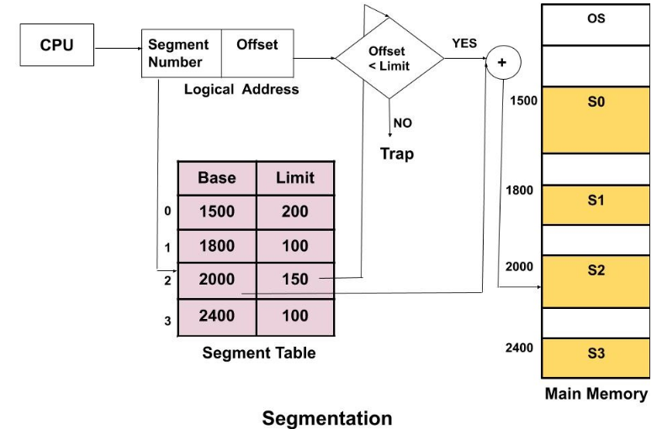

Slide 59
Advantages of Segmentation
The size of the segment table is less compared to the size of the page table.
There is no internal fragmentation.

Slide 60
Disadvantages of Segmentation
When the processes are loaded and removed ( during swapping ) from the main memory then free memory spaces are broken into smaller pieces and this causes external fragmentation.
Here also the time to access the data increases as due to segmentation the main memory has to be now accessed two times. First, we need to access the segment table which is also stored in the main memory and second, combine the base address of the segment with the segment offset and then get the physical address which is again stored in the main memory.

