Slide 1
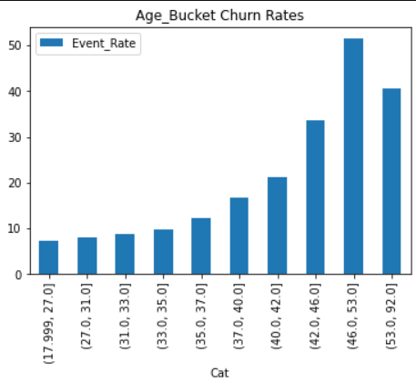
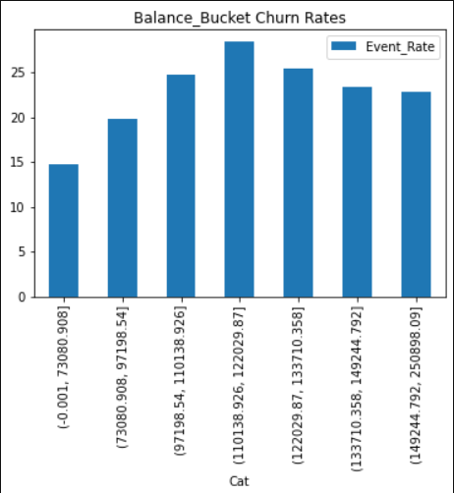
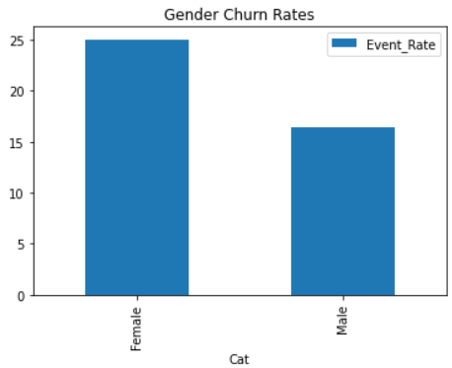
Churn Data EDA
Scoring Population: 10000
Train Population: 7500
Test Population: 2500
Avg Churn Rate: 20.37%
Steps Involved:
1. Stratified sampling for Train and Test Set
2. Separating Categorical and Numerical Variables and converting numerical variables to buckets.
3. Analyzing effect of each variable on Churn Rates.

Slide 2
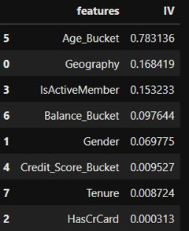
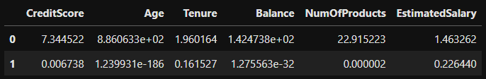
Feature Selection and Model Building
IV Analysis
Steps Involved:
1. Calculating IV values of Each Feature based on Target.
2. Calculating F Scores for each numerical variable
3. Feature Selection and picking features to bucket.
4. One hot Encoding Features
5. Model Building with Logistic Regression, Random Forests and Xgboost.
Selected Features:
- Age - Geography - IsActiveMember - Balance - Gender - CreditScore - EstimatedSalary
F Score Analysis

Slide 3
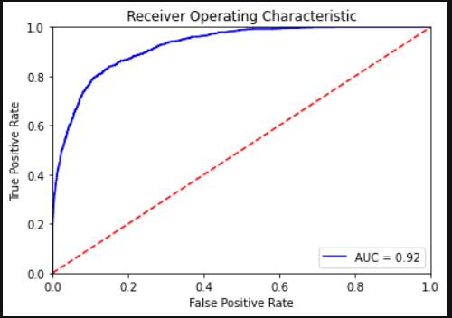
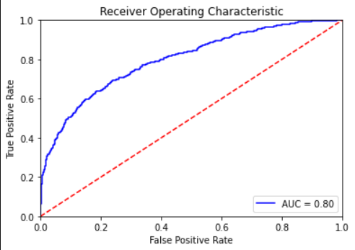
Model Results and Metrics
Final Model Train AUC
AUC Scores:
- Logistic Regression: train: 0.67, test:0.0.668
- Random Forests (Default Params):
Train: 1.0, Test: 0.773
- Random Forests Params Optimized to reduce overfitting using Randomized SearchCV
Train:0.92, Test:0.799
Final Random Forests Model Params:
{'n_estimators': 1000, 'min_samples_split': 10, 'min_samples_leaf': 2, 'max_features': 'sqrt', 'max_depth': 10, 'bootstrap': True}
Final Model Test AUC

