Slide 1



DESTO
Data exchange between distributed energy resources and active customers for stable grid and energy saving by efficient storage

Slide 2
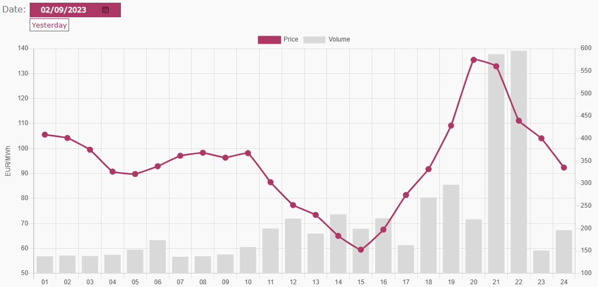
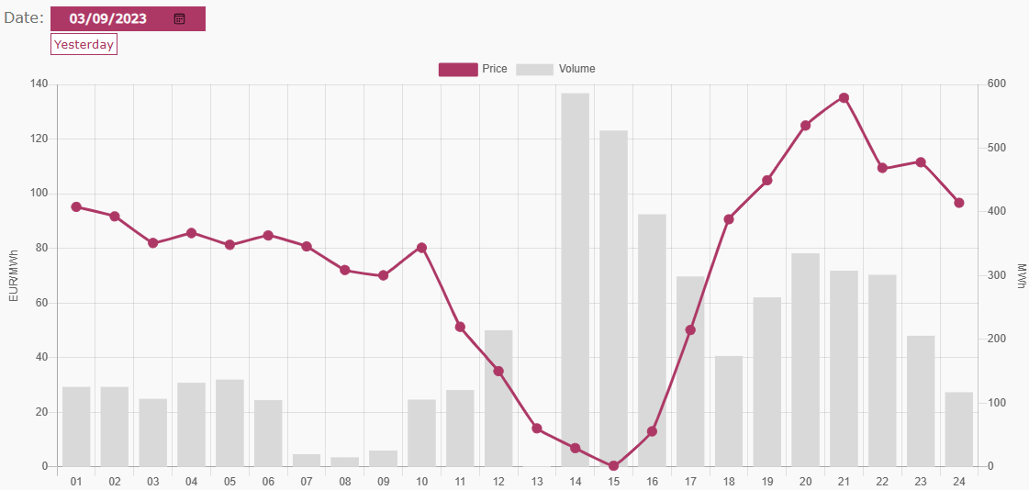
Problem Statement
https://ibex.bg/markets/idm/idm-prices-volumes-with-qh/
General problem
Challenges:
Negative effects:
The energy produced by DER such as photovoltaic, wind, etc. is not efficiently used
Reduced possibility of accurate forecasting of the generation profile
A huge energy storage capacity is required in order to shift the demand
The energy prices are often extremely low for the producers and very high for the consumers, so the both sides are facing significant loses
Reduces ability for reaction to special requests from the Smart Grid
Difficult to balance the network

Slide 3
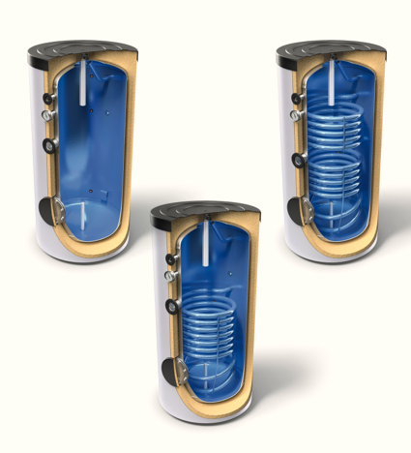
Our Solution - Concept
High tariff
Fossil fuel based
Low tariff
Renewable based
High tariff
Fossil fuel based
Demand shift
Thanks to the storage nature of the water storage heaters, the time for running the appliances could be shifted to the periods when DER produce energy at lower prices without compromising the user experience.

Slide 4
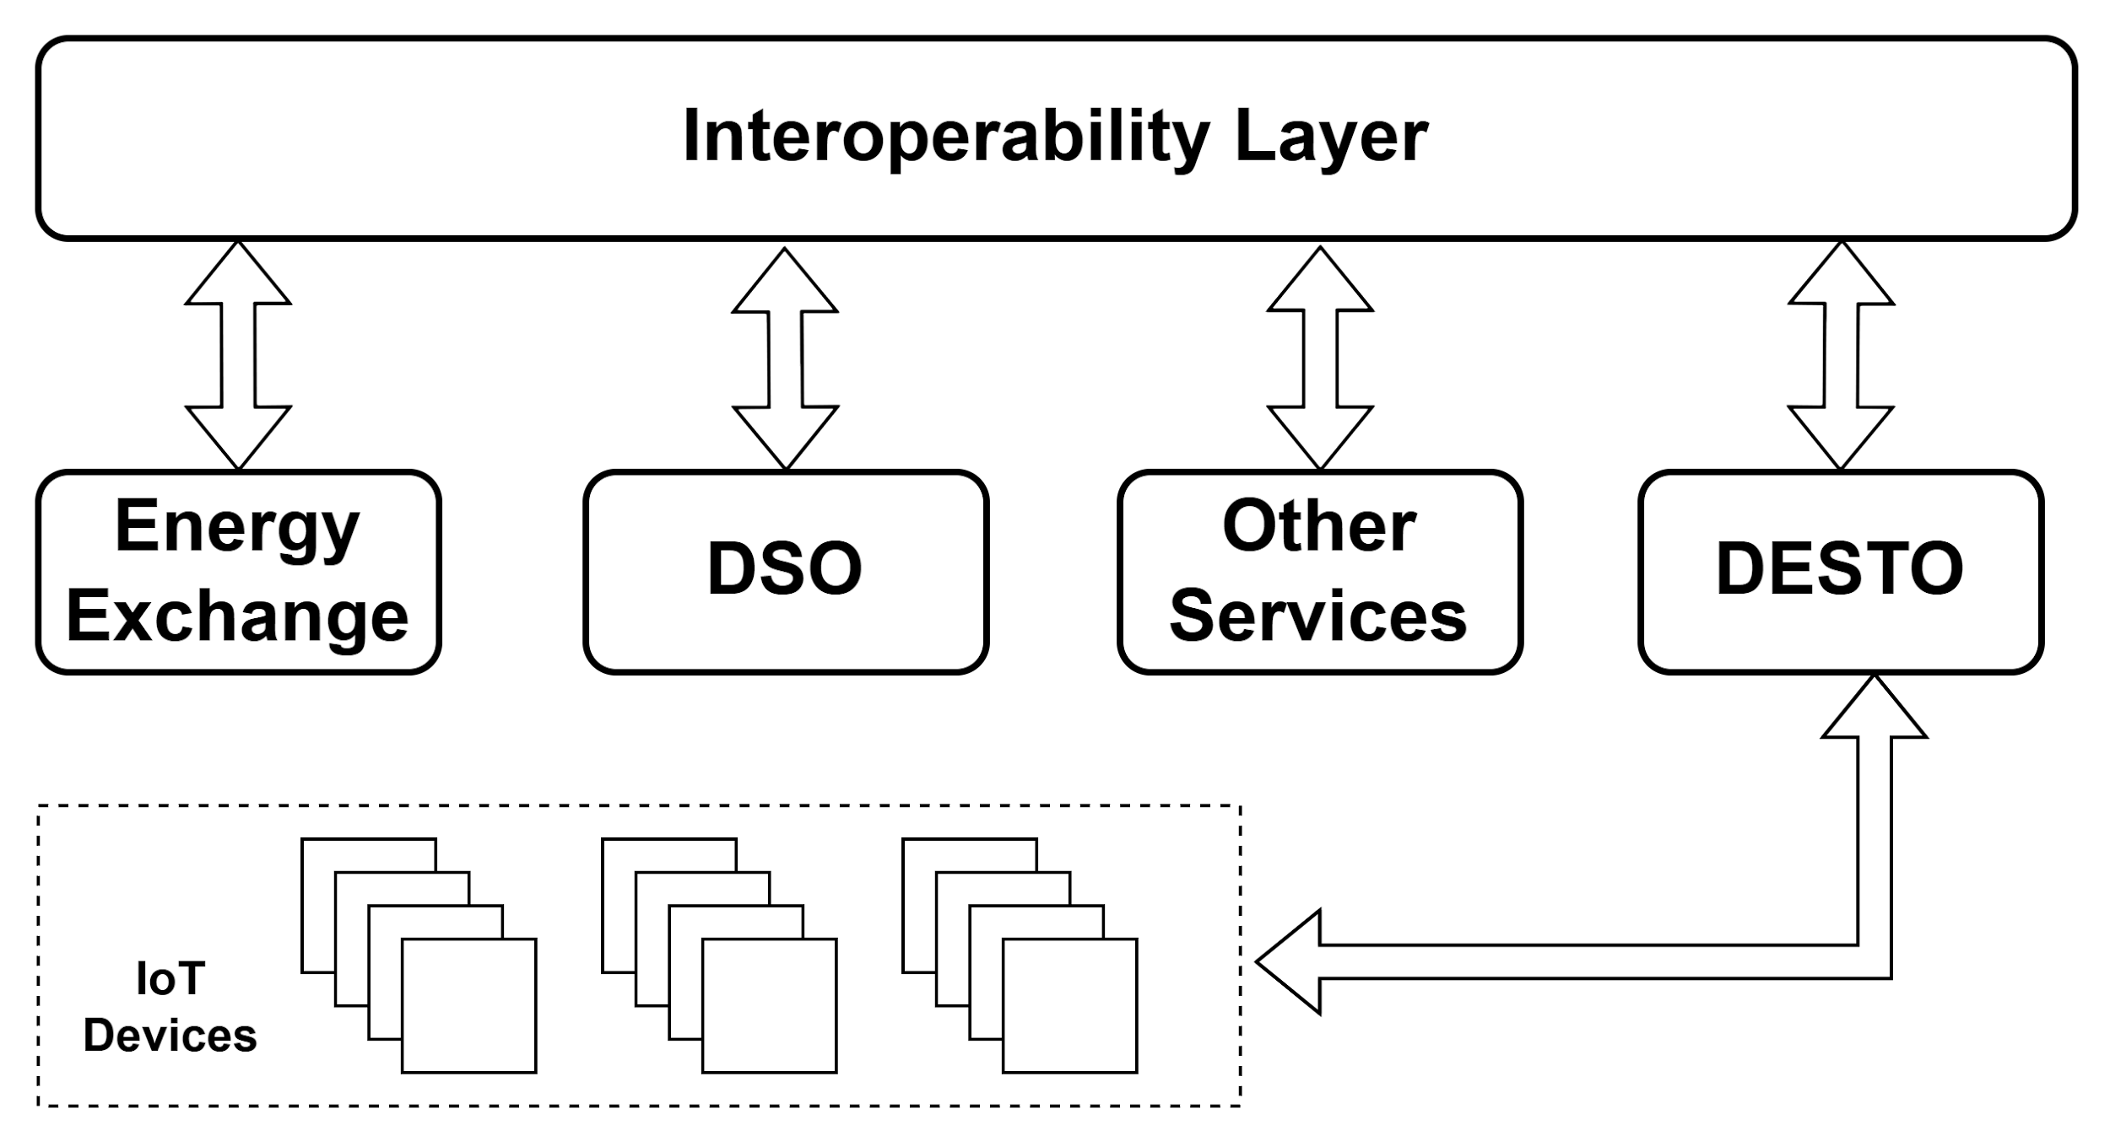
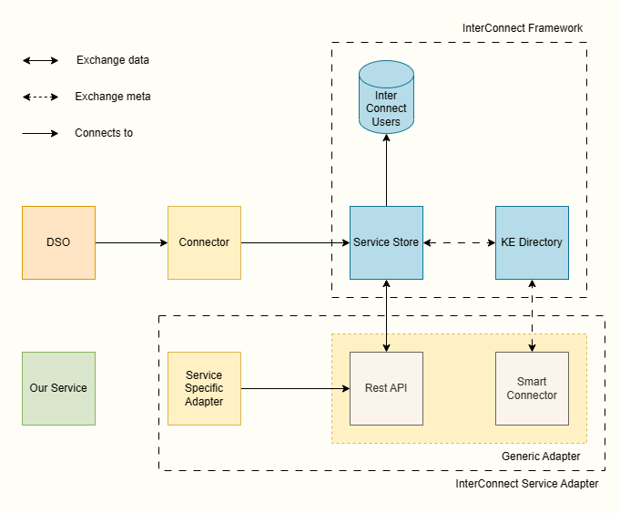
Our Solution - Technical
Provides interface between the IoT devices related to energy consumers (storage water heaters in this particular use case) and producers in order to allow reliable operation and savings based on demand side management and energy storage.
High level system architecture

Slide 5
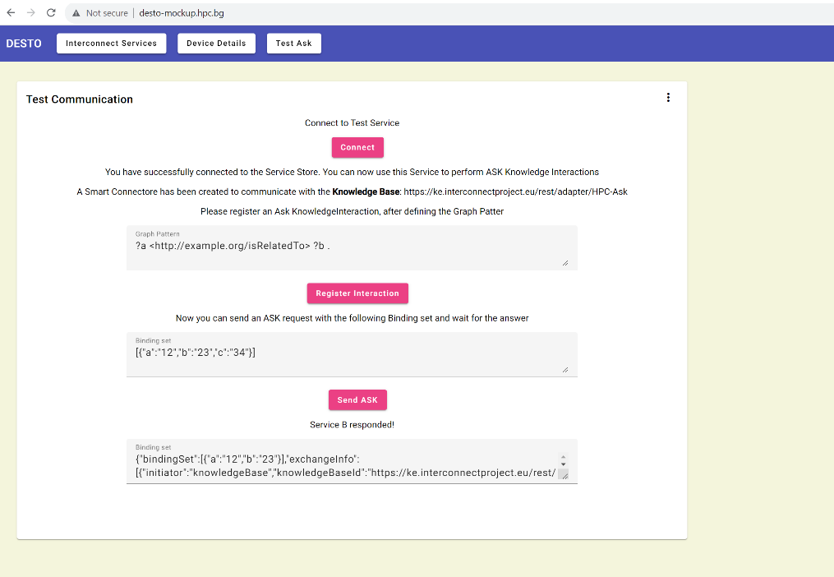
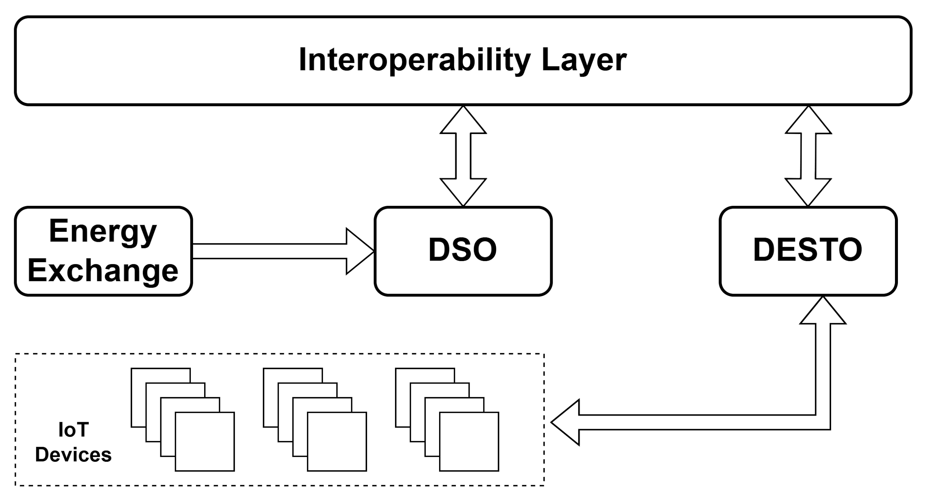
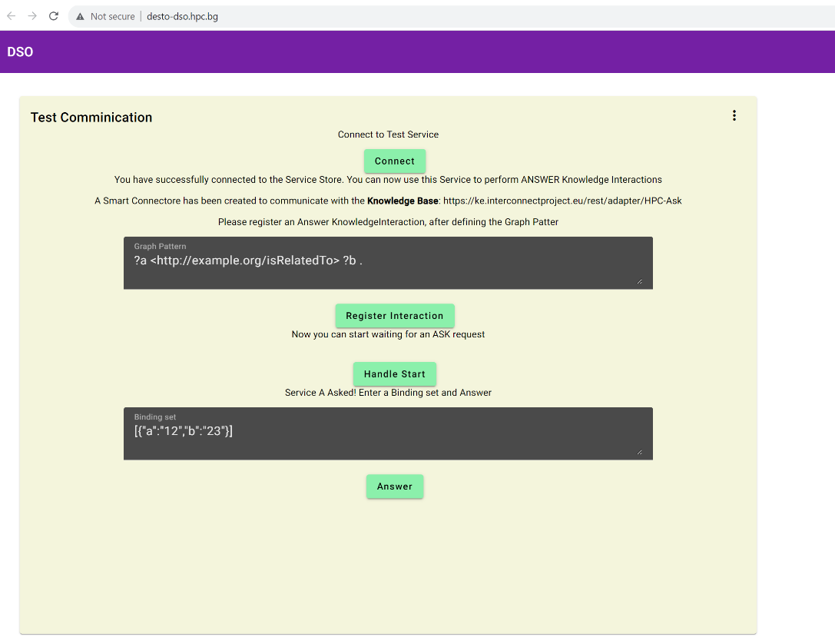
Our Solution - Demo
To demonstrate the functionality and the benefits of the solution, a service that gets information about the prices ahead from the Bulgarian Energy Exchange has been created.
This service communicates with our application via the InterConnect Platform.

Slide 6
Impact – Grid stakeholder engagement
Partner Name | Role | Tasks | Engagement Strategy
TESY Ltd | Technology adopter | Testing and verification of the solution on their product line – Pilot. | Cooperation agreement for testing end piloting the new solution on their products. Acetract customers with innovative solution that allows significant energy costs savings.
Association of traders with energy in Bulgaria | Data source provider and promotor | Provides data about from the grid and promote the solution. | The Interoperability enhances the trading process making it seamless and transparent.
Sofia Development Association | Service user and technology promotor | Test the service and promote the technology. | Reduce energy cost and green image.
Bulgarian Photovoltaic Association | Data source provider and promotor | Provide data about the production profiles and prices and promote the solution. | On the free market, the price might drop to zero when the produced energy exceeds the consumed, usually during the sunny days at noon. Our solution allows this energy to be sold and stored as thermal in many of the available storage water heaters.
Small business on the open market | Technology adopter | Adopt the technology and provide data about the energy usage and savings. | Interested in reducing the energy costs

Slide 7

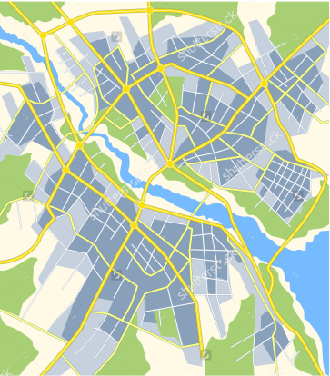




Market Opportunity
Water heating takes a major share of the energy consumption in the residential sector.
The nature of the storage water heaters allows smart energy management such as (re-) scheduling appliances in certain modes.
 | Power | Investment
DESTO Storage | 50 MW (5000 appliances) | 1 750 000
Chemical Battery | 50 MW | 22 500 000
Achieved average energy saving is 55 %
Around 30 MW power is required to control the peaks. When scaled-up the DESTO project is expect to fully cover that amount.
Sofia – 500 000 customers
Bulgaria - 2 000 000 customers
EU – 50 000 000 customers

Slide 8

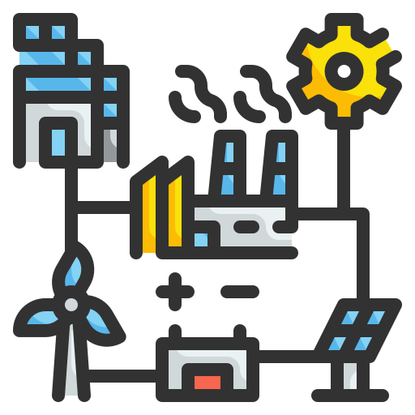


The proposed solution was designed for end consumers to reduce their energy costs, but also engages Distributed Energy Resources (DER) such as photovoltaic, wind, cogeneration, water, geothermal, etc. and could be scaled up to EU level introducing the possibility of smart GRID for supporting the balance of the EU energy market.
Ask/Call to Action
We invite you to join us on this exciting journey as we revolutionize the way smart grid operate. Contact us today to schedule a demo and explore how our solution can transform your organization.

Slide 9
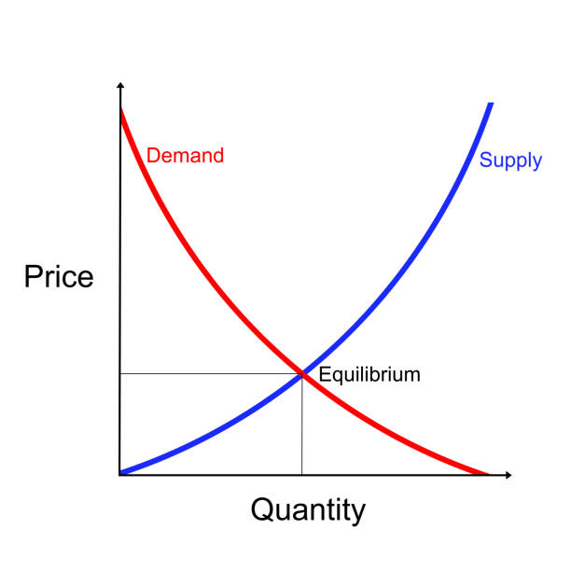
Backup Slides
Perquisites:
Water heating takes a major share of the energy consumption in the residential sector.
The energy storage nature of the storage water heaters allows smart energy management such as (re-)scheduling appliances in certain modes and preferred times using power profiles to optimise energy efficiency.
One of the most important KPI is B2 (reduction of energy costs). After rescheduling the load, the achieved average energy saving is 55 %. These calculations are made using real data from the energy exchange, and turning the appliances on when the prices are 10% lower than average for the next hour.
To estimate KPI B4 (energy storage capacity) we presume the numbers of appliances. For example: To heat to water from 20 to 90 C° in 5000 storage water heaters with capacity 120L, the required energy is 49000 kWh.
In a very optimistic scenario, we could assume a higher number of appliances. As mentioned earlier, one of our partners produces 900 000 standard and 100 000 high-capacity storage water heaters per year. The total capacity is (900 000 x 100 + 100000 x 1000) 190 000 000 L. To heat it to 90 C° the required energy is 15517 MWh and this is the amount that can be stored.
To estimate KPI B5 (Capacity to support DER) we need to find the ratio between the energy produced form sustainable sources such as PV and the capacity to store that energy in the storage water tanks. As mentioned above, the energy storage capacity is comparable to the amount of energy produced by DER, moreover the outcome of the DESTO project will support the local energy production.
KPI B6 (Energy reduction for peak control) takes into consideration the amount of energy required for effective peak control compared to accumulated power of the available appliances that with high possibility could accept the request for power reduction from the grid. It assumed that the required power is around 30000kW and the number of customers is 50 (some of them are non-residential businesses and therefore have bigger and more powerful appliances).

