Slide 1
About Cyber Security
KTUSEC

Slide 2

WHOAREWE
Kerem Demirtürk
Mücahid Doğan

Slide 3
Why are we here?
What does it mean cyber security?
Dark side or Light side?
Social Engineer?
DeepWeb and Tor Network
And your curiosties...

Slide 4
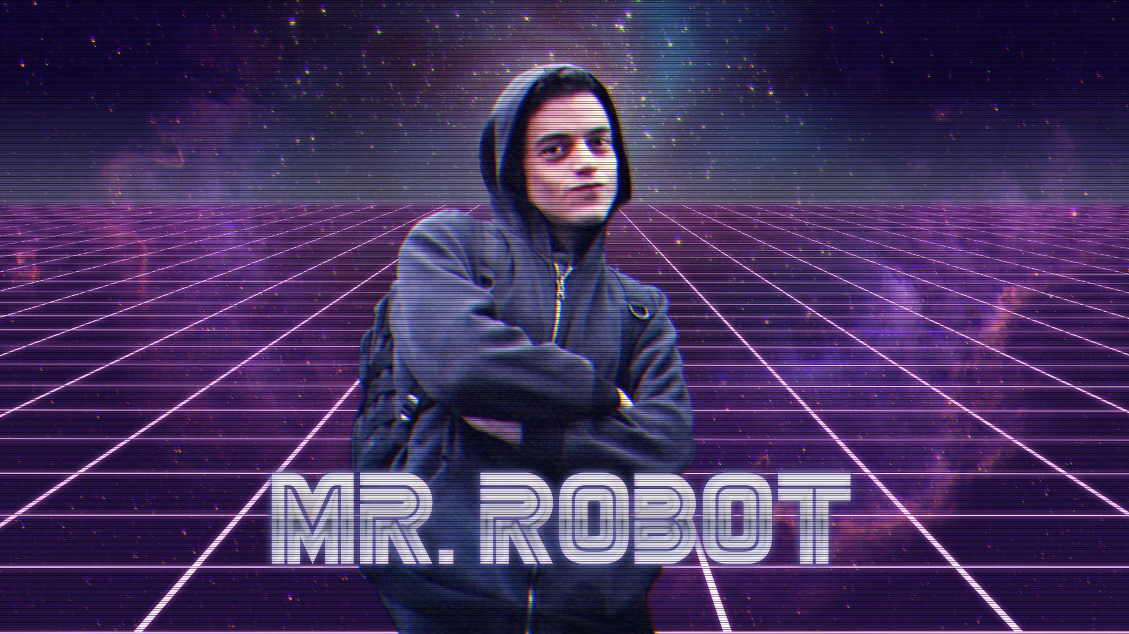
Hackers

Slide 5
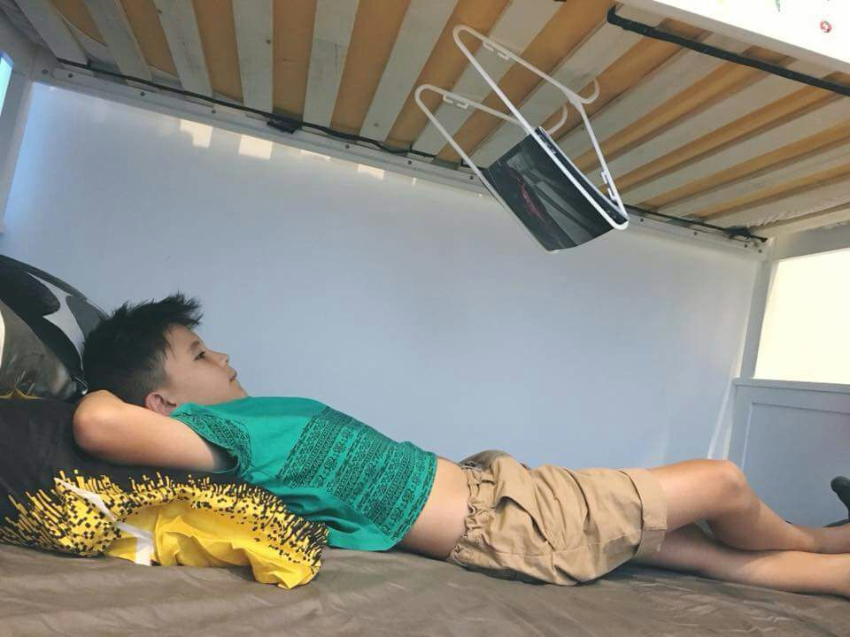
The most creative Hacker :D

Slide 6
What people know
White Hat
Gray Hat
Black Hat

Slide 7
Type of
Hacker
Phreaker
Reverse Engineer
Penetration Tester
...
Script Kiddie
Ddos babe
Lamer
Hacktivist
...

Slide 8
How can i make money with fun?
Bug Bounty

Slide 9
Cryptography
Enigma
Caesar Cipher
Encrypting of information
Public-key cryptography
Symetric-key cryptography
...

Slide 10
Steganography
Hiding data in a normal file..

Slide 11


Slide 12
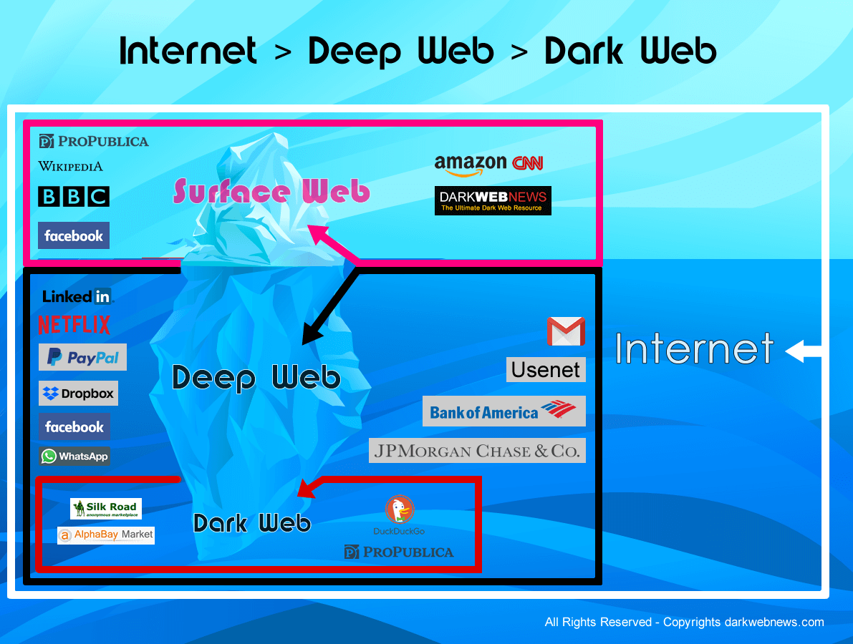
Deep Web

Slide 13
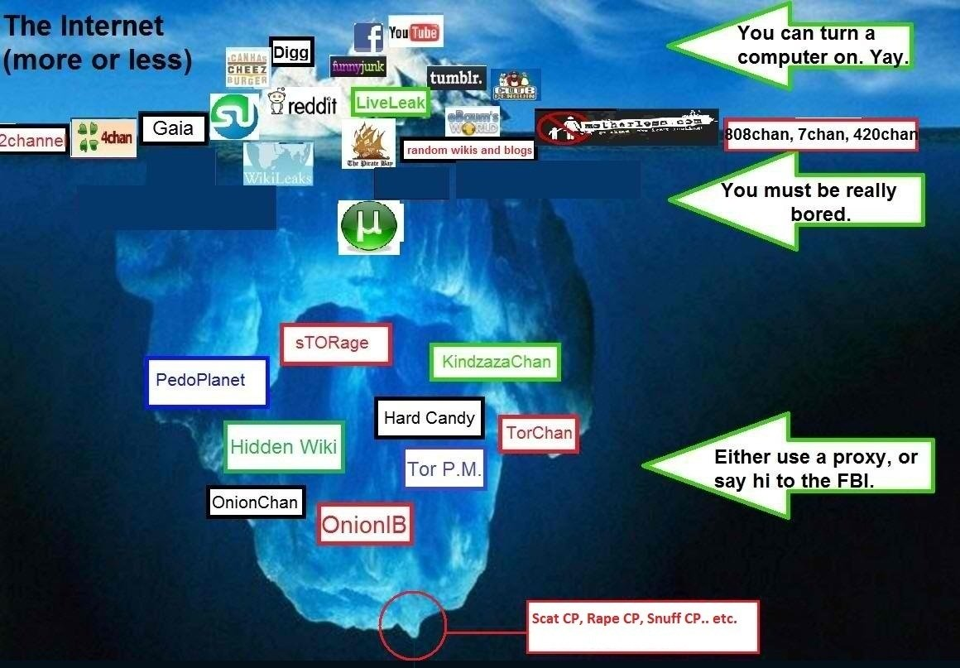

Slide 14
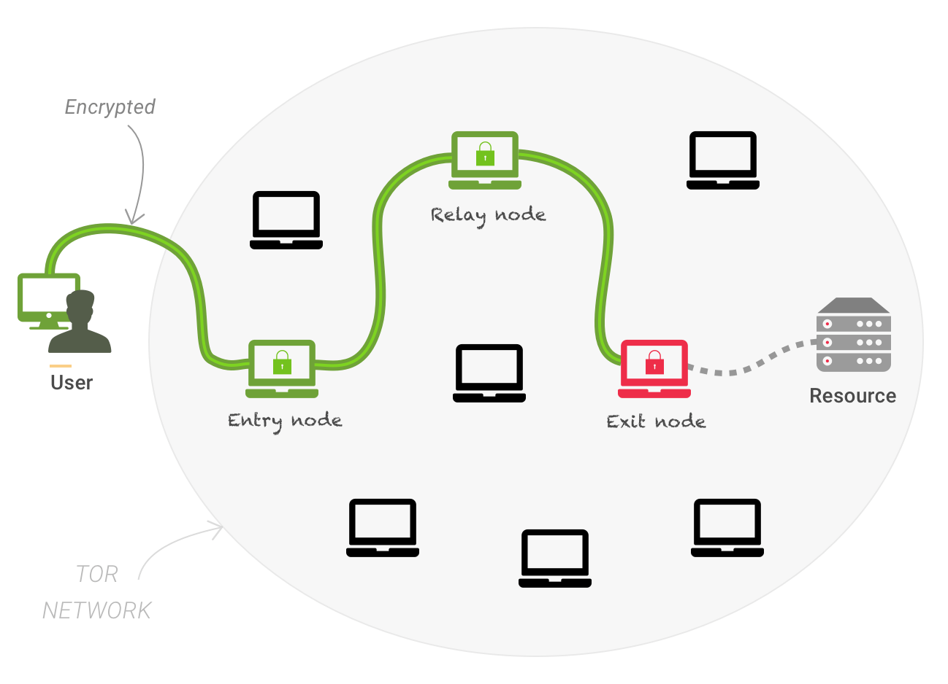
Tor

Slide 15
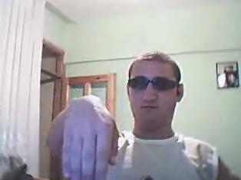
Hekır Okan

Slide 16
How secure is your password?
Go => howsecureismypassword.com

Slide 17
Thanks for watching..
Subcribe us
@ktusec
@keremdemirtrk @mucahiddogan_
ktusec.com
keremdemirtrk.com
mucahiddogan.com
onursanir.com

Slide 18

Questions ???

