Slide 1
Chandan Mehta Wellbeing
Homepage flow: from first glance to first conversation
Logo Photo
Design walkthrough and image direction

Slide 2
1 · FIRST FIVE SECONDS
Arrive: Includes a header, hero image and credibility
Logo
WORK TOGETHER |Rooted Practices | TM | ABOUT ME
GET IN TOUCH
Header
Logo left, menu right. Get in Touch is the one highlighted button.
PHOTO
Hero
Image first. Four short lines carry the idea of rooted, calm, spacious.
Your anchor for a steadier, fuller life.
Credibility strip
Attached to the hero, so trust builds before the first scroll.
Two decades in corporate India. The only certified female TM teacher in Maharashtra. (Explore Working Together )
Say: "The visitor should feel the idea before reading it."

Slide 3
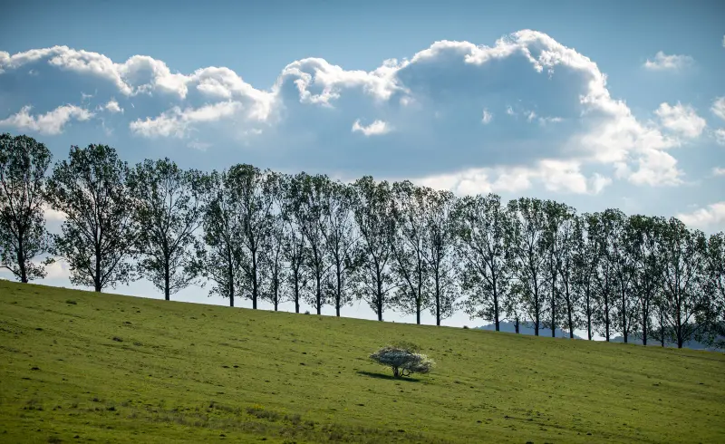


2 · SELF-SELECTION
Who I work with
Hospitality, Wellbeing & Living Spaces
Together, we design a stay where mornings begin with breath and yoga, the mind settles through meditation,
and nourishing evenings leave guests truly rested.
Organisations & Institutions
Practical wellbeing programmes, from a single session to a full retreat, shaped around your people and led personally, so the practices stay with them long after the session.
Networks & Member Communities
Shared experiences that bring members together around something that truly nourishes them.
Leaders & Individuals
A guided path back to your own rhythm, with better sleep, less stress and a steadier mind.
Say: "Four audiences, four headings. The intro sentence stays light so the headings lead."

Slide 4
3 · THREE FULL-WIDTH SECTIONS
How we can work together
PHOTO
Tree root system
PHOTO
Branches reaching up
PHOTO
Single leaf with dew
Strategic Wellbeing Partnership
I work with your leadership to build wellbeing into the heart of your organisation or space, not as another programme, but as the way you operate.
Curated Wellbeing Engagement
I design and lead wellbeing sessions, programmes and retreats around your people, so they learn practices they can use every day.
Personal Wellbeing Journey
I guide you personally through 12 sessions over four months, shaped around your life, your pressures and your goals.
How the partnership unfolds
UNDERSTAND
ARCHITECT
CURATE
IMPLEMENT
INTEGRATE
EVOLVE
Say: "Each tile scrolls to its own full-width section. Testimonials sit right after the claim they support, and all copy stays visible."

Slide 5
4 · THE APPROACH
Understand: the four approaches
PHOTO
Her practising or teaching, or a seated figure by a river
Applied Yogic Science & Pranayama
Kaivalyadhama
Explore →
PHOTO
Fresh herbs, seasonal produce, leafy garden in natural light
Nutrition & Lifestyle
BFY
Explore →
PHOTO
Still pond or sunlit forest floor
Transcendental Meditation
Signature offering
Explore →
PHOTO
Two chairs under a tree, or an open trail
Coaching & Guidance
Jack Canfield
Explore →
Say: "Titles scroll to the homepage summary, and Explore opens that exact section on The Approach page."

Slide 6
5 · SIGNATURE OFFERING
Deepen: TM, heritage and numbers
You do not need to empty your mind.
TM is effortless: 20 minutes, twice a day. Heritage, quote and stats stay compact in one section, not separate full-screen folds.
PHOTO
Ganga or Himalaya at dawn for heritage, still water behind the stats
10M+
people learned TM
100+
countries
480+
peer-reviewed studies
50+
years of study
Say: "TM is her signature, so it gets the most space. The dedicated TM page goes deeper."

Slide 7
6 · THE CLOSE
Connect: about, contact and footer
Chandan Mehta Wellbeing
Mumbai, India
Email
LinkedIn (text link only)
Copyright · Privacy Policy
Wellbeing disclaimer
PHOTO
Natural portrait of her outdoors among trees
PHOTO
Soft low-contrast forest in morning light behind the form
About
Twenty years of corporate India plus a lifelong yogic practice. Knight Frank India testimonial, then More About Me →
Let's Talk
Name · Email · Mobile · Message, then Send Enquiry. A simple thank-you confirms.
Footer
Contact details, a clean LinkedIn link and the medical disclaimer.

Slide 8
3 · THREE FULL-WIDTH SECTIONS
How we can work together
PHOTO
Tree root system
PHOTO
Branches reaching up
PHOTO
Single leaf with dew
Strategic Wellbeing Partnership
Let wellbeing take root in your organisation or space, and grow into the way you live and work. I walk alongside your leadership, from vision to delivery, until it all comes together as one
Curated Wellbeing Engagement
From a single session to a programme or retreat, shaped around the people.
Personal Wellbeing Journey
12 sessions across four months, personally guided.
How the partnership unfolds
UNDERSTAND
ARCHITECT
CURATE
IMPLEMENT
INTEGRATE
EVOLVE
Say: "Each tile scrolls to its own full-width section. Testimonials sit right after the claim they support, and all copy stays visible."

