Slide 1
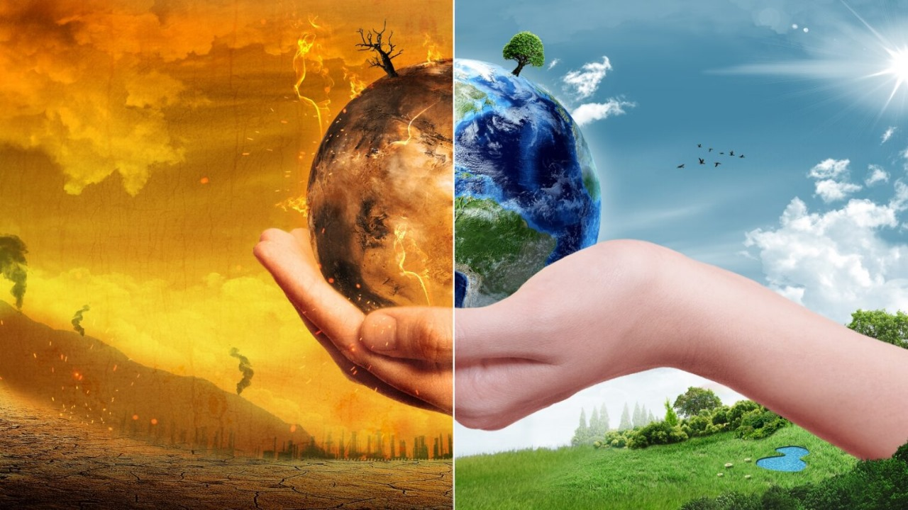
Global warming in india and water availability

Slide 2
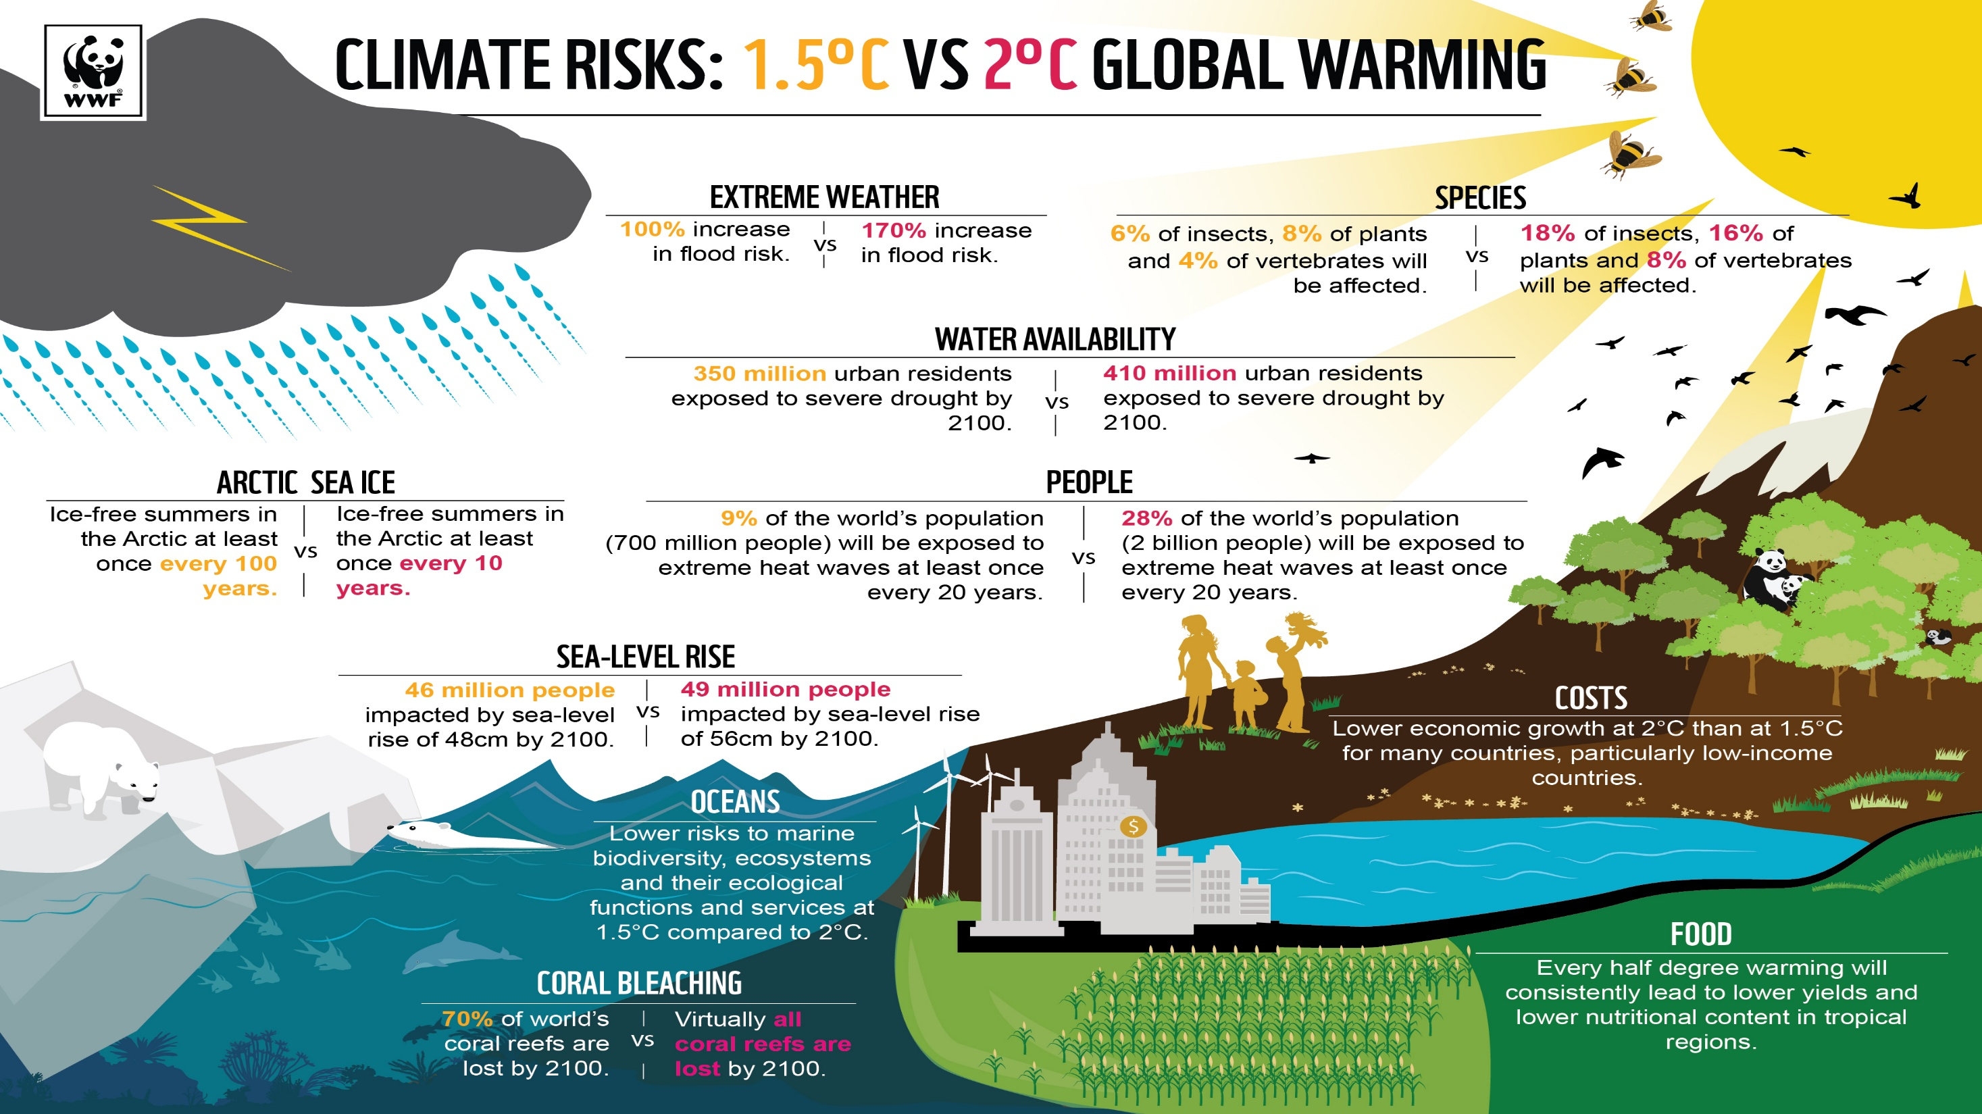

Slide 3
Challenges and Opportunities for Sustainability in Addressing Global Warming
Challenges:
Rising Greenhouse Gas Emissions:-
Challenge: One of the primary contributors to global warming is the continuous rise in greenhouse gas emissions. Industries, transportation, agriculture, and deforestation all release carbon dioxide (CO₂) and other greenhouse gases into the atmosphere, driving global temperature increases.
Impact: These emissions cause more severe climate change impacts, such as rising sea levels, extreme weather events, and ecosystem destruction.

Slide 4
Transitioning to Renewable Energy:
Challenge: Shifting from fossil fuels to renewable energy sources like solar, wind, and hydroelectric power is essential for reducing emissions. However, transitioning infrastructure, policies, and investments from coal and oil-based energy sources to clean energy is complex and costly.
Impact: In many regions, especially developing countries, reliance on fossil fuels for energy and economic growth is deeply entrenched, making the transition difficult.
Economic Costs and Adaptation:
Challenge: Adapting to climate change impacts such as heatwaves, droughts, floods, and extreme weather requires substantial financial resources. This presents a challenge for governments, particularly in poorer nations, that struggle with limited budgets.
Impact: Vulnerable communities, especially in developing nations, face disproportionately high costs for adapting to climate impacts like water shortages, crop failures, and health threats.

Slide 5
Political and Social Resistance:
Challenge: Addressing global warming requires strong political will, international cooperation, and policy changes, which can often face resistance. In many regions, industries or individuals that rely on fossil fuels or deforestation may oppose changes that could hurt their economic interests.
Impact: This resistance can delay or derail efforts to implement effective climate policies and shift toward sustainable practices.
Biodiversity Loss:
Challenge: Global warming is leading to changes in ecosystems, making it difficult for species to survive. Habitat destruction, ocean acidification, and altered weather patterns are contributing to the rapid decline of biodiversity.
Impact: The loss of biodiversity affects food security, agricultural productivity, and natural systems, making sustainability harder to achieve.

Slide 6
Opportunities for Sustainability:
Renewable Energy Development:
Opportunity: The growth of renewable energy offers a promising path to reducing carbon emissions. Technological advances in solar, wind, and battery storage are making clean energy more efficient and affordable.
Impact: By investing in renewable energy, economies can reduce dependence on fossil fuels, create jobs, and lower environmental damage, leading to a more sustainable future.
Energy Efficiency:
Opportunity: Improving energy efficiency in buildings, transportation, and industry can significantly reduce emissions. Green building technologies, electric vehicles (EVs), and energy-efficient appliances are gaining popularity.
Impact: Increased energy efficiency reduces costs, lowers emissions, and fosters sustainable growth, benefiting both the environment and the economy.

Slide 7
Sustainable Agriculture and Forestry:
Opportunity: Shifting to sustainable agricultural practices, such as agroecology, regenerative farming, and organic agriculture, can mitigate emissions, improve soil health, and preserve water resources. Likewise, reforestation and responsible forestry management can help absorb CO₂ and protect biodiversity.
Impact: These practices can increase food security, enhance biodiversity, and restore ecosystems while reducing emissions.
Circular Economy:
Opportunity: A circular economy promotes reusing, recycling, and repurposing materials to reduce waste, conserve resources, and lower environmental impacts. This approach can be applied in industries, packaging, and consumer goods.
Impact: By reducing resource extraction and waste, the circular economy helps reduce emissions and supports a sustainable future.

Slide 8
Carbon Pricing and Financial Incentives:
Opportunity: Implementing carbon pricing mechanisms such as carbon taxes or cap-and-trade systems can incentivize industries to reduce their emissions. Additionally, green financing and investment in sustainable projects are growing.
Impact: Financial incentives can drive innovation and accelerate the transition to low-carbon technologies and sustainable practices.
International Collaboration:
Opportunity: Global cooperation through frameworks like the Paris Agreement offers an opportunity for countries to collectively tackle global warming. Sharing knowledge, technology, and financial resources between developed and developing countries can foster faster progress.
Impact: International agreements can help align goals, set binding targets, and support climate change mitigation and adaptation efforts globally.

Slide 9
Global warming and its significance
Global warming refers to the long-term rise in Earth's average temperature due to the buildup of greenhouse gases like carbon dioxide (CO2) in the atmosphere. These gases trap heat from the sun, creating a "greenhouse effect" that leads to warming. Human activities such as burning fossil fuels, deforestation, and industrial processes are the main contributors.

Slide 10
Significance of Global Warming:
Climate Change: Global warming causes shifts in weather patterns, leading to more frequent and severe heatwaves, storms, droughts, and floods.
Rising Sea Levels: Melting ice caps and glaciers contribute to higher sea levels, threatening coastal communities and ecosystems.
Ecosystem Disruption: Changing temperatures and weather affect wildlife and habitats, leading to a loss of biodiversity.
Agricultural Impact: Altered climate patterns can reduce crop yields, resulting in food shortages and economic instability.
Human Health Risks: Increased temperatures can cause heat-related illnesses, spread diseases, and worsen air pollution.

Slide 11
why water availability is a crucial issue ,particularly for india
Water availability is a crucial issue for India due to several factors, including its large population, climate variability, and over-exploitation of water resources. The country faces significant challenges in managing its water supply, which directly impacts agriculture, livelihoods, and overall well-being.
Key reasons why water availability is particularly important for India:
Large Population and High Demand: India is the second-most populous country in the world, with over 1.4 billion people. The demand for water for drinking, agriculture, industry, and sanitation is immense, and the available freshwater resources are increasingly stretched.

Slide 12
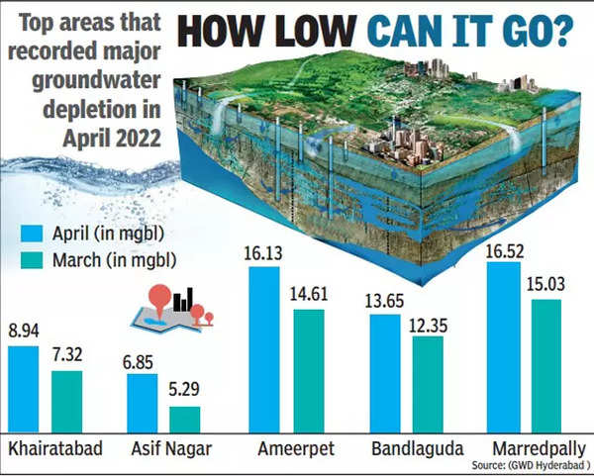

Slide 13
Agriculture Dependency: India is an agrarian economy, with around 60% of its population dependent on agriculture for livelihood. A significant portion of farming relies on water for irrigation, particularly in water-intensive crops like rice, wheat, and sugarcane. Any reduction in water availability directly impacts food production and rural incomes.
Uneven Distribution of Water: While India has a vast network of rivers, the distribution of water resources is highly uneven. Some regions, like the northeastern states, receive abundant rainfall, while others, particularly in the northwestern and central parts, face severe water scarcity. The mismatch between water availability and demand exacerbates regional disparities.
Over-extraction of Groundwater: Many parts of India rely heavily on groundwater for drinking and irrigation. Over-extraction has led to the depletion of groundwater levels in several states, especially in regions like Punjab, Haryana, and Rajasthan. This has caused wells to dry up and increased the cost of accessing water.

Slide 14
Climate Change and Erratic Rainfall: India is highly vulnerable to the impacts of climate change. Changing rainfall patterns, prolonged droughts, and unpredictable monsoon seasons have made water availability more uncertain. Some areas experience floods, while others face severe droughts, further complicating water resource management.
Pollution and Water Quality: Pollution from industrial waste, agricultural runoff, and untreated sewage has contaminated many of India's water sources, making them unfit for consumption. This reduces the availability of clean water for drinking and sanitation, contributing to health problems.
Rapid Urbanization and Industrial Growth: As cities grow and industrialization expands, the demand for water increases. Urban areas, which account for a significant portion of water consumption, often face water shortages and poor management of resources, leading to the depletion of nearby water sources.

Slide 15
Transboundary Water Conflicts: India shares several rivers with neighboring countries like Pakistan, Bangladesh, and China. Disputes over water-sharing agreements, especially related to major rivers like the Indus and the Ganges, can complicate water availability and lead to political tensions.
Consequences:
Agricultural Productivity: Water scarcity can reduce agricultural output, leading to food shortages, higher prices, and rural poverty.
Health Risks: Lack of access to clean drinking water and sanitation increases the risk of waterborne diseases.
Economic Impact: Reduced water availability can hinder industrial growth, affecting employment and economic development.

Slide 16
Global Warming in India
India, like the rest of the world, is experiencing the effects of global warming, with significant implications for its climate, economy, and society. The country has witnessed notable changes in temperature, weather patterns, and environmental conditions over the past century, with consequences on agriculture, water resources, and public health.

Slide 17
Key Statistics on Temperature Rise in India (Last Century)
Average temperature rise: Over the past 100 years, India’s average surface temperature has risen by approximately 0.7°C to 1.0°C.
Warming trends: The last two decades (2000-2020) have experienced higher-than-average warming, with 2016 being recorded as the warmest year in India’s history.
Increase in extreme temperatures: The number of hot days and heatwaves has significantly risen, especially in regions like Northwest India.
Regional variations: Coastal areas like Kerala have shown higher warming compared to the interior regions.

Slide 18
Effects of Global Warming on India’s Climate:
Heatwaves:
Increased frequency and intensity of heatwaves, particularly in northern and central India, resulting in serious health risks.
Rising temperatures cause a higher number of heat stress-related deaths each year.
Monsoon Changes:
Shift in the monsoon pattern: Delayed onset and erratic rainfall, leading to floods in some areas and droughts in others.
Reduced rainfall in some regions (e.g., Northwest India), affecting agriculture and water supply.
Heavy rainfall events are now more intense, leading to more frequent flash floods and landslides.

Slide 19
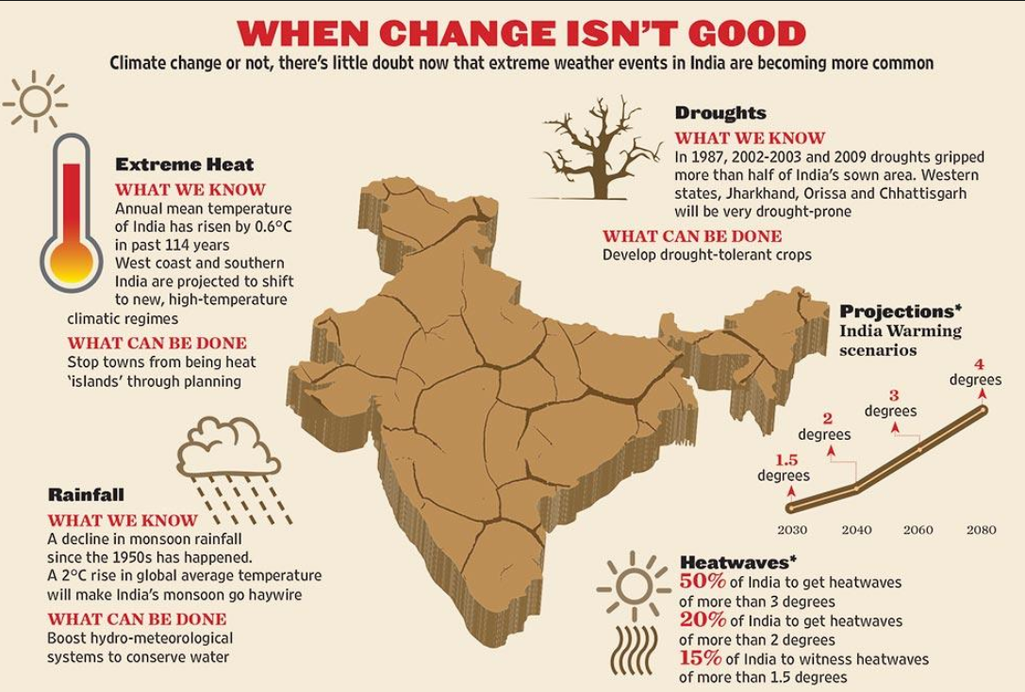

Slide 20
Glacier Retreat: Himalayan glaciers are retreating at alarming rates, reducing water flow in rivers such as the Ganges and Brahmaputra, threatening water availability for millions.By 2030, it is projected that India could lose up to one-third of its glaciers.
Coastal Areas and Sea-Level Rise: Rising sea levels threaten coastal cities like Mumbai, Chennai, and Kolkata with more frequent storm surges and flooding.

Slide 21
Role of Human Activities in Contributing to Global Warming: Industry
Industry:
Industrial activities, particularly in sectors like cement, steel, and power generation, emit large amounts of greenhouse gases (GHGs), especially CO2.
Fossil fuel burning for electricity and manufacturing is a primary source of India’s carbon footprint.
Transportation:
India’s rapidly expanding transportation sector, including cars, trucks, and airplanes, contributes significantly to carbon emissions.
With an increase in vehicle numbers, urban air quality deteriorates, and emissions from fuel combustion further exacerbate global warming.

Slide 22
Deforestation:
Deforestation due to urbanization, agriculture, and mining leads to the release of stored carbon into the atmosphere, while reducing the earth's capacity to absorb CO2.
Forests play a critical role in carbon sequestration, and deforestation limits this natural carbon sink.
Agriculture:
Agricultural practices like rice farming and the use of synthetic fertilizers release methane and nitrous oxide, potent GHGs that contribute to warming.

Slide 23
Melting Glaciers and Reduced River Flows in Himalayan-Fed Rivers
Himalayan Glaciers: The glaciers in the Himalayan region, which feed rivers like the Ganges, Brahmaputra, and Indus, are rapidly melting due to rising temperatures.
Decreased Glacier Mass: Over the last few decades, the glaciers have shrunk significantly, leading to decreased freshwater storage.
Reduced River Flow: As the glaciers melt faster than they can replenish, there is a decline in the flow of river systems, especially during the dry season. This affects water availability for drinking, agriculture, and hydropower generation.
Future Projections: By 2030, projections suggest that up to one-third of the glacial volume in the Himalayas could be lost, significantly impacting water resources.

Slide 24
Erratic Monsoons Affecting Rain-Fed Agriculture
Shifts in Monsoon Patterns: Global warming is causing changes in the timing, intensity, and distribution of the monsoon rains, which are vital for India's agriculture.
Delayed and Uneven Rains: The onset of the monsoon season is becoming more unpredictable, with prolonged dry spells followed by intense rainfall in short bursts. This leads to flooding in some areas and droughts in others.
Impact on Rain-Fed Agriculture: Large portions of Indian agriculture depend on rainwater, especially in rural and rain-fed areas. The disruption of rainfall patterns reduces crop yield, exacerbating water scarcity.
Agricultural Water Stress: In areas that rely on monsoon rains for irrigation, inconsistent rainfall increases water stress, leading to crop failures and reduced food security.

Slide 25
Rising Sea Levels Leading to Salination of Coastal Groundwater
Coastal Areas at Risk: As global warming causes rising sea levels, coastal regions, especially in states like West Bengal, Kerala, and Tamil Nadu, are facing saltwater intrusion into freshwater aquifers.
Saltwater Intrusion: The rise in sea levels pushes seawater into freshwater groundwater reserves, making the water undrinkable due to high salinity.
Impact on Drinking Water Supply: The contamination of coastal groundwater sources threatens the availability of freshwater for drinking and agricultural use.

Slide 26
Agricultural Impact: Saltwater intrusion also affects soil fertility and crop productivity, particularly for rice and other salt-sensitive crops in coastal areas.
Increased Vulnerability of Coastal Communities: The populations living in coastal areas become increasingly vulnerable to water scarcity, requiring significant infrastructure investment to manage freshwater resources.

Slide 27
Depletion of Aquifers Due to Over-Extraction
Over-Extraction of Groundwater:
Excessive pumping of groundwater for irrigation, drinking water, and industrial use has significantly lowered the water levels of aquifers across India.
Agricultural dependence: India is heavily reliant on groundwater for irrigation (especially in regions like Punjab, Rajasthan, and Uttar Pradesh), where surface water sources are insufficient.
Rapid urbanization: Growing urban areas and industrial development also contribute to increased demand for groundwater extraction.

Slide 28
Falling Water Tables
Groundwater tables have dropped dramatically in many regions. In some areas, water tables have fallen by as much as 10 to 15 meters in the past few decades.
As a result, wells have dried up, forcing farmers and communities to dig deeper wells or invest in more expensive methods to access water.
Impact on agriculture: Farmers are struggling to pump enough water for crops, particularly in drought-prone regions, leading to reduced agricultural productivity.

Slide 29
Impact on Aquifer Recharge
Slow natural recharge: Aquifers naturally recharge over time through rainfall and surface water, but over-extraction far outpaces the natural replenishment rate.
Climate change effects: Changing rainfall patterns due to global warming exacerbate the problem, as irregular or insufficient rainfall further limits aquifer recharge.
Reduction in water quality: As the water table falls, the risk of contamination from pollutants and salinity increases, degrading the quality of available groundwater.

Slide 30
Regional Water Availability in India (Part 1)
North India:
Over-dependence on Himalayan Rivers:
North India relies heavily on rivers like the Ganga, Yamuna, and Indus.
These rivers provide water for agriculture, drinking, and industry.
Their flow is decreasing due to climate change and over-extraction.
Declining Groundwater Levels:
Groundwater is over-extracted for irrigation, leading to a significant decline.
Over-reliance on groundwater as a backup resource for agriculture and drinking.
Cities like Delhi and parts of Punjab and Haryana face severe groundwater depletion.
Increasing Water Demand:
Rapid urbanization and population growth are putting immense pressure on existing water resources.
As cities expand, the demand for industrial and domestic water increases.
This escalates competition for already limited water sources

Slide 31
Regional Water Availability in India (Part 2)
South India:
Dependence on Monsoons:
South India relies on the southwest and northeast monsoons for the majority of its rainfall.
Monsoon failures or delays lead to significant drought conditions.
Inconsistent monsoon patterns in states like Tamil Nadu and Andhra Pradesh.
Inter-State River Disputes:
Major disputes over river water sharing, especially with rivers like the Kaveri, Krishna, and Godavari.
Political and legal conflicts between states like Tamil Nadu, Karnataka, Andhra Pradesh, and Kerala.
Disputes over equitable water distribution affect farmers and urban water supply.
Groundwater Overuse:
Groundwater is heavily relied upon in regions like Tamil Nadu and Karnataka due to inadequate surface water supply.
Excessive extraction for irrigation and drinking exacerbates water scarcity.
Over-extraction leads to falling water tables, impacting local agriculture and drinking water access

Slide 32
Regional Water Availability in India (Part 3)
East India:
Risk of Floods:
East India, particularly Bihar and Assam, faces annual flooding due to the overflow of rivers like the Ganga and Brahmaputra.
Floods cause loss of life, displacement, and destruction of crops and infrastructure.
Lack of effective flood control measures increases vulnerability.
Uneven Water Distribution:
Disparities in water availability across states like West Bengal, Odisha, and Bihar.
Some areas face water stress, while others, such as flood-prone regions, face water surplus.
Unequal distribution impacts agriculture and access to clean drinking water.
Climate Change Impact:
Climate change exacerbates flooding and drought cycles.
Unpredictable rainfall patterns make water availability even more volatile.
Increased frequency of extreme weather events challenges existing water infrastructure

Slide 33
Regional Water Availability in India (Part 4)
West India:
Drought-Prone Regions:
States like Rajasthan, Gujarat, and Maharashtra are highly prone to droughts.
Arid regions have limited rainfall and depend heavily on groundwater and surface water from reservoirs.
Long periods of drought severely impact agriculture and drinking water supply.
Limited Access to Water:
In dry regions, water availability is limited due to low groundwater levels and reduced river flows.
Limited access to potable water in rural areas, especially in desert regions like Rajasthan.
Cities like Mumbai and Pune face challenges in meeting growing water demands.
Impact of Water Scarcity:
Agriculture in the region suffers as farmers are unable to irrigate crops effectively.
Water scarcity also affects industries that rely on large amounts of water.
Migration and social issues arise as people seek water from other regions

Slide 34
Case Studies (Part 1)
Water Scarcity Examples:
Bundelkhand Region (Uttar Pradesh and Madhya Pradesh):
A dry region with low rainfall and groundwater depletion.
Chronic droughts have led to a severe water crisis, with many villages running out of water.
Lack of effective irrigation systems exacerbates the crisis, leading to crop failure.
Rajasthan:
Known for extreme water scarcity, especially in desert areas like Jaisalmer and Barmer.
Heavy reliance on groundwater for agriculture, which has led to its rapid depletion.
Water stress worsened by irregular monsoon rains and a growing population.
Marathwada Region (Maharashtra):
A drought-prone region facing a severe water crisis due to delayed monsoons.
Groundwater depletion and lack of irrigation systems lead to poor crop yields.
Water scarcity has led to rural-urban migration and unrest

Slide 35
Case Studies (Part 2)
Flooding Examples:
Bihar (Ganga and Koshi Rivers):
Regular flooding due to the overflow of the Ganga and Koshi rivers.
Flooding displaces millions, destroys infrastructure, and damages crops.
Lack of flood control infrastructure worsens the impact.
Assam (Brahmaputra River):
The Brahmaputra causes frequent flooding, especially during the monsoon.
Massive loss of life and livelihoods, especially in low-lying areas.
Flood control measures are inadequate, and river management is a challenge.
West Bengal (Coastal Flooding):
Coastal areas like the Sundarbans are increasingly vulnerable to flooding.
Sea-level rise, combined with heavy monsoon rains, leads to saltwater intrusion and flooding.
Local communities face displacement, and agriculture is disrupted

Slide 36
Government & Policy Initiatives (Part 1)
National Water Policy:
Focus on equitable water distribution among states.
Promote water conservation through sustainable agricultural practices.
Encourage water-efficient technologies for industries and urban areas.
Jal Jeevan Mission:
Aim to provide piped water supply to every rural household by 2024.
Decentralized water systems for local community involvement and better water management.
Emphasize community participation in maintaining water infrastructure and management.
Climate Action Plans:
National plans focus on adaptation to water-related impacts of climate change.
Measures to reduce water footprints in sectors like agriculture and industry.
Aligning with the Paris Agreement to mitigate climate change impacts on water availability

Slide 37
Government & Policy Initiatives (Part 2)
River Interlinking and Management:
River interlinking projects aim to transfer surplus water from one region to another.
Potential to address water scarcity in drought-prone areas and flood risks in others.
Challenges in execution: high costs, environmental concerns, and inter-state conflicts.
Integrated Water Resource Management (IWRM):
Focus on managing water across sectors (agriculture, industry, and domestic use).
Promotes sustainability in water extraction, reducing dependence on groundwater.
Encourages local participation in planning and water management.
Water Conservation Programs:
Rainwater harvesting and check dams to improve water storage in rural areas.
Promoting efficient irrigation systems like drip irrigation and micro-irrigation.
Support for water conservation education and public awareness campaigns

Slide 38
What Can Be Done? (Part 2)
Innovation in Water Technology:
Development of smart irrigation systems to minimize water wastage.
Water recycling and reuse technologies to conserve freshwater.
Desalination technologies in coastal areas to provide freshwater alternatives.
Policy Reforms and Legal Frameworks:
Strengthen legal frameworks for water sharing and dispute resolution.
Enhance water governance at both local and state levels for better resource management.
Encourage public-private partnerships to improve water infrastructure.
Climate Action Integration:
Link water policies with climate change adaptation strategies.
Focus on sustainable agriculture to reduce the water footprint.
Commit to long-term water security through proactive policy and action

Slide 39
What Can Be Done? (Part 1)
Mitigation Measures:
Reduce emissions through the adoption of renewable energy sources (solar, wind).
Afforestation and reforestation to improve water retention and reduce soil erosion.
Water-efficient industrial practices and technologies to reduce consumption.
Adaptation Strategies:
Build better water storage systems (reservoirs, pipelines) to ensure a steady supply.
Promote water-efficient farming techniques and drought-resistant crop varieties.
Increase adoption of rainwater harvesting systems and groundwater recharge.
Role of Communities:
Local involvement in managing water resources and ensuring equitable access.
Raise awareness through education and community programs on water conservation.
Empower farmers and urban communities to adopt sustainable water practices

Slide 40
Conclusion and Call to Action
Urgency of Addressing Water Issues:
Water scarcity and floods are worsening due to climate change and population growth.
Immediate action is needed to secure water resources for future generations.
Collective efforts can make a substantial difference in preserving water resources.
Innovation and Collaboration:
Governments, industries, and local communities must work together.
Technology, policy reform, and community participation are key to solving water challenges.
Focus on sustainable solutions and integrated water management strategies.
Positive Outlook:
Innovations in water conservation, sustainable farming, and policy changes can secure water.
Collective action can address both current and future water challenges.
Together, we can create a water-secure future for all

Slide 41
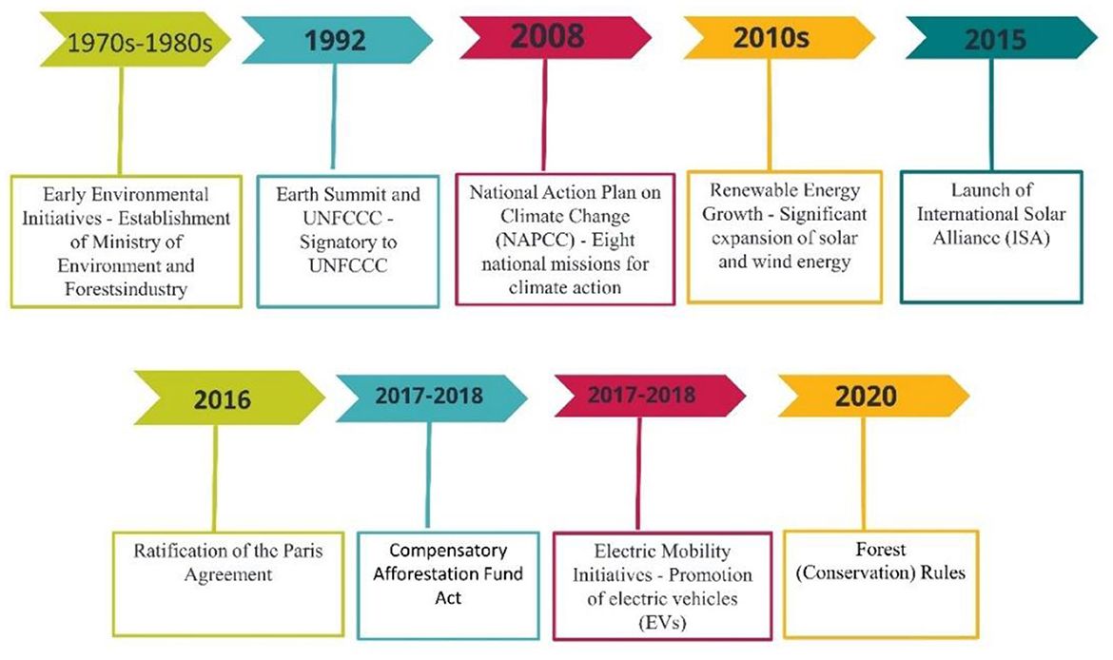

Slide 42
Thank you

