Slide 1







Deep Learning Bootcamp 2024 - 25

Slide 2
Schedule
Event No. | Details
Event 1 1st Nov 2024 | Deep Learning Essentials Covers the basics of Python and necessary packages required for Deep Learning such as numpy, scipy, pandas etc.
Event 2 8th Nov 2024 | PyTorch for Deep Learning Covers the basics of PyTorch, as well as how to use PyTorch for performing classification and regression tasks.
Event 3 TBD, Sem 2 | Deep Learning for Images In this event, we will extend the classification using deep learning, specifically focusing on datasets involving images.
Event 4 TBD, Sem 2 | Deep Learning for Sequence Data (text and time series) In this event, we will focus on using Deep Learning models for datasets involving sequences or temporal relations. We plan to cover examples from both text and time-series datasets.
Event 5 TBD, Sem 2 | Reinforcement Learning The session will introduce Reinforcement Learning with some practical applications.

Slide 3
Session 2 – Getting Started with PyTorch For Regression and Classification

Slide 4
Agenda
Intro to Deep Learning and to PyTorch (30 mins)
Work Session 1 – Working with Tensors (30 mins)
Snacks break (20 mins)
PyTorch – Discussion (20 mins)
Work Session 2 – Solving a classification problem with PyTorch (1 hour)
Challenges – Create your own Neural Network for Regression (30 mins)

Slide 5
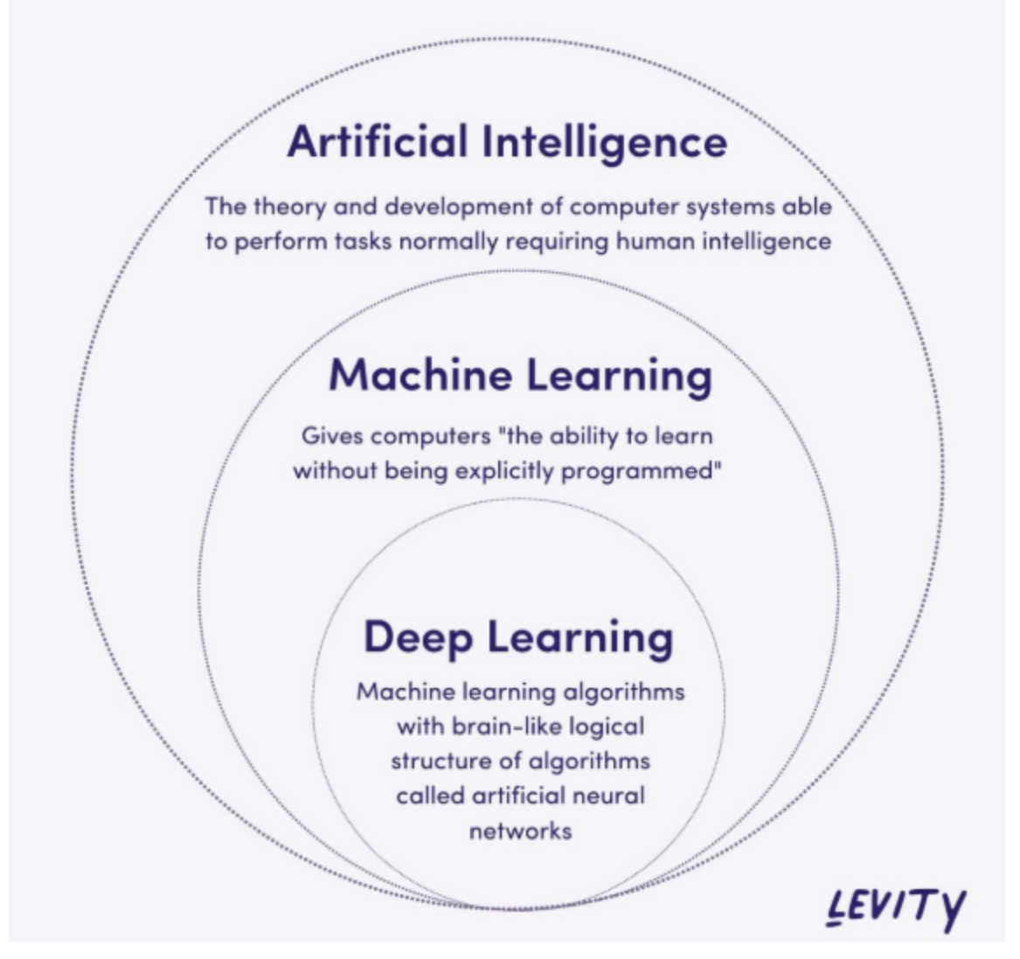
Revisiting Deep Learning
Machine Learning – learning from examples
Deep Learning – Machine Learning with a specific set of architectures – called deep neural networks
Neural Networks – a network of artificial neural networks modeled loosely based on biological neurons

Slide 6
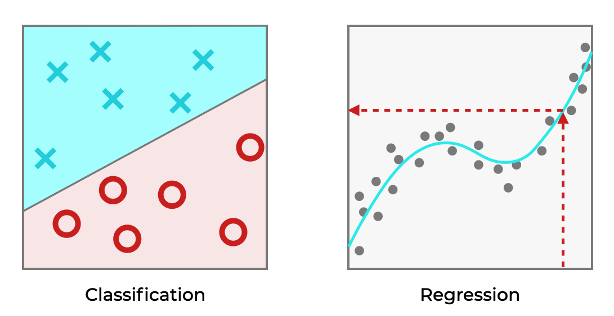
Machine Learning
Goal of machine learning – make accurate predictions about unseen data based on given data.
Classification – predicting which of the given categories does the given input belong to
Regression – predicting a numerical value for a certain input

Slide 7
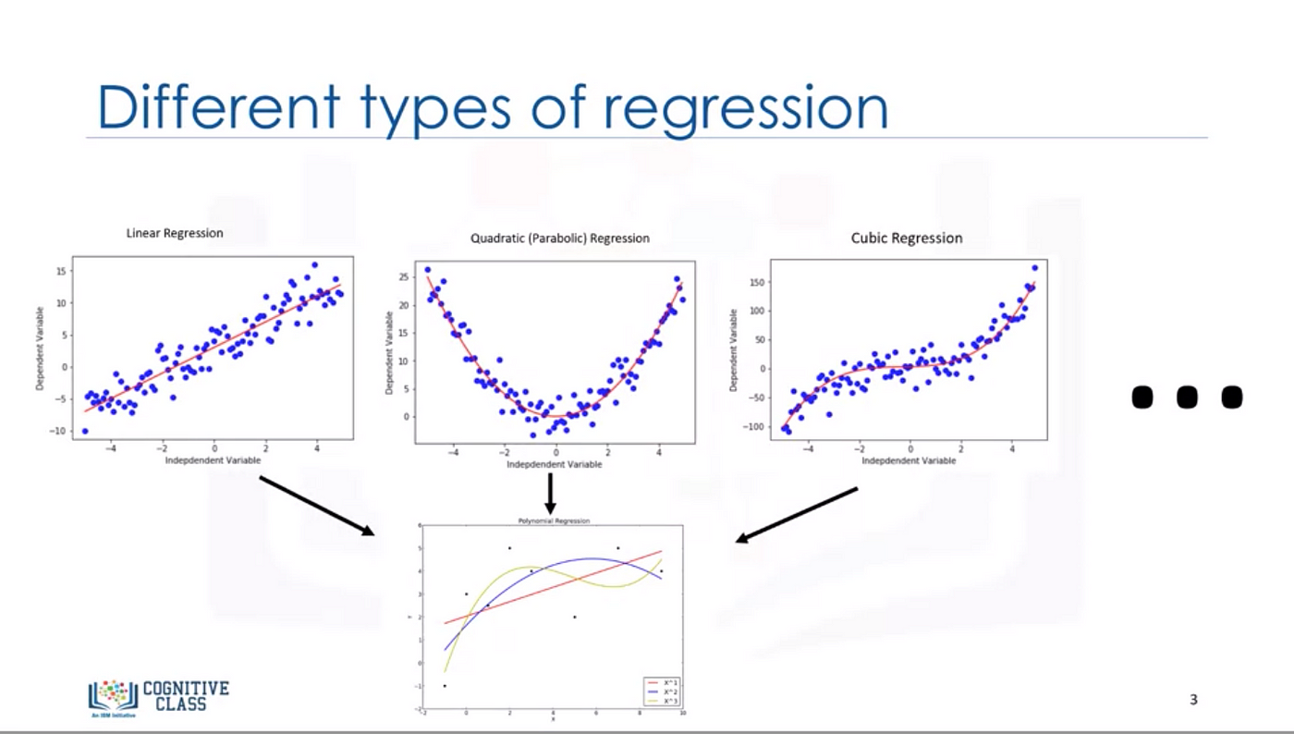
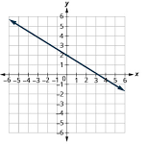
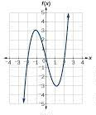
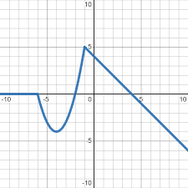
How do we make these predictions?
Inputs
Machine Learning Model
Using models!
We assume that the observed data comes from a target function. We want our model to take the form of this target function.
But the target function could be anything!
Predictions

Slide 8
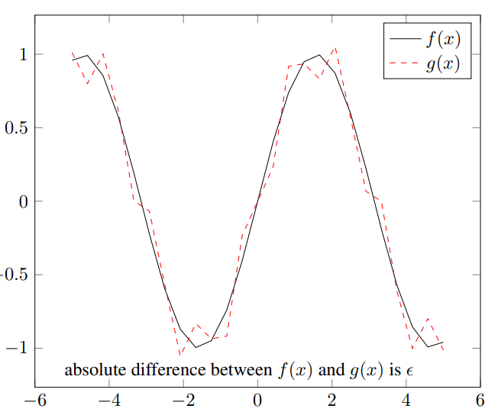
Neural Networks – Universal Function Approximators
Neural networks in their most basic form behave like continuous and piece wise linear (CPWL) functions.
They divide the input space into polygon like regions:
In each region, the function is linear
Between regions, the functions is continuous

Slide 9
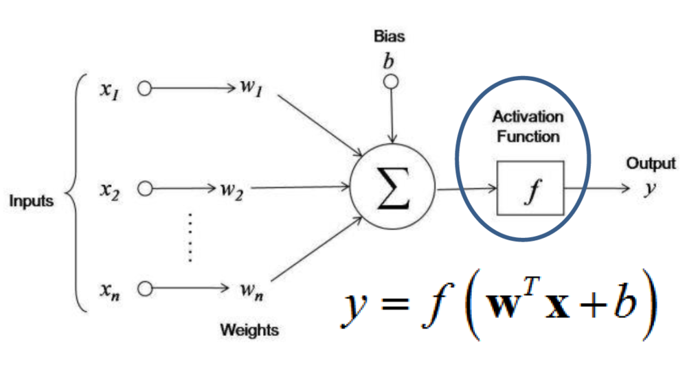
Components of a Neural Network
Artificial neuron – unit of the neural network
Weights for each input
Bias for the neuron
Activation function on the weighted average
Neurons are stacked together to form a layer
Layers are combined sequentially to form the network

Slide 10
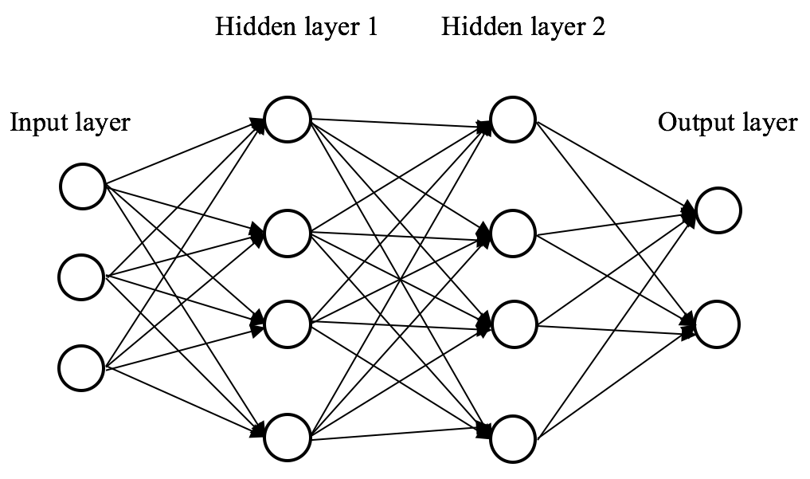
Components of a Neural Network
Neurons are stacked together to form a layer
x_{[i]} = f(W^{T}_{[i]}x_{[i-1]} + b_{[i]})
Layers are combined sequentially to form the network
Y = W^{T}_{[N]} f(… f(W^{T}_{[2]} f(W^{T}_{[1]}x + b_{[1]}) + b_{[2]}))+ b_{[N]})

Slide 11
How do we make the model learn?
Optimization! Find the right set of parameters that let our model perform well on our task of interest
Define a function that describes the loss we want to minimize and let the optimizer do its magic!

Slide 12
Deep Learning Workflow
Training Data
NeuralNetwork
Optimization Algorithm
Loss Function
Trained Neural Network
Score
Test Data
Loss Function

Slide 13
Implementing Deep Learning
Using NumPy, that we used in the previous session
Deep Learning with Numpy Notebook
Using PyTorch
Deep Learning with PyTorch Notebook

Slide 14

Lets us build the network in a modular format – easy to create, easy to maintain
Provides support for GPU acceleration through the use of Tensors
Makes the task of optimization very easy by providing us with an automatic differentiation engine called Autograd

Slide 15
GPUs and Tensors
GPUs are specialized computers, which are composed of a large number of cores which can run things for us in parallel.
Tensors are objects provided by PyTorch that let us make use of this performance acceleration provided by GPUs

Slide 16
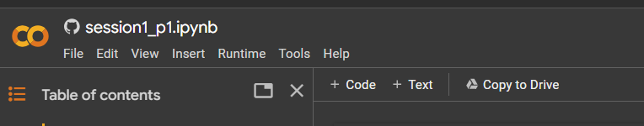

Google Colab Notebook
Let’s get started!

Slide 17
Build a neural network to classify hand-written images

Slide 18
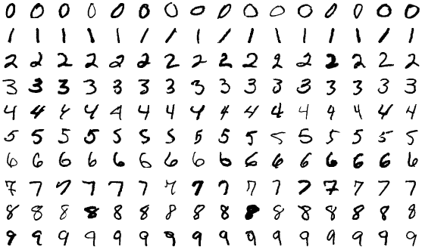
Hand-written images
https://en.wikipedia.org/wiki/MNIST_database
Notes:
An application of this would be reading zip codes from scanned images of postcards.

Slide 19
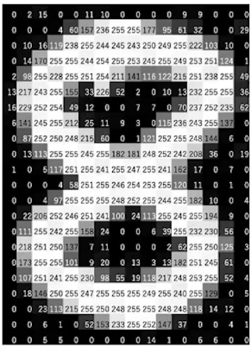
How computers “see” images
https://www.analyticsvidhya.com/blog/2021/03/grayscale-and-rgb-format-for-storing-images/
Notes:
An image is represented as a collection of scalars arranged in a regular grid with a height and and a width in pixels.
We might have a single scalar value per grid point (pixel) or multiple values.
The scalars representing individual pixels are often encoded using 8-bit integers.

Slide 20
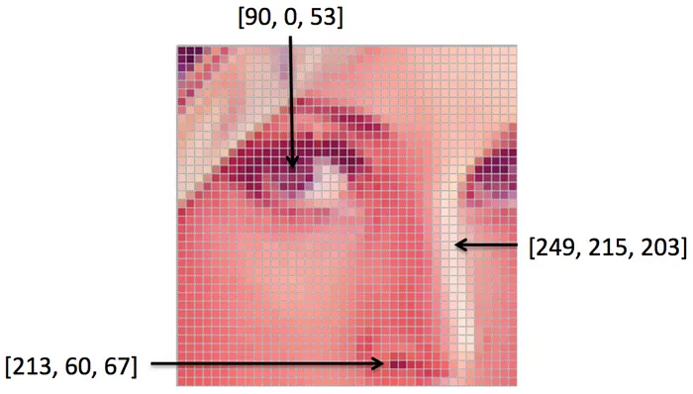
How computers “see” images
Notes:
For RGB images, the color is defined by 3 scalars, representing the intensity of red, green and blue.

Slide 21
The neural network
0
1
.
.
.
9
8

Slide 22
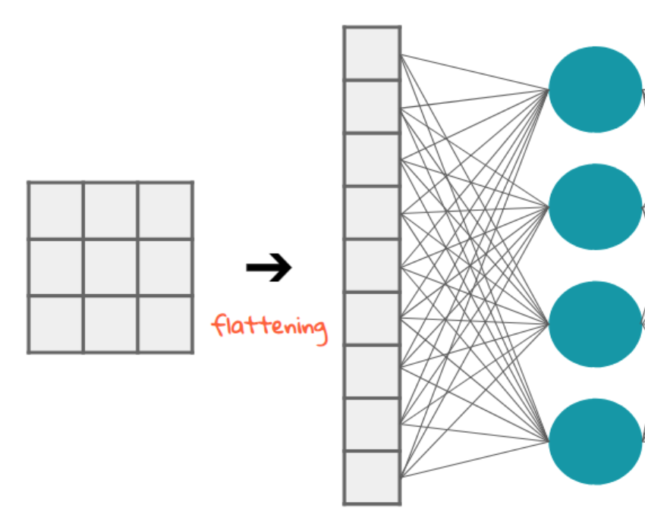
Flattening the input
https://stackoverflow.com/a/73661587/8519202

Slide 23
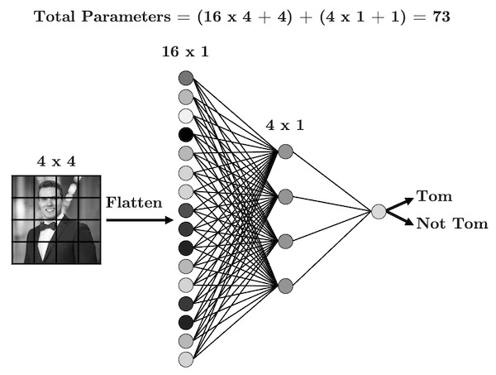
Linear Layer
https://www.tomasbeuzen.com/deep-learning-with-pytorch/_images/cnn-1.png

Slide 24
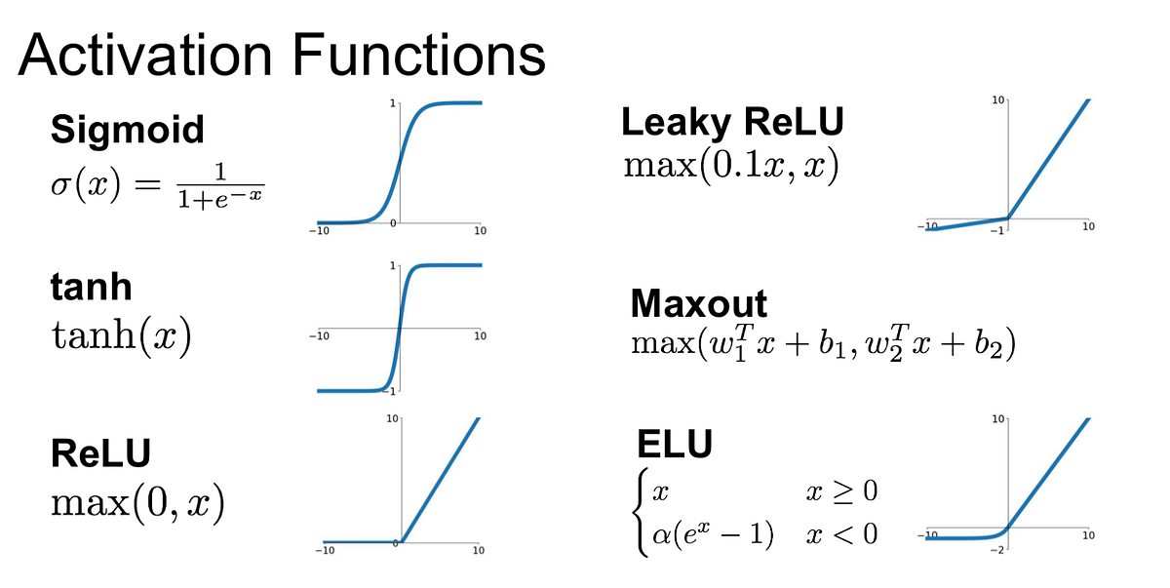
https://medium.com/@krishnakalyan3/introduction-to-exponential-linear-unit-d3e2904b366c

Slide 25
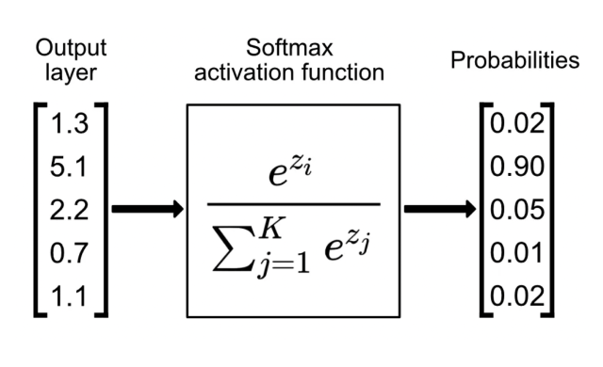
Softmax activation function
https://www.singlestore.com/blog/a-guide-to-softmax-activation-function/

Slide 26
The neural network
0
1
.
.
.
9
8

Slide 27
Open ntudlb-2025-session2-part-2.ipynb in Colab

Slide 28
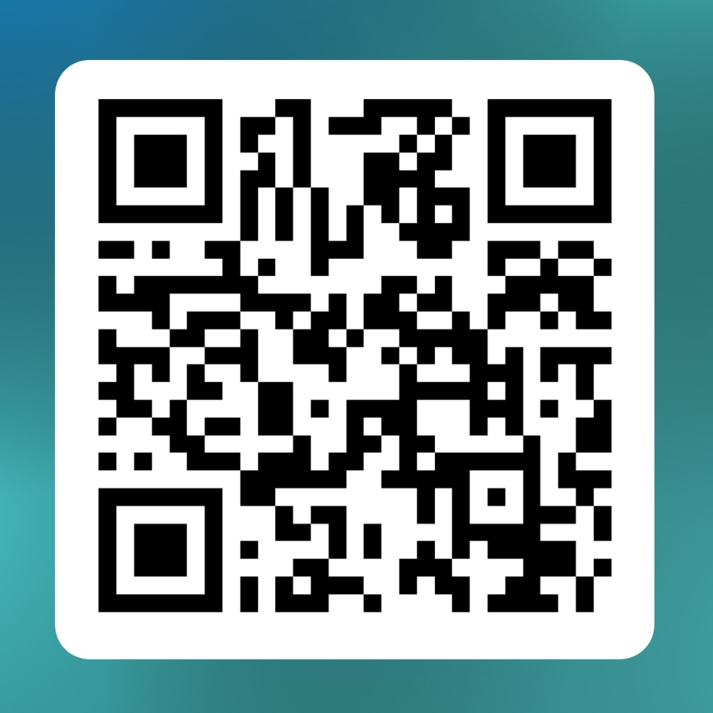
Feedback form for Session 2

Slide 29
For any questions, feel free to drop an e-mail to us! ☺ ntu-dl-bootcamp@e.ntu.edu.sg Bootcamp Website: ntu-dl-bootcamp.github.io//deep-learning-2025/
Thank You!

Slide 30
0
1
.
.
.
9
Sigmoid Non-linearity
Sigmoid Non-linearity
Sigmoid Non-linearity
8
786
256
128
10

