Slide 1
Transformer-based language models for polymer informatics
Yasharth Yadav
School of Physical and Mathematical Sciences,
Nanyang Technological University
DL Bootcamp 2025

Slide 2
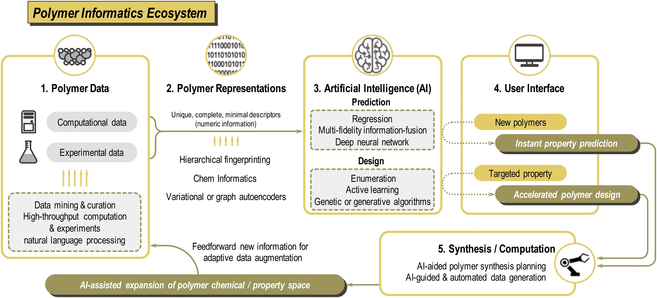
https://doi.org/10.1016/j.mser.2020.100595

Slide 3
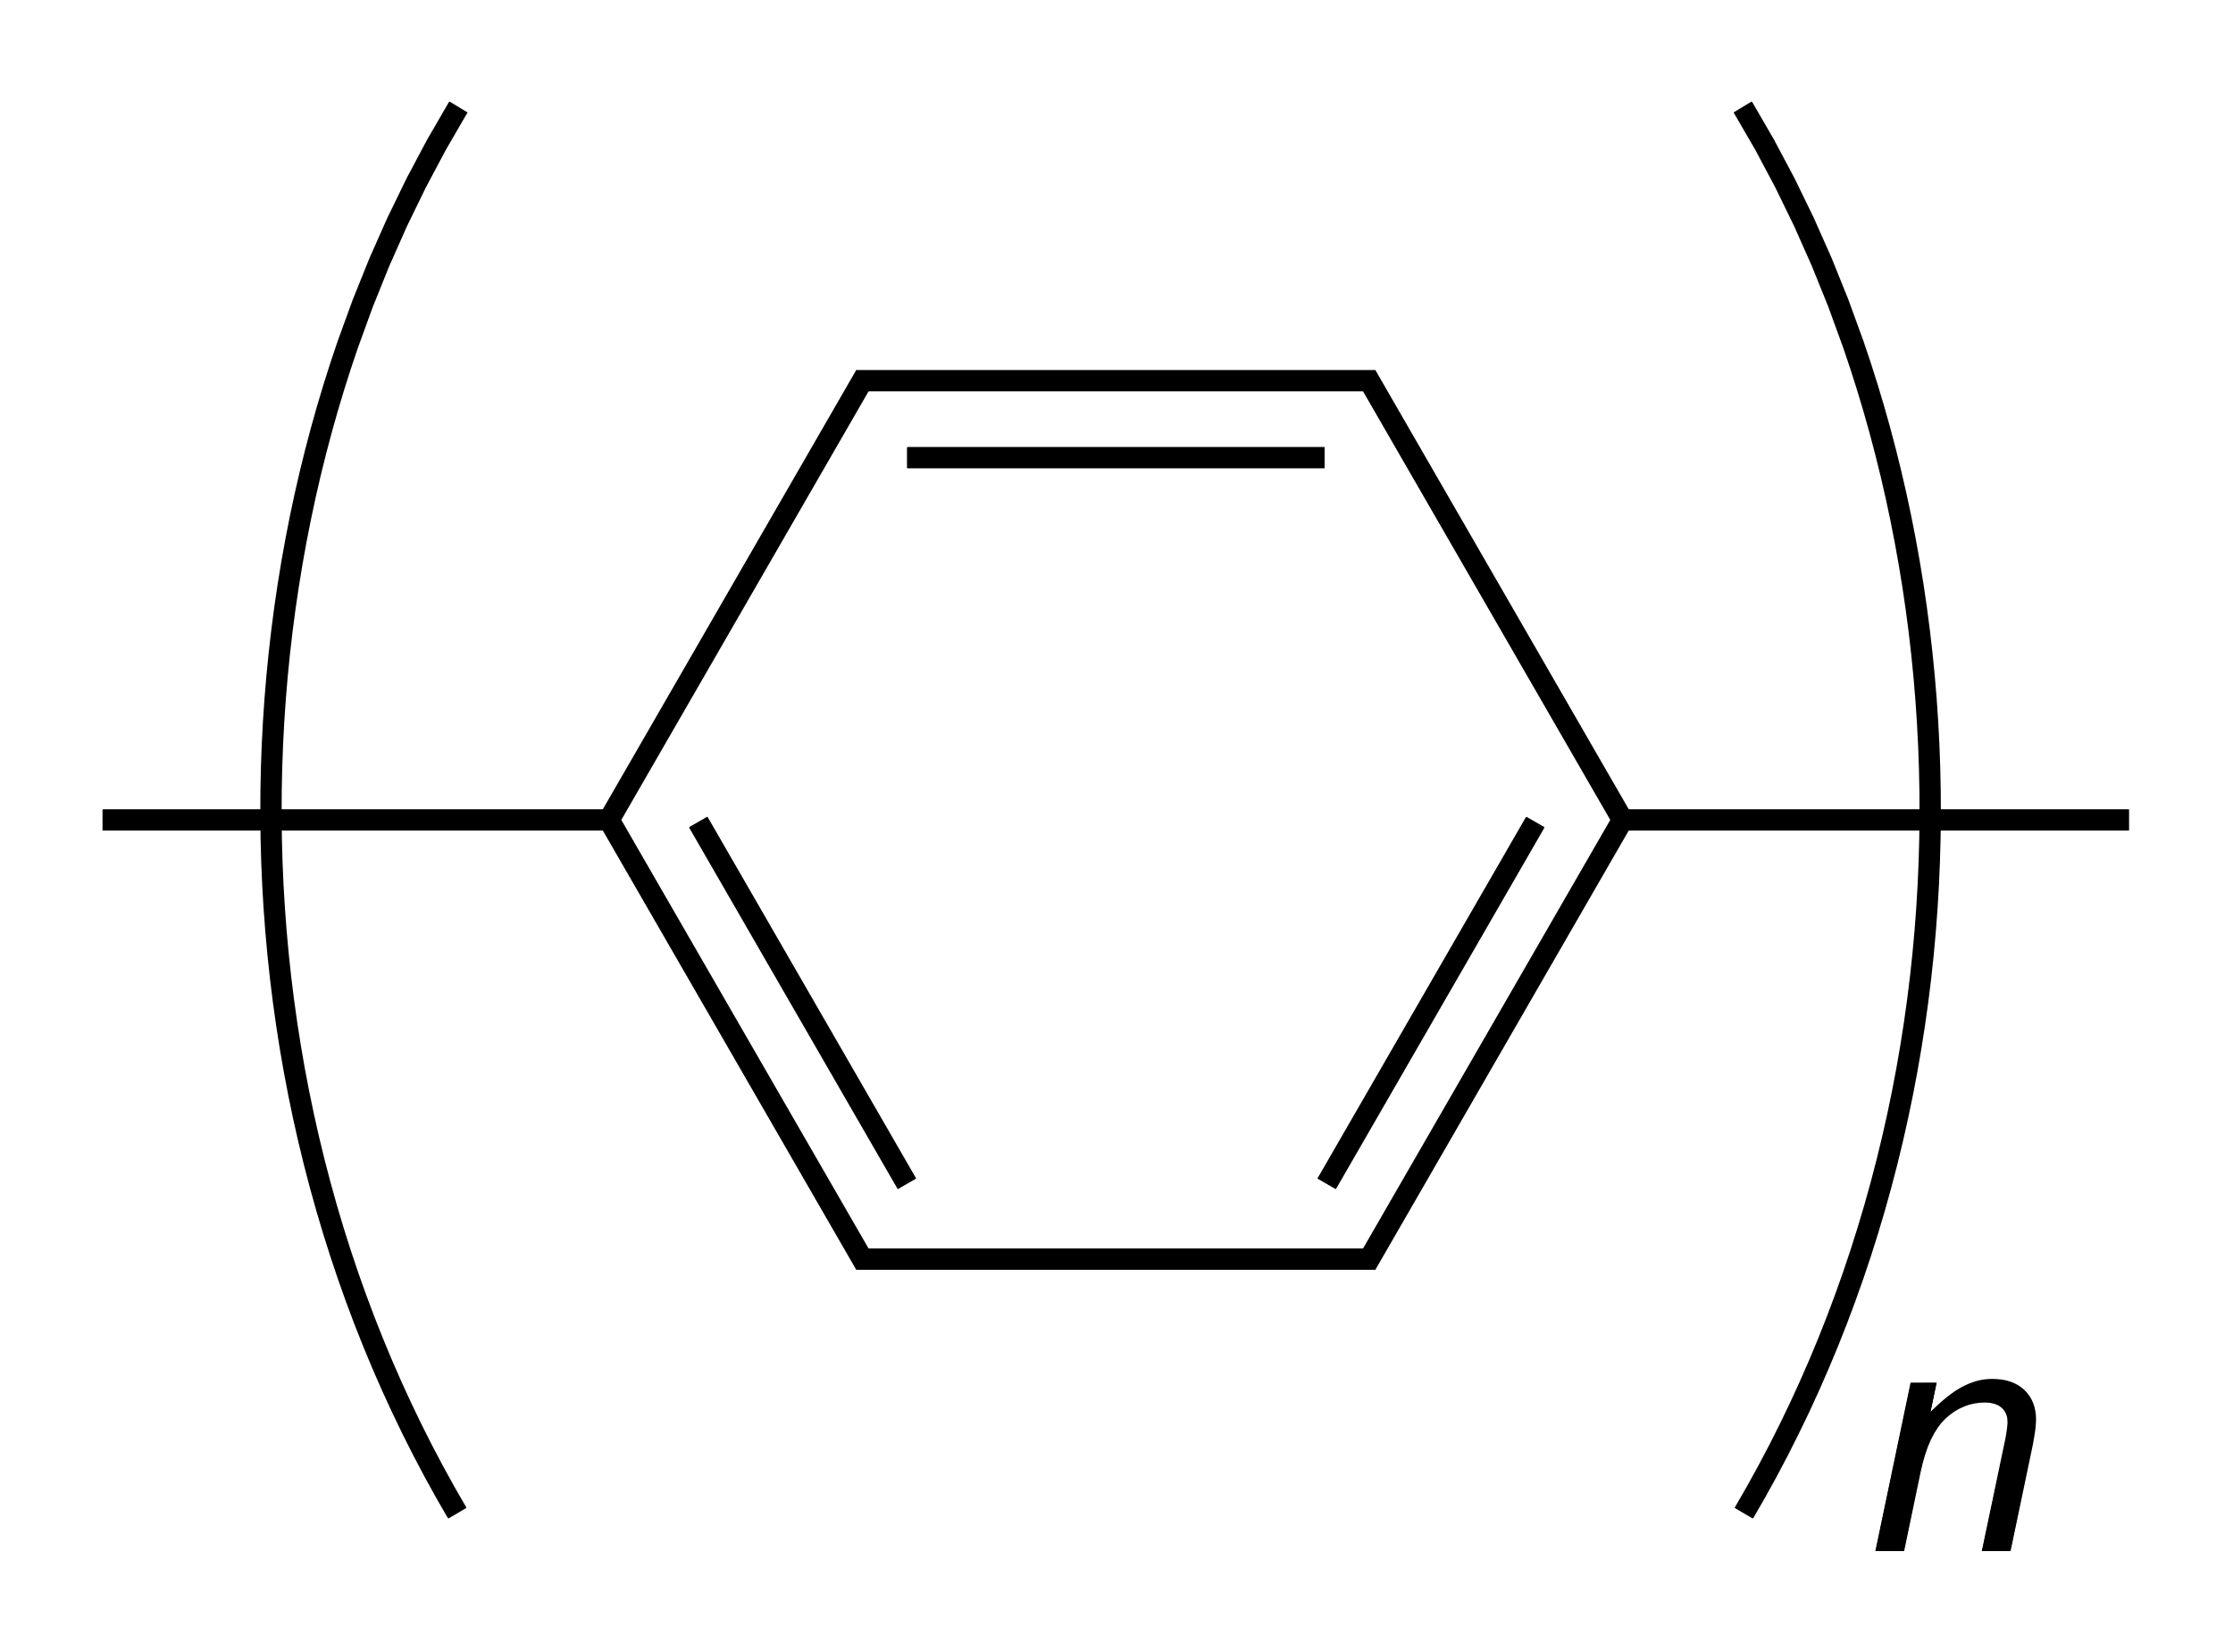
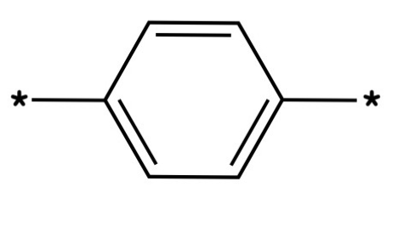
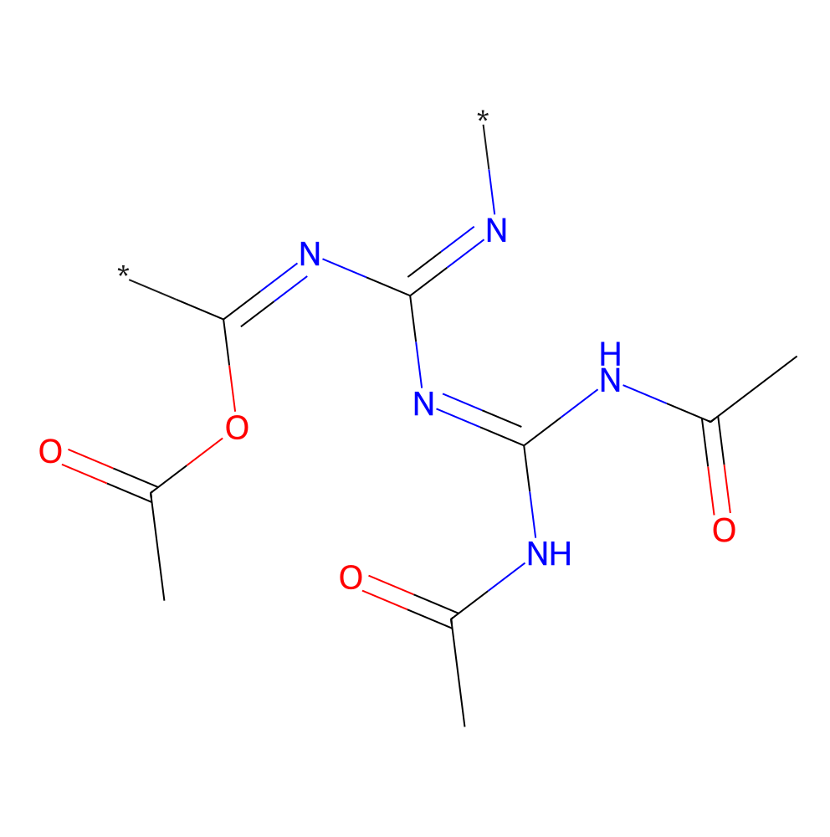
Polymer SMILES representation
Polymers are large molecules composed of several repeating subunits (monomers)
Example: Poly(p-phenylene)
Polymer SMILES (PSMILES): [*]C(C=C1)=CC=C1[*]
[*]N=C(N=C(NC(C)=O)NC(C)=O)N=C([*])OC(C)=O

Slide 4
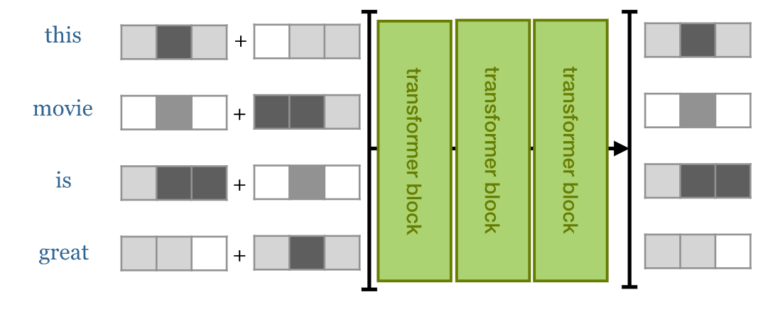
Overview of Transformers
Main steps
Tokenization: Split the the input data into tokens
Token embedding: Convert tokens into numerical vectors
Positional encoding: Represent the order of words in a sentence
Encoder block: Use the self-attention mechanism to learn the relationship between tokens
token
embedding
positional
encoding
encoder blocks
output
sequence
tokens
block 1
block 2
block 3
https://peterbloem.nl/blog/transformers

Slide 5
Tokenization
Split the input sequence into parts. Each part can then be embedded into a vector space.
In NLP, text data is split into words (tokens).
Each token is processed individually by the Transformer.
Vocabulary: set of all the unique tokens in the text data
Popular tokenizers: FastText, Byte-Pair-Encoding (BPE), WordPiece, SentencePiece
token
embedding
positional
encoding
encoder blocks
output
sequence
tokens
block 1
block 2
block 3

Slide 6
Token embedding
Represent each token in the vocabulary by a unique vector with fixed dimensions
Possible approach: one-hot encoding Represent each token by a unit vector in the standard basis
Limitations:
Sparse vectors in very large dimensions for most practical applications (due to large vocabulary size)
No concept of word similarity (since all words are orthogonal to each other)
Popular methods: word2vec, GloVe
token
embedding
positional
encoding
encoder blocks
output
sequence
tokens
block 1
block 2
block 3

Slide 7
Encoder block
This block applies, in order, self-attention layer (equipped with multi-head self-attention mechanism), layer normalization, feed-forward layer (applies a single MLP independently to each vector in the sequence), and layer normalization
Residual connections are added before each layer normalization step
In a typical Transformer architecture, multiple encoder blocks are stacked on top of each other (e.g. BERT)
token
embedding
positional
encoding
encoder blocks
output
sequence
tokens
block 1
block 2
block 3

Slide 8
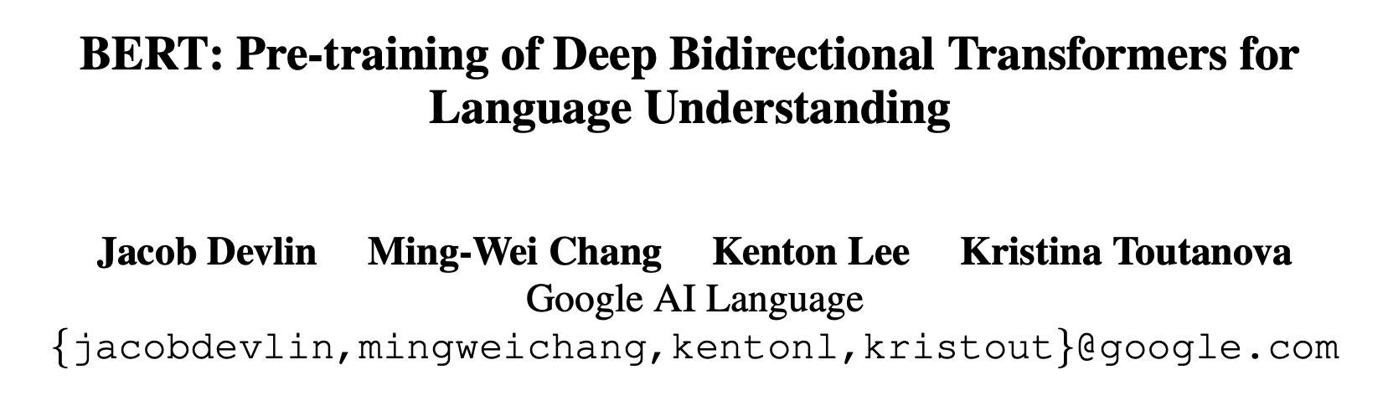
Bidirectional Encoder Representations from Transformers
Two main training steps:
Pre-training
Unsupervised learning – unlabeled data (e.g. raw text inputs)
Two tasks: masked word prediction (Masked Language Model) and next sentence prediction
Fine-tuning
Supervised learning – labeled data (e.g. positive or negative review)
Can be used for both classification and regression

Slide 9
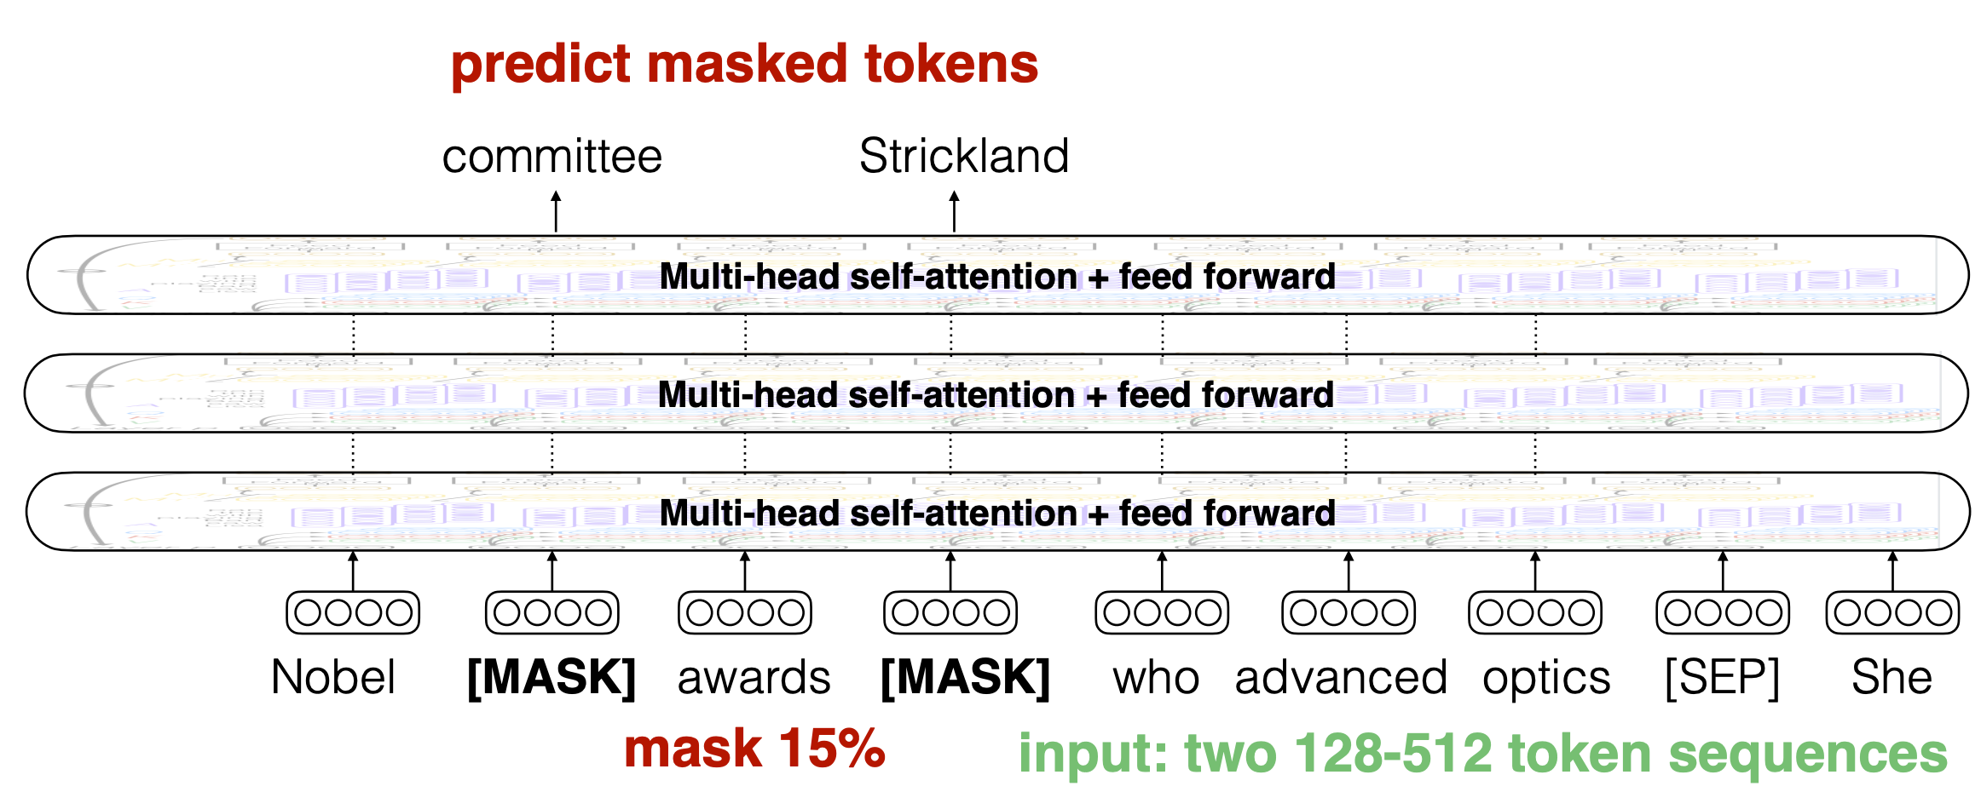
BERT pre-training (MLM)
15% of tokens are selected for possible replacement:
80% become [MASK]
10% are replaced by randomly selected token from the vocabulary
10% remain unchanged
Predict the true values of the [MASK] tokens
http://demo.clab.cs.cmu.edu/11711fa20/

Slide 10
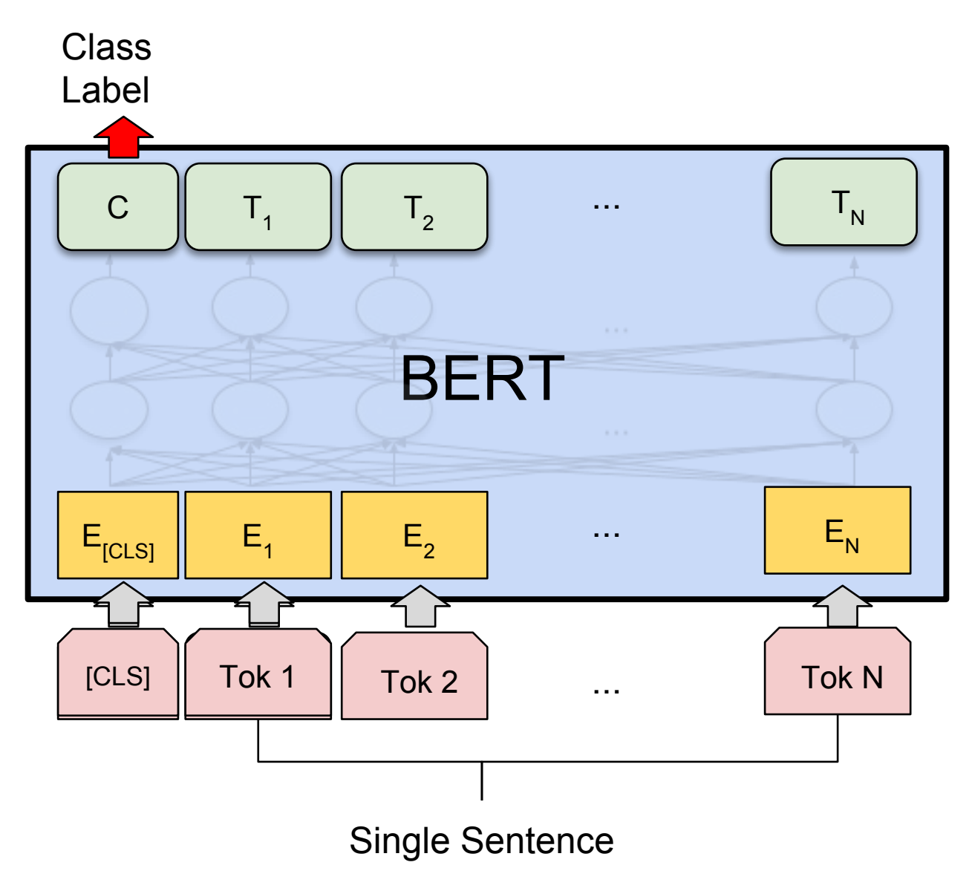
BERT fine-tuning
Add a special token [CLS] at the beginning of the sequence
Use the transformed embedding vector for [CLS] as a feature for classification or regression tasks
http://demo.clab.cs.cmu.edu/11711fa20/

Slide 11
Can we train Transformers to learn a representation of pSMILES strings, and use them to predict polymer properties?
http://demo.clab.cs.cmu.edu/11711fa20/

Slide 12
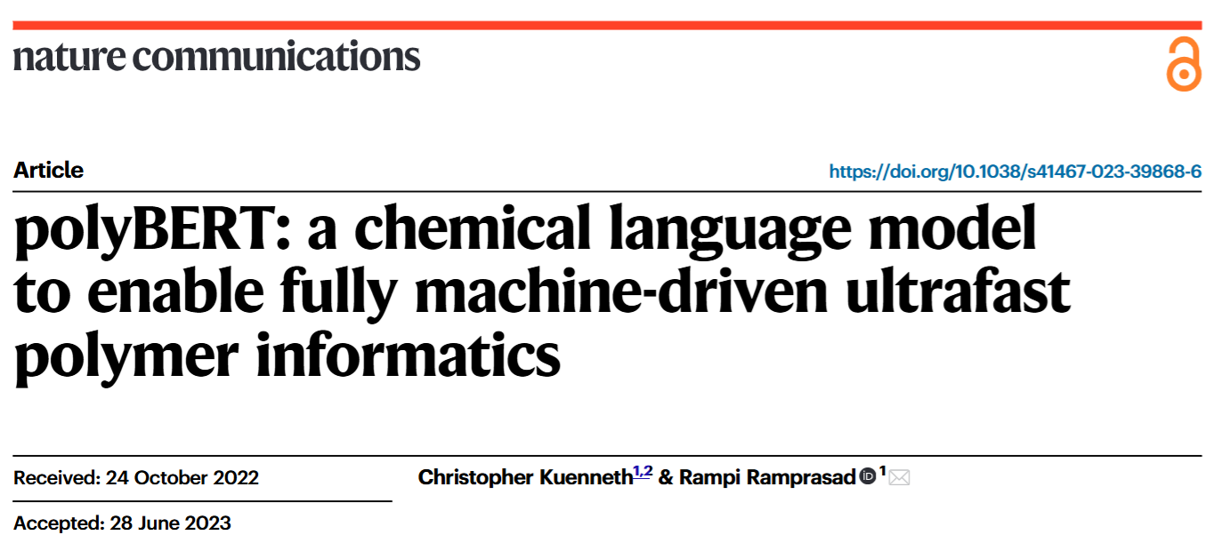
Can we train Transformers to learn a representation of pSMILES strings, and use them to predict polymer properties?
http://demo.clab.cs.cmu.edu/11711fa20/

Slide 13
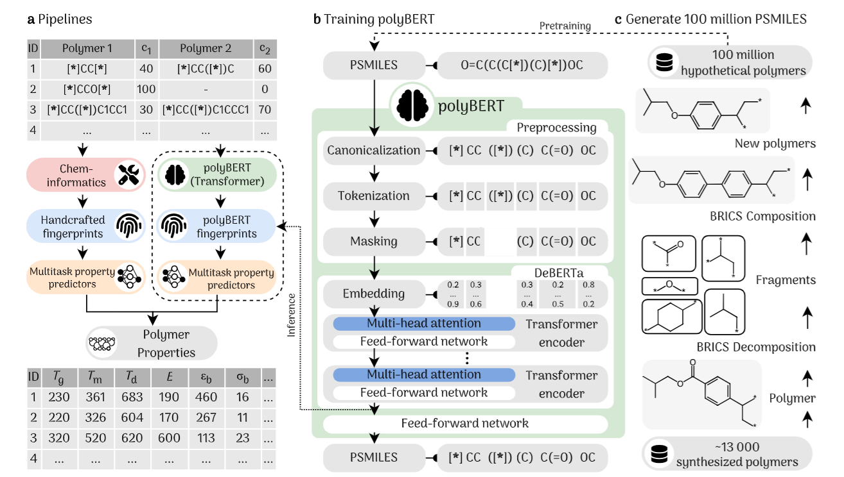

Slide 14
Thank You!

