Slide 1

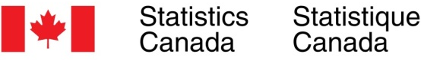

Spatial analysis of cannabis and tobacco consumption among Canadian youth and adults Statistics Canada Ottawa, Ontario June 11, 2019
Kuan Liu¹, Shahriar Shams¹ and Dominika Bhatia²
¹Division of Biostatistics, Dalla Lana School of Public Health, University of Toronto
²Institute of Health Policy, Management and Evaluation, Dalla Lana School of Public Health, University of Toronto

Slide 2
Outline
Background and study objectives
Data and methodology
Results
Policy implications
Discussion

Slide 3
Background and study objectives

Slide 4

Cannabis legalization in Canada
Background
The successful passing of Bill C-45, the Cannabis Act, marked Canada as the second country in the world to legalize recreational use of cannabis nationwide.
The act will:
Restrict and discourage youth consumption,
Promote public health awareness on safe consumption and related health risks,
Minimize criminal gains from cannabis trafficking.
Notes:
Uruguay became the first country in the world to fully legalize marijuana in 2013

Slide 5
Study rationale
Background
Provinces and territories determine jurisdiction-specific rules and restrictions regarding cannabis distribution, sales and consumption.
To develop targeted evidence-based policies, it is important to understand:
Geographic distributions of cannabis consumption
And determinants contributing to the use
Notes:
Understanding the geographic distributions of cannabis consumption, along with determinants contributing to the use, is essential for developing cannabis policies.

Slide 6
Study objectives
Study objectives
To identify Canadian cannabis and tobacco user profiles.
To investigate geographical distribution and variation in the prevalence of cannabis and tobacco consumption at provincial and economic region levels.
To examine characteristics and socio-economic factors associated with frequent cannabis and tobacco consumption in Canada.

Slide 7
Data and methodology

Slide 8
Canadian Tobacco, Alcohol and Drugs Survey
Data - CTADS
A biennial general population survey of tobacco, alcohol and drug use among Canadians collected by Statistics Canada on behalf of Health Canada.
Collection period: February 1st to December 31st of each survey year.
Target population: Household residents aged 15 or older in 10 provinces.
Telephone-based: Computer-assisted telephone interview, adoption of the household survey framework (inclusion of cell phones) since 2015.
Survey year included: 2013, 2015 and 2017 (primary dataset).
Survey Year | Person response rate % | Sample size | Weighted population size
2013 | 81.8% | 14,565 | 29 million
2015 | 79.0% | 15,154 | 29.7 million
2017 | 70.4% | 16,349 | 30.3 million
Notes:
The 2015 and 2017 CTADS adopted a household survey frame comprised of one to three telephone numbers associated with the same address, which includes landline and cellular telephone numbers.

Slide 9
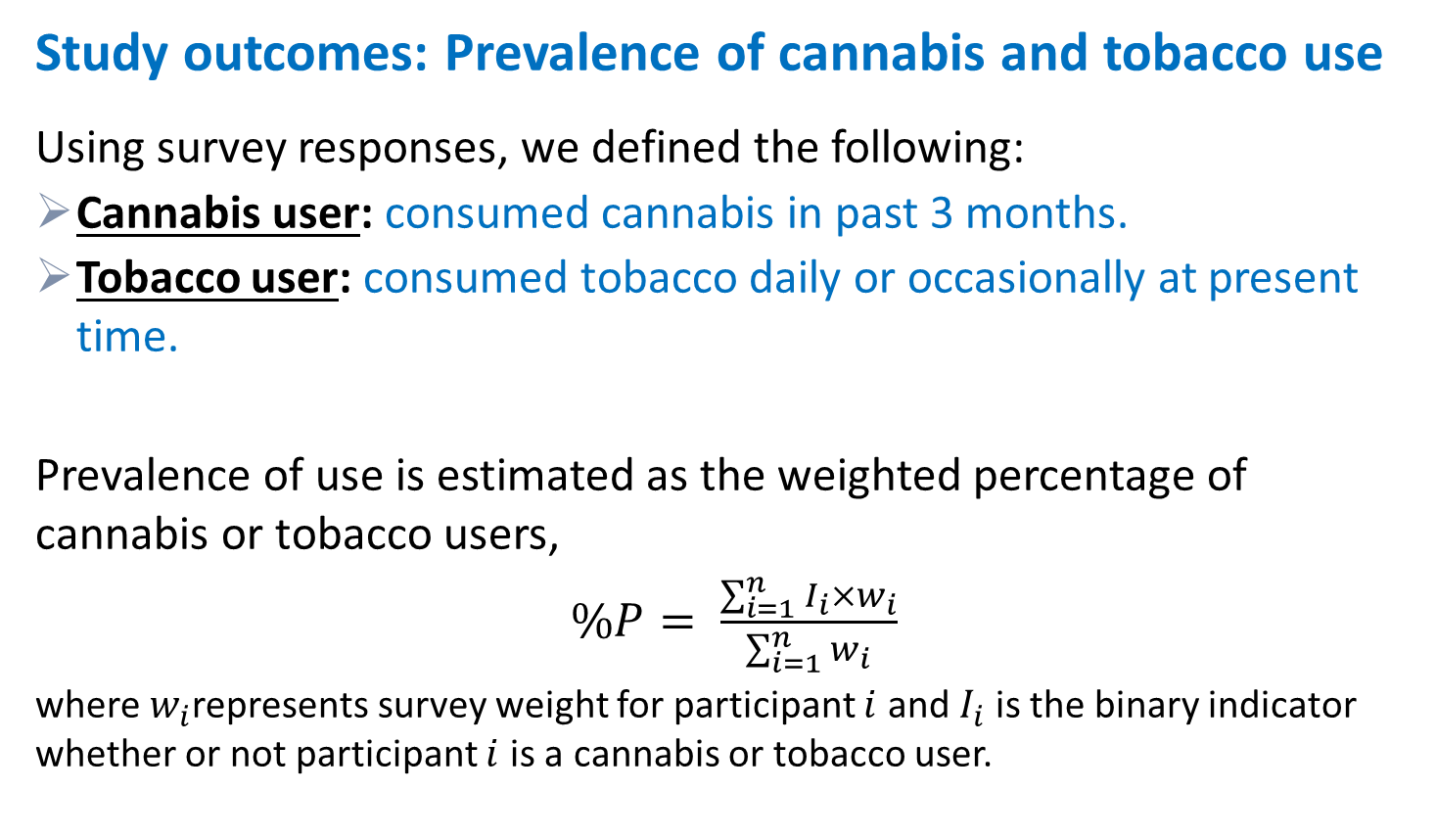
Methodology
Study outcomes: Prevalence of cannabis and tobacco use
Using survey responses, we defined the following:
Cannabis user: consumed cannabis in past 3 months.
Tobacco user: consumed tobacco daily or occasionally at present time.
Prevalence of use is estimated as the weighted percentage of cannabis or tobacco users,
$\%P= \frac{\sum_{i=1}^{n}{I_{i}×w_{i}}}{\sum_{i=1}^{n}{w_{i}}}$
where $w_{i}$represents survey weight for participant $i$ and $I_{i}$ is the binary indicator whether or not participant $i$ is a cannabis or tobacco user.
Notes:
The 2015 and 2017 CTADS adopted a household survey frame comprised of one to three telephone numbers associated with the same address, which includes landline and cellular telephone numbers.

Slide 10
Methodology
Primary analysis
User profiles
Cross-tabulations of prevalence by sex and selected characteristics
Spatial distribution
Maps of unadjusted and adjusted prevalence of use by province
Weighted logistic regression to model individual probability of being a cannabis/tobacco user, adjusted for province, characteristics, as well as whether or not the individual is also a current tobacco/cannabis user.
Likelihood Ratio tests to assess provincial variation.
Adjusted odds ratios were examined to determine associations between sociodemographic factors and consumption.
Notes:
The 2015 and 2017 CTADS adopted a household survey frame comprised of one to three telephone numbers associated with the same address, which includes landline and cellular telephone numbers.

Slide 11
Methodology
Secondary analysis
Cross-tabulations and mapping of province-level prevalence of use for:
Youth (15-19 years of age)
Non-medical cannabis consumption.
Mapping of the estimated prevalence by economic regions for Ontario with location pins on hospitals and licenced dispensaries.
Estimation uncertainty on prevalence is quantified using the 95% bootstrap confidence intervals with 1000 iterations. A p-value < 0.05 is considered statistically significant.
Analyses were performed using SAS 9.4 and R software 3.5.1.
Notes:
The 2015 and 2017 CTADS adopted a household survey frame comprised of one to three telephone numbers associated with the same address, which includes landline and cellular telephone numbers.

Slide 12
Results

Slide 13
Results – user profile
Canadian cannabis user profiles (2017)
 | Overall |  | Male |  | Female
 | Prevalence | 95%CI | Prevalence | 95%CI | Prevalence | 95%CI
Total | 10.8 | (9.3,12.3) | 11.3 | (11.3,15.8) | 6.6 | (6.6,9.9)♦
Age group
15-19 | 12.1 | (10.6,13.8) | 11.7 | (11.7,16.9) | 8.3 | (8.3,11.5)♦
20-24 | 22.6 | (20,25.4)∗ | 23.9 | (23.9,31.7) | 13.7 | (13.7,21.2)♦
25-44 | 16.4 | (13,20.4)∗ | 14.9 | (14.9,26.8) | 8.2 | (8.2,17.1)
44-64 | 6.9 | (5.4,8.6)∗ | 5.9 | (5.9,11.3) | 3.8 | (3.8,7.6)
65+ | 2.6 | (1.2,4.2)∗ | 1 | (1,6) | 0.6 | (0.6,3.7)
Residence
Population Centre | 11.2 | (9.6,13) | 13.7 | (11.2,16.7) | 8.9 | (6.9,10.9)♦
Rural | 9 | (6.9,11.1) | 12.5 | (9,16.4) | 5.4 | (3.7,7.5)♦
Marital status
Single | 19.7 | (16.8,22.7)∗ | 25.2 | (20.7,30) | 13.9 | (10.9,17.2)♦
Other^{i} | 7.3 | (5.7,9)∗ | 8.6 | (6.3,11) | 6 | (4.1,8.1)
Employment status
Worked the week prior | 13.3 | (11.4,15.4) | 15.9 | (13,19.2) | 10.3 | (8.3,12.5)♦
No^{ii} | 7.4 | (5.6,9.6) | 9.4 | (6.8,12.5) | 5.9 | (3.4,8.7)
Statistically significant lower prevalence of female user than male user.
Statistically significant difference from overall.
Other includes common-law/married, widowed, divorced/separated and not stated.
No includes not worked the week prior, don't know, refusal and not stated.

Slide 14
Results – user profile
Canadian tobacco user profiles (2017)
 | Overall |  | Male |  | Female
 | Prevalence | 95%CI | Prevalence | 95%CI | Prevalence | 95%CI
Total | 15.1 | (13.5,16.7) | 16.7 | (14.4,19.1) | 13.5 | (11.5,15.7)
Age group
15-19 | 7.9 | (6.6,9.3)∗ | 9.7 | (7.7,12) | 5.9 | (4.6,7.5)♦
20-24 | 16 | (13.9,18) | 20.4 | (17,23.6) | 11.4 | (9,14)♦
25-44 | 17.9 | (14.4,21.6) | 17.9 | (13,23.4) | 17.9 | (13.2,23.4)
44-64 | 17.6 | (15.2,20.4) | 21 | (16.8,25.3) | 14.3 | (11.3,17.9)
65+ | 8 | (5.6,10.6)∗ | 7.6 | (4.2,11.8) | 8.4 | (5.2,11.6)
Residence
Population Centre | 15 | (13.1,16.8) | 15.8 | (13.1,18.4) | 14.1 | (11.7,16.7)
Rural | 15.5 | (12.6,18.6) | 20.1 | (15.1,25.2) | 10.9 | (8,13.8)♦
Marital status
Single | 17.5 | (15.1,20) | 19.4 | (16,23.1) | 15.5 | (11.9,19)
Other^{i} | 14.1 | (12.1,16.1) | 15.6 | (12.7,18.6) | 12.8 | (10.2,15.4)
Employment status
Worked the week prior | 15.2 | (13.2,17.1) | 17 | (13.9,20.2) | 13.1 | (10.8,15.9)
No^{ii} | 14.9 | (12.3,17.4) | 16.1 | (12.6,19.9) | 13.9 | (10.4,17.5)
Statistically significant lower prevalence of female user than male user.
Statistically significant difference from overall.
Other includes common-law/married, widowed, divorced/separated and not stated.
No includes not worked the week prior, don't know, refusal and not stated.

Slide 15
Summary
Results – user profile
CANNABIS
Users more likely to be young adults (20-24 years of age), male and single.
Statistically significant variation of consumption between sex across multiple characteristics.
TOBACCO
Users more likely to be adults (20-64 year of age).
Statistically significant variation of consumption between sex for youth and young adults (15-24 years of age) and rural residence.

Slide 16
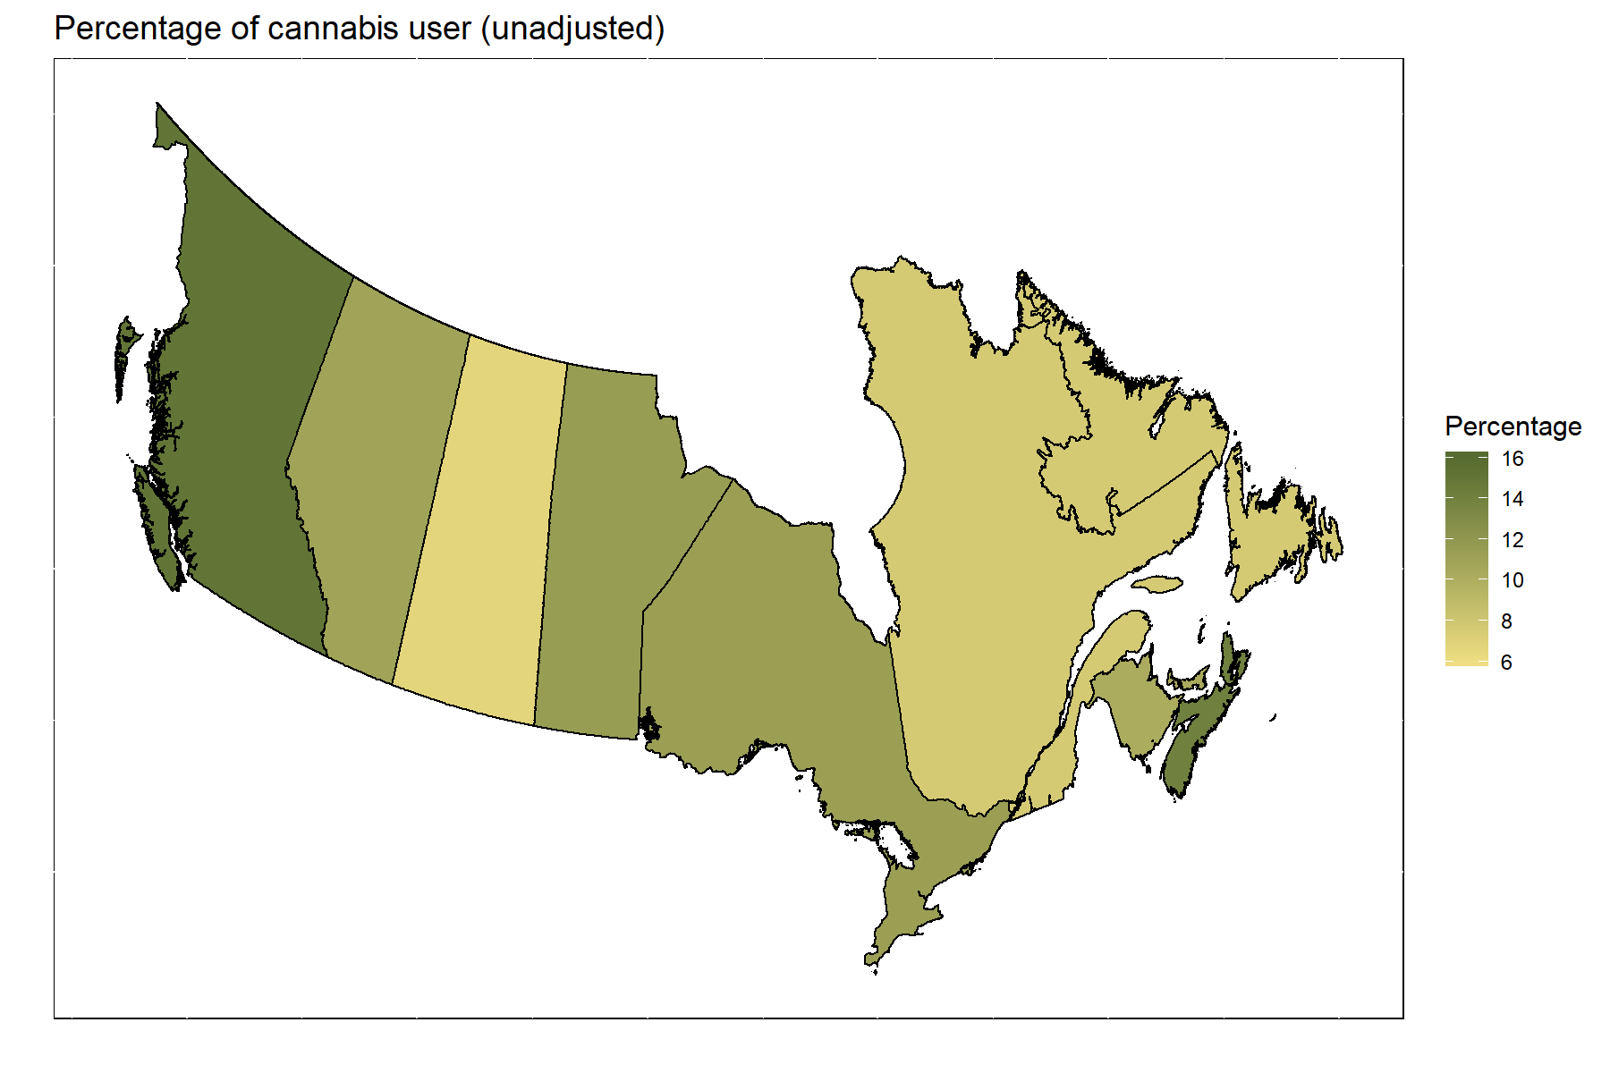
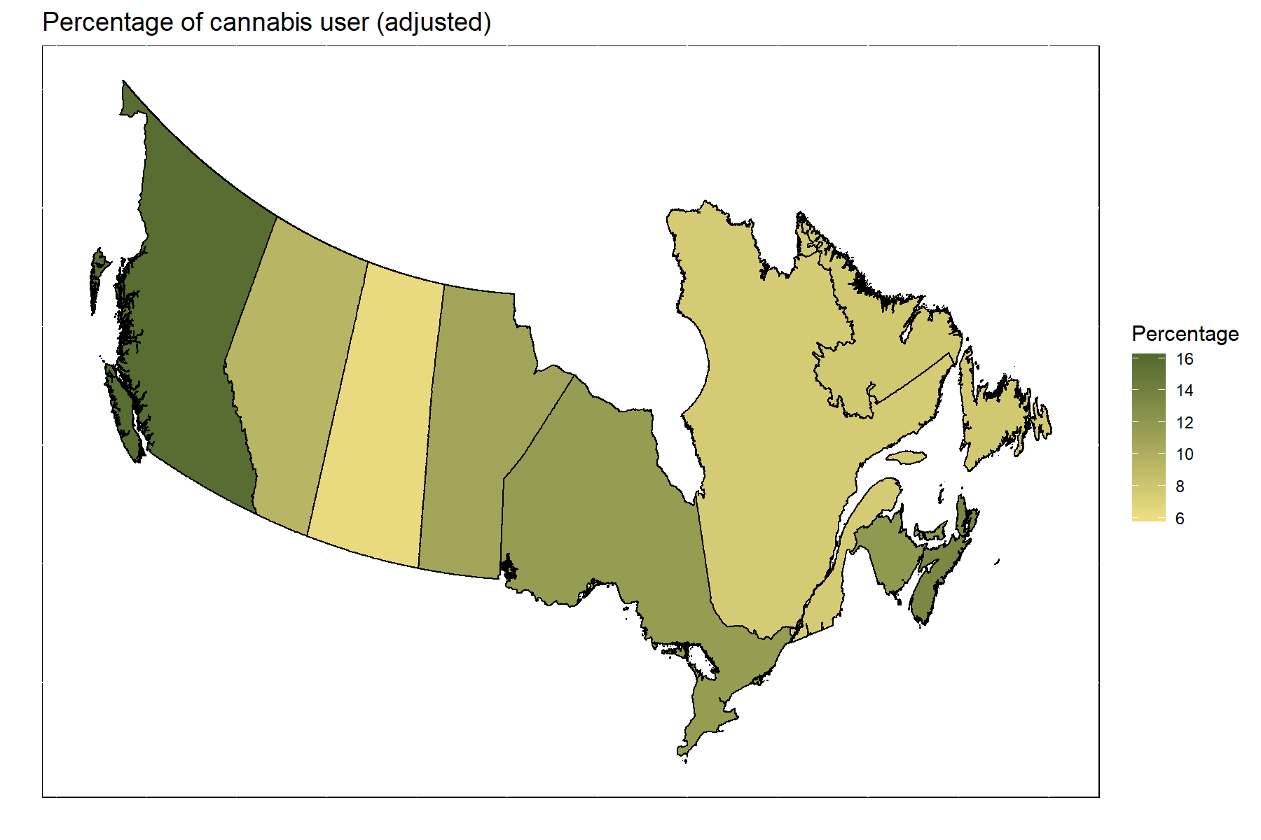
Geographic distribution of cannabis consumption
Results – Geo-distribution
Unadjusted
Adjusted
Statistically significant geo-variation on cannabis prevalence across provinces (P-value<.0001).
British Columbia has the highest estimated prevalence in 2017.
Saskatchewan has the lowest estimated prevalence in 2017.

Slide 17
Results – Geo-distribution
Prevalence of cannabis consumptions by province (2017)
National prevalence 10.8%
10.8(9.3,12.3)

Slide 18
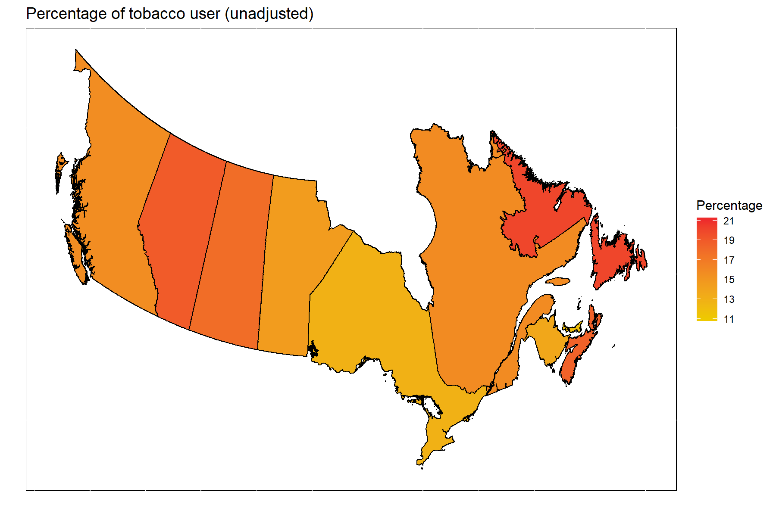
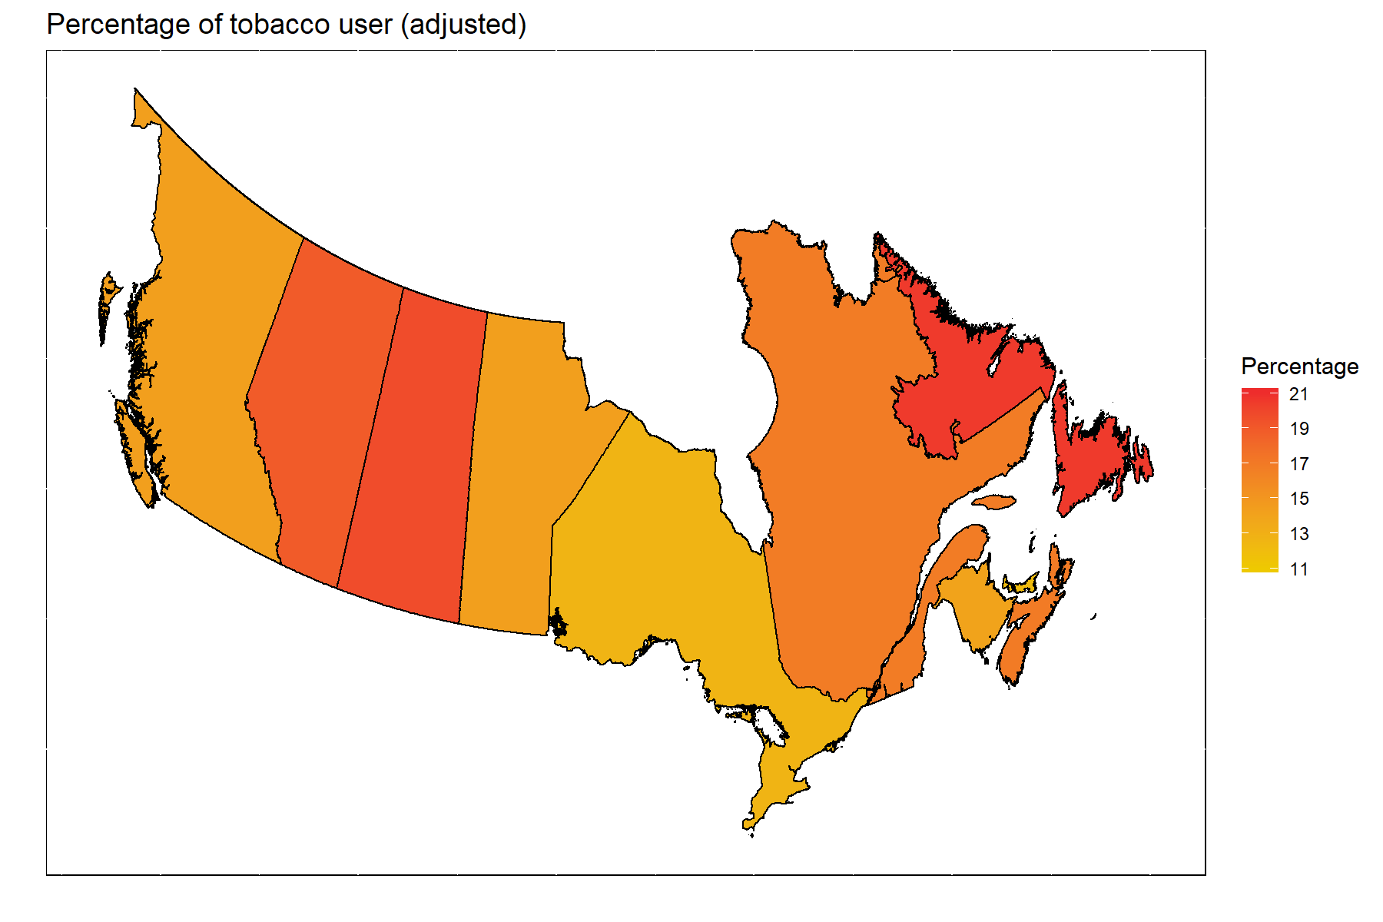
Geographic distribution of tobacco consumption
Results – Geo-distribution
Unadjusted
Adjusted
Statistically significant geo-variation on tobacco prevalence across provinces (P-value=0.042).
Newfoundland and Labrador has the highest estimated prevalence in 2017.
Prince Edward Island has the lowest estimated prevalence in 2017.

Slide 19
Results – Geo-distribution
Prevalence of tobacco consumptions by province (2017)
15.1(13.5,16.7)

Slide 20
Summary
Results – Geo-distribution
Nova Scotia has high prevalence of both cannabis and tobacco consumption.
Greater provincial variation on cannabis consumption compared to tobacco consumption (both statistically significant).
Factors likely contributing to geo-variation:
Demographic differences
Jurisdiction-level policy and infrastructure differences

Slide 21
Associations between covariates and cannabis/tobacco consumption in the weighted logistic regression model
Results – Odds Ratios
Cannabis Consumption
Tobacco consumption
Covariate | Categories | OR (95% CI)
Sex | Male vs Female | 1.65 (1.22, 2.23)♦
Age group | 15-19 vs 20-24 | 0.53 (0.42, 0.67)♦
 | 25-44 vs 20-24 | 0.97 (0.65, 1.47)
 | 45-64 vs 20-24 | 0.38 (0.24, 0.61)♦
 | 65+ vs 20-24 | 0.24 (0.11, 0.50)♦
Residence | Rural vs Urban | 0.92 (0.67, 1.27)
Marital Status | Married, Divorced, Common Law vs single | 0.42 (0.28, 0.62)♦
Employment Status | Worked the week prior vs no | 1.44 (1.01, 2.06)♦
Tobacco consumption | Current user vs not a current user | 6.68 (4.76, 9.37)♦
Covariate | Categories | OR (95% CI)
Sex | Male vs Female | 1.16 (0.89, 1.49)
Age group | 15-19 vs 20-24 | 0.5 (0.38, 0.65)♦
 | 25-44 vs 20-24 | 1.62 (1.12, 2.33)♦
 | 45-64 vs 20-24 | 2.02 (1.35, 3.02)♦
 | 65+ vs 20-24 | 0.76 (0.45, 1.27)
Residence | Rural vs Urban | 1.07 (0.8, 1.42)
Marital Status | Married, Divorced, Common Law vs single | 0.8 (0.55, 1.16)
Employment Status | Worked the week prior vs no | 0.67 (0.5, 0.89)♦
Cannabis consumption | Current user vs not a current user | 6.42 (4.57, 9.02)♦
Statistically significant with P-value < 0.05.
Province was adjusted in both weighted logistic regression models (see additional results for estimates).

Slide 22
Summary
CANNABIS
Young adults (20-24 years of age), male sex, single and actively-employed are associated with higher probability of being a current cannabis user
Current tobacco users have high probability of also being a current cannabis user
TOBACCO
Adults (25-64 year of age) and not actively-employed are associated with higher probability of being a current smoker
Strong association between current cannabis and tobacco consumption

Slide 23
Policy implications
Health
Social
Economic
Focus on cannabis consumption

Slide 24
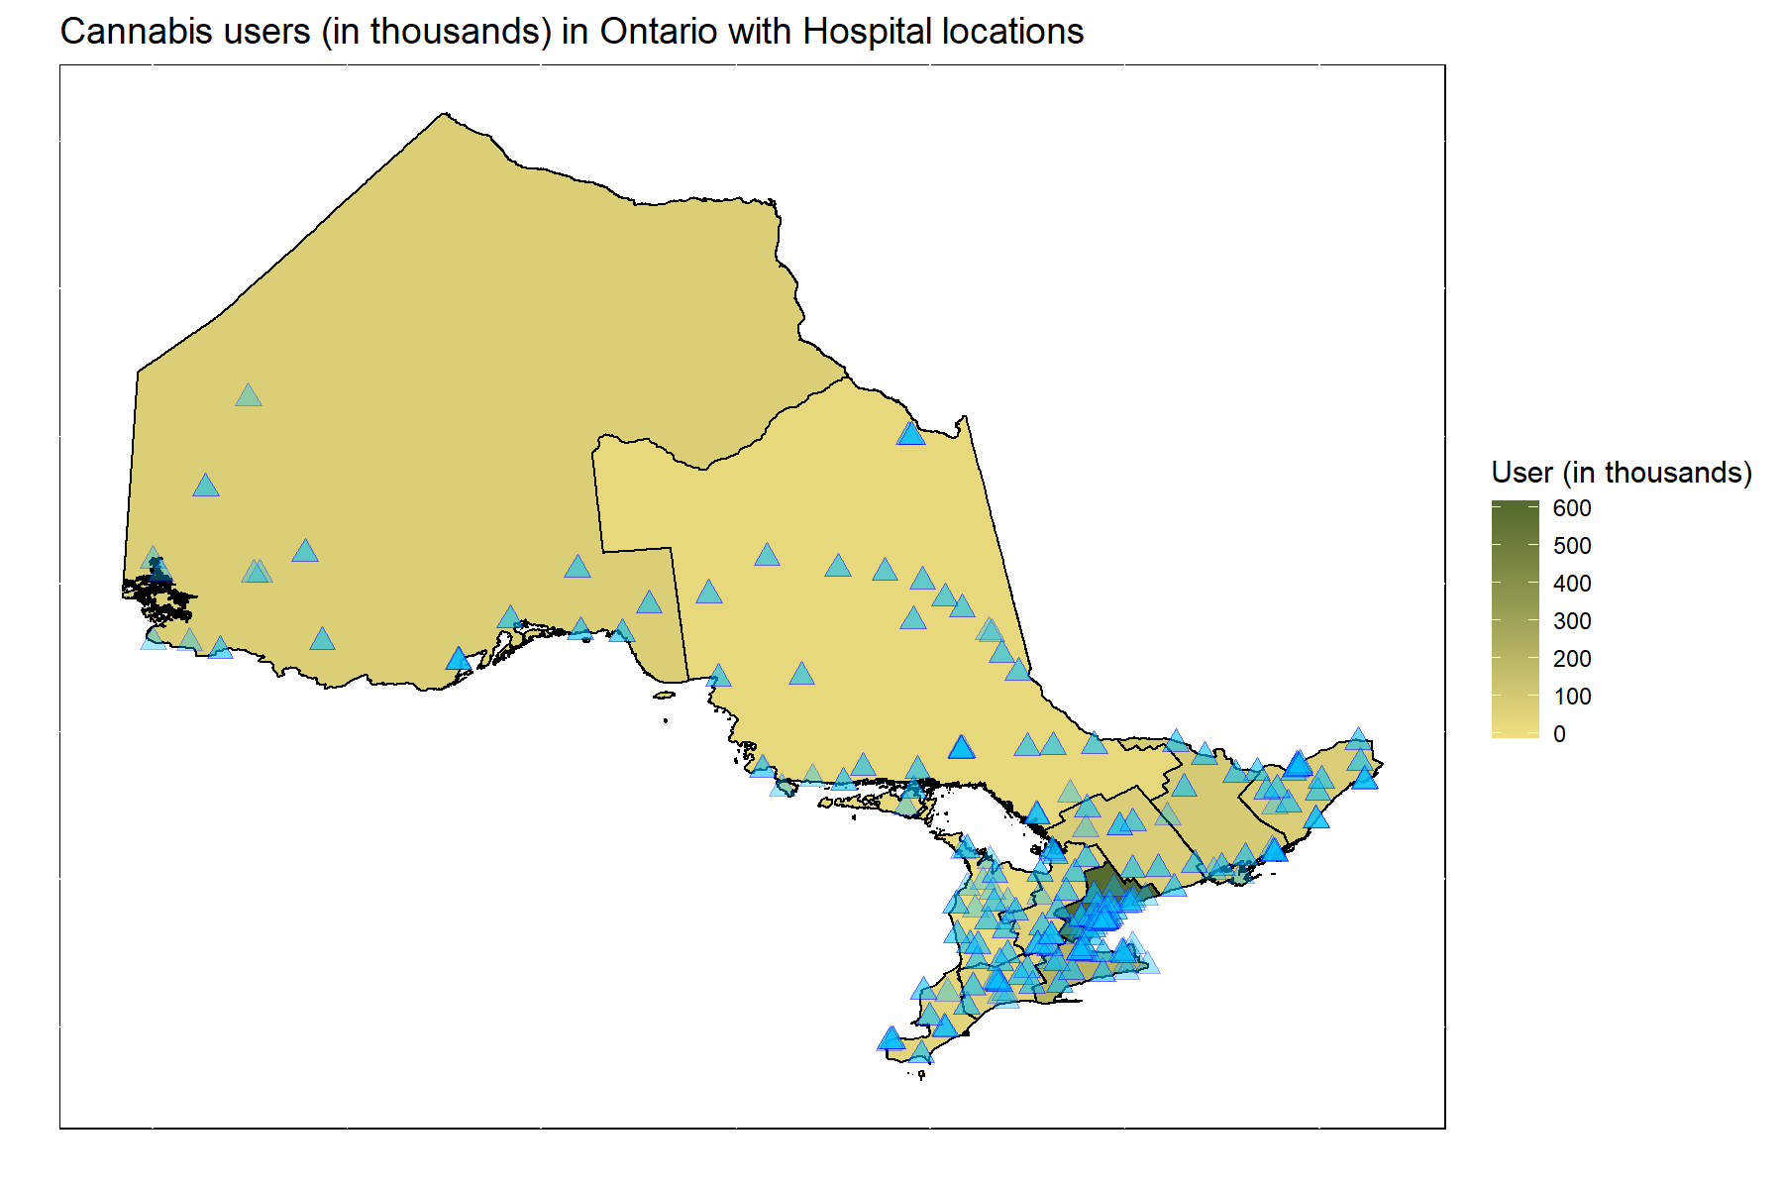
Geographic distribution of cannabis consumption by economic regions of Ontario with hospital locations
Policy implementation - Health
Toronto and Hamilton-Niagara peninsula have the highest cannabis user-to-hospital ratio (~7,000 cannabis users per hospital)
Cannabis use alone increased the risk of a fatal car crash by five-fold
The rising prevalence of cannabis consumption may result in increased demands for health infrastructures and resources
Policy on allocation of funds and resources of cannabis consumption related to health promotion and prevention programs at hospital, community centre and primary care level
Notes:
There is need for fund allocation to develop health promotion policies for cannabis consumption.

Slide 25

Geographic distribution of cannabis consumption by economic regions of Ontario with licenced dispensaries
Policy implementation - Economics
In Ontario, Alcohol and Gaming commission (AGCO) is the regulator for private recreational cannabis stores.
Presently, there are 24 applied dispensaries in Ontario
No dispensary at Kitchener-Waterloo-Barrie, Muskoka-Kawarthas, Northwest, Stratford-Bruce Peninsula and Windsor-Sarnia
Toronto has the highest cannabis user-to-dispensary ratio (~75,000 cannabis users per dispensary).
Strategic licencing of cannabis retailer based on location of demand may improve taxation revenue.
More on cannabis price, household spending on cannabis products at https://www150.statcan.gc.ca/n1/pub/13-610-x/13-610-x2018001-eng.htm

Slide 26
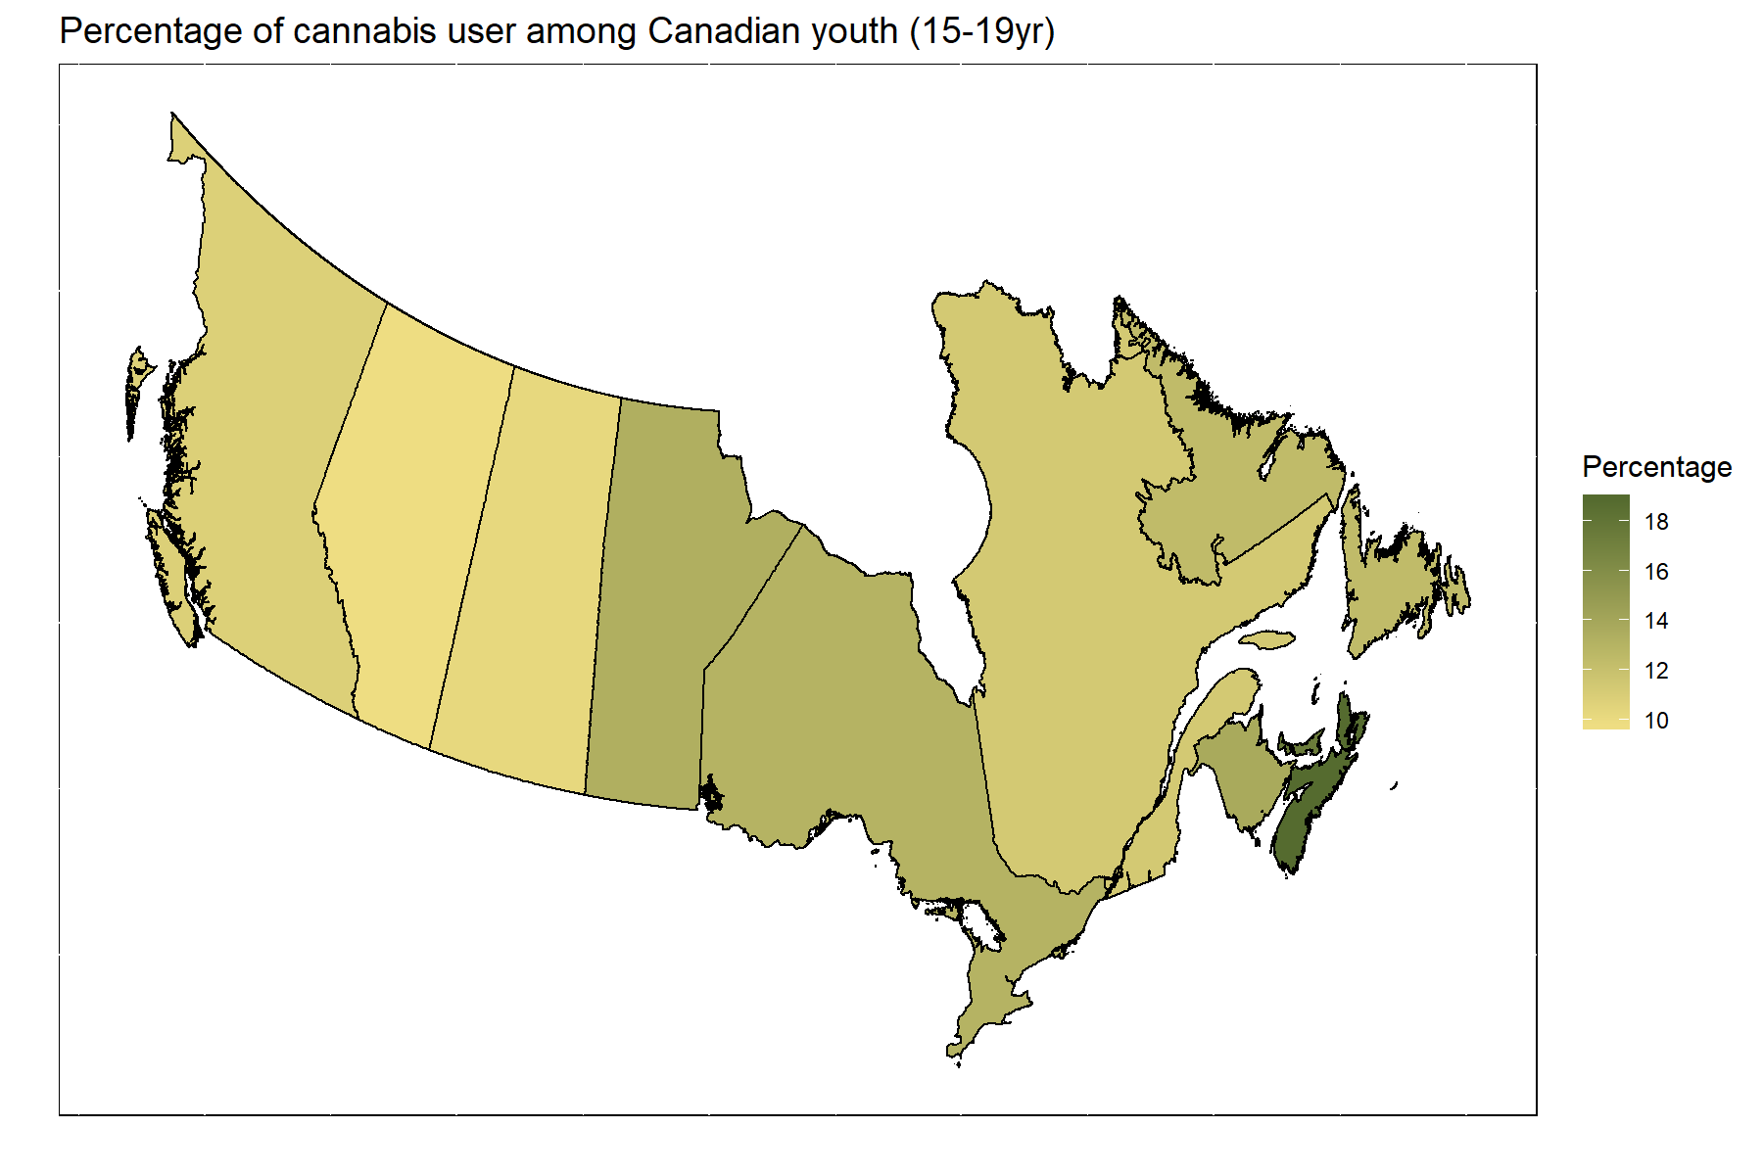
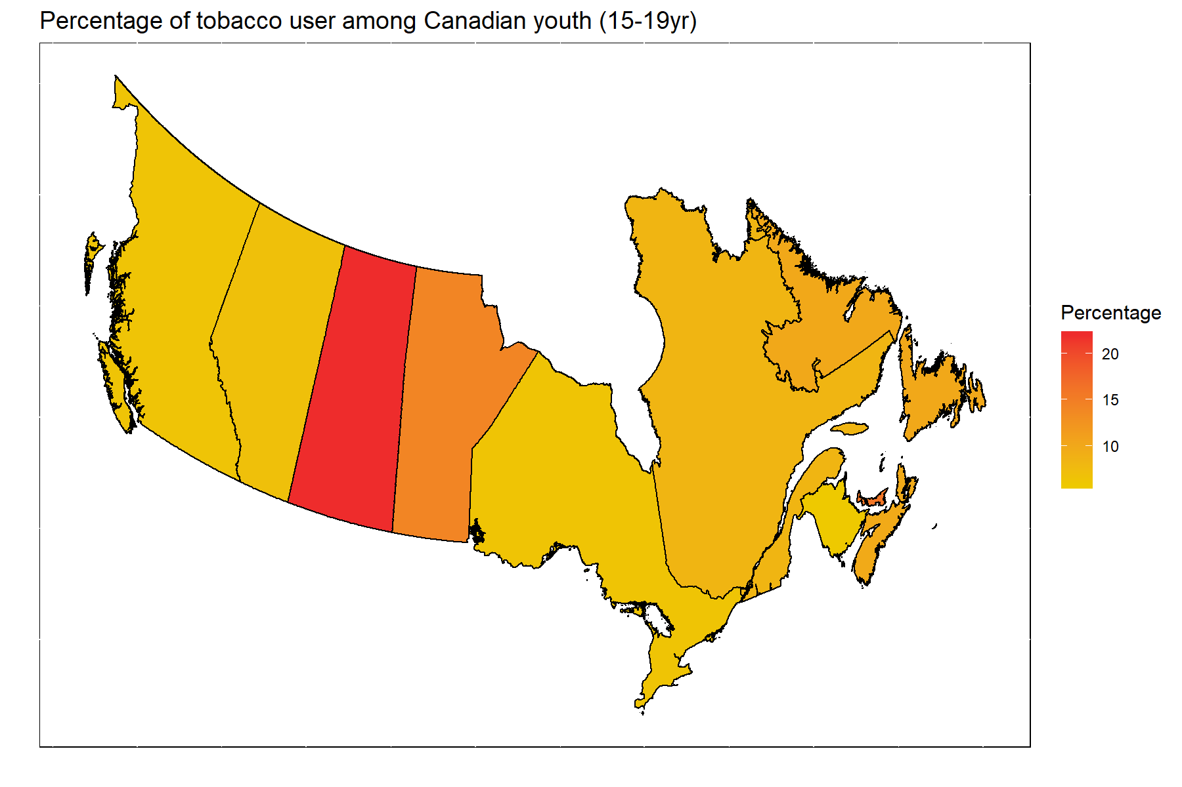
Geographic distribution of youth consumption (15-19 years of age)
Policy implementation - Social
Age of first consumption for cannabis and tobacco is 16 years of age (IQR:15-19, 14-18, respectively)
Nova Scotia has the highest prevalence of youth cannabis consumption.
Saskatchewan has the highest prevalence of youth tobacco consumption.
Policy to restrict youth consumption
Educational resources and programs on cannabis consumption at schools.
Public area smoking (cannabis and tobacco) restrictions.

Slide 27
Policy implementations
Allocation of funds and resources of cannabis consumption related health promotion and prevention programs at hospital, community centre and primary care level
Strategic licensing of cannabis retailers based on location of demand to increase potential taxation revenue
Restrict youth consumption through implementing educational programs at school level and public area smoking restrictions
Policy-making should consider geographic prevalence of consumption as well as user profiles
Notes:
Licensing

Slide 28
Discussion

Slide 29
Summary
Discussion & Summary
We identified Canadian cannabis and tobacco user profiles.
We found significant geographic variation on consumption as well as characteristics, socio-economic factors that were associated with consumption.
Based on our study, we suggested three implementable policies on health, social and economic impact of cannabis consumption.

Slide 30
Limitations
Data limitations
Information collected through the CTADS are self-reported
Small sample size
Unable to investigate key socio-economic factors including income, ethnicity and deprivation due to data availability
The geographical regions were assumed to be spatially independent in all the adjusted analyses
Notes:
Data limitations
Information collected through the CTAS are self-reported. Perception and willingness to report of the respondents are potential bias.
Due to small sample size, consumptions were only reported at the provincial and economic regional level.
Unable to investigate key socio-economic factors including income, ethnicity (diversity) and deprivation due to data availability.
The geographical regions were assumed to be spatially independent in all the adjusted analysis. A proper analysis would require the use of Bayesian estimation with informative priors on the spatial correlation structure between regions.

Slide 31
Future work
Discussion & Summary
Fitting a spatial regression model on the intensity (rate) of cannabis and tobacco consumption at province and economic levels.
Adjusting for geo-socioeconomic factors
Incorporating spatial random effect to assess spatial correlation of consumption.

Slide 32
Acknowledgement
Angela Prencipe, Toronto RDC
Dr. Lennon Li, Public Health Ontario
Prof. Stéphanie Lluis, University of Waterloo
Prof. Eleanor Pullenayegum, The Hospital for Sick Children
Prof. Olli Saarela, University of Toronto
Michela Panarella, University of Toronto

Slide 33
Reference
Michelle R and Kelli L. Prevalence and correlates of marijuana use in Canada, 2012, Health reports, 26(4), 2015, Statistics Canada
Michelle R and Ryan M. Analysis of trends in the prevalence of cannabis use in Canada, 1985 to 2015, Health reports, 29(2), 2018, Statistics Canada
Statistics Canada. Active/inactive survey(s) and statistical programs program(s) including overviews, questionnaires, and related documentation. Available at: https://www23.statcan.gc.ca/
Daniel R, Patrick B, and Tara S. Spatial variation in risk for physician diagnosed environmental sensitivity, Spatial and Spatio-temporal Epidemiology, 23, 2017
Health Canada and Statistics Canada national cannabis survey reports Available at: https://www150.statcan.gc.ca/n1/daily-quotidien/190207/dq190207b-eng.htm
Statistics Canada. Canadian Tobacco, Alcohol and Drugs Survey Microdata File (82M0020X). Available at: http://www5.statcan.gc.ca/olc-cel/olc.action?ObjId=82M0020X&ObjType=2&lang=en&limit=0
Macdonald R, Rotermann M. Experimental Estimates of Cannabis Consumption in Canada, 1960 to 2015. Economic Insights 2017. Available at http://www.statcan.gc.ca/pub/11-626-x/11-626-x2017077-eng.htm
Robertson RD, Hing MM, Pashley CR, Brown SW, Vanlaar WG. Prevalence and trends of drugged driving in Canada. Accident Analysis & Prevention. 2017 Feb 1;99:236-41.
Hall W, Degenhardt L. Adverse health effects of non-medical cannabis use. Lancet 2009; 374: 1383–91.
Fergusson DM, Boden JM. Cannabis use and later life outcomes. Addiction 2008; 103:969–76.
Volkow ND, Baler RD, Compton WM, et al. Adverse health effects of marijuana use. New England Journal of Medicine 2014; 370(23): 2219‒27.
Silins E, Horwood LJ, Patton GC, et al. Young adult sequelae of adolescent cannabis use: An
integrative analysis. Lancet Psychiatry 2014; 1: 286–93.
McGregor K, Makkai T. Self-reported Drug Use: How Prevalent is Underreporting? Barton, Australia: Australian Institute of Criminology, 2003. Available at: http://citeseerx.ist.psu.edu/viewdoc/download?doi=10.1.1.538.9399&rep=rep1&type=pdf
Harrell AV, Kapsak KA Cisin IH, Wirtz PW. The Validity of Self-reported Drug Use Data: The Accuracy of Responses on Confidential Self-administered Answer Sheets. Rockville, Maryland: National Institute on Drug Abuse, National Institutes of Health, 1997.

Slide 34
Additional results
Secular trend of consumption between 2013, 2015 and 2017
Odds ratios estimation for fixed-effect province - the weighted logistic regression models
Geographic distribution of non-medical cannabis consumption by province
Parametric spatial model

Slide 35
Prevalence trend
7.6%, the weighted 2017 national average
¹Proportion of individuals who in the past 3 months consume cannabis daily, almost daily, weekly or monthly

Slide 36
Prevalence trend
3.4%, the weighted 2017 national average
²Proportion of individuals who in the past 3 months consume cannabis daily or almost daily

Slide 37
Odds ratios estimation for fixed-effect province (weighted logistic regression)
 | Cannabis consumption |  |  | Tobacco consumption
Covariates | Estimated Odds Ratio | 95% Confidence interval | P-value | Estimated Odds Ratio | 95% Confidence interval | P-value
Province
Alberta | 0.75 | (0.48,1.18) | 0.214 | 1.69 | (1.13,2.54) | 0.011
British Columbia | 1.54 | (0.94,2.5) | 0.083 | 1.17 | (0.75,1.82) | 0.486
Manitoba | 0.91 | (0.52,1.59) | 0.738 | 1.16 | (0.73,1.85) | 0.518
New Brunswick | 1.03 | (0.67,1.6) | 0.879 | 1.14 | (0.71,1.81) | 0.594
Newfoundland and Labrador | 0.6 | (0.35,1.02) | 0.06 | 1.89 | (1.15,3.13) | 0.013
Nova Scotia | 1.22 | (0.8,1.86) | 0.356 | 1.45 | (0.98,2.16) | 0.066
Prince Edward Island | 1.03 | (0.6,1.75) | 0.916 | 0.93 | (0.57,1.52) | 0.778
Quebec | 0.56 | (0.37,0.87) | 0.009 | 1.44 | (1,2.09) | 0.051
Saskatchewan | 0.46 | (0.27,0.78) | 0.004 | 1.8 | (1.22,2.66) | 0.003
Ontario | Reference
Quebec and Saskatchewan, comparing to Ontario, have lower probability of cannabis consumption.
Alberta, Newfoundland and Labrador and Saskatchewan, comparing to Ontario, have higher probability of tobacco consumption.

Slide 38
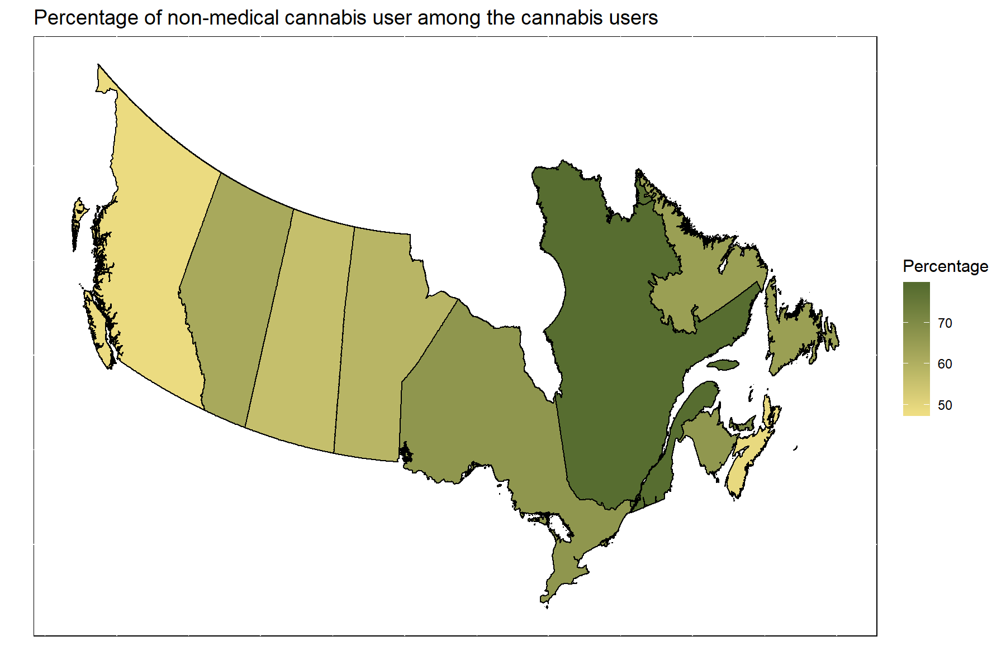
Geographic distribution of non-medical cannabis consumption by province

Slide 39
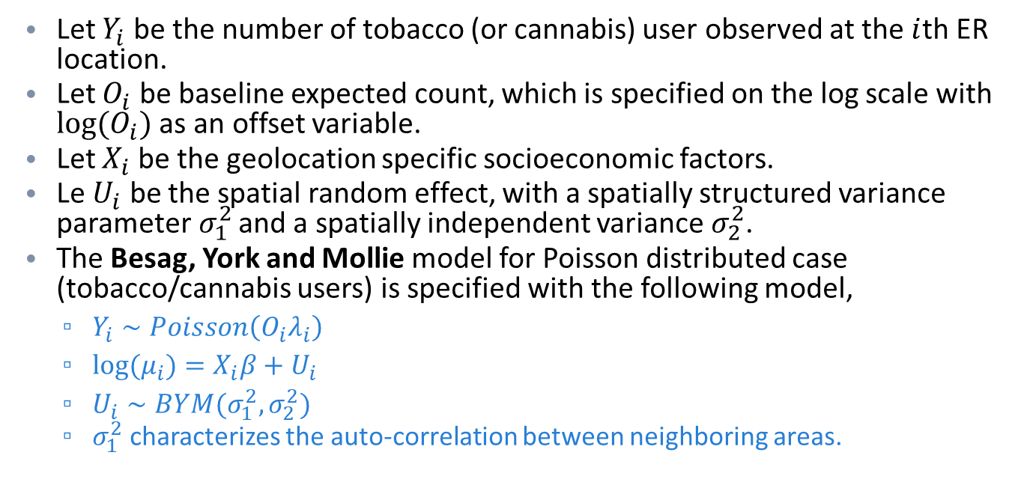
Parametric spatial model
Let $Y_{i}$ be the number of tobacco (or cannabis) user observed at the $i$th ER location.
Let $O_{i}$ be baseline expected count, which is specified on the log scale with $log⁡(O_{i})$ as an offset variable.
Let $X_{i}$ be the geolocation specific socioeconomic factors.
Le $U_{i}$ be the spatial random effect, with a spatially structured variance parameter$σ_{1}^{2}$ and a spatially independent variance${ σ}_{2}^{2}$.
The Besag, York and Mollie model for Poisson distributed case (tobacco/cannabis users) is specified with the following model,
$Y_{i}∼Poisson\left(O_{i}λ_{i}\right)$
$log⁡(μ_{i})=X_{i}β+U_{i}$
$U_{i}∼BYM(σ_{1}^{2}, σ_{2}^{2})$
$σ_{1}^{2}$characterizes the auto-correlation between neighboring areas.

