Slide 1


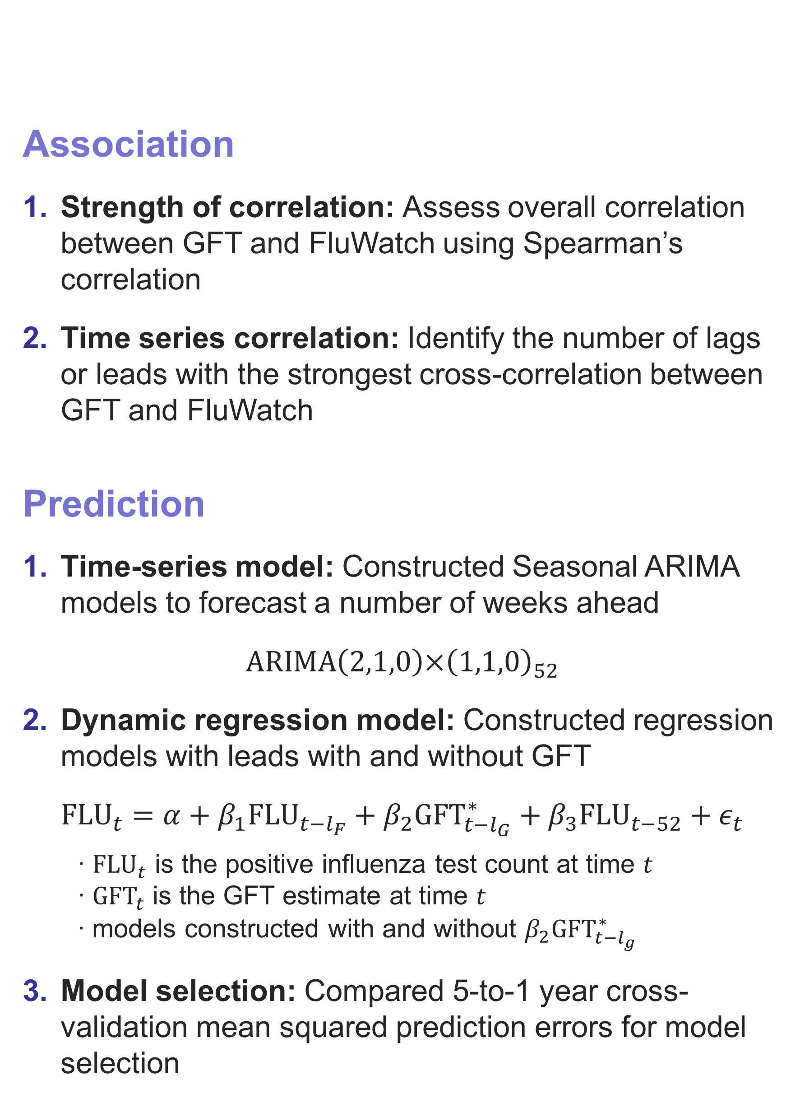
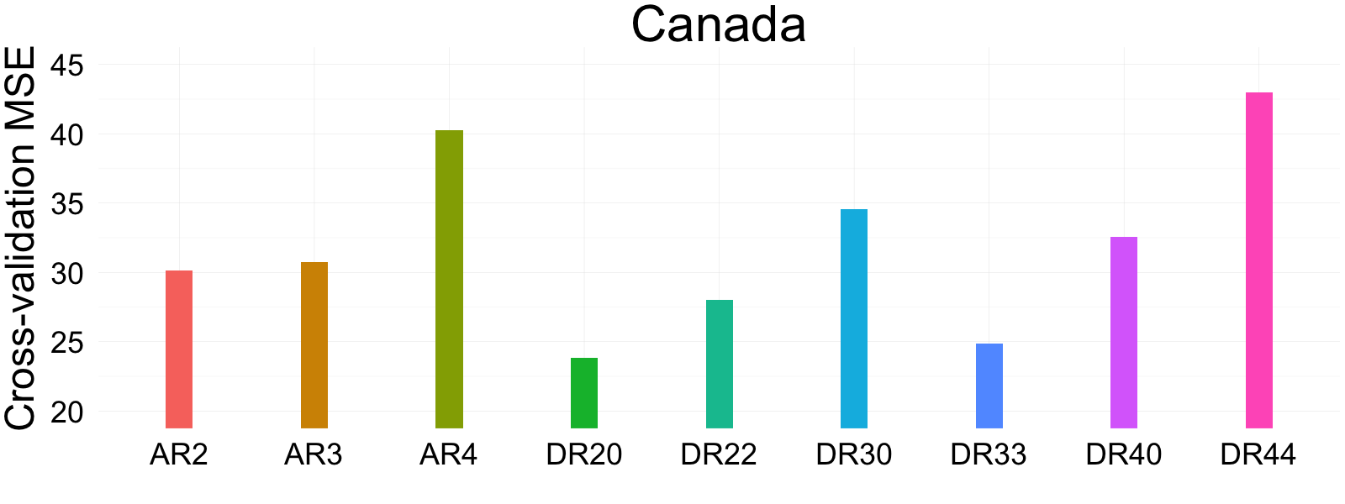
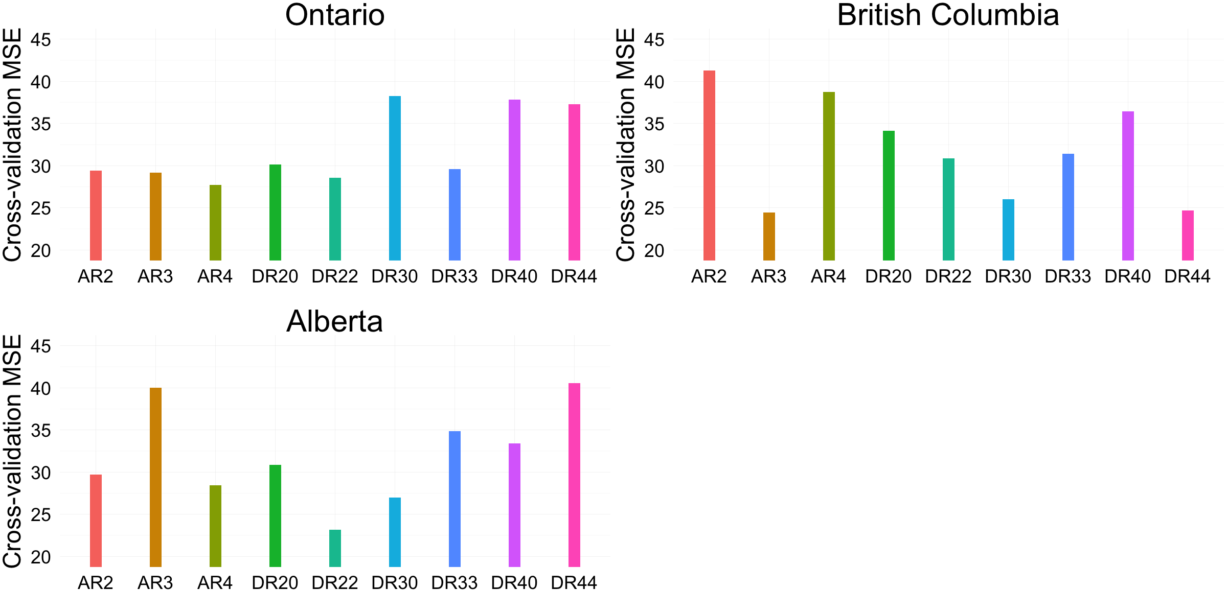
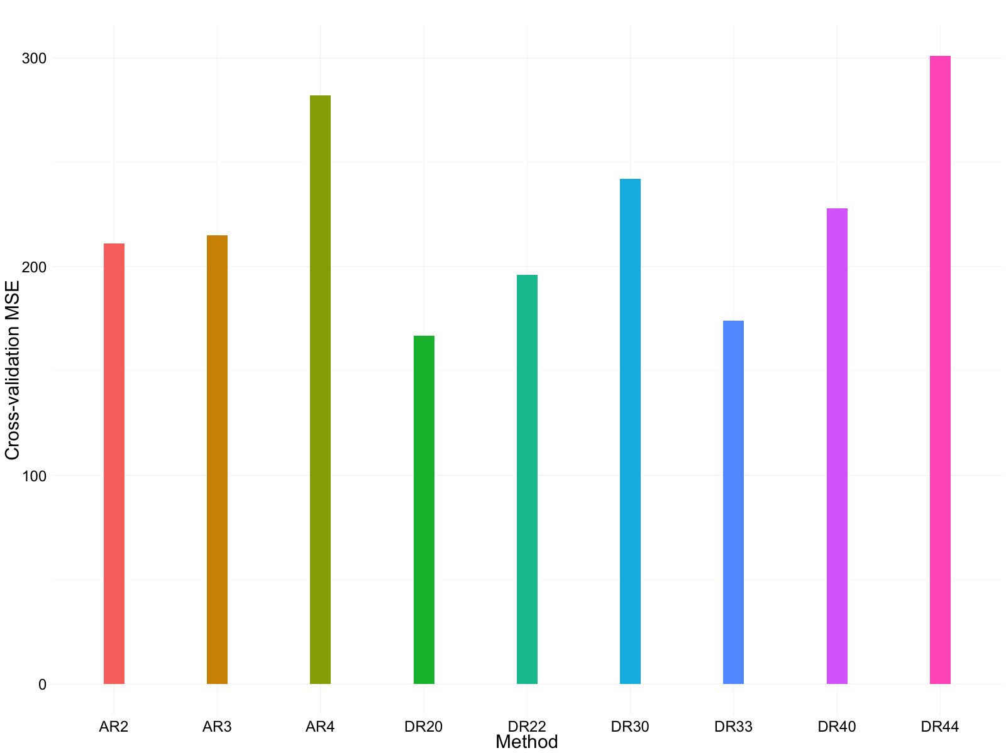
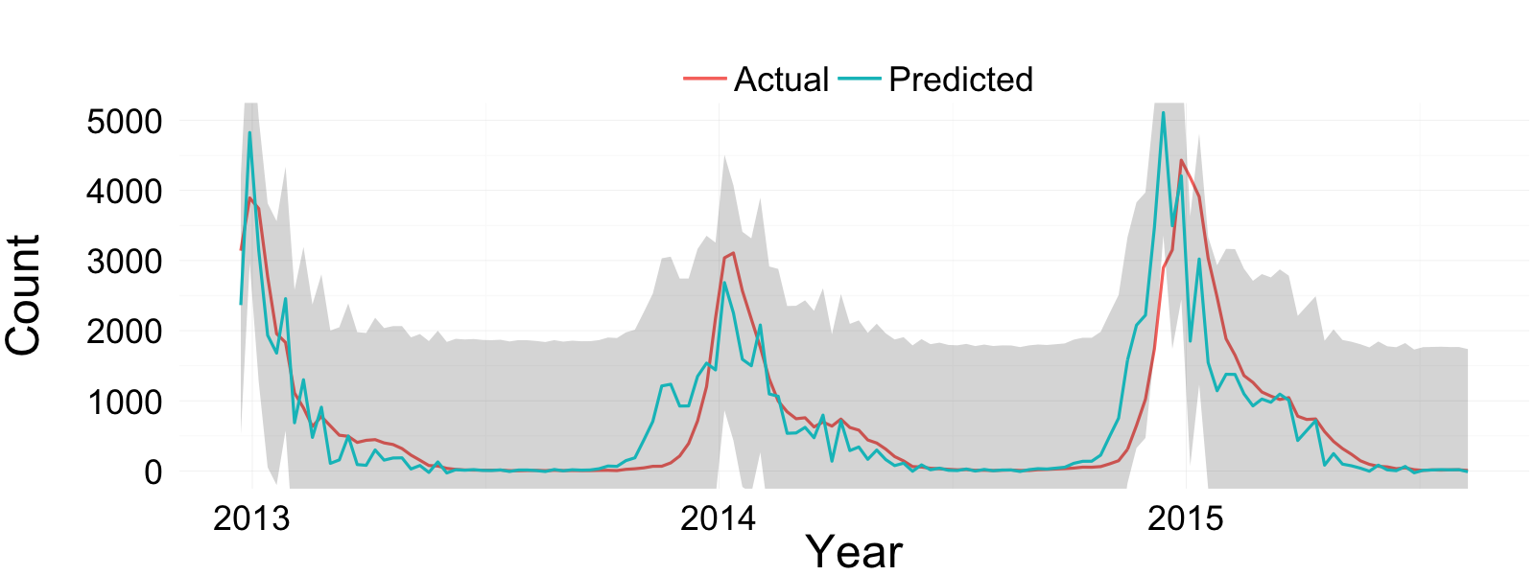
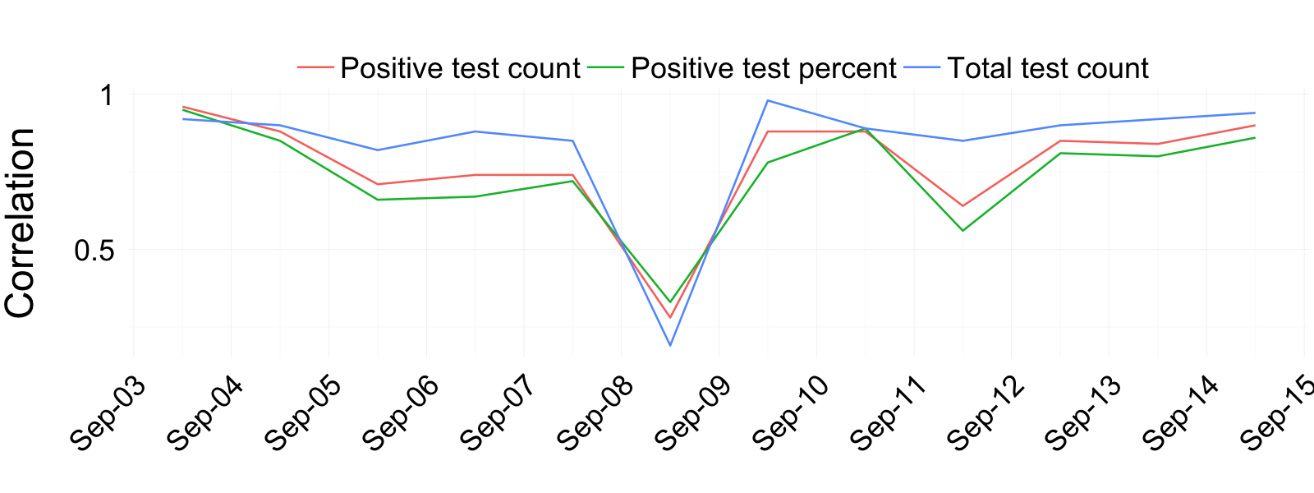
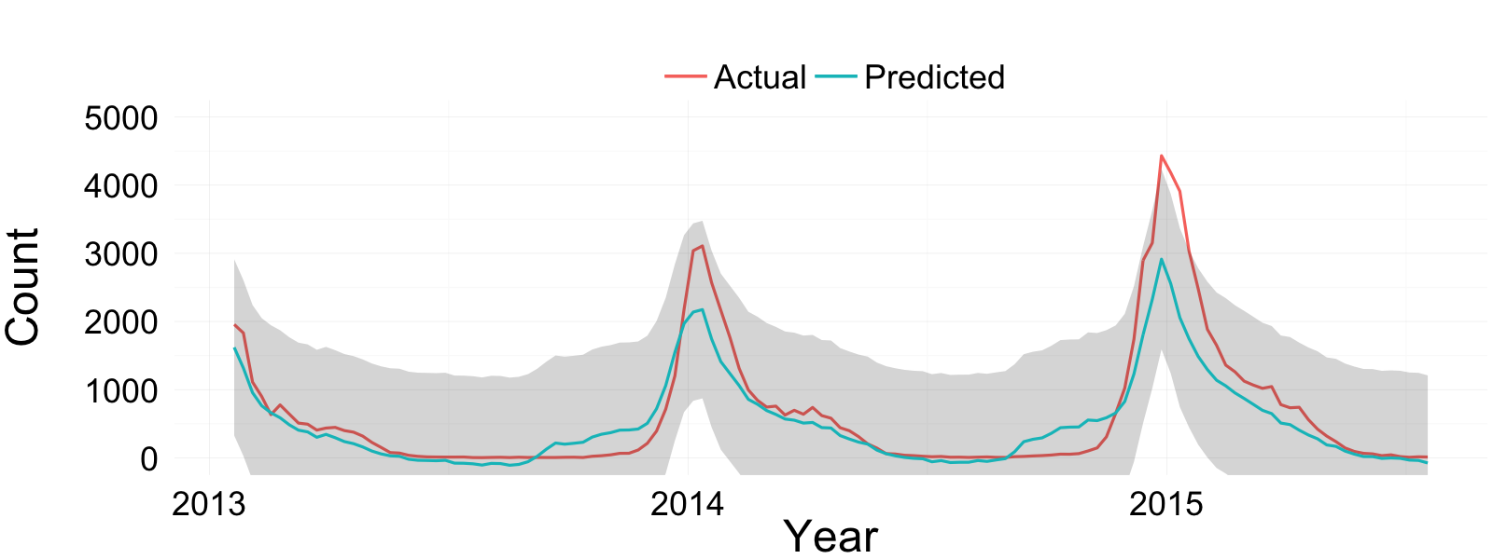
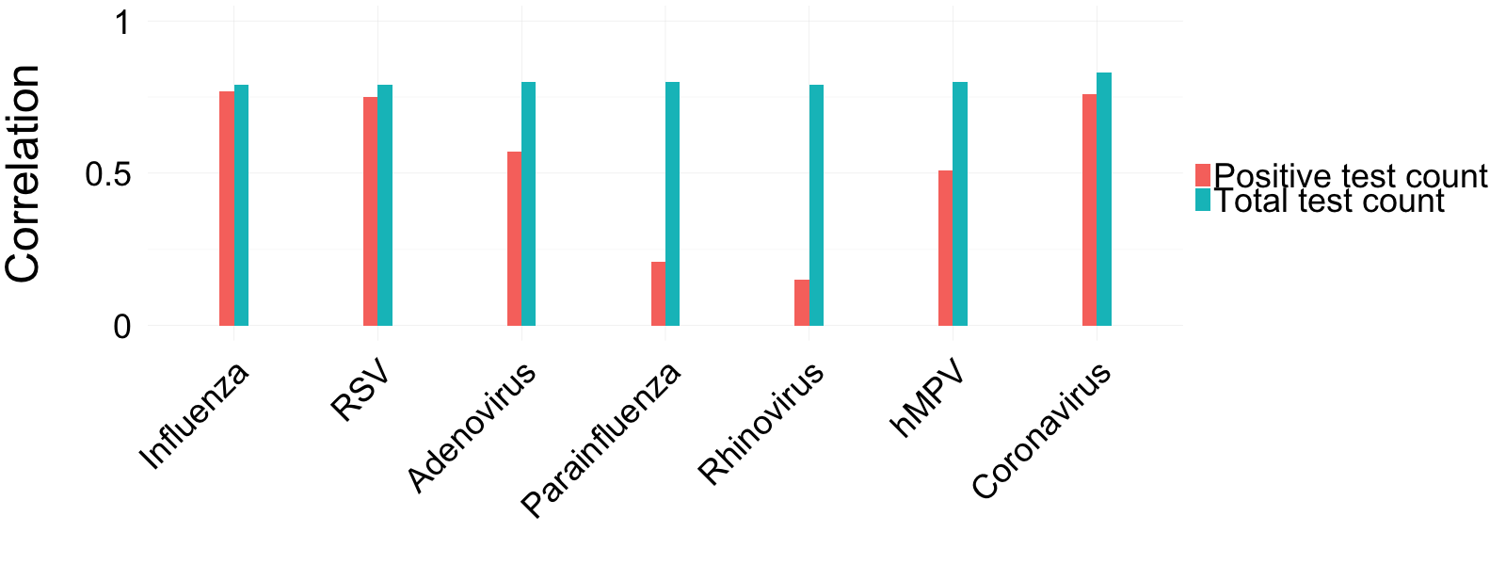
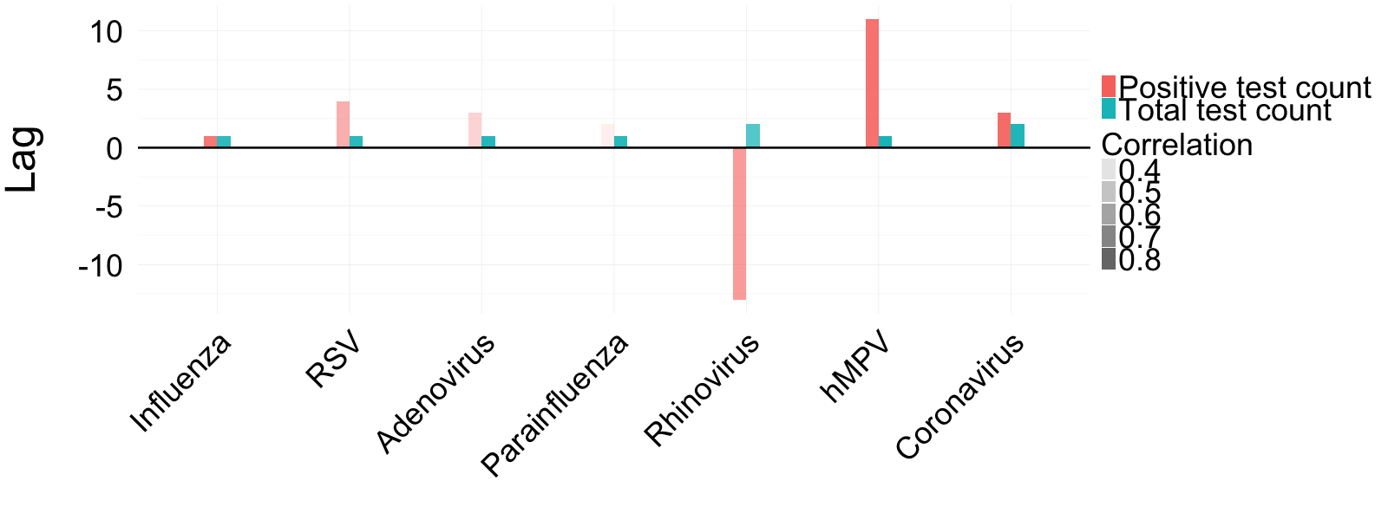
Predicting flu cases using dynamic regression with Google Flu Trend
Mohammad Khan, MSc; Sangook Kim, MSc; Kuan Liu, MMath; Michael Moon, BASc
Department of Biostatistics, Dalla Lana School of Public Health, University of Toronto
FluWatch: Canada’s national surveillance system collecting weekly counts of all tests performed and positive tests for influenza and influenza-like illnesses including parainfluenza virus, adenovirus, human metapneumovirus, rhinovirus and coronavirus
Google Flu Trend (GFT): Influenza case estimates using Google search keywords provided by Google
This research aims to investigate the association between GFT with FluWatch data and whether GFT can help predicting the outbreak curve
Background
Methods
Figure 6. Cross-validation mean square errors for model selection.
Background
Early prediction of influenza outbreak can significantly reduce its burden and impact. Google uses a validated algorithm to provide a region-specific estimates (GFT) of influenza activities in real-time.
Objective
The first objective was to evaluate the association between GFT and various respiratory illness cases in Canada. The second objective was to predict the peak in the number of influenza cases.
Method
Non-parametric Spearman’s correlation and and cross-correlations were used to assess the association between GFT and respiratory illness outbreaks in Canada. A number of seasonal ARIMA and dynamic regression models with GFT were applied to forecast the trend of influenza cases. Model comparisons were conducted using cross-validation.
Results and Conclusion
The results suggested that GFT was significantly associated with the number of influenza tests. Furthermore, GFT improved the three-week forecast of the timing of influenza outbreaks.
Prediction
Abstract
-
To identify the strength and type of the association between:
GFT and FluWatch’s total and positive test counts for influenza in Canada
GFT and FluWatch’s total and positive test counts for other respiratory viruses in Canada
To predict the timing of influenza outbreaks
Objective
SARIMA(2,1,0)x(1,1,0)₅₂
AR2: 2-week forecast
AR3: 3-week forecast
AR4: 4-week forecast
Dynamic Regression
DR20: 2-week lead
DR22: 2-week lead/GFT
DR30: 3-week lead
DR33: 3-week lead/GFT
DR40: 4-week lead
DR44: 4-week lead/GFT
Selected 3-week forecasting models based on the cross-validation MSE while maximizing forecast leads
Figure 7. 3-week forecasts from the Seasonal ARIMA model between Dec 2012 to Aug 2015.
Figure 3. Annual Spearman’s correlations between GFT and influenza cases in Canada.
Association
Figure 1. Weekly data of GFT and FluWatch influenza cases in Canada.
Data
Figure 8. Prediction from the dynamic regression model with 3-week lead and GFT model between Dec 2012 to Aug 2015.
GFT highly correlated with all three series
Low correlation in 2008-2009 during H1N1 pandemic
Figure 4. Overall Spearman’s correlations for each respiratory illness in Canada.
Google Flu Trends. Retrieved May 2, 2016, from https://www.google.org/flutrends/about/.
Grothendieck, G. (2012). dyn: Time Series Regression. R package version 0.2-9. https://CRAN.R-project.org/package=dyn
Martin, L. J., Lee, B. E., & Yasui, Y. (2015). Google Flu Trends in Canada: A comparison of digital disease surveillance data with physician consultations and respiratory virus surveillance data, 2010–2014. Epidemiol. Infect. Epidemiology and Infection, 144(02), 325-332.
R Core Team (2016). R: A language and environment for statistical computing. R Foundation for Statistical Computing, Vienna, Austria. URL https://www.R-project.org/.
Shumway, R. H., & Stoffer, D. S. (2005). Time series analysis and its applications: With R examples. New York: Springer.
Thompson, L. H., Malik, M. T., Gumel, A., Strome, T., & Mahmud, S. M. (2014). Emergency department and ‘Google flu trends’ data as syndromic surveillance indicators for seasonal influenza. Epidemiol. Infect. Epidemiology and Infection, 142(11), 2397-2405.
Wickham, H. (2009). ggplot2: Elegant Graphics for Data Analysis. New York: Springer-Verlag.
Zeileis, A. (2014). dynlm: Dynamic Linear Regression. R package version 0.3-3. URL http://CRAN.R-project.org/package=dynlm.
References
◆ represent the maximum annual counts/percentages
H1N1 pandemic wave between Oct and Dec 2009
Figure 2. Weekly data of GFT and FluWatch other influenza-like cases in Canada.
MSE for the forecasts from the selected dynamic regression model was approx. 16,000 compared to 27,000 for the selected SARIMA
GFT most associated with the total number of tests for respiratory illnesses
GFT leads by 1 week in general
GFT is not a good indicator for pandemic outbreaks
Dynamic regression model provides smoother prediction for better identification of annual peaks
Including GFT in the dynamic regression model improved prediction performance
Limited to 3-week forecasts and predicting local peaks
Limited prediction accuracy for the count of positive influenza cases
Higher correlation with the total test count across all illnesses
Figure 5. Cross-correlation results showing number of weeks illnesses lag compared to GFT in Canada.
Discussion
GFT estimates follow the trend of the total test counts for both influenza and other respiratory illnesses
Percentage and positive test counts less discernible with GFT
GFT leads FluWatch in general
For influenza, 1 week lead had the strongest correlation

