Slide 1
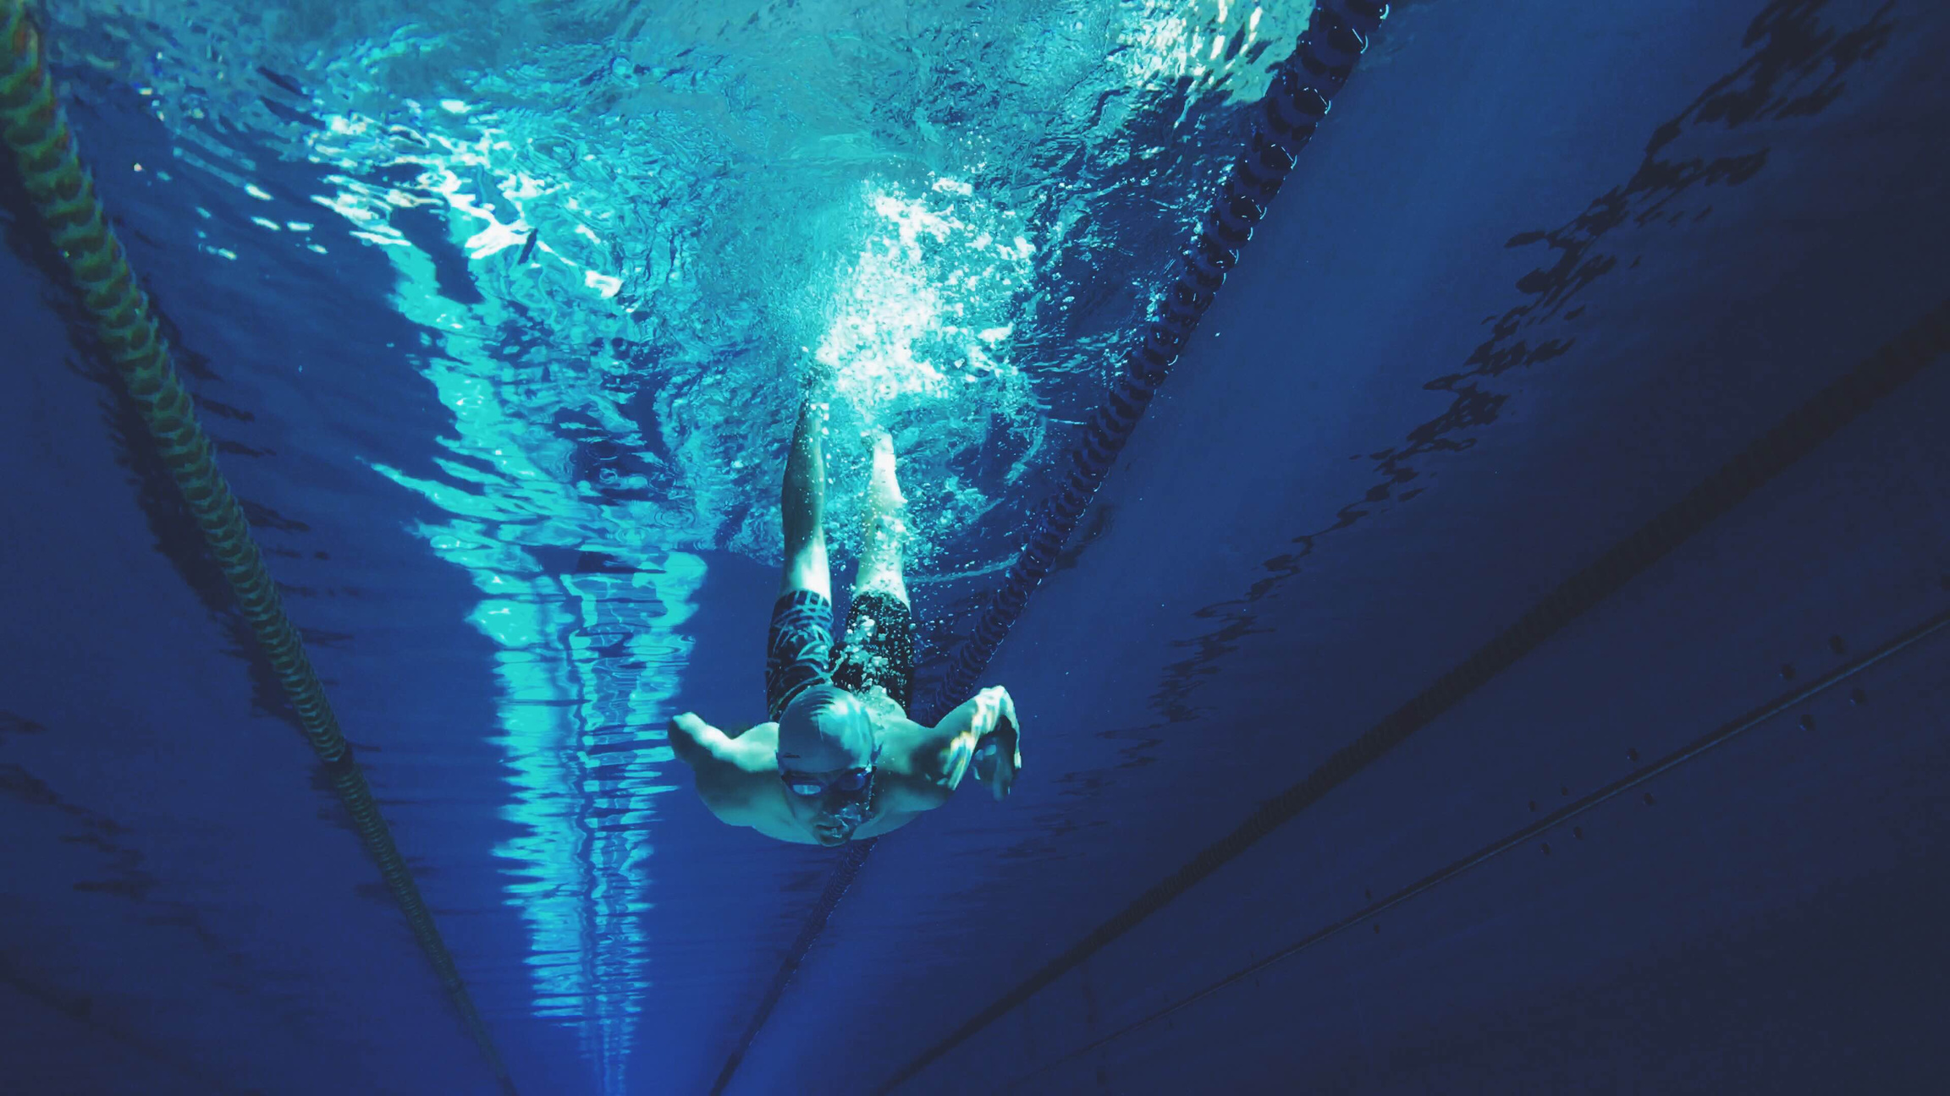

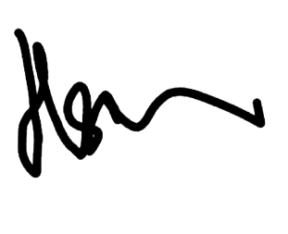

CERTIFICATE OF APPRECIATION
for
{{name}}
Thank you for your invaluable contribution in the NUS Invitational Lifesaving Championship 2025
LIANG KUAN HSIEN
President

