Slide 1
Trending Analysis on Twitter
Team Three:
Kuan Hu
Ningtong Bai

Slide 2
Use Case
Feature 1: Generate top 10 daily trending topics
Feature 2: Search Key words that user inputs
Simulated top popular topics associated with the searched key words
return top mentioned adjective/descriptive words associated with the searched key words
(Further Improvements) Customized topic recommendations to each user

Slide 3
General Methodologies
Topics Generator
Extract key words from tweets
Generate topic based on key words and hashtag (supplementary)
Rank Topics
Rank trending topics based on how many people like on the relevant tweets
Especially consider tweets from celebrities and influential medias
Adjective Extractor
Analyze adjectives/descriptive words on relevant tweets
Visualize

Slide 4
Data Source – Twitter API
Use search/stream API to collect tweets
Magnitude:
100,000 tweets in the past 7 days

Slide 5
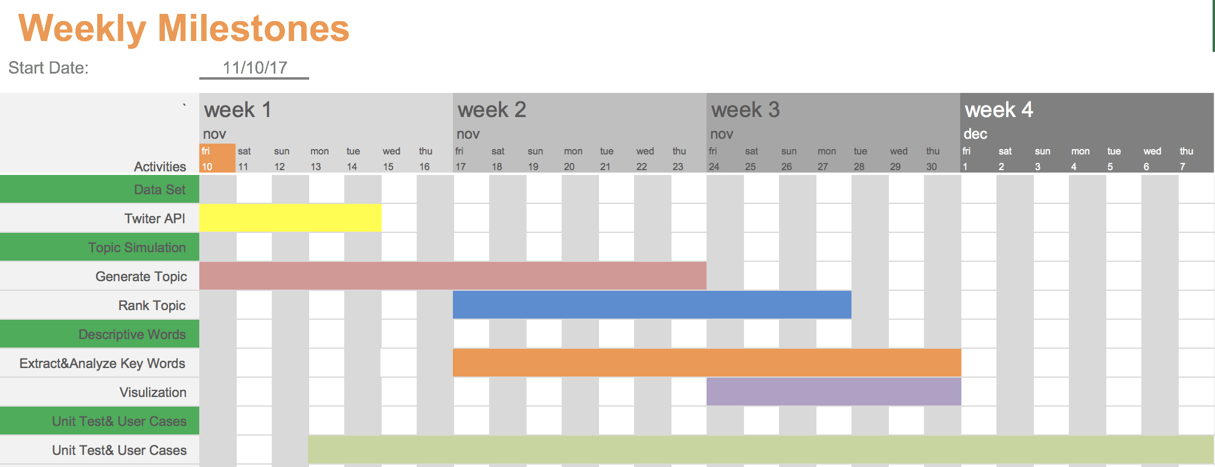

Slide 6
Scala and Code Repository
Code Repository: Github
https://github.com/KuanHu/TopHitsAnalysisOnTwitter
Scala will be used in :
Twitter API
Key words Filter
Tweets Processing
Natural Language Processing
Unit Tests

Slide 7
Acceptance Criteria
Ensure topic generated reasonably from tweets
Acceptance Criteria: 80% accuracy
Rank Top 10 trending topics
Compare results to hashtag popularity
Acceptance Criteria: 60% accuracy
Adjective/Descriptive Words Extractor
Acceptance Criteria:
Characteristics of the words are correctly determined
At least five descriptive words would be extracted

Slide 8
Project Goals
Provide straight-forward information about trending news/topics/things to users
Simulate popular topics relevant to user’s searched words
Analyze the big data to generate desired outcome
Learn how to use data analysis techniques and languages, such as Spark, NLP and Scala to solve real-world big data problems

