Slide 1
Trending AND sentiment analysis ON tweets
Team 3
Kuan Hu hu.kua@husky.neu.edu
Ningtong Bai bai.ni@husky.neu.edu

Slide 2
Project introduction
Utilize Twitter Restful API to acquire real-time tweets and parse twitter sources to JSON Format
Build a Topic Model (LDA model)
Program concurrently acquires real-time tweets in the past 10 seconds time interval, and generates topics/extracts hashtags from the tweets as well as calculate topics’/hashtags’ sentiment scores
Perform Sentiment Analysis on tweets

Slide 3
Project overview
Collect the data set via Twitter Search API
Data Set Magnitude: Up to 100,000 tweets
Train LDA using the dataset to get a set of pre-defined topics
Concurrently acquire tweets that happened in the past 10 seconds
Analyze tweets using Spark techniques
Generate essential topics and extract popular hashtags from tweets that are acquired
Calculated sentiment score for each major topic and hashtag based on the attitude(positive, negative, neutral) of each tweet associated with the topic/hashtag
Output trending topics/hashtags and their sentiment scores

Slide 4
Methodology
Search & Streaming API => Acquiring Tweets
JSON Format Transformation => Parsing Twitter Sources
Tweets Text Filter => Filtering Language, Emoji, Stop Words
Topic Model Training => Training LDA Model
Spark Streaming => Reading Tweets and ranking topics (Mapping & Reducing)
Stanford NLP => Calculating Sentiment Score

Slide 5
use case
User can input keywords or just enter the return button
If user input a keyword, such as sports, the program concurrently acquires real-time tweets that happened in the past 10 seconds and extracts popular hashtags and generates trending topics associated with the keyword - sports
The program also calculates a sentiment score for each topic/hashtag to indicate how people feel about this topic/hashtag
If user inputs nothing or just enters the return button, the program generates generic trending topics and extracts popular hashtags without related to any specific keywords

Slide 6
trending TOPICS & hashtags generation
1
Training Dataset
Training
Tweet.text
LDA Model
(Topic, Count)
2
Upcoming Tweets
ReduceByKey & Sort
Results
Tweet.hashtags
(Hashtags, Count)

Slide 7
sentiment analysis
Utilize Stanford Natural Language Process library to process, split, and parse input tweets
Determine sentiment attitude (positive, natural, negative) on tweets
Calculate sentiment scores and for topics/hashtags

Slide 8
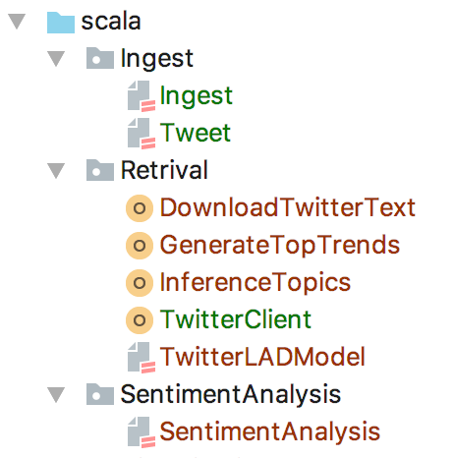
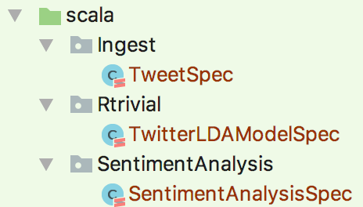
Programing & Test

Slide 9
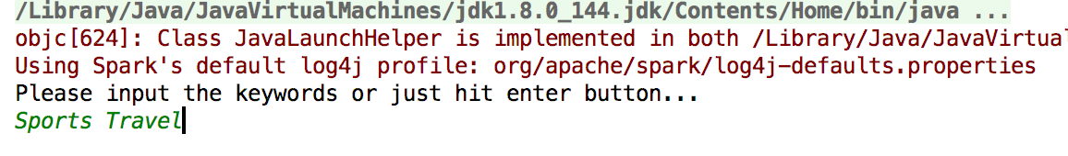
User INput
You can input a list of keywords which are split by space and the streaming API will acquire tweets which are related to these keywords.
Or you can just enter the return button

Slide 10
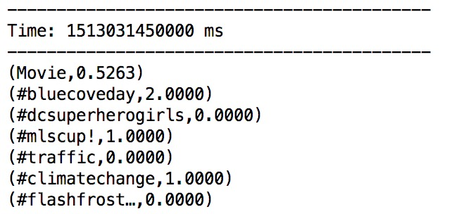
Results
The first position of each row is the topic/hashtag that the program generate/extract, in descending order.
For example, the first one, movie, indicates that move is the most trending topic on twitter now.
The rest are popular hashtags that program extract.
The decimal number on the second position of each row indicates the sentiment score. The score ranges from 0 to 2. 0 implies negative feelings; 1 implies neutral feelings; 2 implies positive feelings. The closer the score to 2 indicates, the more positive feelings people feel about the topic. The closer the score to 0 indicates, the more negative feelings people fell about the topic.

Slide 11

Acceptance criteria
Ensure topic generated reasonably from tweets
The LDA model will generate correct topic with a tweet
Acceptance Criteria: 60% accuracy
Rank trending topics
Rank the topic in the descending order based on the total number of tweets associated with it
Acceptance Criteria: 60% accuracy
Sentiment Analysis
Characteristics of the tweet are correctly determined
Acceptance Criteria: 90% accuracy

Slide 12
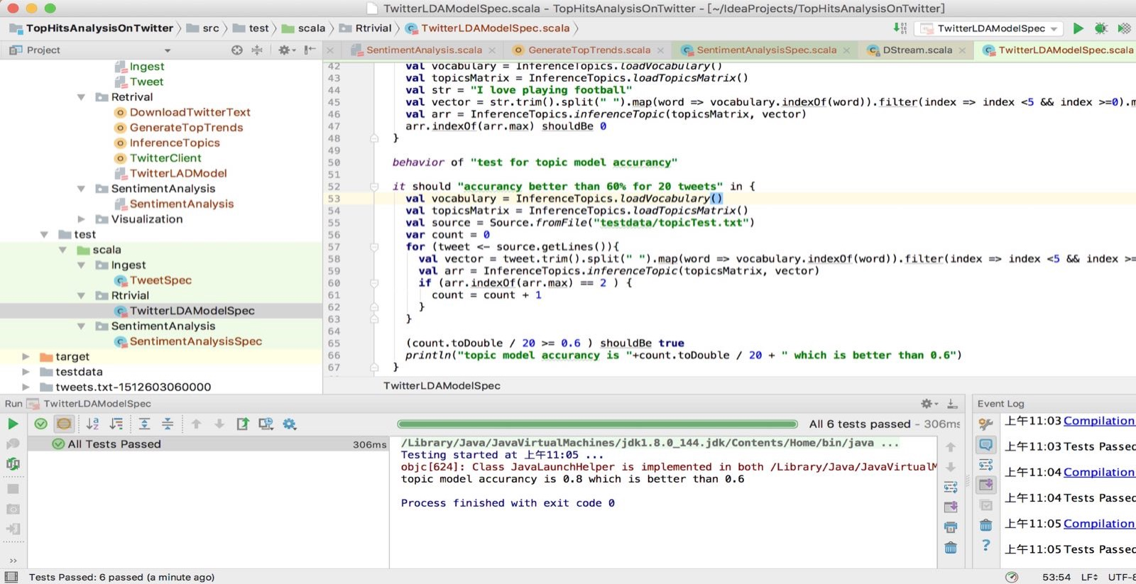
Acceptance Criteria 1 –Classify and generate Topic
We manually input 20 tweets that are about Trump. Our LDA model can identify 16 of them are about Trump, which is 80% accuracy rate. Therefore, this Acceptance Criteria is met

Slide 13
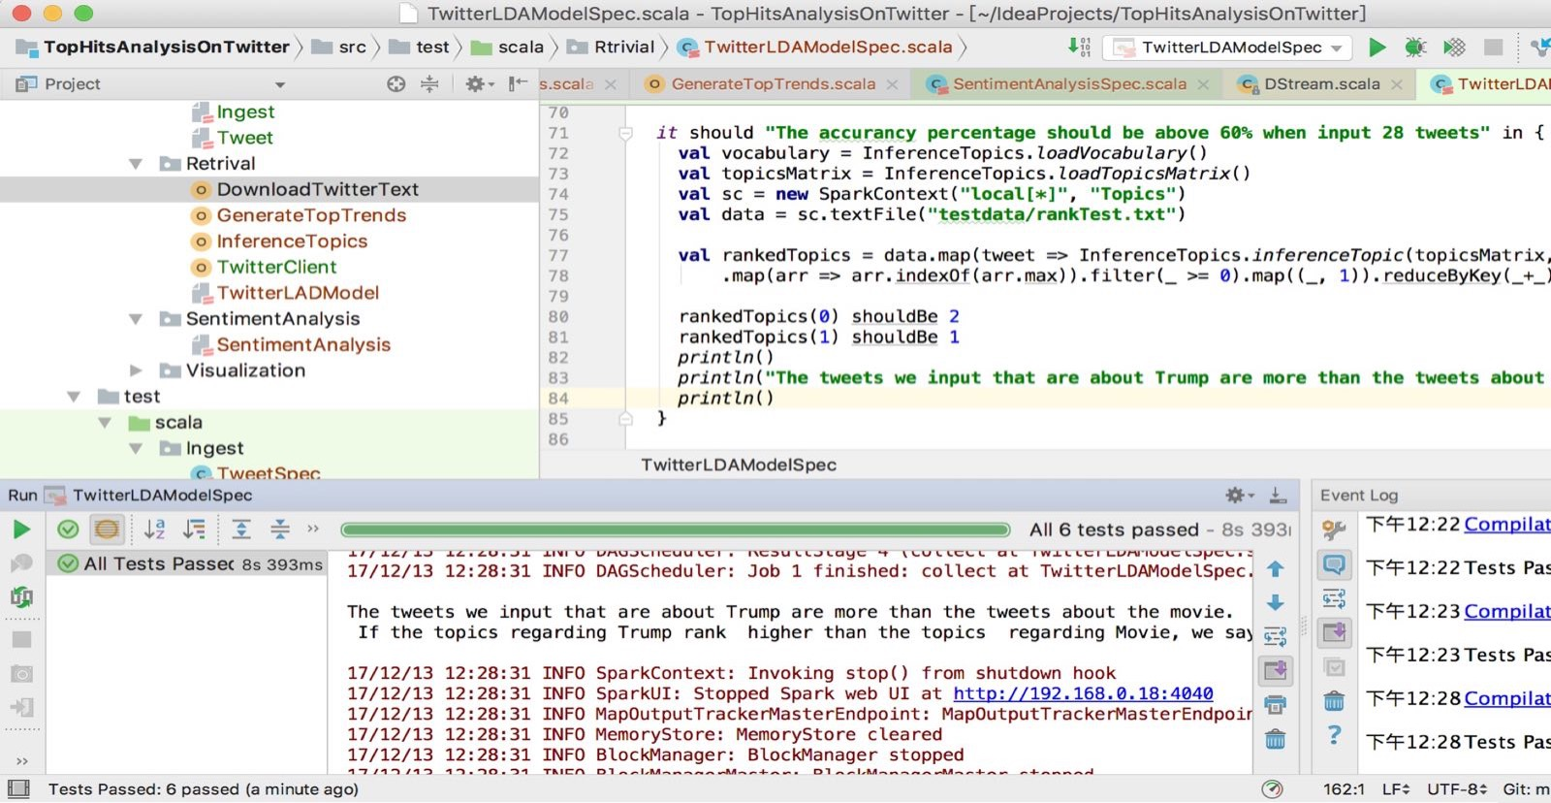
Acceptance Criteria 2 – Ranking Feature
We input a tweet set contains 75% tweets are related to Trump and 25% are tweets related to Movie. Our LDA model can calculate the number of tweets for each topic and rank them. The result shows Trump is the 1st and Movie is the 2nd . Therefore, this Acceptance Criteria is met

Slide 14
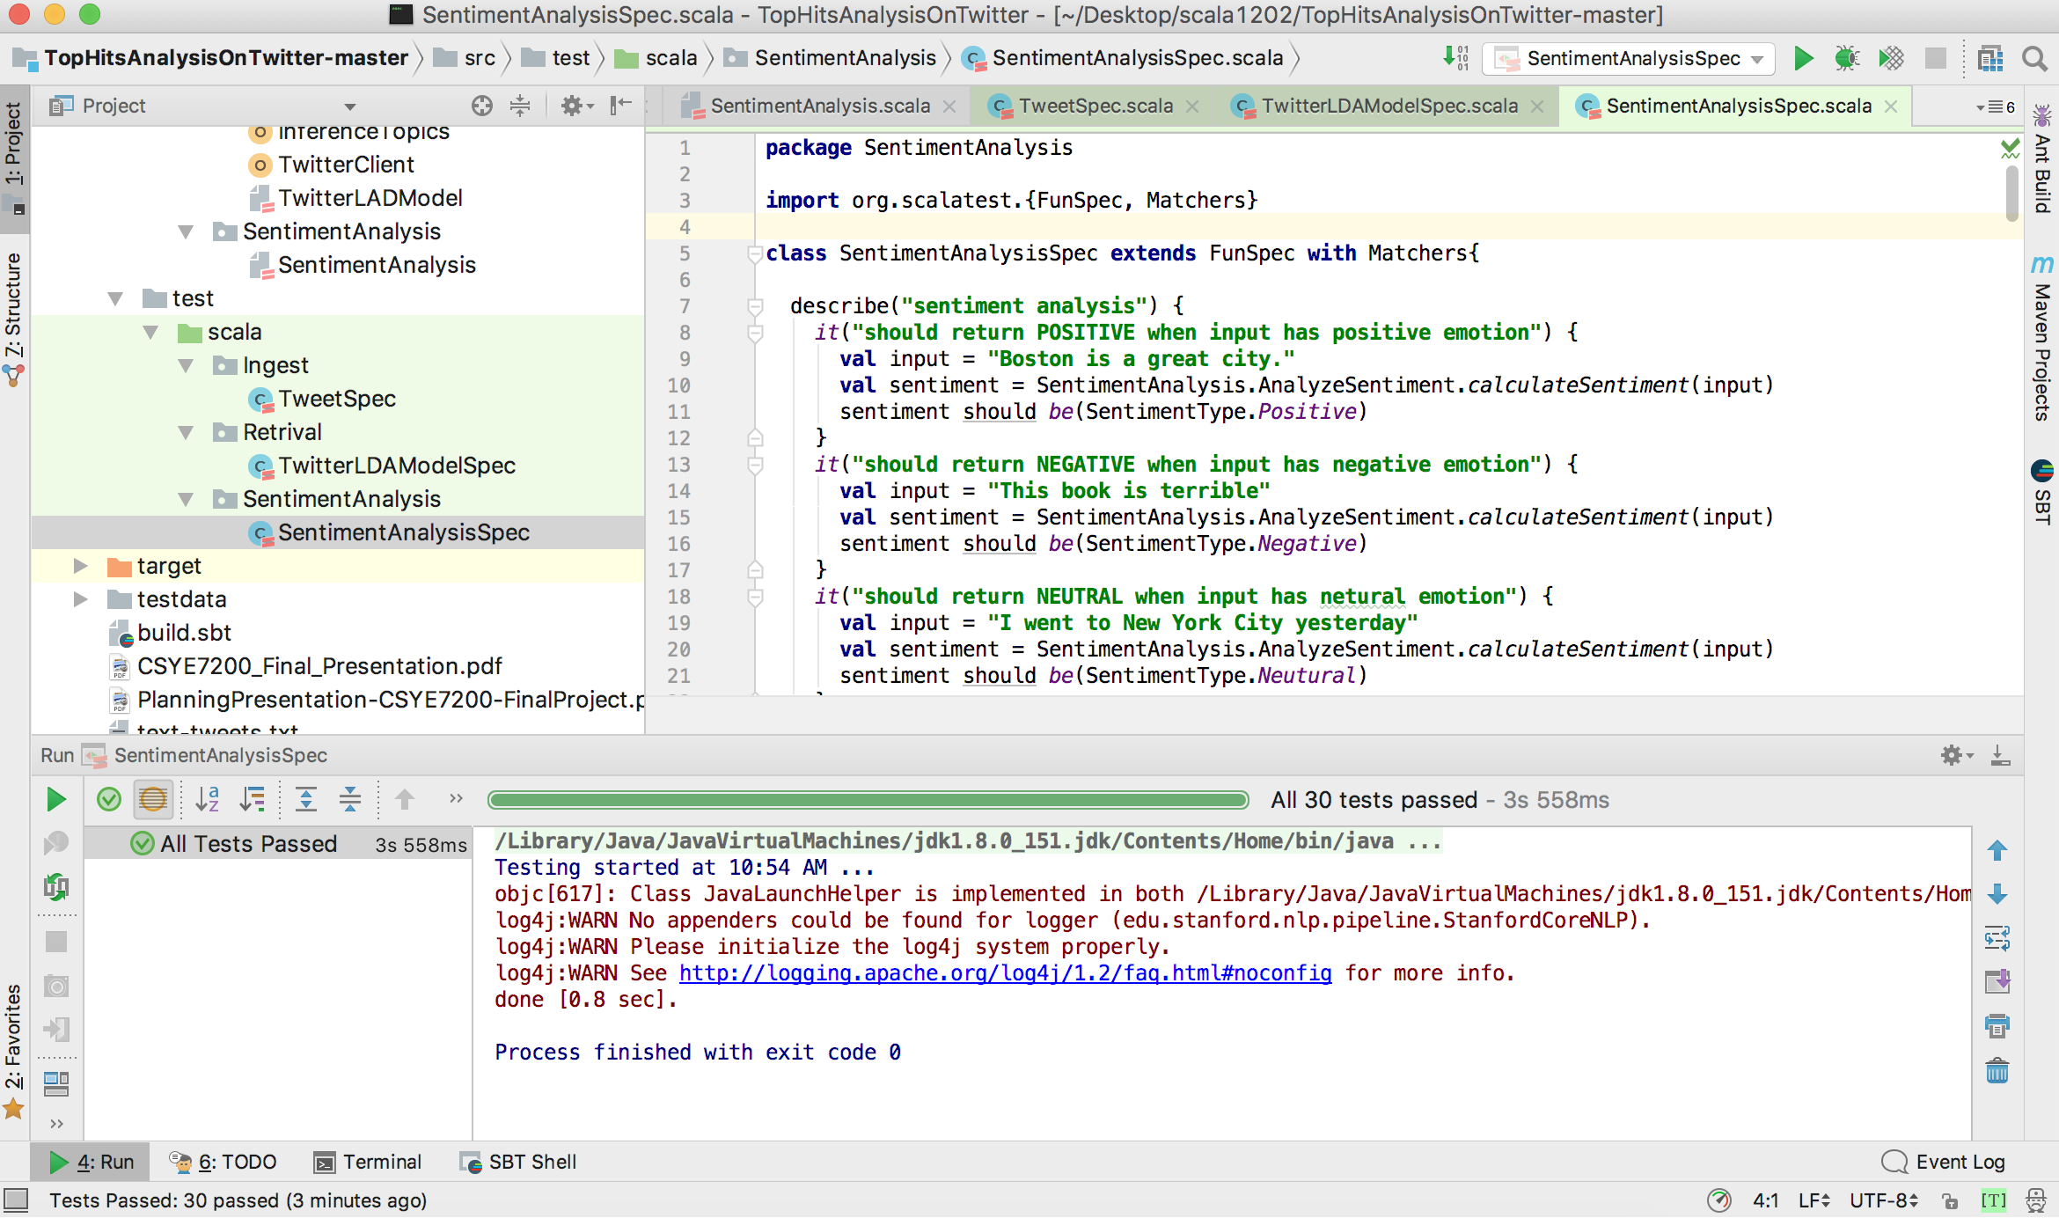
Acceptance Criteria 3 – SENTMIMENT analysis
we wrote thirty tweets in SentimentAnalysisSpec class and we provided correct attitude for each tweet to determine whether it passes the criteria or not.
Result:
All 30 tests passed
100% accuracy
Criteria Passed

Slide 15

Code Repository
https://github.com/KuanHu/TopHitsAnalysisOnTwitter
Reference
https://developer.twitter.com/en/docs/tweets/search/api-reference
http://ampcamp.berkeley.edu/big-data-mini-course/realtime-processing-with-spark-streaming.html
https://fangjian0423.github.io/2016/02/10/sparkstreaming-programming-guide/

