Slide 1
Trending AND sENTIMENT analysis ON tweets
Team 3
Kuan Hu hu.kua@husky.neu.edu
Ningtong Bai bai.ni@husky.neu.edu

Slide 2
Project Goal
Utilize Twitter Restful API to acquire real tweets
Parse twitter sources to JSON Format
Build Topic Model (LDA model)
Process Stream with Spark Streaming
Perform Sentiment Analysis

Slide 3
use cASE
INTPUT:
KeyWord (optional)
OUTPUT:
Top 10 trending topics (including hashtags) from upcoming tweets containing that keyword in 1 minute
The sentiment score for each trending topic
VISUALIZATION :
Echarts Word Cloud Model showing the results

Slide 4
Methodology
Search & Streaming API => Acquiring Tweets
JSON Format Transformation => Parsing Twitter Sources
Tweets Text Filter => Filtering Language, Emoji, Stop Words
Topic Model Training => Training LDA Model
Spark Streaming => Reading Tweets and ranking topics (Mapping & Reducing)
Stanford NLP => Calculating Sentiment
Echart-wordCloud => Visualization

Slide 5
trending TOPICS & hashtags
Training Dataset
Training
Tweet.text
LDA Model
(Topic, Count)
Upcoming Tweets
ReduceByKey & Sort
Results
Tweet.hashtags
(Hashtags, Count)

Slide 6
sentiment analysis
Utilize Stanford Natural Language Process library to process, split, and parse input tweets
Determine sentiment attitude (positive, natural, negative) on tweets
Calculate sentiment scores and assign it to tweets

Slide 7
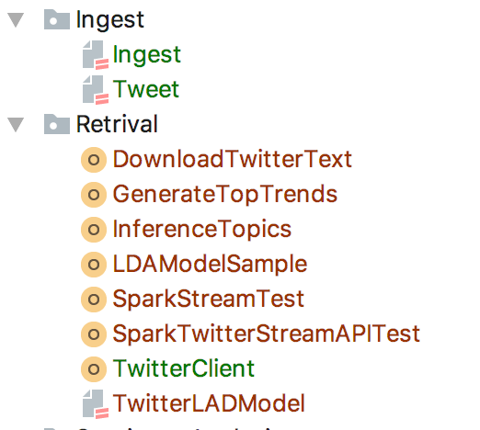
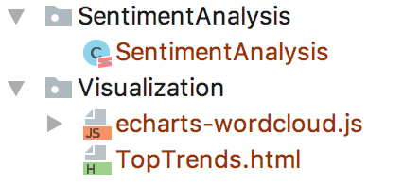
Programing

Slide 8
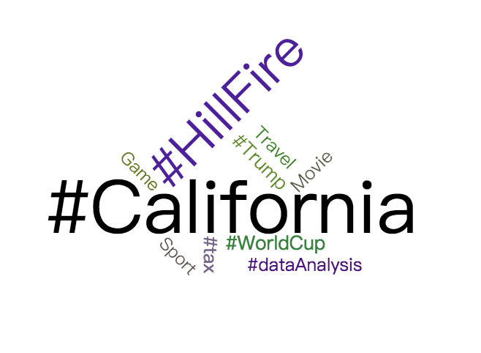
Results

Slide 9

Acceptance criteria
Ensure topic generated reasonably from tweets
The LDA model will generate correct topic with a tweet
Acceptance Criteria: 60% accuracy
Rank Top 10 trending topics
The top 5 topics should related to the keywords
Acceptance Criteria: 60% accuracy
Sentiment Analysis
Characteristics of the tweet are correctly determined
Acceptance Criteria: 90% accuracy

Slide 10

Code Repository
https://github.com/KuanHu/TopHitsAnalysisOnTwitter
Reference
https://developer.twitter.com/en/docs/tweets/search/api-reference
http://ampcamp.berkeley.edu/big-data-mini-course/realtime-processing-with-spark-streaming.html
https://fangjian0423.github.io/2016/02/10/sparkstreaming-programming-guide/

