Slide 1
Lean Six Sigma Case Study – Gentech By Team D16

Slide 2
Project Charter
Title of Project
Business Problem: |  | Executive Sponsor Black Belt Champion : Jeff Hugh
Objective and Scope Objective: Scope: |  | Steering Committee Elliot Smith Grace Monroe
Process Owner: Grace Monroe Black Belt: Jeff Hugh Green Belt: N/A Financial Analyst: N/A | Investment: ~$100k For Scrum, ERP setup, Training, Infra, Market Analysis RISKS: Out of Control Process, Loss in Revenue | Team Members Jeff, Sellers, BSS, Proposal Support Manager, Brand Manager
Gentech has experience loss in bids and which has negatively impacted revenue by 18%.
Reduce Proposal Creation Cycle Time
Eliminate Non-Standard Practices
Improve on skipping unnecessary approvals.
Reduce Inefficiencies and remove redundant tasks.
In Scope: End-to-End Proposal creation process. Out of Scope: New Hire and On-board training.
DMAIC | Plan Start – Plan End | Operational Metric | Baseline | Target
Define | 11.1.2021- 11.30.2021 | Number of defects Cost of Quality Churn Rate | 31.86 days | Reduction of Cycle time by 15%.
Measure | 12.1.2021- 12.31.2021
Analyze | 1.1.2022- 1.31.2022 | Expected Benefits |  | Projected Revenue
Improve | 2.1.2022- 2.28.2022 | Hard Benefits: Increase in Revenue Soft Benefits: Improve communication between teams, streamline process and client satisfaction. Strategic Benefits: Become the Market Leader |  | Increase in revenue by 7.8%

Slide 3
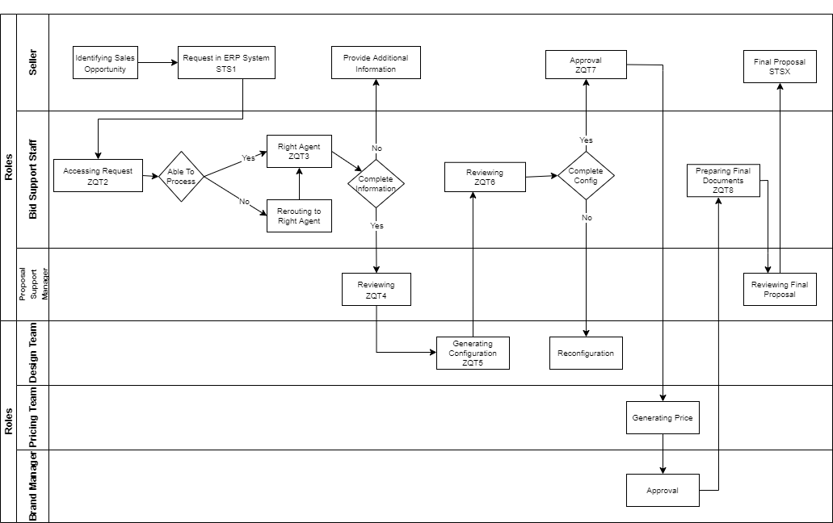
Swim Lane
Assumption: Values provided for each process is considered as time taken by the process to complete.

Slide 4
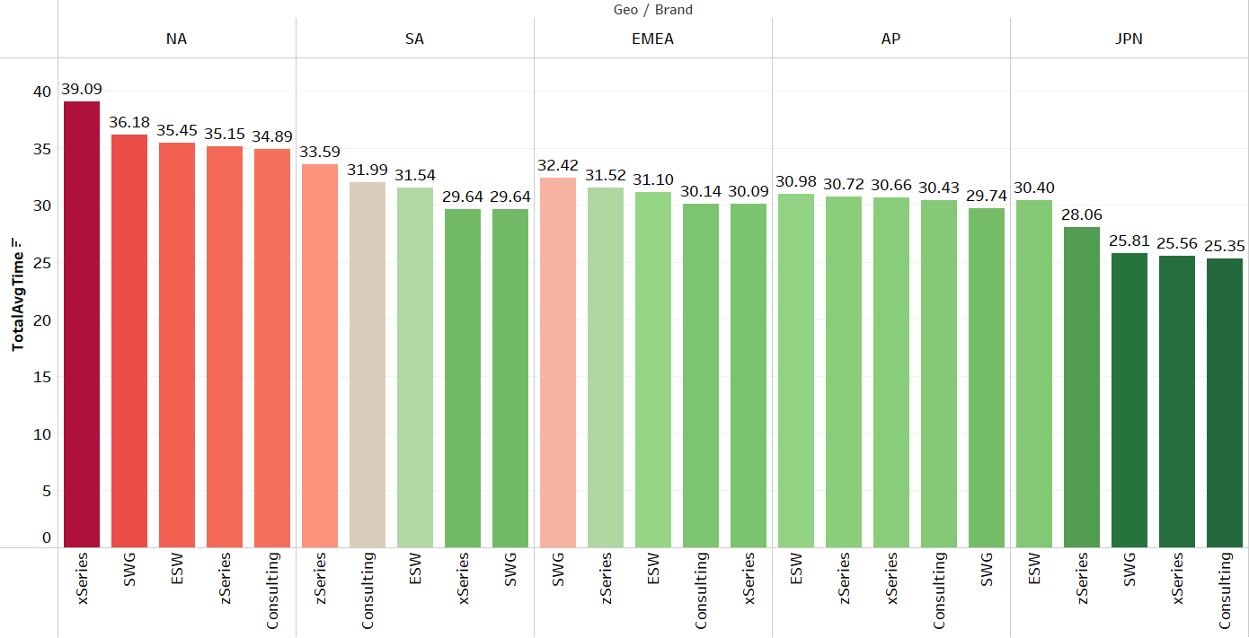
End-To-End Cycle Time at Geo and Brand level
Baseline Metric: 31.86 days

Slide 5
Comparing with Baseline
Average time based on country and brands formatted with respect to Baseline
Observation: Japan’s Consulting and SWG Brands fall within the Baseline Metric at each process step.

Slide 6
DPMO: 21672 defects per million
Opportunities for error: 250000
Number of defects discovered: 5418
Defects per Million Opportunities (DPMO)

Slide 7
Sigma Level
Number of defects discovered: 5418
Opportunities for error: 250000
Sigma level: 2.02038

Slide 8
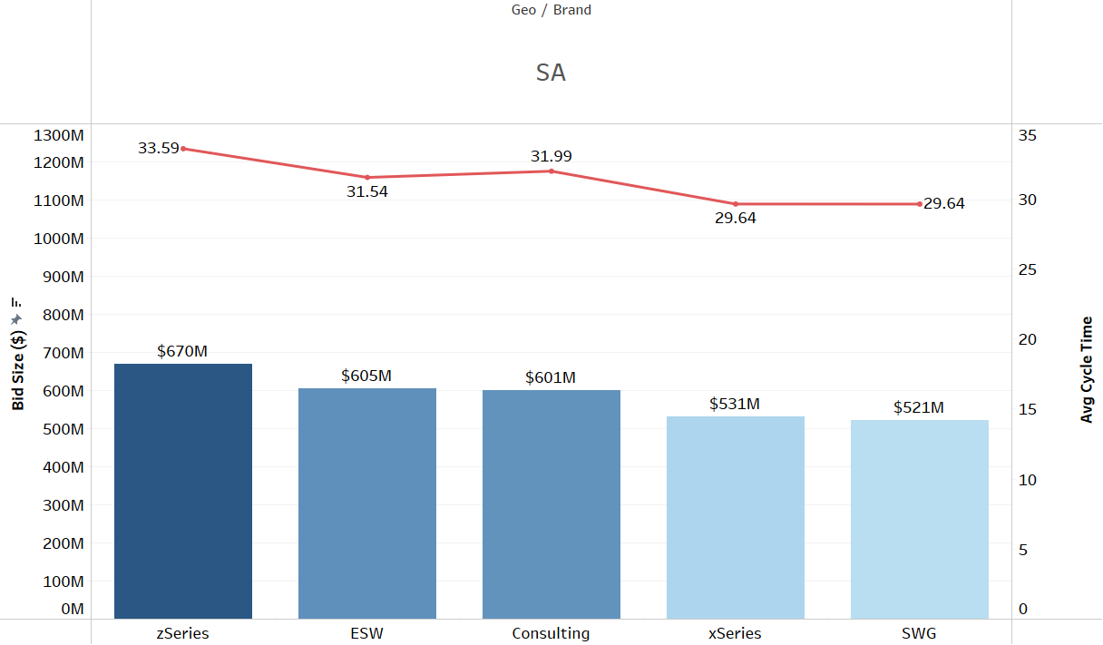
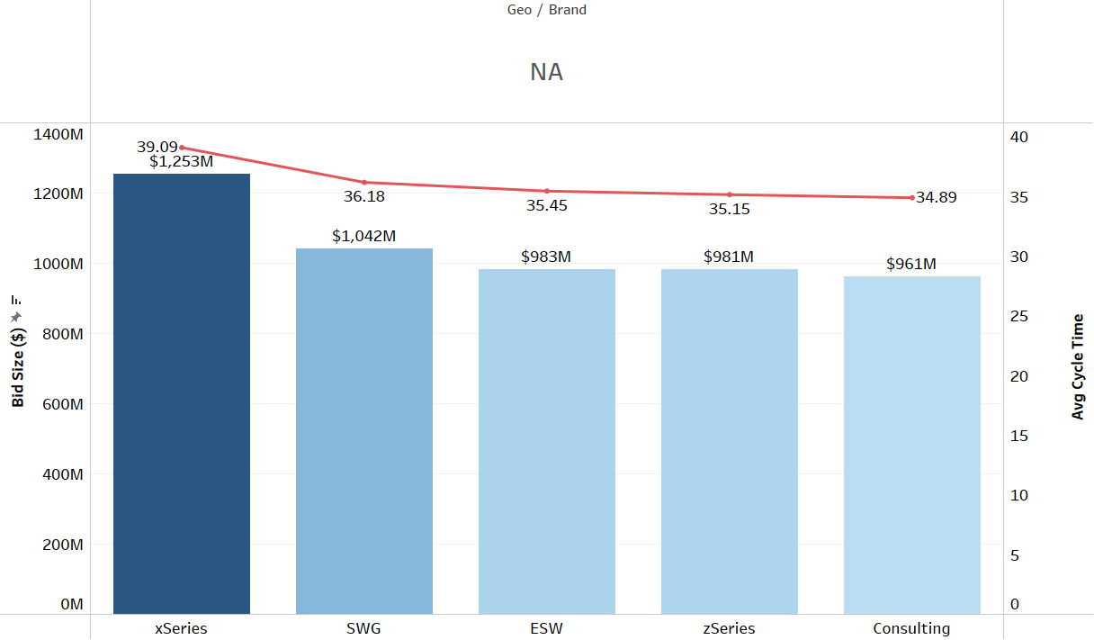
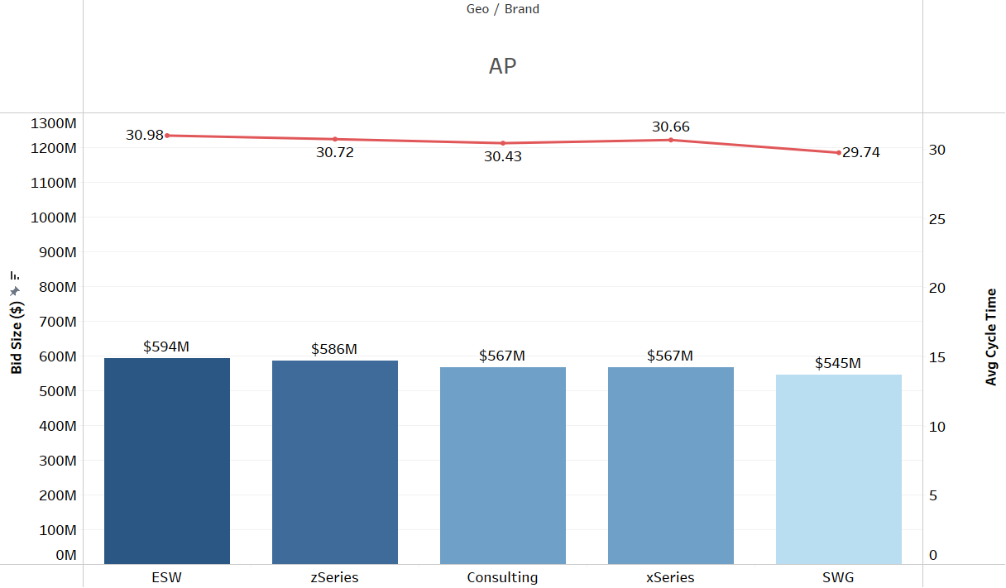
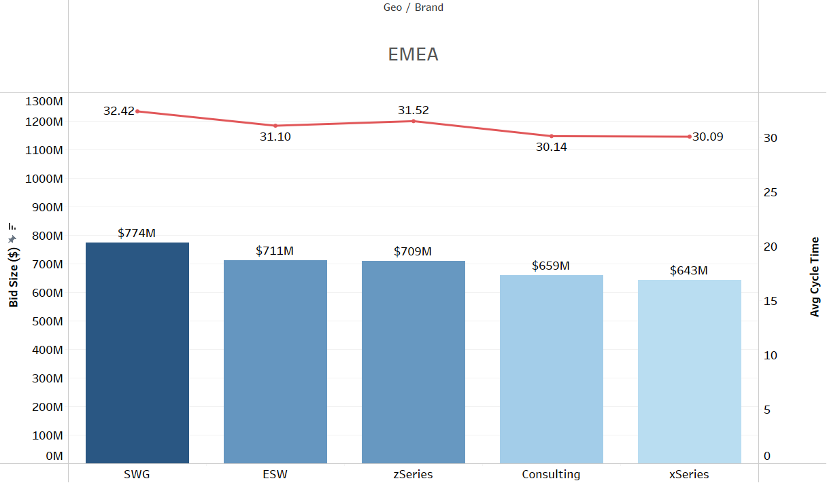
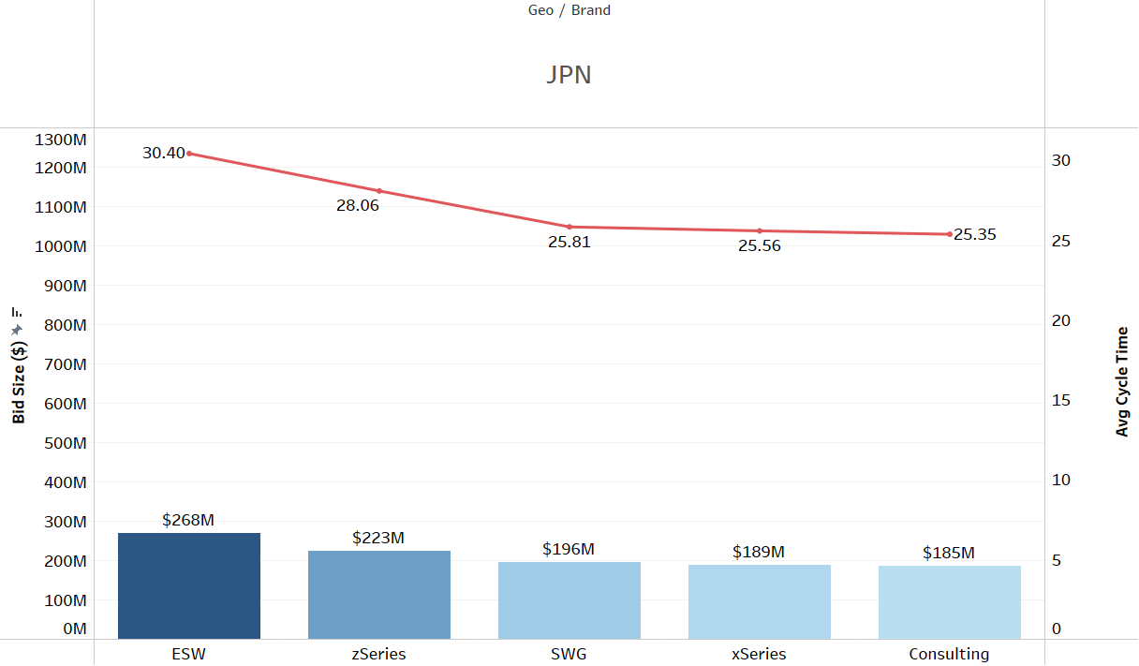
Performance of Brands per Region

Slide 9
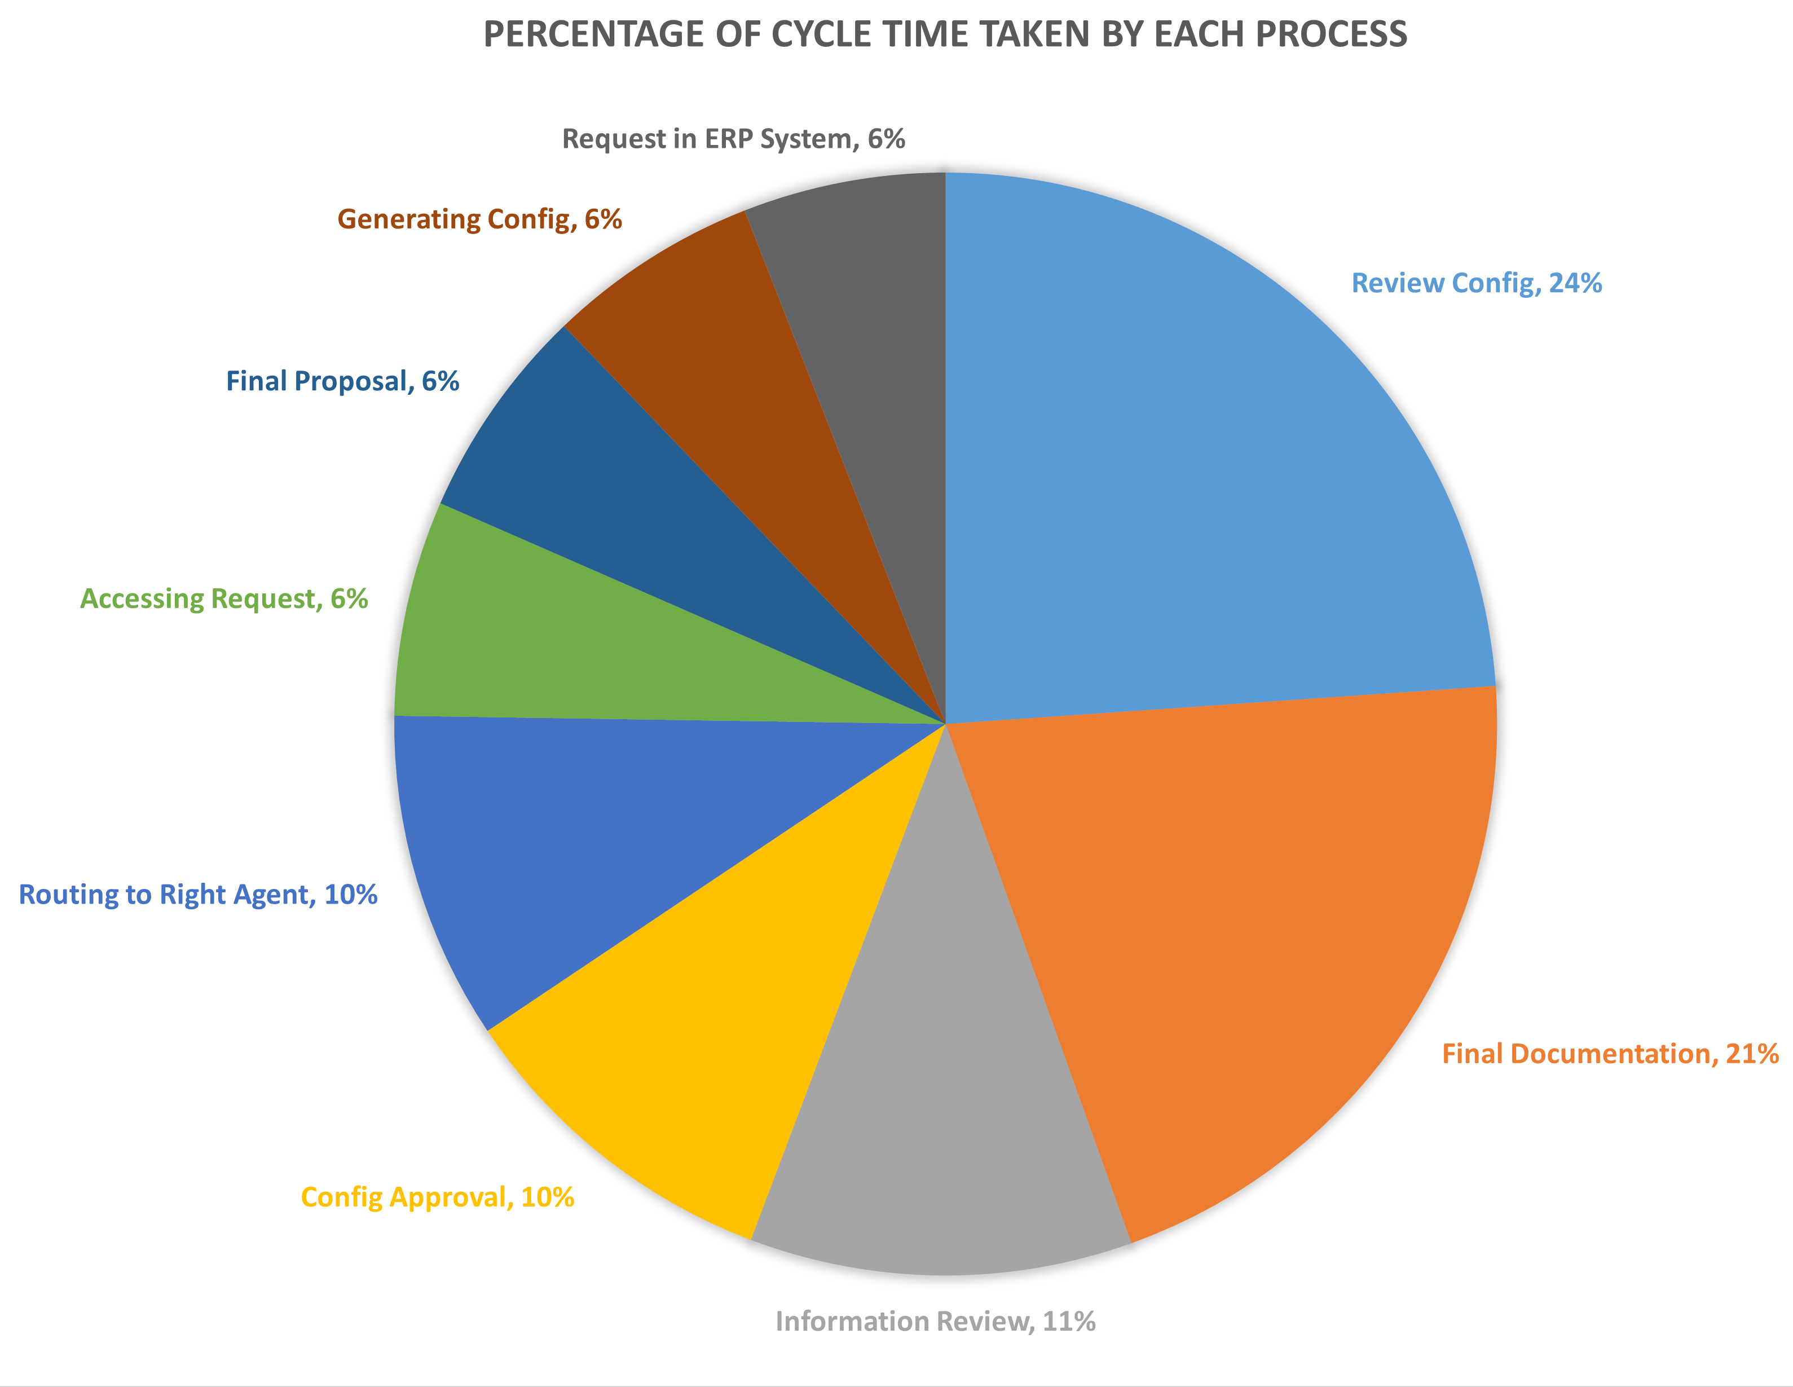
Process time contribution to the cycle time

Slide 10
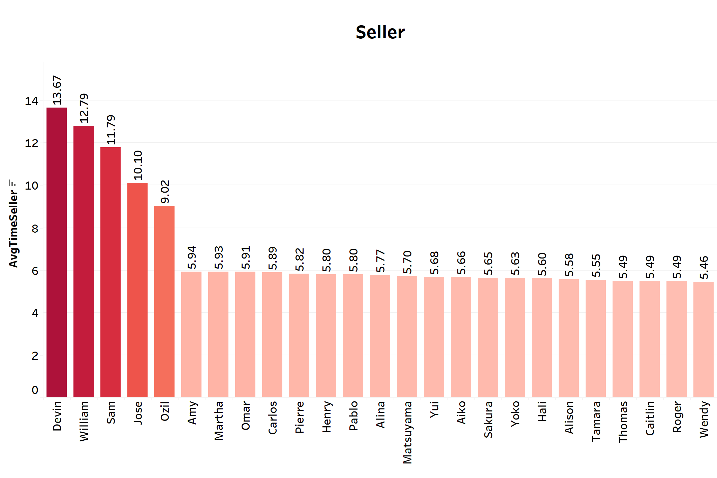
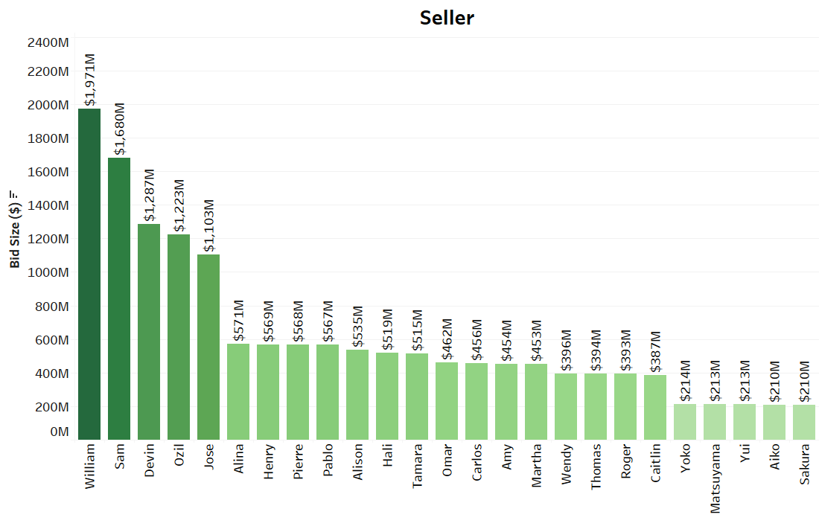
Performance of Seller based on Bid Size and time taken during Proposal Creation Process

Slide 11
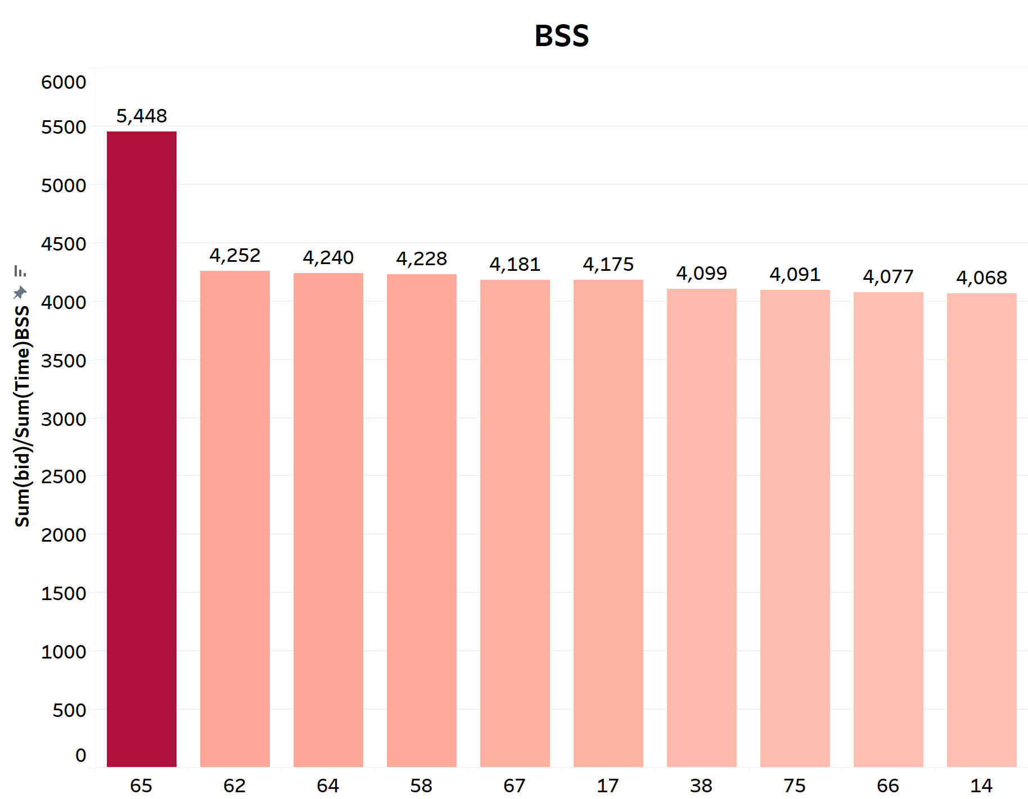
Top BSS performers
Note: BSS Performance is measured based on Total Bid value generated by BSS with respect to the time consumed by BSS, respectively.

Slide 12
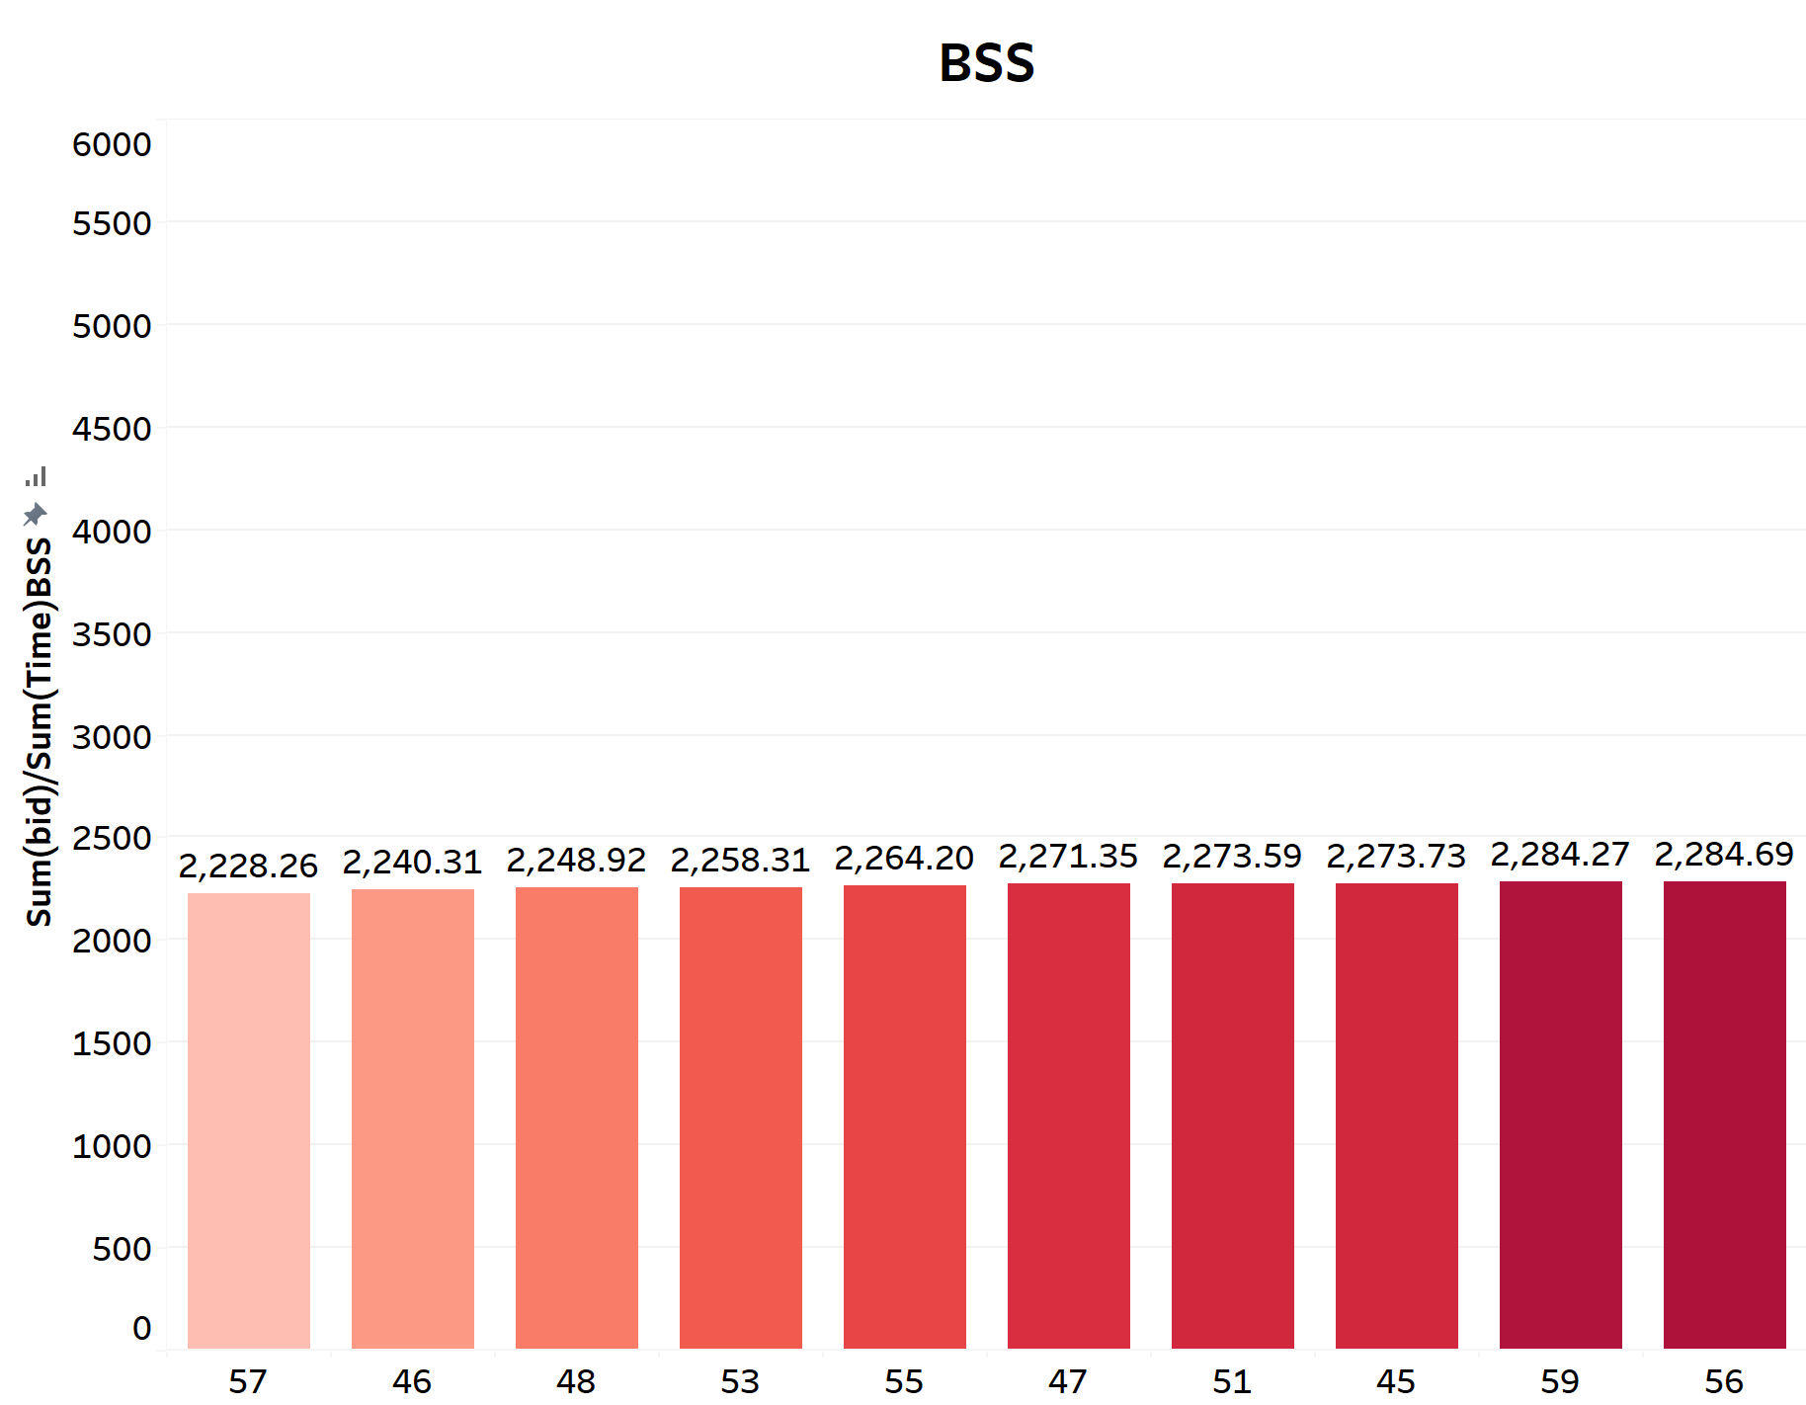
BSS who need more attention

Slide 13
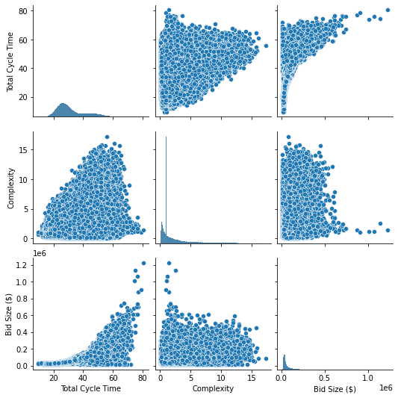
Correlation between Bid Size, its Complexity and Cycle Time
Cycle time and Bid Complexity exhibit a direct positive correlation.
Total Cycle time and Bid Size have a direct positive correlation.

Slide 14
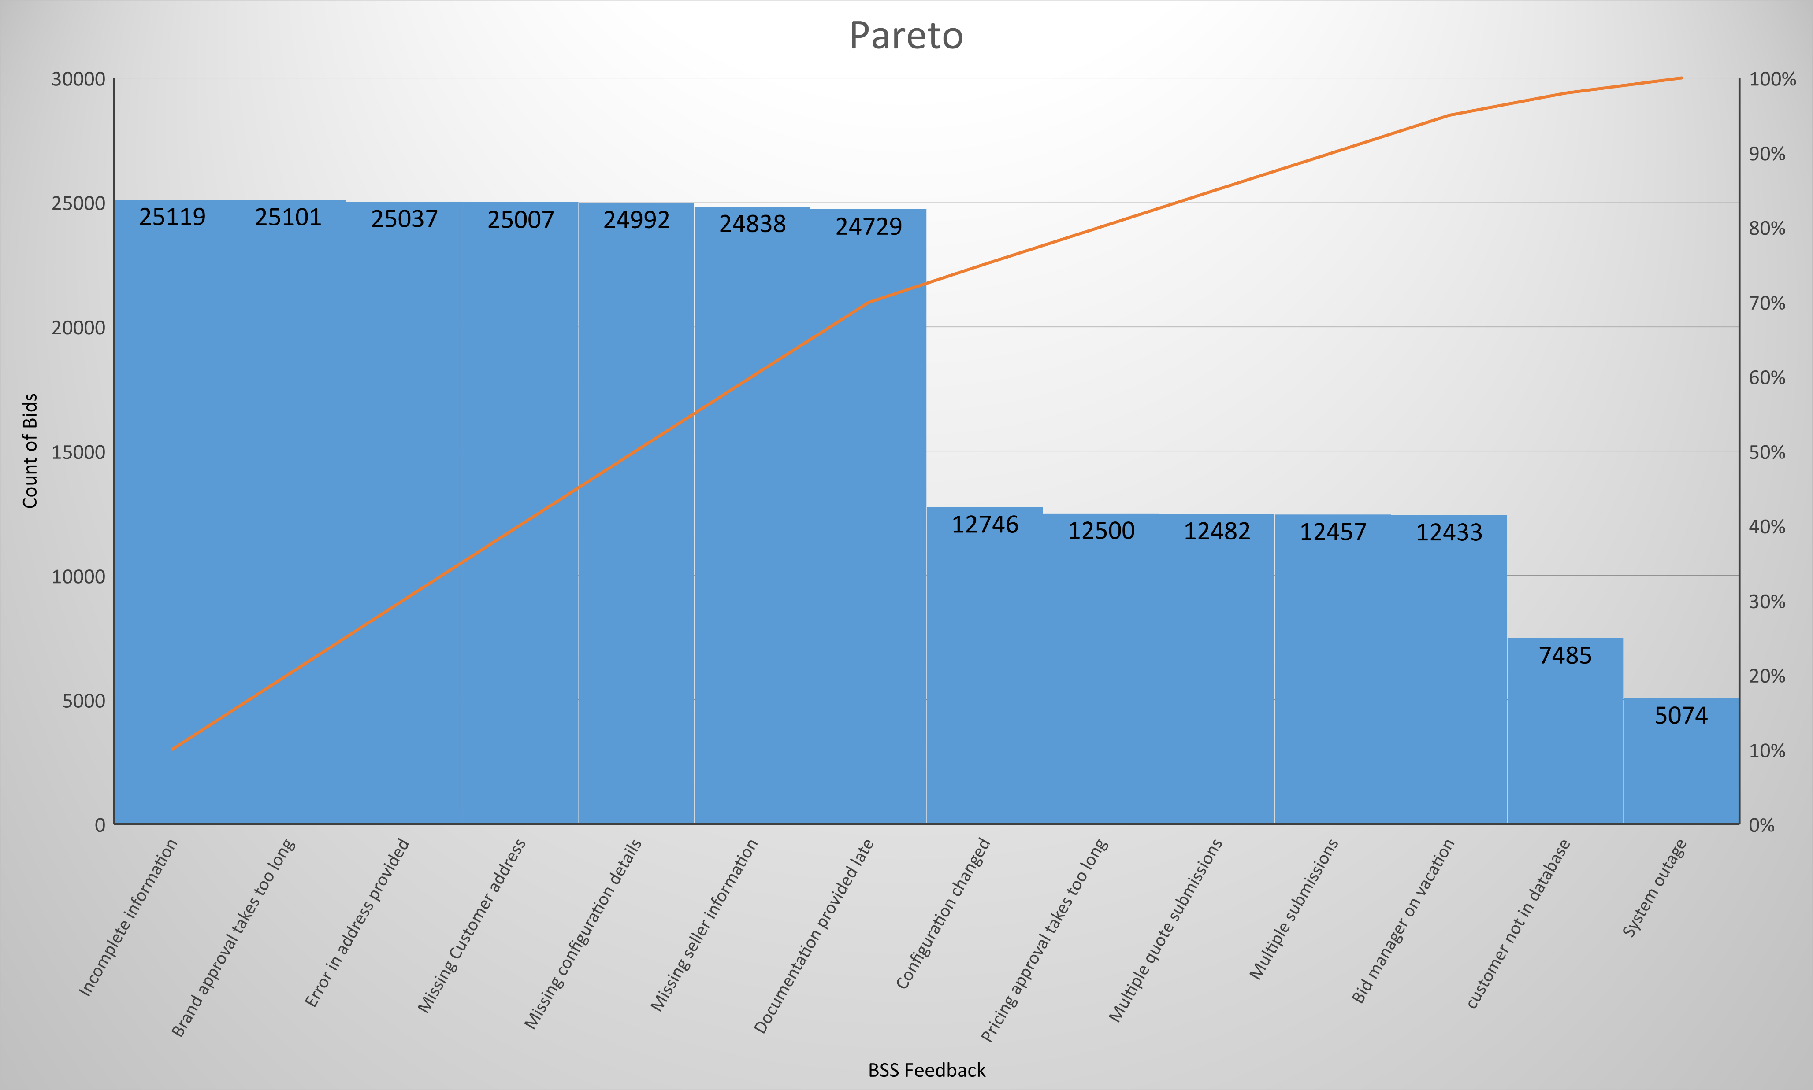
Potential Issues in the Process
Incomplete information
Brand approval takes too long
Error in address provided
Missing Customer address
Missing configuration details
Missing seller information
Documentation provided late

Slide 15
Value Added Non-Value Added Steps

Slide 16
Fishbone based on BSS feedback
People
Method
Error in address provided
Missing Customer address
Missing seller information
Error in address
Incomplete information
Documentation provided late
Bid manager on vacation
Long pricing approval time
Multiple submissions
Long brand approval time
Multiple quote submissions
Missing configuration details
Long cycle
time problem
System outage
Configuration changed
customer not in database
Machine
Environment
Material

Slide 17
Fishbone based on seller feedback
People
Method
Incomplete requirements
Error in configuration
Incorrect configuration
Terms and conditions had errors
Too much churn
Tedious submission process
BSS inexperienced
Long proposal time
BSS lacks domain knowledge
Pricing is not competitive
Too many errors by BSS
Slow responses rate
Long cycle
time problem
Difficult identifying BSS agent
ERP system doesn't work well
Machine
Environment
Material

Slide 18
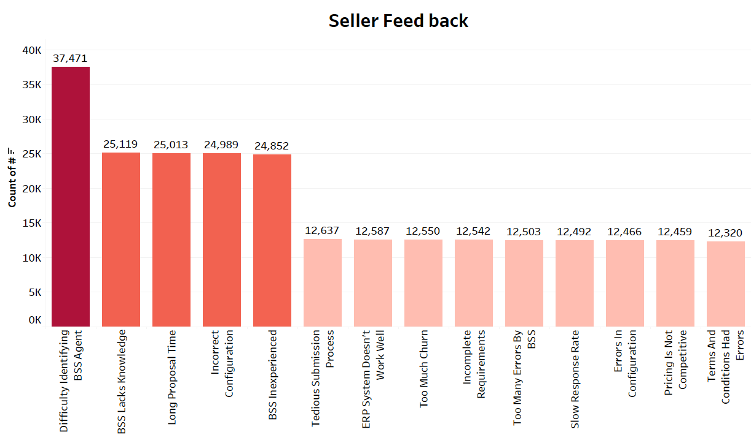

Slide 20
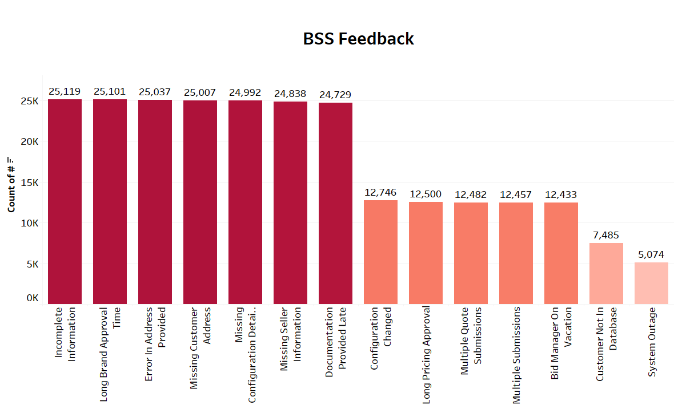

Slide 22
Recommendations
Implementing Scum Methodology
Overhaul of Infrastructure to eliminate power backup Problems
Remove Non-Value Added Process
Creating deadlines at each steps
Creating New ERP system to improve efficiency
Creating new information submission process to remove missing information issues.
Initiating training for inexperienced BSS in order to make then more knowledgeable about the process
Doing market analysis in order to gain more insight about the proposal cost in order to undercut competitors
Process Improvement

Slide 23
Control Plan
Creating control charts with new means and Std Dev.
Doings internal surveys regarding the new implementations
Changes in different feedback frequencies
Comparison between new baseline and old baseline
Cost/Benefit Analysis
Process in Control

Slide 24
Prediction
In order to predict the Cycle Time reduction, we can utilize the recommendations implemented and their effects
Removal of Non-Value-Added process
Improvement of cycle time based on feedbacks, for e.g., making missing fields mandatory
Improvement in cycle time by frequent trainings provided to BSS/Sellers
Impact of power outage on cycle time
Implementing Time-lines/Deadlines

Slide 25
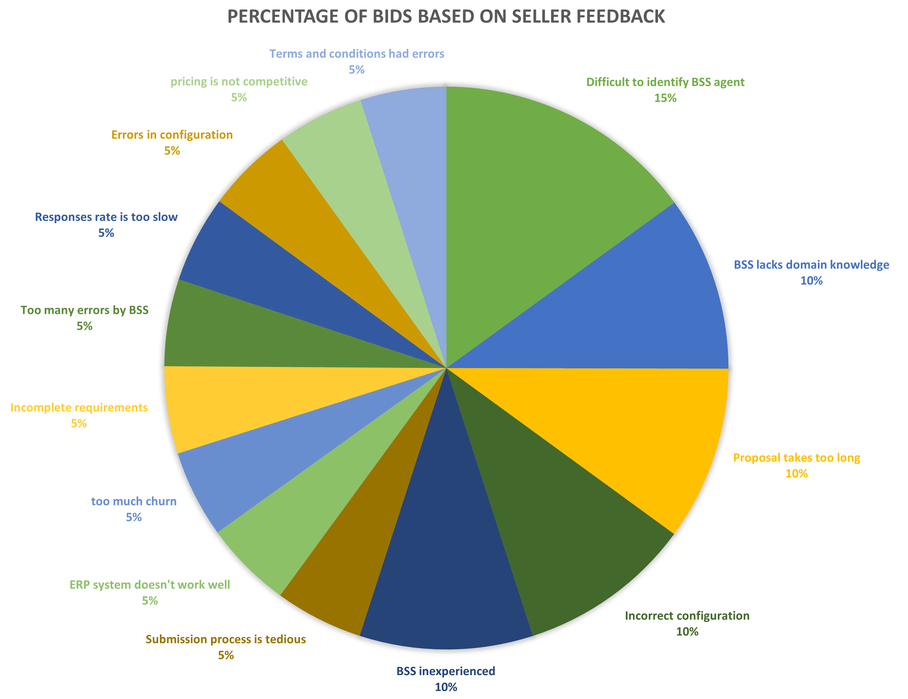
Effective utilization of open text data to gain valuable insights
Based on feedback and their counts, Jeff can initiate Root Cause Analysis to minimize those feedbacks. Some of the recommendations have already been implemented through FMEA, and as the RCA results are out, it will give a better picture to direct Jeff for the next Action plan to cut down feedback counts. Once the actions have been implemented, Jeff can start giving BSS and sellers the options to put all good as feedback, which will help Jeff know whether the implementation was effective.

Slide 26
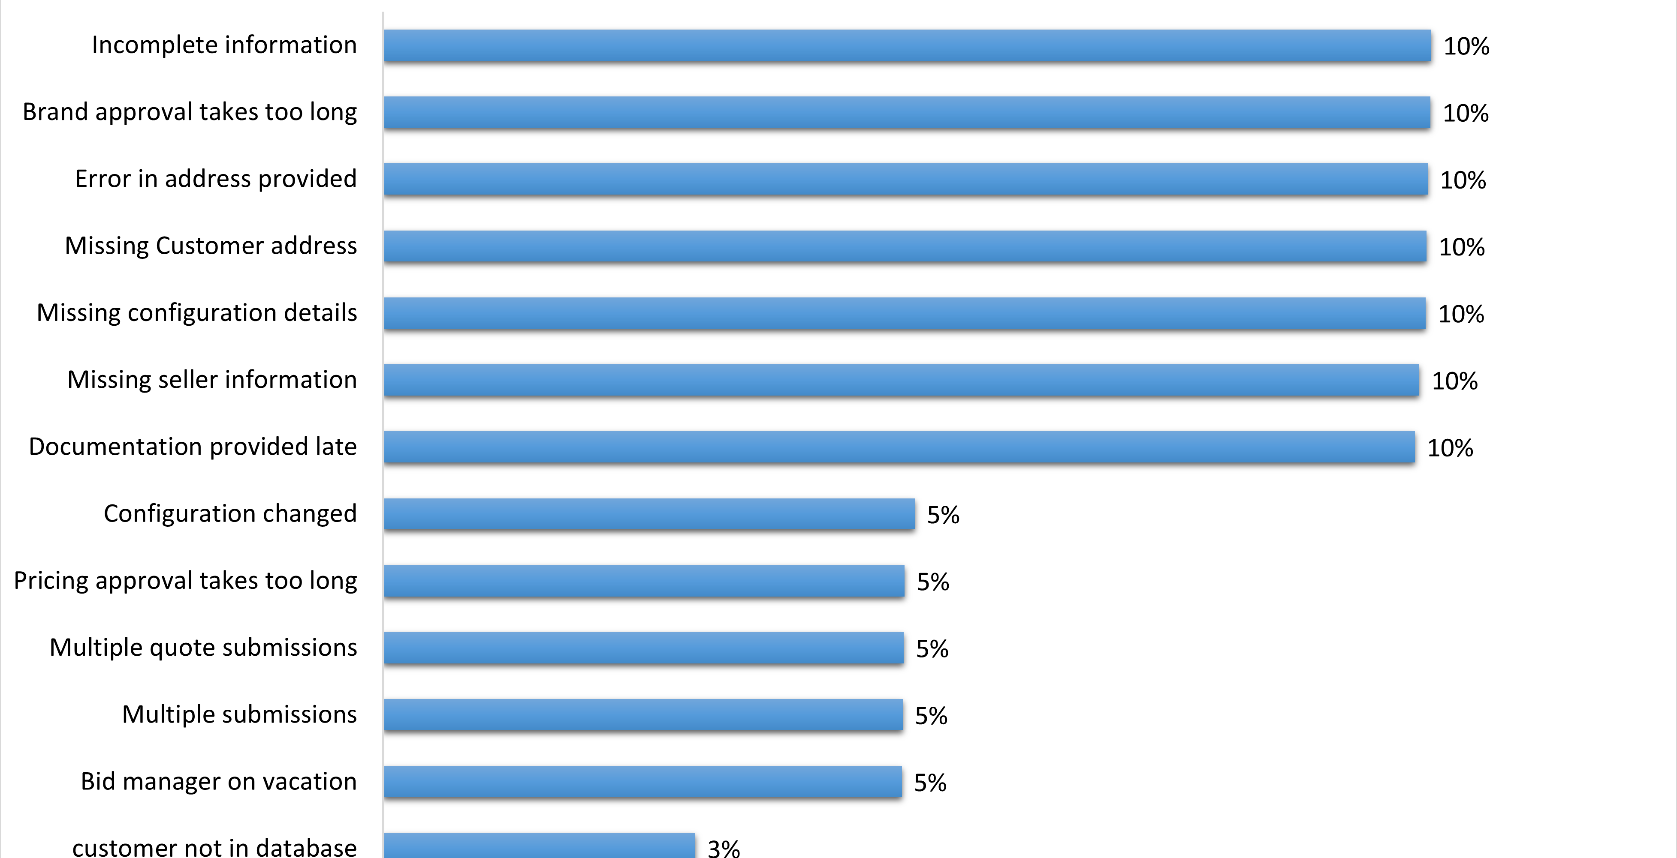

Slide 27
Thank You!

