Slide 1

Case-2 Morelia Mortgage Company
Team D16

Slide 2
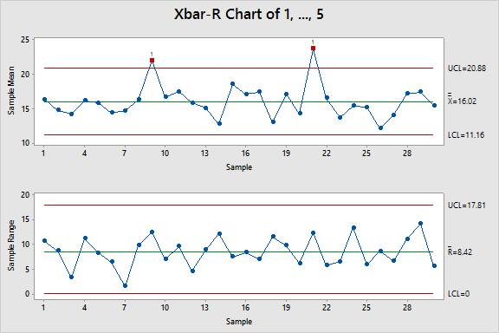
Initial Control Chart showing the process not in statistical control

Slide 3
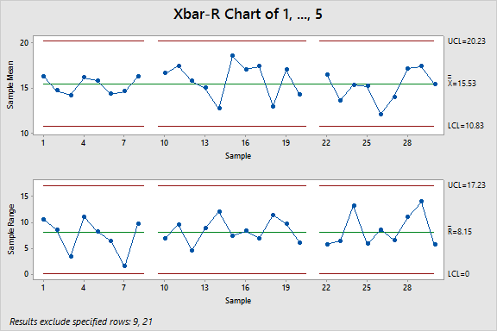
Control Chart after removal of out-of-control point and in a state of Statistical Control

Slide 4
Observations
What do the initial control charts tell you?
There are some pointers after observing the initial control chart
1. No specific pattern is found, and the data seems to be placed randomly.
2. The data points are evenly distributed on either side of the central line.
3. Two peaks are noticed that make the chart out-of-control as these go beyond the Upper Control Limits.
Do any out-of-control conditions exist?
Yes, a couple of special cause variations drifts the Upper Control limit beyond the mentioned Upper Specification limit of 20.5 Hours. These instances are spotted at points 9 and 21.

Slide 5
Observations
If the process is not in control, what might be the likely causes, based on the available information?
Shaun seems to be contributing to the delay as Shaun had three shifts in the first 15 days, and the average time taken by Shaun is 20.36. Of these three days, the processing time for two days exceeds the specification limits, causing the anomaly seen in the control chart.
Is MMC facing a serious problem that it needs to address?
As we know that MMC expanded its mortgage refinancing and home remodeling credit operations, it seems that even after doing 2 shifts they are not able to handle the increase in business.
How might the company eliminate the problems of slow loan processing?
They could hire new employees to accommodate the growing business needs of MMC. As we already established that Shaun is adding to the high processing time, the management can have Shaun undergo a training process to help Shaun catch up to speed with other employees.

Slide 6
Control Charts Post Achieving Control

Slide 9
Observations
Does any evidence suggest that the process has changed relative to the established control limits?
We can tell from the first chart that UCL and LCL limits have been squeezed than it used to be, so the control limits have good progress.
If any out-of-control patterns are suspected, what might be the cause?
In the first chart we can tell that the points out of control are 9, 21, 46. We can easily tell from the data that this happens while Shaun was working, so we should check whether Shaun is again having some problem that needs to be help.
In the second chart, point 35, which represents Carmen, is out of control. By observing the raw data, we find that the reason might be the fifth processing time is extreme small, which may reflect there is a recording error in this point.

Slide 10
Observations
What should the company investigate?
As the previous question we know that Shaun’s performance is worse that the other too, we can also see that the shift for Shaun is less than the other too. So, is there any related issue between the performance and shift been assigned is what the company need to investigate. If they are somehow connected than the company should reconsider how to assign shifts for their employees to meet the best performance.
Also, the company can investigate whether there is a recording error in point 35. If there is not recording error in this point, then the company can ask Carmen how did he do that that transaction so that company can learn from his case, decreasing the processing time.

