Slide 1
CS525: Special Topics in DBs Large-Scale Data Management
Hadoop/MapReduce Computing Paradigm
Spring 2013 WPI, Mohamed Eltabakh

Slide 2

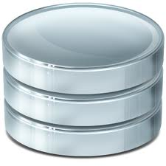
Large-Scale Data Analytics
MapReduce computing paradigm (E.g., Hadoop) vs. Traditional database systems
Database
vs.
Many enterprises are turning to Hadoop
Especially applications generating big data
Web applications, social networks, scientific applications

Slide 3






Why Hadoop is able to compete?
Database
vs.
Scalability (petabytes of data, thousands of machines)
Performance (tons of indexing, tuning, data organization tech.)
Flexibility in accepting all data formats (no schema)
Features:
- Provenance tracking
- Annotation management
- ….
Efficient and simple fault-tolerant mechanism
Commodity inexpensive hardware

Slide 4
What is Hadoop
Hadoop is a software framework for distributed processing of large datasets across large clusters of computers
Large datasets → Terabytes or petabytes of data
Large clusters → hundreds or thousands of nodes
Hadoop is open-source implementation for Google MapReduce
Hadoop is based on a simple programming model called MapReduce
Hadoop is based on a simple data model, any data will fit

Slide 5
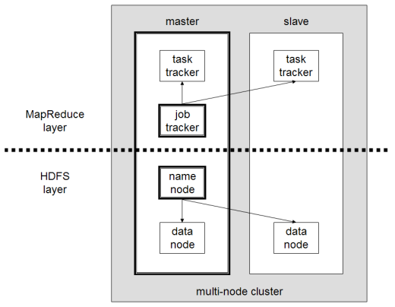
What is Hadoop (Cont’d)
Hadoop framework consists on two main layers
Distributed file system (HDFS)
Execution engine (MapReduce)

Slide 6
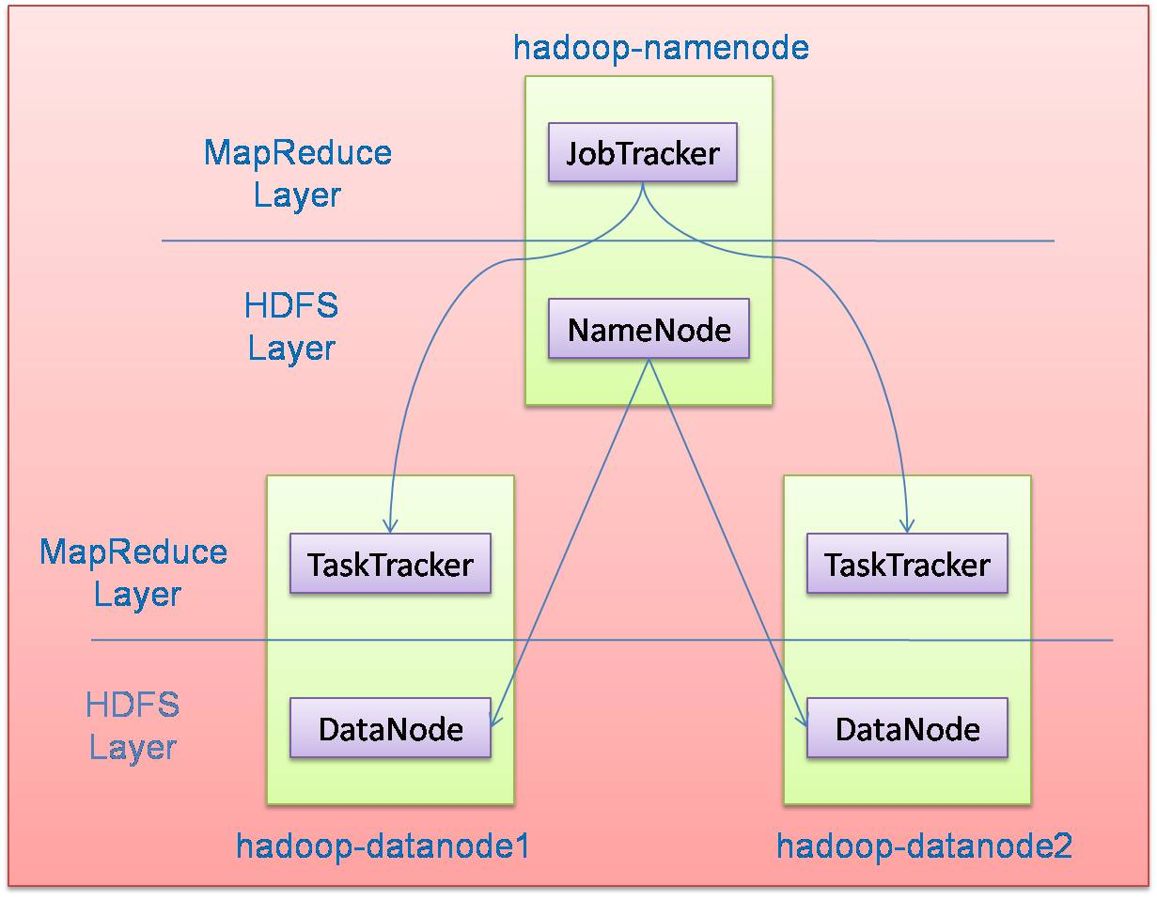
Hadoop Master/Slave Architecture
Hadoop is designed as a master-slave shared-nothing architecture
Master node (single node)
Many slave nodes

Slide 7
Design Principles of Hadoop
Need to process big data
Need to parallelize computation across thousands of nodes
Commodity hardware
Large number of low-end cheap machines working in parallel to solve a computing problem
This is in contrast to Parallel DBs
Small number of high-end expensive machines

Slide 8
Design Principles of Hadoop
Automatic parallelization & distribution
Hidden from the end-user
Fault tolerance and automatic recovery
Nodes/tasks will fail and will recover automatically
Clean and simple programming abstraction
Users only provide two functions “map” and “reduce”

Slide 9
How Uses MapReduce/Hadoop
Google: Inventors of MapReduce computing paradigm
Yahoo: Developing Hadoop open-source of MapReduce
IBM, Microsoft, Oracle
Facebook, Amazon, AOL, NetFlex
Many others + universities and research labs

Slide 10
Hadoop: How it Works

Slide 11
Hadoop Architecture
Distributed file system (HDFS)
Execution engine (MapReduce)
Master node (single node)
Many slave nodes

Slide 12
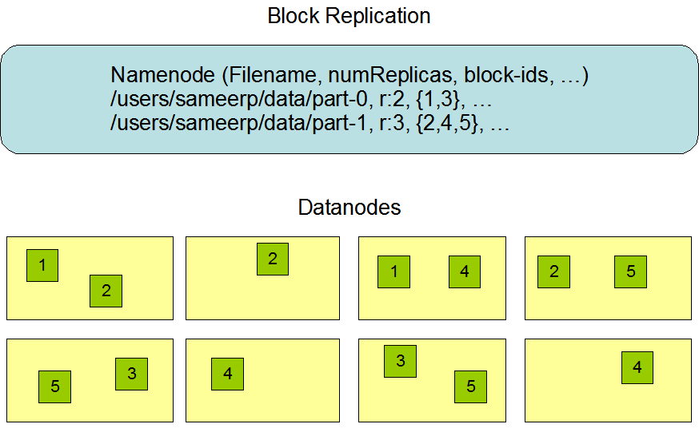
Hadoop Distributed File System (HDFS)
Centralized namenode
- Maintains metadata info about files
File F
1
2
3
4
5
Blocks (64 MB)
Many datanode (1000s)
- Store the actual data
- Files are divided into blocks
- Each block is replicated N times
(Default = 3)

Slide 13
Main Properties of HDFS
Large: A HDFS instance may consist of thousands of server machines, each storing part of the file system’s data
Replication: Each data block is replicated many times (default is 3)
Failure: Failure is the norm rather than exception
Fault Tolerance: Detection of faults and quick, automatic recovery from them is a core architectural goal of HDFS
Namenode is consistently checking Datanodes

Slide 14
Map-Reduce Execution Engine (Example: Color Count)
Input blocks on HDFS
Produces (k, v)
( , 1)
Shuffle & Sorting based on k
Consumes(k, [v])
( , [1,1,1,1,1,1..])
Produces(k’, v’)
( , 100)
Users only provide the “Map” and “Reduce” functions

Slide 15
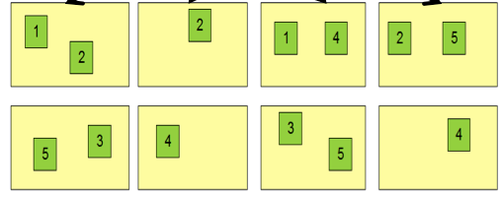
Properties of MapReduce Engine
Job Tracker is the master node (runs with the namenode)
Receives the user’s job
Decides on how many tasks will run (number of mappers)
Decides on where to run each mapper (concept of locality)
Node 1
Node 2
Node 3
This file has 5 Blocks → run 5 map tasks
Where to run the task reading block “1”
Try to run it on Node 1 or Node 3

Slide 16
Properties of MapReduce Engine (Cont’d)
Task Tracker is the slave node (runs on each datanode)
Receives the task from Job Tracker
Runs the task until completion (either map or reduce task)
Always in communication with the Job Tracker reporting progress
In this example, 1 map-reduce job consists of 4 map tasks and 3 reduce tasks

Slide 17
Key-Value Pairs
Mappers and Reducers are users’ code (provided functions)
Just need to obey the Key-Value pairs interface
Mappers:
Consume <key, value> pairs
Produce <key, value> pairs
Reducers:
Consume <key, <list of values>>
Produce <key, value>
Shuffling and Sorting:
Hidden phase between mappers and reducers
Groups all similar keys from all mappers, sorts and passes them to a certain reducer in the form of <key, <list of values>>

Slide 18
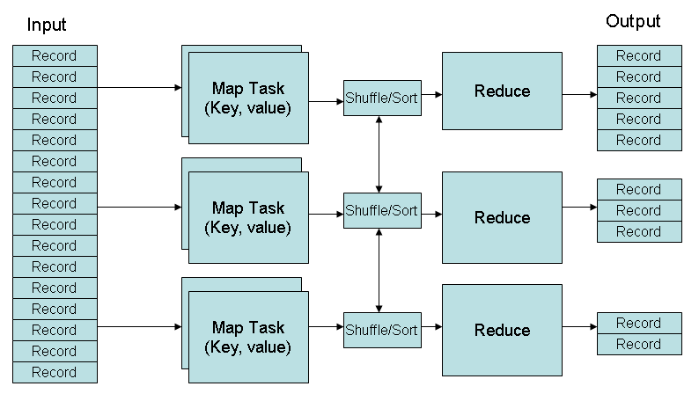
MapReduce Phases
Deciding on what will be the key and what will be the value ➔ developer’s responsibility

Slide 19
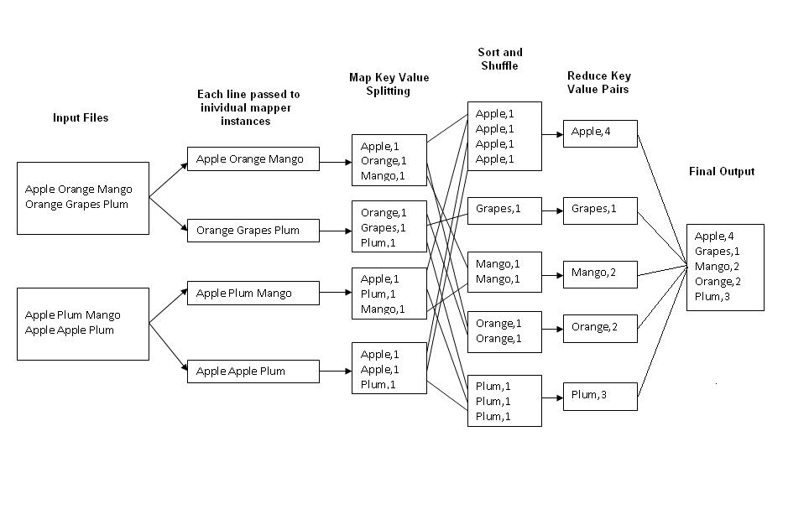
Example 1: Word Count
Job: Count the occurrences of each word in a data set
Map
Tasks
Reduce
Tasks

Slide 20
Example 2: Color Count
Job: Count the number of each color in a data set
Input blocks on HDFS
Produces (k, v)
( , 1)
Shuffle & Sorting based on k
Consumes(k, [v])
( , [1,1,1,1,1,1..])
Produces(k’, v’)
( , 100)
Part0001
Part0002
Part0003
That’s the output file, it has 3 parts on probably 3 different machines

Slide 21
Example 3: Color Filter
Job: Select only the blue and the green colors
Each map task will select only the blue or green colors
No need for reduce phase
Input blocks on HDFS
Produces (k, v)
( , 1)
Write to HDFS
Part0001
Write to HDFS
Part0002
That’s the output file, it has 4 parts on probably 4 different machines
Write to HDFS
Part0003
Write to HDFS
Part0004

Slide 22
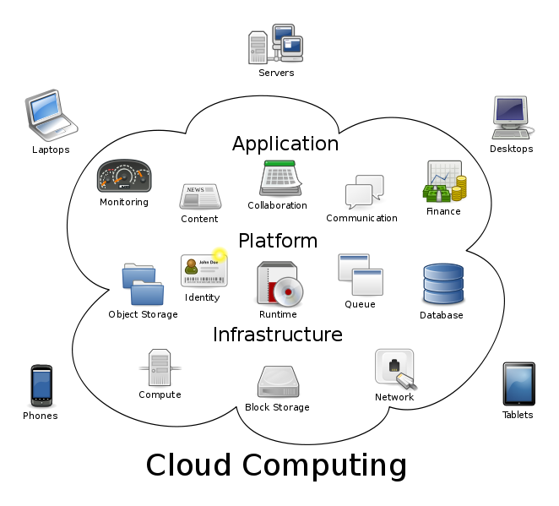
Bigger Picture: Hadoop vs. Other Systems
 | Distributed Databases | Hadoop
Computing Model | Notion of transactions Transaction is the unit of work ACID properties, Concurrency control | Notion of jobs Job is the unit of work No concurrency control
Data Model | Structured data with known schema Read/Write mode | Any data will fit in any format (un)(semi)structured ReadOnly mode
Cost Model | Expensive servers | Cheap commodity machines
Fault Tolerance | Failures are rare Recovery mechanisms | Failures are common over thousands of machines Simple yet efficient fault tolerance
Key Characteristics | - Efficiency, optimizations, fine-tuning | - Scalability, flexibility, fault tolerance
Cloud Computing
A computing model where any computing infrastructure can run on the cloud
Hardware & Software are provided as remote services
Elastic: grows and shrinks based on the user’s demand
Example: Amazon EC2

