Slide 1
CS525: Special Topics in DBs Large-Scale Data Management
Advanced Analytics
on Hadoop
Spring 2013 WPI, Mohamed Eltabakh

Slide 2



Data Analytics
Include machine learning and data mining tools
Analyze/mine/summarize large datasets
Extract knowledge from past data
Predict trends in future data

Slide 3
Data Mining & Machine Learning
Subset of Artificial Intelligence (AI)
Lots of related fields and applications
Information Retrieval
Stats
Biology
Linear algebra
Marketing and Sales

Slide 4
Tools & Algorithms
Collaborative Filtering
Clustering Techniques
Classification Algorithms
Association Rules
Frequent Pattern Mining
Statistical libraries (Regression, SVM, …)
Others…

Slide 5
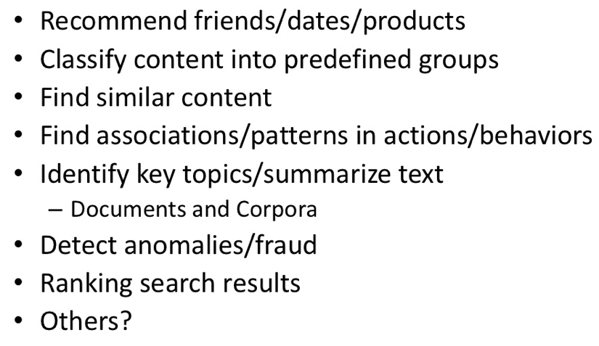
Common Use Cases

Slide 6


In Our Context…
--Efficient in analyzing/mining data
--Do not scale
--Efficient in managing big data
--Does not analyze or mine the data
How to integrate these two worlds together

Slide 7
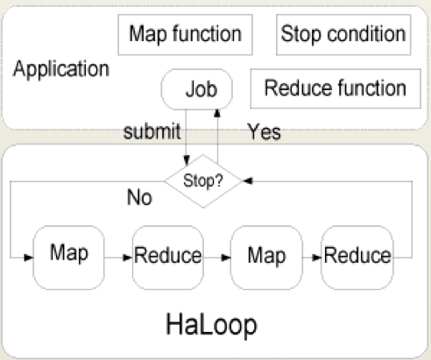
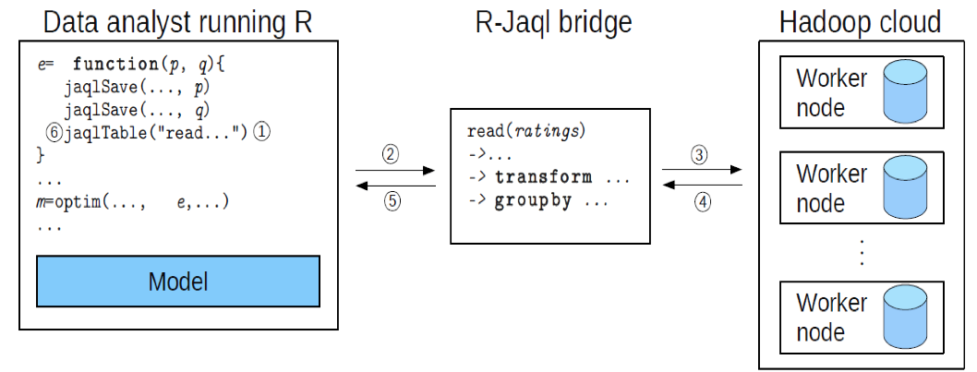
On Going Research Effort
Ricardo (VLDB’10): Integrating Hadoop and R using Jaql
Haloop (SIGMOD’10): Supporting iterative processing in Hadoop

Slide 8


Other Projects
Apache Mahout
Open-source package on Hadoop for data mining and machine learning
Revolution R (R-Hadoop)
Extensions to R package to run on Hadoop

Slide 9

Apache Mahout

Slide 10

Apache Mahout
Apache Software Foundation project
Create scalable machine learning libraries
Why Mahout? Many Open Source ML libraries either:
Lack Community
Lack Documentation and Examples
Lack Scalability
Or are research-oriented

Slide 11
Goal 1: Machine Learning

Slide 12
Goal 2: Scalability
Be as fast and efficient as the possible given the intrinsic design of the algorithm
Most Mahout implementations are Map Reduce enabled
Work in Progress

Slide 13
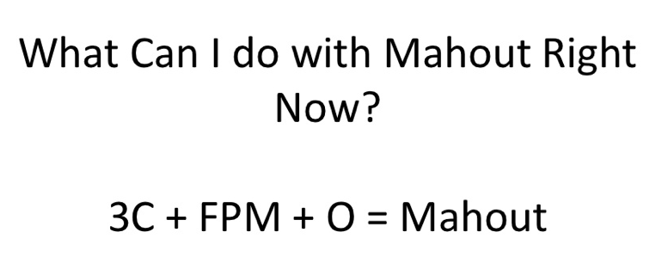
Mahout Package

Slide 14
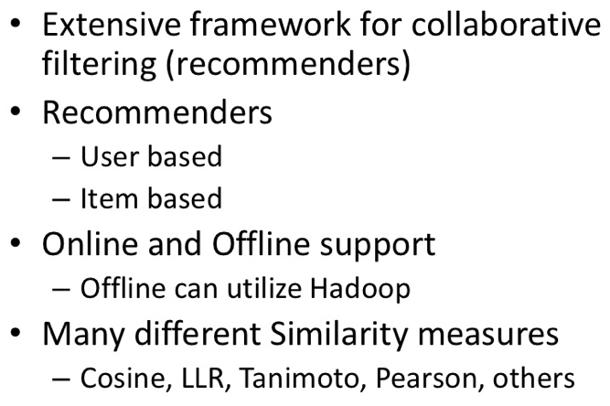
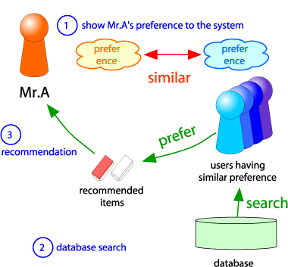
C1: Collaborative Filtering

Slide 15
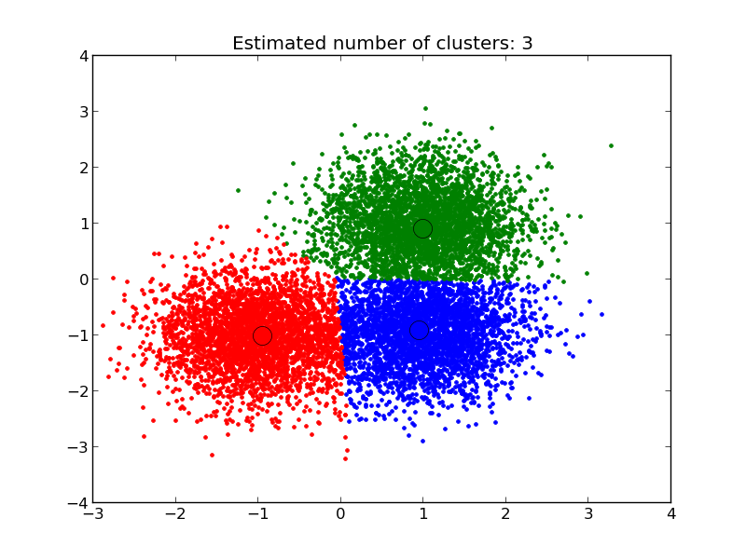
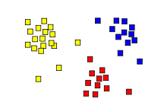
C2: Clustering
Group similar objects together
K-Means, Fuzzy K-Means, Density-Based,…
Different distance measures
Manhattan, Euclidean, …

Slide 16
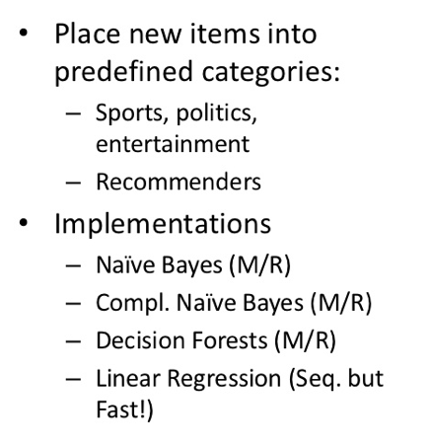
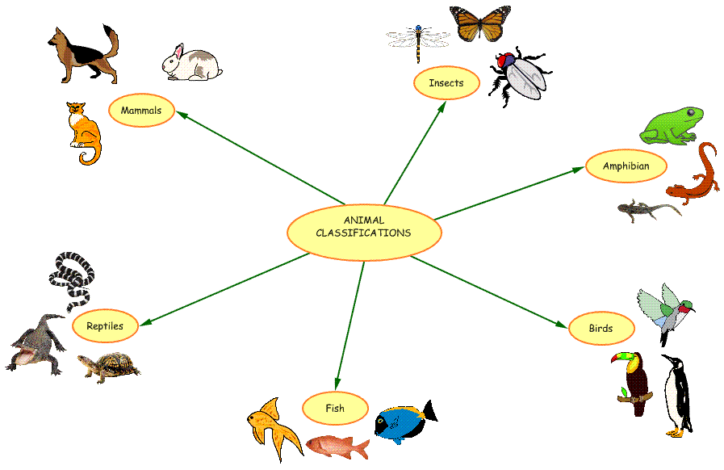
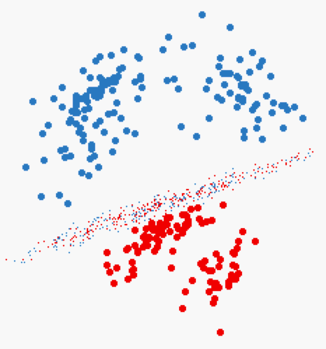
C3: Classification

Slide 17
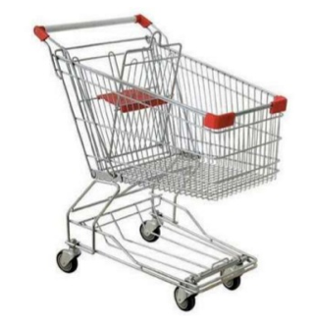
FPM: Frequent Pattern Mining
Find the frequent itemsets
<milk, bread, cheese> are sold frequently together
Very common in market analysis, access pattern analysis, etc…

Slide 18
O: Others
Outlier detection
Math libirary
Vectors, matrices, etc.
Noise reduction

Slide 19
We Focus On…
Clustering ➔ K-Means
Classification ➔ Naïve Bayes
Frequent Pattern Mining ➔ Apriori
-- Technique logic
-- How to implement in Hadoop

Slide 20
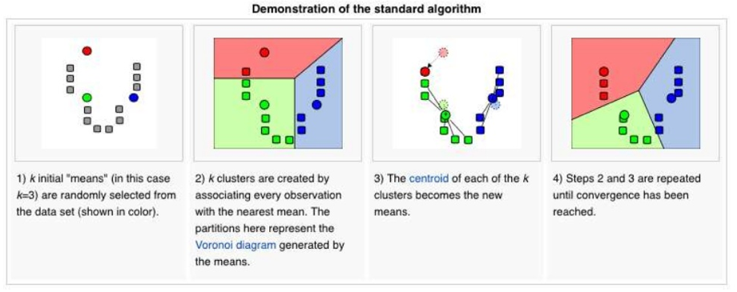
K-Means Algorithm
Iterative algorithm until converges

Slide 21
K-Means Algorithm
Step 1: Select K points at random (Centers)
Step 2: For each data point, assign it to the closest center
Now we formed K clusters
Step 3: For each cluster, re-compute the centers
E.g., in the case of 2D points ➔
X: average over all x-axis points in the cluster
Y: average over all y-axis points in the cluster
Step 4: If the new centers are different from the old centers (previous iteration) ➔ Go to Step 2

Slide 22
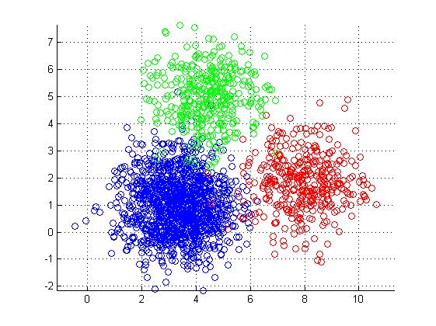
K-Means in MapReduce
Input
Dataset (set of points in 2D) --Large
Initial centroids (K points) --Small
Map Side
Each map reads the K-centroids + one block from dataset
Assign each point to the closest centroid
Output <centroid, point>

Slide 23
K-Means in MapReduce (Cont’d)
Reduce Side
Gets all points for a given centroid
Re-compute a new centroid for this cluster
Output: <new centroid>
Iteration Control
Compare the old and new set of K-centroids
If similar ➔ Stop
Else
If max iterations has reached ➔ Stop
Else ➔ Start another Map-Reduce Iteration

Slide 24
K-Means Optimizations
Use of Combiners
Similar to the reducer
Computes for each centroid the local sums (and counts) of the assigned points
Sends to the reducer <centroid, <partial sums>>
Use of Single Reducer
Amount of data to reducers is very small
Single reducer can tell whether any of the centers has changed or not
Creates a single output file

Slide 25
Naïve Bayes Classifier
Given a dataset (training data), we learn (build) a statistical model
This model is called “Classifier”
Each point in the training data is in the form of:
<label, feature 1, feature 2, ….feature N>
Label ➔ is the class label
Features 1..N ➔ the features (dimensions of the point)
Then, given a point without a label <??, feature 1, ….feature N>
Use the model to decide on its label

Slide 26
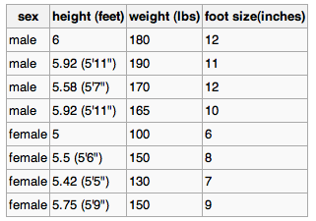
Naïve Bayes Classifier: Example
Best described through an example
Three features
Class label (male or female)
Training dataset

Slide 27

Naïve Bayes Classifier (Cont’d)
For each feature in each label
Compute the mean and variance
That is the model (classifier)

Slide 28

Naïve Bayes: Classify New Object
Male or female?
For each label ➔ Compute posterior value
The label with the largest posterior is the suggested label

Slide 29

Naïve Bayes: Classify New Object (Cont’d)
Male or female?
>> evidence: Can be ignored since it is the same constant for all labels
>> P(label): % of training points with this label
>> p(feature|label) = , f is feature value in sample
f

Slide 30


Naïve Bayes: Classify New Object (Cont’d)
Male or female?

Slide 31
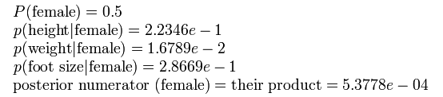
Naïve Bayes: Classify New Object (Cont’d)
Male or female?
The sample is predicted to be female

Slide 32

Naïve Bayes in Hadoop
How to implement Naïve Bayes as a map-reduce job?
Part of project 4…

Slide 33
Frequent Pattern Mining
Very common problem in Market-Basket applications
Given a set of items I ={milk, bread, jelly, …}
Given a set of transactions where each transaction contains subset of items
t1 = {milk, bread, water}
t2 = {milk, nuts, butter, rice}

Slide 34
Frequent Pattern Mining
Given a set of items I ={milk, bread, jelly, …}
Given a set of transactions where each transaction contains subset of items
t1 = {milk, bread, water}
t2 = {milk, nuts, butter, rice}
What are the itemsets frequently sold together ??
% of transactions in which the itemset appears >= α

Slide 35
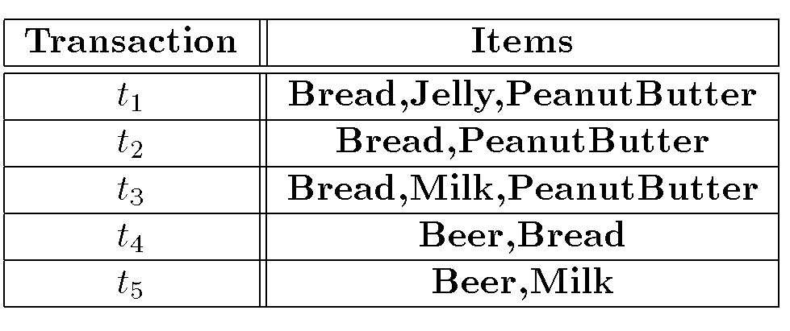
Example
Assume α = 60%, what are the frequent itemsets
{Bread} → 80%
{PeanutButter} → 60%
{Bread, PeanutButter} → 60%
called “Support”

Slide 36
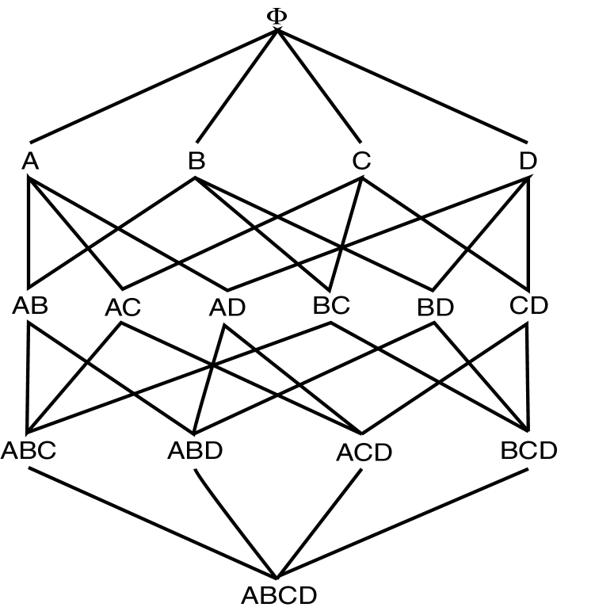
How to find frequent itemsets
Naïve Approach
Enumerate all possible itemsets and then count each one
All possible itemsets of size 1
All possible itemsets of size 2
All possible itemsets of size 3
All possible itemsets of size 4

Slide 37
Can we optimize??
Assume α = 60%, what are the frequent itemsets
{Bread} → 80%
{PeanutButter} → 60%
{Bread, PeanutButter} → 60%
called “Support”
Property
For itemset S={X, Y, Z, …} of size n to be frequent, all its subsets of size n-1 must be frequent as well

Slide 38
Apriori Algorithm
Executes in scans (iterations), each scan has two phases
Given a list of candidate itemsets of size n, count their appearance and find frequent ones
From the frequent ones generate candidates of size n+1 (previous property must hold)
All subsets of size n must be frequent to be a candidate
Start the algorithm where n =1, then repeat
Use the property reduce the number of itemsets to check

Slide 39
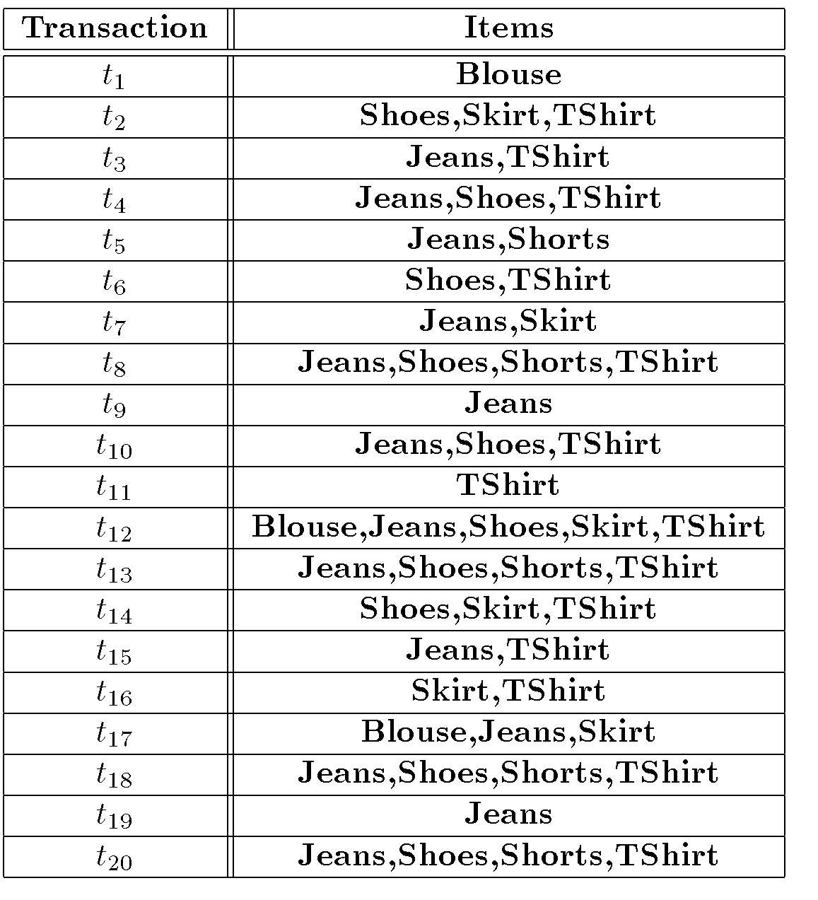
Apriori Example

Slide 40
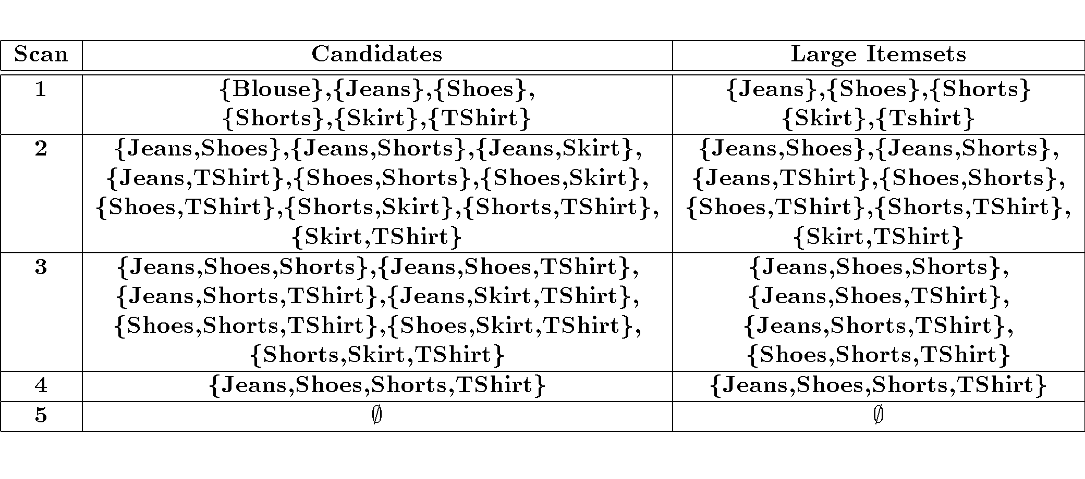
Apriori Example (Cont’d)

Slide 41
FPM in Hadoop
How to implement FMP as map-reduce jobs?

Slide 42
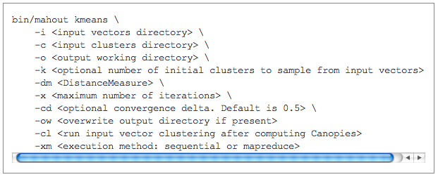
Apache Mahout
http://mahout.apache.org/

