Slide 1
CS525: Special Topics in DBs Large-Scale Data Management
MapReduce High-Level Langauges
Spring 2013 WPI, Mohamed Eltabakh

Slide 2
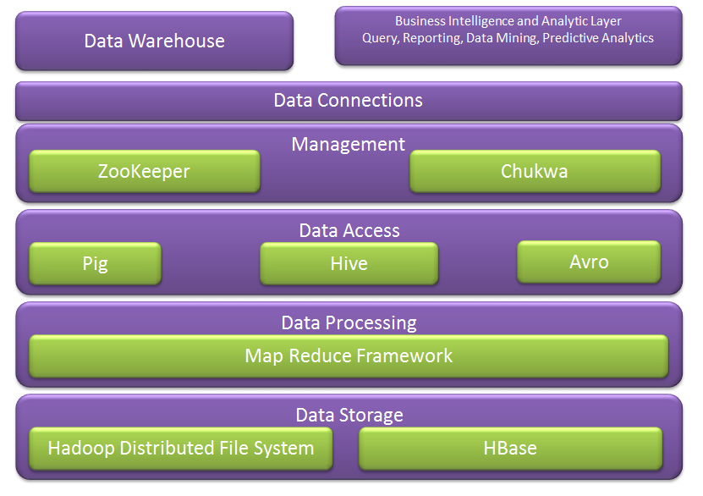
Hadoop Ecosystem
Next week we cover more of these
We covered these

Slide 3
Query Languages for Hadoop
Java: Hadoop’s Native Language
Pig: Query and Workflow Language
Hive: SQL-Based Language
Hadoop Streaming
HBase: Column-oriented Database for MapReduce

Slide 4
Hive

Slide 5
Motivation
Yahoo worked on Pig to facilitate application deployment on Hadoop.
Their need mainly was focused on unstructured data
Simultaneously Facebook started working on deploying warehouse solutions on Hadoop that resulted in Hive.
They focused on structured data

Slide 6

Apache Hive
A data warehouse infrastructure built on top of Hadoop for providing data summarization, query, and analysis
Hive Provides
ETL
Structure
Access to different storage (HDFS or HBase)
Query execution via MapReduce
Key Building Principles
SQL is a familiar language
Extensibility – Types, Functions, Formats, Scripts
Performance

Slide 7
Hive Components
High-level language (HiveQL)
Set of commands
Two Main Components
Two execution modes
Local: reads/write to local file system
Mapreduce: connects to Hadoop cluster and reads/writes to HDFS
Interactive mode
Console
Two modes
Batch mode
Submit a script

Slide 8
Hive deals with Structured Data
Data Units
Databases
Tables
Partitions
Buckets (or clusters)
Very similar to SQL and Relational DBs

Slide 9
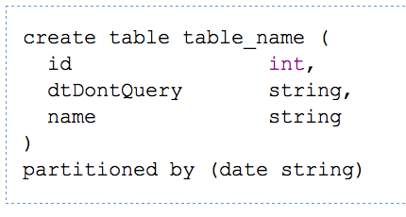
Hive DDL Commands
CREATE TABLE sample (foo INT, bar STRING) PARTITIONED BY (ds STRING);
SHOW TABLES '.*s';
DESCRIBE sample;
ALTER TABLE sample ADD COLUMNS (new_col INT);
DROP TABLE sample;
A table in Hive is an HDFS directory in Hadoop
Schema is known at creation time (like DB schema)
Partitioned tables have “sub-directories”, one for each partition

Slide 10
Hive DML
Load data from local file system
Delete previous data from that table
LOAD DATA LOCAL INPATH './sample.txt' OVERWRITE INTO TABLE sample;
LOAD DATA INPATH '/user/falvariz/hive/sample.txt’ INTO TABLE partitioned_sample PARTITION (ds='2012-02-24');
Load data from HDFS
Augment to the existing data
Must define a specific partition for partitioned tables
Loaded data are files copied to HDFS under the corresponding directory

Slide 11
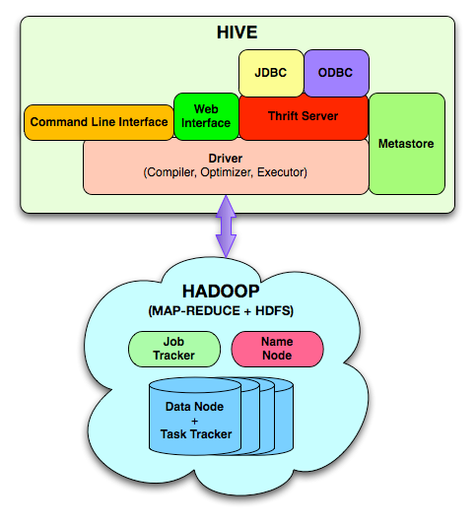
Hive Components
Hive CLI: Hive Command Line Interface
MetaStore: For storing the schema information, data types, partitioning columns, etc…
Hive QL: The query language, compiler, and executer
Thrift Server: cross-language framework to support many languages C, Java, Python, Ruby, PHP

Slide 12
Data Model
3-Levels: Tables → Partitions → Buckets
Table: maps to a HDFS directory
Table R: Users all over the world
Partition: maps to sub-directories under the table
Partition R by country name
It is the user’s responsibility to upload the right data to the right partition
Bucket: maps to files under each partition
Divide a partition into buckets based on a hash function on a certain column(s)

Slide 13
Data Model (Cont’d)

Slide 14
Query Examples I: Select & Filter
SELECT foo FROM sample WHERE ds='2012-02-24';
INSERT OVERWRITE DIRECTORY '/tmp/hdfs_out' SELECT * FROM sample WHERE ds='2012-02-24';
INSERT OVERWRITE LOCAL DIRECTORY '/tmp/hive-sample-out' SELECT * FROM sample;
Create HDFS dir for the output
Create local dir for the output

Slide 15
Query Examples II: Aggregation & Grouping
SELECT MAX(foo) FROM sample;
SELECT ds, COUNT(*), SUM(foo) FROM sample GROUP BY ds;
FROM sample s INSERT OVERWRITE TABLE bar SELECT s.bar, count(*) WHERE s.foo > 0 GROUP BY s.bar;
Hive allows the From clause to come first !!!
Store the results into a table
This new syntax is to facilitate the “Multi-Insertion”

Slide 16
Query Examples III: Multi-Insertion
FROM page_view_stg pvs
INSERT OVERWRITE TABLE page_view PARTITION(dt='2008-06-08', country='US')
SELECT pvs.viewTime, … WHERE pvs.country = 'US'
INSERT OVERWRITE TABLE page_view PARTITION(dt='2008-06-08', country='CA')
SELECT pvs.viewTime, ... WHERE pvs.country = 'CA'
INSERT OVERWRITE TABLE page_view PARTITION(dt='2008-06-08', country='UK')
SELECT pvs.viewTime, ... WHERE pvs.country = 'UK';

Slide 17
Example IV: Joins
CREATE TABLE customer (id INT,name STRING,address STRING)
ROW FORMAT DELIMITED FIELDS TERMINATED BY '#';
CREATE TABLE order_cust (id INT,cus_id INT,prod_id INT,price INT)
ROW FORMAT DELIMITED FIELDS TERMINATED BY '\t';
SELECT * FROM customer c JOIN order_cust o ON (c.id=o.cus_id);
SELECT c.id, c.name, c.address, ce.exp
FROM customer c JOIN (SELECT cus_id,sum(price) AS exp
FROM order_cust
GROUP BY cus_id) ce ON (c.id=ce.cus_id);

Slide 18
Example V: Another Syntax for Join
FROM page_view pv JOIN user u ON (pv.userid = u.id)
INSERT INTO TABLE pv_users
SELECT pv.*, u.gender, u.age
WHERE pv.date = 2008-03-03;
Join
FROM page_view pv FULL OUTER JOIN user u
ON (pv.userid = u.id)
INSERT INTO TABLE pv_users
SELECT pv.*, u.gender, u.age
WHERE pv.date = 2008-03-03;
Outer Join

Slide 19
Inserts into Files, Tables and Local Files
FROM pv_users
INSERT INTO TABLE pv_gender_sum
SELECT pv_users.gender, count_distinct(pv_users.userid)
GROUP BY(pv_users.gender)
INSERT INTO DIRECTORY ‘/user/tmp/dir’
SELECT pv_users.age, count_distinct(pv_users.userid)
GROUP BY(pv_users.age)
INSERT INTO LOCAL DIRECTORY ‘/home/local/dir’
FIELDS TERMINATED BY ‘,’
LINES TERMINATED BY \013
SELECT pv_users.age, count_distinct(pv_users.userid)
GROUP BY(pv_users.age);

Slide 20
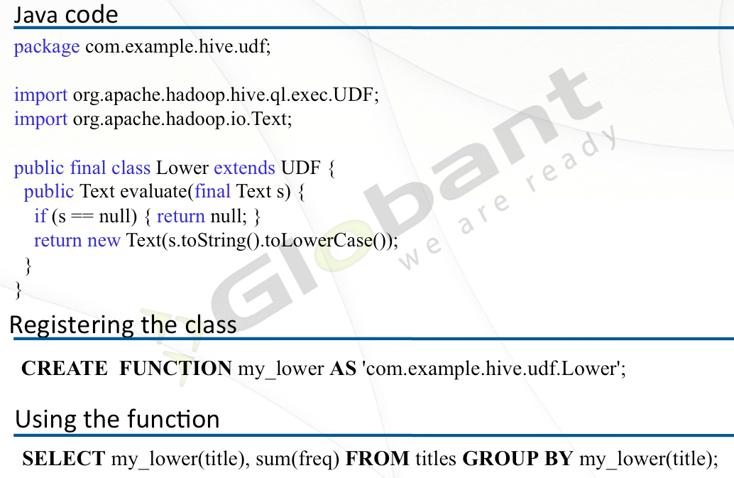
User-Defined Functions

Slide 21
Word Count in Hive
FROM (
MAP doctext USING 'python wc_mapper.py' AS (word, cnt)
FROM docs
CLUSTER BY word ) a
REDUCE word, cnt USING 'pythonwc_reduce.py’;
>> The map & reduce functions are black-box written in Python

Slide 22
Hadoop Streaming

Slide 23
Hadoop Streaming
Hadoop streaming is a utility that comes with the Hadoop distribution
The utility allows you to create and run map/reduce jobs with any executable or script as the mapper and/or the reducer
C, Python, Java, Ruby, C#, perl, shell commands
Map and Reduce classes can even be written in different languages

Slide 24
Using Streaming Utility
Path to the streaming jar library
> hadoop jar <dir>/hadoop-*streaming*.jar \
-file /path/to/mapper.py \
-mapper /path/to/mapper.py \
-file /path/to/reducer.py \
-reducer /path/to/reducer.py \
-input /user/hduser/books/* \
-output /user/hduser/books-output
Location of mapper file, and define it as mapper
Location of reducer file, and define it as reducer
Input and output locations

Slide 25
Hadoop Streaming: Basic Concept
Map and reduce functions read their input from STDIN and produce their output to STDOUT
Map
Hadoop streaming reads the input data line by line
Pass it to the map function through the STDIN
Do your code (any language)
Produce output to STDOUT
Key + \t + value
Hadoop streaming reads the output from STDOUT
Performs the shuffling and sorting based on the Key part
User’s code

Slide 26
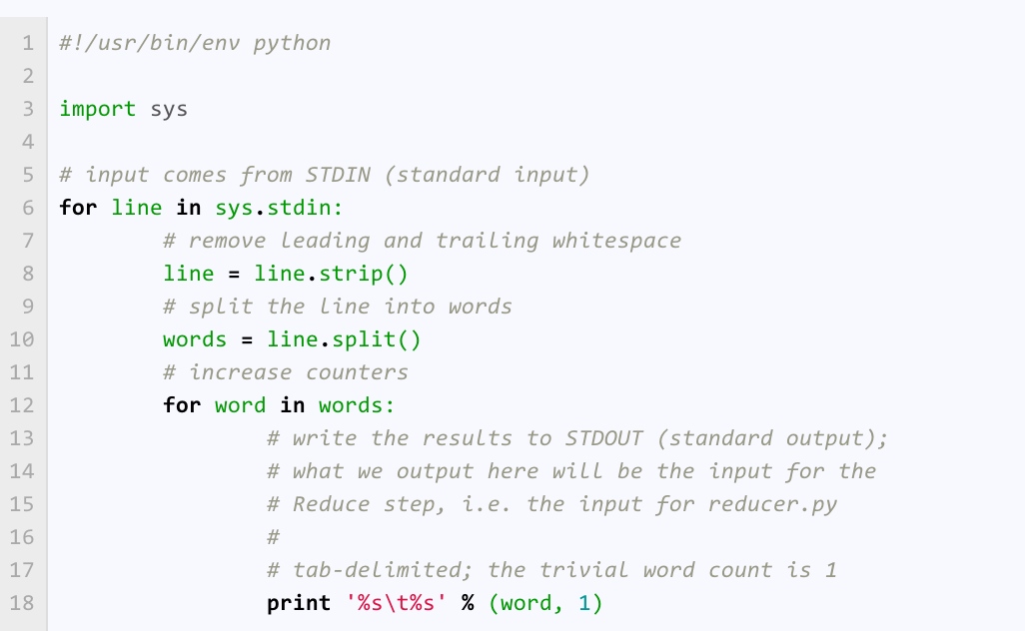
WordCount: Mapper.py
The code is simply reading from STDIN and writing to STDOUT
Tab delimited Key + value

Slide 27
Hadoop Streaming: Basic Concept (Cont’d)
Reducer
Hadoop streaming shuffles and sorts the map outputs based on the Key
Passes one record at a time to the reduce function through the STDIN
Do your code (any language)
Produce output to STDOUT
Key + \t + value
Hadoop streaming reads the output from STDOUT
Writes to the output file
Assume the data is sorted but not grouped

Slide 28
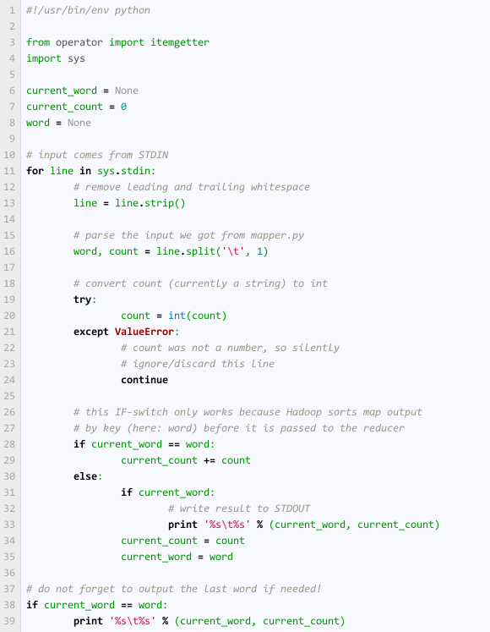
WordCount: Reducer.py
Read from STDIN
Make one split to get the word and the count
If it is like the previous word, then increment. Otherwise, report.

Slide 29
Call the Utility
> hadoop jar <dir>/hadoop-*streaming*.jar \
-file /path/to/mapper.py \
-mapper /path/to/mapper.py \
-file /path/to/reducer.py \
-reducer /path/to/reducer.py \
-input /user/hduser/books/* \
-output /user/hduser/books-output
HDFS files

Slide 30
Test Code in Local Mode
> cat inputs | ./mappper.py | sort | ./reducer.py
Should preduce each word and its count (in local mode)

Slide 31
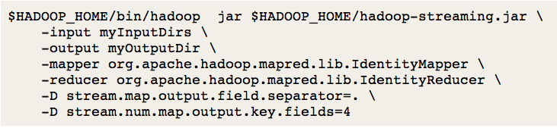
Possible Customization
Many parameters to set
-- The map output fields are “.” separated
-- The first 4 fields form the key

Slide 32
HBase

